Slide 1
Dependency injection

Slide 2
Dependency injection
A design pattern

Slide 3
Dependency injection
A design pattern
Dagger2

Slide 4
Dependency injection
A design pattern
Dagger2
Hilt standardisation

Slide 5
Dependency injection
A design pattern
Dagger2
Hilt standardisation
Can be used in Java and Kotlin

Slide 6
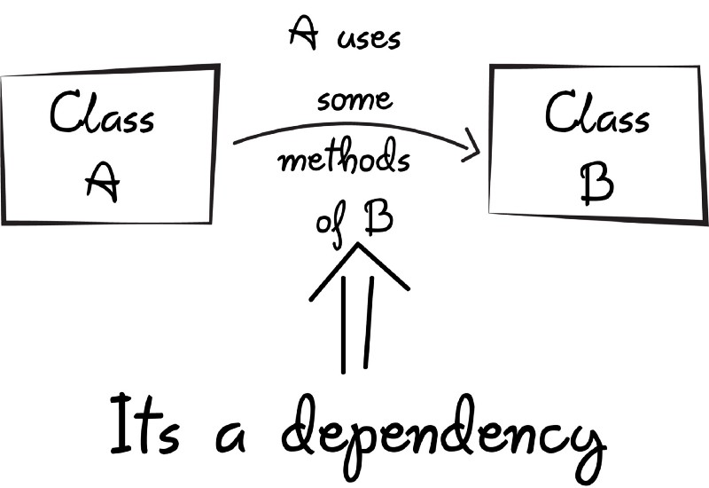
Dependency injection

Slide 7
Examples
A User class has a field of type Address

Slide 8
Examples
A User class has a field of type Address
Image loaders (Picasso, Glide) use HTTP internally

Slide 9
Examples
A User class has a field of type Address
Image loaders (Picasso, Glide) use HTTP internally
RecyclerView depends on Adapter

Slide 10
Examples
A User class has a field of type Address
Image loaders (Picasso, Glide) use HTTP internally
RecyclerView depends on Adapter
In MVVM, View depends on ViewModel

Slide 11
Abstract example
Car manufacturing

Slide 12
Abstract example
Car manufacturing
Engine and wheels are dependencies of Car

Slide 13
Abstract example - without DI
class Car {
private val engine: Engine
private val wheels: Wheels
fun Car() {
engine = Engine()
wheels = Wheels()
}
fun Drive() {
...
}
}

Slide 14
Abstract example - without DI
Car manufacturing
Engine and wheels are dependencies of Car
Engine needs skill and tools to be built blocks, cylinders, spark plugs etc

Slide 15
Abstract example - without DI
Car manufacturing
Engine and wheels are dependencies of Car
Engine needs skill and tools to be built blocks, cylinders, spark plugs etc
Same for wheels tires, rims etc

Slide 16
Abstract example - without DI
Car manufacturing
Engine and wheels are dependencies of Car
Engine needs skill and tools to be built blocks, cylinders, spark plugs etc
Same for wheels tires, rims etc
Lots of complexity means lots of boilerplate code

Slide 17
Abstract example - without DI
class MainActivity: AppCompatActivity() {
override fun onCreate(savedInstanceState: Bundle?) {
super.onCreate(savedInstanceState)
setContentView(R.layout.activity_main)
val block = Block()
val cylinders = Cylinders()
val sparkPlugs = SparkPlugs()
val tires = Tires()
val rims = Rims()
val engine = Engine(block, cylinders, sparkPlugs)
val wheels = Wheels(tires, rims)
val car = Car(engine, wheels)
car.drive()
}
}

Slide 18
Abstract example - with DI
@AndroidEntryPoint
class MainActivity: AppCompatActivity() {
@Inject lateinit var car: Car
override fun onCreate(savedInstanceState: Bundle?) {
super.onCreate(savedInstanceState)
setContentView(R.layout.activity_main)
car.drive()
}
}

