Slide 1
Android Architectures

Slide 2
Android Architectures - Why
A way to structure code

Slide 3
Android Architectures - Why
A way to structure code
Maintainability

Slide 4
Android Architectures - Why
A way to structure code
Maintainability
Scalability

Slide 5
Android Architectures - Why
A way to structure code
Maintainability
Scalability
Testing

Slide 6
Android Architectures - Why
A way to structure code
Maintainability
Scalability
Testing
Adding functionality

Slide 7
Android Architectures - How
Separate responsibility in app

Slide 8
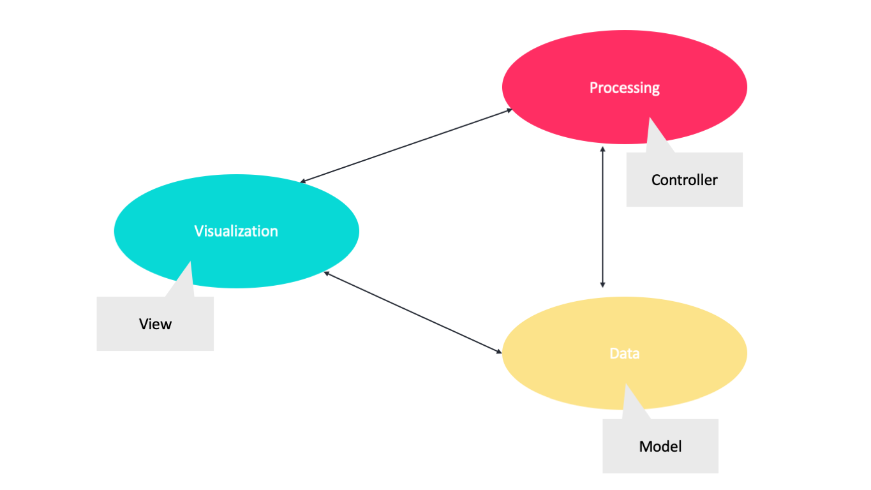
Android Architectures - How
Separate responsibility in app

Slide 9
Android Architectures
MVC - Model View Controller

Slide 10
Android Architectures
MVC - Model View Controller
MVP - Model View Presenter

Slide 11
Android Architectures
MVC - Model View Controller
MVP - Model View Presenter
MVVM - Model View ViewModel

Slide 12
Android Architectures
MVC - Model View Controller
MVP - Model View Presenter
MVVM - Model View ViewModel
MVI - Model View Intent

