Slide 1
Why MVI

Slide 2
MVI
An adaptation of MVVM architecture

Slide 3
MVI
An adaptation of MVVM architecture
Rely on Intent and State for communication

Slide 4
MVI
An adaptation of MVVM architecture
Rely on Intent and State for communication
Not specific to Android

Slide 5
MVI
An adaptation of MVVM architecture
Rely on Intent and State for communication
Not specific to Android
High level overview

Slide 6
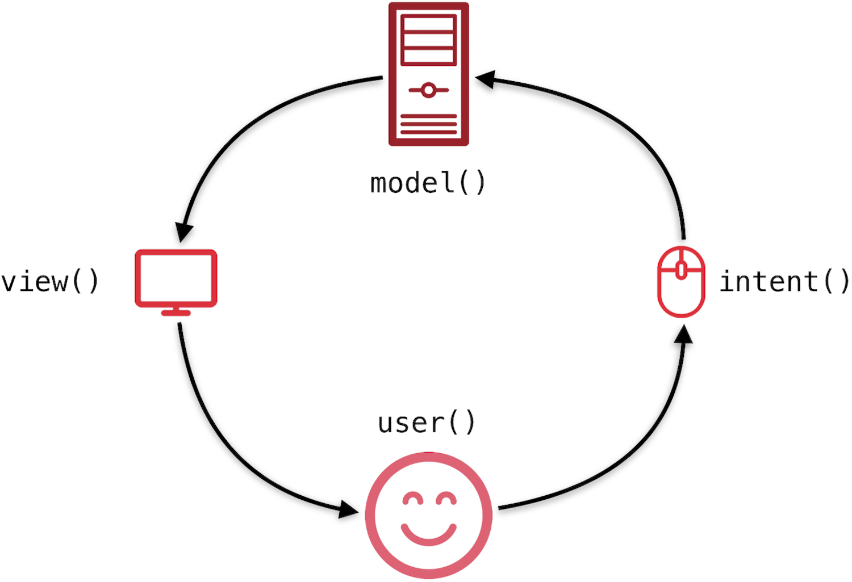
MVI
An adaptation of MVVM architecture
Rely on Intent and State for communication
Not specific to Android
High level overview

Slide 7
MVI
Model is formalized as State

Slide 8
MVI
Model is formalized as State
Single source of truth - ViewModel

Slide 9
MVI
Model is formalized as State
Single source of truth - ViewModel
Reactive programming - no callbacks

Slide 10
MVI
Model is formalized as State
Single source of truth - ViewModel
Reactive programming - no callbacks
Independent components

Slide 11
MVI
Model is formalized as State
Single source of truth - ViewModel
Reactive programming - no callbacks
Independent components
State persistence

Slide 12
MVI - Advantages
State is maintained by default

Slide 13
MVI - Advantages
State is maintained by default
Reproducibility

Slide 14
MVI - Advantages
State is maintained by default
Reproducibility
Easy to debug

Slide 15
MVI - Advantages
State is maintained by default
Reproducibility
Easy to debug
More decoupling - separation of concerns

Slide 16
MVI - Advantages
State is maintained by default
Reproducibility
Easy to debug
More decoupling - separation of concerns
Testability

Slide 17
MVI - Disadvantages
Boilerplate code

Slide 18
MVI - Disadvantages
Boilerplate code
Lots of objects stored in memory

