Slide 1
MVI

Slide 2
MVI
Two new concepts:

Slide 3
MVI
Two new concepts:
Intent - user interaction
State - internal to model

Slide 4
MVI
Two new concepts:
Intent - user interaction
State - internal to model
User produces intents

Slide 5
MVI
Two new concepts:
Intent - user interaction
State - internal to model
User produces intents
Model updates state

Slide 6
MVI
Two new concepts:
Intent - user interaction
State - internal to model
User produces intents
Model updates state
View reflects state back to user

Slide 7
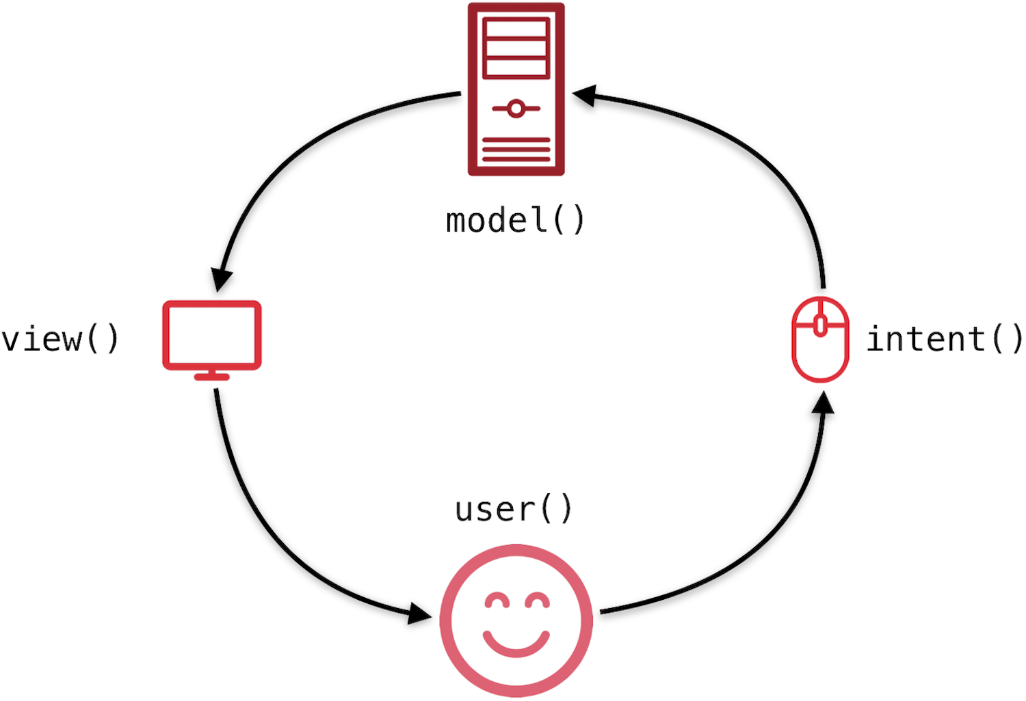
MVI

Slide 8
MVI
MVVM architecture

Slide 9
MVI
MVVM architecture
ViewModel exposes state to the view

Slide 10
MVI
MVVM architecture
ViewModel exposes state to the view
View updates based on the ViewModel state

