Slide 1
How to contribute to NorCPM
Ingo bethke^{1,2}
¹University of Bergen
²Bjerknes centre for climate research
EMAIL: ingo.bethke@uib.no

Slide 2
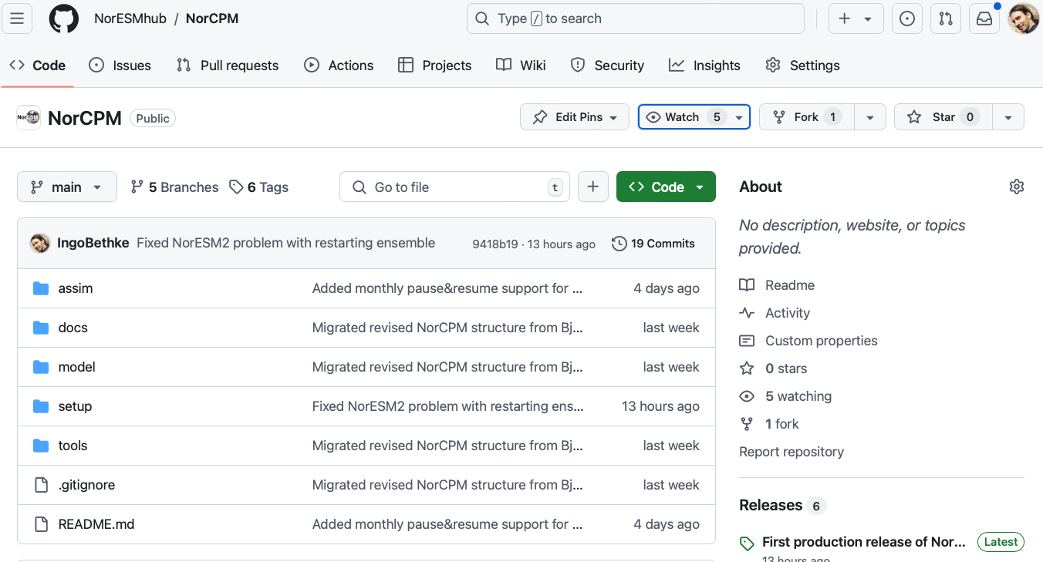
How to contribute to NorCPM
Step 1: create fork NorESMhub/NorCPM in your personal github space

Slide 3
How to contribute to NorCPM
Step 2: log on to Betzy and clone NorCPM from your personal github space
mkdir -p /cluster/projects/nn9039k/people/$USER
cd /cluster/projects/nn9039k/people/$USER
git clone ssh://git@github.com/<my github user>/NorCPM.git NorCPM
IMPORTANT: Before you can use ”ssh://git@github.com” form Betzy, you need to create a public ssh-key on Betzy and upload the key to your github profile.

Slide 4
How to contribute to NorCPM
Step 3: apply changes to your local NorCPM clone on Betzy

Slide 5
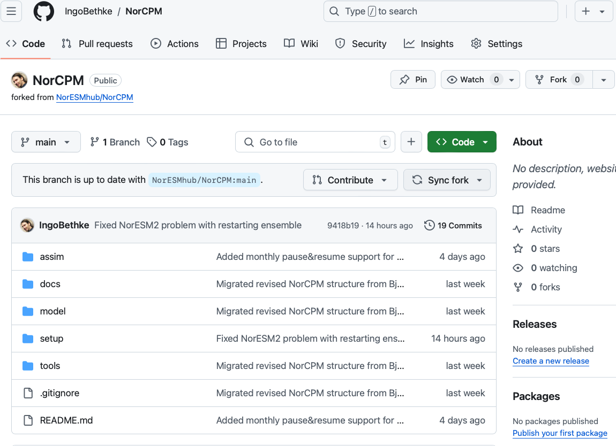
How to contribute to NorCPM
Step 4: synchronize your fork with the latest NorESMhub/NorCPM state

Slide 6
How to contribute to NorCPM
Step 5: synchronize your local NorCPM clone with your github fork
git pull

Slide 7
How to contribute to NorCPM
Step 6: commit your changes to your local NorCPM clone
git add .
git status
git commit –m 'my commit message'

Slide 8
How to contribute to NorCPM
Step 8: push the changes from your local NorCPM clone to your github fork
git push

Slide 9
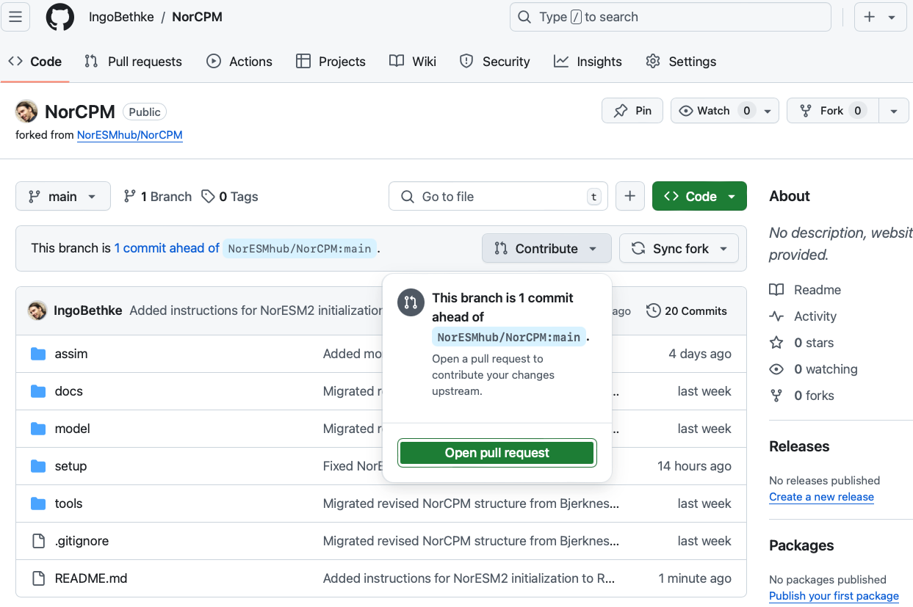
How to contribute to NorCPM
Step 9: issue pull request for applying changes from your fork to NorESMhub/NorCPM

Slide 10
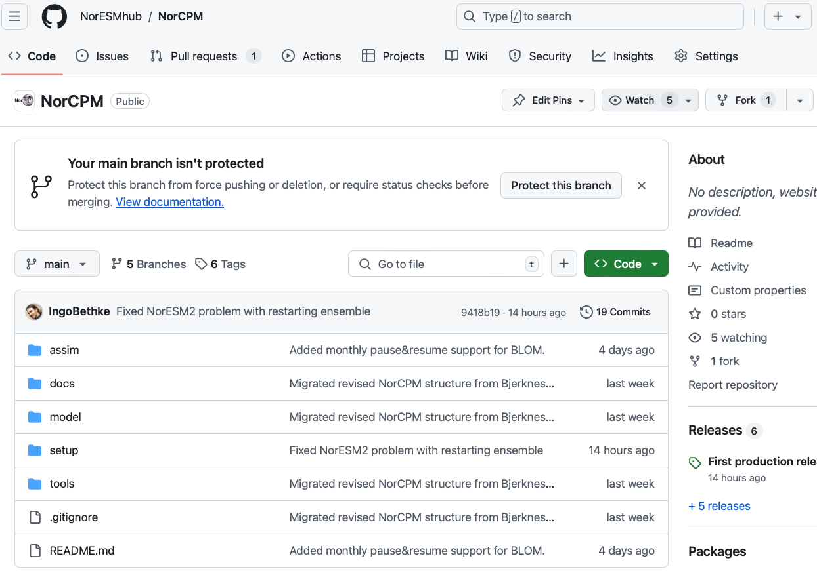
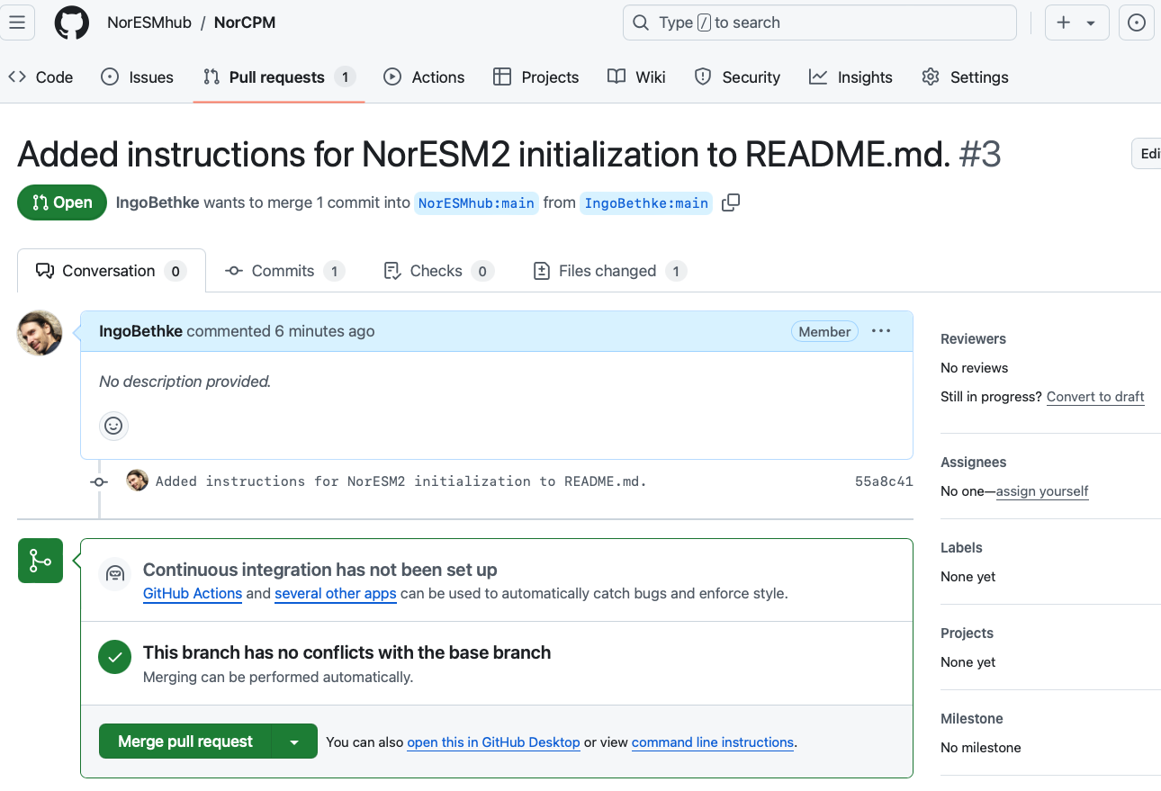
How to contribute to NorCPM
Step 10: merge pull request (only for maintainers)

