Slide 1
Dalek

Slide 2

Introduction
Brede
Faltin
Ingrid
Magnus
Sandra
Notes:
Brede second year on a bachelor in bioinformatics
Faltin second year on a bachelor in bioinformatics
Sandra third year on a bachelor in bioinformatics
Magnus second year on a bachelor in Information and communication technology
Ingrid third year on a bachelor in computer technology

Slide 3
Group organization
Kanban and SCRUM hybrid
One task each
Weekly meetings(sprint)
Issues
Size on tasks in todo list
Time
Github
Fixes
Minimize the amount of work given in a todo task
Specific agenda for meetings
Notes:
choose a hybrid between Kanban and SCRUM
Key point to keep things as simple as possible, yet organized enough to make sure we have a steady way of working
One task each
Writing test while programming
Running tests often ( at least every time we make a new functionality)
Sprint/iteration each week, retrospective and planning on each meeting
Slack
Communication, asking questions, planning, trouble
Trello
Todo list, organisation of tasks, making sure everyone has tasks, not stepping on each others toes
Google docs
Summary of meetings, group organisation, sharing of text
Github
Sharing code, some communication by comments commits etc.
Issues
Trouble making tasks small enough in the todo list,
The amount of time get trough the agenda and cover everything on meetings, this was a lot harder than we expected
Trouble with github in the beginning, but when solved everything has (so far) gone smoothly
Fixes
A solution to making tasks smaller is to try and break them down into smaller pieces so they are manageable
A Solution to time used in meetings is to have a specific agenda to go through

Slide 4
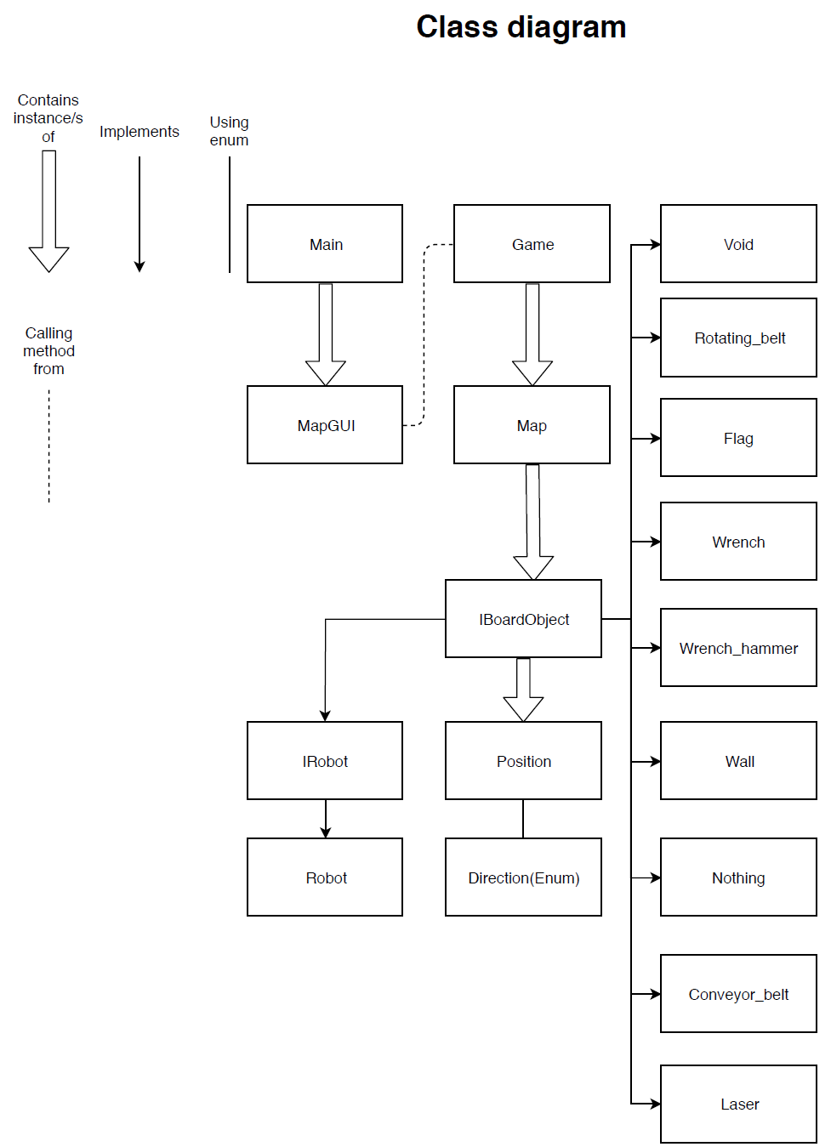
Priorities
What have we prioritized
Game skeleton
Why
Overview
Issues
Less overview
Fixes
Focus on prioritized list
Notes:
Priorities:
Game skeleton
We prioritized making a game skeleton, with some stronger prioritized classes such as Map, Robot, game etc with a lot of other smaller less filled classes such as flag, conveyorbelt etc.
The reason for doing it this way is that we think this will give us an advantage by giving us an overview early in the process by letting us visualize how we can resolve problems or plan strategies before it becomes a concern
Issues
Becomes a bit more messy than perhaps what's necessary this early in the making, but as said we think it will make it easier later in the project
Fixes
Our fixes for this is to stick to our project method, and try to focus on the prioritized lists we make each week

Slide 5
Experiences to bring forward
Most important experiences so far
Work amount
Amount of time used
Most important things to work on in the future
Add functionality
Efficiency
Notes:
Most important experiences is
as magnus briefly mentioned The amount of time all these different processes(coding, planning, reviewing, retrospective) takes we really didn’t excpect
How much/little the workload is compared to what one first imagines
Most important things to work on in the future
Efficiency
Concerning both time and work
At meetings
While coding
Adding functionality will obviously be a thing to work on in the future
We also think that one of the most important things to work on is making our sprints/Itertations a rutine and making it more efficient

Slide 6
Demo
Notes:
This is our map and robot with some items all drawn by Ingrid, however all we do at this point is moving the picture not the actual robot class

Slide 7
Questions?

