Slide 1
Liberi. - Research
Alex Maslarski

Slide 2
Target group
The main target group for the website is all active sport supporters over the age of 14.
Mainly European audience as the ultras culture is not that popular in the USA and in other parts of the world with some small exceptions.
Interested in sports and the casual subculture.

Slide 3
Perfect user
The perfect user would be in the age between 14 and 35 years old, supports a football team actively and is interested in ultras. Also is interested in casual clothing brands such as Weekend Offender, PeacefullHooligan, Pgwear, Adidas, Nike, NewBalance and othere similar.
The user would go on the website to check out the latest news in the ultras world, see performances, choreographies, pyroshows, fights and other interesting information such as interviews, history, ideas and campaigns.
He would also be able to find a shop where he can buy clothing matching his taste.

Slide 4
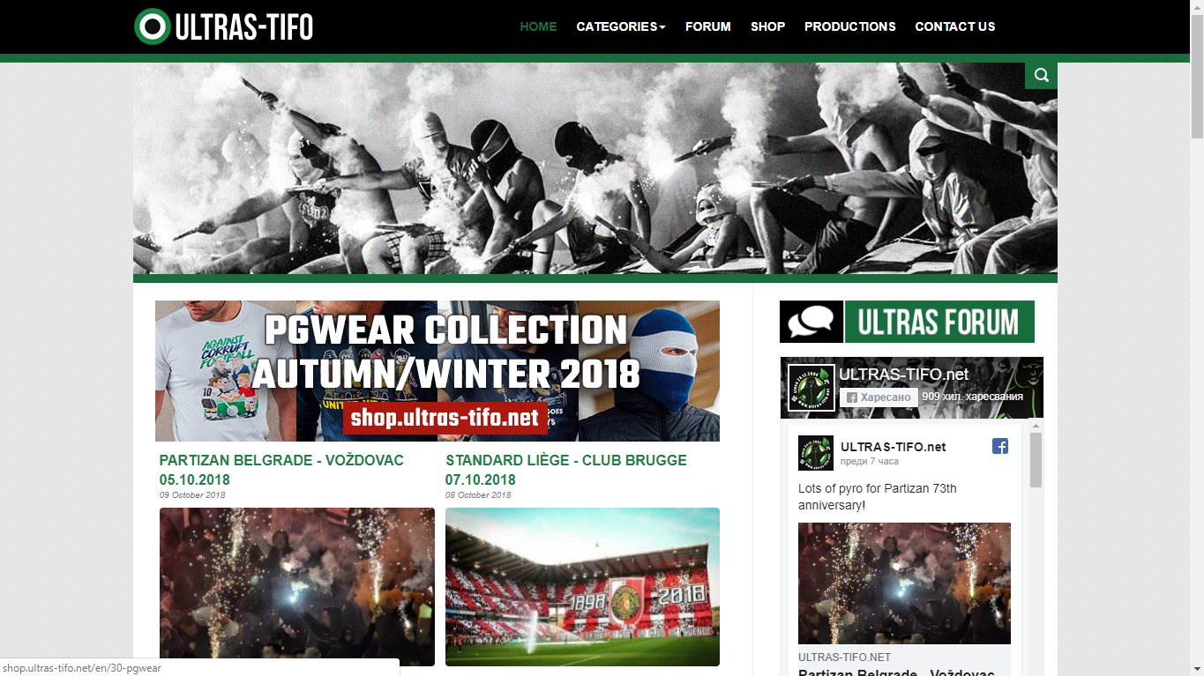
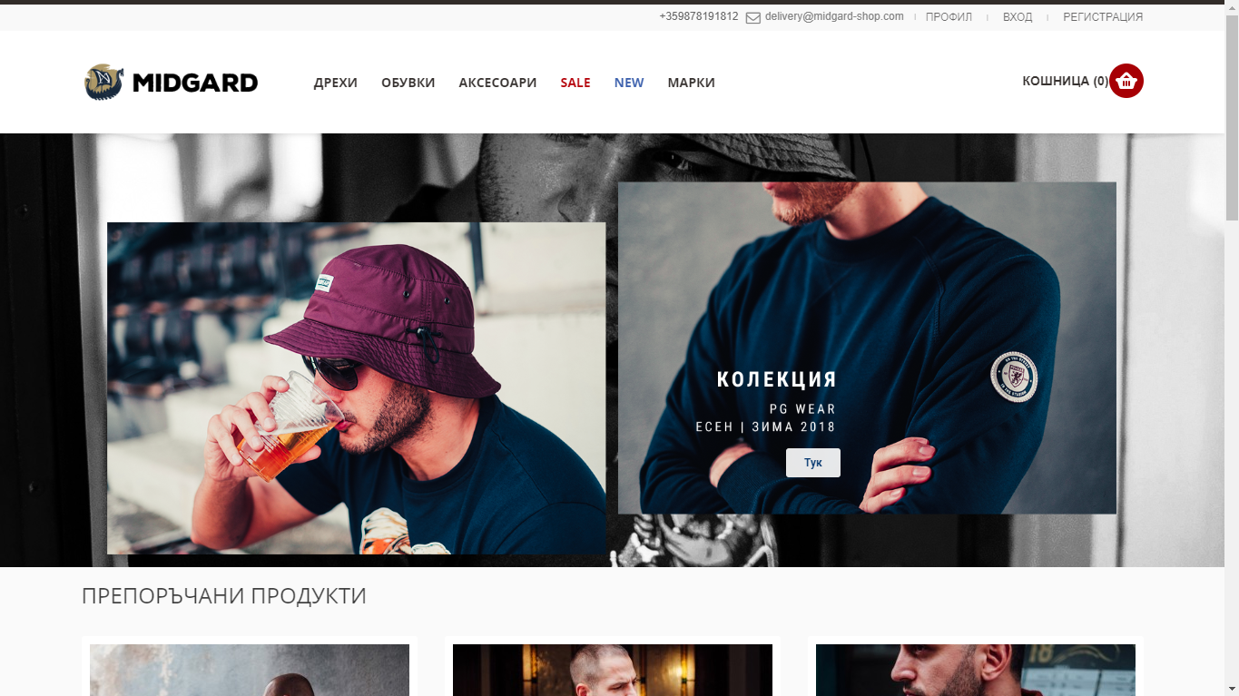
Inspirations
Of course I myself am a user of this type of online magazines, so I took inspiration from them and also thought about what I as a user would like to see in one place .

Slide 5
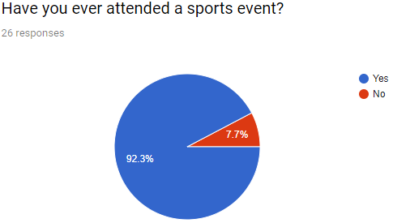
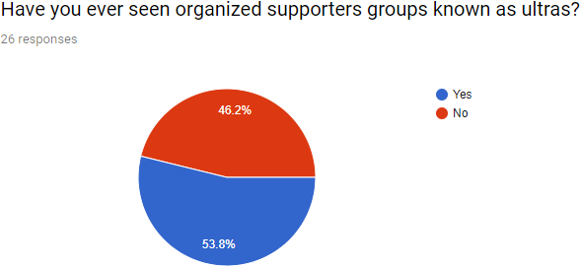
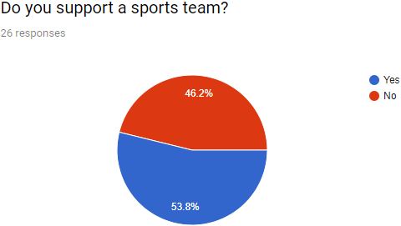
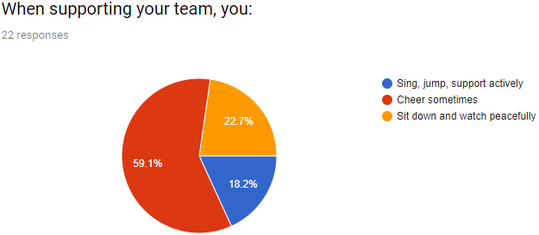
Research - Surveys
In a survey I carried out I found out that over 50% of the international students in Aarhus actively support a football or other sports club. Most of the people are interested in casual clothing and would like to see more information about it.

Slide 6
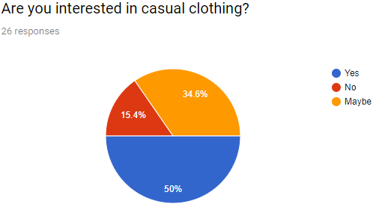
Casual clothing - Surveys
Majority of the people are interested in casual clothing, so I decided to showcase a shop on my website. The shop I linked is external and belongs to other supporters from Bulgaria. They gave me their permission to use their products in my website.

Slide 7
Research – Interviews with classmates
Based on the interviews with 4 of my classmates, I understood that even if they are not interested in this topic at first, after they took a look of some performances and after hearing some stories from me, they became more and more interested and would consider reading more about this type of culture. Most of them attended sports events but didn’t pay much attention to the supporters’performance on the stands. My online magazine’s aim is to change that. Also some of them consider their clothing style as casual and think that a link to a shop would be useful for them.
Questions:
Have you ever attended a sports event?
What do you think of the atmosphere?
Are you interested in sport fans and their performance on the stands?
Would you like to know more about a specific supporters group, their performances, history etc.?
Are you interested in casual clothing and would you consider your dressing as casual? Favourite brands?

Slide 8
LYUDMIL
Yes. Basketball and football
Inspiring and Exciting
Yes probably in football
Yes of course
Yes I consider my clothing style as casual. I wear Adidas and Lacoste.
ADAM
Yes, Ice hockey
A lot of fans cheering, aggressive, lots of fun
Not much
Yes
Yes, Nike, vans, Jordan H&M
PAVEL
Yes, Football, wrestling, tennis, volleyball, running, drifting, racing, slalom
Yes, Pleasant, Cheering, flags and BEER
Not much
Yes, history, fighting political views
Yes, Nike, H&M, ZARA, Hollister, Levi’s, VANS
JARO
Yes, Football, Hockey
Yes, it depends on the opponent
Maybe yes
Yes definitely
Yes, Nike

Slide 9
Summary
Based on all research and information gathered, the purpose of my online magazine is to keep people from the ultras culture informed about the latest news, but also let other more regular supporters and people dive in the culture and understand it more as it sometimes seems crazy when looking from the side. The magazine will have some articles explaining some specific parts of the ultras world so regular people understand it more.

