Slide 1
Feather GEMM: Toward cuBLAS performance
This presentation roughly takes ? minutes.

Slide 2
This mini-project proves:
I have basic skills in using cuda, ncu profiler, git, CMake
I understand how cuda programming model works and the basic gpu architecture
I can optimize cuda kernel based on profiling result
I have patience to learn new things and deal with bugs.

Slide 3
This presentation has 3 parts:
Profile result demonstration
Optimization worklog and concept illustration
Todo and confusion

Slide 4
Profile result demonstration
How I profile the kernel performance:
I know that profile is almost as important as writing the kernel itself.
On my laptop I use ncu to help me collect the duration and flops and other metrics.
On cloud gpu, I can neither use ncu , nor lock the clock of gpu due to lack of admin privilege. So I can only use cudaEvent to time the kernel.
I profile many times to ensure basic reproducibility.
When profiling, I avoid unnecessary process which might consume resources.
So the analysis is mainly focused on my laptop RTX 4060, I am sorry if it is not quite convincible.

Slide 5
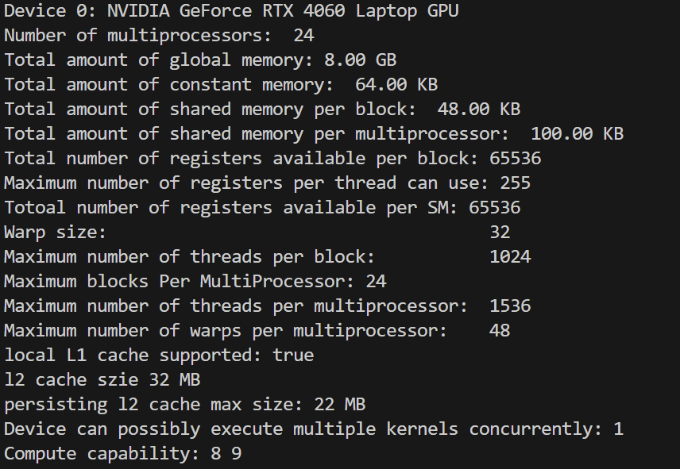
Profile result demonstration
Result on my laptop RTX4060:
Basic properties about RTX4060

Slide 6
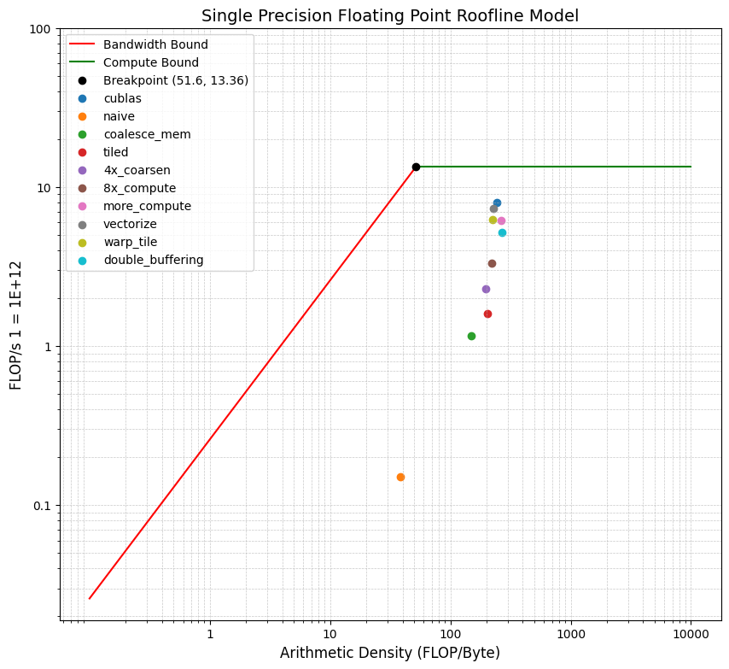
Profile result demonstration
Result on my laptop RTX4060:
Different Kernel Comparison,
M = N = K = 2048

Slide 7
Profile result demonstration
Result on my laptop RTX4060:
Different Problem Size,
Choose :
cublas,
vectorize,
warp_tile,
double_buffering

Slide 8
Profile result demonstration
Results on cloud gpu A100-PCIE-40GB
Basic properties about A100-PCIE-40GB

Slide 9
Profile result demonstration
Results on cloud gpu A100-PCIE-40GB:
Different kernel
M = N = K = 2048

Slide 10
Profile result demonstration
Results on cloud gpu A100-PCIE-40GB:
Change size,
Choose:
cublas,
vectorize,
warp_tile,
double_buffering

Slide 11
Results on cloud gpu H800

Slide 12
Optimization worklog and concept illustration

Slide 13
Todo and confusion

