Slide 1
Feather GEMM: Toward cuBLAS performance
This presentation roughly takes ? minutes.

Slide 2
This mini-project proves:
I have basic skills in using cuda, ncu profiler, git, CMake
I understand how cuda programming model works and the basic gpu architecture
I can optimize cuda kernel based on profiling result
I have patience to learn new things and deal with bugs.

Slide 3
This presentation has 4 parts:
Profile result demonstration
Optimization worklog and concept illustration
Todo and confusion
Bonus

Slide 4
Profile result demonstration
How I profile the kernel performance:
I know that profile is almost as important as writing the kernel itself.
On my laptop I use ncu to help me collect the duration and flops and other metrics.
On cloud gpu, I can neither use ncu , nor lock the clock of gpu due to lack of admin privilege. So, I can only use cudaEvent to time the kernel.
I profile many times to ensure basic reproducibility.
When profiling, I avoid unnecessary process which might consume resources.
The analysis is mainly focused on my laptop RTX 4060, I am sorry if it is not quite convincible or limited.

Slide 5
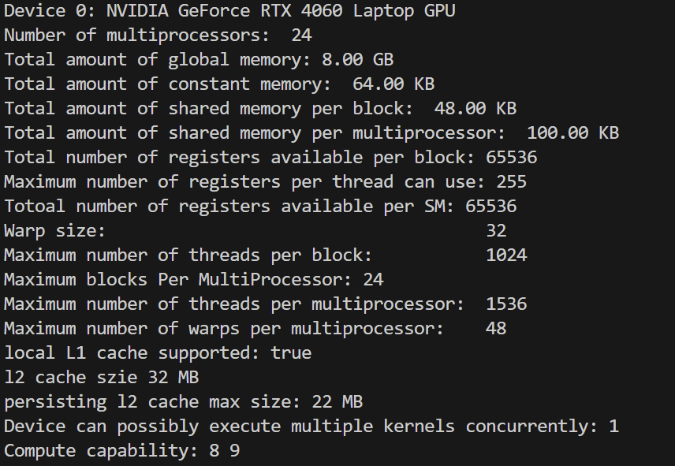
Profile result demonstration
Result on my laptop RTX4060:
Basic properties about RTX4060

Slide 6
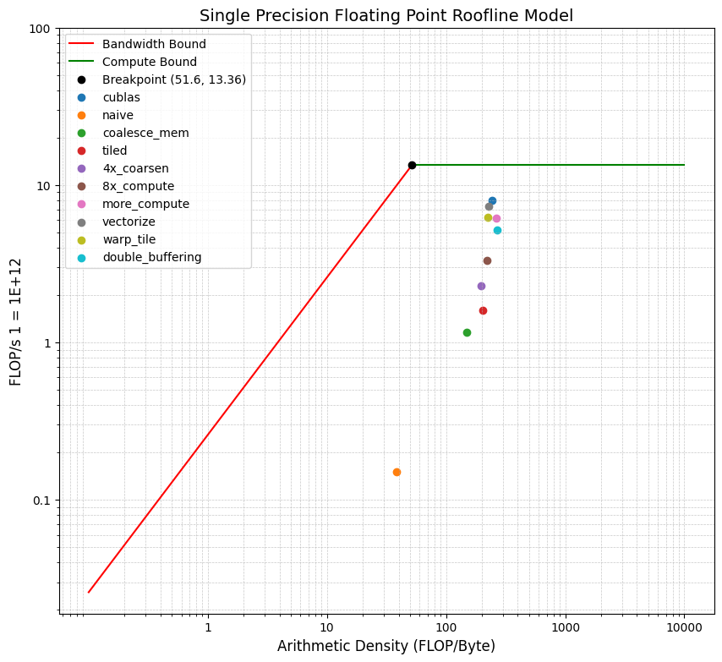
Profile result demonstration
Result on my laptop RTX4060:
M = N = K = 2048

Slide 7
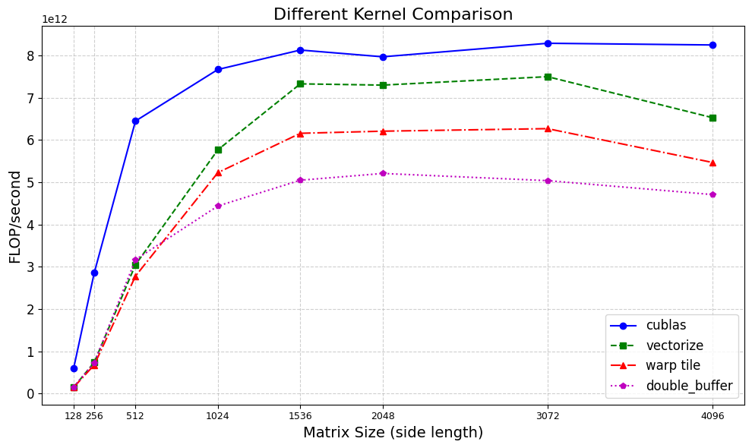
Profile result demonstration

Slide 8
Optimization worklog and concept illustration
Before diving into GPU kernel optimization...
Data acquisition (I/O)
Data preprocessing
Network latency and bandwidth
Python level multiprocessing
The overall performance improvement gained by optimizing a single part of a system is limited by the fraction of time that the improved part is actually used.
-- Amdahl's law

Slide 9
Optimization worklog and concept illustration
FP32 GEMM:
C = α * AB + β * C
When the dimension is small, this kernel is memory bound.
When the dimension is large, this kernel is computation bound.
I use square matrix for simplicity and avoid tile quantization.
Take M = N = K = 2048 for example.

Slide 10
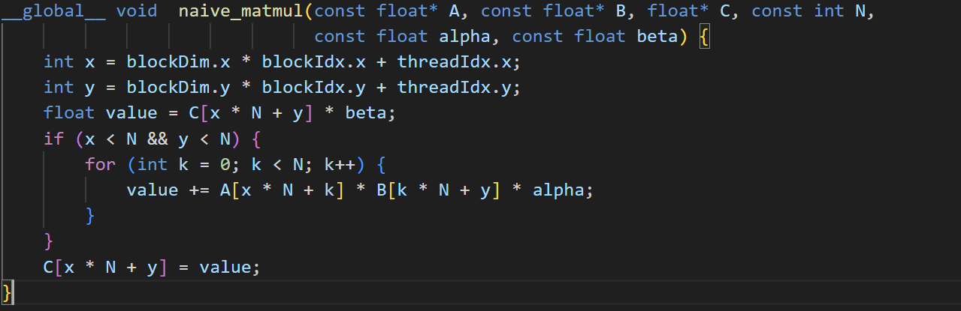
Optimization worklog and concept illustration
Too much global memory access.
The computation of x and y is wrong.

Slide 11
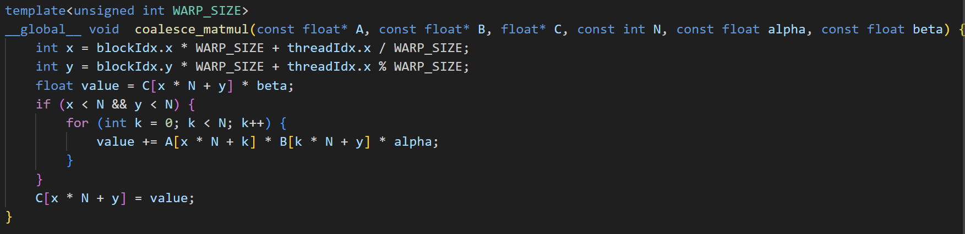
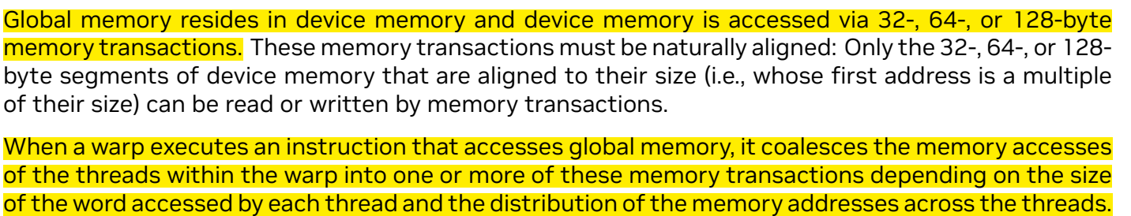
Optimization worklog and concept illustration

Slide 12
Optimization worklog and concept illustration
Compared with the naive implementation,
the memory throughput of the coalesce kernel improves 101%,
from 3.85 GB/s to 7.75 GB/s

Slide 13
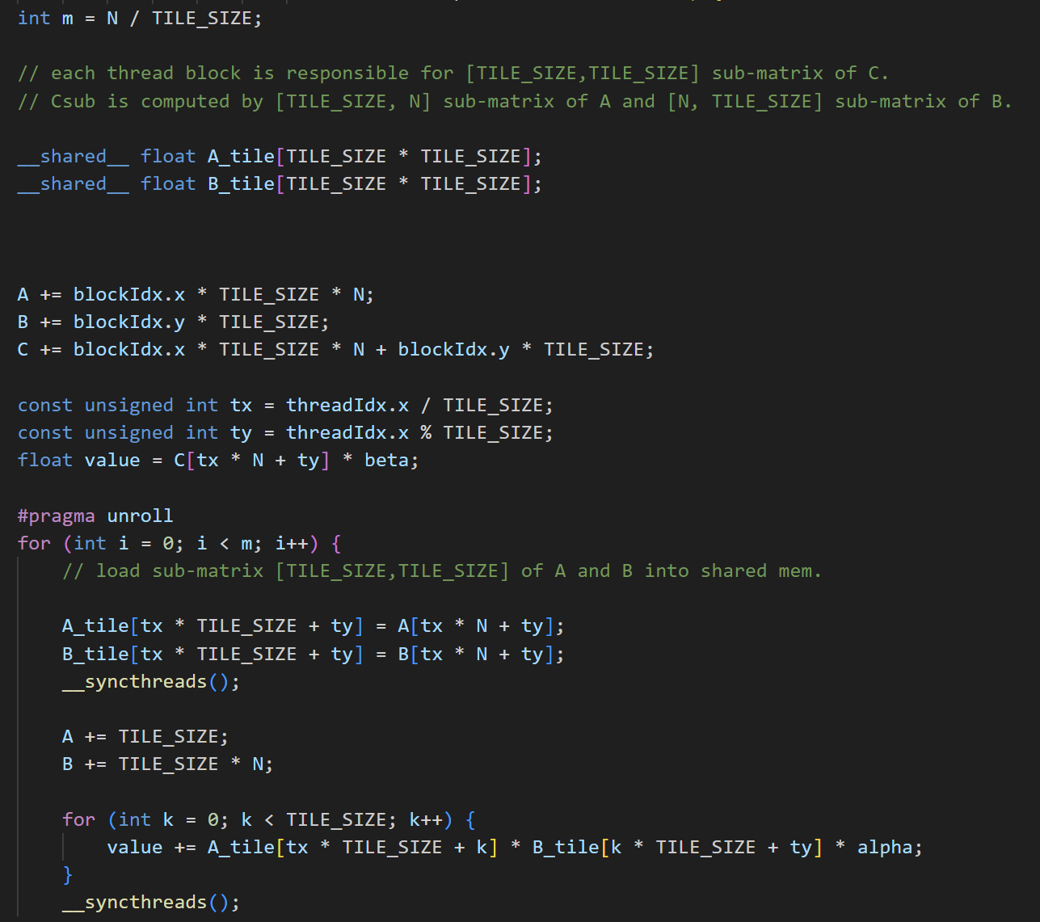
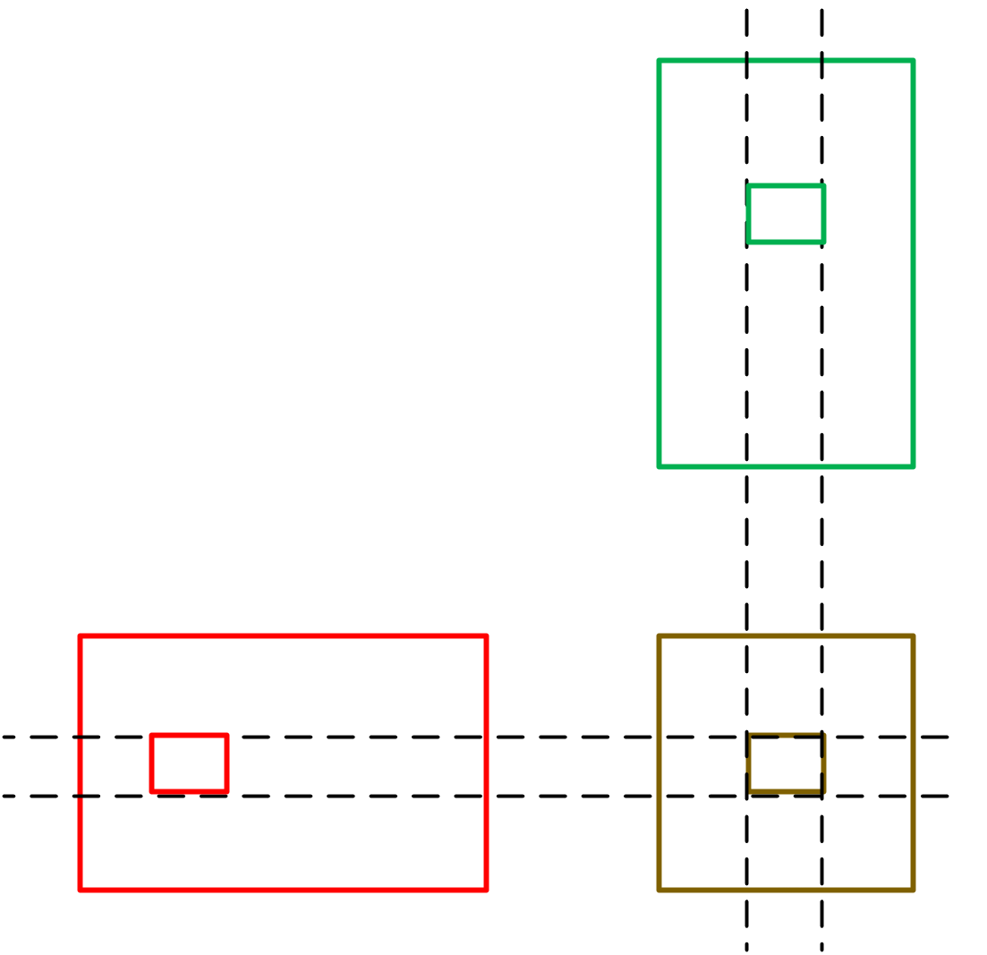
Optimization worklog and concept illustration

Slide 14
Optimization worklog and concept illustration
By using shared memory, the flops now is 1.60E12 ,
compared to the coalesce kernel, which has 1.16E12 flops.

Slide 15
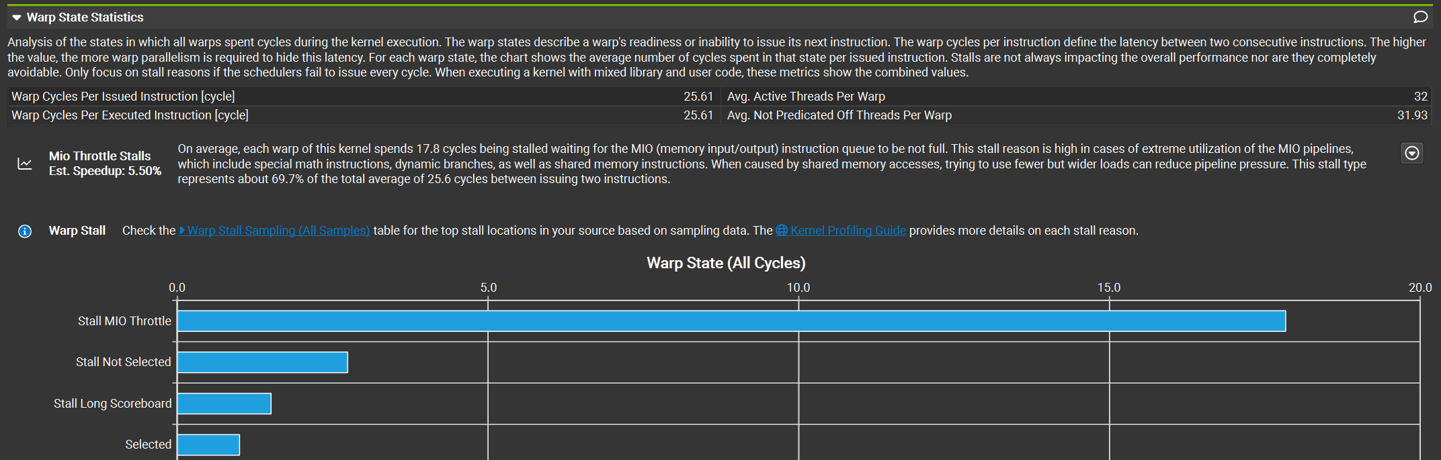
Optimization worklog and concept illustration
By profiling the tiled kernel, I can tell that:

Slide 16
Optimization worklog and concept illustration
Thread coarsening: make each thread do more things.
A simple idea is one thread now load and compute more elements.
Another idea is to change the size of A_TILE and B_TILE, this doesn’t change the global load to compute C_TILE, but makes each thread compute more elements.
For example:
i) A_TILE = 64 x 64, B_TILE = 64 x 64
ii) A_TILE = 64 x 8, B_TILE = 8 x 64
Both results in a 64 x 64 C_ACCUMULATE.
If i) and ii) share the same launch settings, threads in ii) compute 8x elements.

Slide 17
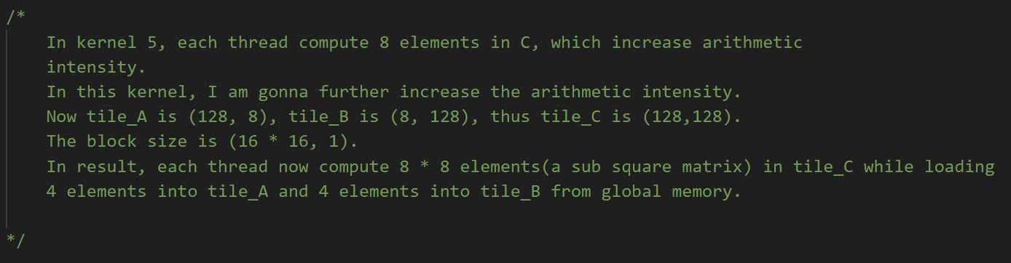
Optimization worklog and concept illustration
I will illustrate this kernel more specifically

Slide 18
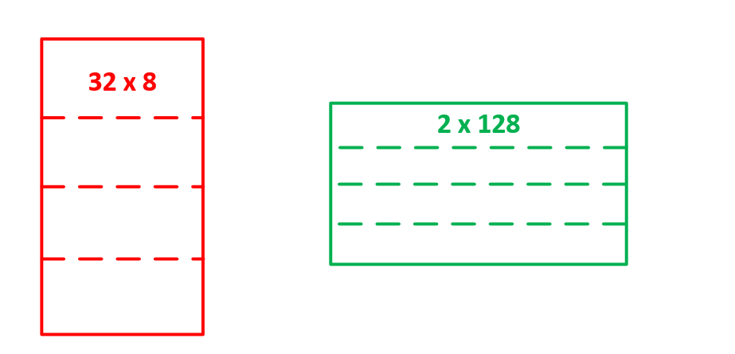
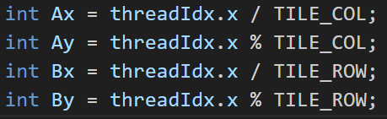
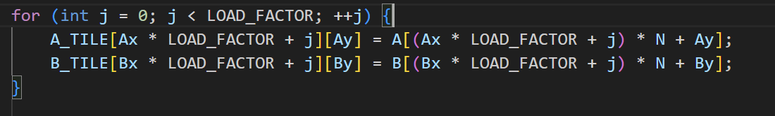
Optimization worklog and concept illustration
Load 4 elements each thread in to shared memory.

Slide 19
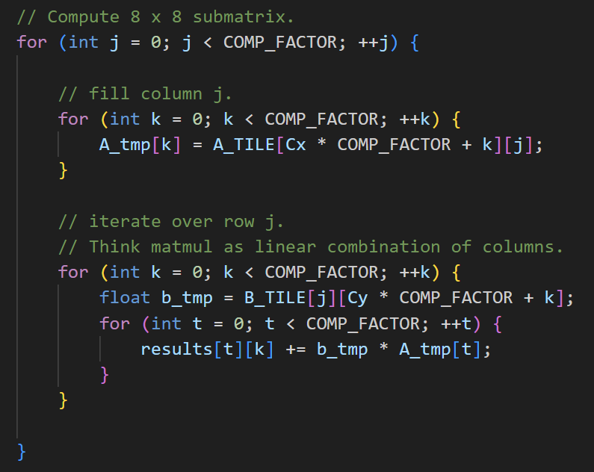
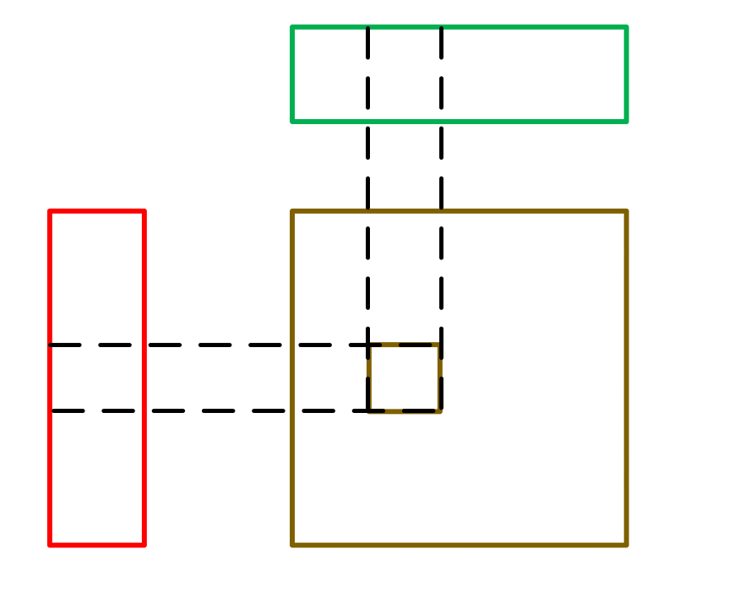
Optimization worklog and concept illustration
Compute a sub-square 8 x 8 matrix per thread.

Slide 20
Optimization worklog and concept illustration
Let me compare the load/store instruction per element computation per thread needs.
i) A_TILE: 32 x 32, B_TILE: 32 x 32, N = 2048, step = 64, global load into smem: 64 x 2, smem load: 64 x 32 x 2, global store: 1, compute 1 element.
1 element computation needs: 128 global load, 4096 smem load, 1 global store.
ii) A_TILE = 128 x 8, B_TILE = 8 x 128, N = 2048, step = 256,
global load into smem: 256 x 2 x 4, smem load: 256 x 8 x (8 + 8), global store: 64
compute 64 element.
1 element computation needs: 32 global load, 512 smem load, 1 global store.
(ignore registers usage for now.)

Slide 21
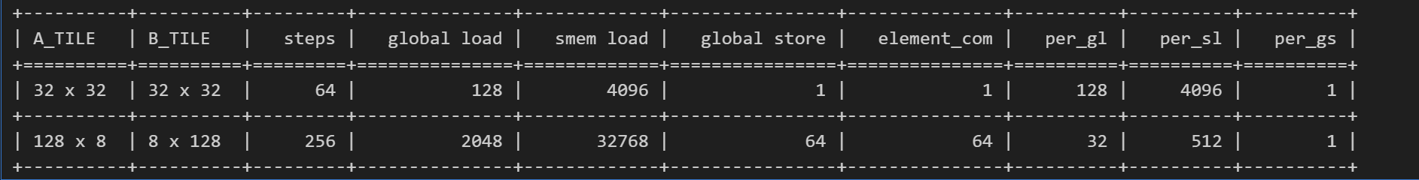
Optimization worklog and concept illustration
Let me compare the load/store instruction per element computation per thread needs.

Slide 22
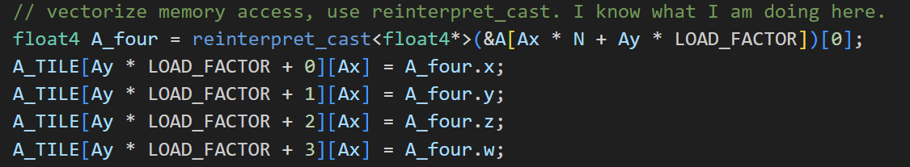
Optimization worklog and concept illustration
Vectorize load: float4

Slide 23
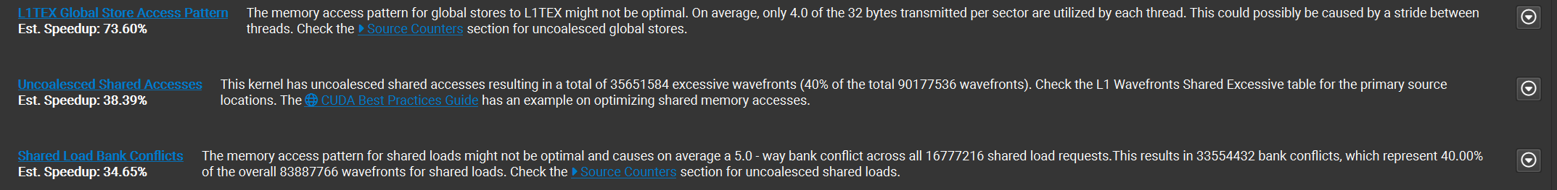
Optimization worklog and concept illustration
The kernel 7, which uses vectorize memory access, works pretty good now, but there are still bottlenecks.
From the profiler, I can tell that the two main bottleneck:
One is uncoalesced global memory store in C, the other is bank conflict.
I will illustrate these two bottlenecks more specifically.

Slide 24
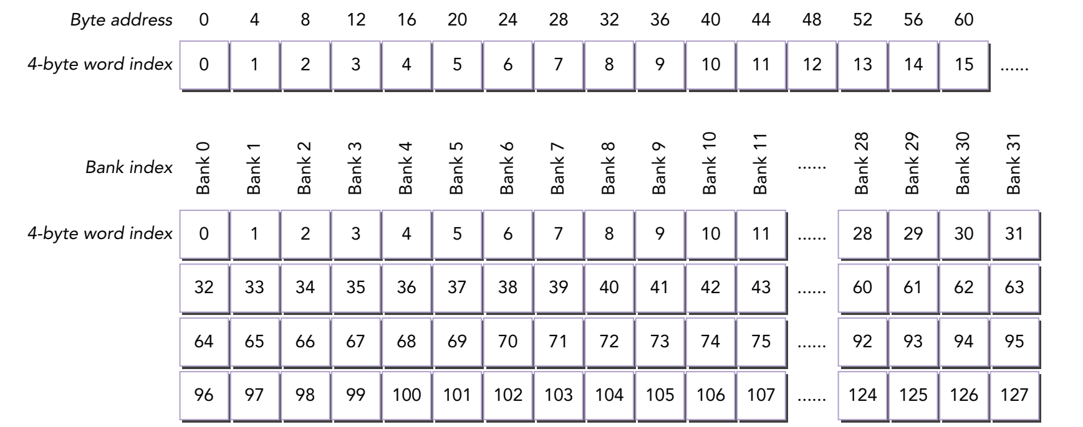
Optimization worklog and concept illustration
Let me start by bank conflict of shared memory first.
Bank conflict happens within a warp.
Shared memory has 32 banks that are organized such that successive 32-bit words map to successive banks. Each bank has a bandwidth of 32 bits(a single float32) per clock cycle.

Slide 25
Optimization worklog and concept illustration
There are 4 patterns when multiple threads within a warp access shared memory.
Each thread access different bank accordingly. The optimal pattern.
Each thread access random different bank. Not bad.
There are some threads accessing the same word in the same bank. Not bad.
There are threads accessing the same bank, but different words. Bad.

Slide 26
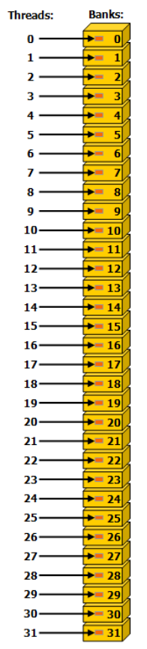
Optimization worklog and concept illustration
Each thread access different bank accordingly. The optimal pattern.

Slide 27
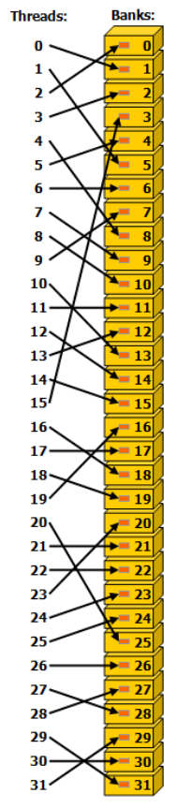
Optimization worklog and concept illustration
Each thread access random different bank. Not bad.

Slide 28
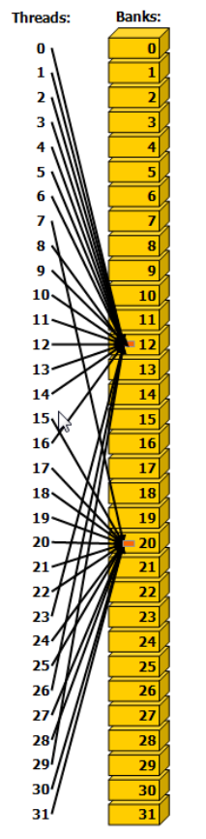
Optimization worklog and concept illustration
There are some threads accessing the same word in the same bank. Not bad.

Slide 29
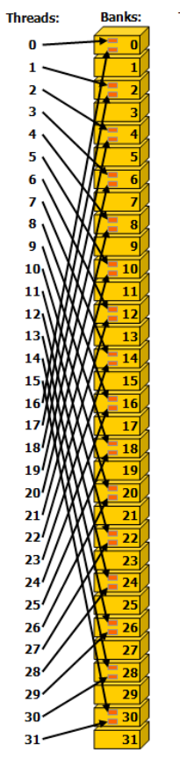
Optimization worklog and concept illustration
There are threads accessing the same bank, but different words. Bad. When multiple addresses fall into the same bank, the request must be serialized. In the picture above, a two-way bank conflict occurs.

Slide 30
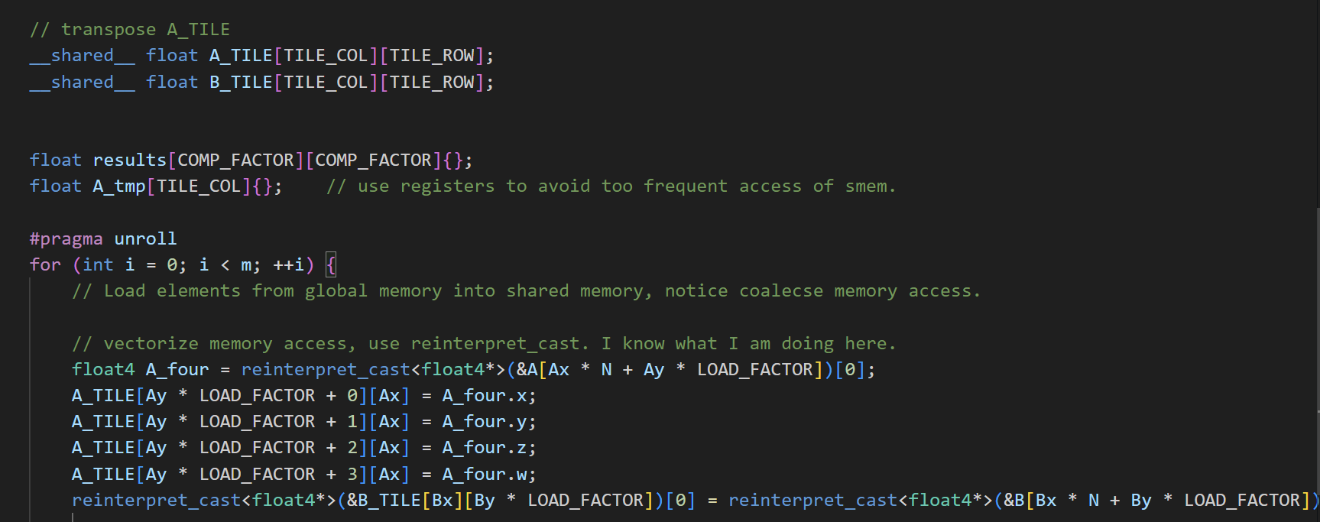
Optimization worklog and concept illustration
Why my kernel 7 suffers from bank conflict:

Slide 31
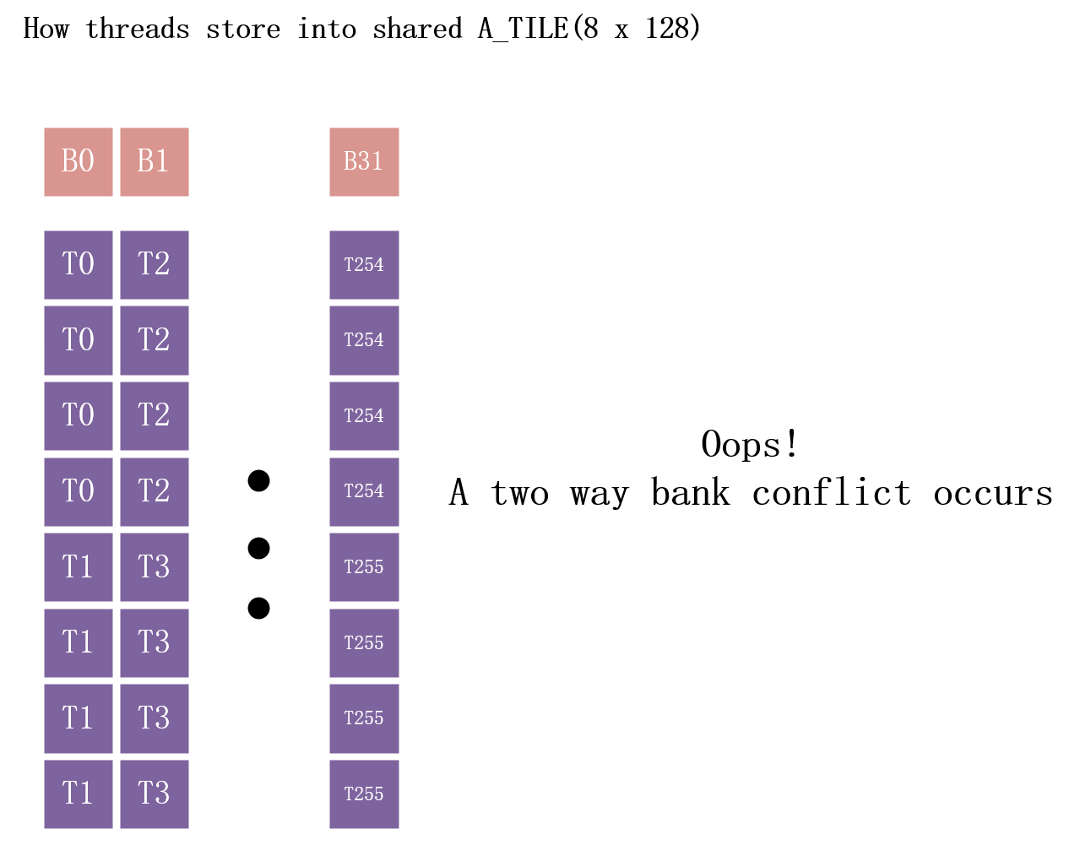
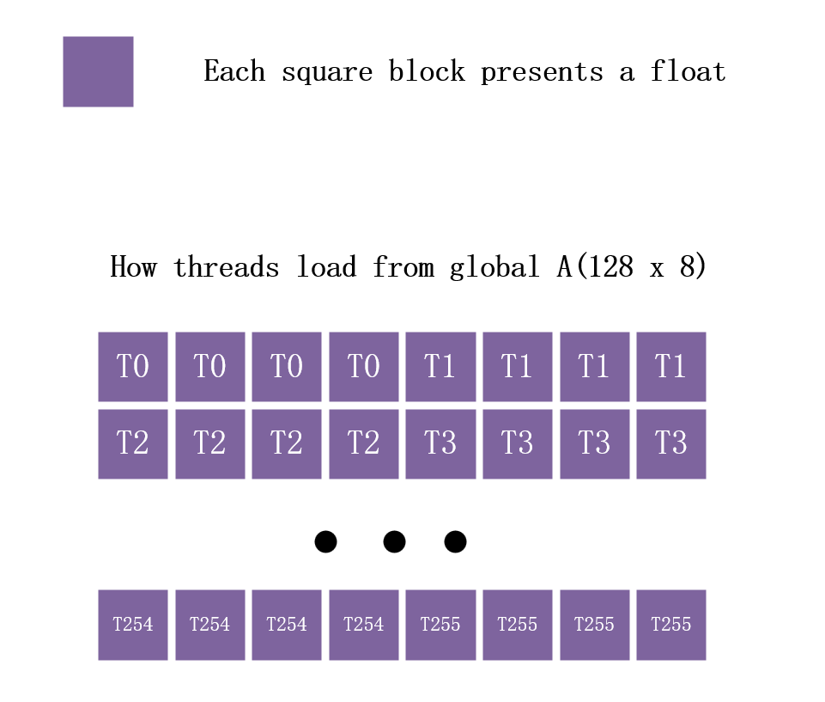
Optimization worklog and concept illustration

Slide 32
Optimization worklog and concept illustration
In fact, the shared memory access pattern is even worse for B,
which results in a 4-way conflict.
Before thinking how to resolve bank conflict, let me check another problem, uncoalesced global store.

Slide 33
Optimization worklog and concept illustration
Each cache line in the GPU is dedicated by sectors, which are the smallest unit of memory that can be transferred into the cache. What it is telling me is that out of the 32 bytes that need to be fetched to get a full sector, only 1 byte is read by my kernel, whereas the rest is just eating up cache space and bandwidth.
Remember that in kernel 7, each thread computes an 8 x 8 square submatrix of C. Why it is bad ?

Slide 34
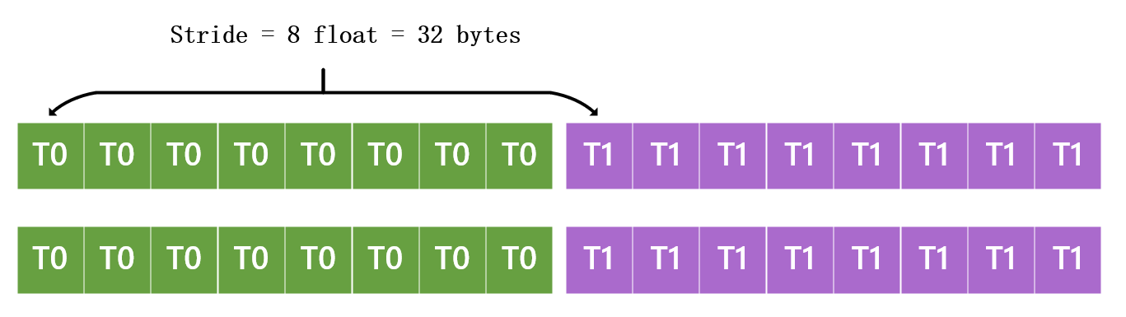
Optimization worklog and concept illustration
Global store pattern of C:
That is why only 4 bytes from a 32 bytes fetch is useful.
I need to avoid stride between threads .

Slide 35
Optimization worklog and concept illustration
Let me conclude the two problems:
The access pattern for shared memory is bad, I need to arrange how threads within a warp access shared memory.
The global store pattern is bad due to stride between threads. I need to arrange how threads within a warp access global memory.
Now the optimization direction is quite clear, in addition to block level parallelism, I need to introduce the warp level parallelism.

Slide 36
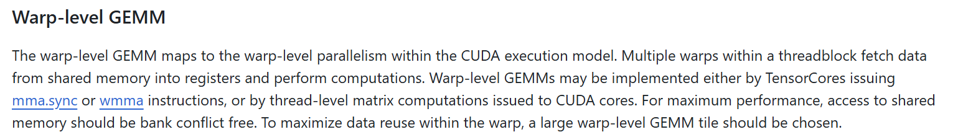
Optimization worklog and concept illustration
The cutlass document says that . . .
I choose the second way, thread-level matrix computations issued to cuda cores.
Utilizing tensor cores typically needs mixed precision.

Slide 37
Optimization worklog and concept illustration
To think in warp level:
256 threads per block means 8 warps per block.
The size of A_TILE is 128 x 8, means each thread loads 4 elements, means each warp loads 4 x 32 = 128 elements. This is the same for B_TILE.
The size of C_TILE is 128 x 128, means each thread computes 64 elements, means each warp computes 64 x 32 = 2048 elements.

Slide 38
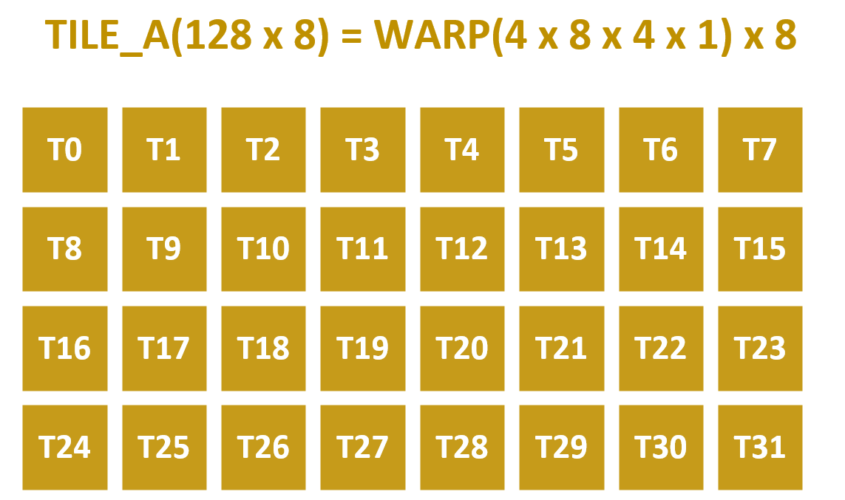
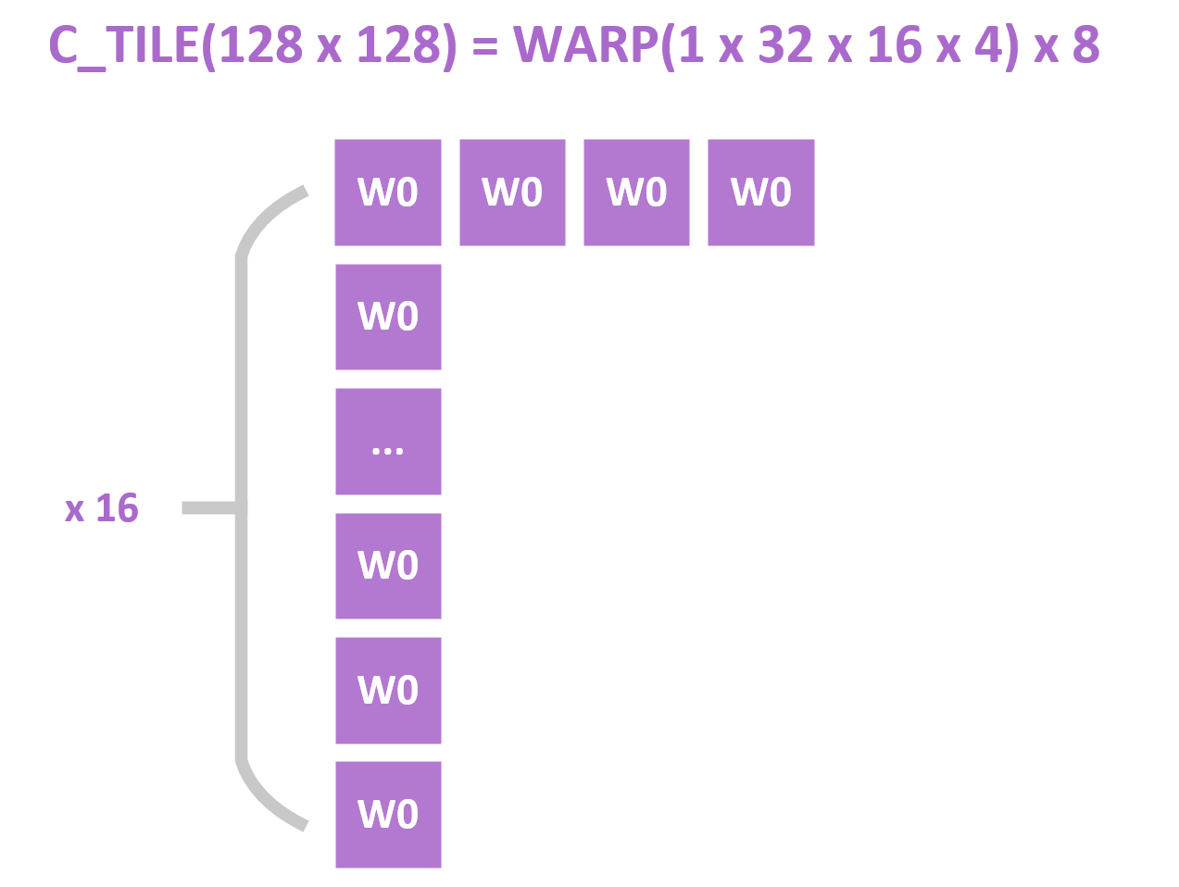
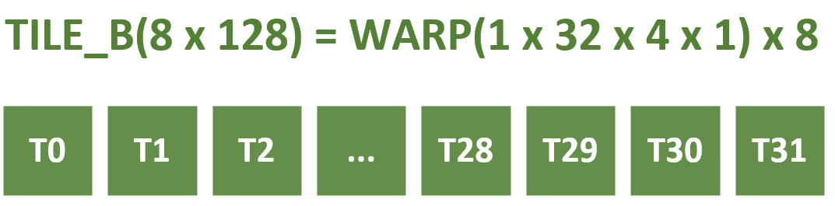
Optimization worklog and concept illustration

Slide 39
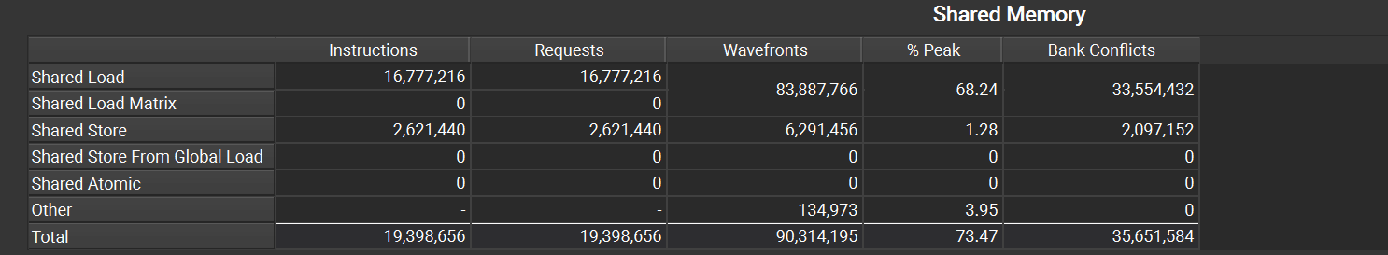
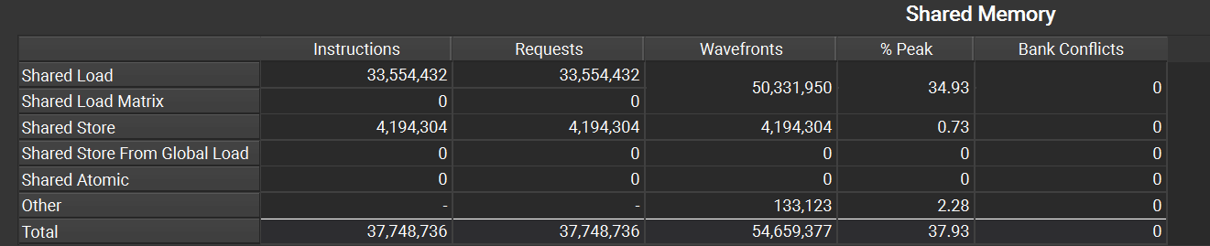
Optimization worklog and concept illustration
kernel 07
I avoid the bank conflict completely. I think this is impressive.
kernel 08
Notes:
The 23rd slide shows the possible optimization.

Slide 40
Optimization worklog and concept illustration
kernel 07
Number of sectors requested: 4,194,304
I optimized the global store pattern:
4,194,304 = 524,288 x 8 (Remember the 8 elements stride in slide 34)
Number of sectors requested: 524,288
kernel 08
Notes:
The 23rd slide shows the possible optimization.

Slide 41
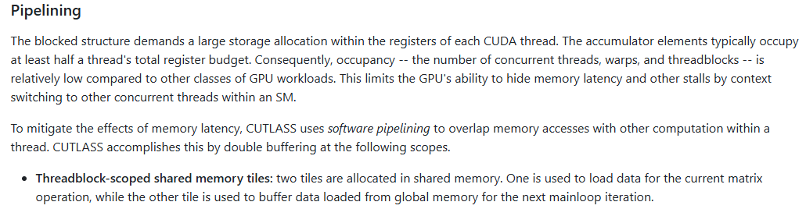
Optimization worklog and concept illustration
As cutlass document said:

Slide 42
Optimization worklog and concept illustration
Data transfers from global memory to shared memory have significantly higher latency compared to arithmetic operations.
During this time, threads are forced to stall, idly waiting for the data needed to compute TILE_A * TILE_B.
One way to mitigate this latency is by overlapping data transfers(ld instruction) with computations(fma instruction), leveraging instruction-level parallelism.
The pseudo code is as follows:

Slide 43
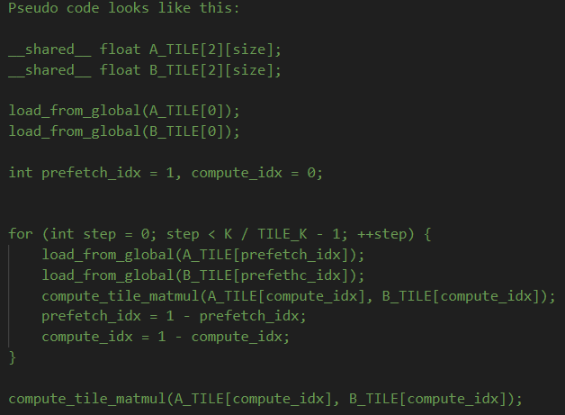
Optimization worklog and concept illustration

Slide 44
Confusion and TODO
The main problems are:
Even kernel 8(warp_tile) solves the bank conflict and uncoalesced global store, the performance is worse than kernel 7.
Kernel 9(double buffering) performs even worse than kernel 8, this is because of excessive register usage.

Slide 45
Confusion and TODO
TODO:
Test more configurations.
asm() can be used to integrate PTX code into CUDA code, I wonder if it brings any performance improvement.
For now, my kernels only deal with perfect square matrix with no tile quantization.
Sgemm can’t use tensor core, bf16 format is useful in mixed precision training.
Hopper GPU has some new features: TMA, asynchronous barrier.
Maybe I will digger deeper into CUTLASS.

Slide 46
Bonus
How ncu profiler works

Slide 47
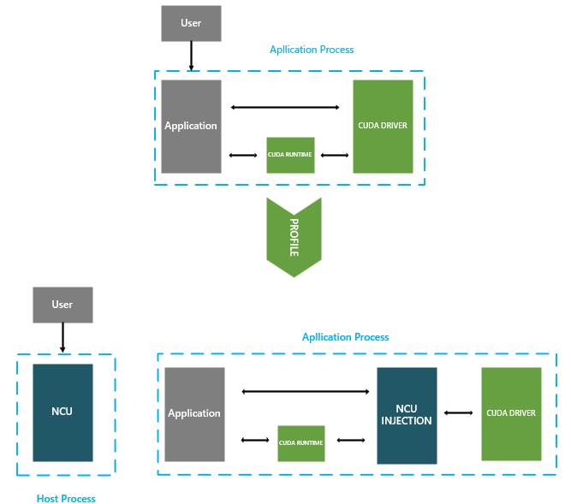
Bonus

Slide 48
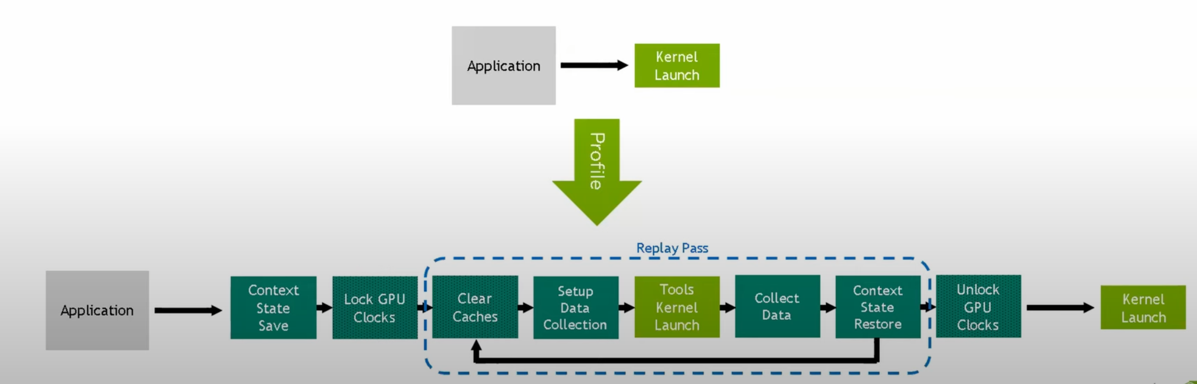
Bonus
If collecting many metrics using ncu, one profile pass may not be enough because the profiling itself consumes gpu resources. To not have a negative impact on the kernel, typically multiple passes are needed to collect all the information. When replaying the kernel, ncu does the below:

Slide 49
Thank you for your time.

