Slide 1
Jasper
Movie similarity analysis
Group 9

Slide 2




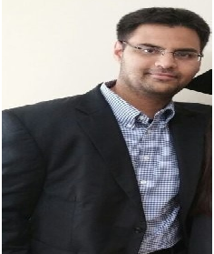
The Team
Akanksha Rawat | LinkedIn
CEO
Experience:
The Smart Cube
Benjamin Turner | LinkedIn
CISO
Experience:
KPMG .
Gaurij Hardikar | LinkedIn
CFO
Experience:
JPMorgan Chase .
Sahib Singh| LinkedIn
Chief Data Scientist
Experience:
Netflix
Vipin Gyanchandani| LinkedIn
GTO
Experience:
ITC InfoTech .

Slide 3
Problem Statement
Movie recommendation engines can aid consumers in selecting movie content that is aligned with their personal interests.
However, proprietary engines are controlled by businesses that only recommend titles they have available for consumer consumption.
Consumers thus do not have easy access to a recommendation engine that recommends titles based upon all known titles.

Slide 4


Data Sources
CSV
CSV
Web scrape
Web scrape
Movie Info
(4m records)
User Ratings
(4m records)
List of Critics
(3k records)
Reviews per Critic
(80k records)
Web scrape
Box Office Success
(ad-hoc)

Slide 5
Application Flow
Data?
Collect movie input
Identify / sort similar movies
Execute .py
Output results
Download / scrape data
Cleanse / merge / save data

Slide 6
Features
Feature | Current | Future
User input | Console input Collect movie name Match movie based on name Exception handling for non-existent movies or movies with same name but different release year | User interface Release year range filters
Similarity analysis | Cosine similarity of up to 3 movie genres Selecting similar movies based on critic / user ratings | Cosine-based similarity of up to n-based tags extracted from movie critic reviews via NLP
User output | Top 20 movies by similarity and user / critic ratings w/ basic information Visualization of box office success Visualization of user votes / ratings | Filtered movies by release year range Sample selection of movie critic reviews Sample selection of relevant tweets

Slide 7
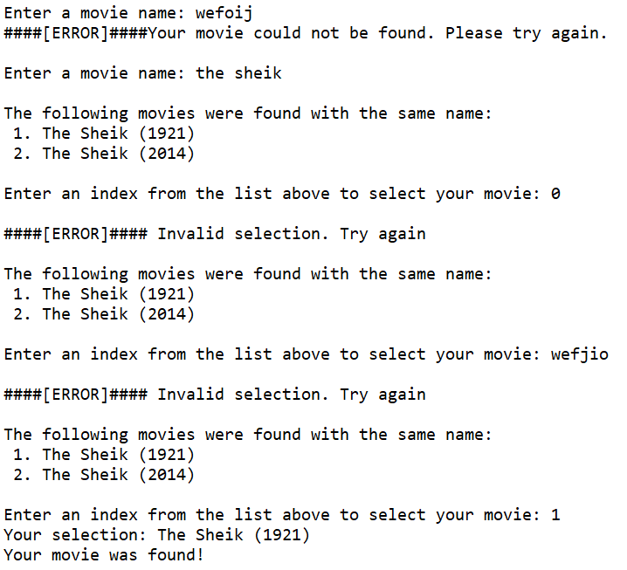
User Input
Happy path:
Enter movie name. Case insensitive.
Select movie from list if required.
Exception handling:
Movie entered that does not match a movie in dataset
Index entered that exceeds array bounds when movies w/ duplicate names
Non-integer entered when movies w/ duplicate names

Slide 8
TFIDF
TFIDF, short for term frequency–inverse document frequency, is just a way to measure the importance of tokens in text.
IDF(t) = log_e(Total number of documents / Number of documents with term t in it).
Consider a document containing 100 words wherein the word comedy appears 3 times.
The term frequency (i.e., tf) for comedy is then (3 / 100) = 0.03
Now, assume we have 10 million documents and the word comedy appears in one thousand of these.
Then, the inverse document frequency (i.e., idf) is calculated as log(10,000,000 / 1,000) = 4.
Thus, the TF-IDF weight is the product of these quantities: 0.03 * 4 = 0.12
Notes:
TFIDF, short for term frequency–inverse document frequency, is just a way to measure the importance of tokens in text
We can simply count the number of times each term occurred in the document (Term Frequency), and use that result for the term score in the vector, but the results wouldn't be very good. Extremely common terms (such as "is", "and", and "the") would cause lots of documents to appear similar to each other.
TF-IDF adjusts the raw term frequency by taking into account how frequent each term occurs in general (the Document Frequency).
Inverse Document Frequency is usually the log of the number of documents divided by the number of documents the term occurs in.
Put simply, the higher the TF*IDF score (weight), the rarer the term and vice versa.
For a term t in a document d, the weight Wt,d of term t in document d is given by:
Wt,d = TFt,d log (N/DFt)
Consider a document containing 100 words wherein the word sun appears 3 times.
The term frequency (i.e., tf) for sun is then (3 / 100) = 0.03.
Now, assume we have 10 million documents and the word sun appears in one thousand of these.
Then, the inverse document frequency (i.e., idf) is calculated as log(10,000,000 / 1,000) = 4.
Thus, the Tf-idf weight is the product of these quantities: 0.03 * 4 = 0.12
The resulting similarity ranges from −1 meaning exactly opposite, to 1 meaning exactly the same, with 0 indicating orthogonality or decorrelation, while in-between values indicate intermediate similarity or dissimilarity. For text matching, the attribute vectors A and B are usually the term frequency vectors of the documents. Cosine similarity can be seen as a method of normalizing document length during comparison. In the case of information retrieval, the cosine similarity of two documents will range from 0 to 1, since the term frequencies (using tf–idf weights) cannot be negative. The angle between two term frequency vectors cannot be greater than 90°.

Slide 9
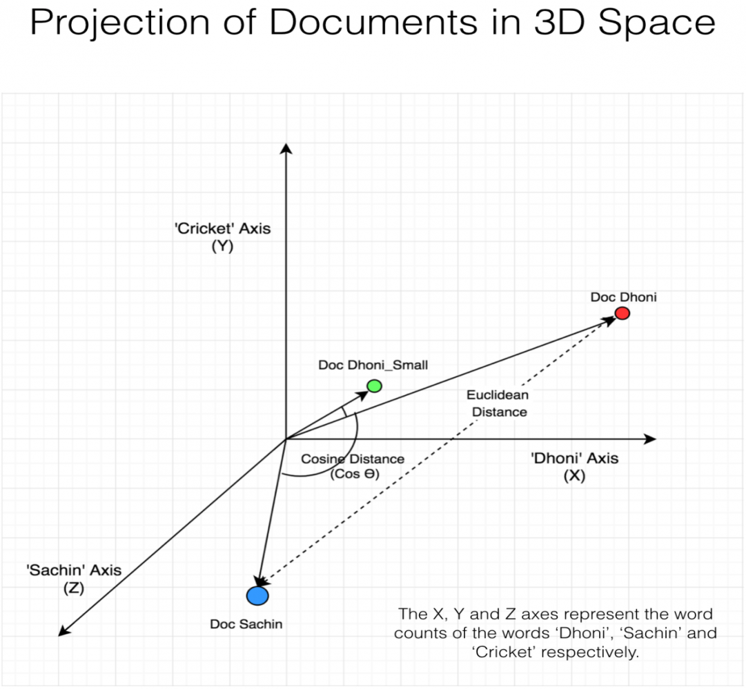
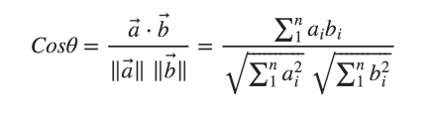
Similarity Analysis
Notes:
TFIDF, short for term frequency–inverse document frequency, is just a way to measure the importance of tokens in text
We can simply count the number of times each term occurred in the document (Term Frequency), and use that result for the term score in the vector, but the results wouldn't be very good. Extremely common terms (such as "is", "and", and "the") would cause lots of documents to appear similar to each other.
TF-IDF adjusts the raw term frequency by taking into account how frequent each term occurs in general (the Document Frequency).
Inverse Document Frequency is usually the log of the number of documents divided by the number of documents the term occurs in.
Put simply, the higher the TF*IDF score (weight), the rarer the term and vice versa.
For a term t in a document d, the weight Wt,d of term t in document d is given by:
Wt,d = TFt,d log (N/DFt)
Consider a document containing 100 words wherein the word sun appears 3 times.
The term frequency (i.e., tf) for sun is then (3 / 100) = 0.03.
Now, assume we have 10 million documents and the word sun appears in one thousand of these.
Then, the inverse document frequency (i.e., idf) is calculated as log(10,000,000 / 1,000) = 4.
Thus, the Tf-idf weight is the product of these quantities: 0.03 * 4 = 0.12
The resulting similarity ranges from −1 meaning exactly opposite, to 1 meaning exactly the same, with 0 indicating orthogonality or decorrelation, while in-between values indicate intermediate similarity or dissimilarity. For text matching, the attribute vectors A and B are usually the term frequency vectors of the documents. Cosine similarity can be seen as a method of normalizing document length during comparison. In the case of information retrieval, the cosine similarity of two documents will range from 0 to 1, since the term frequencies (using tf–idf weights) cannot be negative. The angle between two term frequency vectors cannot be greater than 90°.

Slide 10
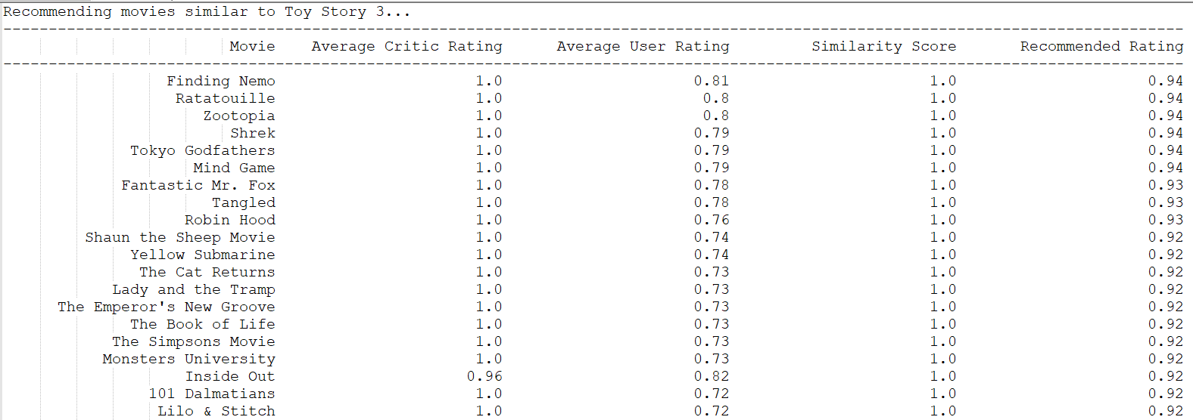
User Output
Table w/ ratings | Box office success | User ratings to movie

Slide 11
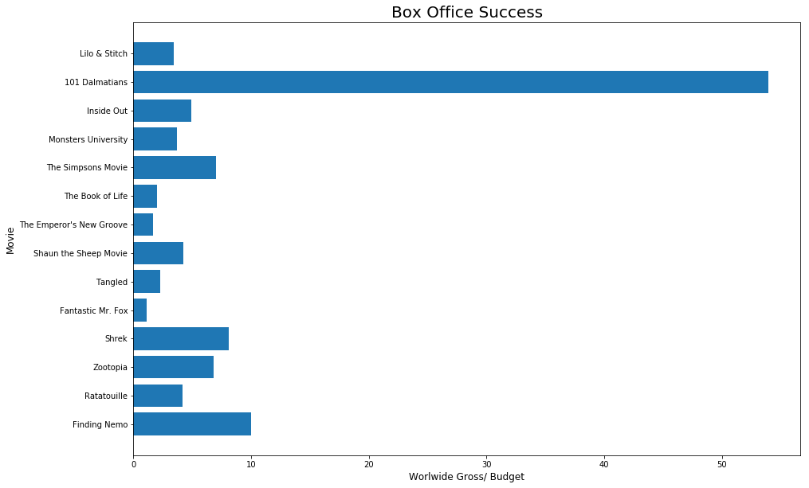

Slide 12
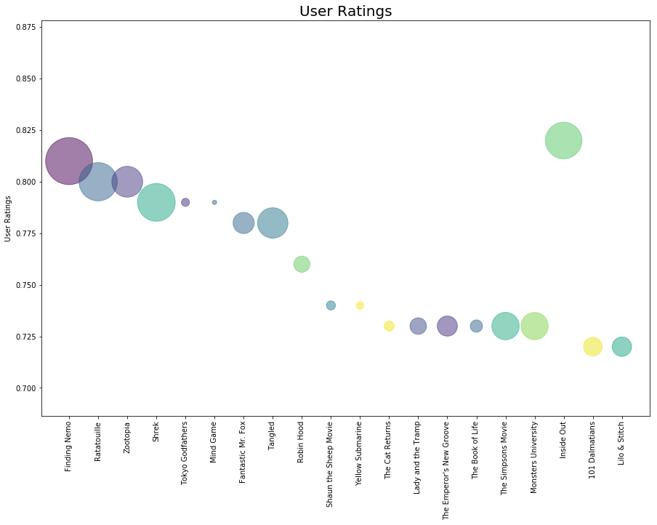

Slide 13
Lessons Learned
Automated checking for / downloading files
.gzip file extraction and reading from csv
Panda joins and filters
TFID vectorization
Cosine-similarity analysis
Advanced visualizations

