Slide 1
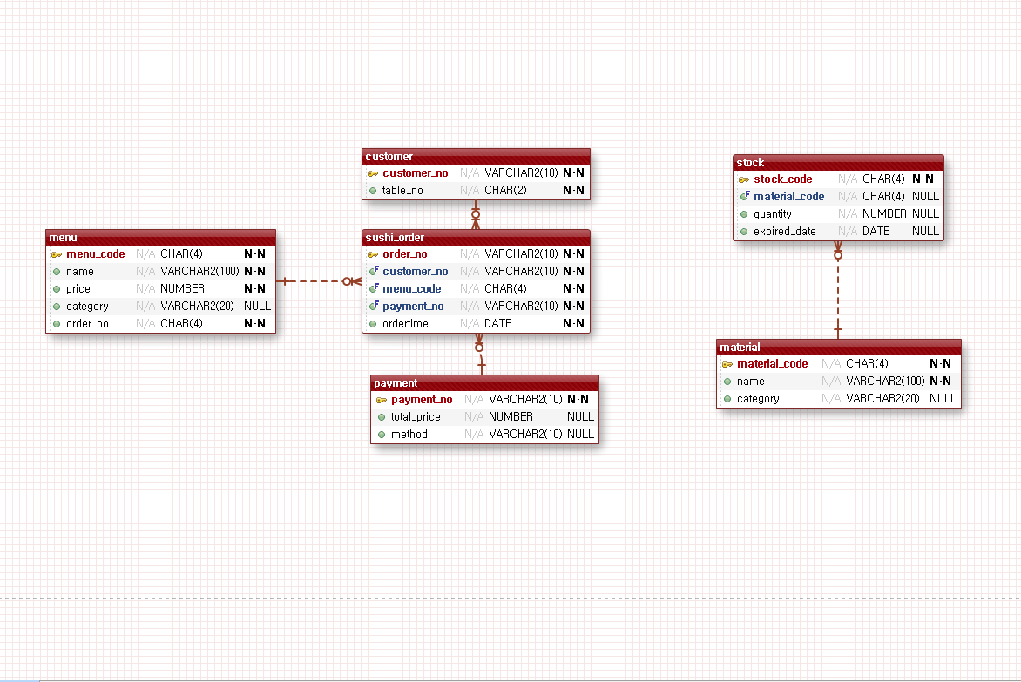
SQ_CUSTOMER_NO
1~999999999
SQ_STOCK_CODE
1000-9999
SQ_MENU_CODE
1000~9999
SQ_METERIAL_CODE
1000-9999
SQ_ORDER_NO
1~999999999
SQ_PAYMENT_NO
1~999999999

