Slide 1
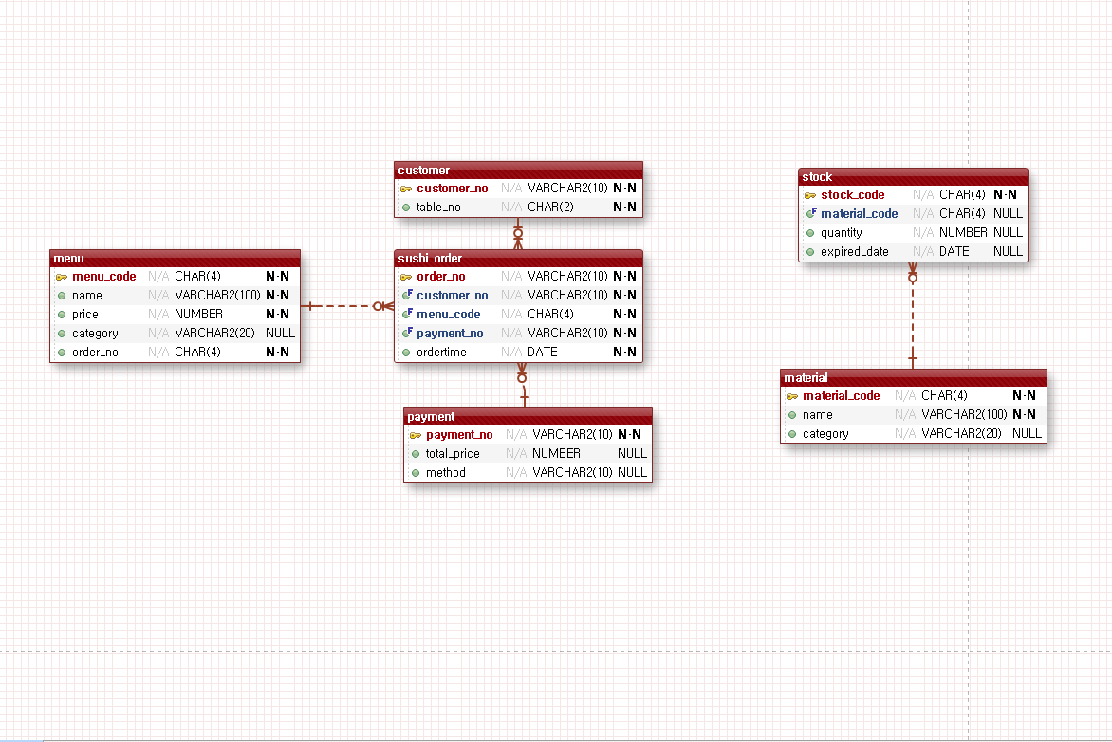
SQ_CUSTOMER_NO
1~999999999
SQ_STOCK_NO
1-9999
NO VARCHAR2(10)
●ADD_DATE DATE
image VARCHAR2(100)
SQ_MENU_CODE
1000~9999
SQ_METERIAL_CODE
1000-9999
SQ_ORDER_NO
1~999999999
SQ_PAYMENT_NO
1~999999999

