Slide 1
z/OSMF – Installation Walkthrough
Eduardo Henrique Rocha
z/OS Systems Programmer

Slide 2
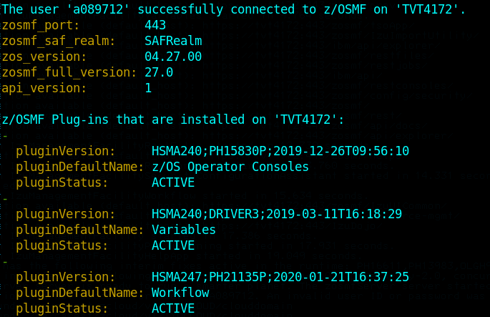
z/OSMF - What are we covering ?
Today we will cover a basic installation of z/OSMF that will allow you to exploit :
z/OSMF Web Interface
z/OSMF Workflows and Workflow REST Services
z/OSMF Dataset and File REST Services
z/OSMF Jobs REST Services
z/OSMF TSO Address Space REST Services
z/OSMF Console REST Services
z/OSMF Information retrieval REST Services
2

Slide 3
z/OSMF Supporting Jobs
JobName | Origin | Function
ZOSMFDEL | Mainframe Service Line Engineering | Delete ALL z/OSMF Resources
ZOSMFCPY | Mainframe Service Line Engineering | Copy Proclib and Parmlib
ZOSMFLST | Mainframe Service Line Engineering | List z/OSMF Resources
ZOSMFUSS | Mainframe Service Line Engineering | Set z/OSMF Permissions
CEA00001 | SYS1.SAMPLIB(CEASEC) | CEA Setup
CFZCIM01 | SYS1.SAMPLIB(CFZSEC) | CFZCIM Setup
GLOBAL | Mainframe Service Line Engineering | Create a "Global root" filesystem
* I will not cover the setup for CEA and CFZCIM, but If you have not setup CEA and CIM, you can use the CEA00001 and CFZCIM Jobs to help you through.
* I have used the ZOSMFDEL job on my system in order to remove everything and create this documentation.
*In case you have a READ only root filesystem you can use the GLOBAL job to create a "Global root"
3

Slide 4
z/OSMF Installation Flow
JobName | Origin | Function
ZOSMF001 | Mainframe Service Line Engineering | Create z/OSMF Data zFS, mount it and create base directories
ZOSMF002 | SYS1.SAMPLIB(IZUSEC) | Define Core Resources
ZOSMF003 | SYS1.SAMPLIB(IZUASSEC) | Define Autostart Resources
ZOSMF004 | SYS1.SAMPLIB(IZUATSEC) | Define Administrator Tasks
ZOSMF005 | SYS1.SAMPLIB(IZUCASEC) | Define Configuration Assistant
ZOSMF006 | SYS1.SAMPLIB(IZUCPSEC) | Define Capacity Provisioning
ZOSMF007 | SYS1.SAMPLIB(IZUDCSEC) | Define Discover CPC Function
ZOSMF008 | SYS1.SAMPLIB(IZUDMSEC) | Define Software Management
ZOSMF009 | SYS1.SAMPLIB(IZUSTSEC) | Define z/OSMF Settings
ZOSMF010 | Mainframe Service Line Engineering | Basic CEA Setup if you did not customized it previously
4

Slide 5
z/OSMF Installation Flow
JobName | Origin | Function
ZOSMF011 | Copied from SYS1.SAMPLIB(IZUGCSEC) | Define z/OSMF Console Services
ZOSMF012 | Mainframe Service Line Engineering | Define and permit all ICSF Resources needed by z/OSMF
ZOSMF013 | Copied from SYS1.SAMPLIB(IZUILSEC) | Define z/OSMF Incident Log
ZOSMF014 | Copied from SYS1.SAMPLIB(IZUISSEC) | Define ISPF
ZOSMF015 | Copied from SYS1.SAMPLIB(IZUNASEC) | Define ZERT
ZOSMF016 | Copied from SYS1.SAMPLIB(IZUNFSEC) | Define Notification Settings
ZOSMF017 | Copied from SYS1.SAMPLIB(IZUCPSEC) | Define Cloud Provisioning
ZOSMF018 | Copied from SYS1.SAMPLIB(IZURFSEC) | Dataset and Files REST interface
ZOSMF019 | Copied from SYS1.SAMPLIB(IZURMSEC) | Resource Monitoring
5

Slide 6
z/OSMF Installation Flow
JobName | Origin | Function
ZOSMF020 | Copied from SYS1.SAMPLIB(IZUSASEC) | Configuration Security Assistant
ZOSMF021 | Copied from SYS1.SAMPLIB(IZUSPSEC) | Sysplex Monitoring
ZOSMF022 | Copied from SYS1.SAMPLIB(IZUSWSEC) | Swagger Documentation
ZOSMF022 | Copied from SYS1.SAMPLIB(IZUTLSEC) | Setup for AT-TLS
ZOSMF024 | Copied from SYS1.SAMPLIB(IZUWFSEC) | Workflows Setup
ZOSMF025 | Copied from SYS1.SAMPLIB(IZUWMSEC) | Setup Workload Management
ZOSMF026 | Copied from SYS1.SAMPLIB(IZUSKSEC) | Setup Shared Keyring
ZOSMF027 | Mainframe Service Line Engineering | Fix Unix permissions
6

Slide 7
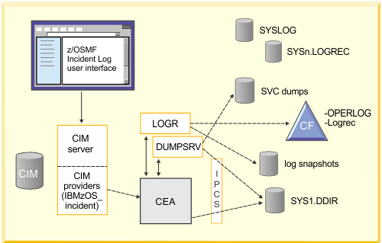
z/OSMF - CFZCIM
What is CIM ?
The Common Information Model (CIM) is an open standard that defines how managed elements in an IT environment are represented as a common set of objects and relationships between them.
CIM on z/OS brings all z/OS specifics into a schema that can be queried for information on various aspects of the system such as disks, number of CPUs, Sysplex Structures , etc.
Z/OSMF makes use of CIM to obtain information from a z/OS system and also to execute actions, like releasing a job (by means of REST APIs) or request services from CEA.
https://www.gsebelux.com/system/files/2011_06_09%20zOS%20CIM%20Overview%20and%20Security%20Aspects.pdf
file:///home/eduardor/Downloads/SHARE_Atlanta_2012_CIM.pdf
7

Slide 8
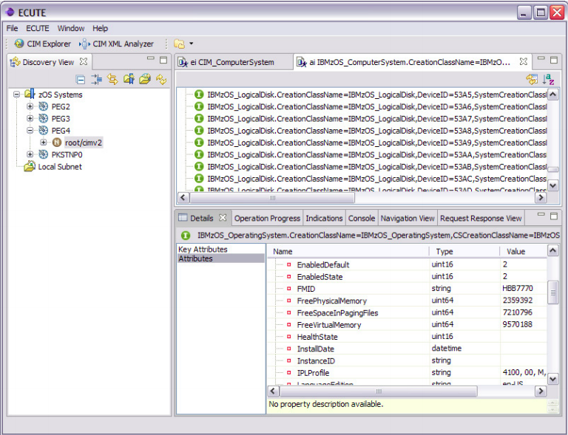
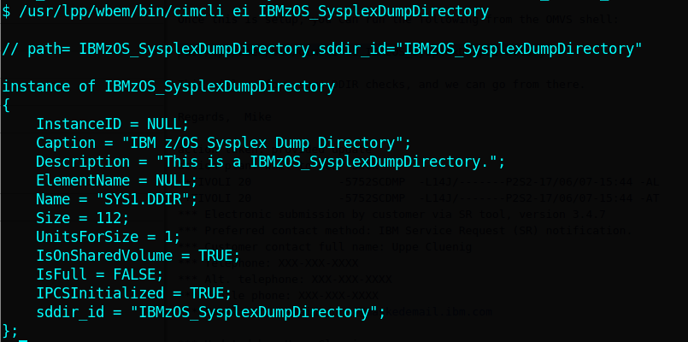
z/OSMF - CFZCIM
8

Slide 9
z/OSMF - CEA
What is CEA ?
The common event adapter (CEA) component of z/OS has security profiles for protecting different portions of its processing. For example, users of the Incident Log task require access to the CEA.CEAPDWB* profile in the SERVAUTH class. For the profiles related to CEA, see Resource authorizations for common event adapter (CEA).
z/OSMF requires that CEA runs in full function mode on your system. In this mode, both internal z/OS components and clients such as CIM providers can use CEA indication functions.
9

Slide 10
z/OSMF - Core Functions
Core Functions :
Functions that are enabled with z/OSMF at all times even when you do not specify on the IZUPRMxx member, these are :
Welcome
Notifications / Notification Settings
Workflows / Workflows Editor
Links
Application Linking Manager
Import Manager
Usage Statistics
Z/OSMF Settings / FTP Settings / General Settings
System
Z/OSMF Diagnostic Assistance
10

Slide 11
z/OSMF - Notice
Now that we have prepared the environment we are ready to begin our z/OSMF core installation.
**My jobs/slides are based on z/OS 2.4, if you are not at that level that is ok, you will end up with all the resources you need up until z/OS 2.4.
For instance, if you are using z/OS 2.2 some plugins are still not available, you will have all the z/OSMF resources required up until z/OS 2.4, so unless a PTF comes out requesting new resources to be created you will not have to worry about a z/OSMF resource until you get to z/OS 2.4.
z/OS 2.2
z/OS 2.3
z/OS 2.4
11

Slide 12

z/OSMF - Before you start
If you did not install z/OSMF Before, it is likely that you do not have the Parmlib and Proclib members copied into your user/system datasets.
Customize and run the ZOSMFCPY job in order to copy the IBM samples to your live system :
SMPEPROC is the location your SMPE updates your IBM Supplied procs .
SMPESAMP is the location your SMPE updates your Samplib
USERPROC is the location of your system's PROCLIB
USERPARM is the location of your system's PARMLIB
** You will need to have the RACF SPECIAL (or equivalent) attribute or be delegated CLASSAUTH to the classes used throughout this material.
** During setup many RACF CLASSES get ACTIVATED , please review these jobs with your Security Admin to avoid activating classes that are not supposed to be active on your shop.
** About 90% of z/OSMF Setup is performed by the Security Professional.
12

Slide 13

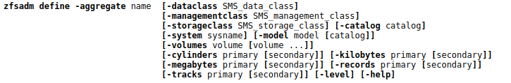
z/OSMF - Before you start
If you did not install z/OSMF Before, it is likely that you do not have created a ZFS that will serve as a container for the z/OSMF filesystem, if you would like to do this at this time , customize and run the ZOSMF001 Job.
OSMFROOT is the target z/OSMF Directory
OSMFFSNM is the target ZFS name for the z/OSMF Directory
OSMFFSSZ is the target Size for the ZFS dataset in MB,provide primary and secondary
** It is assumed you use SMS and your ACS is configured. If you do not use or do not wish to use SMS , further customization is needed for the ALLOCZFS step, the parameters can be changed for the zfsadm command as described here :
13

Slide 14
z/OSMF - Starting Our Setup (core)
We will start with the very basic job for z/OSMF - IZUSEC or if you are using my library ZOSMF002.
** It is assumed that you have configured RACF to use AUTOGID and AUTOUID, if you have not , you will have to perform additional customization
** It is assumed you will use the self signed certificate that is generated with the IZUSEC or ZOSMF002 job, additional steps are needed to use and external signed certificate, these actions can be taken after the setup.
Edit job ZOSMF002 and customize it with the target hostname for the RACDCERT command and submit:
HOSTNAME is the hostname of the machine you will run z/OSMF
14

Slide 15
z/OSMF - Running Installation Jobs
** You will need to edit the jobcard according to your installation standards for ALL jobs.
You will edit and submit the following jobs :
ZOSMF003, to create profiles for the AUTOSTART function of z/OSMF.
ZOSMF004, to create profiles that protect the links on the admin tasks.
ZOSMF009, to create profiles for the z/OSMF Settings task.
ZOSMF011, to create profiles for the z/OSMF Consoles task and REST APIs.
ZOSMF012, to create the necessary profiles for ICSF.
ZOSMF013, to create profiles for the Incident Management Plugin.
ZOSMF014, to create profiles for the ISPF Plugin.
ZOSMF018, to create profiles for the Dataset and Files REST APIs.
ZOSMF020, to create profiles for the Security Configuration Assistant (Available for z/OS 2.4 only).
ZOSMF023, If you run AT-TLS , so z/OSMF can start before PolicyAgent.
ZOSMF024, to create profiles for z/OSMF Workflows.
ZOSMFUSS, to set z/OSMF permissions for the z/OSMF data filesystem.
15

Slide 16

z/OSMF - Updating Parmlib
Now we are going to edit our parmlib member, edit IZUPRM00 member that is on your parmlib concatenation and make sure all the parameters look good for your system.
Under PLUGINS we will enable the plugins we have customized previously, z/OSMF Core functions do not need to be specified :
For testing purposes, set your CSRF_SWITCH to OFF.
16

Slide 17
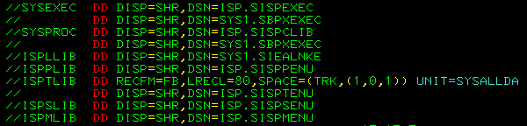
z/OSMF - Updating Proclib
Now we are going to edit our proclib members.
IZUANG1 – No modifications required if you are using a standard z/OS installation
IZUFPROC – You will need to make sure the datasets for ISPF and base z/OS Components are correct :
IZUINSTP – No modifications are required
17

Slide 18
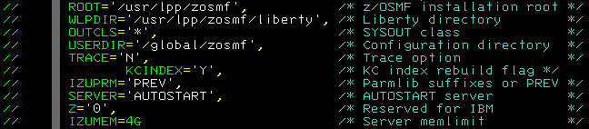

z/OSMF - Updating Proclib
IZUSVR1 – Check if these match your system, if not , make adjustments :
Do not attempt to run z/OSMF with less than 4GB it will most likely be worse and fail.
** Important, check if the STATUS of your members copied from the sample libraries match the FMID installed, mine is 2.4 so it looks like this, if you use an older z/OSMF proc with a new release, it will most likely fail. The same applies when upgrading z/OS to a new level, you have to copy the new version of the procs:
18

Slide 19
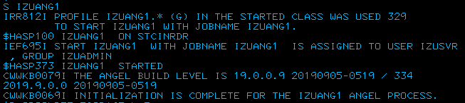
z/OSMF - Starting the z/OSMF Angel
IZUANG1 – Required z/OSMF Component that interfaces with SAF.
19

Slide 20
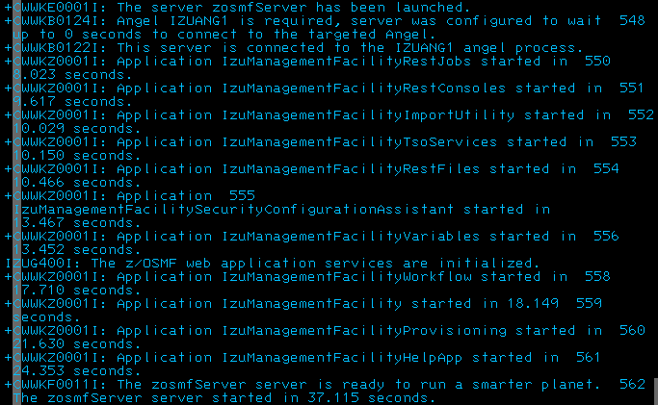
z/OSMF - Starting the z/OSMF Server
IZUSVR1 – Start the z/OSMF Server with the S IZUSVR1 Command:
After you start z/OSMF, you should see the messages above, message CWWKF0011I indicates
the z/OSMF server is ready.
20

Slide 21
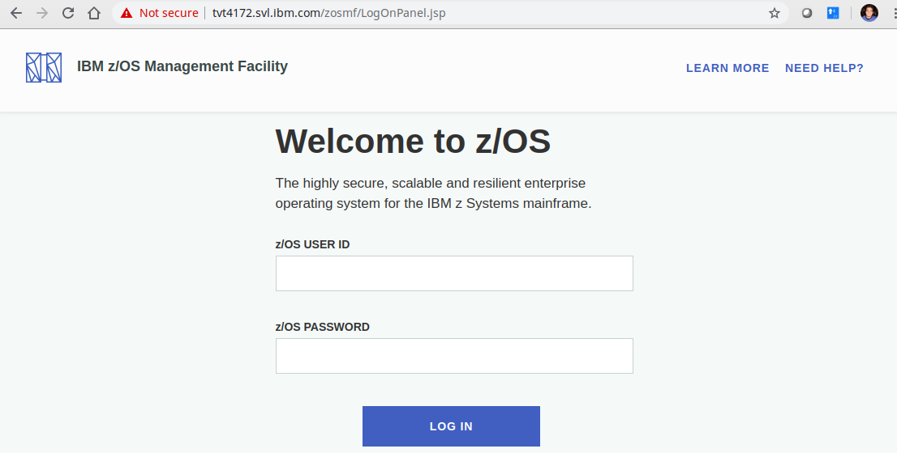
z/OSMF - Logging on to the web
To test z/OSMF, open a browser window and navigate to :
https://<your-host-name>:<your-port>/zosmf
You will be greeted by the logon page:
21

Slide 22
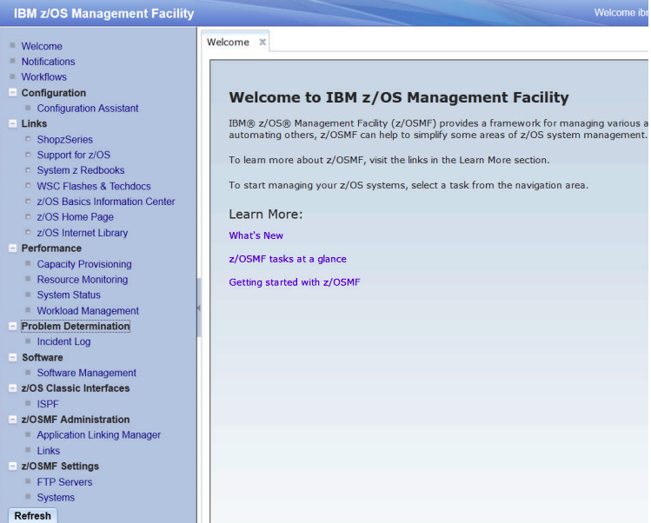
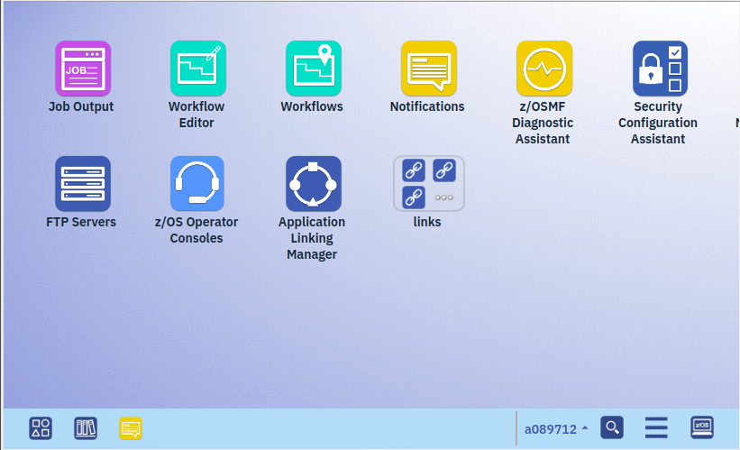
z/OSMF - Different Versions
After you logon, you will be presented with one of these two screens:
z/OS 2.3 and Before – Tree oriented
z/OS 2.3 and After – Desktop Version
For z/OS 2.3 you can choose depending of the PTF level you are running
22

Slide 23
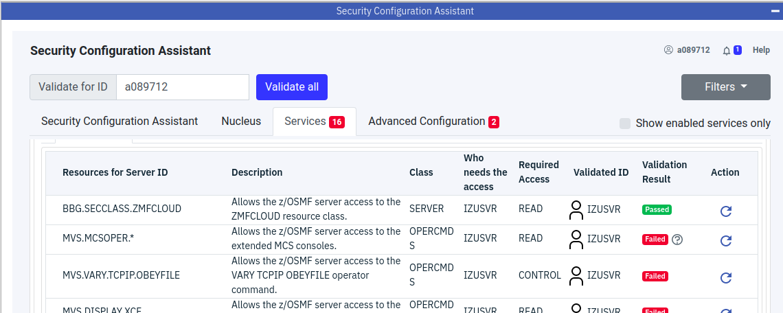
z/OSMF - Security Config. Assistant
If you are on a 2.4 system , you will have access to the Security Configuration Assistant which will tell you what is missing in terms of general resources for you to have a full z/OSMF install.
23

Slide 24
z/OSMF - Testing the Rest APIs
For our testing here, I will show you one example going through the hard way (using curl and "raw" HTTPS requests) then I will use Zowe throughout the rest of the demo (because it is neat and a LOT easier).
Z/OSMF REST Services are protected by the SAF profiles :
IZUDFLT.ZOSMF.REST.<zosmf-service>.<reversed-host-name>
So , to make your REST call work you have to whitelist the originating host.
If you want to make your server opened to requests you can do the following :
RDEF ZMFAPLA IZUDFLT.ZOSMF.REST.** UACC(NONE)
PERMIT IZUDFLT.ZOSMF.REST.** CL(ZMFAPLA) ID(IZUSVR) AC(R)
SETR RACLIST(ZMFAPLA) REFRESH
After permitting, restart the z/OSMF server.
** Note – This is not recommended for production, for production we recommend that you permit on a remote server basis.
24

Slide 25
z/OSMF - The "Hard" Way
We will use cURL which is a very popular tool available for Windows/Linux/Mac.
This is considered the "Hard" or programatic way because you have to know how to build the structure of the request.
For a simple GET request, using cURL or any other tool to test REST APIs like Postman, you need to have at least :
Identification, Headers , Request Type and Body content. This is a simple GET request to list Datasets :
So , based on the cURL command below, these are :
curl -k
-u user:pass
-H "Content-Type:application/json" -H "X-CSRF-ZOSMF-HEADER: zosmf"
-X GET "https://tvt4172.svl.ibm.com/zosmf/restfiles/ds?dslevel=SUPZOS.*"
25

Slide 26
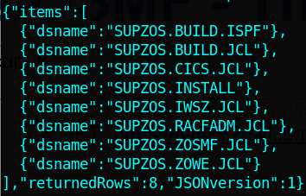
z/OSMF - The "Hard" Way
curl -k
-u user:pass
-H "Content-Type:application/json" -H "X-CSRF-ZOSMF-HEADER: zosmf"
-X GET "https://tvt4172.svl.ibm.com/zosmf/restfiles/ds?dslevel=SUPZOS.*"
More information on how to request z/OSMF Files REST Services can be found here :
https://www.ibm.com/support/knowledgecenter/SSLTBW_2.4.0/com.ibm.zos.v2r4.izua700/IZUHPINFO_API_RESTFILES.htm
26

Slide 27
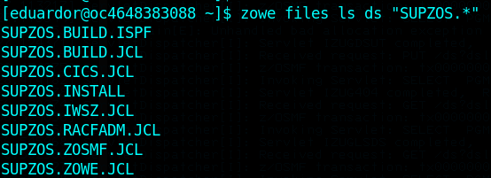
z/OSMF - The "Fun" Way
Ok, so now forget the last slide and let's look how to achieve the same response with Zowe.
Yes , it is ridiculous , I know :
Using REST Services you can call for a lot of services, I will show you some ..
27

Slide 28
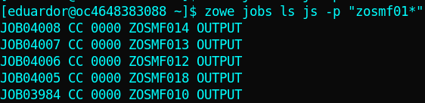
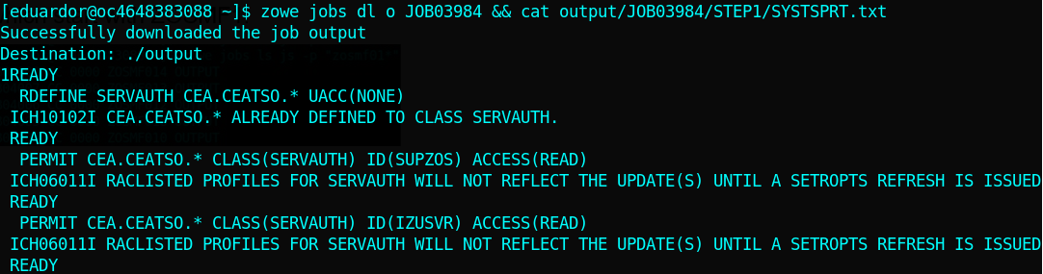
z/OSMF - The "Fun" Way
A Little demo :
List the jobs we used for the install
which start with ZOSMF1:
Issue an MVS Console Command:
Issue an MVS Console Command and trap output ? Yes :)
Display the output for job JOB03984/STEP1:
28

Slide 29


z/OSMF - Why this is important ?
z/OSMF Rest Services allows you to :
Use the solutions being developed by our team and increase your productivity such as EZ-Services, z/OSMF Workflows and more, these can be found on our IBM Internal github repository :
https://github.ibm.com/Mainframe-Services
Use Standard market tools to integrate the mainframe into your continuous delivery and integration environment,
Here are some of these tools :
Circle CI , Travis and Jenkins
29

Slide 30
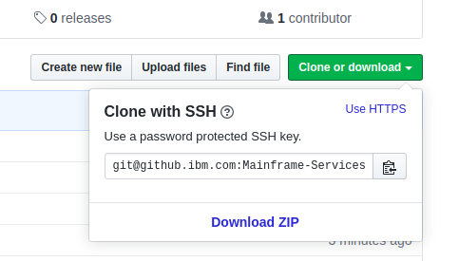
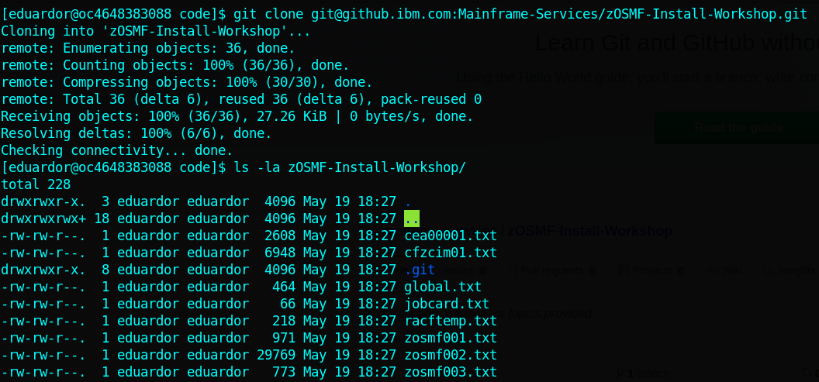
z/OSMF - How to download the source
Here are the methods you can use to download these jobs :
1. Download them directly from our repository :
https://github.com/Iniciativaz/zosmf-install-jobs/
Select Download ZIP .
2. Clone our repository using github (c'mon, it is easy enough):
30

Slide 31
Thank you
Eduardo Henrique Rocha
z/OS Systems Programmer

Slide 32
z/OSMF - How to download the source
Here are the methods you can use to download these jobs :
1. Download them directly from our repository :
https://github.ibm.com/Mainframe-Services/zOSMF-Install-Workshop
Select Download ZIP .
2. Clone our repository using github (c'mon, it is easy enough):
git clone git@github.com:Iniciativaz/zosmf-install-jobs.git
32

