Slide 1


P.E.G.A.S.U.S
SURVEILLANCE DRONES
TEAM APEX-4

Slide 2
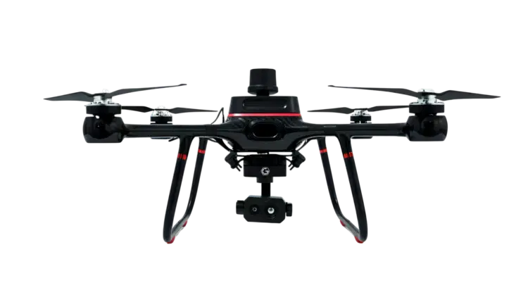
THE PROBLEM STATEMENT
To build a multirotot U.A.V. that would patrol the campus through a fixed path. The drone would carry a gimbal camera that would livestream the video to a ground station
01

Slide 3
1
2
PROJECT GOALS
To build a 3 kg drone that would carry a camera payload
Livestream the camera’s recording to a ground station
02

Slide 4
THE BUILD
•A quadcopter with15 inch propellers
•Comprises of a gimbal with a camera and an RF transmitter for livestreaming
•Pixhawk flight controller and a power distribution board for driving the rotors and guiding the UAV
•GPS to track and guide the drone
•LiDAR for height determination and landing
•Failsafe Mechanisms
03

Slide 5
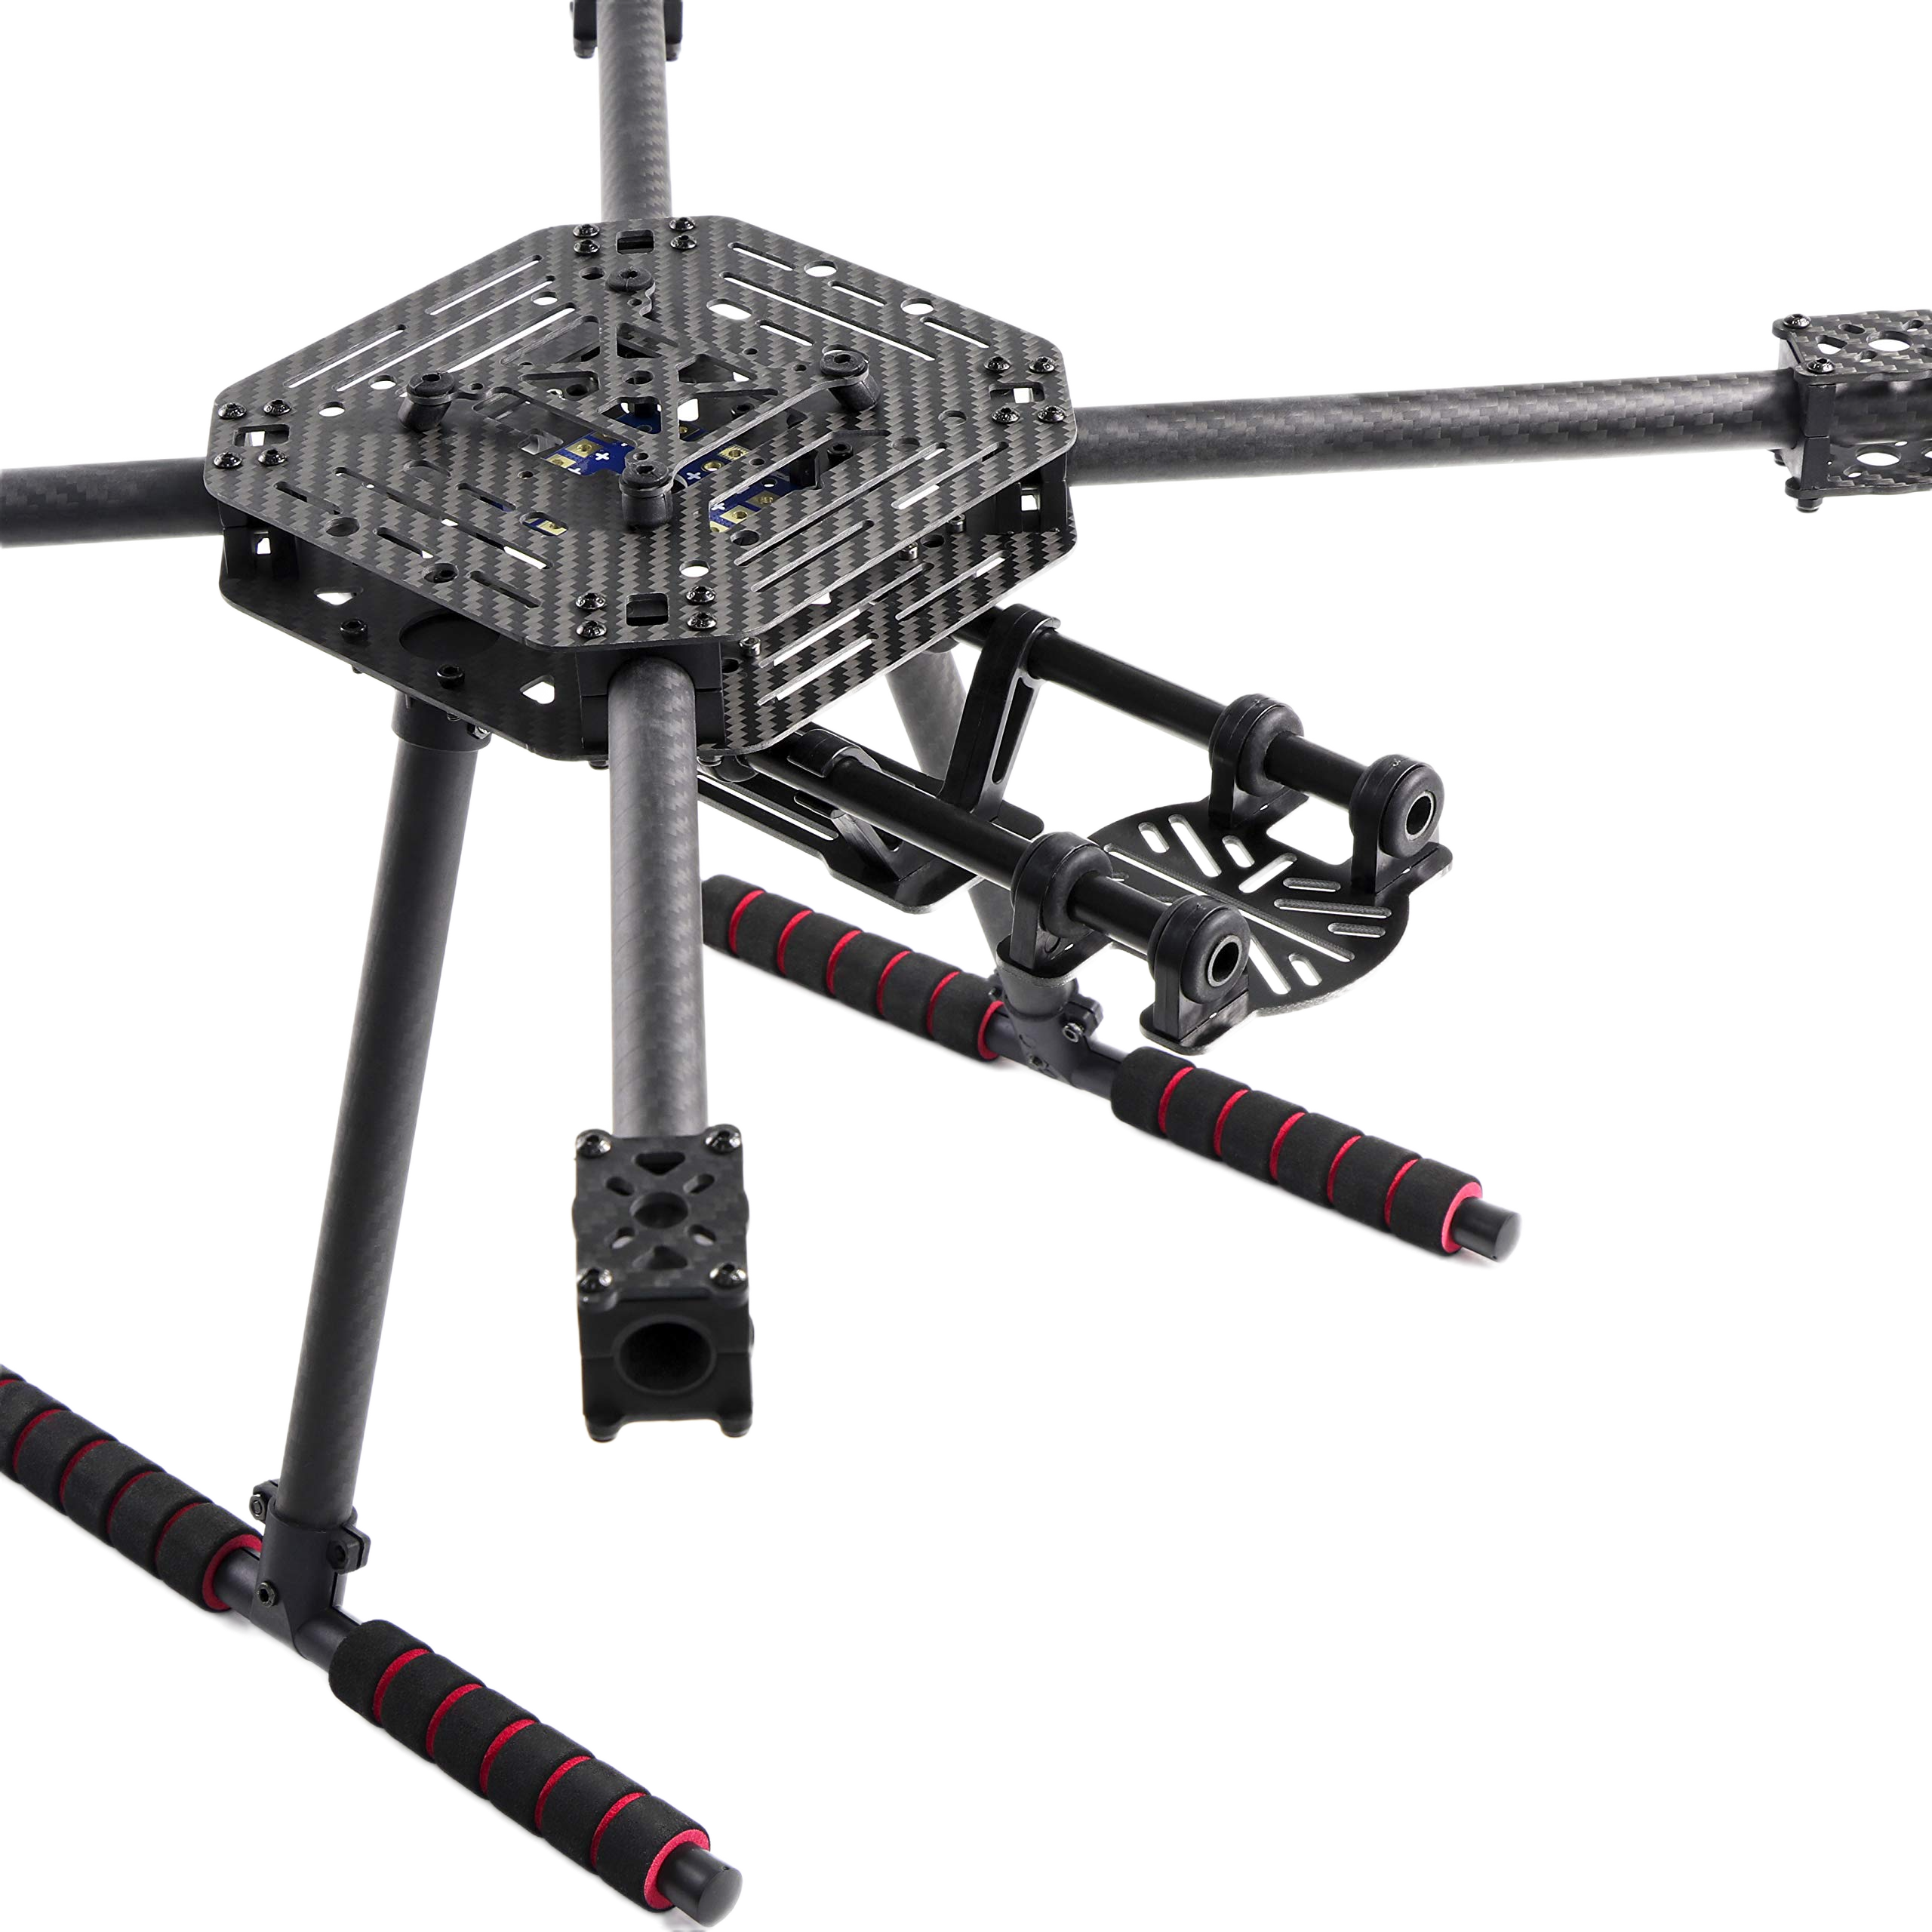
THE FRAME, PROPELLERS AND LANDING GEARS
•The frame is cross shaped, with the rotor to rotor diagonal measuring about 550 mm
•Carbon fiber is the ideal material for both the frames and the propellers, since it exhibits high strength despite being lightweight
•The propellers are about 15 inches wide in diameter
•The landing gear is fixed, attached to the frame and made up of the same material
04

Slide 6
FAIL-SAFES
•When the battery reaches around 20% of its capacity, the power module will detect it by reading the terminal voltage of the battery
•GPS could also fail in GPS denied areas
•During these situations, our failsafe protocol will land the drone in the nearest safe location, already marked on the predetermined path
•The nearest safe location could be identified through the previously known position determined through GPS and a magnetometer is used for navigation
05

Slide 7
POWER AND MASS BUDGET
•The battery delivers 22.2 V with 12.6 Ah of charge and could deliver 279 Wh of energy
• A Li-ion battery is used since it is better for long duration endurance and the 5 m/s winds do not cause a big spike in thrust, so Li-ion batteries could handle it
•The net power for just hovering is about 323 W, with just the motors consuming about 300 W
•Assuming 80% efficiency of conversion, we get a 40+ minute hover time and about 30 minutes of flight time
•The mass of the drone is about 2.7 kg and the propellers deliver about 7.2 kg of thrust, giving us a thrust:weight ratio of about 2.6:1
06

Slide 8
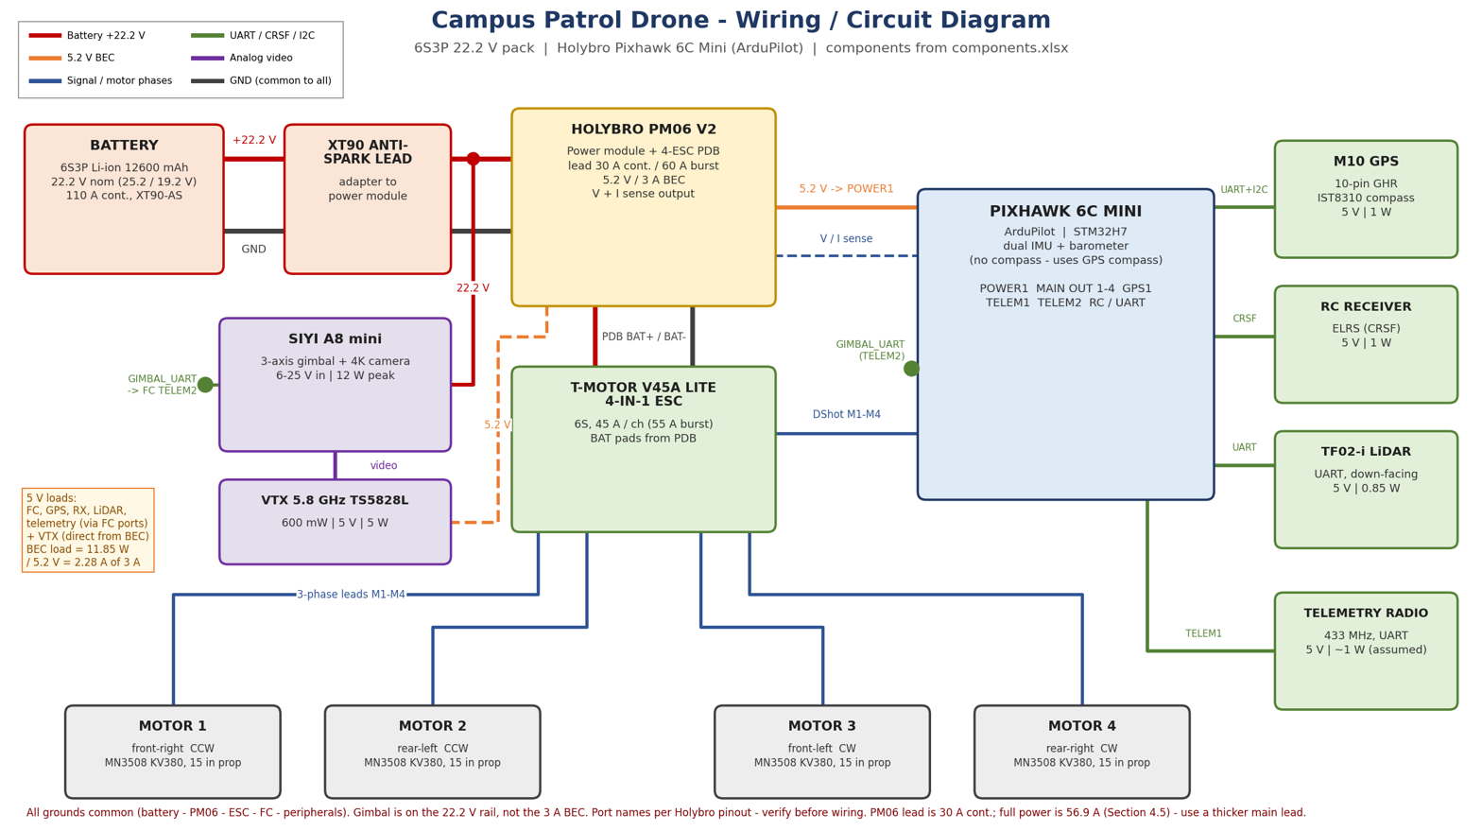
THE ELECTRONICS
07

Slide 9
NAVIGATION
•Our navigation is based on a pre-determined path and GPS
•The GPS will locate the drone around the pre-determined path and the LiDAR will locate the drone’s height from the ground, therefore, we could get its approximate position at any time
•As a failsafe, the magnetometer would guide the drone to a safe area
•A constraint of a 5m/s windspeed is given, which would be handled by tilting the drone. The vibrations and abnormal movement will be measured by the built-in IMU in the flight controller
•If there is sufficient charge left in the battery, there is an option to make it return to a specific place labelled as ‘home’
08

Slide 10
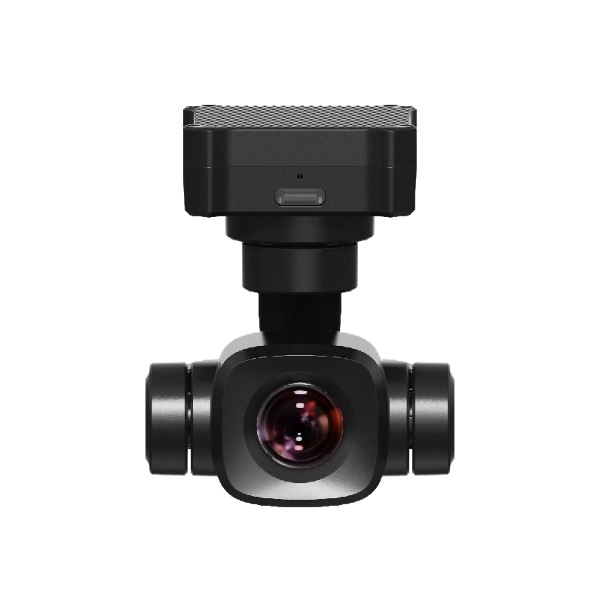
THE CAMERA
•The camera present records in 4k ultra HD, but it might be compromised while sending it through the RF transmitter
•The RF transmitter could transmit the video within a 5 km range
•A gimbal is used to stabilise the camera, even when the drone tilts
09

Slide 11
PROPOSED IMPROVEMENTS
  The drone could be more powerful when weight is not constrained
  Quality of RF transmitter could be improved
  Drone’s frame could be made better
  Human and vehicle tracking using machine learning models after the footage is stored in a ground station
10

Slide 12
THANK YOU
11

