Slide 1
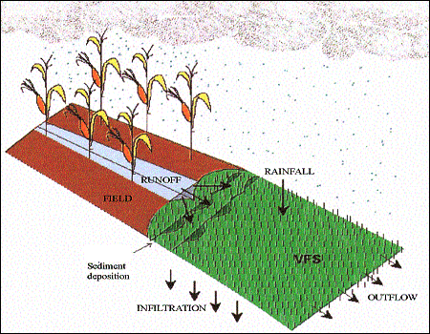
Grafical User Interface for VFSMOD and UH
Model developers:
-Rafael Muñoz-Carpena, University of Florida
-John E. Parsons, North Carolina State University
GUI developer:
-Iñigo Barberena Ruiz, Public University of Navarre
Version 1.0.0
Contact for Questions or Problems: carpena@ufl.edu
Attribution-NonCommercial-NoDerivatives 4.0 International Licence
Copyright 2024

