Slide 1

Design and Build 2025
MazeBot
Group NO. 17
Yifan Chen
Zixuan Wang
Congbo Li
Mengdi Yang
Memebers Cheng Wei
Yunlu Zhang
Yanda Shao
Lirui Pan
Siyan Wu
Fuyang Li
Kuangyu Chen
Design and Build 2025

Slide 2
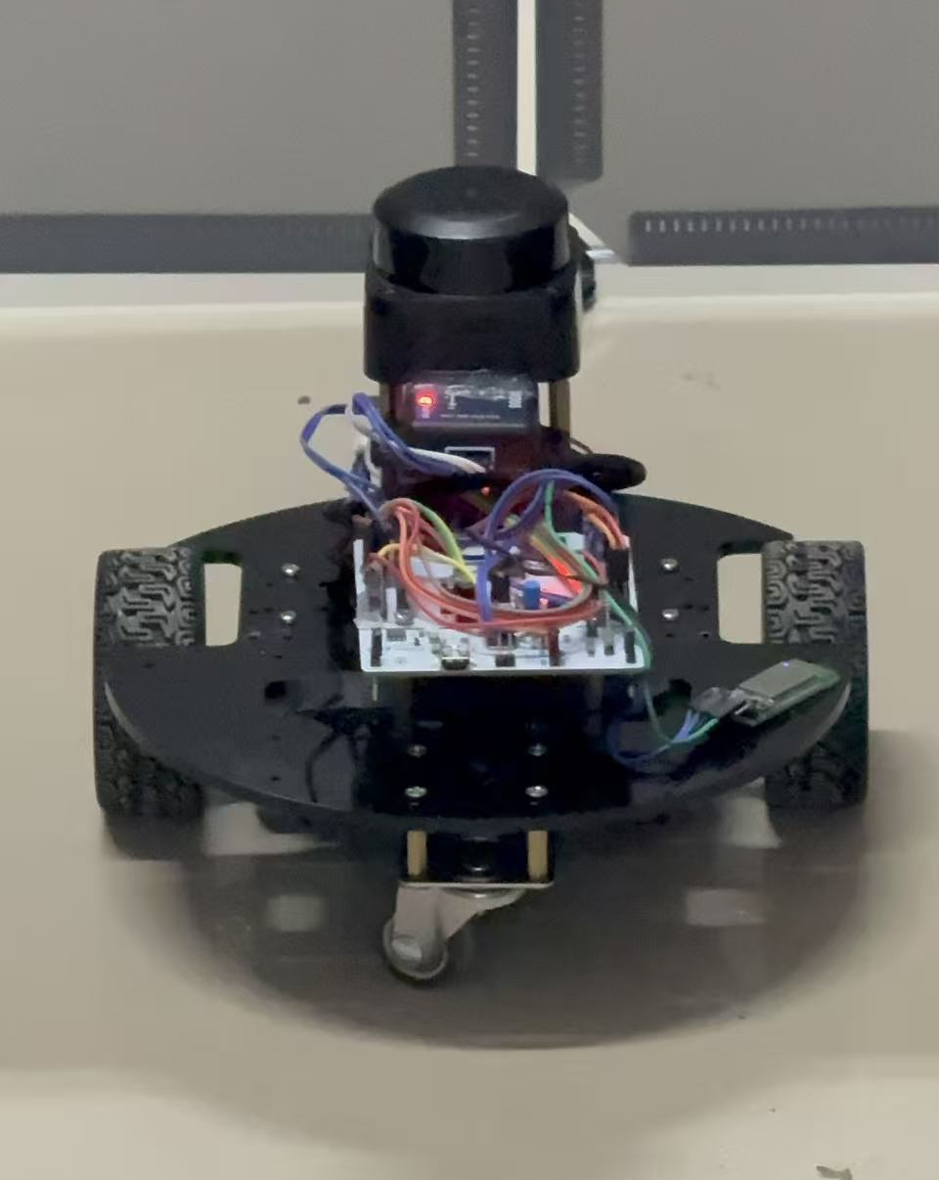
Brief Introduction
MazeBot is an intelligent maze exploration robot system based on STM32, integrating fully independently designed technologies such as lidar SLAM, automatic route finding & mapping, precise motion control, and real-time visualization.

Slide 3
Our Innovation
The mapping algorithm of the upper computer was all handwritten by myself and did not call any Python libraries
A perfect UI interface and a parameter adjustment system tailored to different scenarios
An accurate mileage calculation method was obtained by combining the robot's own mechanical parameters, motor parameters and kinematic formulas

Slide 4
Content
1
Autonomous Robot Hardware Architecture
4
Software Technical Details
2
Firmware Technical Details
5
System integration and optimization
3
Upper-Lower Computer Collaboration Architecture
Epilogue
6

Slide 5

Part
01
Autonomous Robot Hardware Architecture

Slide 6
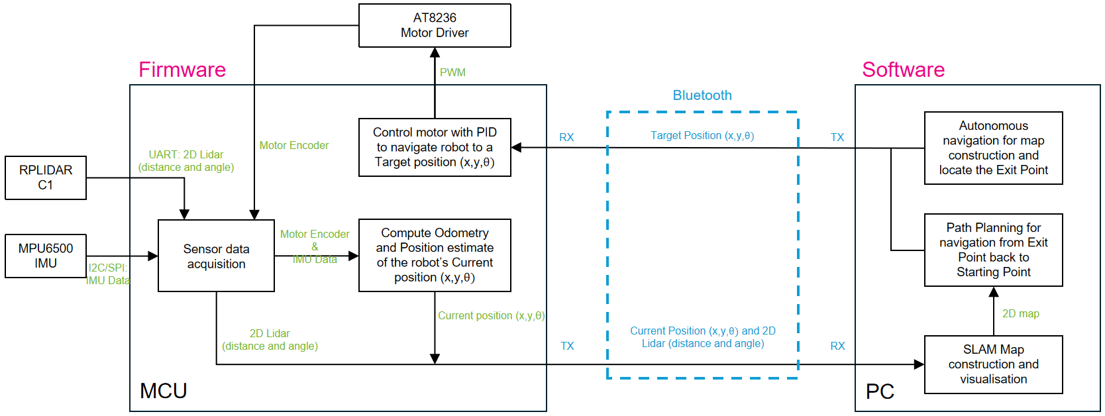
Design Process

Slide 7
Hardware Architecture
1.1 Main Controller
STM32 Microcontroller - Core Processing Unit
FreeRTOS RTOS - Real-time Multi-tasking
Task Priority Management:
Priority 4 (Highest): Bluetooth Control, Motor Control
Priority 3 (High): IMU Data Acquisition, LiDAR Processing
Priority 1-2 (Medium/Low): Auxiliary Tasks
1.2 Sensor System
RPLidar C1 Laser Radar
Scan Rate: 10Hz
Range: 0.1-3.5m
Resolution: 360°/rotation
Protocol: Custom Binary
IM948 9-Axis IMU
Update Rate: 250Hz
Data Output: Euler Angles, Spatial Displacement, Quaternions
Feature: Magnetometer Fusion
Encoder System
Independent Wheel Encoders
390 Pulses/Revolution (13 lines × 30 ratio)
Interrupt-driven Counting
1.3 Communication System
HC-04 Bluetooth: 921600 Baud Rate
Multi-UART Architecture:
Bluetooth: Host Communication
IMU: Sensor Data
LiDAR: Scan Data

Slide 8
Part
02
Firmware Technical Details

Slide 9
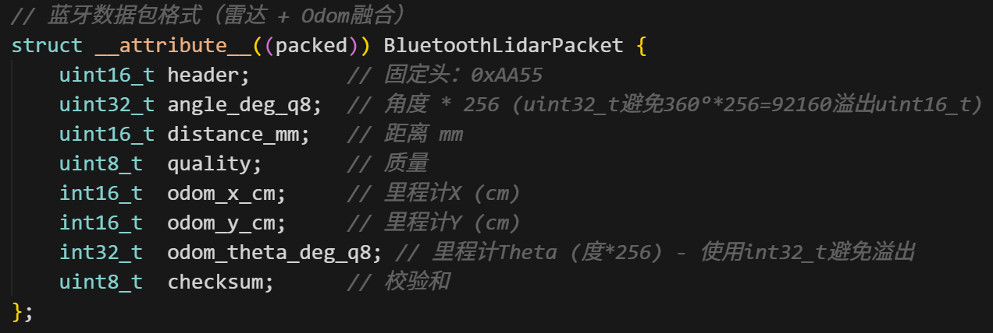
LiDAR Module (LidarModule.h)
Core Functions
Data Packet Parsing: 5-byte RPLidar protocol parsing
Quality Filtering: Filter low-quality points (quality < 5)
Distance Correction:
Linear scaling factor: 0.79
Non-linear close-range correction: Correct distortion within 0.5m
Data Fusion: LiDAR data and odometry data fusion transmission
Technical Features
// Data packet structure (18 bytes)
struct BluetoothLidarPacket { uint16_t header; // 0xAA55 uint32_t angle_deg_q8; // Angle × 256 uint16_t distance_mm; // Distance (mm) uint8_t quality; // Quality (0-63) int16_t odom_x_cm; // Odometry X (cm) int16_t odom_y_cm; // Odometry Y (cm) int32_t odom_theta_deg_q8; // Orientation × 256 uint8_t checksum; // XOR checksum
};

Slide 10
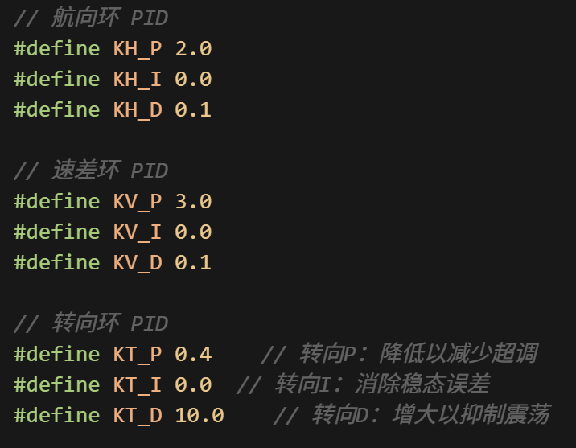
Motor Control Module (MotorControl.h)
PID Control System
Three-Layer PID Architecture
Heading Loop: Angle Error → Target Speed Difference
Speed Difference Loop: Speed Difference → Duty Cycle Difference Steering Loop: Angle Error → Duty Cycle
PID Parameters
cpp
// Heading Loop
#define KH_P 2.0, KH_I 0.0, KH_D 0.1
// Speed Difference Loop
#define KV_P 3.0, KV_I 0.0, KV_D 0.1
// Steering Loop
#define KT_P 0.4, KT_I 0.0, KT_D 10.0
Motion Control Modes
Control Strategies
Open-Loop Control: Basic direction control
Closed-Loop Control: Precise distance/angle control
Precision Commands
F50: Forward 50cm
L90: Turn left 90°
R45: Turn right 45°

Slide 11
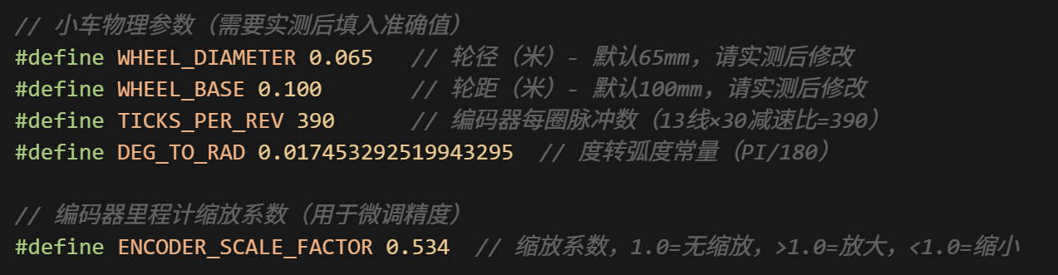
Encoder Odometry Module (EncoderModule.h)
Differential Wheel Odometry Algorithm
Physical Parameters
cpp
#define WHEEL_DIAMETER 0.065 // Wheel diameter 65mm
#define WHEEL_BASE 0.100 // Wheel base 100mm
#define TICKS_PER_REV 390 // Pulses per revolution
#define ENCODER_SCALE_FACTOR 0.534 // Accuracy correction factor
Calculation Principle
4-Step Processing Pipeline
Read Encoder Increments - Capture pulse counts from both wheels
Convert to Linear Distance - Transform pulses to actual wheel movement
Differential Calculation - Compute robot center movement using differential drive kinematics
World Coordinate Update - Combine with IMU orientation for global position tracking

Slide 12

IMU Data Processing (im948_CMD.h)
Data Fusion Strategy
Multi-Sensor Integration
Encoder Odometry: High-precision short-distance displacement
IMU Orientation: Accurate angle information
Timestamp Synchronization: 100-data point circular buffer
Independent Odom Transmission
High-Performance Data Stream
11-byte Independent Packet (0xBB55 header)
250Hz High-Frequency Update
Zero-Delay Pose Transmission

Slide 13
Part
03
Upper-Lower Computer Collaboration Architecture

Slide 14






Role Split: STM32 vs Python
A clean division of labor for a tightly coupled system.
Lower Computer (STM32)
Upper Computer (Python)
Real-time Sensor Acquisition:Collects raw data from IMU, LiDAR, and encoders.
Motor PID Control: Executes precise, real-time motion commands.
Encoder Odometry: Calculates robot's position and orientation.
Bluetooth Communication: Handles low-level data transmission and command responses.
Live Visualization: Renders sensor data and map in real-time.
SLAM Algorithm: Constructs and updates the environment map.
Path Planning: Makes high-level navigation decisions.
User Interface: Provides controls for parameter tuning and robot command.

Slide 15











Layered Data Flow Pipeline
From raw sensors to actionable UI, a journey through the system's core.
1. Sensor Layer
IMU, LiDAR, Encoder (Data Origin)
2. Firmware Processing
Multi-tasking & Data Fusion on STM32
3. Communication Layer
Bluetooth Transmission & Data Packet Delivery
4. Software Processing
Real-time Mapping & Algorithm Computation
5. UI Layer
Visualization Control & Parameter Adjustment

Slide 16
Lightweight Packet Blueprint
LiDAR Fusion Packet
Standalone Odom Packet
Control Command Packet
For scan-synced odometry.
Header: 0xAA55
Payload: Angle, Distance, Quality, Odometry
Size: 18 bytes
Frequency: 10 Hz
For high-rate localization.
Header: 0xBB55
Payload: Position, Orientation
Size: 11 bytes
Frequency: 250 Hz
For motion and system tasks.
Format: ASCII String
Examples: W/S/A/D, F50, L90, x, S
Size: Variable
Type: Human-readable

Slide 17
Realtime & Sync Tactics
Guaranteeing Real-Time Performance
Maintaining Data Synchronization
STM32 Firmware
Utilizes a priority-based RTOS to ensure critical tasks (motor control, odometry) are executed with minimal jitter.
Timestamp Alignment
MU data is buffered and synchronized with LiDAR scan data to ensure a consistent snapshot of the robot's state.
Python Software
Employs a dedicated RX thread to prevent data loss and maintain UI responsiveness during heavy computation.
Pose Interpolation
High-frequency odometry allows for pose correction even as the LiDAR scan is being received, preventing map distortion.
Communication
UART baud rate is maximized to 921600 to create a high-throughput, low-latency link.
Coordinate Unification
Automatic conversion from the LiDAR's left-hand coordinate system to the screen's right-hand system is performed.

Slide 18
Part
04
Software Technical Details

Slide 19



Visualizer Engine Architecture
A multi-threaded design in lidar_visualizer.py for maximum performance.
Performance Metrics
1. Data Reception Thread
An independent thread solely responsible for reading and parsing data from the serial port to prevent I/O blocking.
166Hz
UI Update Frequency
2. Main Thread
Handles real-time visualization rendering and SLAM processing, ensuring the GUI remains fluid and responsive.
15k
Data Packets per Frame
Independent thread processing
3. Shared Odom Data
A thread-safe buffer that allows the RX thread to deposit odometry data for the main thread to consume without race conditions.
Multi-Core Utilization

Slide 20
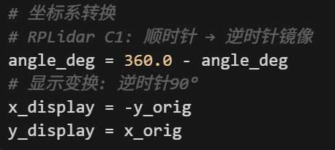
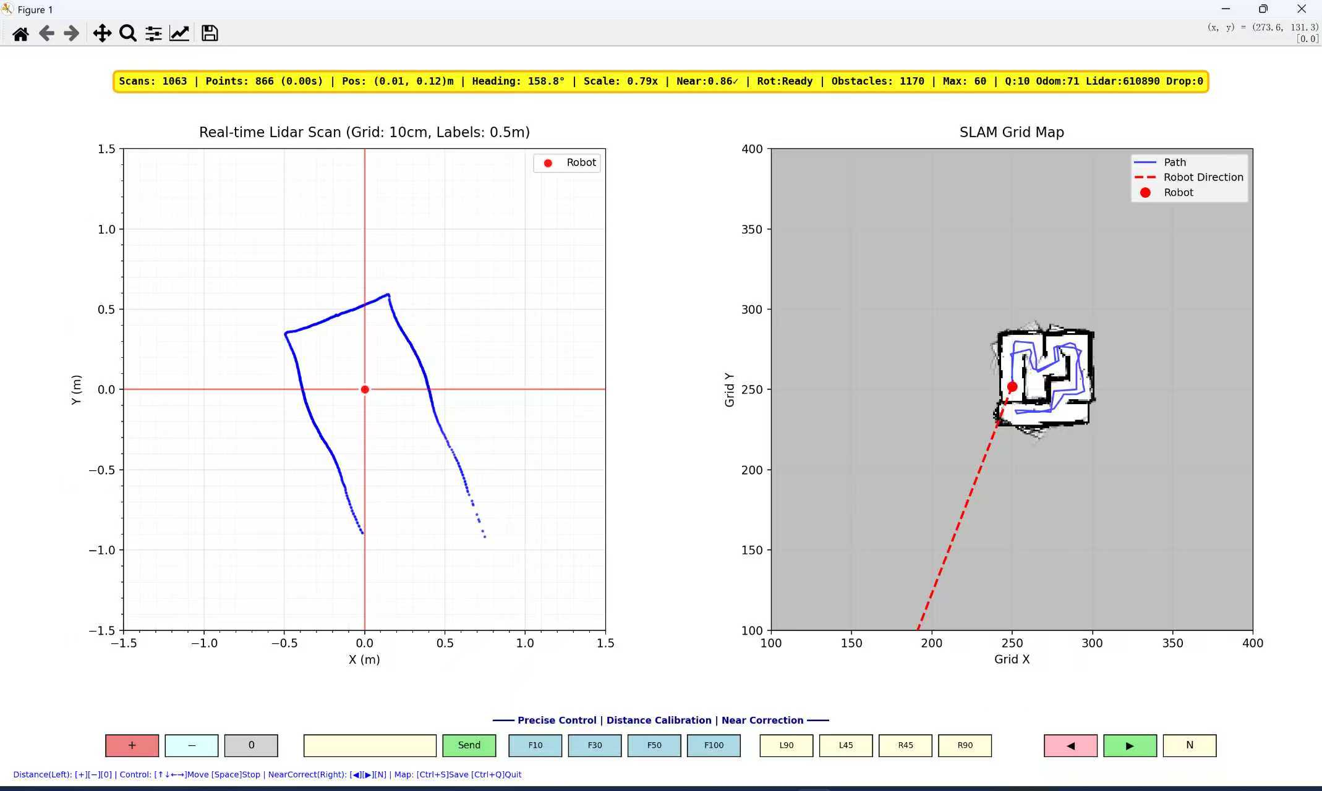
SLAM Algorithm (SimpleGridSLAM Class)
Coordinate system unification
Grid map construction
Map size: 500×500 raster
Resolution: 5cm per grid
Probability Update: Cumulative weight of obstacles
Intelligent filtering
Rotation detection filtering: Prevents trailing in mapping during rotation
Motion prediction filtering: Eliminate historical point trailing
Overlap protection mechanism: Protecting the characteristics of the real environment

Slide 21




Frontier Detection & Selection Logic
Data Preprocessing
LiDAR data undergoes dual distance correction, quality filtering, and time-windowing.
Environmental Perception
Detects open areas (>5m) as potential exits and recognizes obstacles from point clouds.
Path Planning
The A* algorithm plans the optimal route to the selected frontier on the grid map.

Slide 22
Frontier Detection & Selection: Detailed Explanation
1. Preprocessing Layer
Dual Distance Correction, Time-Windowing
2. Frontier Identification
Grid-Based Search, Open-Space Recognition
3. Frontier Evaluation & Ranking
Reachability Test, Priority Assignment
4. Path Planning & Selection
A Algorithm*, Dynamic Re-Evaluation
5. UI Layer
Visualization Control & Parameter Adjustment

Slide 23
Part
05
System integration and optimization

Slide 24
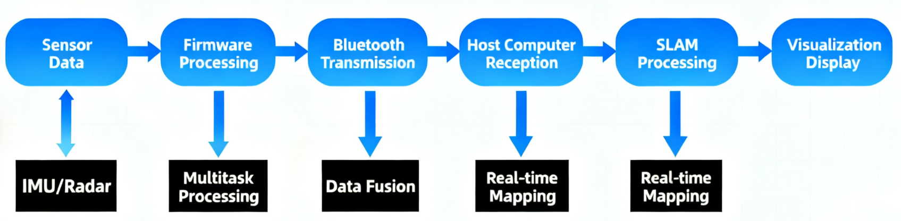
System integration and optimization
Real-time performance: <5ms position update delay
Accuracy: ±1cm/ m displacement accuracy
Stability: 250Hz IMU update, 10Hz radar scan Robustness: Multi-level data checksum and error recovery
Performance Indicators

Slide 25
Part
06
Epilogue

Slide 26
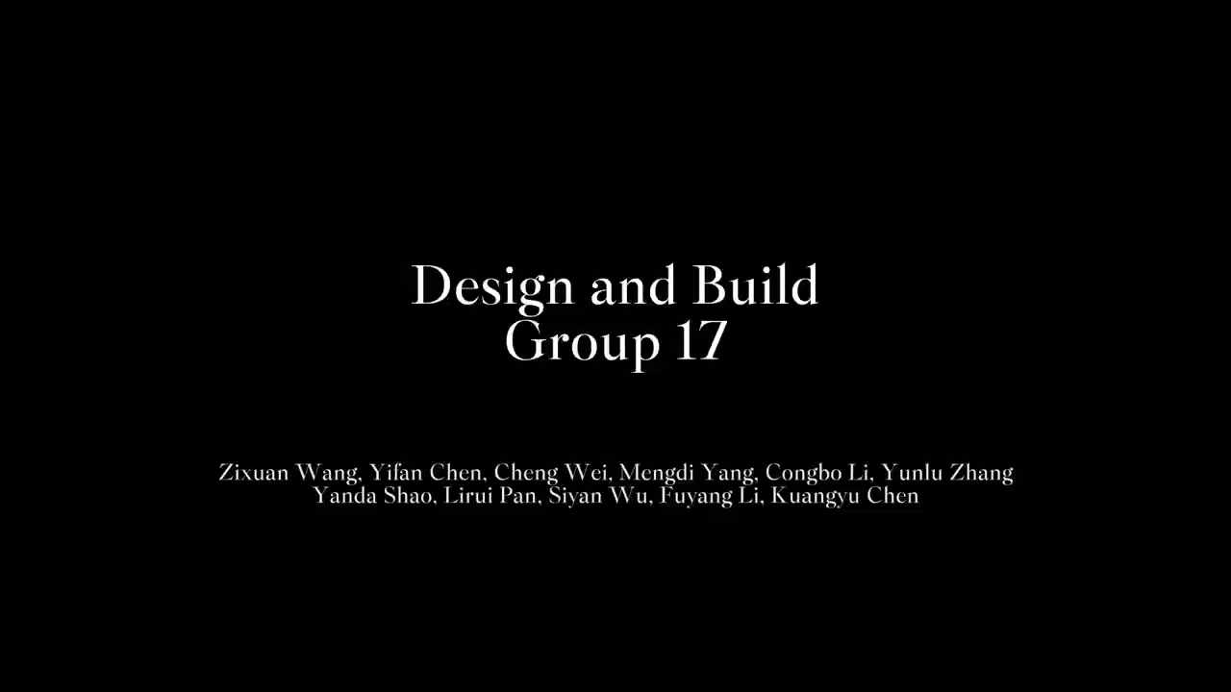

Slide 27
Task Allocation
Member | Class | BUPT ID | Task Allocation
Yifan Chen | 2023215103 | 2023213098 | Coordinate progress, design wiring schemes, connect and check hardware issues, design FreeRTOS tasks and debugging programs for each sensor, consult hardware manuals and function descriptions, and write documents.
Zixuan Wang | 2023215101 | 2023213051 | Assist in progress management, write documents, collect and integrate code, hardware manuals and other materials, and assist in function testing and vehicle assembly.
Cheng Wei | 2023215105 | 2023213171 | Check program logic, inspect hardware circuits, design and debug motion control logic, design IMU and radar data collection, calculation and filtering functions, and record serial port debugging data.
Mengdi Yang | 2023215107 | 2023213226 | Collect and integrate code, hardware manuals and other materials, collect and integrate key hardware driver library functions and guide team members to use them, assist in writing documents, and beautify the vehicle.
Congbo Li | 2023215109 | 2023213269 | Inspect, test and repair hardware circuits, assemble and repair vehicles, assist in manual and information consultation, assist in testing motion functions and parameter adjustment, and assist in writing documents.
Yunao Zhang | 2023215117 | 2023213519 | Assemble and repair vehicles, check program logic, inspect hardware circuits, assist in testing motion functions and parameter adjustment, and assist in writing documents.
Lower
Member | Class | BUPT ID | Task Allocation
Fuyang Li | 2023215122 | 2023213632 | Responsible for software overall architecture design and development planning; coordinate the integration of automatic navigation main program, path planning, obstacle avoidance and mapping modules; design task scheduling and system communication framework; be responsible for overall debugging and performance verification; write main software description and acceptance documents.
Lirui Pan | 2023215113 | 2023213401 | Responsible for the implementation of automatic navigation main logic and integration of core algorithms; lead the development and parameter adjustment of the A* path planning module; implement path planning, obstacle detection and target state machine logic; assist in constructing the return path reuse mechanism.
Yanda Shao | 2023215111 | 2023213335 | Responsible for the development of SLAM mapping and localization module; fuse laser radar and IMU data to realize map construction and position estimation; design map update, visualization and data interface; verify mapping accuracy and system robustness.
Siyan Wu | 2023215115 | 2023213467 | Responsible for the implementation of DWA (Dynamic Window Approach) dynamic obstacle avoidance algorithm; construct speed window and obstacle avoidance cost function based on the car dynamics model; perform obstacle avoidance performance tuning and testing in complex environments.
Kuangyu Chen | 2023215124 | 2023213698 | Responsible for FreeRTOS task scheduling and multi-thread communication; design the synchronization mechanism between sensor data collection, control commands and planning tasks; debug task priority and system real-time performance; assist in the integration and joint debugging test of the whole system.
Upper

Slide 28
Thank You

