Slide 1
HEALTH INSURANCE PREDICTION
USING MACHINE LEARNING

Slide 2
OBJECTIVE
The goal of this project is to predict whether an individual possesses health insurance by employing diverse machine learning techniques and determining the most effective one among them. The target variable is labeled as 'Response'.
The dataset is sourced from Kaggle.com, and the project is done on Google Colab Notebook.

Slide 3
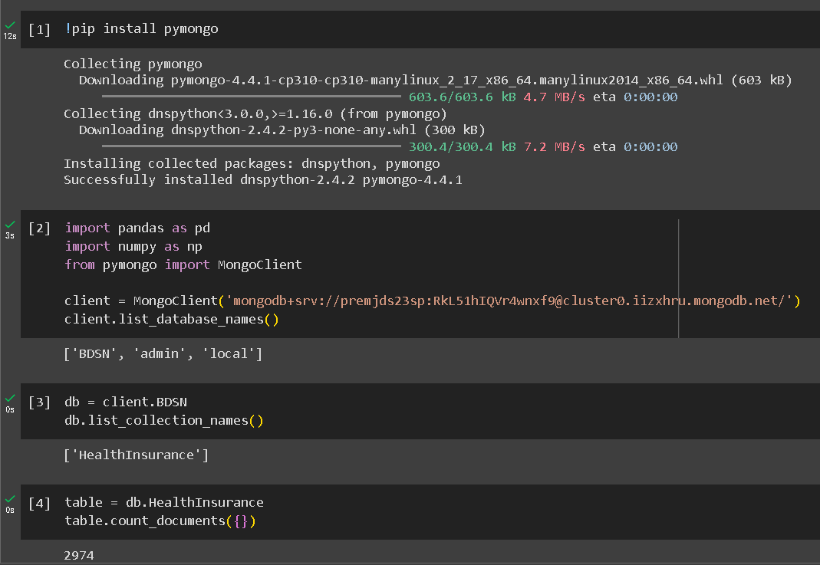
MONGO DB
The dataset is stored in a MongoDB cloud which is retrieved using the given credentials. After using the right credentials, we access the database ‘BDSN’ and through there, we access ‘HealthInsurance’ collection.

Slide 4
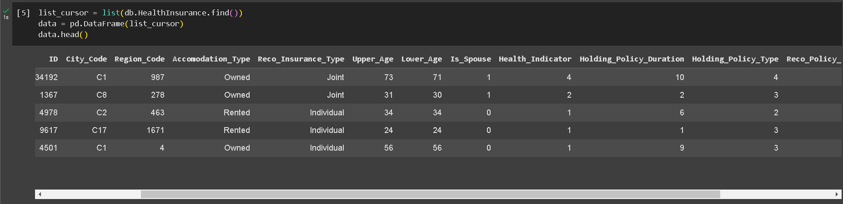
DATASET
There are 15 columns out of which the first column is just the indexer from MongoDB which needs to be dropped. There are 2974 records.

Slide 5
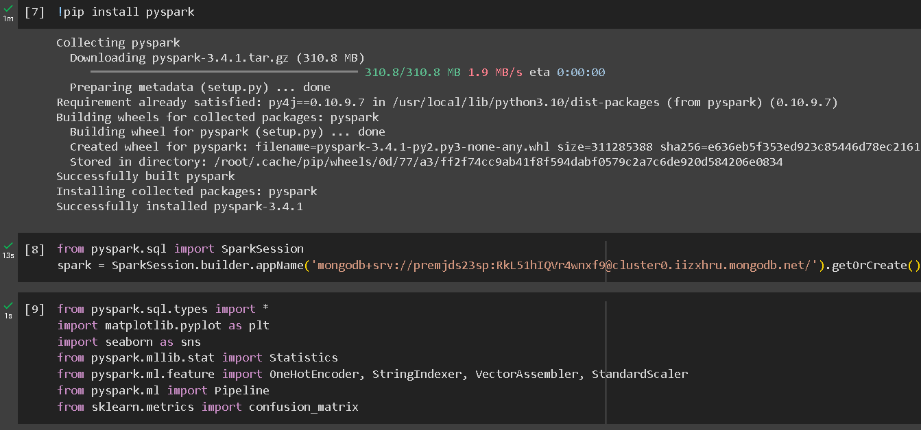
INITIALISING SPARK

Slide 6
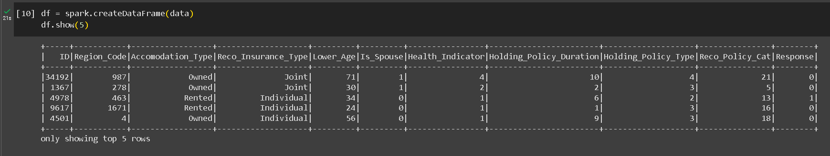
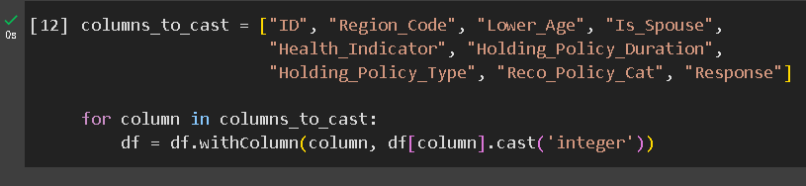
SPARK DATAFRAME & COLUMN DATATYPE

Slide 7
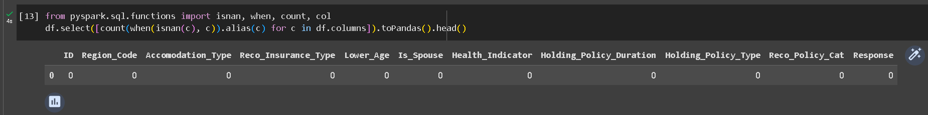
CHECKING FOR NULL VALUES
As we can see, there are no null values in the dataset.

Slide 8
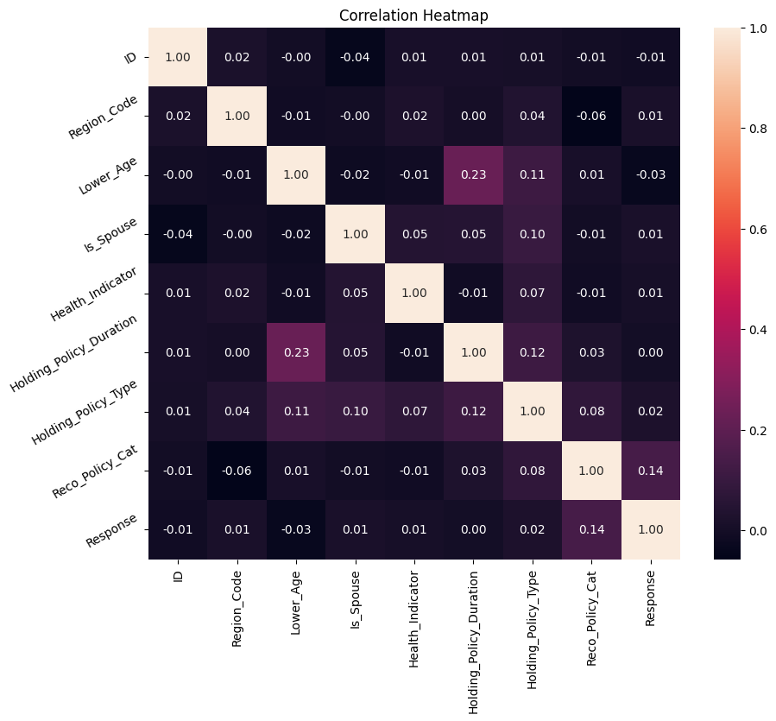
CORRELATION HEAT MAP
None of the variables have correlation coefficient values more than even 0.5. So, there shouldn’t be any multicollinearity issues.

Slide 9
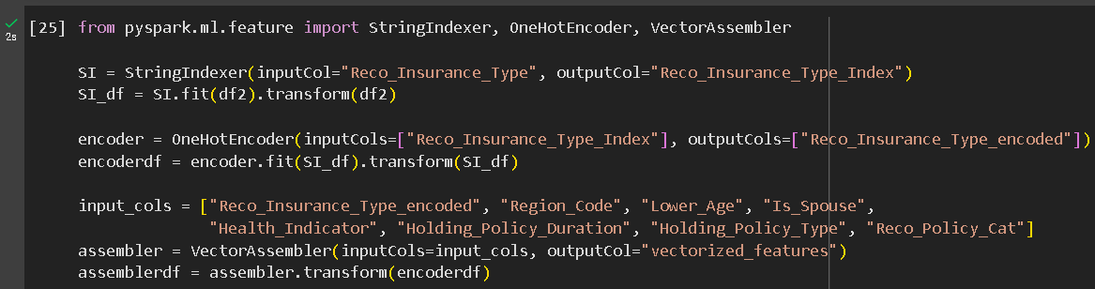
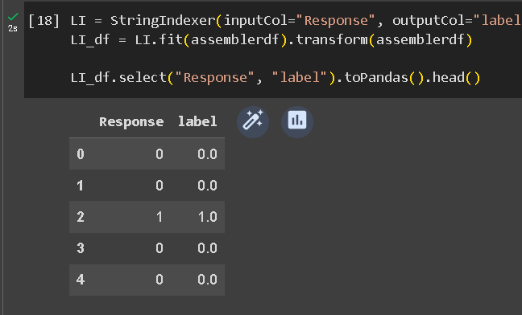
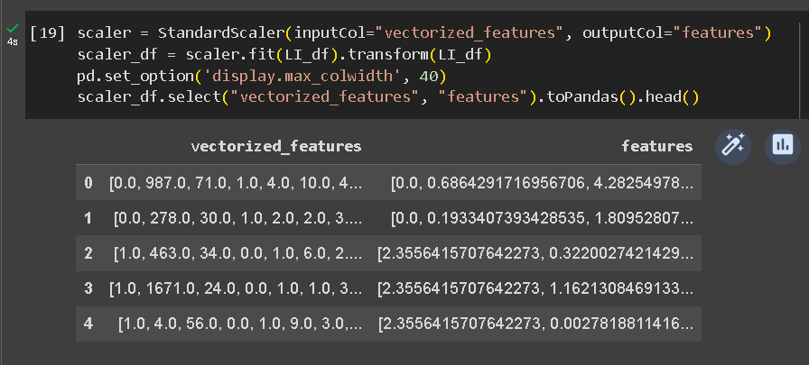
DATA PREPARATION
String Indexer
One Hot Encoder
Vector Assembler
Label Indexer
Standard Scaler

Slide 10

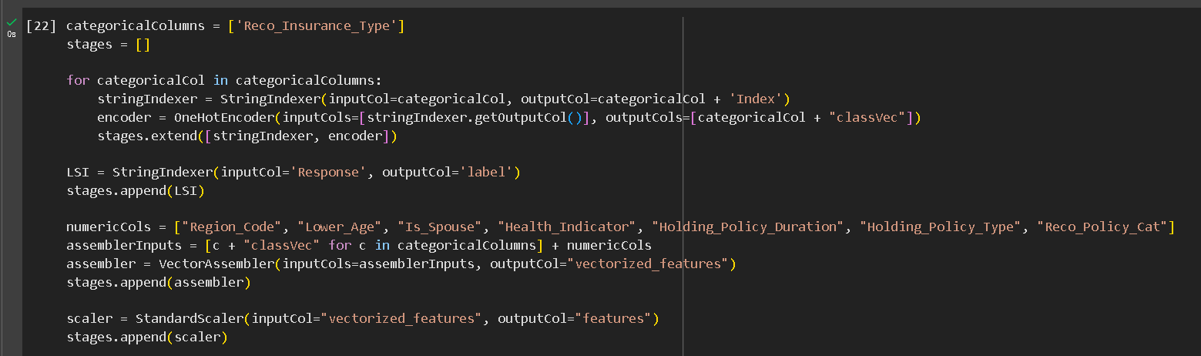
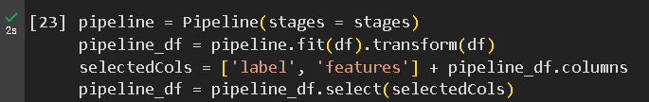
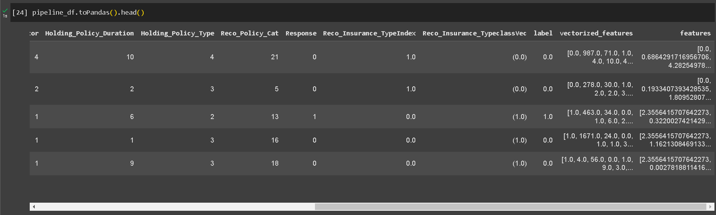
PIPELINE APPLICATION

Slide 11
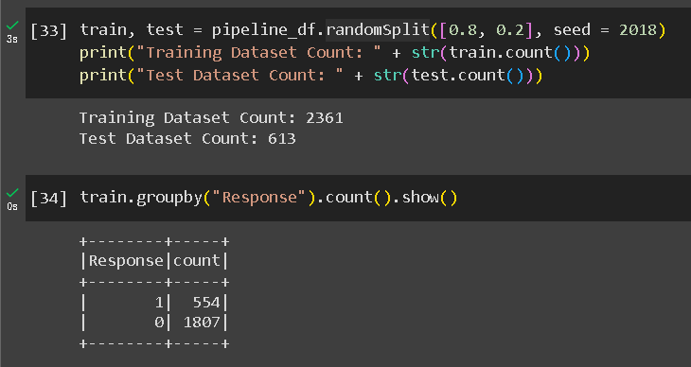
TRAIN-TEST SPLIT
In the train-test split, we keep 80% of the data for training and the remaining 20% for testing.

Slide 12
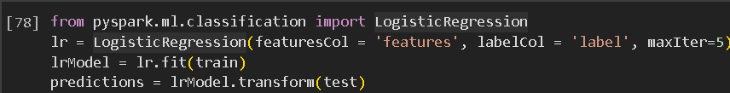
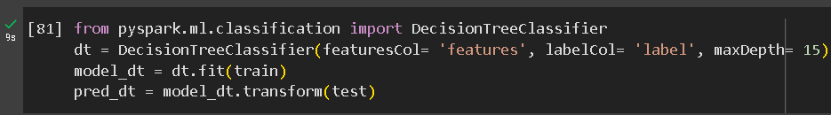
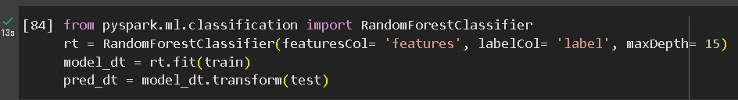
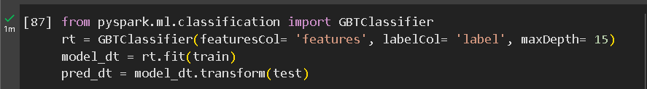
MODEL TRAINING
Logistic Regression
Decision Tree
Random Forest
GBT Classifier
4 different models used for training the data and the outputs were evaluated.

Slide 13
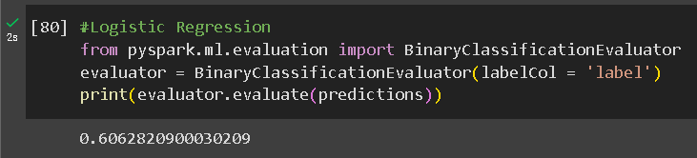
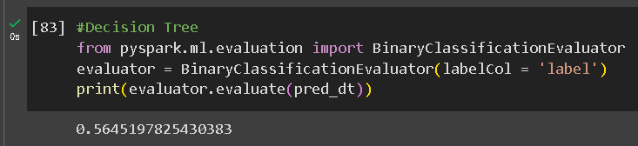
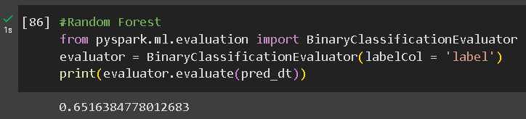
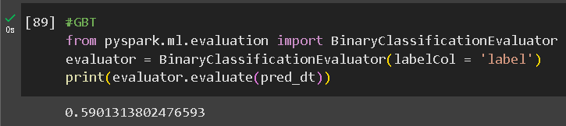
MODEL EVALUATION

Slide 14
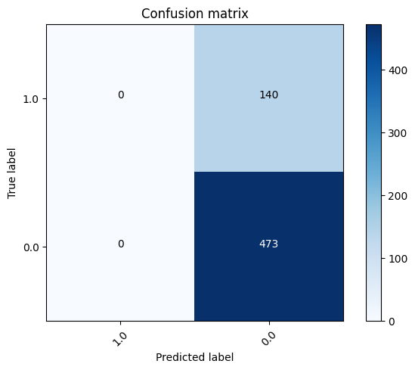
CONFUSION MATRIX

Slide 15
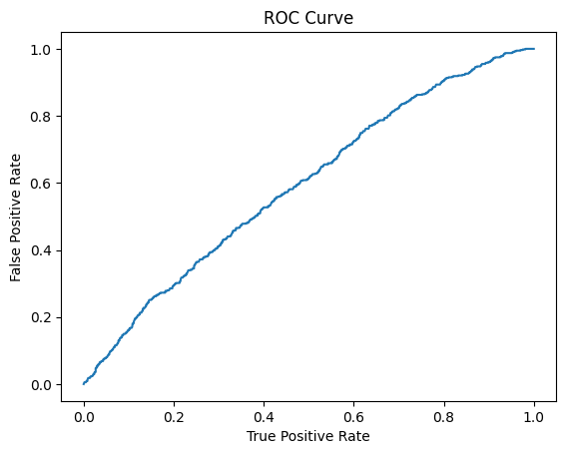
ROC CURVE

Slide 16
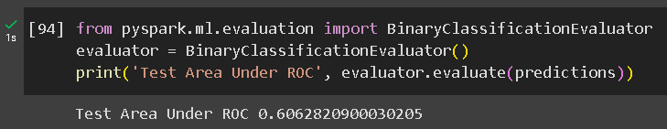
CONCLUSION - BEST MODEL
As we can see, the best model is Logistic Regression as we get
the best AUC-ROC score with it.

Slide 17
THANK YOU

