Slide 1
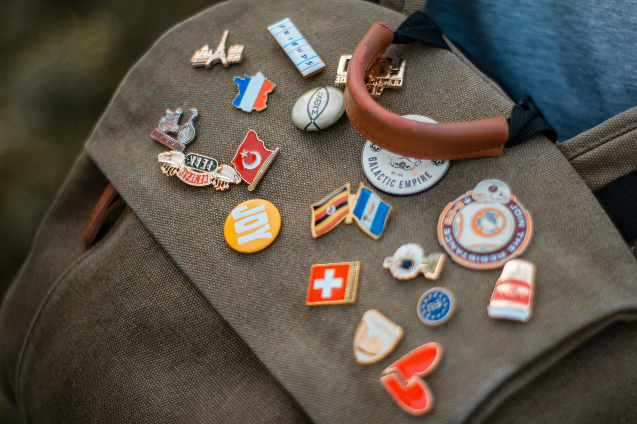
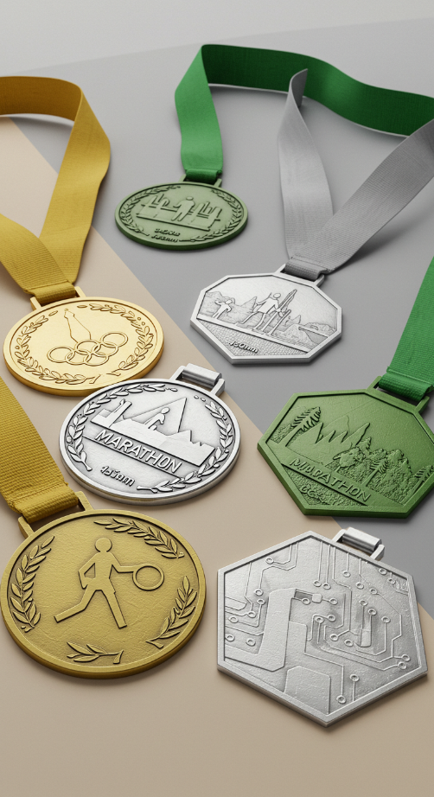
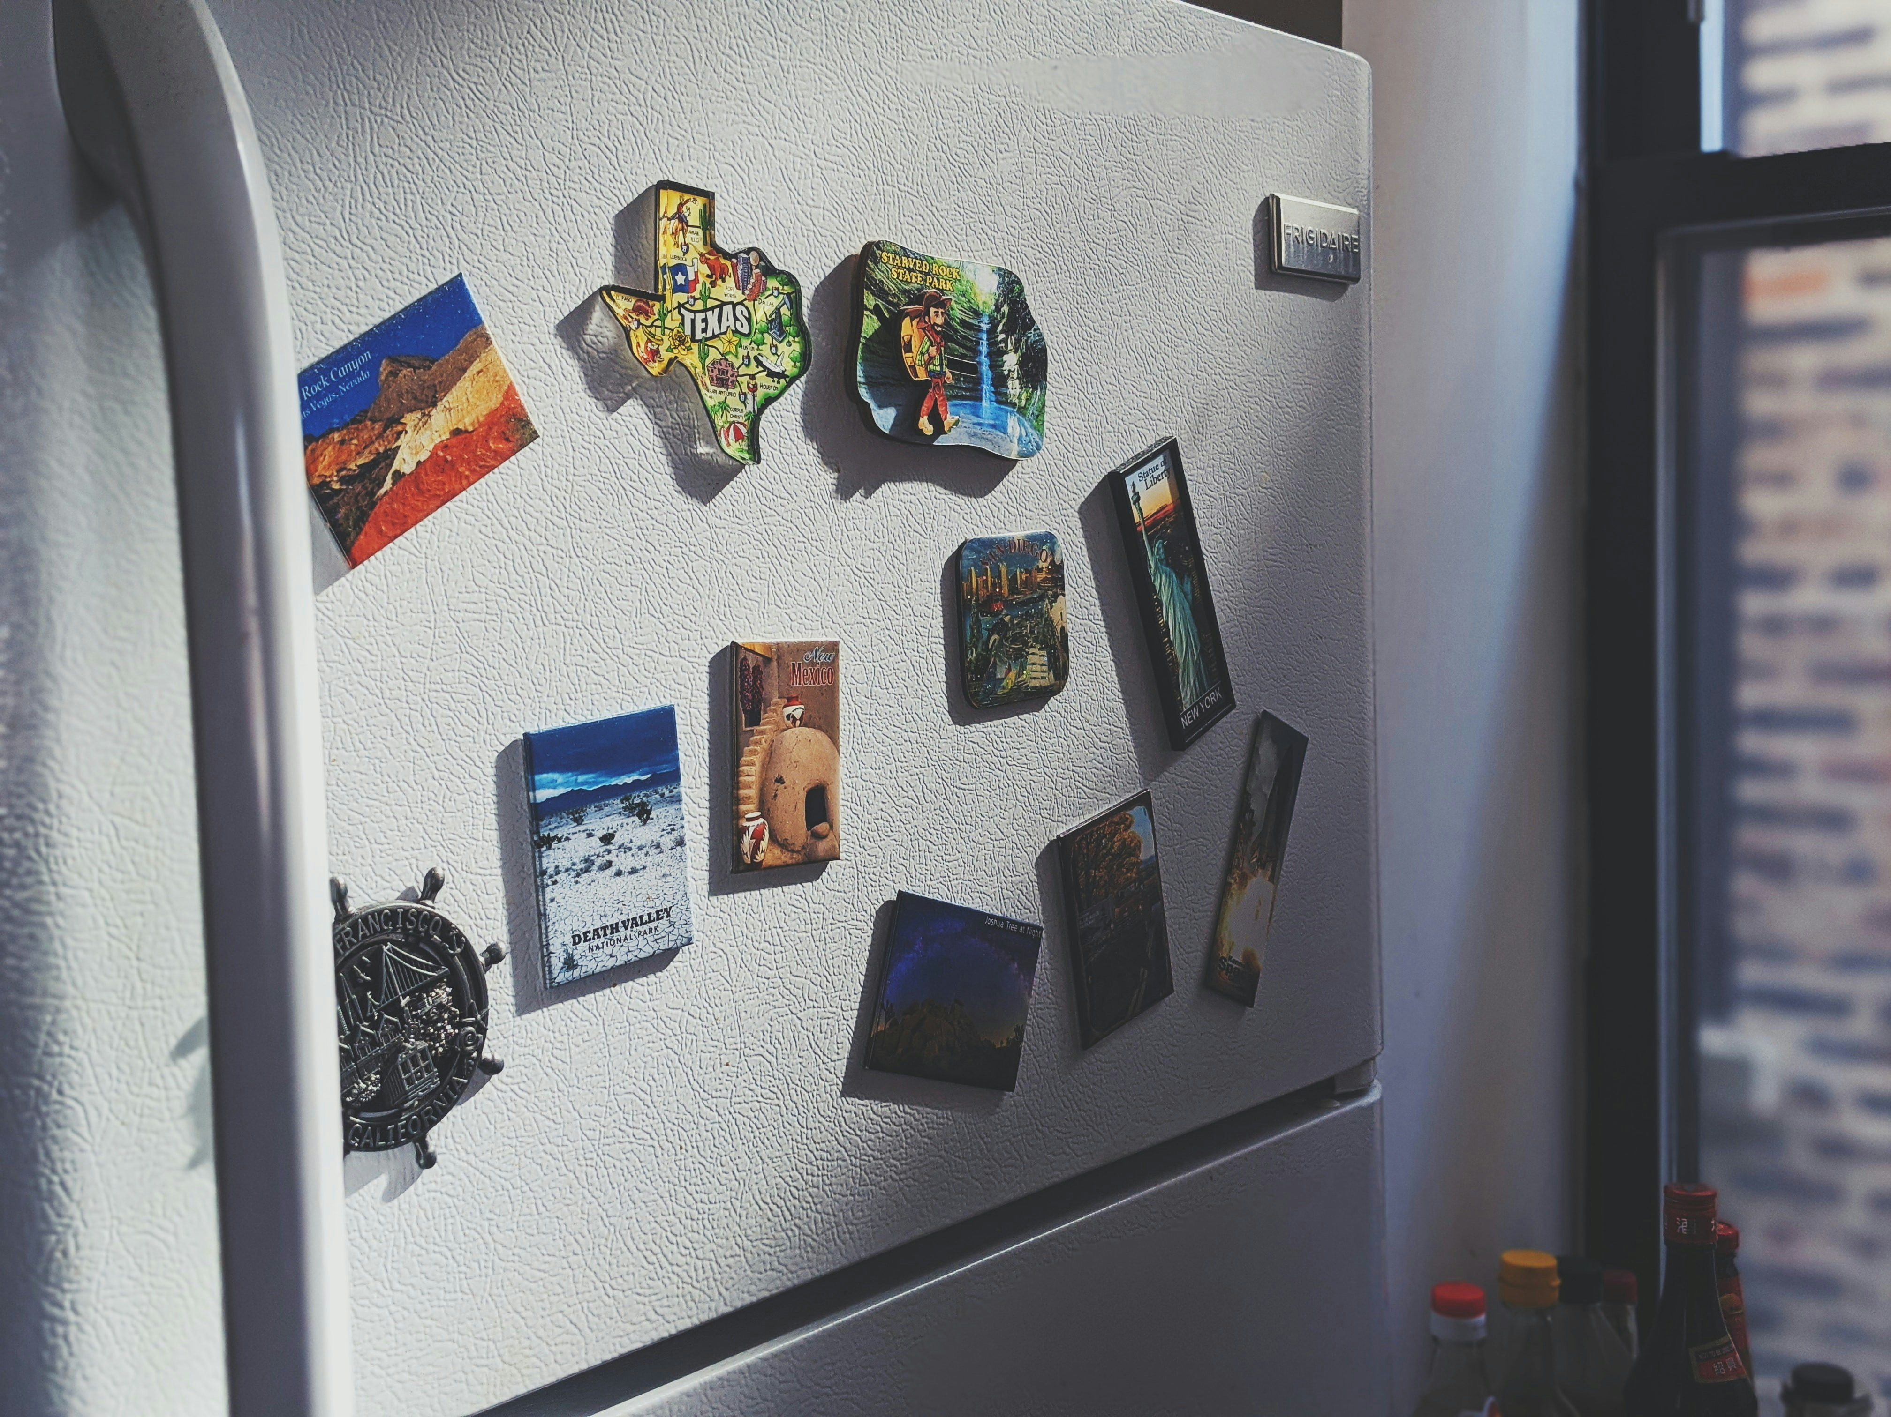
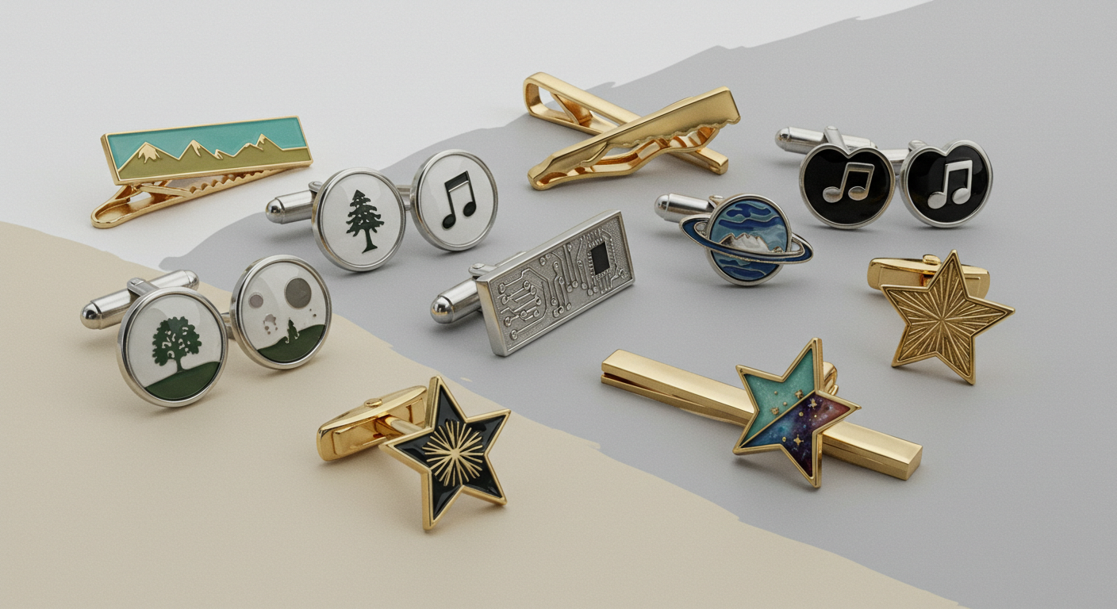
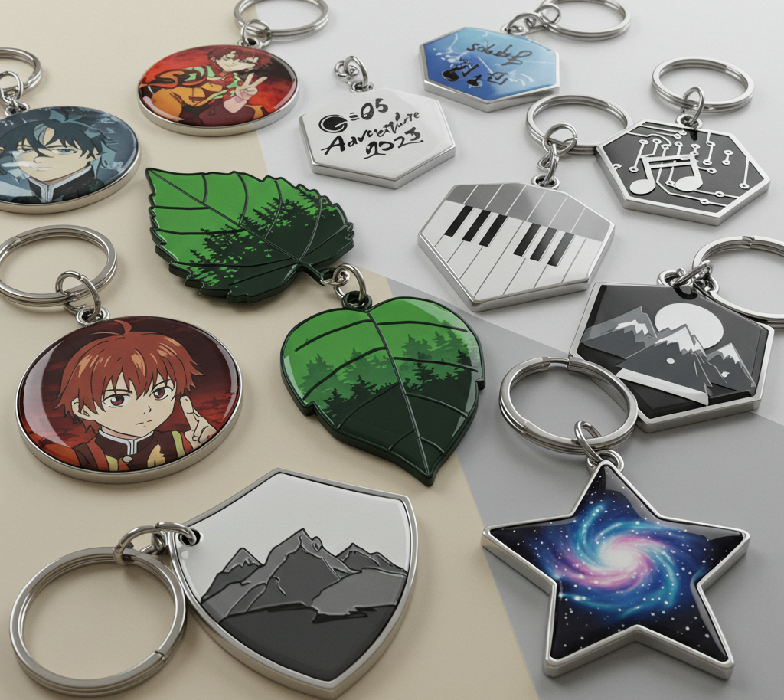
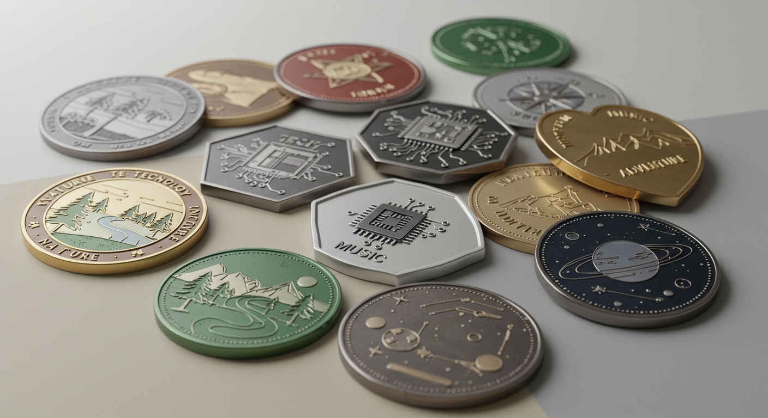
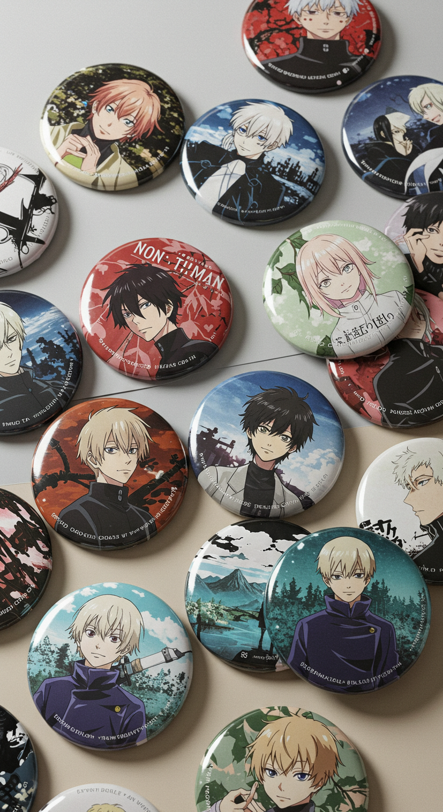
CM Crafts & Gifts Co., Ltd
Quality Gifts,
Made Simple
From idea to product, we help you turn thoughts into tangible, quality gifts.

Slide 2



C&M Crafts
Contents
PAGE 01
COMPANY OVERVIEW
PAGE 02
PRODUCT LIST
PAGE 03
ATTACHMENTS
PAGE 04
ORDERING GUIDE

Slide 3

C&M Crafts
Milestones of D&M Gifts
2025
Establishment of International Sales Department for direct export operations.
Future
C&M Crafts
2022
Expansion to in-house production lines for full-process manufacturing.
2018
Commenced OEM manufacturing for regional clients.
Since 2015
Entry into the metal crafts industry and product research.

Slide 4
About Us
1
2
3
What We Do
Who We Are
What We Want
Luckygifts is a company specializing in the design, production, and sales of metal gifts and crafts. We are dedicated to providing high-quality custom and wholesale services to designers and importers worldwide.
Our team includes friendly salespeople, experienced designers, and skilled artisans. Whether for individual projects or large orders, we ensure each client receives attentive, reliable service tailored to their needs.
We help bring customers' ideas to life with exceptional craftsmanship and innovative design. By supporting our clients' visions, we strive to deliver quality products that inspire success and good fortune.
Forever Driven by Dreams, Forever Guided by Gratitude

Slide 5
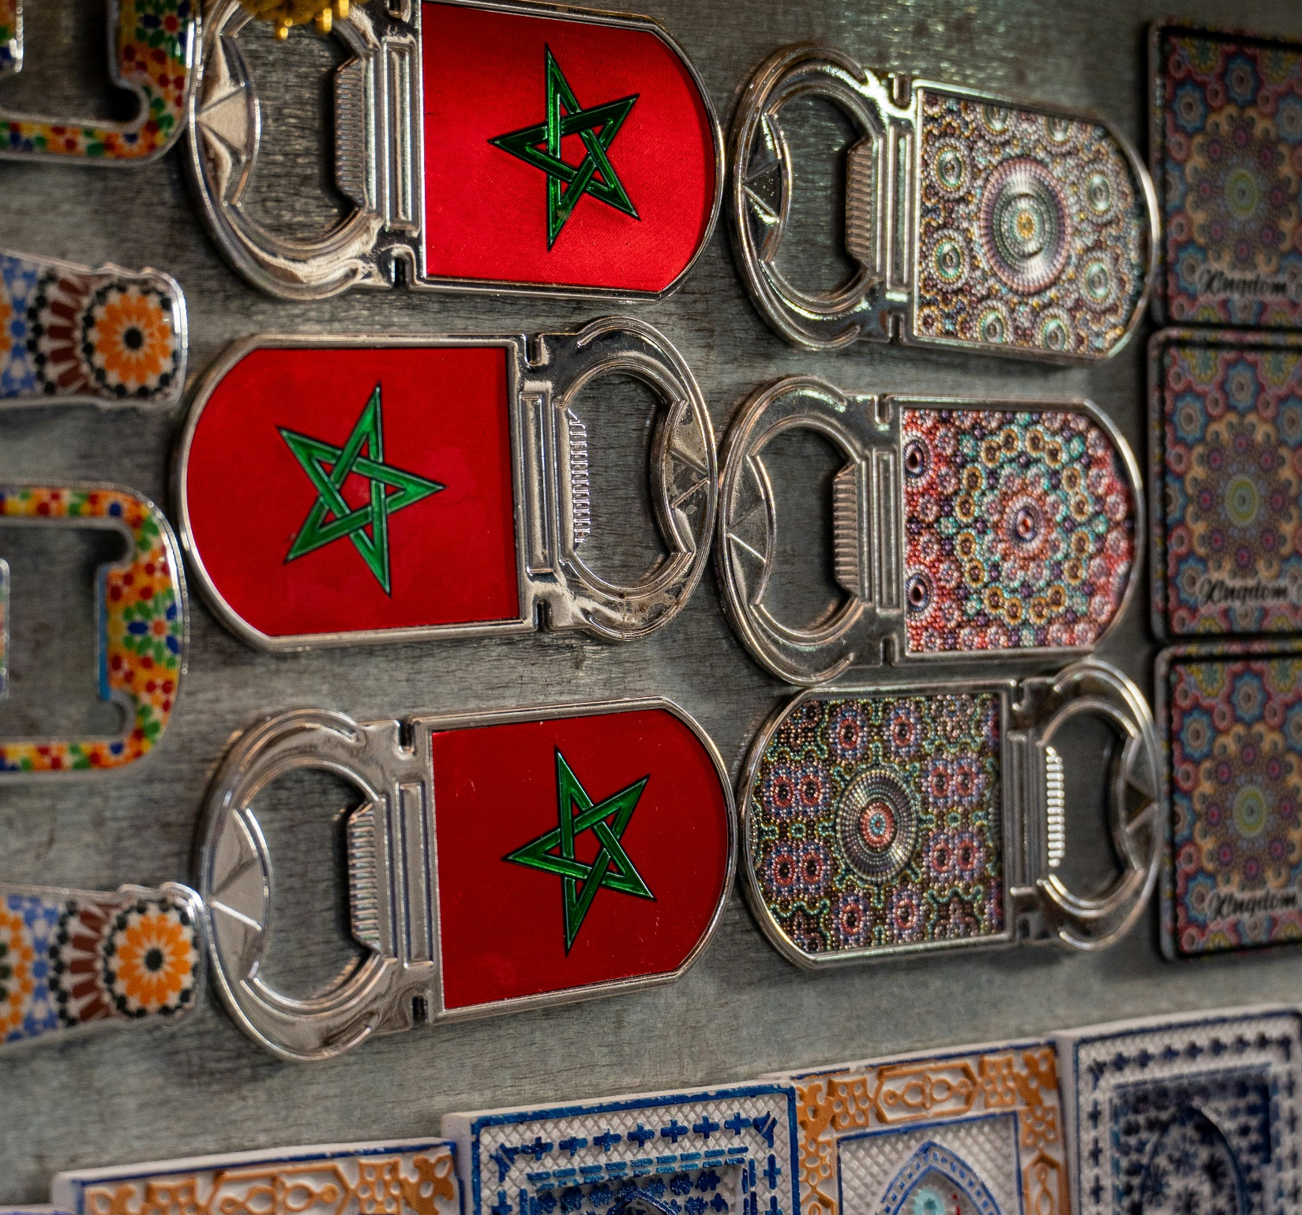
Medal
Fridge Magnet
Cufflinks&Tie-clip
Quality Gifts,
Made Simple
From idea to product, we help you turn thoughts into tangible, quality gifts.
Lapel pin/Badge
Tinplate Badge
Keychain
Bottle-Opener
Challenge Coin

Slide 6
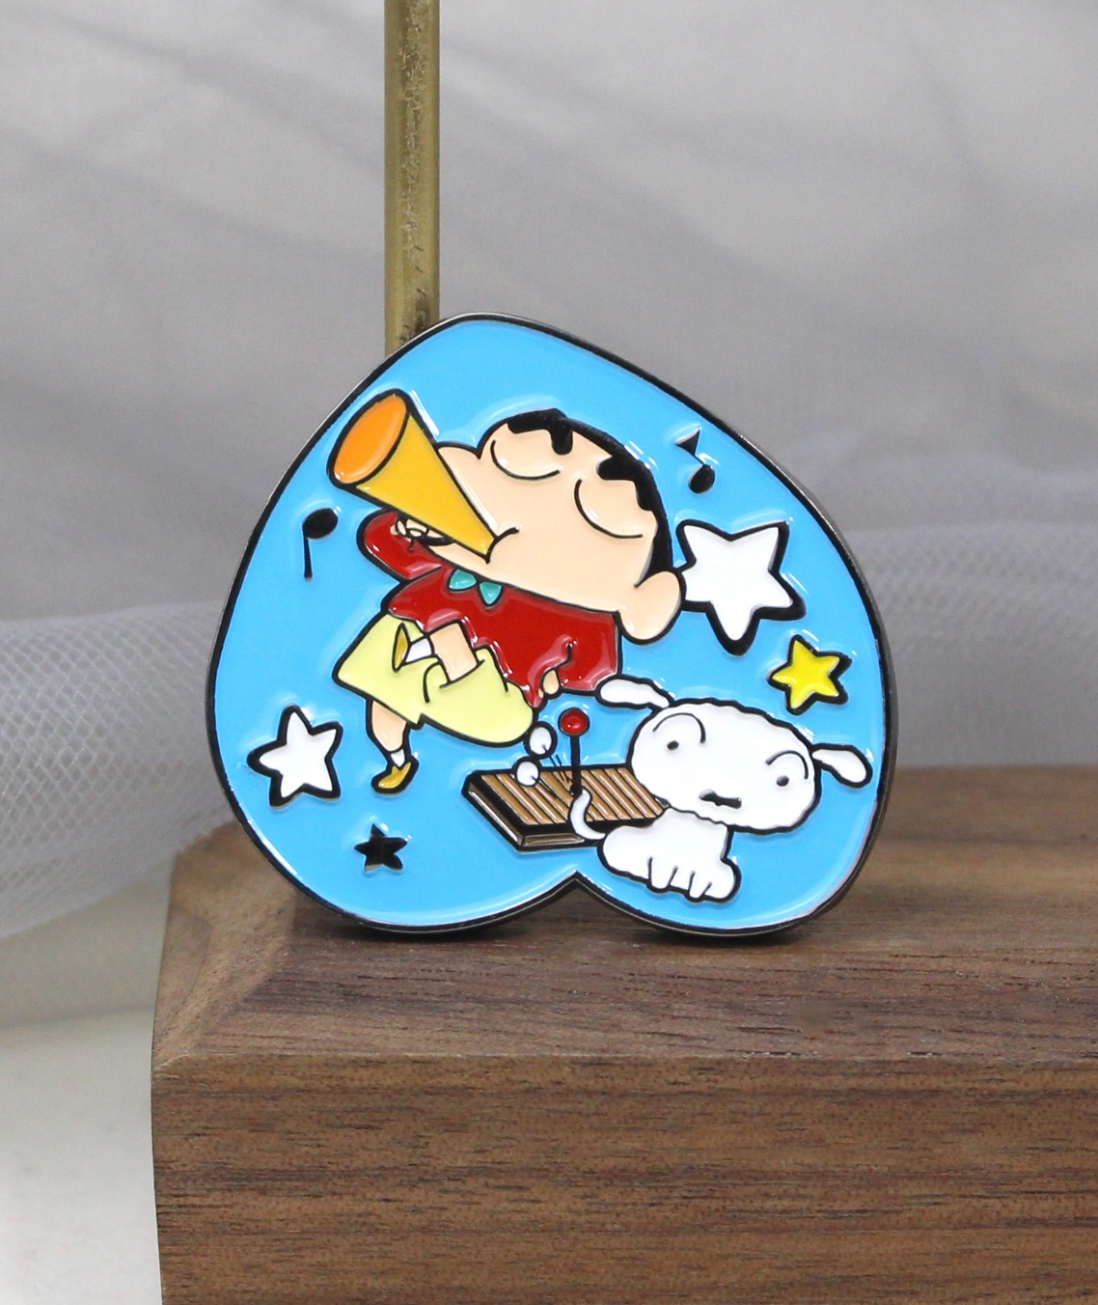
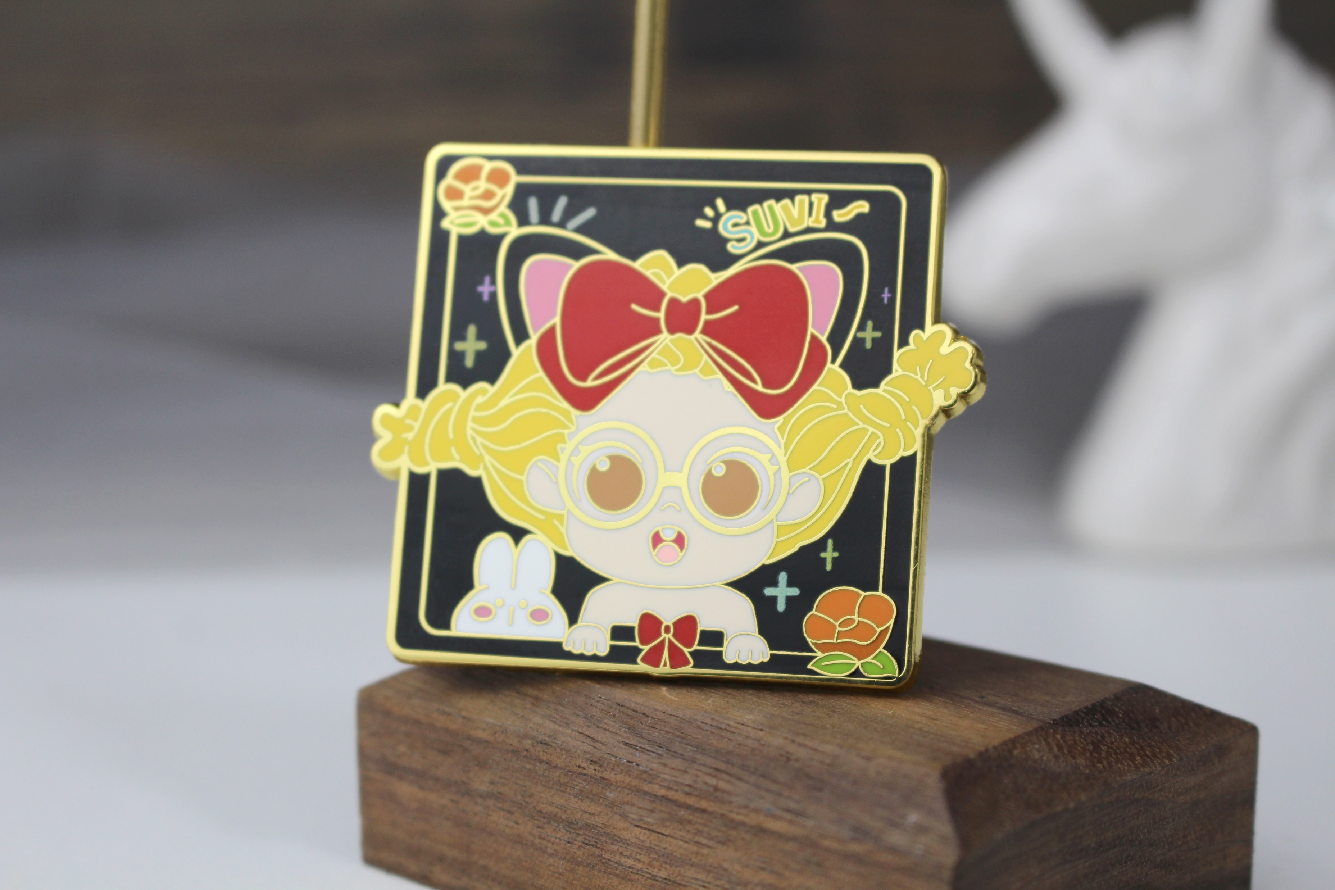
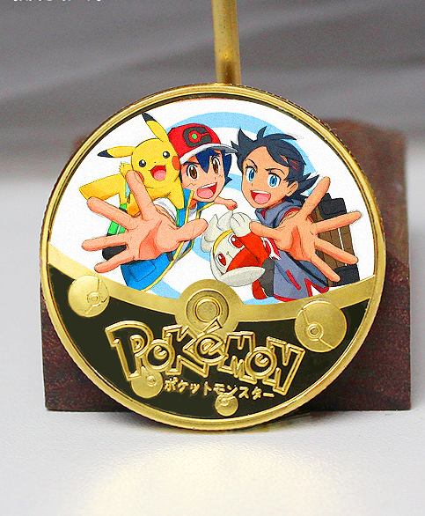
Lapel Pin/Badge
C&M Crafts
Soft Enamel Pin Badge
Hard Enamel Pin Badge
Printing Pin Badge
D&M CRAFTS 01
* For detailed information on the process, please refer to page 15.

Slide 7


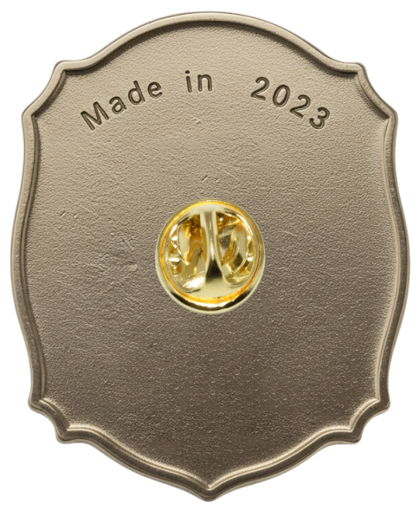
Lapel pin/Badge
D&M Crafts
PRODUCED BY MK
Regarding customized products, we can provide:
Craft:
soft enamel, hard enamel, 3D effect, etc.
Material:
Available in brass, iron, zinc alloy or stainless steel, etc.
Plating:
gold, silver, copper, matt or antique, etc.
Regarding Customization
Marking:
Molded text, Laser engraving or printing.
custom designs with no MOQ. Our team will gladly assist in turning your creative ideas into a draft—completely free of charge.
Attachment:
Options include metal clutch, rubber clutch, safety pin, etc.
Create as you
wish
Back Finish:
The reverse side can be sandblasted, polished smooth, etc.
D&M CRAFTS 01

Slide 8
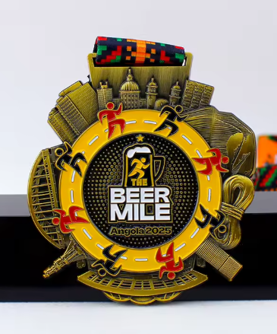
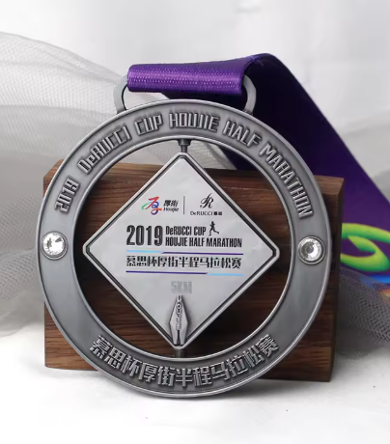
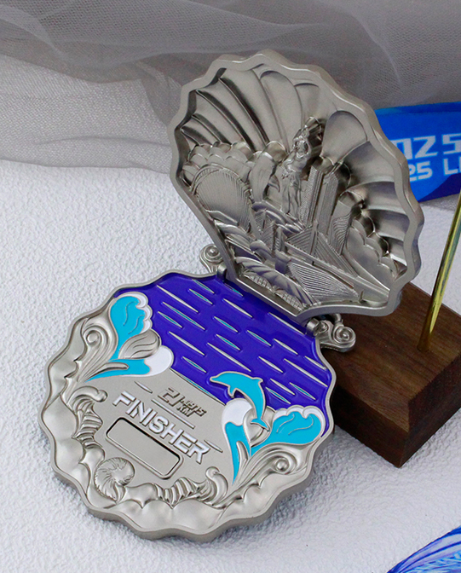
Medal
D&M Crafts
PRODUCED BY MK
Soft Enamel Antique Medal
Movable Part Medal
Printing Pin Badge
D&M CRAFTS 01

Slide 9

Medal
D&M Crafts
PRODUCED BY MK
Regarding customized products, we can provide:
Ribbon:
Customize color, type, and printing logo, etc.
Create as you
wish
Ready to start? Contact us for a free virtual proof.
Attachment:
Available in many different styles.
Marking:
Laser engraving or printing, etc.
Plating:
gold, silver, copper, matt or antique, etc.
Craft:
Soft enamel, 3D effect, etc.
D&M CRAFTS 01

Slide 10
Challenge Coin
D&M Crafts
PRODUCED BY MK
Soft Enamel Antique Medal
Movable Part Medal
Printing Pin Badge
D&M CRAFTS 01

Slide 11

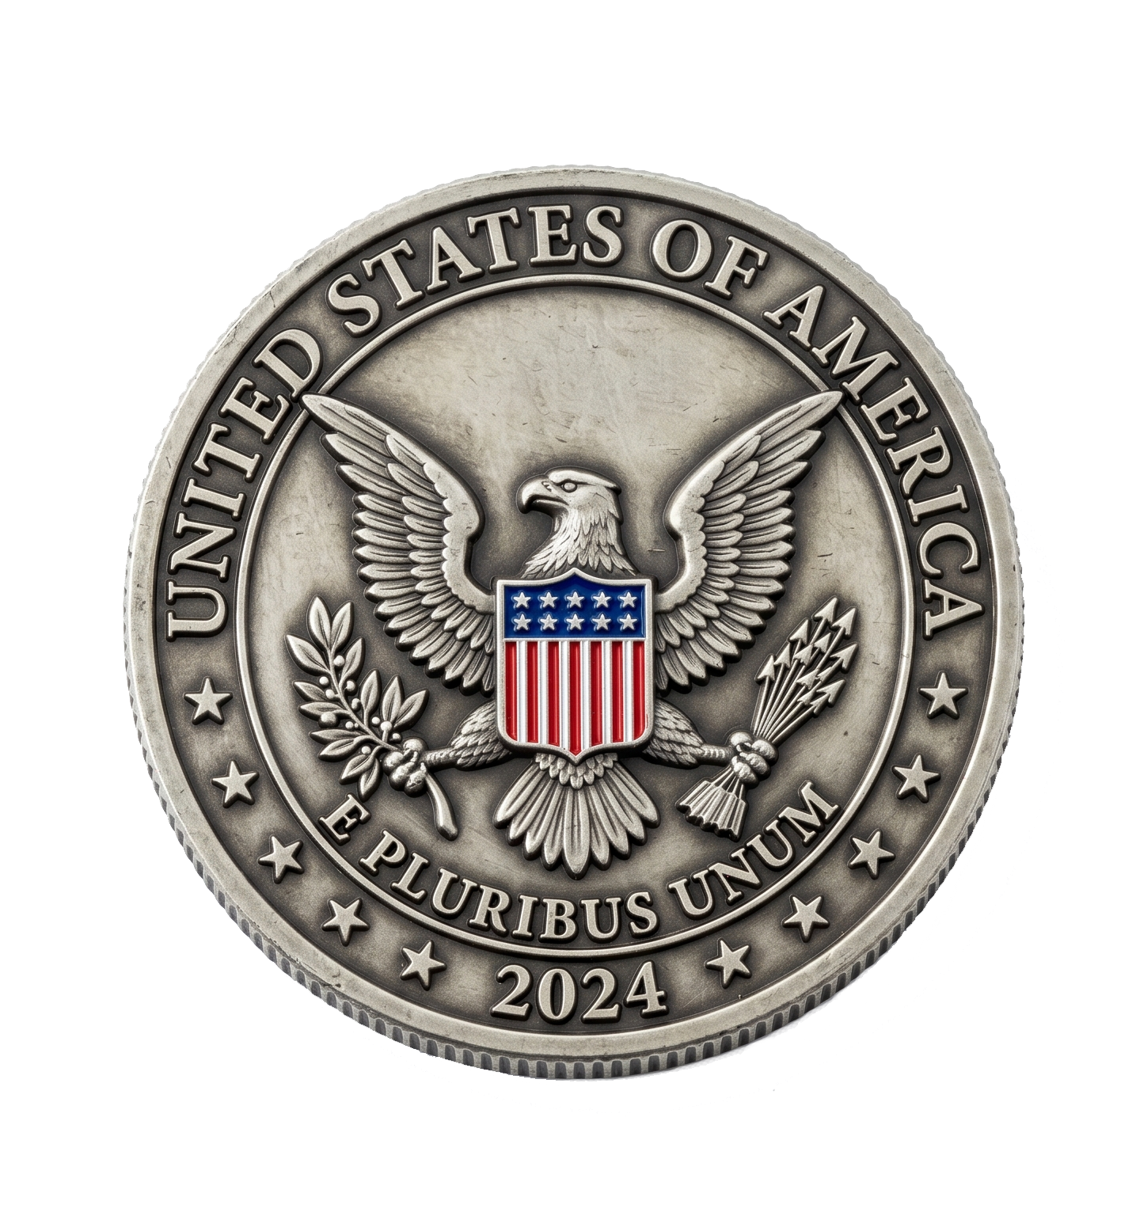
Challenge Coin
D&M Crafts
PRODUCED BY MK
Regarding customized products, we can provide:
Craft:
Soft enamel, UV printing, etc.
Plating:
Gold, Silver, Bronze, Antique finished, etc.
Edge:
flat, reeded, diamond cut, or wave cut, etc.
Create as you
wish
Ready to start? Contact us for a free virtual proof.
Back:
Independent reverse design with precise 180° alignment.
Numbering:
Laser engraved sequential numbers, Metal raised, etc.
D&M CRAFTS 01

Slide 12
Tinplate Badge
D&M Crafts
PRODUCED BY MK
Soft Enamel Antique Medal
Movable Part Medal
Printing Pin Badge
D&M CRAFTS 01

Slide 13
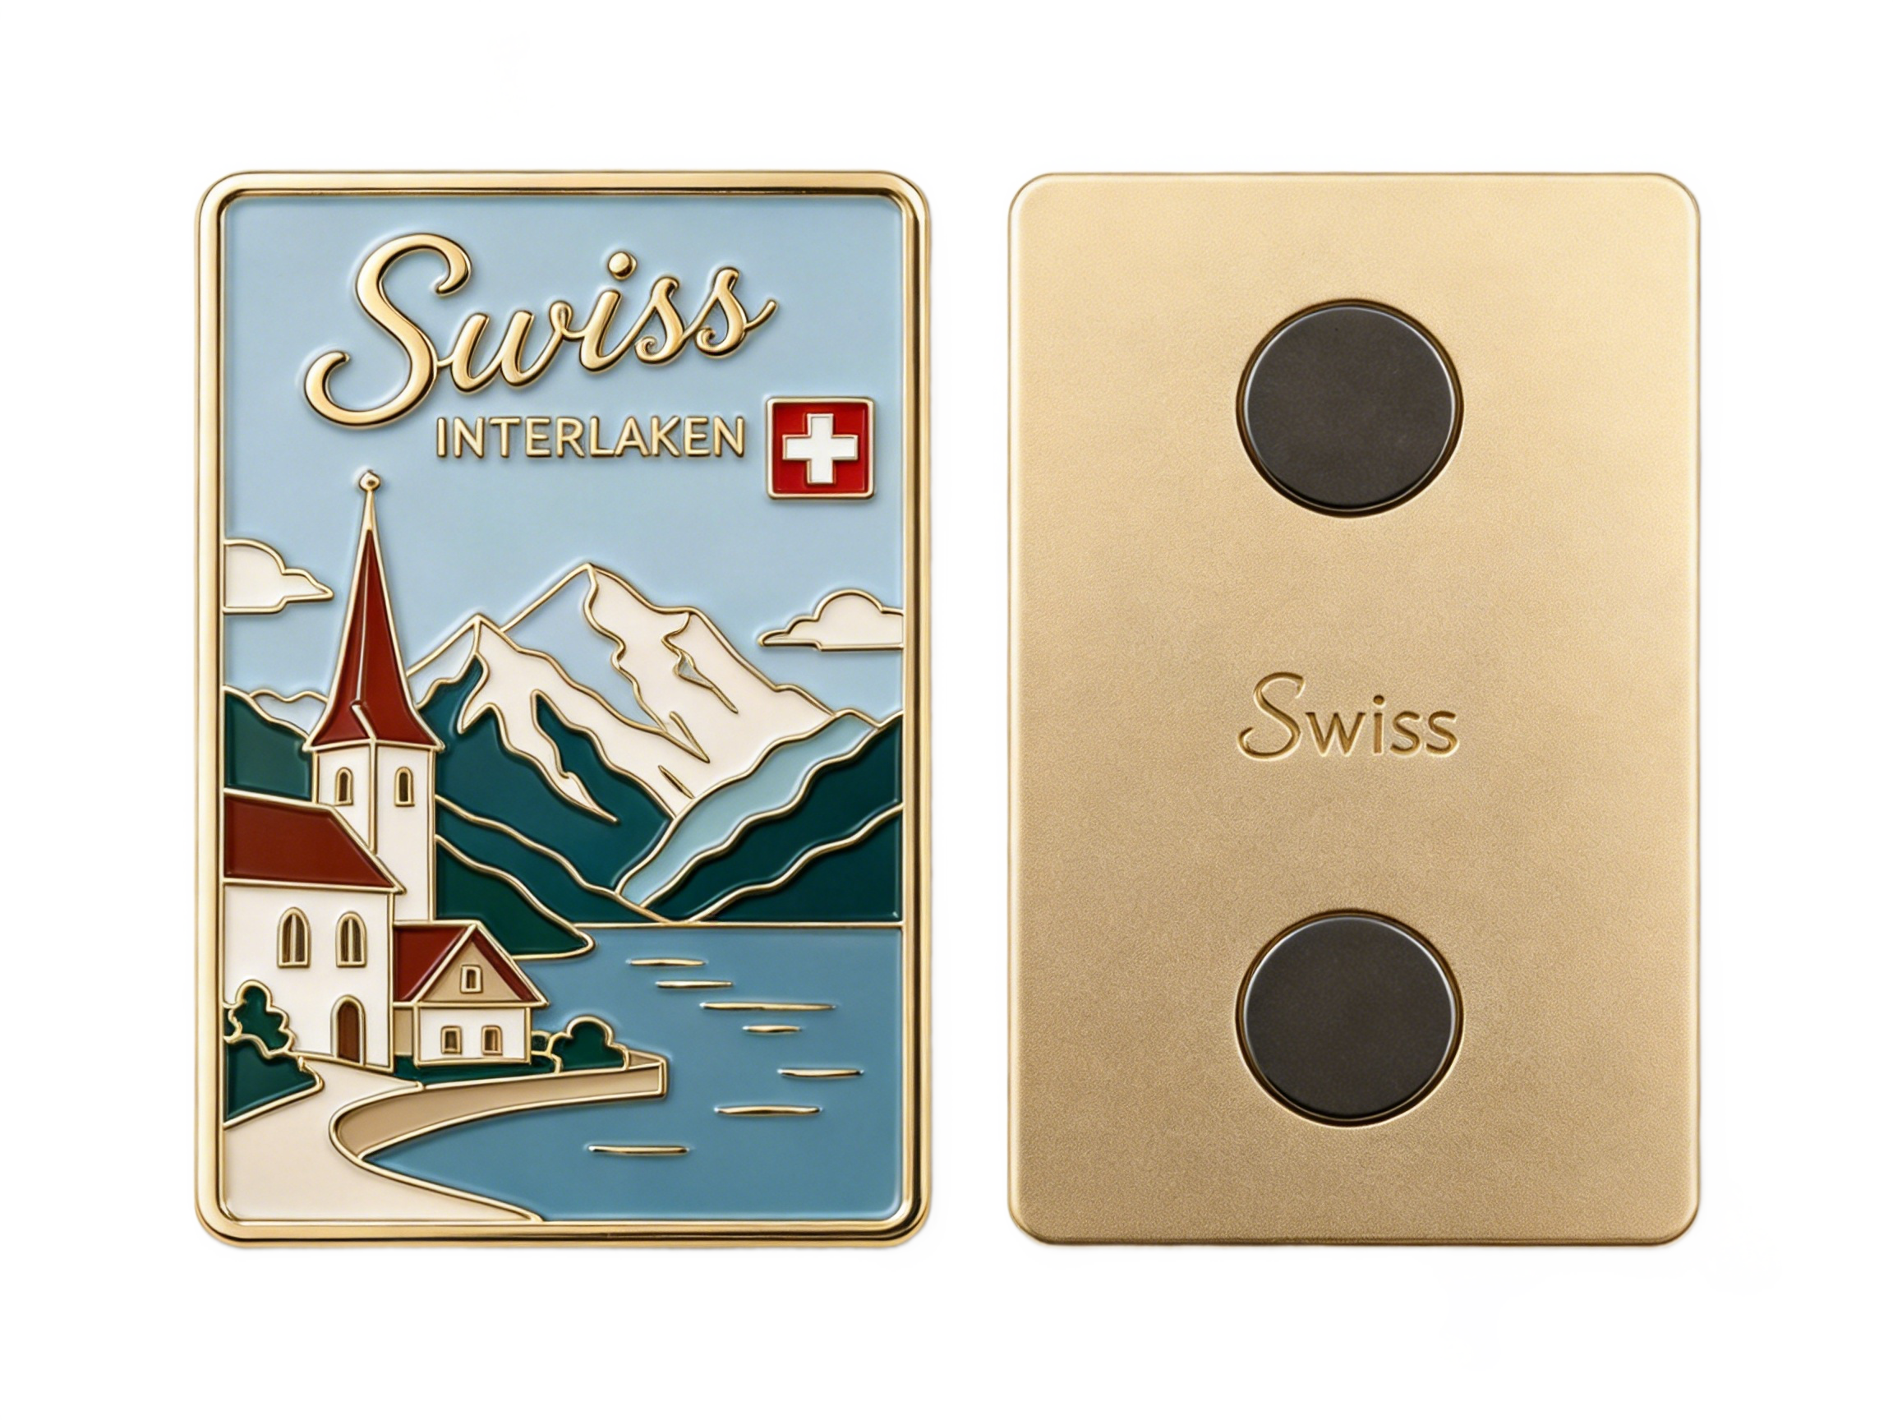
Fridge Magnet
D&M Crafts
PRODUCED BY MK
Regarding customized products, we can provide:
Craft:
Soft enamel, Hard enamel, 3D effect, etc.
Attachment:
Strong magnets, rubber magnets, or ferrite magnets, etc.
Marking:
Laser engraving or printing, etc.
Plating:
gold, silver, copper, matt or antique, etc.
Function:
Integrated bottle opener or other functional designs.
Create as you
wish
Ready to start? Contact us for a free virtual proof.
D&M CRAFTS 01

Slide 14
Tinplate Badge
D&M Crafts
PRODUCED BY MK
Soft Enamel Antique Medal
Movable Part Medal
Printing Pin Badge
D&M CRAFTS 01

Slide 15
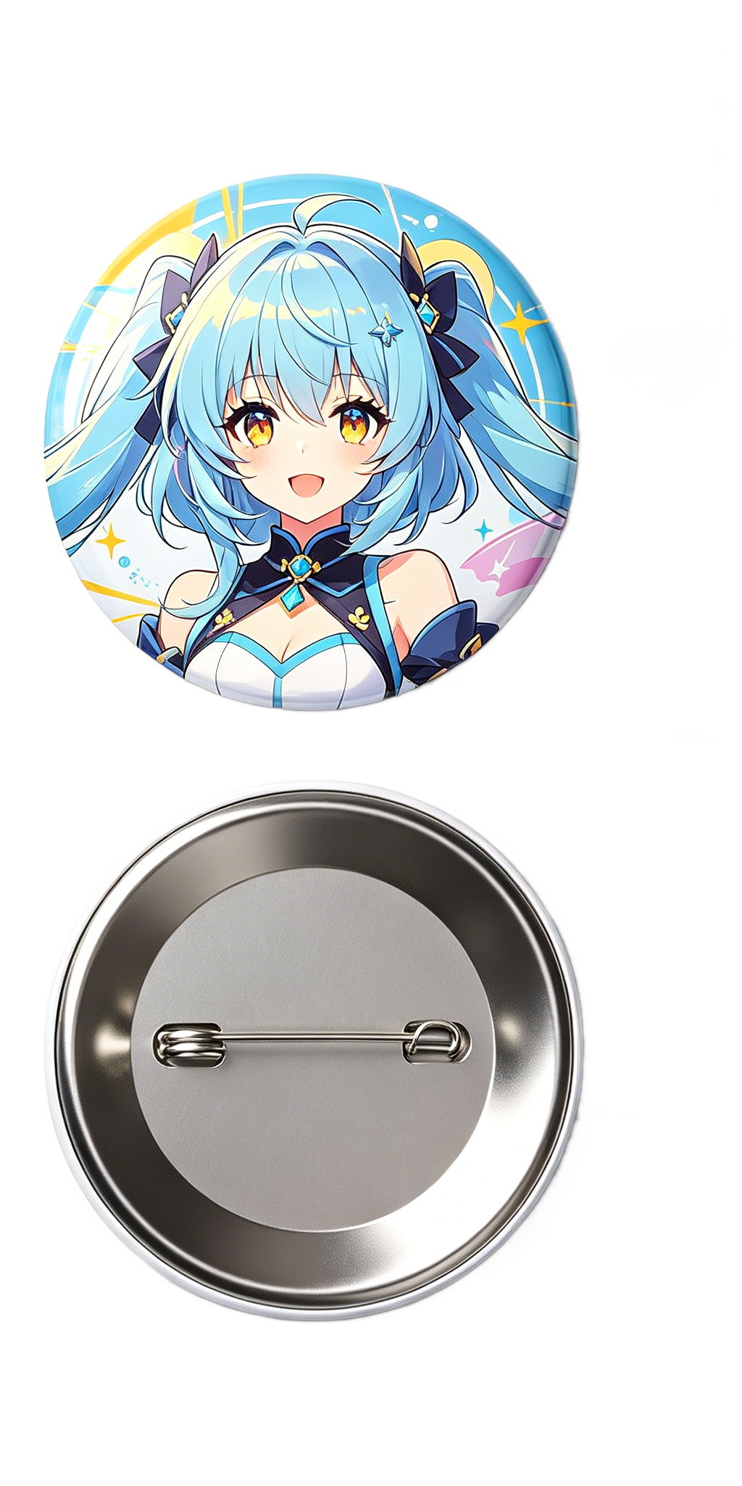
Tinplate Badge
D&M Crafts
PRODUCED BY MK
Regarding customized products, we can provide:
Surface:
Glossy, matte, or frosted film coating, etc.
Printing:
High-definition Offset (CMYK) or UV digital printing, etc.
Create as you
wish
Ready to start? Contact us for a free virtual proof.
Material:
Tin-plated steel, Stainless Steel, Plastic, Aluminum, etc.
Back:
Safety pin, plastic backing, or magnet options, etc.
Function:
Adjust to bottle openers or compact mirror backs.
D&M CRAFTS 01

Slide 16
Bottle-opener
D&M Crafts
PRODUCED BY MK
Soft Enamel Antique Medal
Movable Part Medal
Printing Pin Badge
D&M CRAFTS 01

Slide 17
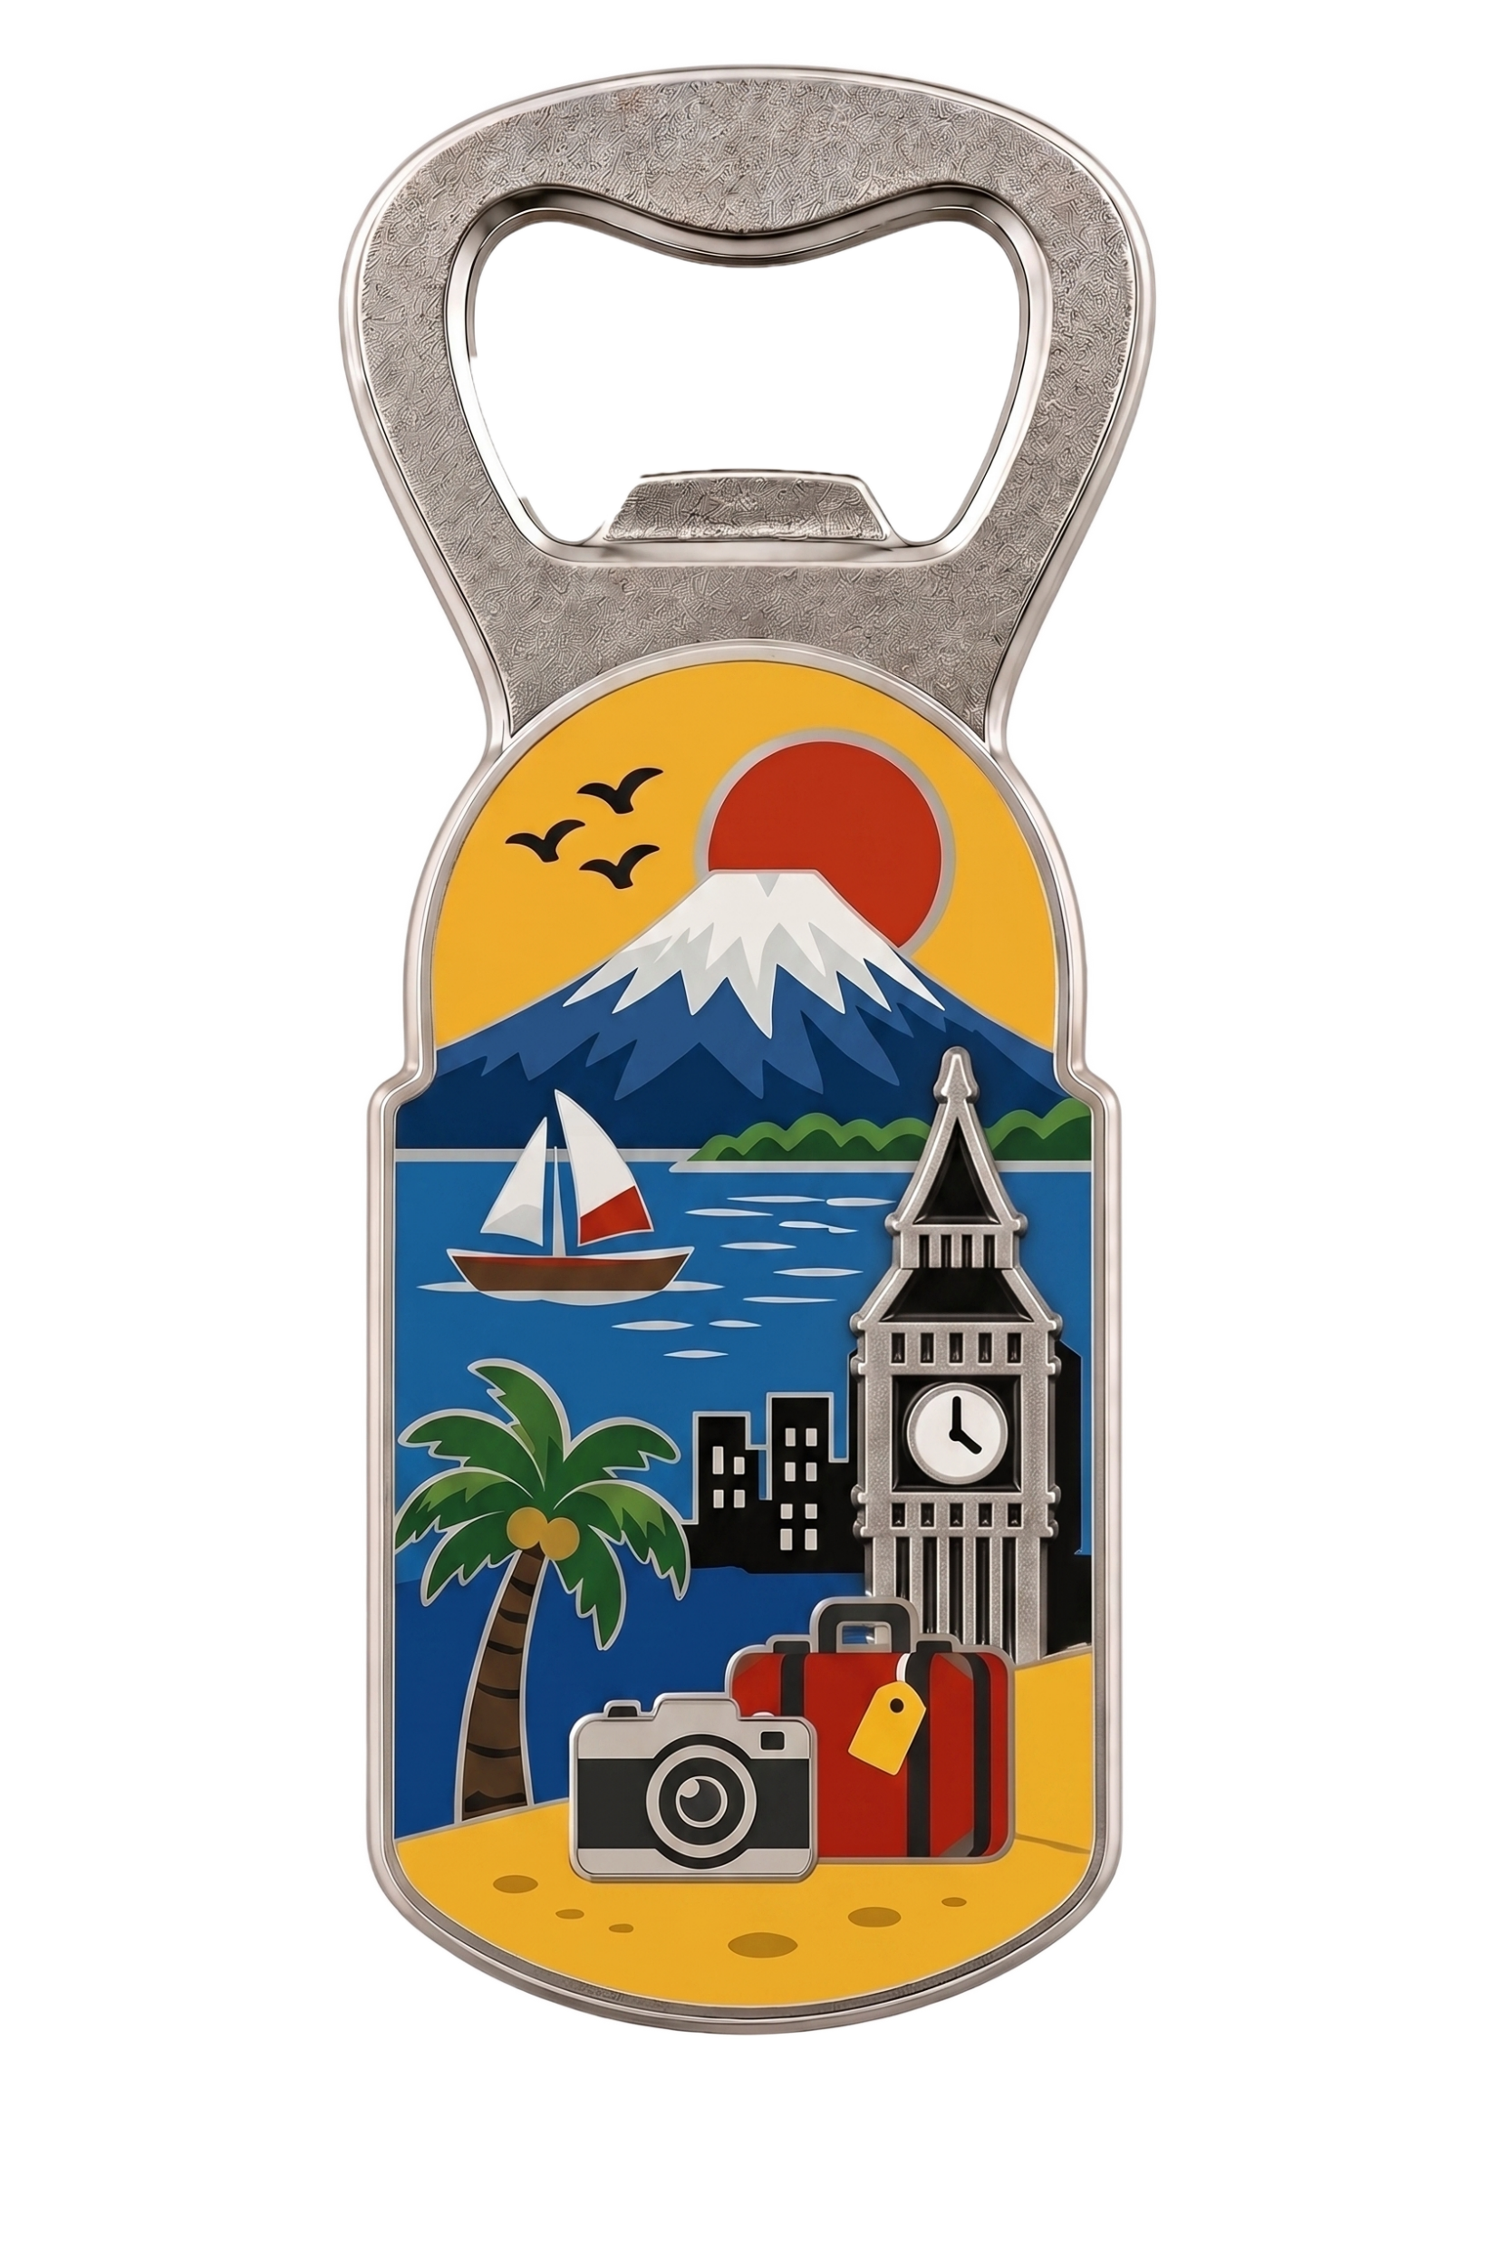
Bottle-opener
D&M Crafts
PRODUCED BY MK
Regarding customized products, we can provide:
Material:
High-strength zinc alloy or stainless steel, etc.
Plating:
Gold, Silver, Bronze, Antique finished, etc.
Create as you
wish
Craft:
Soft enamel, Hard enamel, UV printing, etc.
Ready to start? Contact us for a free virtual proof.
Shape:
keychains, fridge magnets, or medals for multi-purpose use.
D&M CRAFTS 01

Slide 18
Challenge Coin
D&M Crafts
PRODUCED BY MK
Regarding customized products, we can provide:
Craft:
Soft enamel, UV printing, etc.
Plating:
Gold, Silver, Bronze, Antique finished, etc.
Edge:
flat, reeded, diamond cut, or wave cut, etc.
Create as you
wish
Ready to start? Contact us for a free virtual proof.
Back:
Independent reverse design with precise 180° alignment.
Numbering:
Laser engraved sequential numbers, Metal raised, etc.
D&M CRAFTS 01

Slide 19
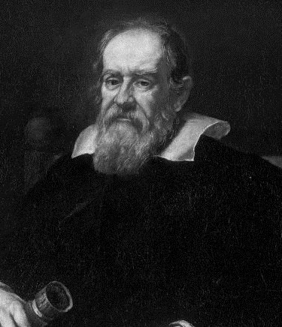
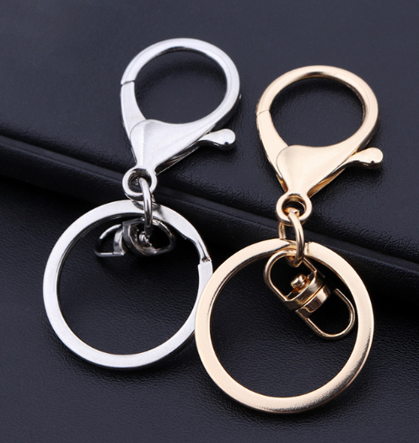
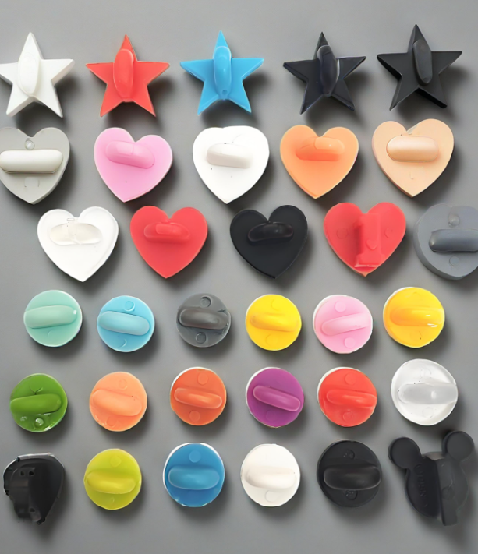
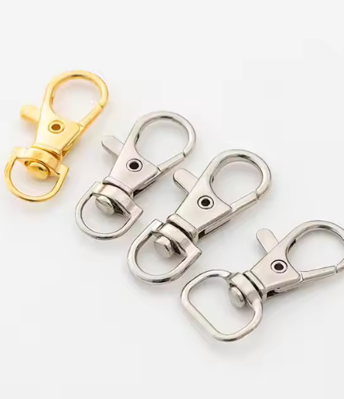
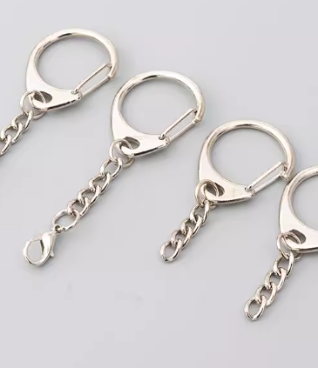
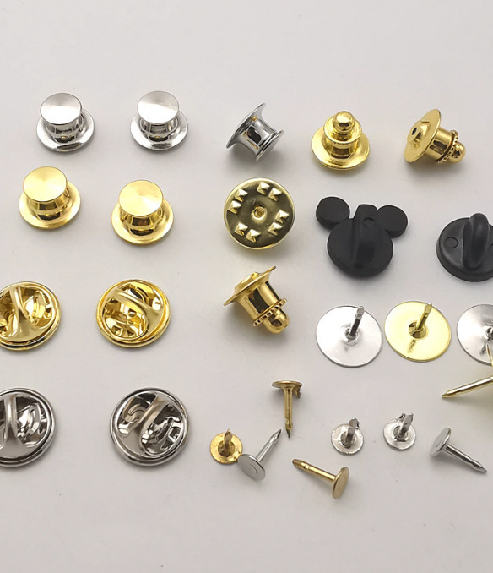
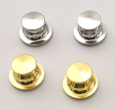
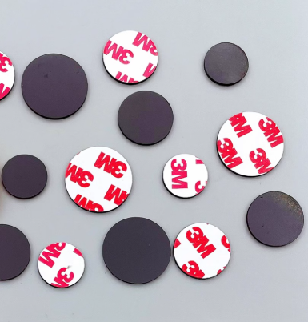
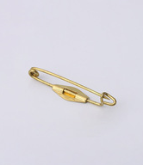
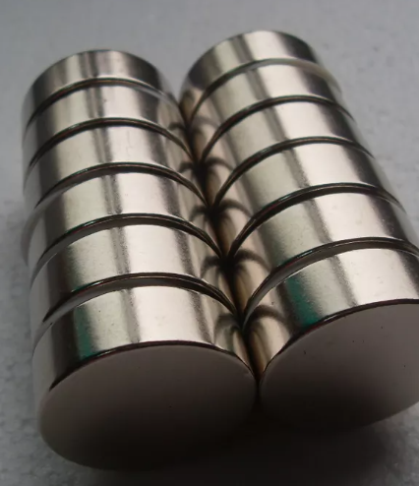
D&M Crafts
PRODUCED BY MK
ATTACHMENTS
The items shown here are only part of our available options. Additional accessory models are available upon request. We also support custom development based on your specifications.
D&M CRAFTS 05
D&M CRAFTS 01

Slide 20
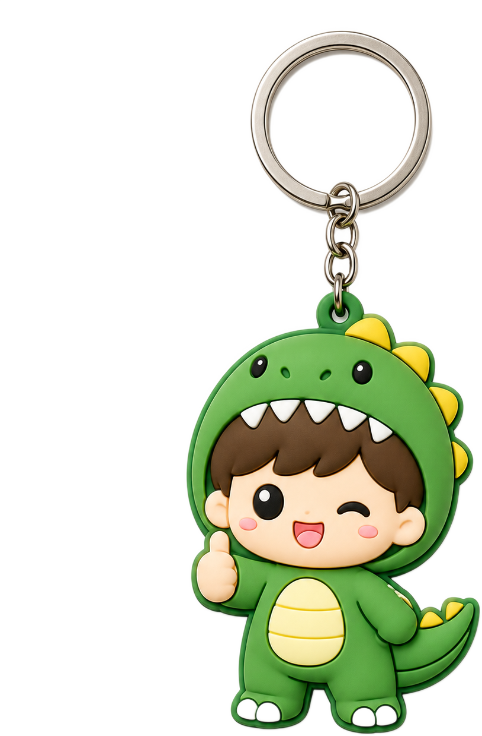
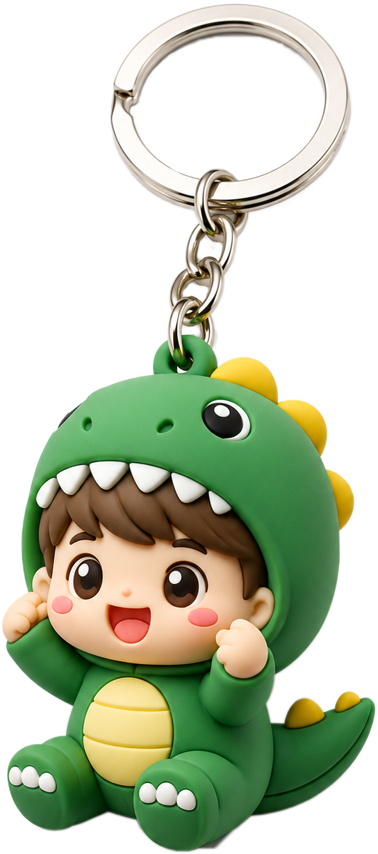
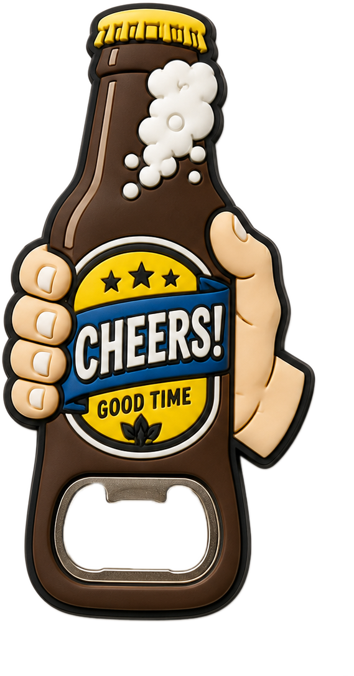
D&M Crafts
Rubber & PVC Collection
PRODUCED BY MK
2D Layered Design: Clear color blocking with layered structure for a neat visual presentation.
3D Full-Relief: Fully sculpted relief with rounded lines, delivering genuine 3D texture.
Translucent & Glow Effects: Available with translucent or glow-in-the-dark material options.
Multi-Color Injection: Precision multi-color injection, ideal for complex logos and fine lines.
D&M CRAFTS 01

Slide 21
ORDERING GUIDE
D&M Crafts
PRODUCED BY MK
Inquiry & Consultation
Design & Craft
1
Share your initial ideas and any design inspirations. We will guide you through the details to clarify every aspect of your needs.
2
We create an artwork and propose the most suitable crafting techniques exclusively for your project.
Approval & Quotation
Order & Production
3
We will provide the quotation after you confirm the artwork. You do not have any obligations before that.
4
Upon your order confirmation and deposit, your design comes to life in our factory.
Inspection & Packaging
Logistics & Transportation
5
Each product undergoes rigorous quality inspection and proper packaging to ensure it arrives undamaged.
6
Your products are shipped via reliable international logistics. Tracking information will be provided for your peace of mind.
D&M CRAFTS 05

Slide 22
D&M Crafts
PRODUCED BY MK
Looking forward to collaborating with you
We will meticulously bring your brilliant ideas to life for you.
www.dmcrafts.com | contact@dmcrafts.com
D&M CRAFTS 05

Slide 23
D&M Crafts
PRODUCED BY MK
ATTACHMENTS
D&M CRAFTS 01

Slide 24
ORDERING GUIDE
D&M Crafts
PRODUCED BY MK
Soft Enamel
1
Share your initial ideas and any design inspirations. We will guide you through the details to clarify every aspect of your needs.
Hard Enamel
1
Share your initial ideas and any design inspirations. We will guide you through the details to clarify every aspect of your needs.
UV Printing
1
Share your initial ideas and any design inspirations. We will guide you through the details to clarify every aspect of your needs.
D&M CRAFTS 05

Slide 25
ORDERING GUIDE
D&M Crafts
PRODUCED BY MK
Inquiry & Consultation
Design & Craft
1
Share your initial ideas and any design inspirations. We will guide you through the details to clarify every aspect of your needs.
2
We create an artwork and propose the most suitable crafting techniques exclusively for your project.
Approval & Quotation
Order & Production
3
We will provide the quotation after you confirm the artwork. You do not have any obligations before that.
4
Upon your order confirmation and deposit, your design comes to life in our factory.
Inspection & Packaging
Logistics & Transportation
5
Each product undergoes rigorous quality inspection and proper packaging to ensure it arrives undamaged.
6
Your products are shipped via reliable international logistics. Tracking information will be provided for your peace of mind.
D&M CRAFTS 01

Slide 26
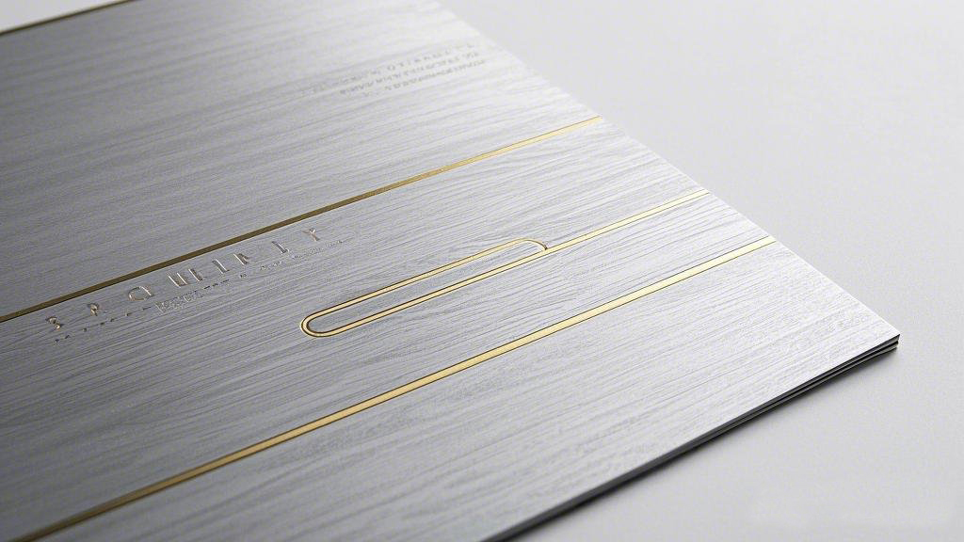
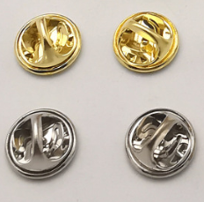

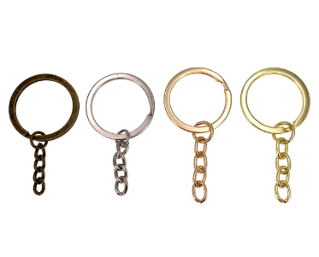
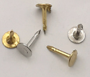
Accsories
2

Slide 27
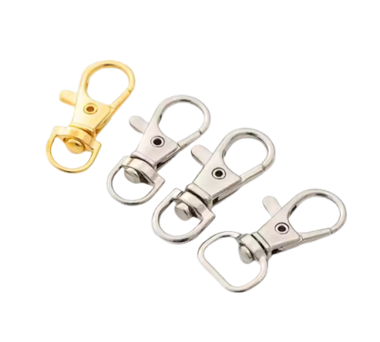
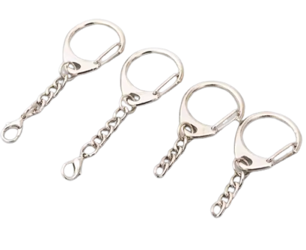
D&M Crafts
PRODUCED BY MK
D&M CRAFTS 05

Slide 28
ORDERING GUIDE
D&M Crafts
PRODUCED BY MK
You share your design ideas, usage scenarios, expected quantity, and dimensions. We guide you through the details to clarify your needs.
Once you are satisfied with the design draft, we provide a precise quotation. There is no obligation before this stage.
Once you are satisfied with the design draft, we provide a precise quotation. There is no obligation before this stage.
Inquiry & Consultation
Approval & Quotation
Approval & Quotation
Design & Craft Proposal
Order & Production
Order & Production
Based on our discussion, we create a custom artwork draft and propose the most suitable manufacturing techniques for your project.
Upon your order confirmation and deposit, your design enters workshop production according to the approved specifications.
Upon your order confirmation and deposit, your design enters workshop production according to the approved specifications.
D&M CRAFTS 01

Slide 29
ORDERING GUIDE
D&M Crafts
PRODUCED BY MK
Design & Craft Proposal
Design & Craft Proposal
Order & Production
Order & Production
Order & Production
Order & Production
Upon your order confirmation and deposit, your design enters workshop production according to the approved specifications.
Upon your order confirmation and deposit, your design enters workshop production according to the approved specifications.
Upon your order confirmation and deposit, your design enters workshop production according to the approved specifications.
Upon your order confirmation and deposit, your design enters workshop production according to the approved specifications.
Based on our discussion, we create a custom artwork draft and propose the most suitable manufacturing techniques for your project.
Based on our discussion, we create a custom artwork draft and propose the most suitable manufacturing techniques for your project.
D&M CRAFTS 01

Slide 30
ORDERING GUIDE
D&M Crafts
Ordering Process
PRODUCED BY MK
Inquiry & Consultation
Approval & Quotation
You share your design ideas, usage scenarios, expected quantity, and dimensions. We guide you through the details to clarify your needs.
Once you are satisfied with the design draft, we provide a precise quotation. There is no obligation before this stage.
Order & Production
Upon your order confirmation and deposit, your design enters workshop production according to the approved specifications.
Design & Craft Proposal
Based on our discussion, we create a custom artwork draft and propose the most suitable manufacturing techniques for your project.
D&M CRAFTS 01

