Slide 1



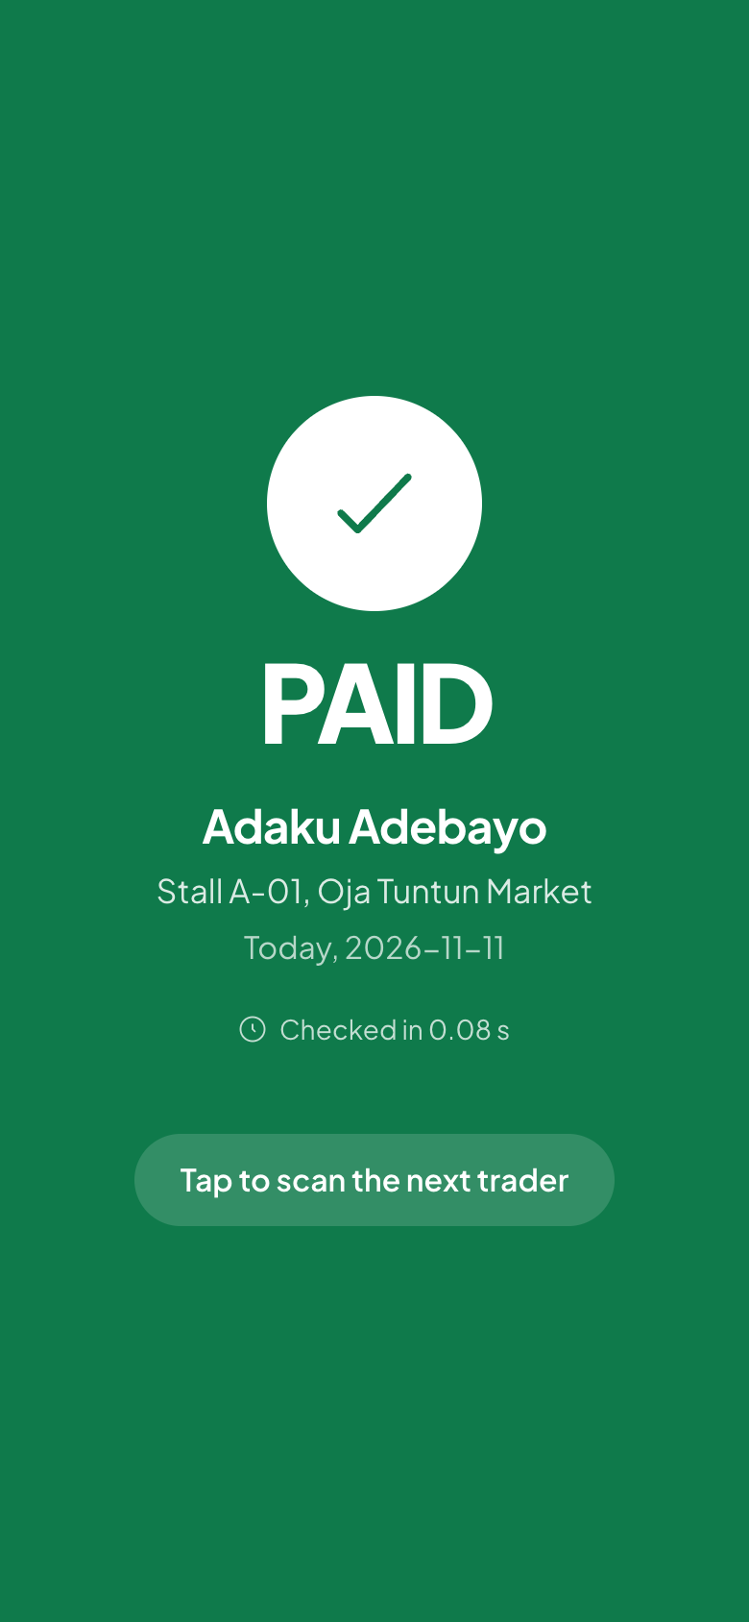
LevyPass
Track 01: Payments and Financial Infrastructure
Traders pay market and motor-park levies by USSD, transfer or card. The money settles to the government's account, and an officer confirms payment with one QR scan.
Team FET | team13 | team13.xtradot.co
Oluwaseun Kehide Oso software developer
Olanbiwoninu Iteoluwakiishi project manager

Slide 2
The problem
Who: market traders, keke and okada riders, and street vendors who pay daily or weekly levies, mostly in cash.
Today: no receipt, or a paper ticket anyone can print. Touts and real officers look the same, so the same levy is collected twice.
The cost: traders pay more than they owe and are harassed when they can't prove payment. Money collected in the government's name never reaches its account, and no one can audit it.
98%
of informal businesses surveyed already pay levies: to councils, unions, market groups and touts
SBM Intelligence, 2021
38%
pay two or three different groups for the same business
SBM Intelligence, 2021
No cash
The 2026 tax framework cut 100+ sub-national taxes to 9 revenue heads and prohibits cash payment
Joint Revenue Board, Aug 2026

Slide 3
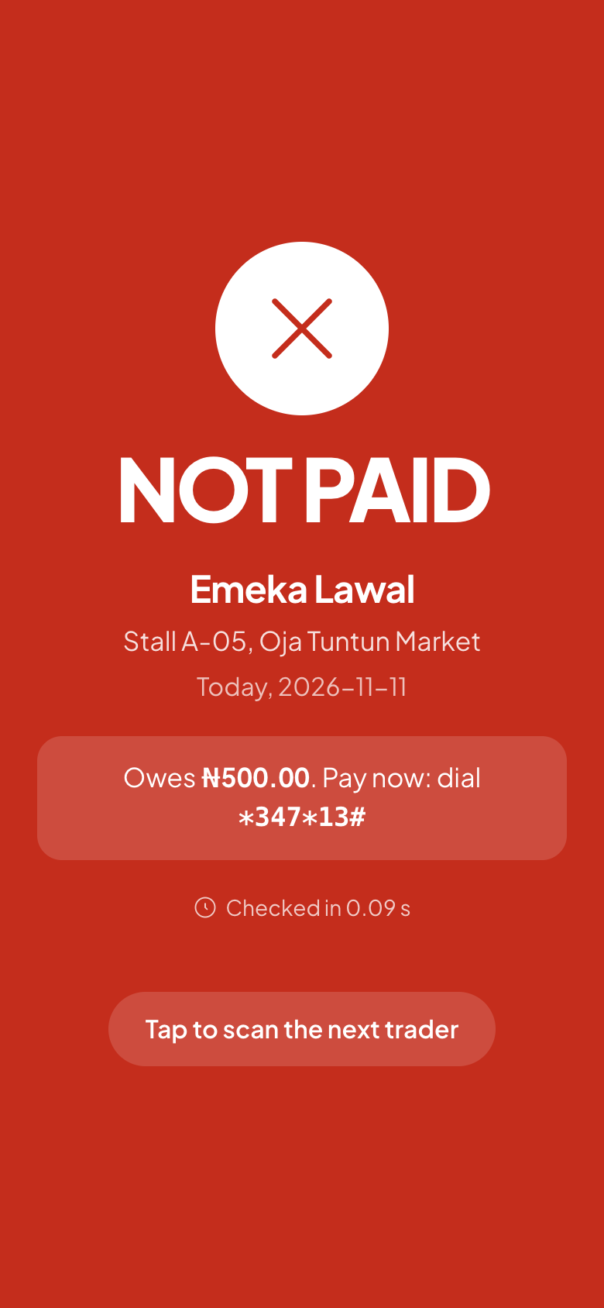
Our solution
Every levy paid digitally into the government's account, and provable on the spot with one scan.
1
Register with a phone OTP; get a signed QR pass for the stall.
2
Pay by USSD *347*13# on any phone, or transfer or card. SMS receipt in about 3 seconds.
3
Officer scans the QR: PAID or NOT PAID in under a second, with a pay-now code.
4
Trader scans the officer's ID: genuine, or suspended and flagged.
5
Revenue office sees live totals, fraud flags and reconciliation with the bank.
Officer app, captured from the running build

Slide 4
Unique Value Proposition and Competitive Advantage
 | Cash to collectors | Paper tickets | E-payment portals | LevyPass
Proof on the spot | No | Easy to forge | Officer can't check | Signed QR, one scan
Works on a feature phone | Yes | Yes | Partly | USSD and SMS
Money to the government | No | No | Yes | Yes, through Access Bank
Stops double charging | No | No | No | Flagged, credited forward
Trader can check the officer | No | No | No | Officer ID QR
Ledger matches the bank | No | No | Partly | To the kobo, daily
Why the advantage lasts
Legal grounding
Each levy records its legal basis; only approved levies, collected by authorised officers.
Bank-grade money
Append-only ledger, verify before value, idempotent both ways. Reconciles to the bank.
Bank rails, no float
Funds move through Access Bank. LevyPass never holds money; it works as a technology provider.

Slide 5
Technology and security
How it works: one Next.js app and Postgres in our Forge namespace. Every payment is a bank checkout; the signed webhook is only a hint until a server-to-server verify, then one transaction allocates, posts the ledger, issues the receipt and queues the SMS.
APIs used: Xtradot Bank sandbox (checkout, USSD, verify, webhooks, settlements, reconciliation). Huawei MaaS triages complaints in English, Pidgin and Yoruba, with a keyword fallback if the model fails.
Security and fraud: Ed25519-signed QR codes; HMAC webhook check with a 5-minute window; Idempotency-Key on every bank POST; never resend on timeout, requery instead; a database trigger makes the ledger append-only.
Privacy (NDPA 2023): name, phone and stall only; no BVN; no data to the bank for credit without opt-in consent.
Trader
USSD, SMS, web
Officer
phone app
Revenue office
dashboard
LevyPass app (one container)
kobo money, Lagos periods, allocation, signed tokens
poller: requery, outbox, reconciliation
Postgres
append-only ledger
Xtradot Bank
checkout, verify, settle
Huawei MaaS
complaint triage
Bank webhooks are signed and de-duplicated; one rate limiter for all 60 calls a minute.

Slide 6
Business model and impact
Trader
Pays nothing extra
Proof of payment, no double charges, protection from fake collectors.
Government
Pays a fee per collection
More revenue reaching its account, live data, an audit trail, no cash handling.
Access Bank
Integration support
Collection balances, new trader accounts, transaction volume, credit data with consent.
How LevyPass earns
Illustration: one market
₦130m a year
1,000 stalls × ₦500 a day × 260 trading days. Every 10% of leakage closed returns ₦13m to the council.
Traders
The 38% who pay two or three groups today pay once, and get a receipt that holds up.
Collection fee paid by the authority on each successful payment, out of revenue it loses today.
Set-up fee per market: QR stickers, officer training, onboarding.
Analytics for state revenue agencies across many councils.
Later: a share of savings and credit products with Access Bank, opt-in only.

Slide 7
Bank fit and scale
Collections: councils and state revenue agencies hold levy collection accounts at Access Bank, with settlement and reconciliation built in.
New customers: every trader arrives with a phone number, a verified stall and a payment history: a route to accounts for the unbanked.
Credit, with consent: a payment streak is a credit signal for small loans and savings, shared only on opt-in.
Beyond markets: the same flow fits motor parks, street-trading permits, signage and waste fees, in any council, with each levy's legal basis on record.
Next steps
Demo 13 Nov 2026
Full loop live on the Forge sandbox
Pilot One market
MOU with a council; counsel confirms each levy's legal basis
Scale Full council
All markets and motor parks; officers trained
Grow Other cities
State revenue agencies, Access Bank products

Slide 8
Access Youth Tech Forge 2026
LevyPass · Team FET · team13.xtradot.co

