Slide 1
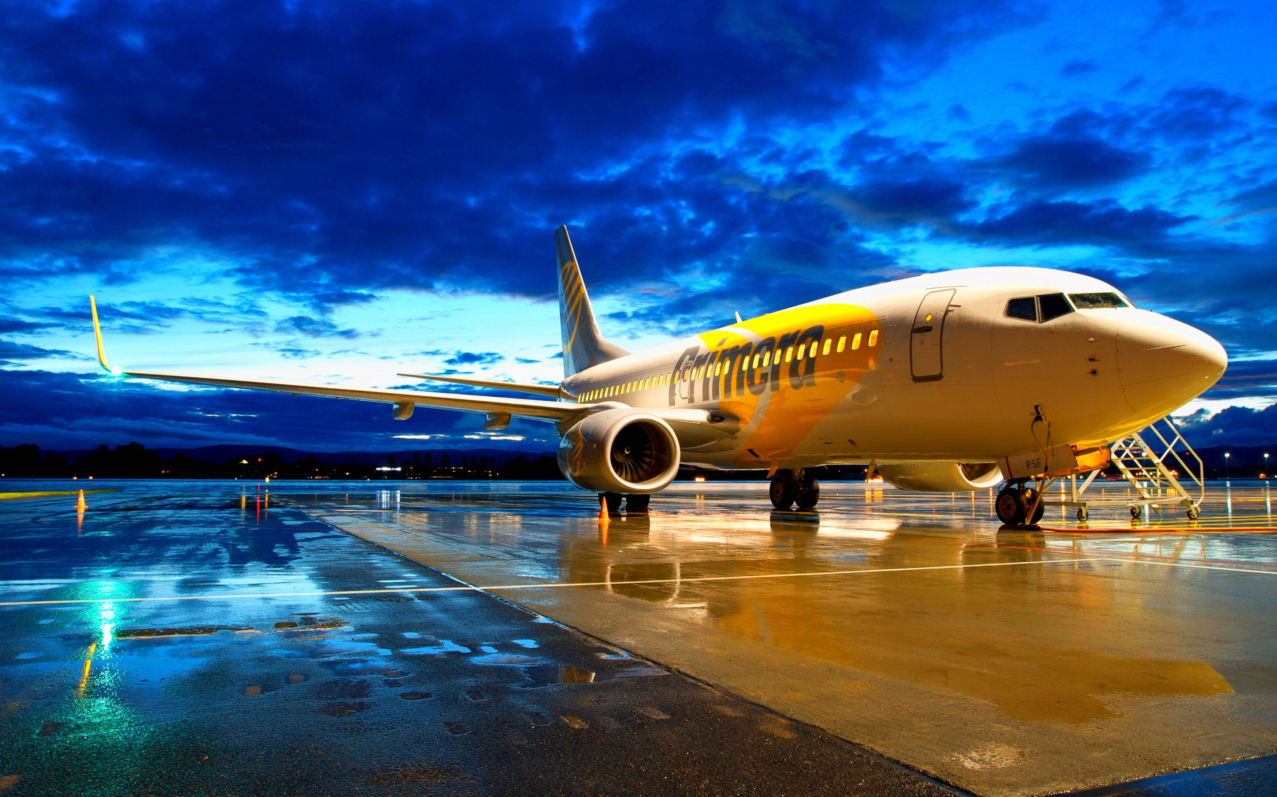
Airport Database
Team 5
Martin Inkyov Borislav Georgiev
Kristina Nikiforova Sagyndyk Tukovayev

Slide 2
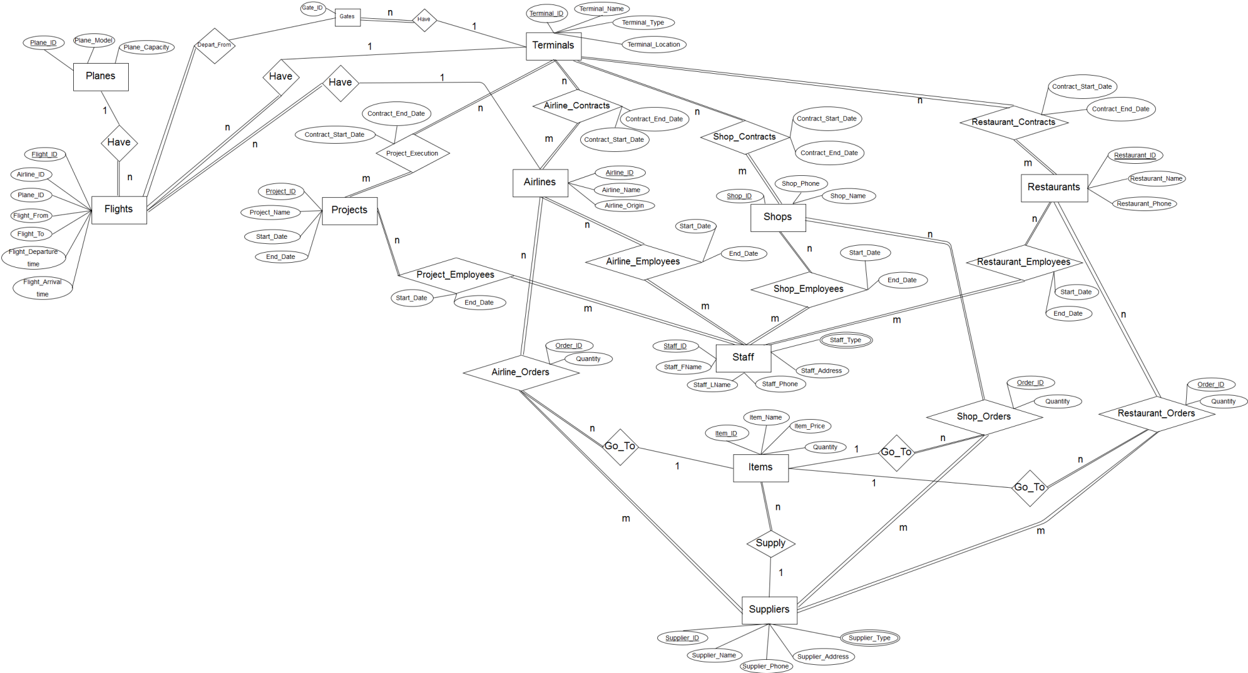
ER Model

Slide 3
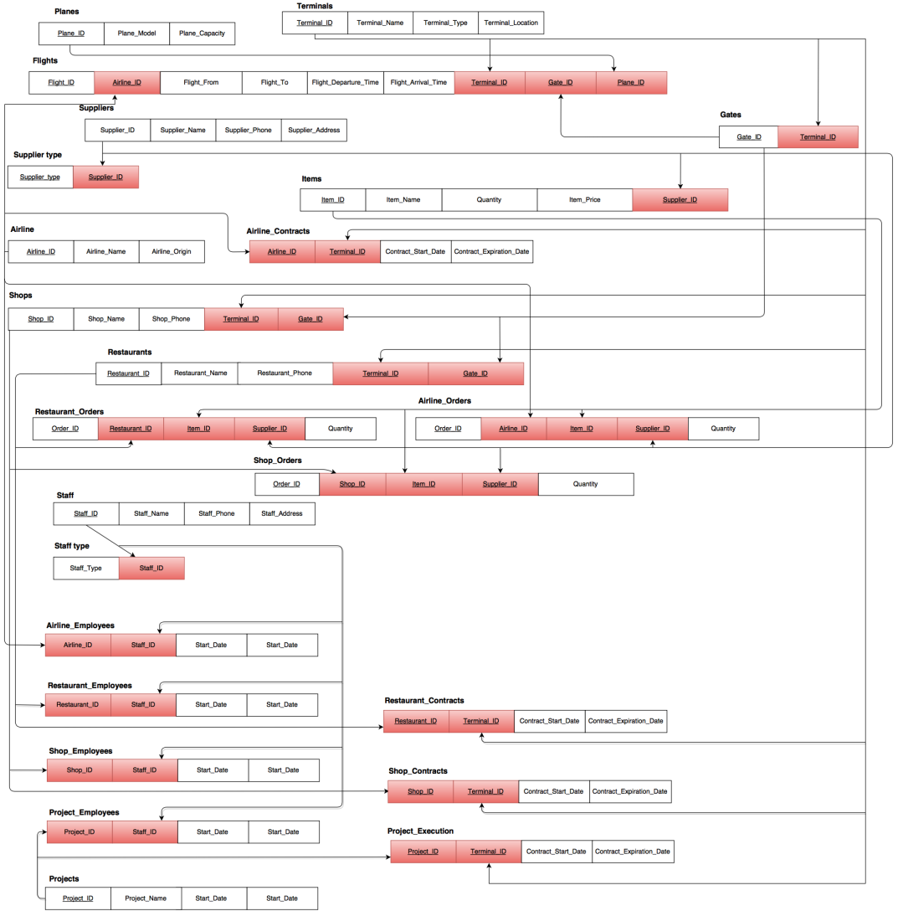
Relational
Model

Slide 4
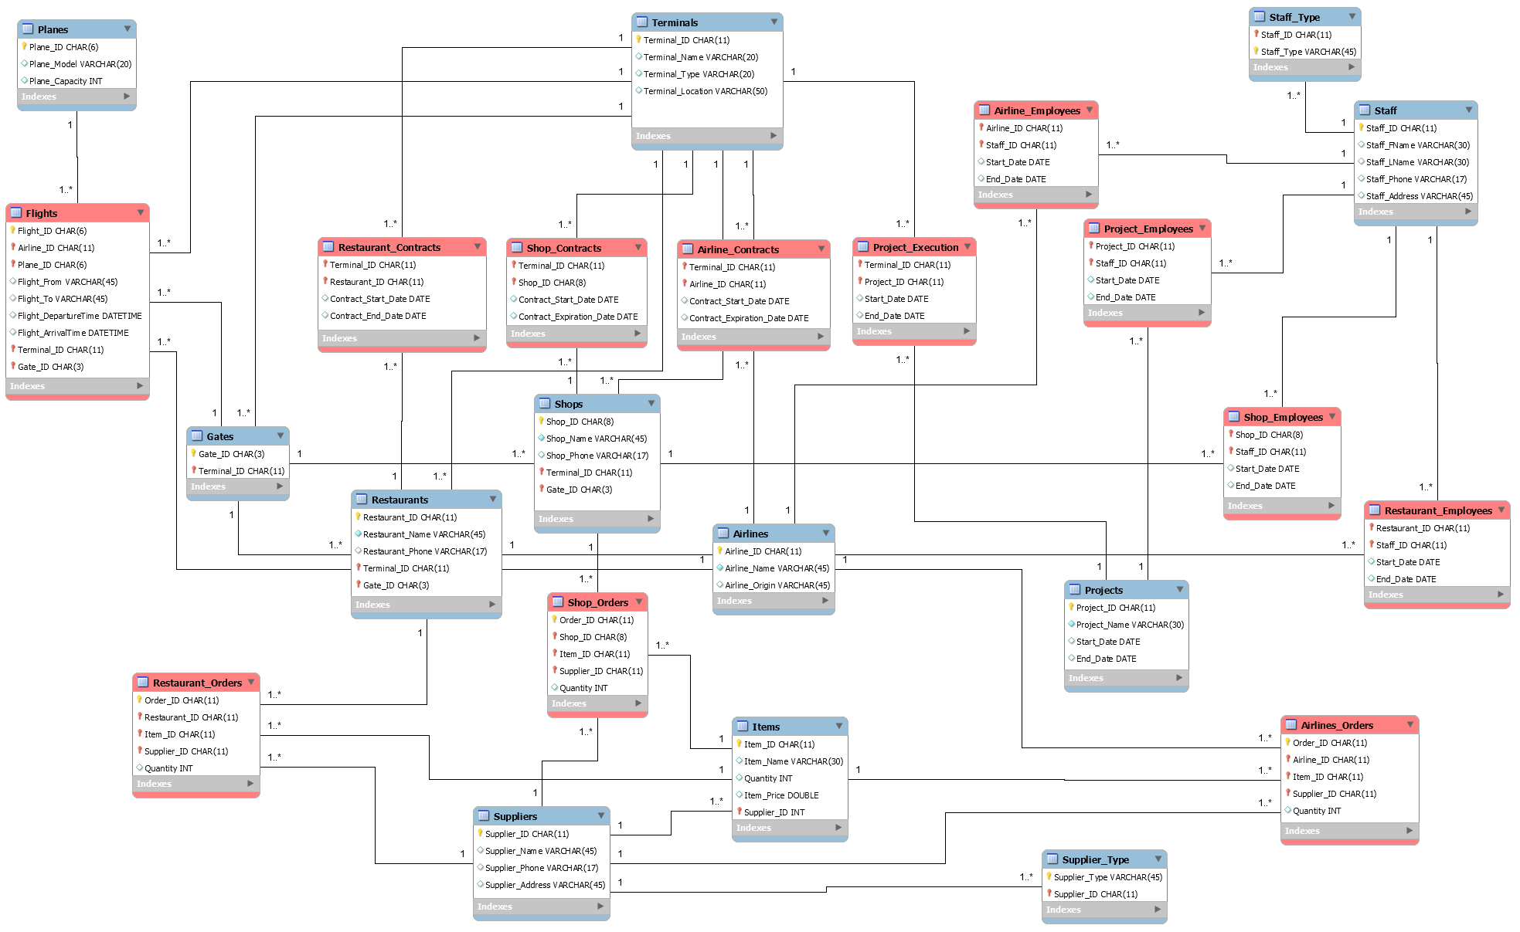
EER Model

Slide 5

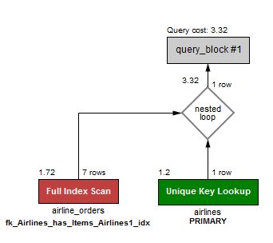
SQL Queries
1. Returns airlines that have ordered item with Item_ID = I00003
Select airlines.*
From airlines
Where Airline_ID In
(Select Airline_ID
From airline_orders
Where Item_ID = 'I00003');
Execution time: 0:00:0.00130091

Slide 6
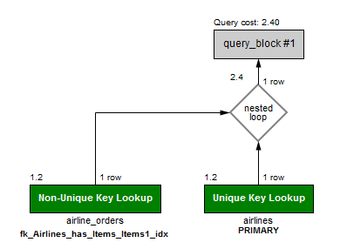
Optimization of Query 1
Select airlines.*
From airlines Inner Join airline_orders Using (Airline_ID)
Where Item_ID = 'I00003';
Execution time: 0:00:0.00063891

Slide 7
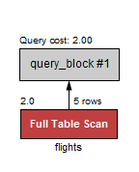
2. Returns flights that are leaving from gates A1 and B2
Select flights.*
From flights
Where Gate_ID In ('A1','B2');
Execution time: 0:00:0.01825674

Slide 8
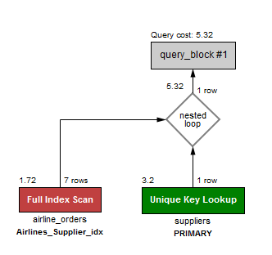

3. Returns suppliers that have supplied KLM
Select Supplier_Name
From suppliers
Where Supplier_ID In
(Select Supplier_ID
From airline_orders
Where airline_ID = 'KLM');
Execution time: 0:00:0.01225877

Slide 9
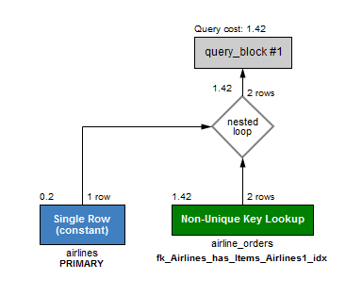

4. Returns the number of orders made by Air France
Select COUNT(Order_ID)
From airline_orders Inner Join airlines Using (Airline_ID)
Where airline_orders.Airline_ID ='AF';
Execution time: 0:00:0.00123456

Slide 10

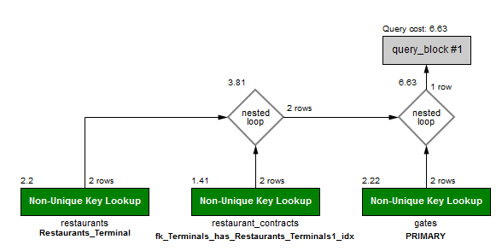
5. Returns only restaurants on Terminal 1, Gate A1
Select Restaurant_ID, Restaurant_Name
From restaurants
Where Terminal_ID In
(Select Terminal_ID
From restaurant_contracts
Where restaurants.Terminal_ID In ('T01')
And Gate_ID In
(Select Gate_ID
From gates
Where gates.Gate_ID In ('A1')));
Execution time: 0:00:0.02679862

Slide 11
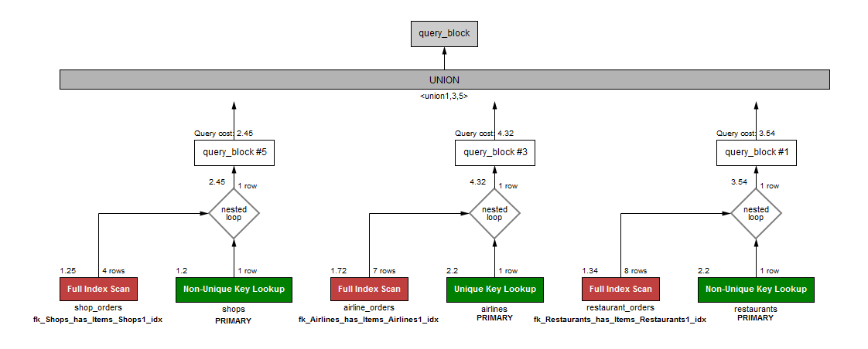
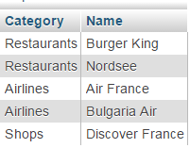
6. Returns every airline, restaurant and shop who bought I00001
Select "Restaurants" As Category, Restaurant_Name As "Name"
From restaurants
Where Restaurant_ID In
(Select Restaurant_ID
From restaurant_orders
Where Item_ID='I00001')
Union
Select "Airlines",Airline_Name
From airlines
Where Airline_ID In
(Select Airline_ID
From airline_orders
Where Item_ID='I00001')
Union
Select "Shops",Shop_Name
From shops
Where Shop_ID In
(Select Shop_ID
From shop_orders
Where Item_ID='I00001');
Execution time: 0:00:0.01325983

Slide 12
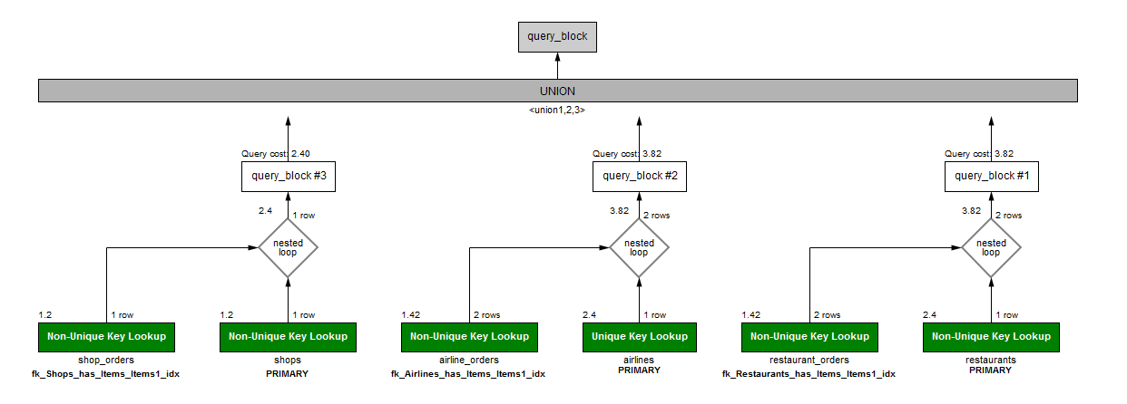
Optimization of Query 6
Select "Restaurants" As Category, Restaurant_Name As Name
From restaurants Inner Join restaurant_orders Using (Restaurant_ID)
Where Item_ID='I00001'
Union
Select "Airlines",Airline_Name
From airlines Inner Join airline_orders Using (Airline_ID)
Where Item_ID='I00001'
Union
Select "Shops",Shop_Name
From shops Inner Join shop_orders Using (Shop_ID)
Where Item_ID='I00001';
Execution time: 0:00:0.00131337

Slide 13
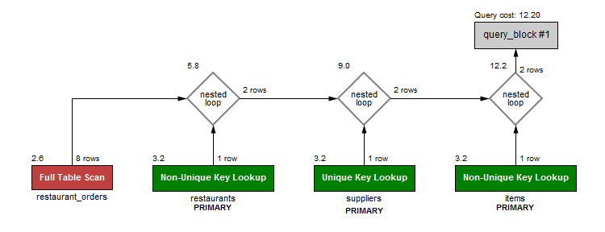
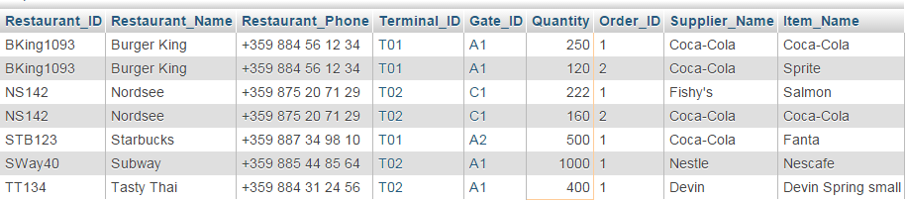
7. Returns restaurants that ordered more than 100 items, order_ID, supplier and item_Name
Select restaurants.*, restaurant_orders.Quantity, restaurant_orders.Order_ID, suppliers.Supplier_Name, items.Item_Name
From restaurants Inner Join restaurant_orders Using (restaurant_ID)
Inner Join suppliers Using (Supplier_ID)
Inner Join items Using (Item_ID)
Where restaurant_orders.Quantity > 100;
Execution time: 0:00:0.02696351

Slide 14
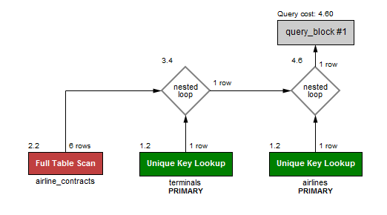
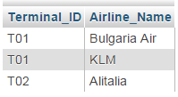
8. Returns the terminal and airline whose contract ends between 2020 and 2025
Select terminals.Terminal_ID, airlines.Airline_Name
From terminals Inner Join airline_contracts Using (Terminal_ID)
Inner Join airlines Using (Airline_ID)
Where Contract_Expiration_Date Between '2020-01-01' And '2025-12-31';
Execution time: 0:00:0.01949863

Slide 15

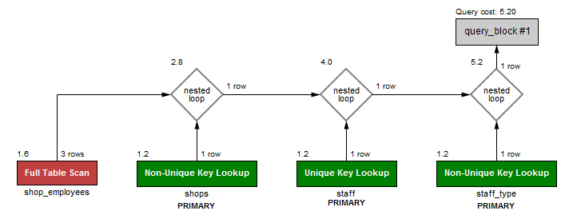
9. Returns the names of the employees, their positions and their working place who are still working there
Select staff.Staff_FName, staff.Staff_LName, staff_type.Staff_Type, shops.Shop_Name
From staff Inner Join shop_employees Using (Staff_ID)
Inner Join staff_type Using (Staff_ID)
Inner Join shops Using (Shop_ID)
Where shop_employees.End_Date Is NULL;
Execution time: 0:00:0.00691656

Slide 16
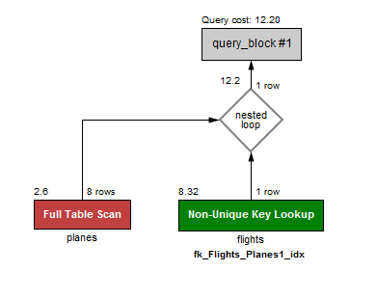
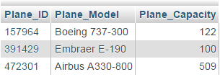
10. Returns all planes that didn’t do any flights
Select planes.*
From flights Right Outer Join planes On (flights.Plane_ID = planes.Plane_ID)
Where Flight_ID Is Null;
Execution time: 0:00:0.00379973

Slide 17
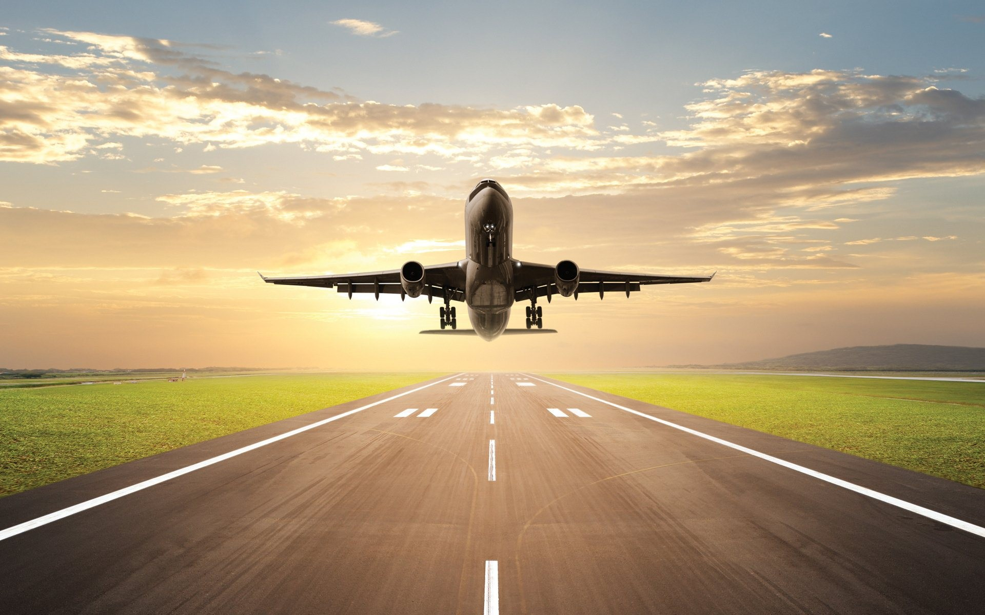
Thank you!

