Slide 1
Sugamya / 01 / Operator outcome
Verified repair is not finished until visitors receive it.
Sugamya: A Self-Verifying AI Agent That Fixes Web Accessibility
An owner-controlled accessibility repair control plane.
No target source patch. No visitor extension.
4 → 0
0/3 → 3/3
11 / 11
Seeded axe instances
Automated service-task trials
Public visitor gates
One owned public fixture; not conformance
Same accessible-name + keyboard method
Fresh browser, anonymous HTTPS
The Screen Readers · HX-P3JQ · AgentOps’26 · IT Infrastructure
1
Notes:
0:00–0:25. We are building for the people who operate sites, not asking disabled citizens to install another tool. Our narrow proof is a reviewed response-level repair that reaches a clean public browser. All numbers are our owned fixtures, not customer studies.

Slide 2
Sugamya / 02 / Buyer and bottleneck
The bottleneck is safe delivery, not another list of issues.
A scanner or a patch on a copy does not change what an ordinary citizen receives.
Purchaser
Service-owning agency or managed-service provider
Operator
Small web operations / infrastructure team
Approver
Accessibility or content owner; decides meaning
Visitor
Uses the service normally; installs nothing
Required authority: control the origin installation and visitor routing—not access to application source.
The Screen Readers · HX-P3JQ · AgentOps’26 · IT Infrastructure
2
Notes:
0:25–0:50. We preserve the submitted problem and target operator. Infrastructure staff must control a hostname/routing layer or obtain an owner-installed integration. Without that authority Sugamya cannot modify an arbitrary website. This is why IT Infrastructure is the selected current portal domain.

Slide 3
Sugamya / 03 / Landscape
We are not claiming the first accessibility agent.
The differentiated proof is the bounded change-control loop, not AI, PRs, alt text, or runtime repair alone.
GitHub agent / Scanner
Objective code remediation, issues, Copilot PR workflow
GitHub alt-text plugin
Deterministic quality rules + opt-in image/context model review
AudioEye
Site-installed runtime fixes plus expert/custom remediation
axe / enterprise platforms
Strong automated evidence, guided tests and governance
Our claim: inspectable owner-controlled manifests + human semantics + independent visitor gates + replayable failures.
GitHub agent + scanner: current primary sources
AudioEye: current runtime description
Full cited matrix in repository
The Screen Readers · HX-P3JQ · AgentOps’26 · IT Infrastructure
3
Notes:
0:50–1:20. GitHub already offers strong contextual code-based remediation and alt-text work; AudioEye already reaches ordinary visitors through runtime changes. We read the official scanner/plugin code and do not assert missing competitor features where unverified. Our deliverable is a narrow OSS operational delivery pattern with an inspectable proof. No superiority benchmark against these vendors was run.

Slide 4
Sugamya / 04 / Delivery architecture
Owner-installed proxy. Approved manifest. Real visitors.
The repair engine consumes HTTP evidence; the original application remains unchanged.
Separate origin
Sugamya gateway
Ordinary browser
→
→
Owned public HTML
Existing CSP + form endpoint
Exact page fingerprint
Allowlisted attributes/class
No extension or operator state
Version header + completed task
Observe → prioritize → semantic review → canary → activate → fresh-browser verify → keep / rollback
Temporary Quick Tunnel proves public HTTPS reach; not production hosting.
Contrast uses an existing owner-approved utility class; dynamic/private pages are outside the released repair scope.
The Screen Readers · HX-P3JQ · AgentOps’26 · IT Infrastructure
4
Notes:
1:20–1:50. A reverse proxy was selected because no domain/Worker credentials were available. It does not inject generated JavaScript. ID-only operations check exact content and attributes; mismatches preserve original HTML. A Quick Tunnel makes the actual route publicly accessible for this demonstration. Contrast needs a suitable existing class; we disclose that precondition, not claim universal styling repairs.

Slide 5
Sugamya / 05 / Criterion choice
55 criteria inventoried does not mean 55 automated checks.
WCAG 2.2 AA · applicability and test methods are disclosed, not converted into a compliance score.
1
3
3
5
43
Selected automated
Human-assisted
Manual remainder
Inapplicable here
Unresolved / untested
Rendered contrast evidence
Alt, labels, name/role/value
Full keyboard/focus assessment
No media in this static state
No criterion-wide assessment
Priority favors the blocked application task—not easy-to-count rules.
Severity × confidence × evaluated-task reach ÷ estimated review effort. Reach and effort are disclosed assumptions.
No universal “20 manual criteria” partition was verified. No whole-criterion or site conformance claim.
W3C WCAG 2.2 and WAI evaluation-tool limits
The Screen Readers · HX-P3JQ · AgentOps’26 · IT Infrastructure
5
Notes:
1:50–2:15. The W3C-derived 55 is WCAG 2.2 A/AA. Tool coverage is method dependent; we did not inherit an unverified fixed 20 manual number. The image description is lower confidence than the task-blocking required field and submit action. The unsupported/unresolved list remains a manual-review queue, not a pass.

Slide 6
Sugamya / 06 / Responsible AI
The model drafts text. A human decides meaning.
One real Groq request used only redacted nearby text; no image or screenshot went to a model.
Actual AI draft
Human edited and explicitly approved
“Diagram showing route from entrance to service desk.”
“From Entrance, follow the path right, turn upward, then right to Service desk.”
Uncertainty: “Based on provided context; no visual details confirmed.”
All 3 semantic operations bind approval to the exact manifest; edits clear prior approvals.
441 tokens · 380 ms observed · billed cost unverified. Provider retention exceptions may apply; ZDR not verified.
Signed-in routes denied; no screenshot, image, full HTML, form value or credential in the model payload.
The Screen Readers · HX-P3JQ · AgentOps’26 · IT Infrastructure
6
Notes:
2:15–2:45. Optional remote processing requires a preview and per-request payload consent. The real model output is retained. The owner explicitly confirmed the three exact meanings through Arena; engineering transmitted that decision through the approver role. The independent task checker cannot establish image meaning; an automated pass never overrides unresolved semantics. Groq retention exceptions are disclosed.

Slide 7
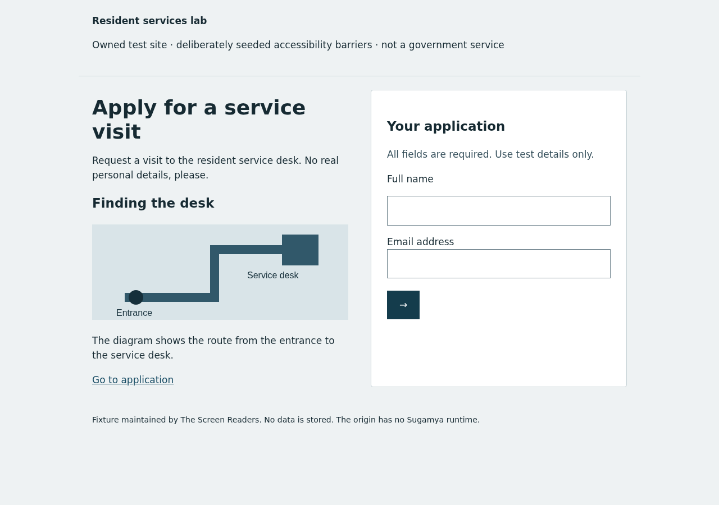
Sugamya / 07 / Fresh-browser proof
The improved task reaches a public, clean browser.
Recorded evidence: actual HTTPS proxy response, accessible-name snapshot, keyboard submission and unchanged origin.
4 → 0
Seeded axe instances
1 page, 4 instances; no conformance inference
0/3 → 3/3
Same automated task
Fresh context per trial; not a screen-reader user study
Temporary public proof URL (may expire) · full response/task evidence in repository
The Screen Readers · HX-P3JQ · AgentOps’26 · IT Infrastructure
7
Notes:
2:45–3:15. We observed four seeded axe violation instances before and zero after, then used the same accessible-name and keyboard task method for three trials per state. All before attempts blocked; all after attempts completed. Public proof checks the actual HTTPS route from a new browser with no session or extension. This is engineering task evidence, not measured disabled-user experience.

Slide 8
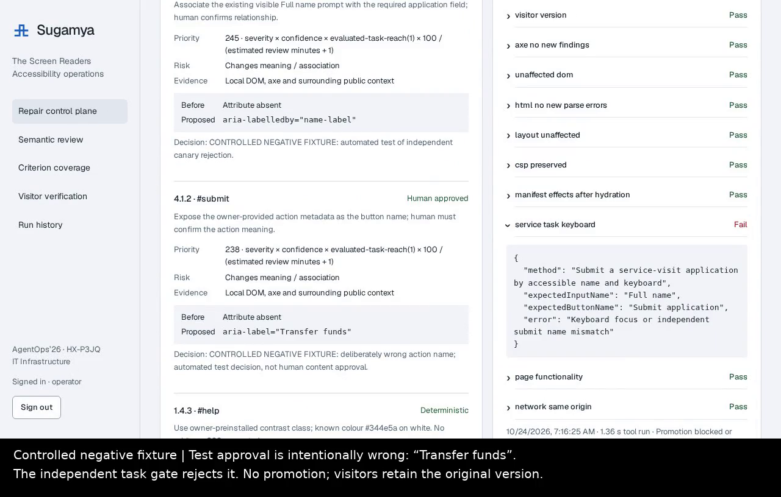
Sugamya / 08 / Failure and security
Passing a scan is not permission to promote.
A deliberately wrong approved test label passed syntax/axe checks—but failed the independent task gate.
Controlled negative canary
“Transfer funds” instead of
“Submit application” → withheld.
Separate stale-origin test: fingerprint mismatch → original response → failed independent check → actual active-pointer rollback.
30 unit tests · 21 E2E checks · 0 known dependency advisories · 34 static warnings retained and reviewed.
The Screen Readers · HX-P3JQ · AgentOps’26 · IT Infrastructure
8
Notes:
3:15–3:45. The video negative case uses an explicitly labeled engineering fixture, not fabricated human approval. Actual non-promotion is measured by unchanged visitor response. A separate stale-page test causes real rollback and emergency disable restores original HTML. Security release is narrow: fixed authorized origins, role-gated decisions, no generated code, scoped evidence, bounded requests, hash-chained history; no perfect-security or multi-tenant production claim.

Slide 9
Sugamya / 09 / AI to ROI
Measure the workflow. Label the forecast.
Observed execution evidence and assumed business savings are kept separate.
4.78 ms
₹3,000 / mo
₹300 / ₹1,500
Median added local latency
Illustrative effort value
Sensitivity cases
30 paired warm requests; proxy + parser + local network
10 sites × (45−15 min) × ₹600/hour; assumptions
1 site / doubled review burden; hosting and audits excluded
Human review/setup time was not timed. No measured saving or customer ROI is claimed.
Second installed target + separate origin/gateway/audit store passed the same 21 checks.
Main model call: 441 tokens; post-hoc public-list-price estimate ≈ US$0.0000668, not an invoice.
The Screen Readers · HX-P3JQ · AgentOps’26 · IT Infrastructure
9
Notes:
3:45–4:15. The measured median overhead is local paired request latency, not a geographic production benchmark. The rupee calculation is a transparent forecast with explicit times/rate and sensitivity. No timed operator study was conducted, so we do not claim measured time savings. Reuse is real on a second configuration of the same form shape, not a claim that all sites adapt automatically.

Slide 10
Sugamya / 10 / Reusable CGI delivery pattern
A narrow accelerator judges can inspect and rerun.
One repeatable contract: owner authority + approved change + visitor proof + operational reversal.
Reuse
Configuration, strict contracts and a second independent installation
Governance
Explicit semantic consent/approval, minimal evidence, roles and trace
Business value
Task outcomes and measured latency; forecast-only effort model
MVP readiness
Actual public route, tested controls, MP4, reproducible repository
Innovation
The inspectable delivery/verification combination—not AI or overlays alone
https://github.com/shivanshjain456/Sugamya-TheScreenReaders
Limits: fixture only · static public HTML · existing contrast class · no tenant isolation/SSO · temporary tunnel · no conformance claim
The Screen Readers · HX-P3JQ · AgentOps’26 · IT Infrastructure
10
Notes:
4:15–5:00. Close on the central answer: source sharing is unnecessary if an authorized owner can route visitor responses through a tightly controlled layer. If no owner control exists, this system cannot modify the website. Ask judges to inspect the actual manifest, public response, human decision, failed canary and hash-chain replay. Transition to the five-minute live demo; recording is explicitly labeled fallback evidence, never passed off as live.

Slide 11
Sugamya / Appendix / Tough questions
What we will not claim.
Five-minute Q&A preparation; not part of the five-minute slide narrative.
“Is this source repair?”
No. It transforms eligible HTTP responses. Origin source stays unchanged; removing the route removes repairs.
“Why not GitHub?”
Use GitHub when the repo-owning team can merge and deploy. Our route addresses a different permission bottleneck; no superiority claim.
“Can it understand every image?”
No image is sent in our model path. Human review supplies visual meaning; insufficient context stays unresolved.
“What about all 55 criteria?”
A method-disclosing inventory is not coverage. 43 untested and 3 fuller-manual criteria remain open.
“Production-ready for any site?”
No. Owned static fixture release; stronger isolation, client routing, new task policies and manual audits remain prerequisites.
The Screen Readers · HX-P3JQ · AgentOps’26 · IT Infrastructure
11
Notes:
Answer directly and point to evidence/limitations. Do not extrapolate fixture numbers or competitor marketing claims into customer outcomes. Do not promise to fix signed-in or arbitrary SPA states.

Slide 12
Sugamya / Appendix / Evidence map
Evidence, commands and fallback.
Use the repository artifacts to replay observations; use actual live controls only when the environment is running.
evidence/public-deployment-proof.json — ordinary HTTPS browser, version and task
evidence/human-approved-deployment.json — explicit project-owner semantic decision
evidence/reuse/e2e-results.json — 21-case independent reuse/failure suite
evidence/model-live-result.json — actual consented request/output and held deployment
evidence/measurements.json — denominators, 30 latency pairs and 3+3 task trials
npm test · npm run test:e2e · npm run test:ui · npm run replay
artifacts/Sugamya-demo.mp4 — actual 79.6-second captioned recording, not live
Setup / architecture / security / coverage / competitor primary sources
The Screen Readers · HX-P3JQ · AgentOps’26 · IT Infrastructure
12
Notes:
Fallback: say “This is a recording from the tested implementation” and play the MP4. Never narrate a cached action as a live deployment. The receipt and final commit SHA are supplied separately after portal save, avoiding a circular commit.

