Slide 1
Project NBA
Team Members: Jasmeet Bajwa, Jordan Nesbitt, Criselda Dimacali, Inna Gurevitch

Slide 2
Initial Correlations: All Positions
Independent variables:
weight
age
Years_played (end-start)
Team_rank
Dependent variables, Set1:
# Player Efficiency Rating'
# True Shooting %'
# 'Assist Percentage'
# Block Percentage'
# 'Win Shares Per 48 Minutes'
Dependent variables, Set2:
# Free Throw Rate
# Total Rebound Percentage
# Steal Percentage
# Turnover Percentage
# Usage Percentage
Dependent variables, Set3:
# Win Shares
# Field Goal Percentage
# 2-Point Field Goal Percentage
# 3-Point Field Goal Percentage
# Effective Field Goal Percentage
# Free Throw Percentage
Dependent variables, Set4:
# Total Rebounds
# Steals
# Turnovers
# Personal Fouls
# Points

Slide 3
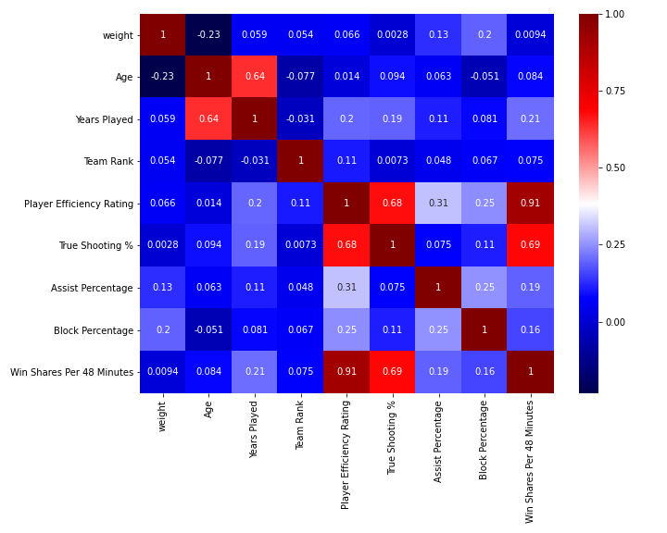
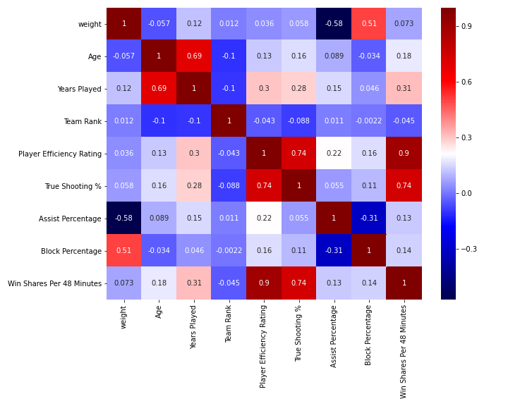
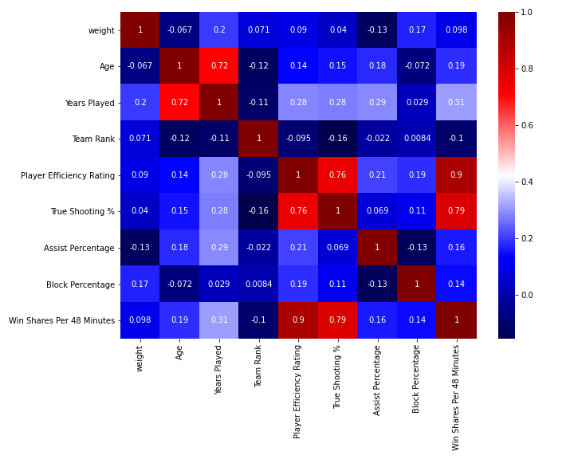
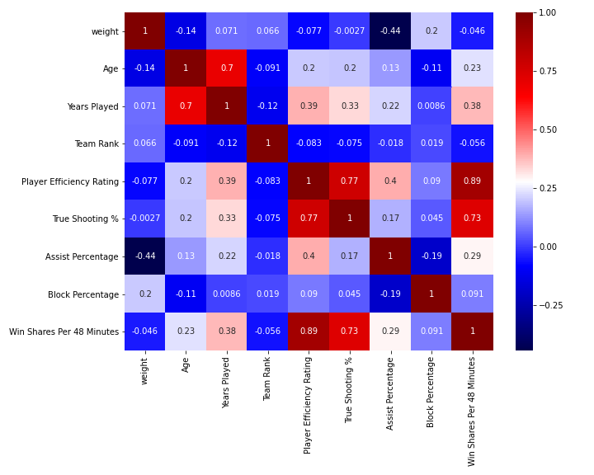
Initial Correlations: All Positions
C_Positions
Position groups:
All
G_Positions: G; G-F
C_Positions: C; C-F
F_Positions: F; F-G; F-C
F_Positions
Dependent variables, Set1:
# Player Efficiency Rating'
# True Shooting %'
# 'Assist Percentage'
# Block Percentage'
# 'Win Shares Per 48 Minutes'
G_Positions

Slide 4
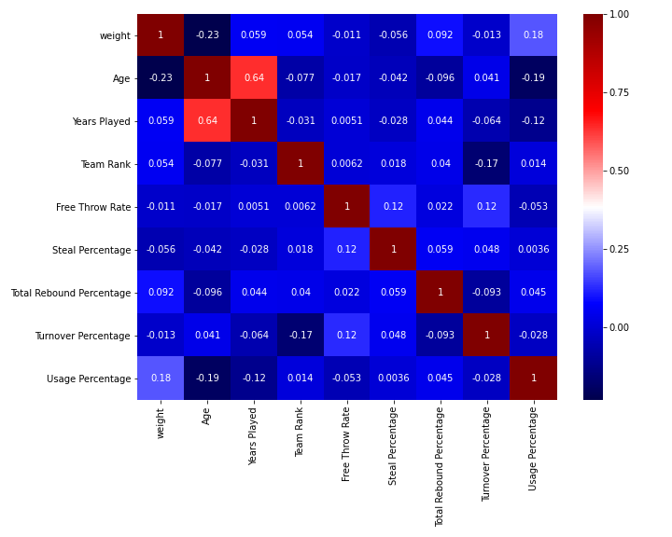
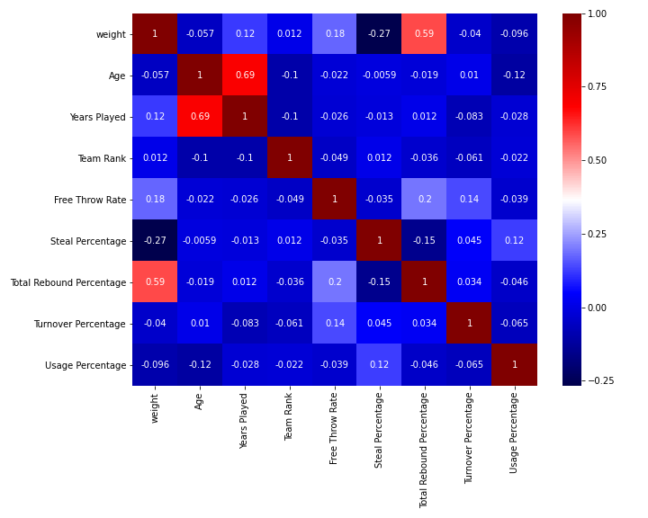
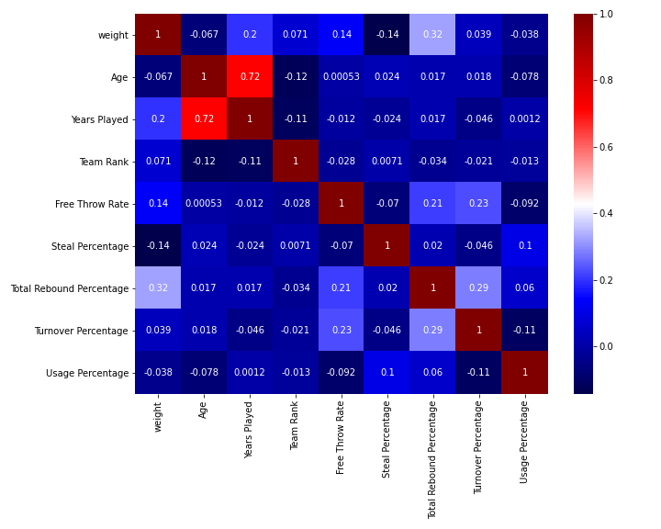
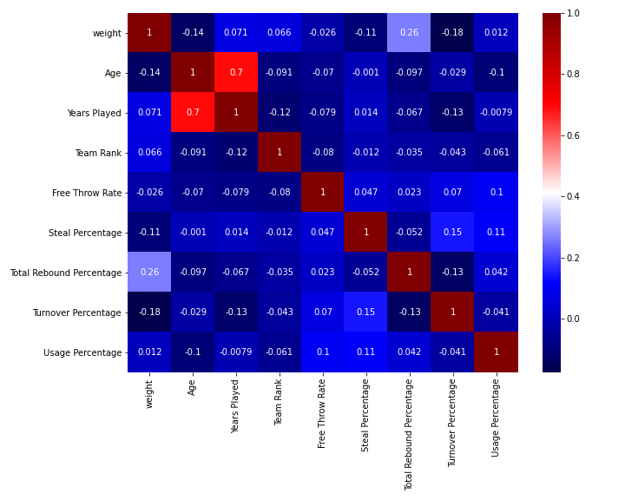
Initial Correlations: All Positions
C_Positions
Position groups:
All
G_Positions: G; G-F
C_Positions: C; C-F
F_Positions: F; F-G; F-C
F_Positions
Dependent variables, Set2:
# Free Throw Rate
# Total Rebound Percentage
# Steal Percentage
# Turnover Percentage
# Usage Percentage
G_Positions

Slide 5
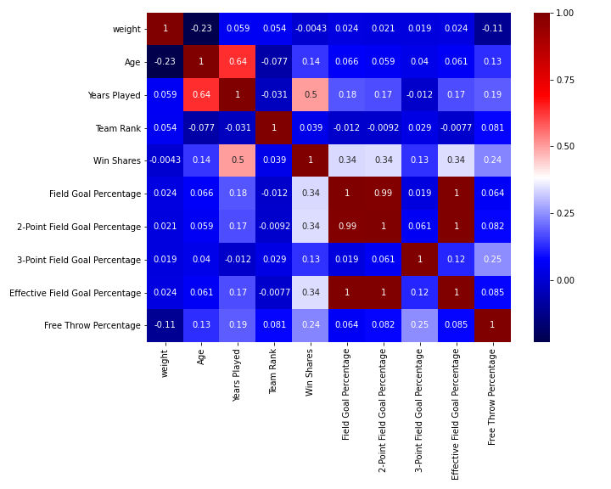
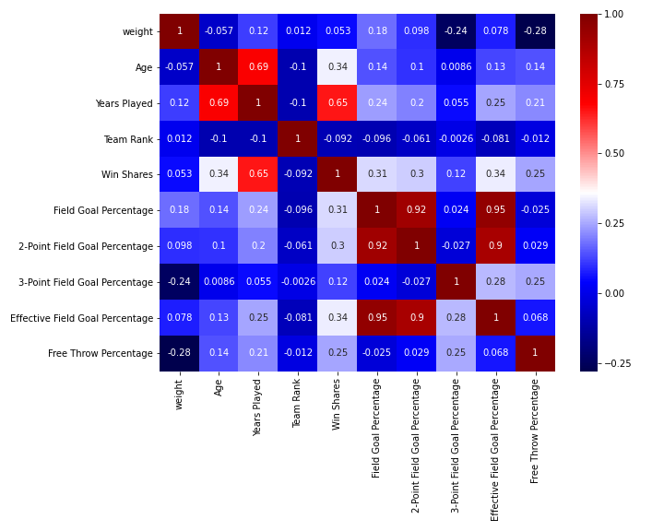
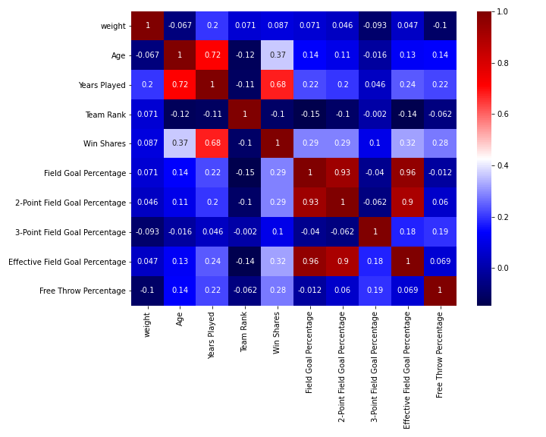
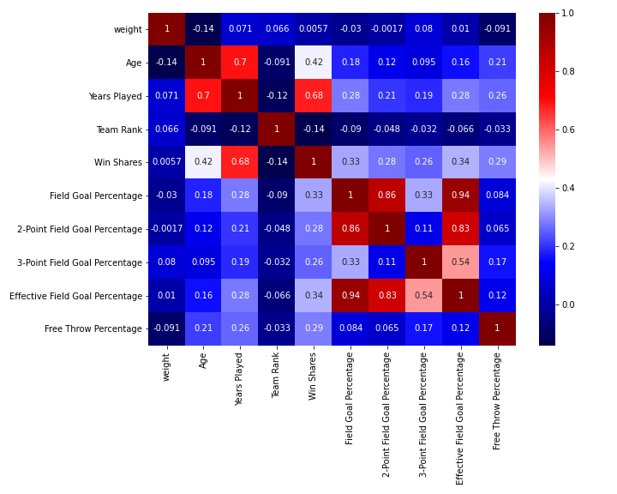
Initial Correlations: All Positions
C_Positions
Position groups:
All
G_Positions: G; G-F
C_Positions: C; C-F
F_Positions: F; F-G; F-C
F_Positions
Dependent variables, Set3:
# Win Shares
# Field Goal Percentage
# 2-Point Field Goal Percentage
# 3-Point Field Goal Percentage
# Effective Field Goal Percentage
# Free Throw Percentage
G_Positions

Slide 6
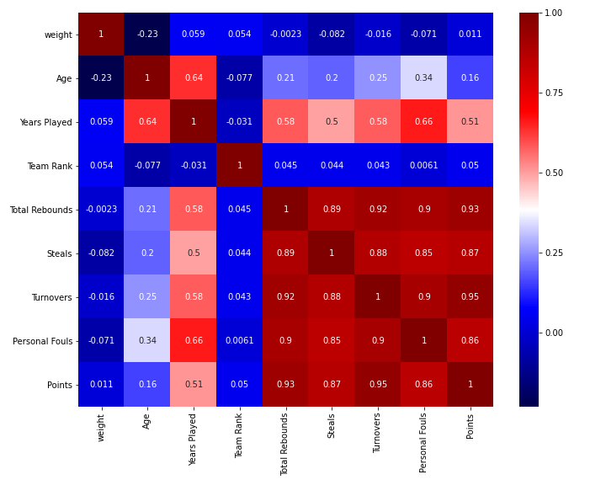
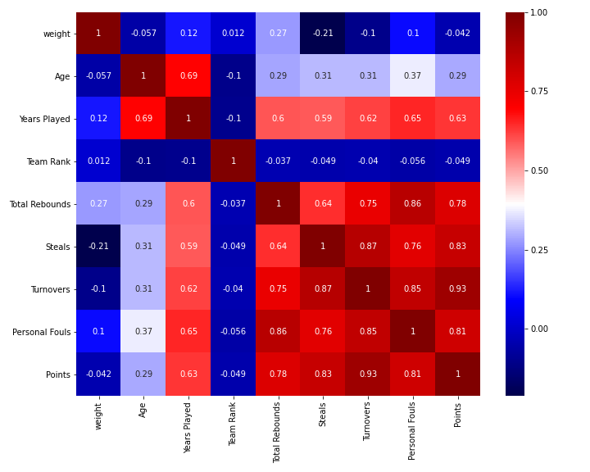
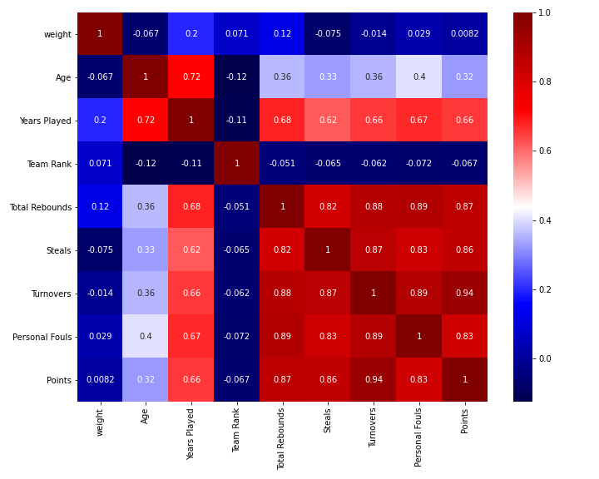
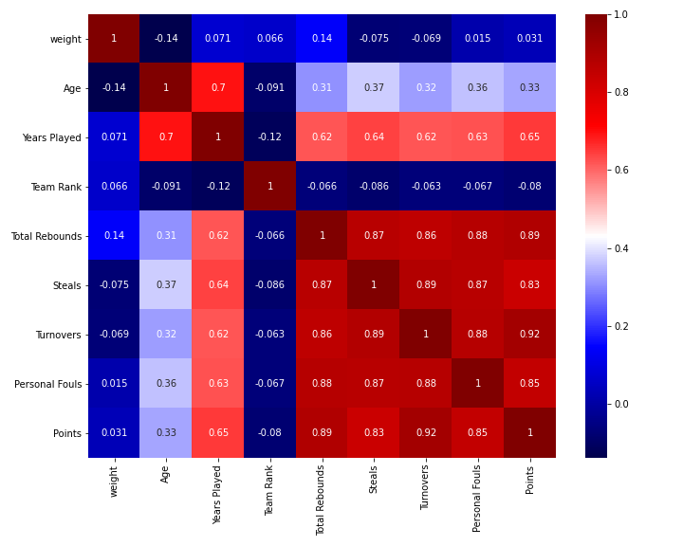
Initial Correlations: All Positions
C_Positions
Position groups:
All
G_Positions: G; G-F
C_Positions: C; C-F
F_Positions: F; F-G; F-C
F_Positions
Dependent variables, Set4:
# Total Rebounds
# Steals
# Turnovers
# Personal Fouls
# Points
G_Positions

