Slide 1
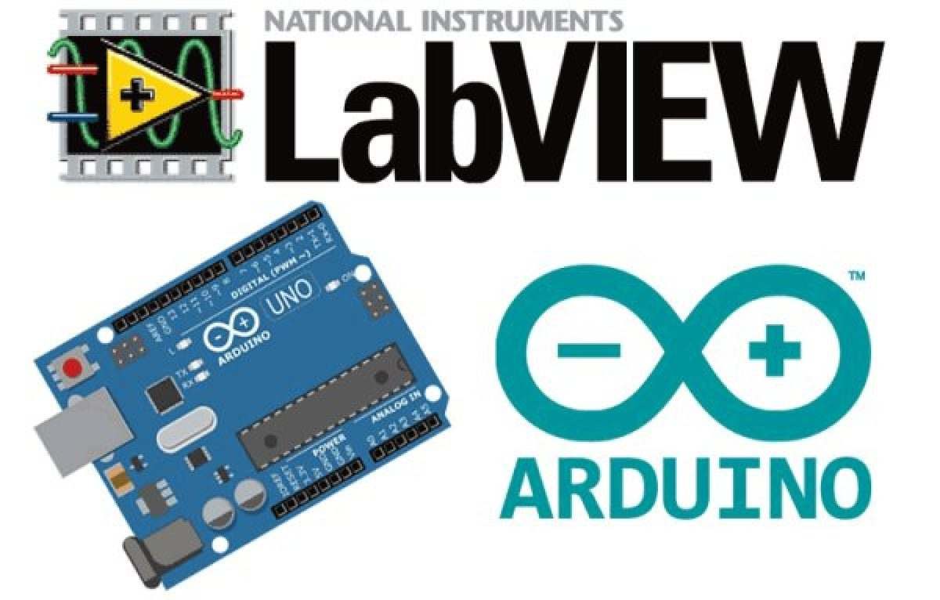

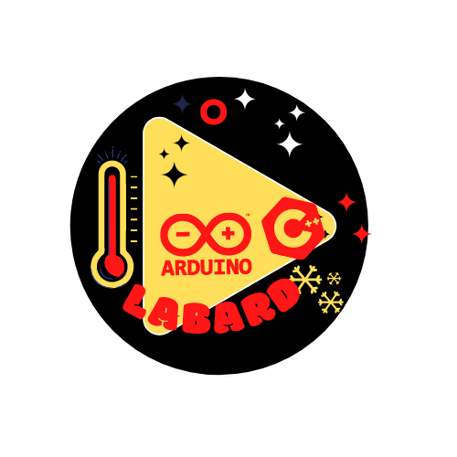
LabArd
Nouhaila INNAN

Slide 2
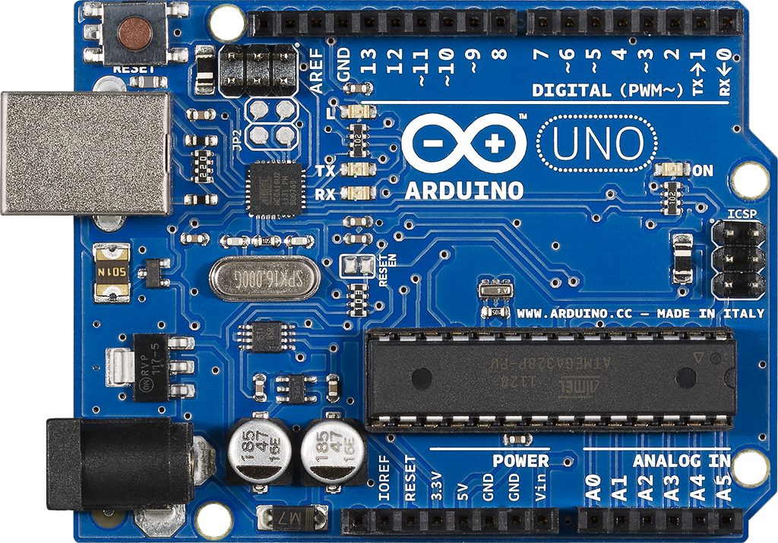
Arduino
Bouton de remise à zéro
LED de test de la broche 13
Entrées/sorties numériques
Port USB : Transport des
données et alimentation
LED témoin de mise sous tension
LED de transmission/ réception
Microcontrôleur
Permet de connecter une alimentation
Broches d’alimentation
Entrées Analogiques

Slide 3
Requirements
To interface LabVIEW with Arduino, you require the following software’s and hardware’s,
LabVIEW (software)
NI VISA (software) (https://www.ni.com/en-lb/support/downloads/drivers/download.ni-visa.html#346210 )
VI packet manager (software)
Arduino IDE (software) (https://www.arduino.cc/en/Guide/Windows)
LINX, (this will be available inside VI package manager, open VI package manager and search for it, double click on it. You will reach to an installation window. Click install button visible to you in that window.)
LabVIEW Interface for Arduino, this will be available inside VI package manager, open VI package manager and search for it, double click on it. You will reach to an installation window. Click install button visible to you in that window,

Slide 4
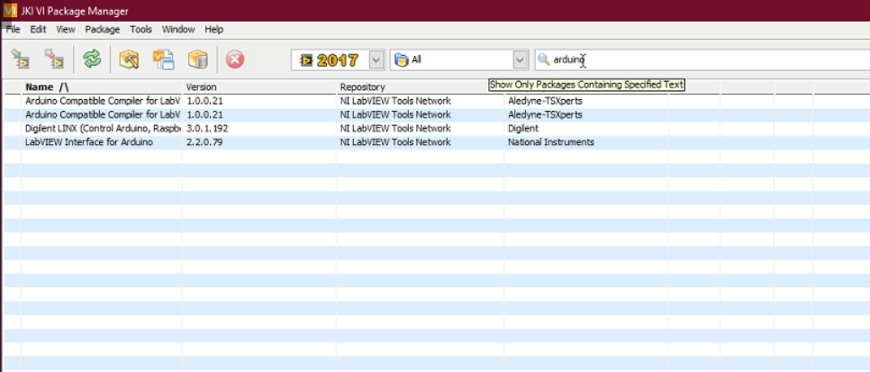
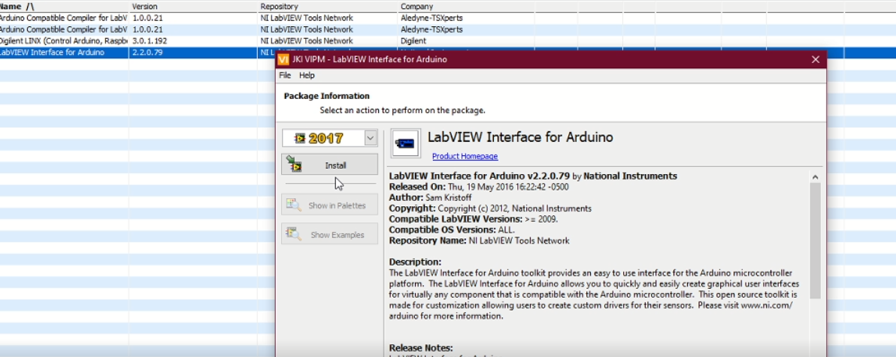
LabVIEW Interface for Arduino

Slide 5
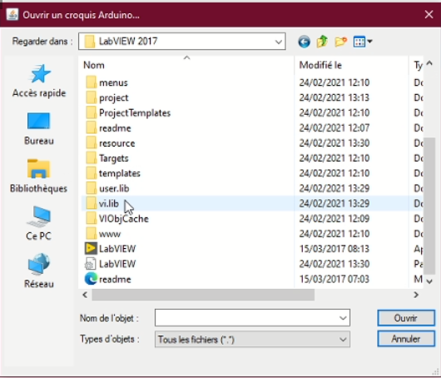
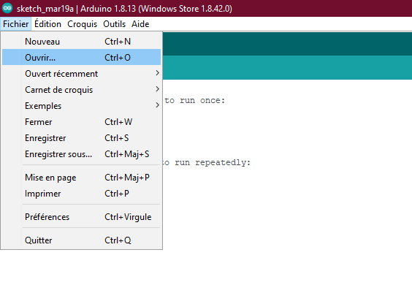
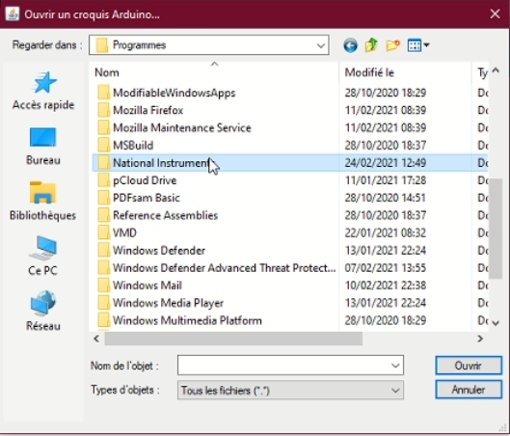
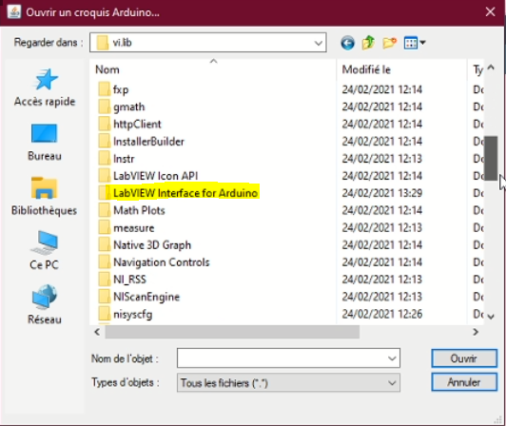
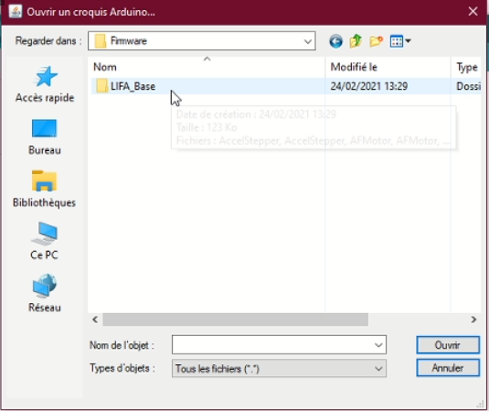
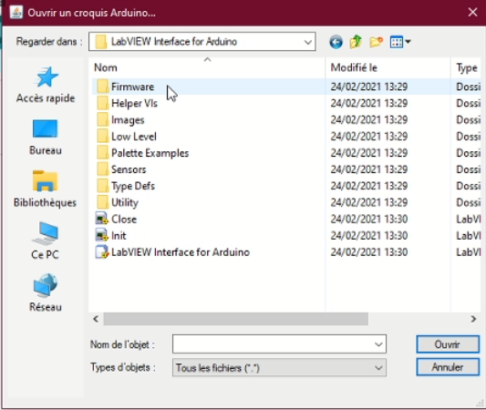
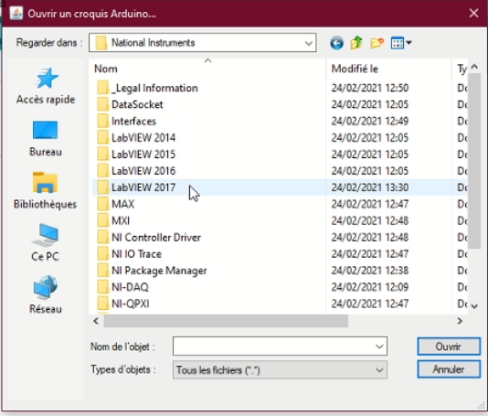
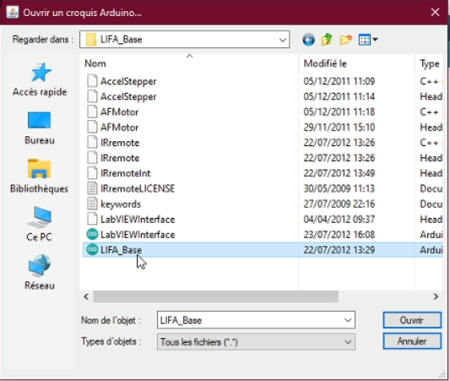
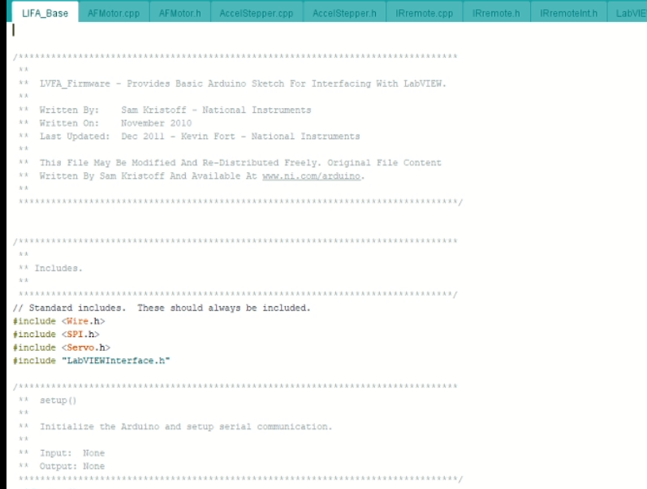
LabVIEW Interface for Arduino

Slide 6
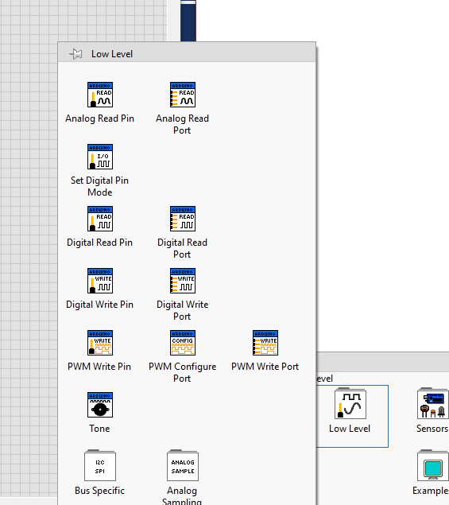
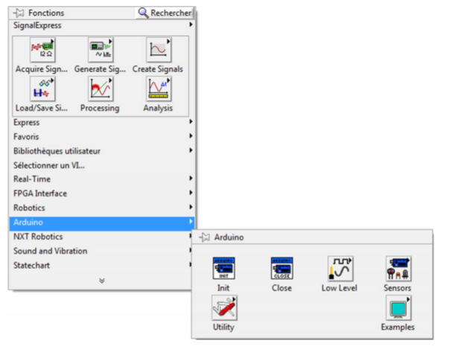
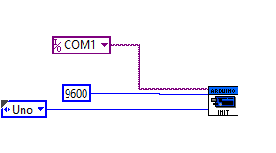
LabVIEW Interface for Arduino

Slide 7
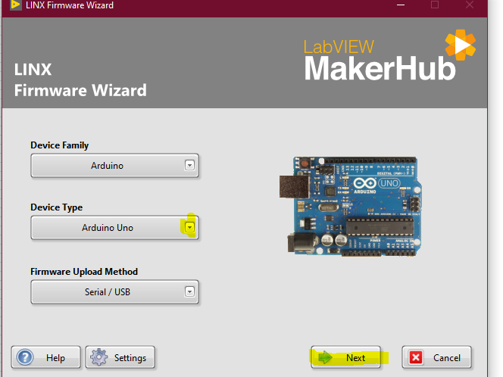
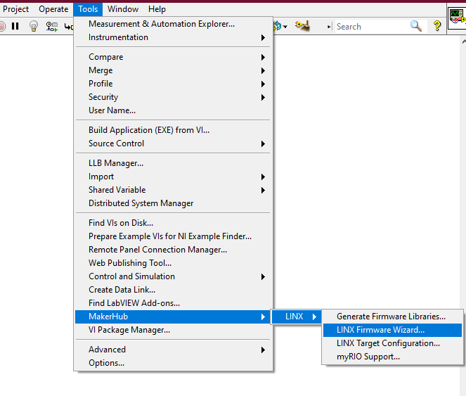
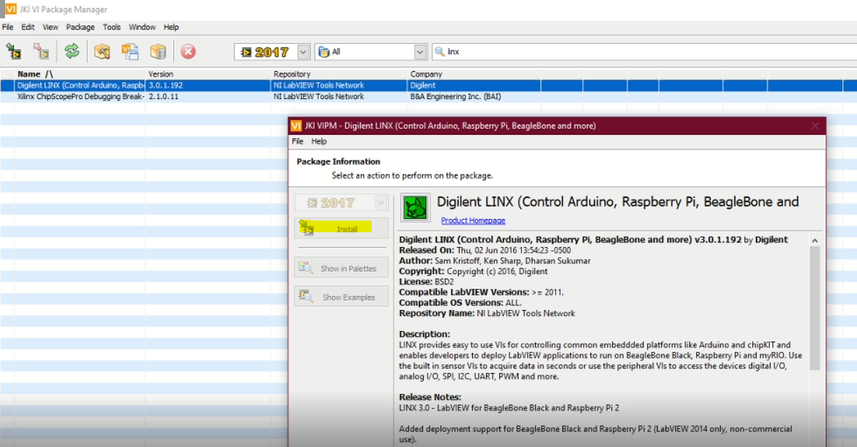
LINX

Slide 8
Capteurs
Temperature sensor: LM35
Humidity and temperature sensor: DHT11 module
Ultrasonic module HC-SR04
Flame sensor: KY-026

