Slide 1

O’Reilly provided segment title slide.

Slide 2
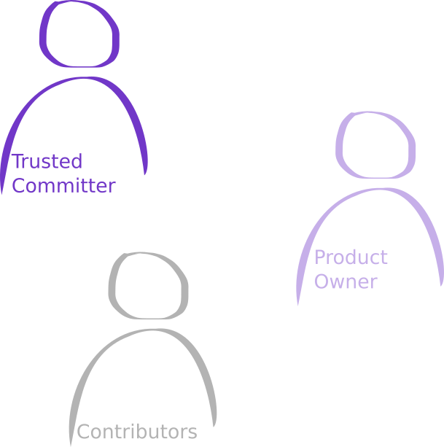

Slide 3
Becoming an InnerSource Contributor
The Contributor Ethos
Mechanics of Contributing
Benefits of Contribution
Conclusion

Slide 4
Contributors are the lifeblood of InnerSource.
They bring contributions to host teams.
These can be code, tests, documentation fixes, good issues, ...

Slide 5
A Trusted committer is your host in the host project.
Will mentor you throughout the contribution process.

Slide 6
Product fit
Road map fit
UI/ UX consistency

Slide 7
Needs link overlay to following five video sections

Slide 8
Becoming an InnerSource Contributor

Slide 9
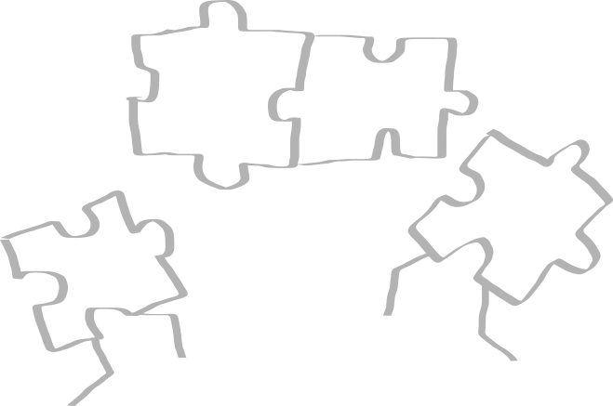
"Gaining by sharing." (Niels Basjes)
Notes:
Sharing Mindset
You're implementing a new feature for your product.
Before jumping into the implementation: Slow down:
Is this a general issue that could benefit from a solution that multiple teams work on?
Do other teams face the same challenge because they operate in the same business domain?
Is this functionality orthogonal to your business domain?
If any of this is the case - look beyond your own team: Is there a shared solution that you can rely on? Should there be one?

Slide 10
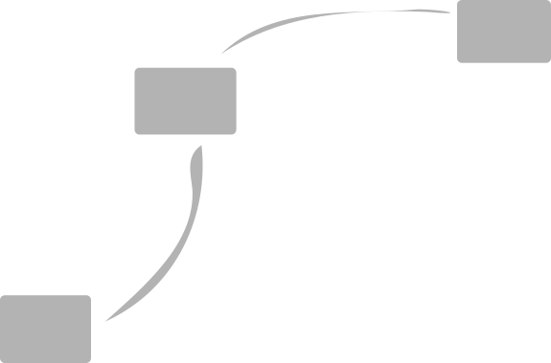
Dealing with dependencies
Notes:
So you've found that the functionality that you need already exists within your company.
On a technical level, the solution is easy: Introduce a dependency in your project, go ahead and re-use what others did before you.

Slide 11
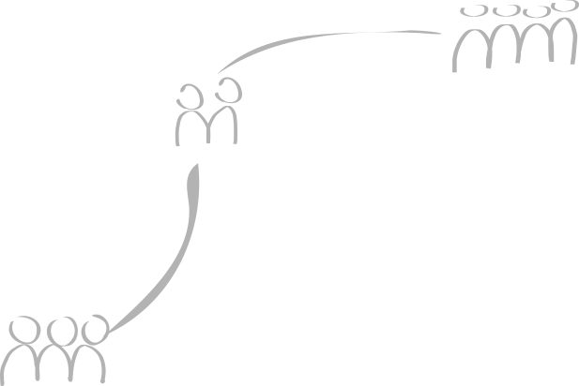
Dealing with dependencies
Notes:
What looks easy on first sight becomes more complicated when we remember that all of those components are being built by humans - colleagues, working in different teams, potentially against different roadmaps, potentially using different design patterns than your own team.
Introducing dependencies light-heartedly comes at a cost: The features you need, may not be on the roadmap of the team working on that component. The component may lack some minor modification that you need in order to meaningfully use it. At the end of the day you make your success dependent on another team.

Slide 12
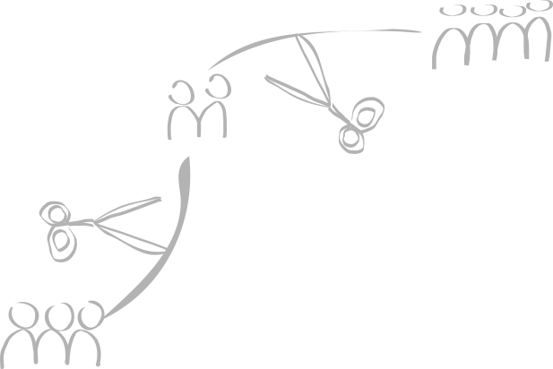
Dealing with dependencies
Notes:
The typical solution is to cut dependencies wherever possible. This means that you can move independent and faster. It also means that you will duplicate effort that others already invested.

Slide 13
Dealing with dependencies
Notes:
InnerSource gives you a path in between the two options of being fully dependent on another team or cutting the dependency entirely:
For InnerSource projects you are invited to join the effort. If a feature you need is not provided and is not on the roadmap of the original team just yet, you have the option to implement that feature yourself and contribute that implementation to the project. Instead of spending all the effort to re-implement the entire functionality you can focus on only adding the feature that you need. In addition you will get help and mentorship on how to make the modifications that you need.
Contributing those changes to the other team's codebase means that they will take over maintanance for you going forward reducing the work that you will have to do.
As a good contributor you should be able to make a call for when re-using a component provides a benefit to your team in terms of collaboration with others to move faster and reduce waste.

Slide 14
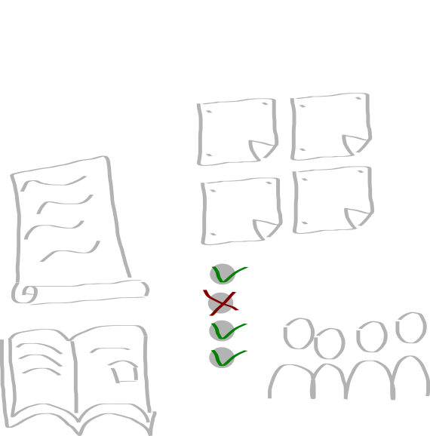
More than source code
Notes:
So - it's called InnerSource - that means, this is just about source-code, correct?
If you are a user of an InnerSource project, you want to ensure the project is well run and well maintained. You can help the host team with that: In addition to source code contributions, you can help with improving the documentation. You can help with providing issues for bugs you find. You can help by providing additional information to existing issues. You can help with fixing tests, in addition to reporting bugs you can help with providing (failing) test cases for these bugs. You can help with mentoring other users of the InnerSource component.

Slide 15
Contributor ethos and behavior

Slide 16
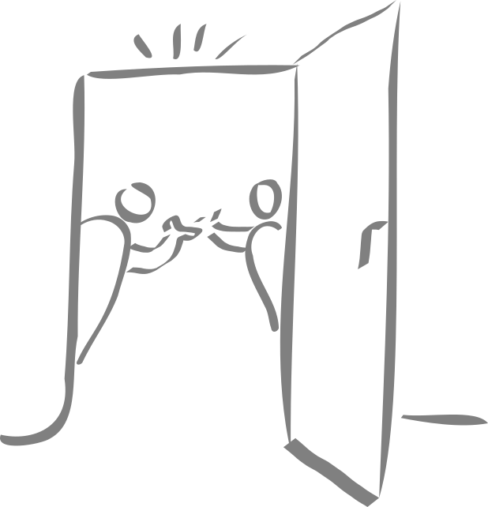
Being a guest
Notes:
InnerSource contributors understand that essentially they are guests in the house of the host team.
When visiting your neighbors - even if their door is open, you probably won't enter without knocking on the door first.
The same is true for a lot of InnerSource projects: Inviting contributions from the outside does not imply giving write access to everyone right from the start. Instead you will submit your changes through a pull request and have them reviewed by existing trusted committers.
Much like in the real world you'll follow contributions guidelines set by the host project. In turn, those active in the project will mentor you and show you around.
So - is the process the same for all types of changes? Let's look at a specific scenario in the real world. Remember that lovely summer party that you went to at your friends' place? Likely before knocking on the door you received an invitation with a set time and date. Likely your friends spent some time planning for there to be enough food available.
The same is true if you need major modifications in an InnerSource project: Likely you'll first submit an issue proposing your changes, discussing architectural options - maybe even finding a suitable start date so the trusted committers have enough bandwidth to mentor you throughout the change. Most likely you will be encouraged to share your progress early. Like Yonik's law of patches states:
https://cwiki.apache.org/confluence/display/solr/HowToContribute
"A half-baked patch in Jira, with no documentation, no tests
and no backwards compatibility is better than no patch at all."
Sharing progress early on makes it easier for those providing mentorship to do so early, guiding you towards a great solution, showing you caveats that may not be obvious to you as contributor. Sharing this project in a way that is visible for the entire InnerSource project instead of in one-on-one settings enables everyone involved to help you out. Essentially that means sharing a lot more in writing and visible to others than in other common software engineering projects.
Does that mean that there's no space for face to face communication? Of course not: Teams and friendships need a certain level of face to face interaction. Don't be surprised though if Trusted Committers are directing you back to the canonical written, archived, searchable medium.

Slide 17
Being a guest
Knock on door
Notes:
InnerSource contributors understand that essentially they are guests in the house of the host team.
When visiting your neighbors - even if their door is open, you probably won't enter without knocking on the door first.
The same is true for a lot of InnerSource projects: Inviting contributions from the outside does not imply giving write access to everyone right from the start. Instead you will submit your changes through a pull request and have them reviewed by existing trusted committers.
Much like in the real world you'll follow contributions guidelines set by the host project. In turn, those active in the project will mentor you and show you around.
So - is the process the same for all types of changes? Let's look at a specific scenario in the real world. Remember that lovely summer party that you went to at your friends' place? Likely before knocking on the door you received an invitation with a set time and date. Likely your friends spent some time planning for there to be enough food available.
The same is true if you need major modifications in an InnerSource project: Likely you'll first submit an issue proposing your changes, discussing architectural options - maybe even finding a suitable start date so the trusted committers have enough bandwidth to mentor you throughout the change. Most likely you will be encouraged to share your progress early. Like Yonik's law of patches states:
https://cwiki.apache.org/confluence/display/solr/HowToContribute
"A half-baked patch in Jira, with no documentation, no tests
and no backwards compatibility is better than no patch at all."
Sharing progress early on makes it easier for those providing mentorship to do so early, guiding you towards a great solution, showing you caveats that may not be obvious to you as contributor. Sharing this project in a way that is visible for the entire InnerSource project instead of in one-on-one settings enables everyone involved to help you out. Essentially that means sharing a lot more in writing and visible to others than in other common software engineering projects.
Does that mean that there's no space for face to face communication? Of course not: Teams and friendships need a certain level of face to face interaction. Don't be surprised though if Trusted Committers are directing you back to the canonical written, archived, searchable medium.

Slide 18

Being a guest
Knock on door
Follow the house rules
Notes:
When visiting your neighbors - they'll show you around. If you're staying for longer, they'll tell you what's particular about their home. In my case you shouldn't turn on the dish washer and the electric kettle at the same time - otherwise you'll blow the fuse.
You can expect the same explanations of how things work at InnerSource projects: You'll find that in their README.md (or alternatively in a document called CONTRIBUTING.md) you'll find hints about how to contribute: This document will contain information on where to check the project out, how to build the project and how to run the test suite. It will list anything that deviates from standard tooling.
Typically looking at this documentation saves you a lot of ramp up time as it stops you from trial and error but also from going down the wrong path. Just as with the source code itself - if you find things are missing from your point of view as an early contributor: Suggest these additions to the documentation.
The more you contribute to a project, the closer you will feel you belong to that project's team - maybe at some point you'll be invited to be part of it as another trusted committer. However as long as you're approaching the project as a contributor you should understand that you are a guest to the InnerSource project. Ultimately accountability for the project lies with the existing Trusted Committers. As such they are the ones who make a final call on what contributions need to look like. Also they are the ones making the final call on whether or not to accept a contribution.

Slide 19

Making major changes
Share intention early
Notes:
When visiting your neighbors - they'll show you around. If you're staying for longer, they'll tell you what's particular about their home. In my case you shouldn't turn on the dish washer and the electric kettle at the same time - otherwise you'll blow the fuse.
You can expect the same explanations of how things work at InnerSource projects: You'll find that in their README.md (or alternatively in a document called CONTRIBUTING.md) you'll find hints about how to contribute: This document will contain information on where to check the project out, how to build the project and how to run the test suite. It will list anything that deviates from standard tooling.
Typically looking at this documentation saves you a lot of ramp up time as it stops you from trial and error but also from going down the wrong path. Just as with the source code itself - if you find things are missing from your point of view as an early contributor: Suggest these additions to the documentation.
The more you contribute to a project, the closer you will feel you belong to that project's team - maybe at some point you'll be invited to be part of it as another trusted committer. However as long as you're approaching the project as a contributor you should understand that you are a guest to the InnerSource project. Ultimately accountability for the project lies with the existing Trusted Committers. As such they are the ones who make a final call on what contributions need to look like. Also they are the ones making the final call on whether or not to accept a contribution.

Slide 20
Making major changes
Share intention early
Share progress early
Notes:
When visiting your neighbors - they'll show you around. If you're staying for longer, they'll tell you what's particular about their home. In my case you shouldn't turn on the dish washer and the electric kettle at the same time - otherwise you'll blow the fuse.
You can expect the same explanations of how things work at InnerSource projects: You'll find that in their README.md (or alternatively in a document called CONTRIBUTING.md) you'll find hints about how to contribute: This document will contain information on where to check the project out, how to build the project and how to run the test suite. It will list anything that deviates from standard tooling.
Typically looking at this documentation saves you a lot of ramp up time as it stops you from trial and error but also from going down the wrong path. Just as with the source code itself - if you find things are missing from your point of view as an early contributor: Suggest these additions to the documentation.
The more you contribute to a project, the closer you will feel you belong to that project's team - maybe at some point you'll be invited to be part of it as another trusted committer. However as long as you're approaching the project as a contributor you should understand that you are a guest to the InnerSource project. Ultimately accountability for the project lies with the existing Trusted Committers. As such they are the ones who make a final call on what contributions need to look like. Also they are the ones making the final call on whether or not to accept a contribution.

Slide 21

Written over verbal
... there are limits to written conversations
Create and use passive documentation.
Notes:
When visiting your neighbors - they'll show you around. If you're staying for longer, they'll tell you what's particular about their home. In my case you shouldn't turn on the dish washer and the electric kettle at the same time - otherwise you'll blow the fuse.
You can expect the same explanations of how things work at InnerSource projects: You'll find that in their README.md (or alternatively in a document called CONTRIBUTING.md) you'll find hints about how to contribute: This document will contain information on where to check the project out, how to build the project and how to run the test suite. It will list anything that deviates from standard tooling.
Typically looking at this documentation saves you a lot of ramp up time as it stops you from trial and error but also from going down the wrong path. Just as with the source code itself - if you find things are missing from your point of view as an early contributor: Suggest these additions to the documentation.
The more you contribute to a project, the closer you will feel you belong to that project's team - maybe at some point you'll be invited to be part of it as another trusted committer. However as long as you're approaching the project as a contributor you should understand that you are a guest to the InnerSource project. Ultimately accountability for the project lies with the existing Trusted Committers. As such they are the ones who make a final call on what contributions need to look like. Also they are the ones making the final call on whether or not to accept a contribution.

Slide 22

Staying around for longer
Start with documentation in README.md
Common issues documented.
House rules documented.
Notes:
When visiting your neighbors - they'll show you around. If you're staying for longer, they'll tell you what's particular about their home. In my case you shouldn't turn on the dish washer and the electric kettle at the same time - otherwise you'll blow the fuse.
You can expect the same explanations of how things work at InnerSource projects: You'll find that in their README.md (or alternatively in a document called CONTRIBUTING.md) you'll find hints about how to contribute: This document will contain information on where to check the project out, how to build the project and how to run the test suite. It will list anything that deviates from standard tooling.
Typically looking at this documentation saves you a lot of ramp up time as it stops you from trial and error but also from going down the wrong path. Just as with the source code itself - if you find things are missing from your point of view as an early contributor: Suggest these additions to the documentation.
The more you contribute to a project, the closer you will feel you belong to that project's team - maybe at some point you'll be invited to be part of it as another trusted committer. However as long as you're approaching the project as a contributor you should understand that you are a guest to the InnerSource project. Ultimately accountability for the project lies with the existing Trusted Committers. As such they are the ones who make a final call on what contributions need to look like. Also they are the ones making the final call on whether or not to accept a contribution.

Slide 23
Contributing mechanics

Slide 24
Opportunity acquisition and preparation

Slide 25
Crafting the contribution

Slide 26
Polishing, wrapping and presenting the contribution

Slide 27

InnerSource vs. classic development
You're new - to project and team.
Plan ahead.

Slide 28

InnerSource vs. classic development
You're new - to project and team.
Plan ahead.
Plan for enough lead time.

Slide 29
InnerSource vs. classic development
You're new - to project and team.
Plan ahead.
Plan for enough lead time.
Make expectations explicit.

Slide 30
Trust through rapport and face-to-face meeting

Slide 31

Working in the open
Trusted committers expect to mentor you

Slide 32
Working in the open
Trusted committers expect to mentor you.
Possibility to unblock yourself.

Slide 33

Working in the open
Trusted committers expect to mentor you.
Possibility to unblock yourself.
Use project channels.

Slide 34
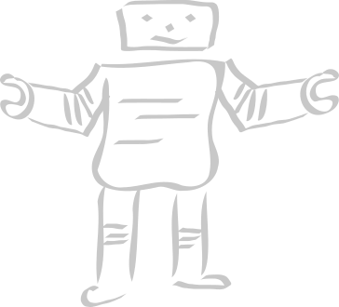
Tests
Automated validation
Documentation

Slide 35

Nobody is perfect

Slide 36
Benefits of contributing slides go here

Slide 37

Individual motivation
Notes:
Contributors are the life blood of inner source projects. What are motivations for individual contributors to become active?
Much like in open source: Instead of working around issues, fix them at the source. Typical scratch your own itch reasoning.
Instead of working in isolation, collaborate with subject matter experts that you can learn from and that are willing to act as mentors.
Look beyond your own team to learn both technical skills (likely other teams use slightly different tricks for build management, testing, design or deployment) and communication skills.
On the flip side your own impact and reputation grows beyond the walls of your own team.
Aside from these obvious factors many people observe that being part of an Innersource project is perceived as full-filling and fun.

Slide 38
Individual motivation
Mastery on technical level.
Communication skills.
Impact on reputation.
Notes:
Contributors are the life blood of inner source projects. What are motivations for individual contributors to become active?
Much like in open source: Instead of working around issues, fix them at the source. Typical scratch your own itch reasoning.
Instead of working in isolation, collaborate with subject matter experts that you can learn from and that are willing to act as mentors.
Look beyond your own team to learn both technical skills (likely other teams use slightly different tricks for build management, testing, design or deployment) and communication skills.
On the flip side your own impact and reputation grows beyond the walls of your own team.
Aside from these obvious factors many people observe that being part of an Innersource project is perceived as full-filling and fun.

Slide 39

Individual motivation
Mastery on technical level.
Communication skills.
Impact on reputation.
Have fun!
Notes:
Contributors are the life blood of inner source projects. What are motivations for individual contributors to become active?
Much like in open source: Instead of working around issues, fix them at the source. Typical scratch your own itch reasoning.
Instead of working in isolation, collaborate with subject matter experts that you can learn from and that are willing to act as mentors.
Look beyond your own team to learn both technical skills (likely other teams use slightly different tricks for build management, testing, design or deployment) and communication skills.
On the flip side your own impact and reputation grows beyond the walls of your own team.
Aside from these obvious factors many people observe that being part of an Innersource project is perceived as full-filling and fun.

Slide 40

Team motivation
Build bridges.
Learn from each other.
Balance re-use.
Notes:
Now we know what motivates individuals to become active in InnerSource projects. What are reasons for teams to make space for other team members to participate in host teams?
If you're already using software from the host team. If you've already made fixes to it. Why should you spend the time to make sure these fixes make their way back to the host team's project? If you donate them back, with every new release of that component the fix will already be integrated. Essentially the host team take over not only ownership of the fix, but also maintenance associated with it.
Having someone active in the host project typically builds a bridge to that team - it typically makes it easier to have a voice in future direction of that component.
Last but not least, InnerSource can provide a middle path between the "be independent and (potentially re-)build your own" and "use something existing but create a dependency to another team's output". Balancing reimplementing and reusing suddenly becomes easier.

Slide 41

Corporate motivation
Balance centralization and autonomy.
Increase knowledge transfer.
Better quality and security.
Integrate customers.
Notes:
All of your teams operate in the same business domain. Likely there is some level of base functionality that all of these teams need. InnerSource provides a way to balance centralization and autonomy when creating shared assets that multiple teams need.
The focus on mentorship helps avoid the situation where vital software components are being maintained by just a single software engineer thus reducing the risk that come with abandoned components.
InnerSource encourages cross team collaboration leading to learning and knowledge sharing within an organisation.
When looking at purely technical benefits, the inherent focus on transparency and review typically leads to software components of better quality and security properties.
Taken a step further InnerSource can provide a first step towards integrating project users and customers in the development flow. What is common in most open source projects: The goal of turning users of a software system into contributors and collaborators in the past has proven as an option that is appreciated by customers.

Slide 42
For conclusion part: Overlay with links to further material.

