Slide 1
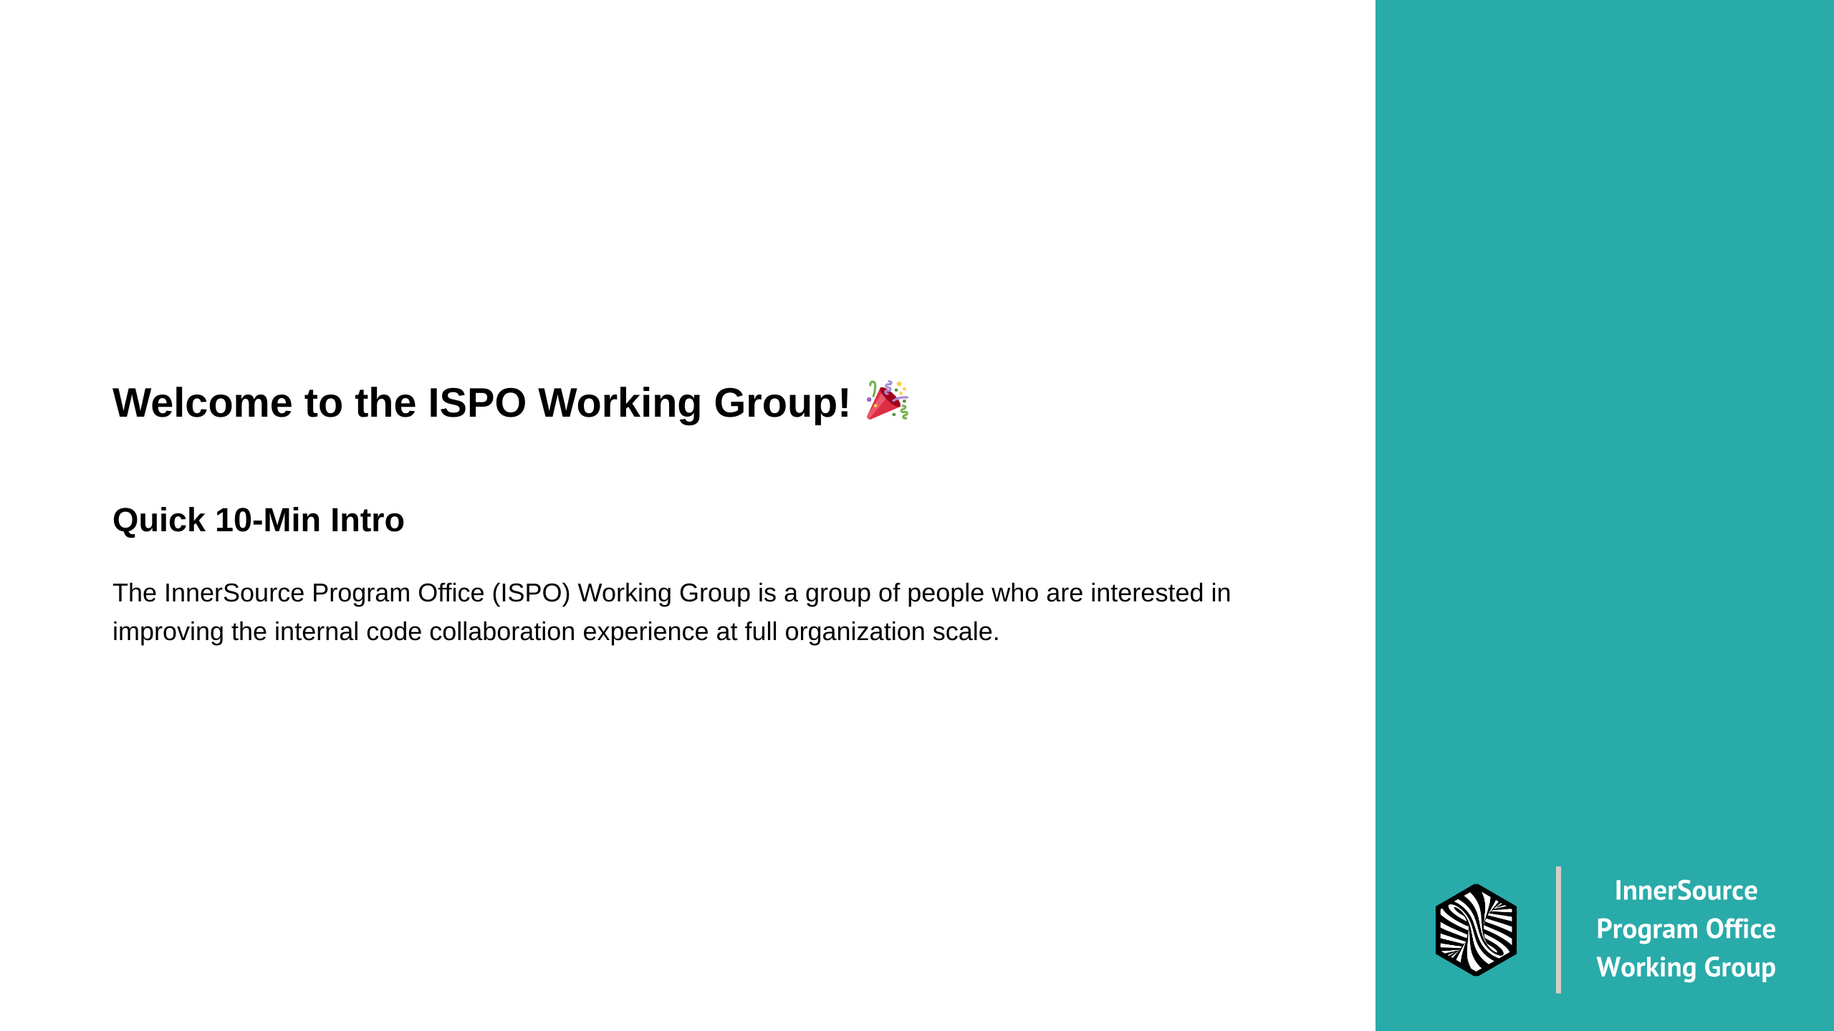
Notes:
The InnerSource Program Office (ISPO) Working Group is a group of people who are interested in improving the internal code collaboration experience at full organization scale.

Slide 2
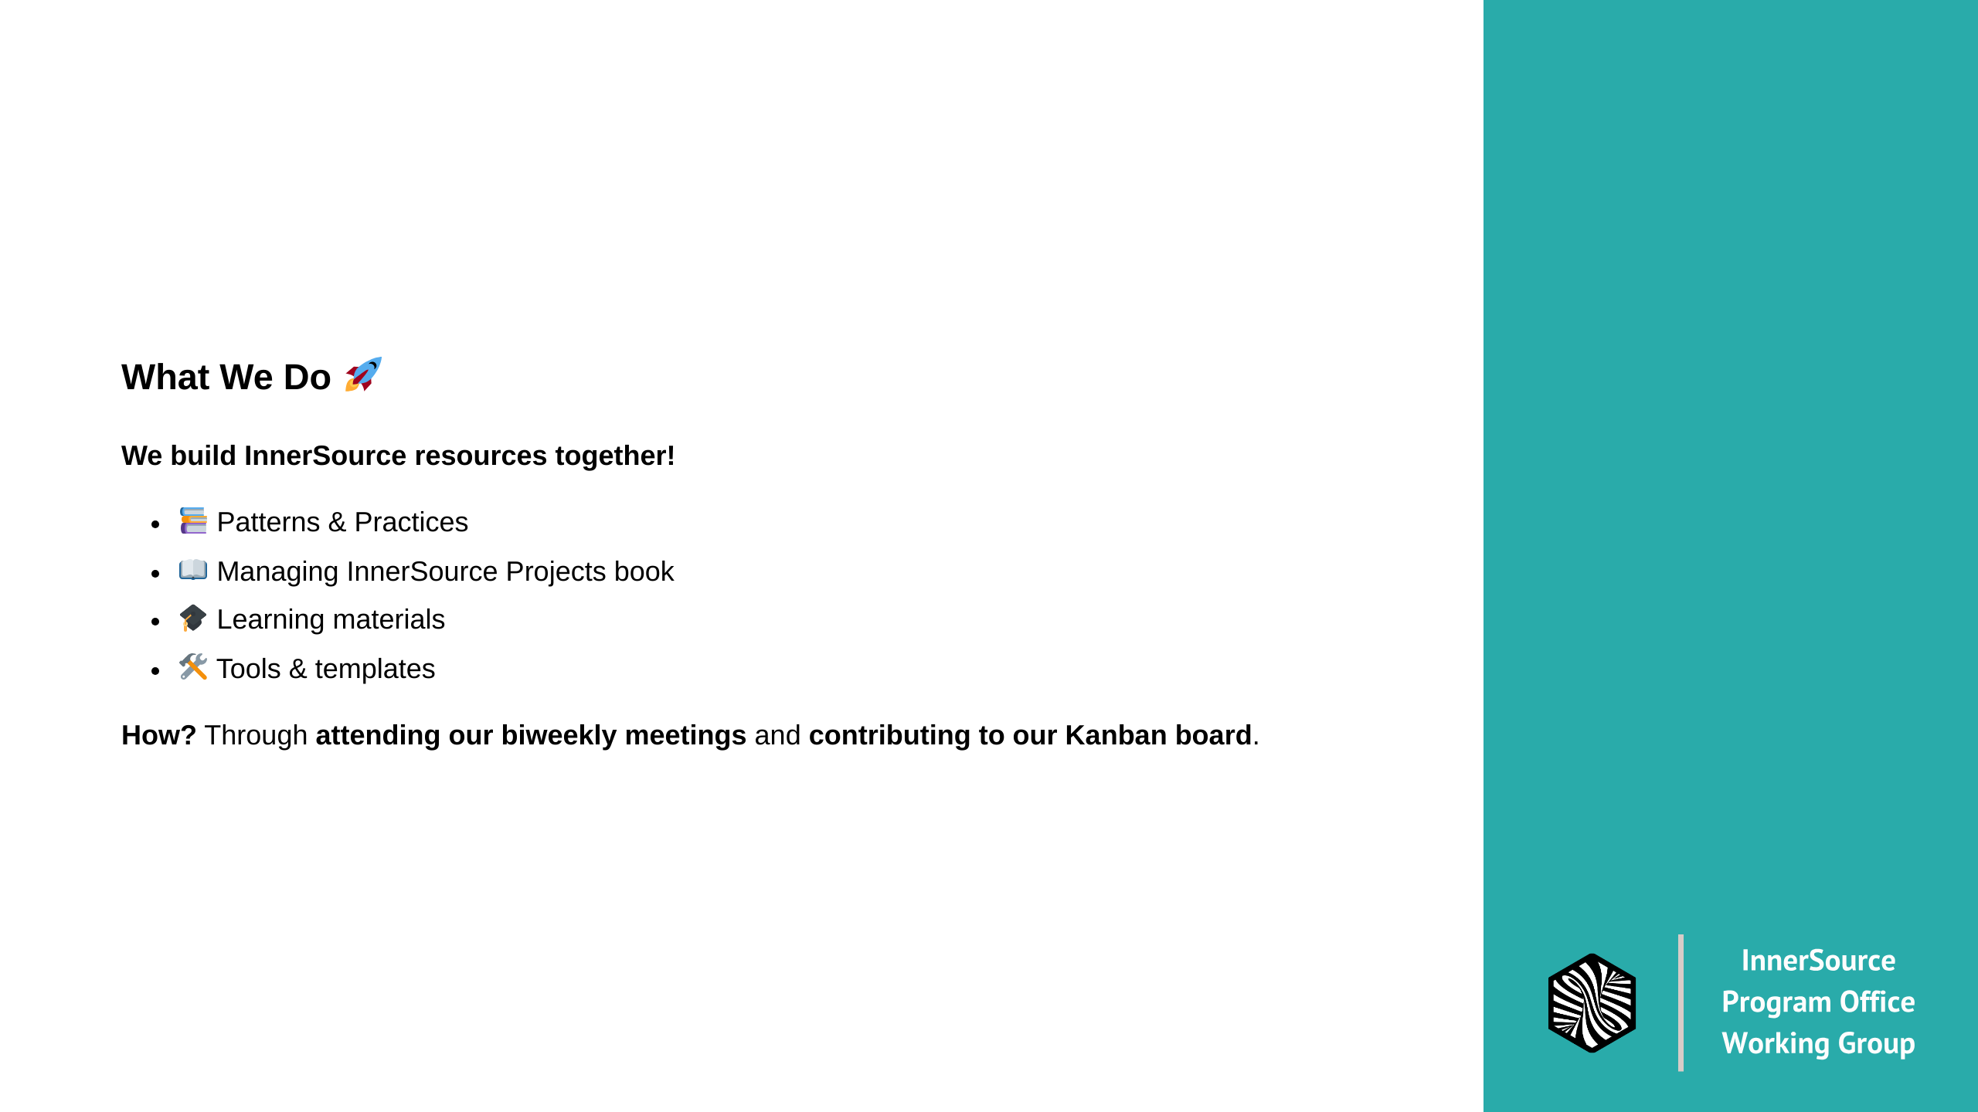
Notes:
So what do we actually do? We create resources for people doing InnerSource work at scale.
We do this through something called "mobbing" - it's like pair programming but with a whole team.
You rotate between being the Driver (who types), Navigator (who proposes solutions), and Gallery (who observes and suggests).
It's actually really fun and you learn a ton!

Slide 3
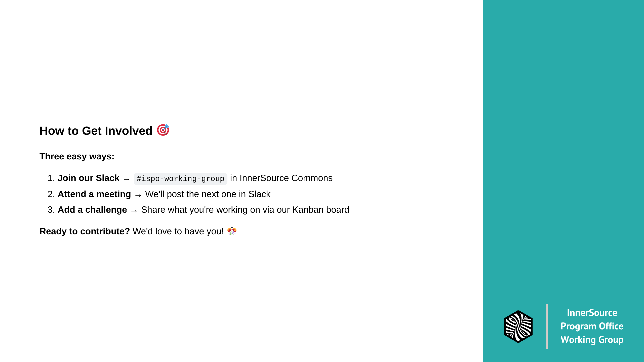
Notes:
So how do you get involved? Super simple:
1. Join our Slack channel - we post meeting times there
2. Come to a meeting - we're friendly, I promise!
3. Share what you're working on - add it to our Kanban board
That's it! No pressure, just come hang out and see if it's your thing.
We're always looking for new perspectives and fresh ideas.

