Slide 1
Facial Emotion Detection Project

Slide 2
Problem Definition
Context:
Facial Emotion Recognition is valuable for several key reasons:
Improving future AI interaction with Humans
Better understanding the psychophysiology of emotion to better understand ourselves
Create better AI especially in the field of robotics to create more human androids
Objectives:
Our goal is to create a model that can accurately identify and learn what human emotion looks like, although simple with only 4 categories we can create a great jumping off point that could expand to cover a wider range of emotions.
Key Questions:
Do “most” humans share similar emotional reactions?
Are there any defining features that best describe the physical states of Happy, Sad, Neutral, and Surprised?
Can an algorithm accurately and sufficiently evaluate facial emotional responses?
How accurate can the machine get, even with the lowest resolution of images?

Slide 3
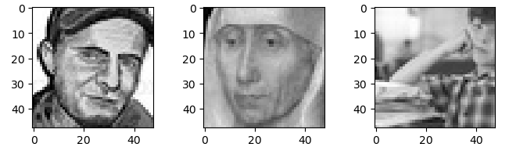
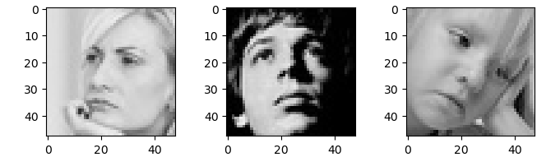
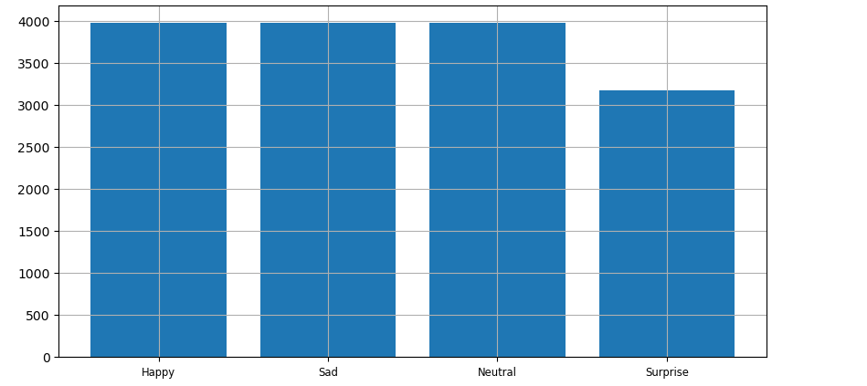
Data Exploration: Initial Takeaways
Image Analysis:
Not all faces show the same emotion the same, however there is more similarity between subjects than there are differences,
Not all of the images share the same “style”, although all black and white, features vary greatly:
high contrast, low contrast, realistic, artistic, centrally located, askew/off to the side.
This will affect the algorithms learning ability, Data Augmentation will be needed to account for these variations.
Data Distribution:
The provided files are well distributed

Slide 4
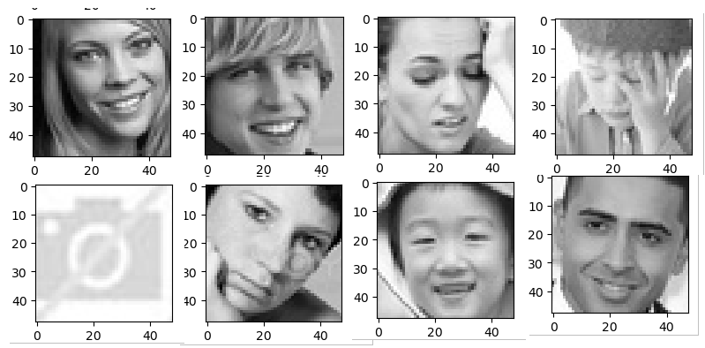
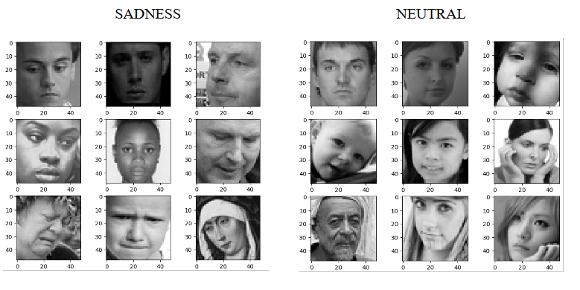
Data Exploration: Limitations
Dataset Limitation
Two major limitations exist:
1. Poorly Categorized Images (these are all ‘neutral’)
All 4 categories have “bad” data in their sets.
Neutral has it the most extremely
2. Variation and similarities of emotion
Even when not poorly categorized emotional expression varies
Some sadness looks neutral, some neutral looks sad. 100% subject dependent.
1.
2.

Slide 5
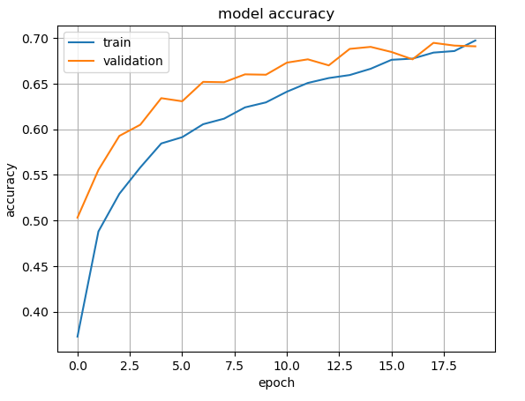
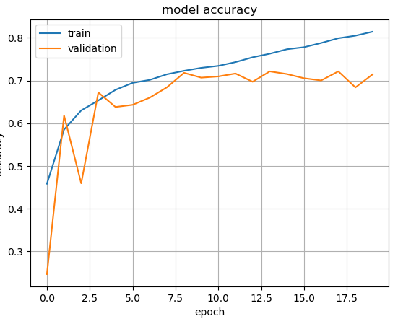
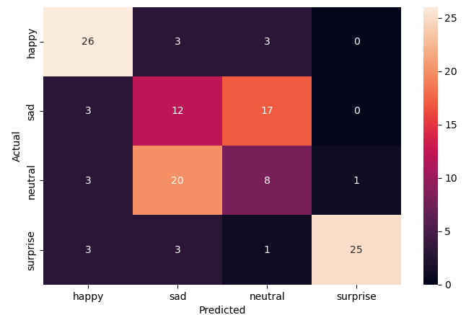
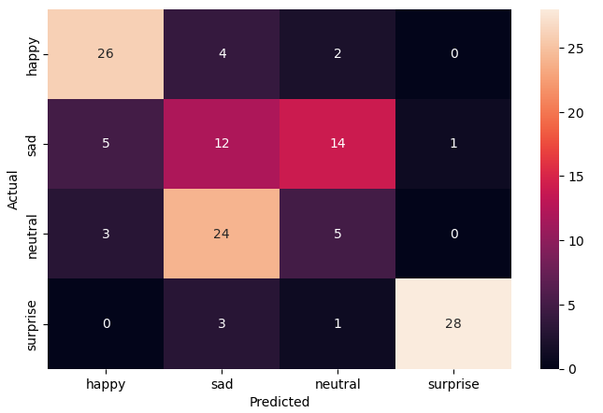
Solution Approach: Initial Models
Model 2
Train Acc: 81%
Valid Acc: 71%
Test Acc: 54%
Model 1
Model 2
Model 1
Train Acc: 70%
Valid Acc: 69%
Test Acc: 55%
- Simple Models easily detect Happy and Surprised
faces
- They have a much harder time predicting Sad and
Neutral
- This is likely in part due to the data set, but also the
extreme similarities between the two categories
- Interestingly in both models Neutral was predicted
as sad and sad was predicted as neutral with more
often with the test photos.

Slide 6
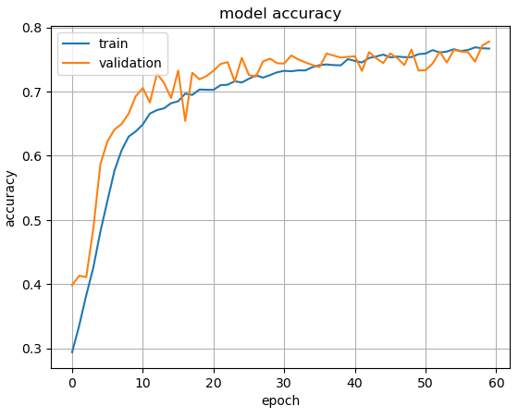
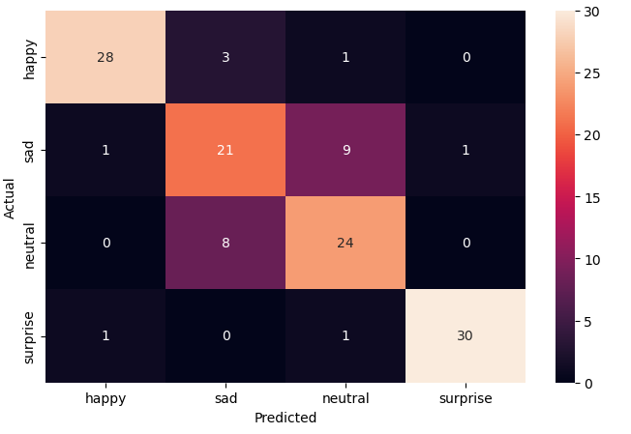


Proposed Model: Custom CNN
Note on Transfer Models:
Transfer Models Underperformed with the data
Visual Models are designed for general object identification and categorization.
They were not trained for complex emotion reactions
Proposed Model:
Combined best features of first to demo models plus additional complexity.
Data Augmentation Fine Tuning
Slower Model Growth/Learn Rate
Benefits and Results:
Not overly complex, no overfitting, while retaining a usable speed with best overall performance
Overall Acc of 80.4% (79% – 82%)
Happy: 88%
Surprised: 93%
Sad: 68%
Neutral: 75%

Slide 7
Proposed Business Solution
Provided Model Is a ‘Great Start’ but not there yet:
The model shows that the machine can accurately detect features even with ‘bad data’
Any model for production would need cleaner source data
Have a team of experts re-categorize the poorly sorted data without skewing bias
Remove all “non-value photos” (photos without faces, full bodies, faces fully snipped/hidden)
Model should easily reach 90% or greater if the time is taken to better sort data.
Why to Pursue:
A well trained emotional recognition NN is going to be key for the future of AI, Robotics, and how we interact with said AI and robotics. The AI of the future is an empathetic AI.
Investing the time to design the model with better working data would give anyone a strong working model to achieve such goals.

Slide 8
Questions

Slide 9
Thank You

Slide 10
Appendix

Slide 11
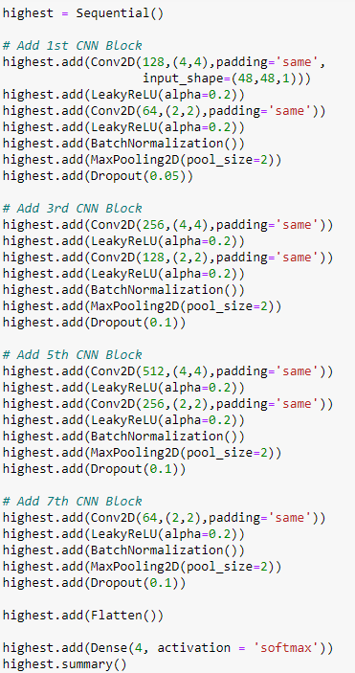
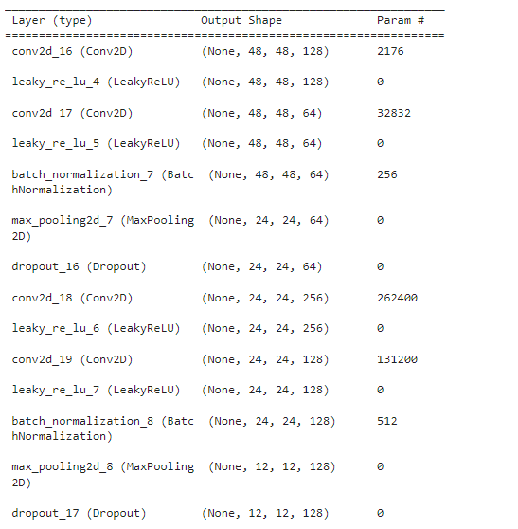
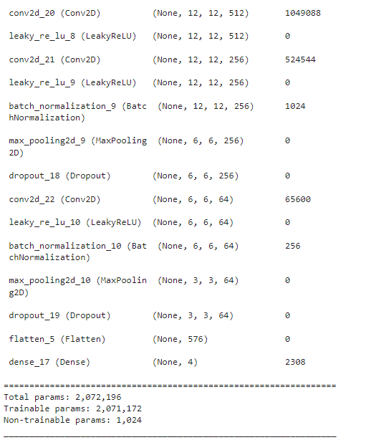
Final Model Architecture

