Slide 1


WHERE
WHO
WHAT
WHEN
WHY
HOW
WHICH
QUESTION
WORDS
ENGLISH

Slide 2


WHERE
Where are the TIE fighters
flying to?
ENGLISH
02

Slide 3

WHO?
Who is Luke’s father?
ENGLISH
03

Slide 4
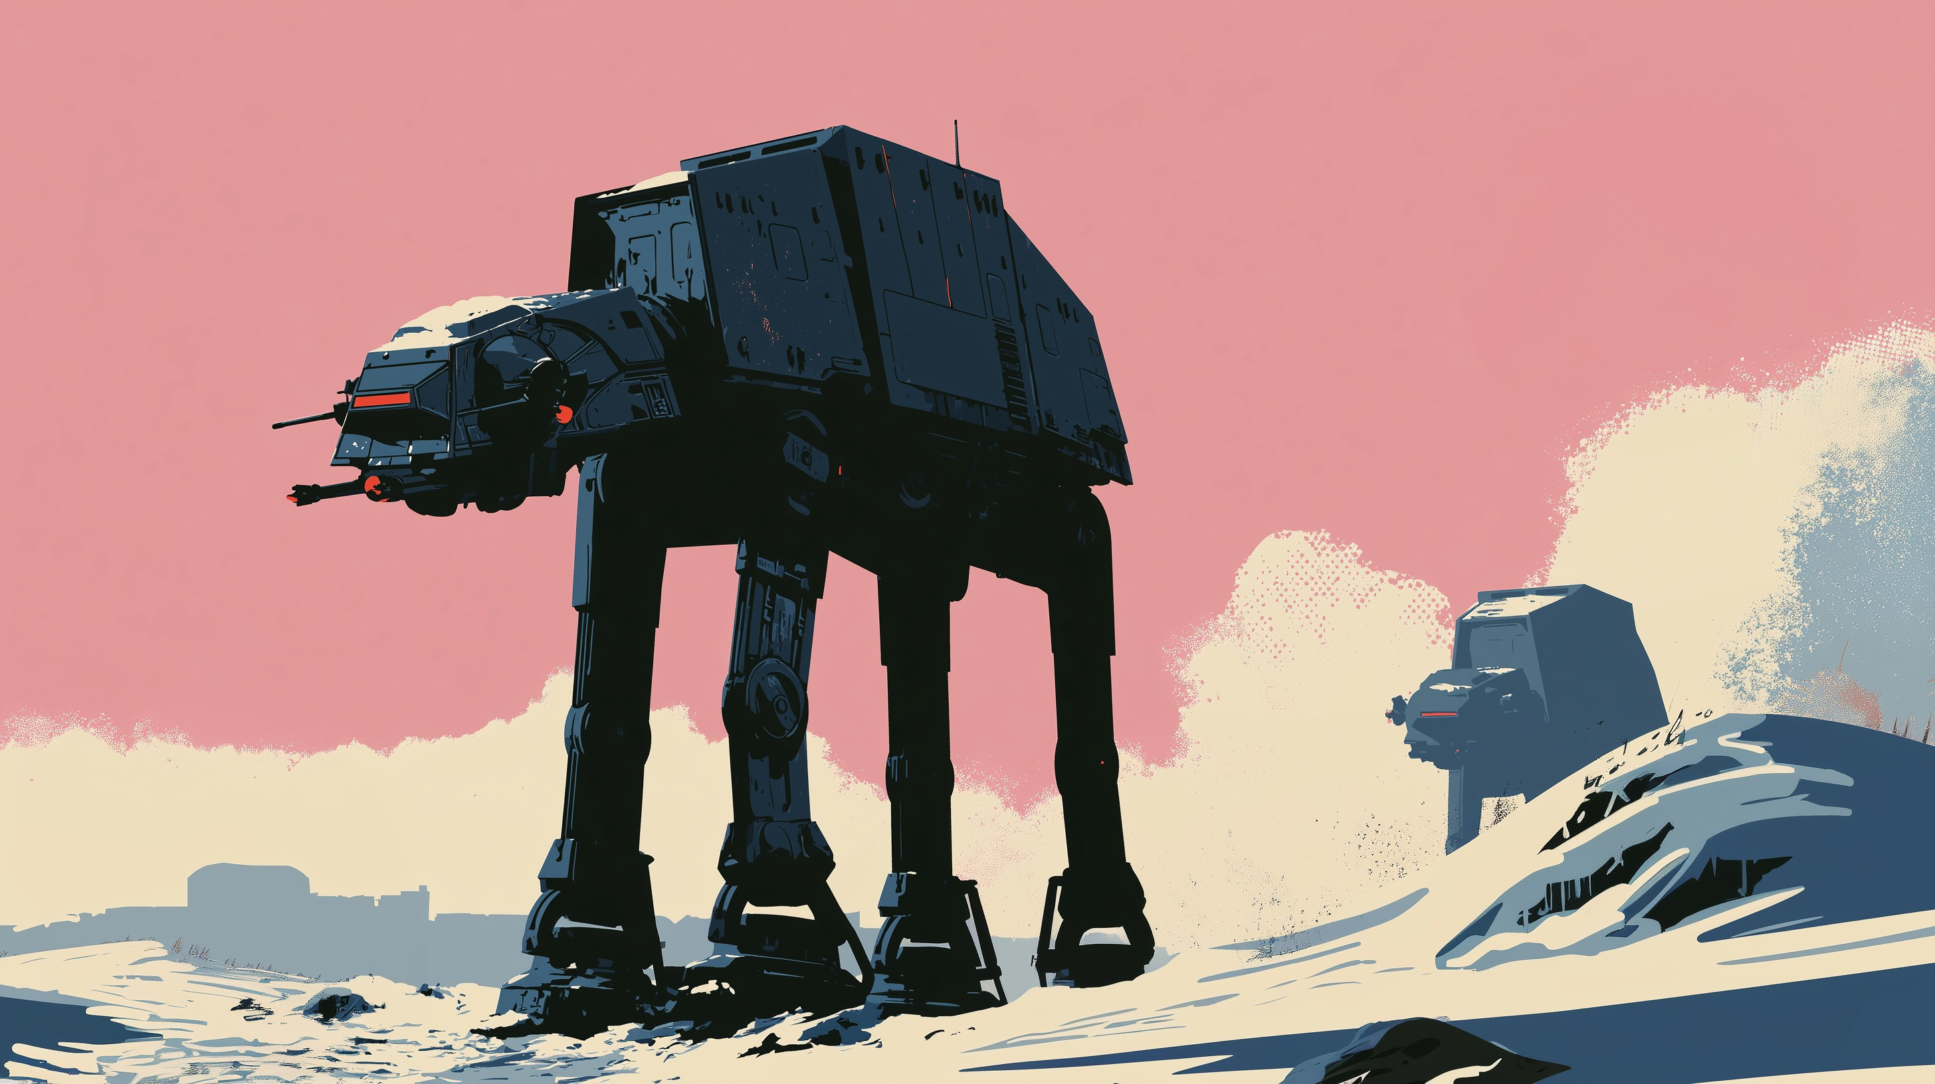
HOW MANY?
How many AT-ATs
are there?
ENGLISH
04

Slide 5
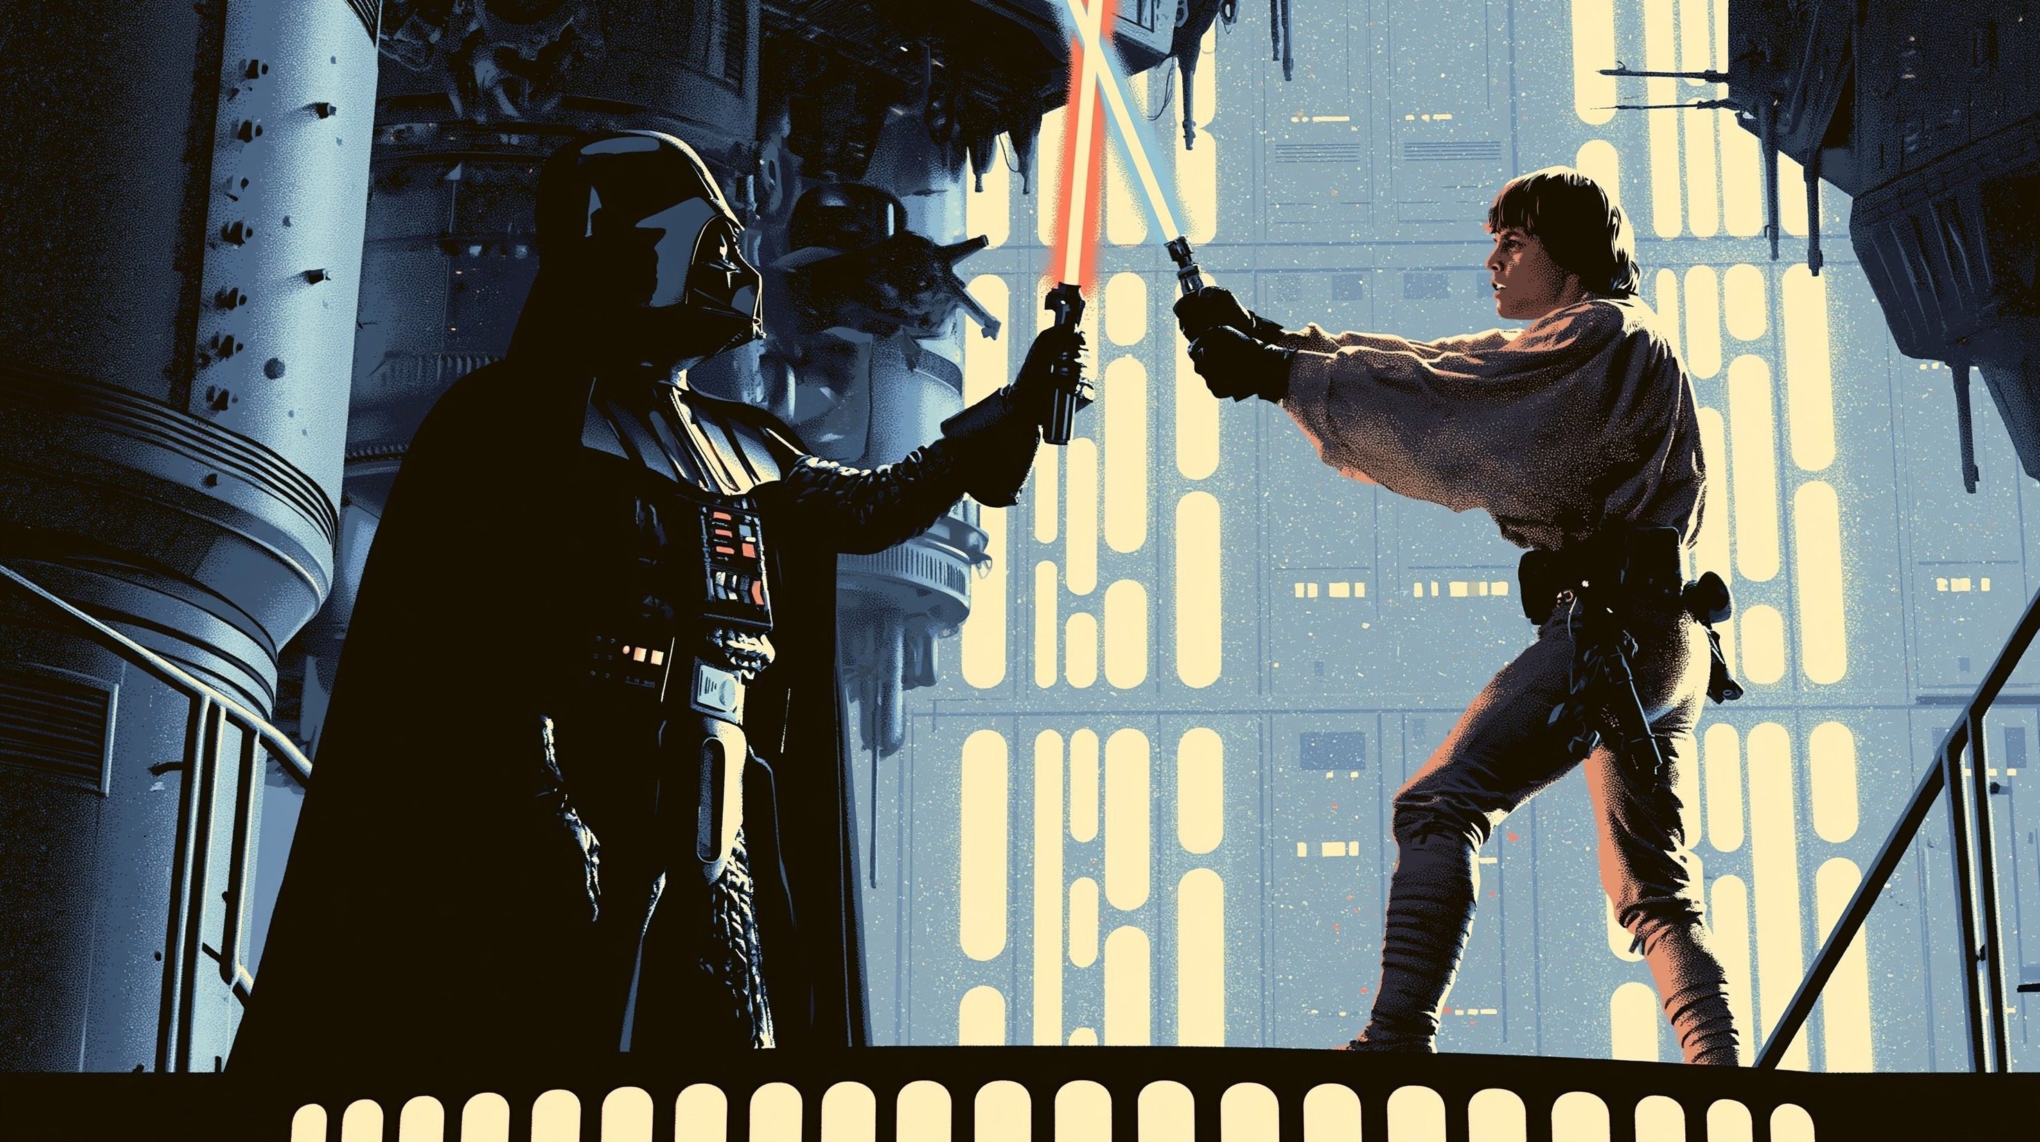
WHAT COLOR?
What color are their
lightsabers?
ENGLISH
05

Slide 6

When are you going
to pay Jabba?
WHEN?
ENGLISH
06

Slide 7

WHY?
Why is Luke training
with Yoda?
ENGLISH
07

Slide 8

HOW
MUCH?
How much does Jabba want
to release Han Solo?
ENGLISH
08

Slide 9
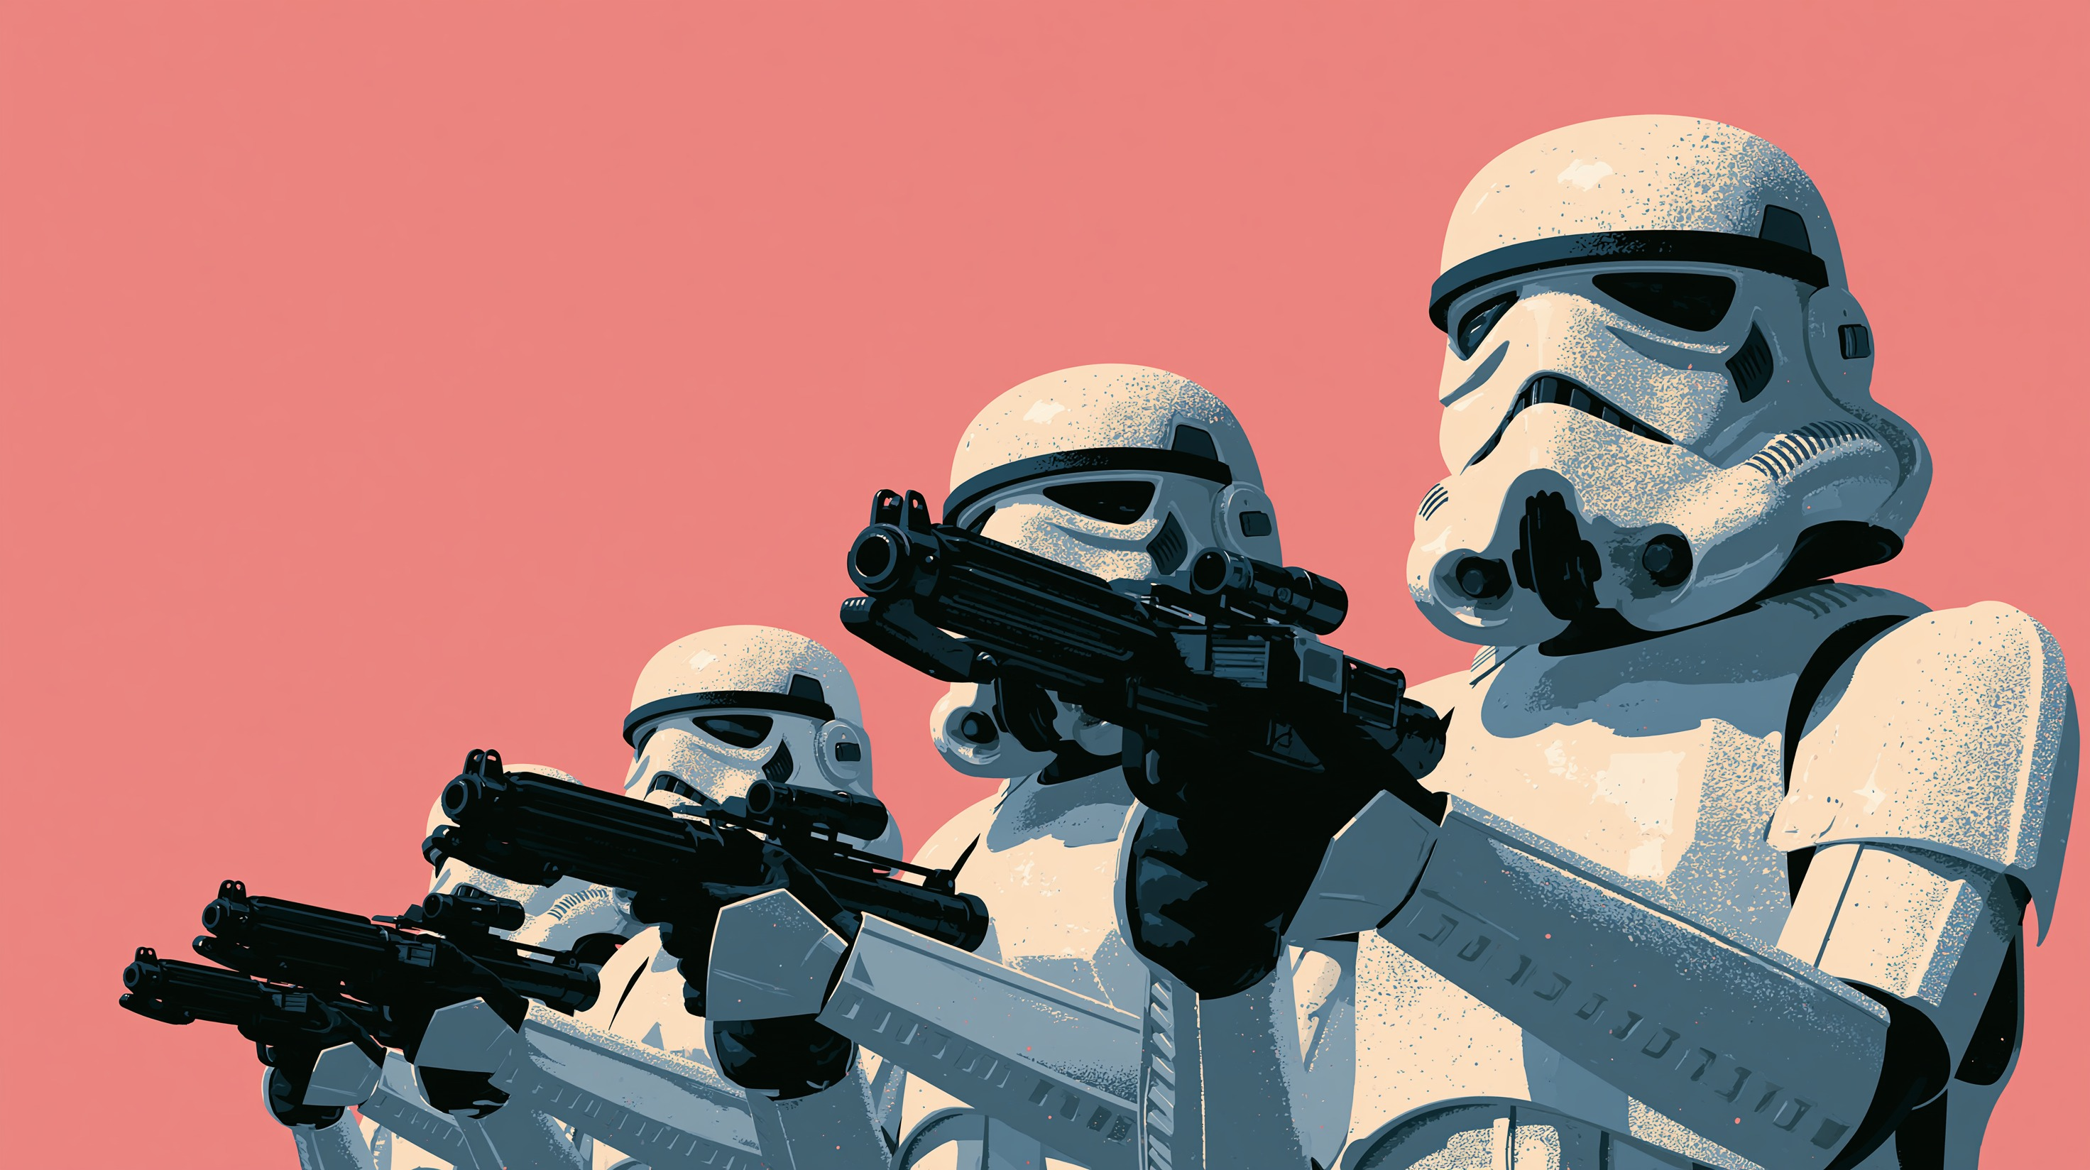
WHAT KIND OF?
What kind of weapons are the
Stormtroopers holding?
ENGLISH
09

Slide 10
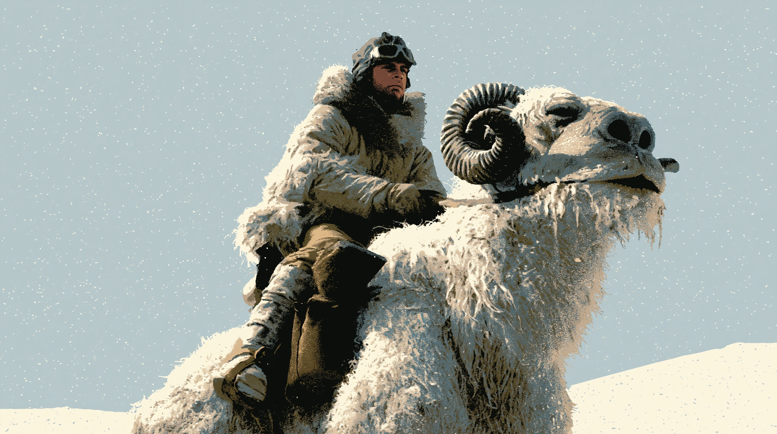
WHICH?
Which planet are you on?
ENGLISH
11

Slide 11
KEY
WHICH?
possible answers
I’m on Hoth.
WHERE … TO?
They are flying toward a distant base.
WHEN?
I’m going to pay Jabba soon.
WHO?
Darth Vader is Luke’s father.
WHY?
He is training to become a Jedi.
HOW MANY?
There are two AT-ATs.
HOW MUCH?
The amount is open for discussion.
WHAT COLOR?
They are red and blue.
WHAT KIND OF?
ENGLISH
They are holding blaster rifles.
11

