Slide 1
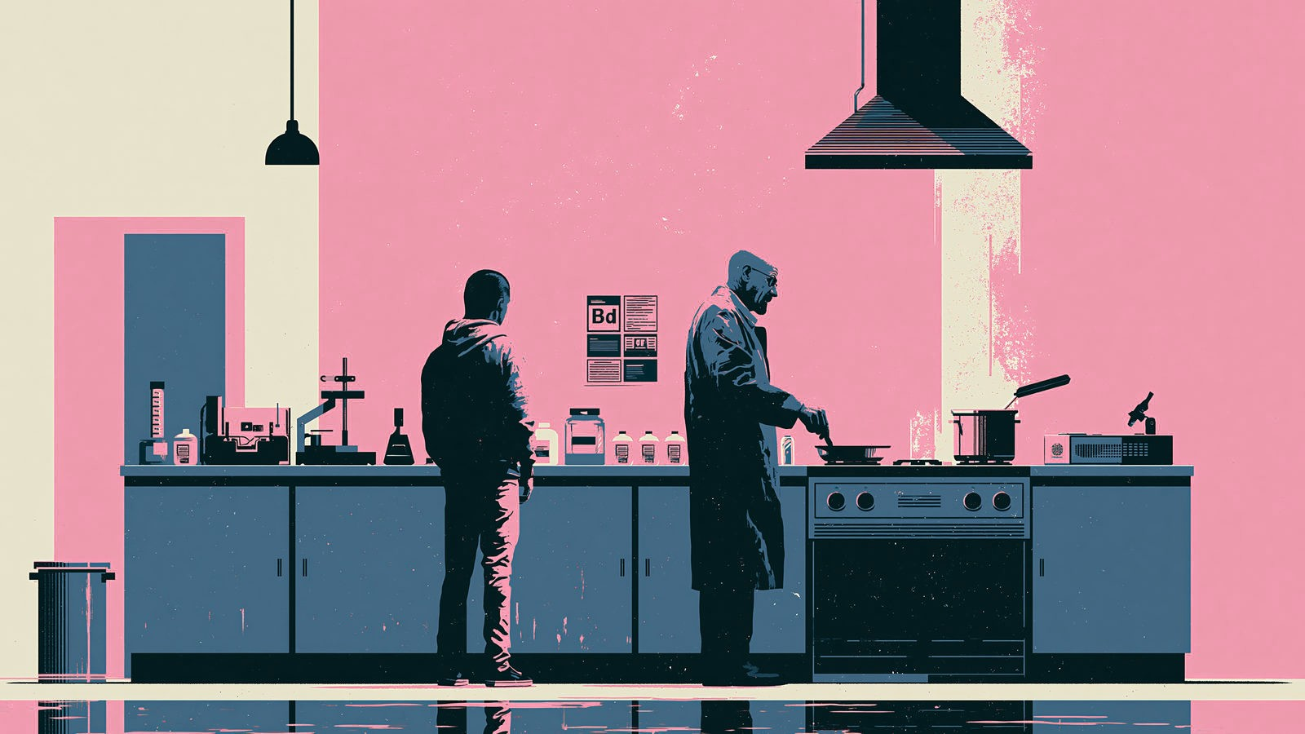

Present Continuous
BAKING BREAD
What is happening right now?
Notes:
[Sources]
- User-provided image: C:/Users/black/Downloads/blackisler_Jessie_Pinkmann_and_Walter_White_from_Breaking_Bad_e17c1b3d-3dff-4622-86ce-87b69193bd41_3.png
[/Sources]

Slide 2

Talk about what is happening now
SUBJECT
AM / IS / ARE
VERB + ING
Jessie
is
smoking
Look → choose the subject → add be → use -ing
Now describe every scene in a complete sentence.
Notes:
[Sources]
- No external sources; original grammar summary.
[/Sources]

Slide 3

What is Saul doing?
Saul is sitting in his office
Notes:
[Sources]
- User-provided image: C:/Users/black/Downloads/blackisler_Saul_Goodman_minimalist_vector_illustration_style__4fd6b2e8-644a-4e7a-afb6-ccadeae8c712_3.png
[/Sources]

Slide 4
What is Jessie doing?
Jessie is smoking
Notes:
[Sources]
- User-provided image: C:/Users/black/Downloads/blackisler_Jessie_Pinkmann_from_Breaking_Bad_minimalist_vecto_76496762-f19a-48c2-bfea-cbec6e8a4243_0.png
[/Sources]

Slide 5
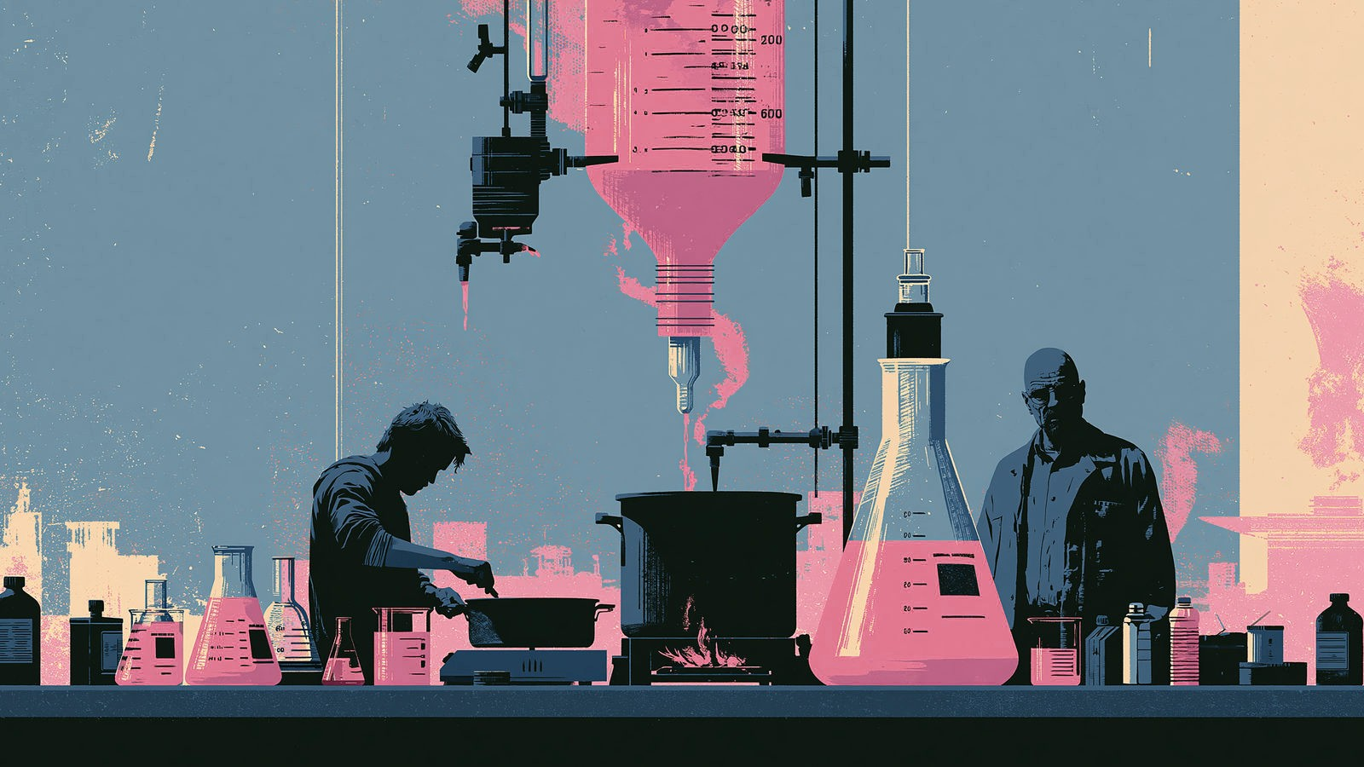
Jessie and Walt are baking bread
Notes:
[Sources]
- User-provided image: C:/Users/black/Downloads/blackisler_Jessie_Pinkmann_and_Walter_White_from_Breaking_Bad_e17c1b3d-3dff-4622-86ce-87b69193bd41_1.png
[/Sources]

Slide 6

Where is Jessie lying?
Jessie is lying down on the couch
Notes:
[Sources]
- User-provided image: C:/Users/black/Downloads/blackisler_Jessie_Pinkmann_from_Breaking_Bad_minimalist_vecto_94b497ea-1410-4660-a48b-182d934f778c_0.png
[/Sources]

Slide 7
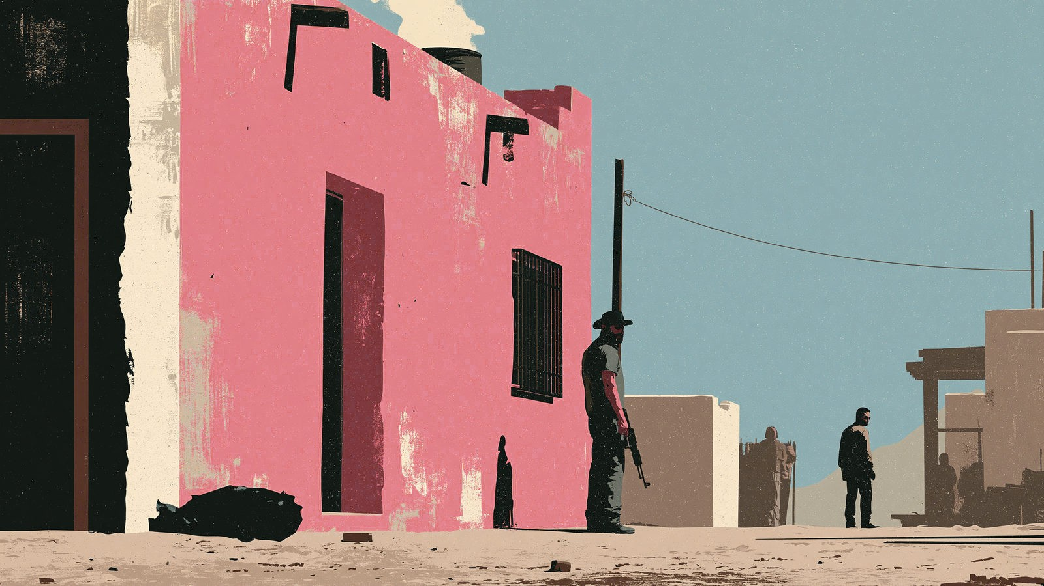
The men are guarding the house
Notes:
[Sources]
- User-provided image: C:/Users/black/Downloads/blackisler_breaking_bad_Tuco_minimalist_vector_illustration_s_bc9d6f8e-98ab-4d70-af22-57b39bb9bfb7_0.png
[/Sources]

Slide 8
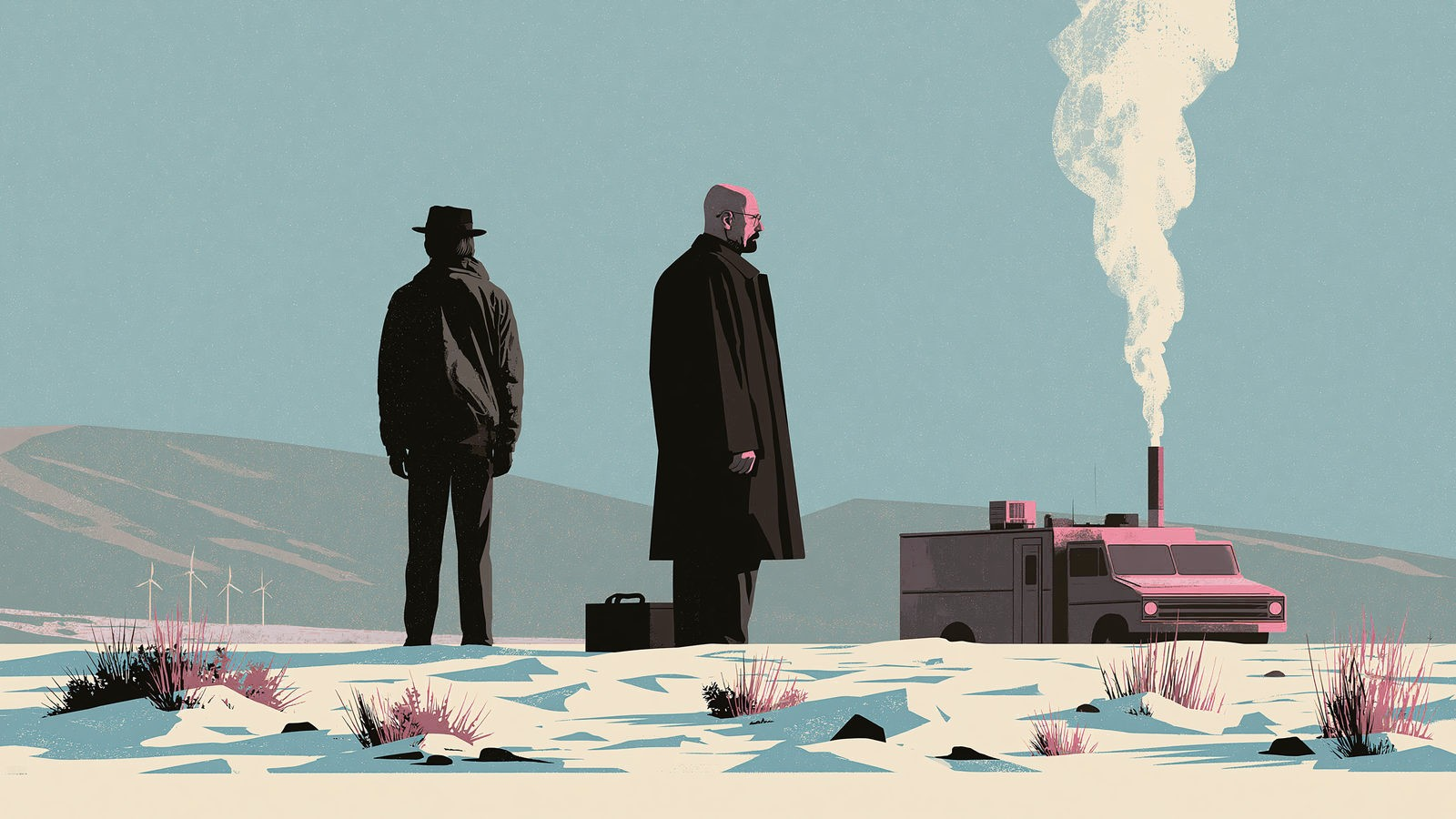
Jessie and Walt are standing in the desert
Where are they standing?
Notes:
[Sources]
- User-provided image: C:/Users/black/Downloads/blackisler_breaking_bad_Jessie_and_Walter_White_minimalist_ve_40169f06-c827-4e1f-8e0d-fe55606b7903_3.png
[/Sources]

Slide 9
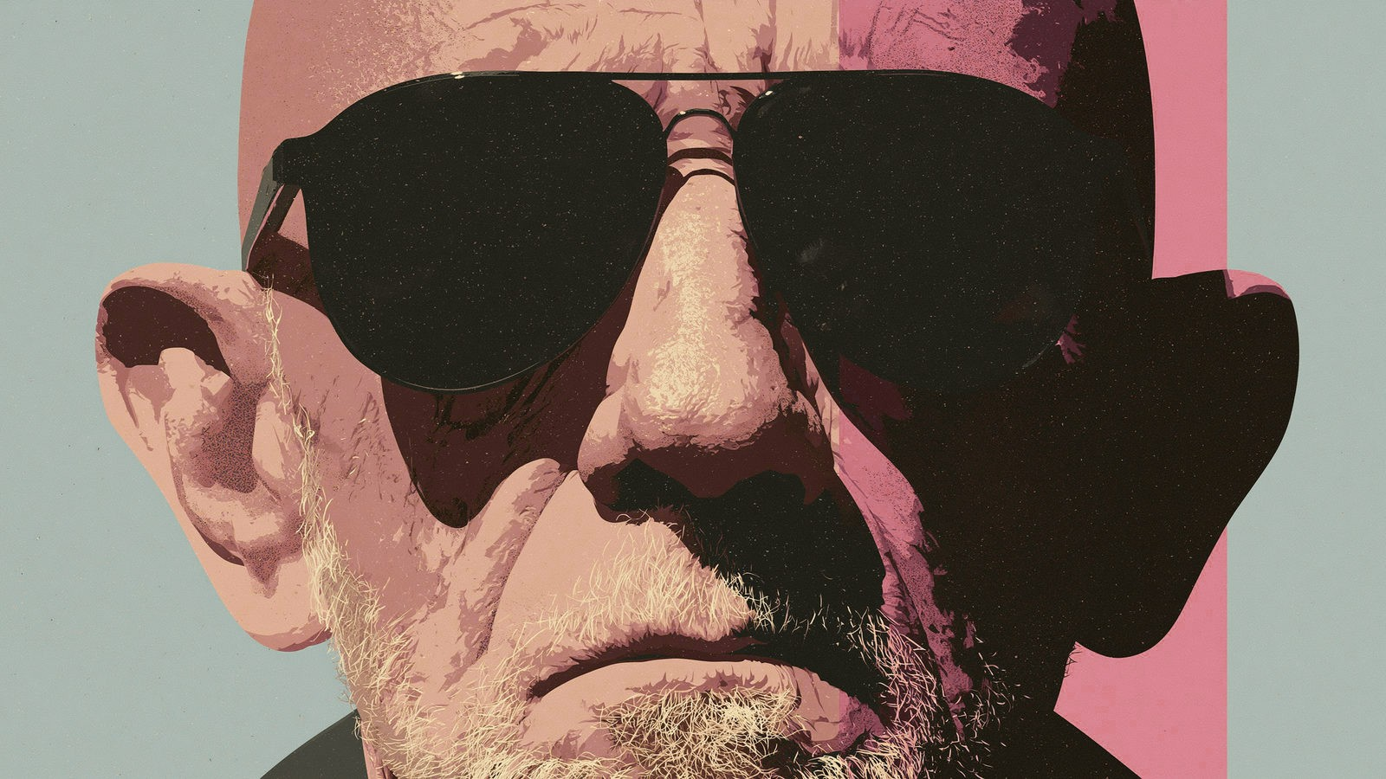
What is Mike wearing?
Mike is wearing sunglasses.
Notes:
[Sources]
- User-provided image: C:/Users/black/Downloads/blackisler_Mike_from_Breaking_Bad_minimalist_vector_illustrat_d6f03f43-3ace-4ab1-9e98-765696f240f6_2.png
[/Sources]

Slide 10
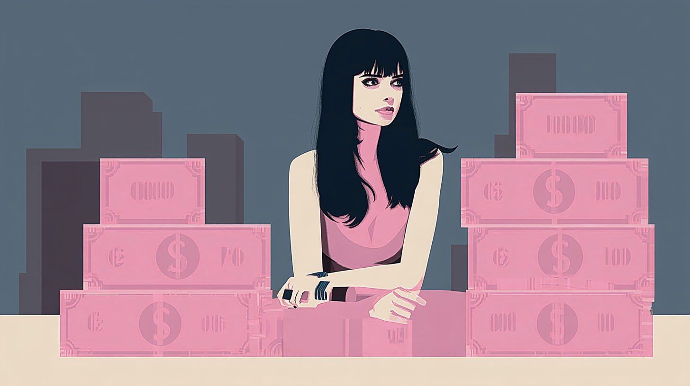
What is Jane doing?
Jane is saving her money for a rainy day
Notes:
[Sources]
- User-provided image: C:/Users/black/Downloads/blackisler_Jane_from_Breaking_Bad_counting_dollars_minimalist_e581eb51-c8de-46e2-92da-6502234c2b28_1.png
[/Sources]

Slide 11
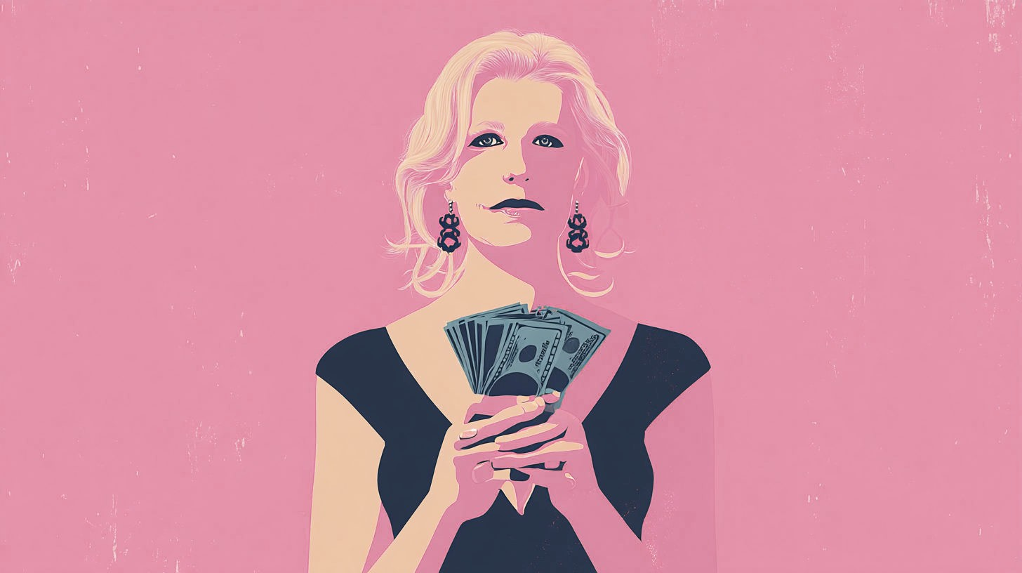
Skyler is counting the cash
Notes:
[Sources]
- User-provided image: C:/Users/black/Downloads/blackisler_Skyler_White_from_Breaking_Bad_counting_dollars_mi_0a84b73c-cad9-4c6f-aec7-34d4cb58a236_2.png
[/Sources]

Slide 12
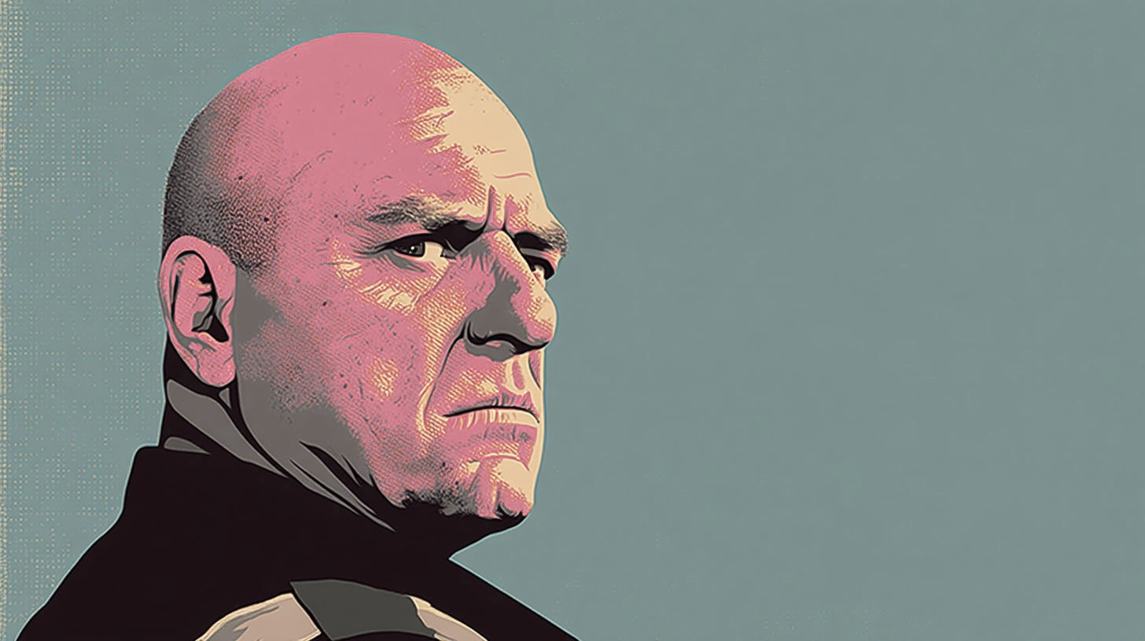
Hank is realising something important
Notes:
[Sources]
- User-provided image: C:/Users/black/Downloads/blackisler_The_primary_law_enforcement_officer_in_Breaking_Ba_e8327da2-d517-430a-bdb4-9e4d0baa7452_0.png
[/Sources]

Slide 13
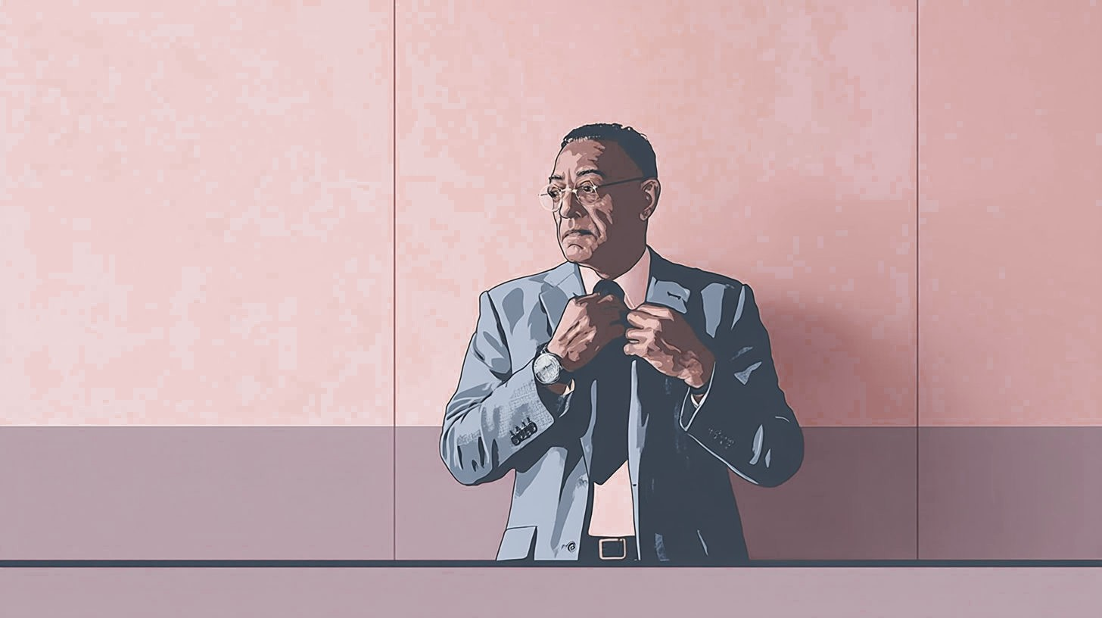
Gustav is adjusting his tie
Notes:
[Sources]
- User-provided image: C:/Users/black/Downloads/blackisler_Gustavo_Fring_Meticulously_and_calmly_adjusting_hi_260db0c0-cfc0-4947-a521-0efdc7dcff88_3.png
[/Sources]

Slide 14
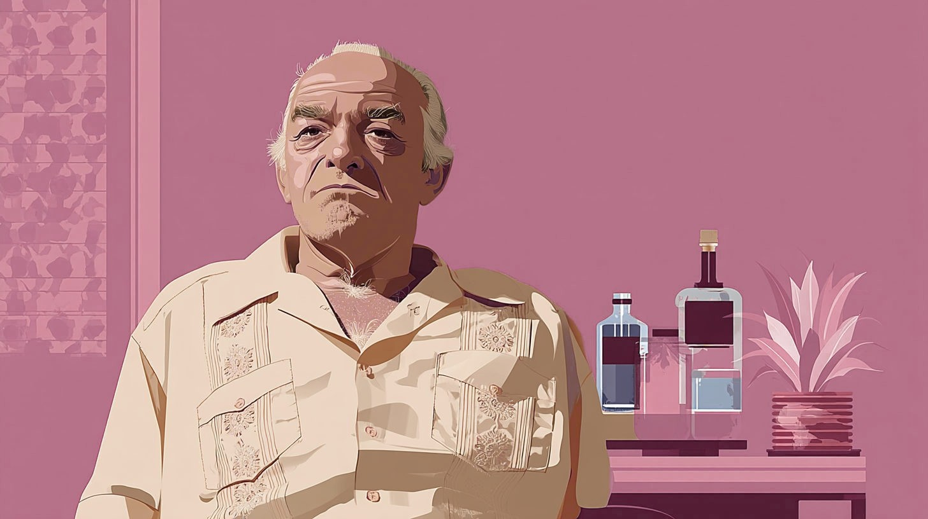
Hector is planning his revenge
Notes:
[Sources]
- User-provided image: C:/Users/black/Downloads/blackisler_Hector_Salamanca_minimalist_vector_illustration_st_a026a225-6ffd-4670-87dc-9acf3d4b3c95_2.png
[/Sources]

Slide 15
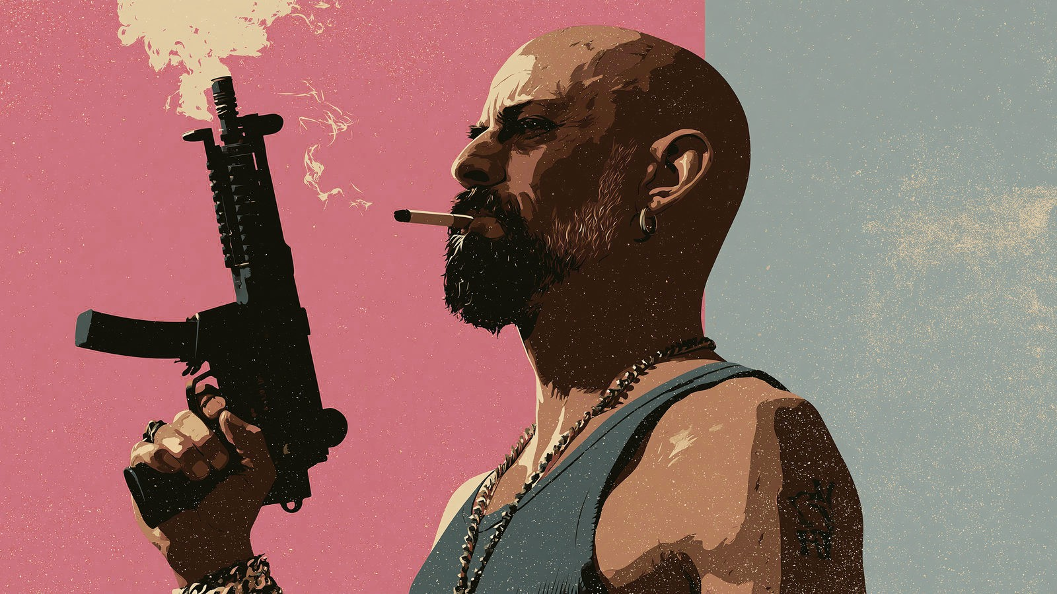
The gangster is holding a machine gun
Notes:
[Sources]
- User-provided image: C:/Users/black/Downloads/blackisler_breaking_bad_Tuco_minimalist_vector_illustration_s_bc9d6f8e-98ab-4d70-af22-57b39bb9bfb7_2.png
[/Sources]

Slide 16

Your turn
Describe the scene
1. Who is in the scene?
2. Which form of ‘be’ do you need?
3. What is the -ing verb?
4. Add one place or object detail.
SUBJECT
+
BE
+
VERB-ING
Say one complete sentence aloud.
Notes:
[Sources]
- No external sources; original classroom retrieval activity.
[/Sources]

