Slide 1

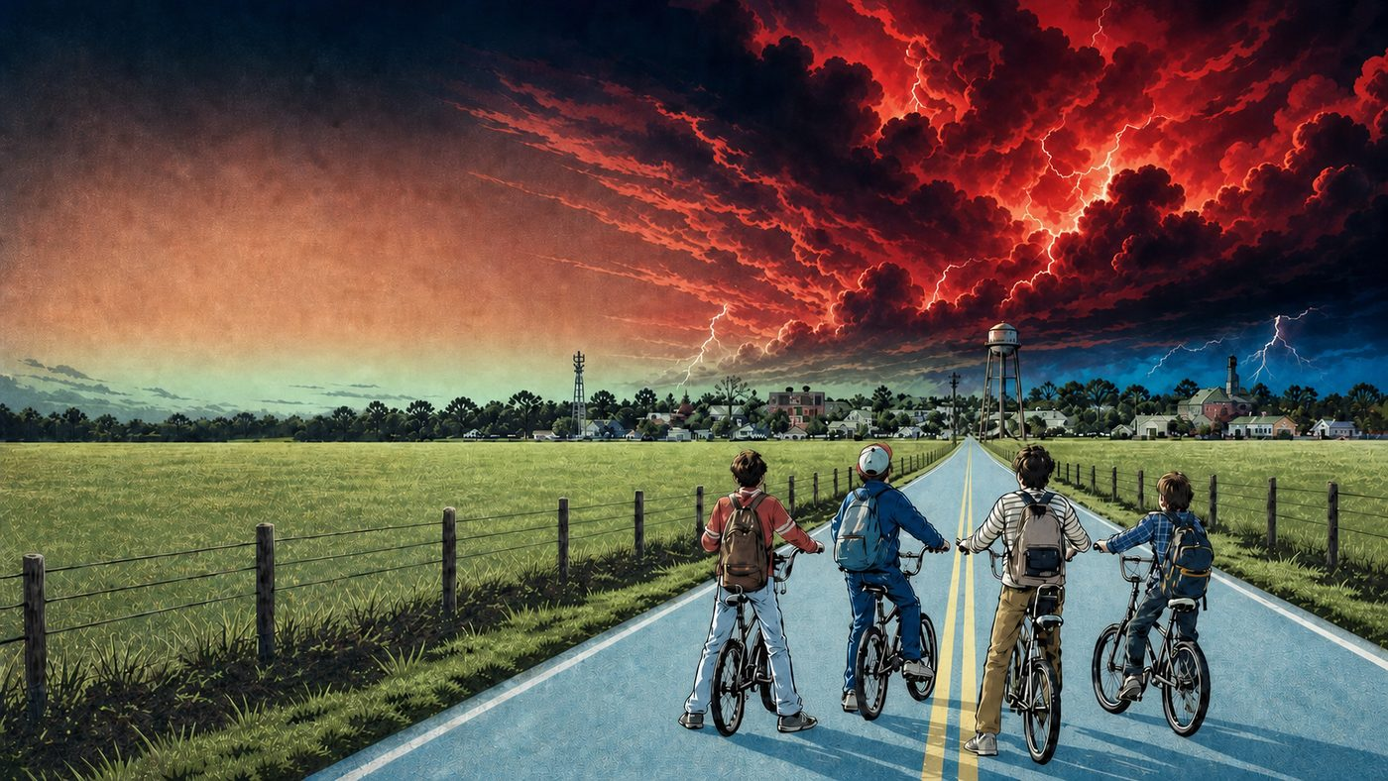





FORBES ENGLISH • PREPOSITIONS
TWIN
PEAKS
HAWKINS FIELD GUIDE
A VISUAL GUIDE TO PREPOSITIONS
A VISUAL GUIDE
TO PREPOSITIONS
Notes:
[Sources]
- User-supplied Stranger Things Season 1 character/reference sheet: stranger things bible.pdf
- User-supplied Hawkins road reference: stranger.webp
- User-supplied palette references: stranger things palette 2.jpg, stranger things palette 3.jpg, and st graphicnove;.jpg
- User-supplied cover logo: stranger-things-logo-png_seeklogo-509066B.png
- User-supplied Hellfire Club emblem reference: codex-clipboard-5f3595d0-15de-4255-89d8-c79a6045cada.png
- Artwork: AI-generated composition proof and vector-style transformation created for this deck.
[/Sources]

Slide 2
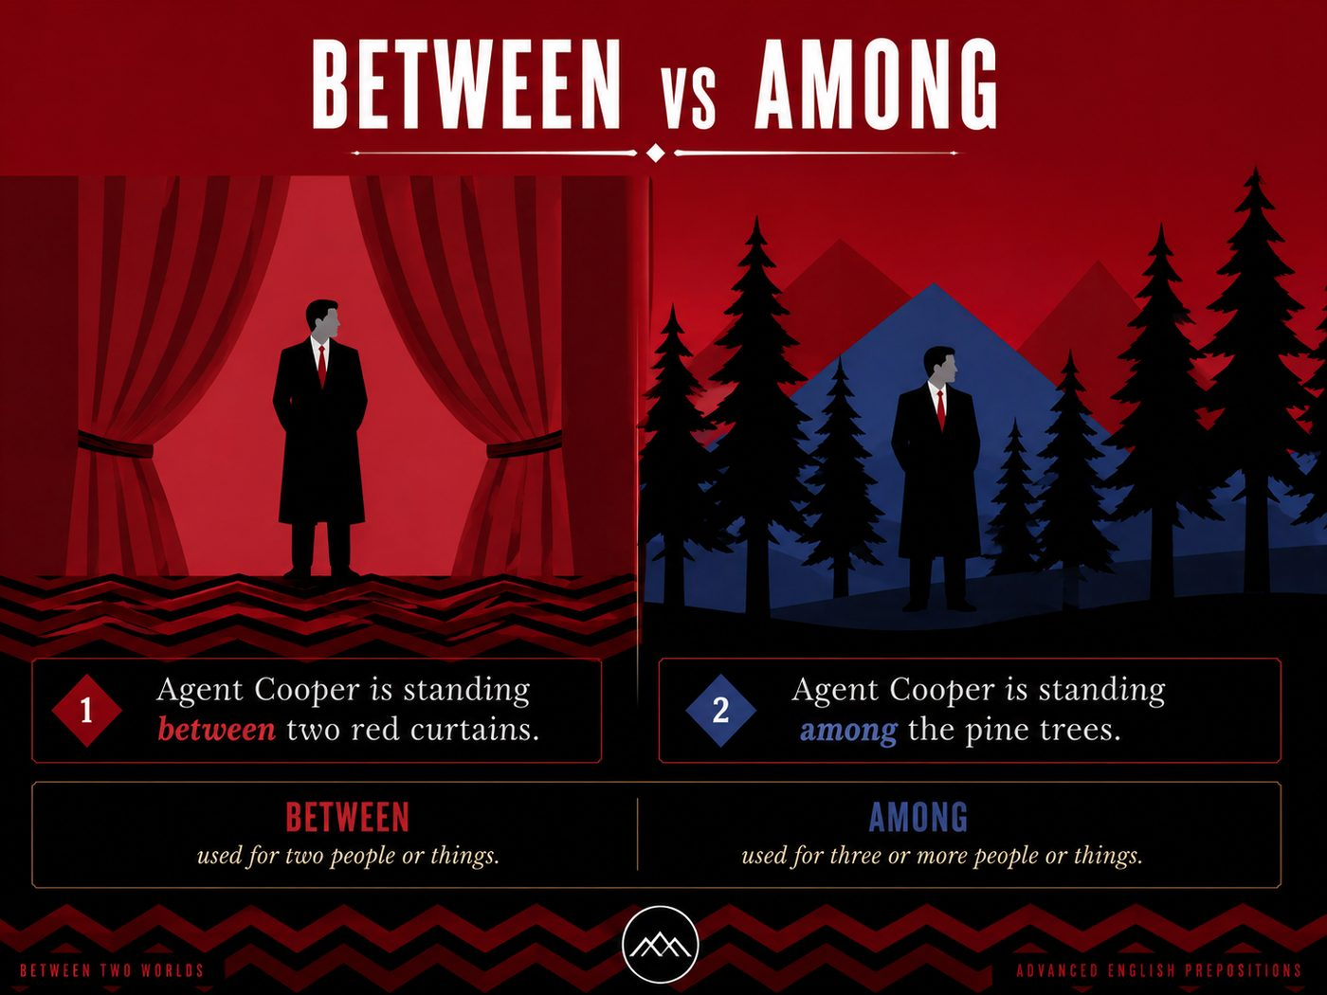
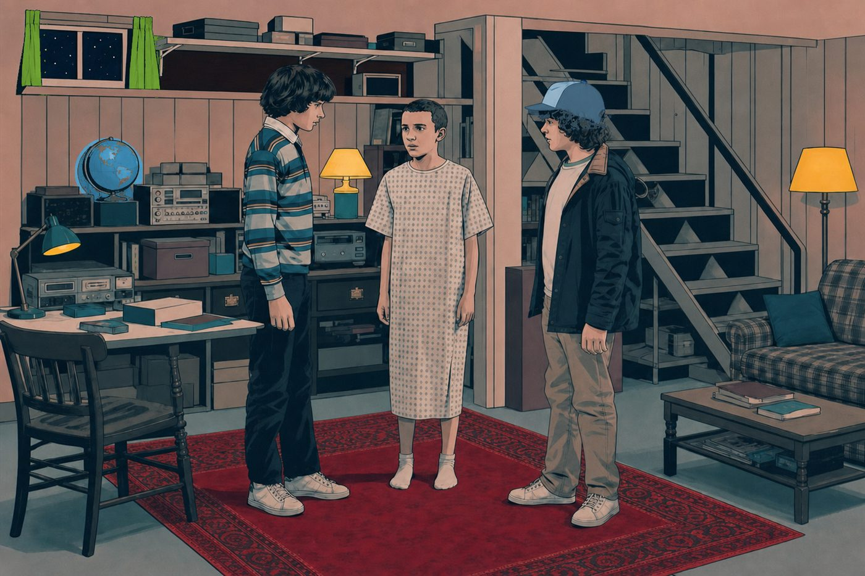
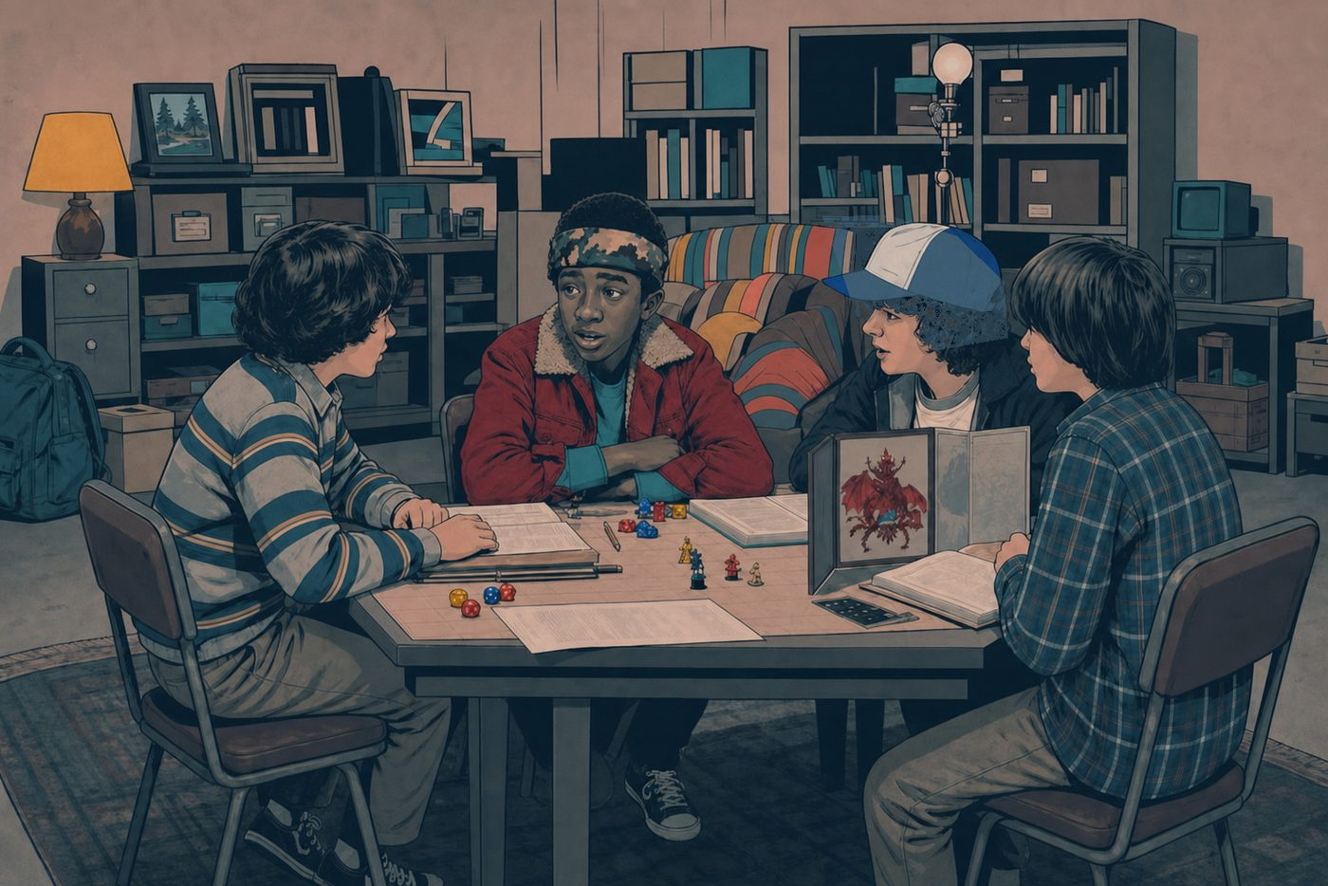
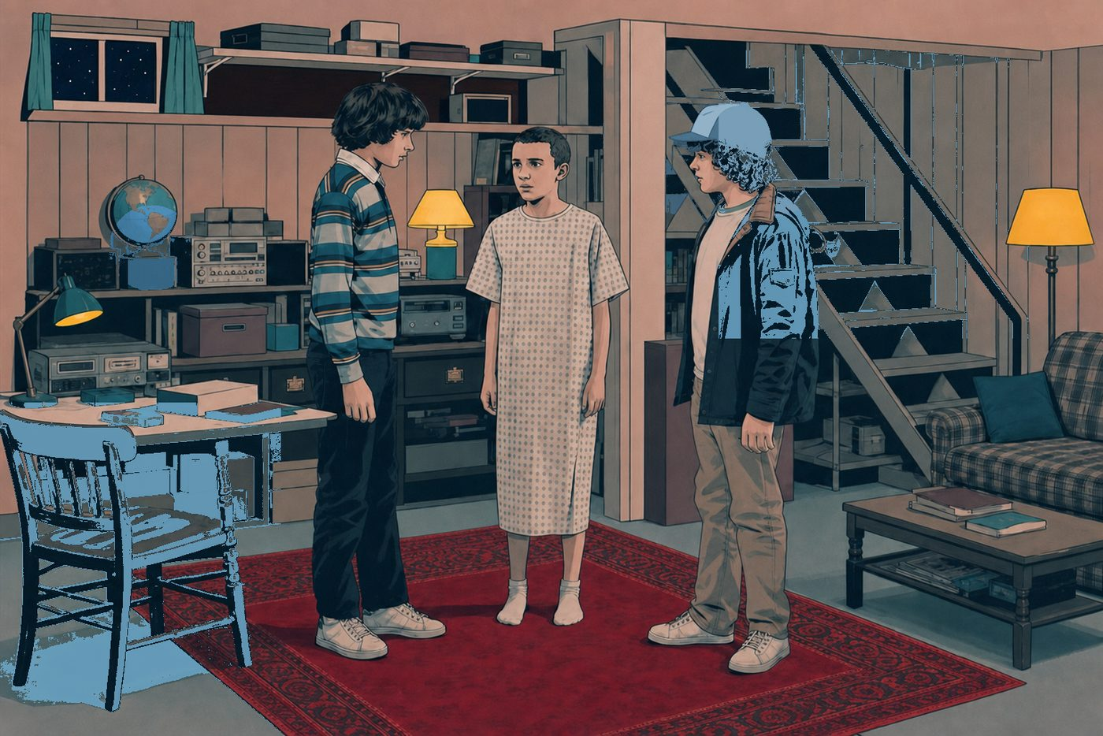

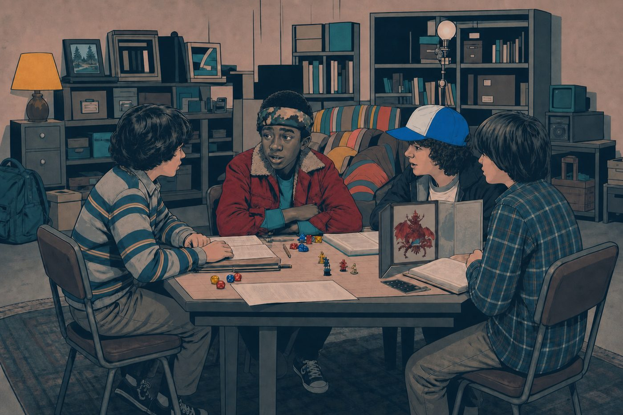


FORBES ENGLISH • PREPOSITIONS
FORBES ENGLISH • PREPOSITIONS
1
FORBES ENGLISH • PREPOSITIONS
1
BETWEEN
BETWEEN
AMONG
AMONG
Eleven is standing between Mike and Dustin.
Lucas is sitting among the boys.
BETWEEN
AMONG
Use between for a position separating two distinct people or things.
Use between for a position separating two distinct people or things.
Use among when someone or something is surrounded by a group.
Use among when someone or something is surrounded by a group.
used for two people or things.
used for three or more people or things.
HAWKINS FIELD GUIDE
Forbes
HAWKINS FIELD GUIDE
ENGLISH
Notes:
[Sources]
- Identity references: user-supplied Stranger Things Season 1 character sheet in stranger things bible.pdf.
- User-supplied palette references: stranger things palette 2.jpg, stranger things palette 3.jpg, and st graphicnove;.jpg.
- User-supplied Hellfire Club emblem reference: codex-clipboard-5f3595d0-15de-4255-89d8-c79a6045cada.png.
- Artwork: AI-generated photorealistic composition proof, then AI-generated flat editorial vector-style transformation for slide 2.
[/Sources]

Slide 3
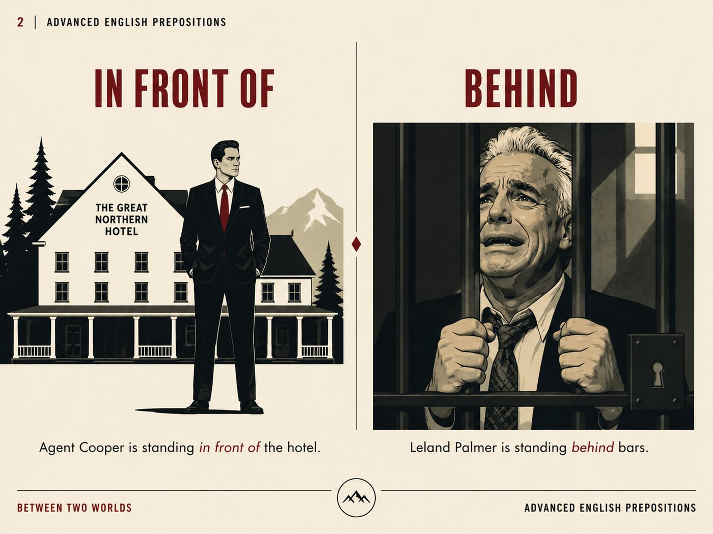


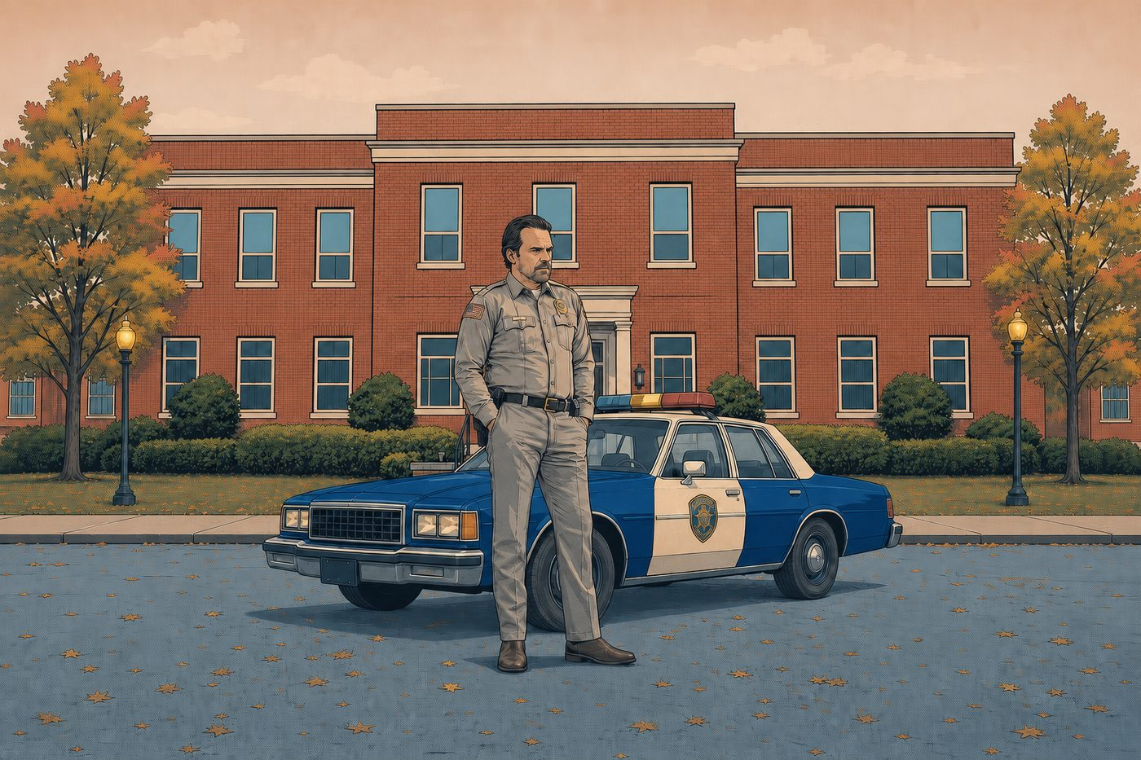

FORBES ENGLISH • PREPOSITIONS
2
FORBES ENGLISH • PREPOSITIONS
IN FRONT OF
IN FRONT OF
BEHIND
BEHIND
Hopper is standing in front of the police station.
Dr Brenner is standing behind the observation glass.
Leland Palmer is standing behind bars.
Use in front of for a position ahead of another person or object.
Use in front of for a position ahead of another person or object.
Use behind for a position at the back of someone or something.
Use behind for a position at the back of someone or something.
HAWKINS FIELD GUIDE
Forbes
ENGLISH
Notes:
[Sources]
- Identity references: user-supplied Stranger Things Season 1 character sheet in stranger things bible.pdf.
- User-supplied palette references: stranger things palette 2.jpg, stranger things palette 3.jpg, and st graphicnove;.jpg.
- User-supplied Hellfire Club emblem reference: codex-clipboard-5f3595d0-15de-4255-89d8-c79a6045cada.png.
- Artwork: AI-generated photorealistic composition proof, then AI-generated flat editorial vector-style transformation for slide 3.
[/Sources]

Slide 4

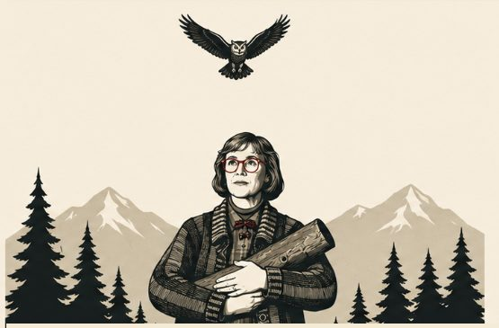

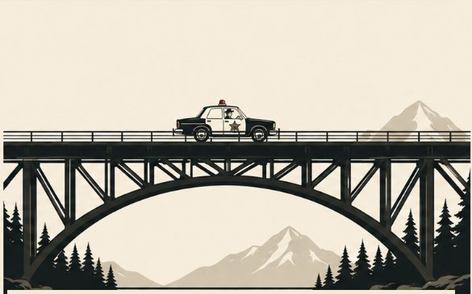
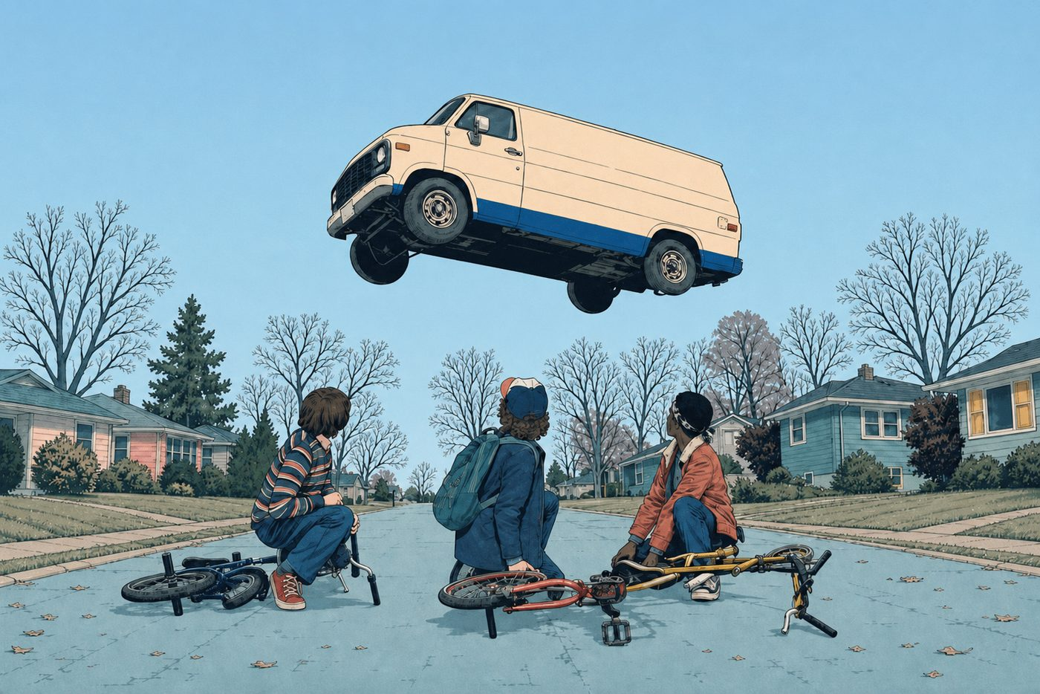
FORBES ENGLISH • PREPOSITIONS
3
FORBES ENGLISH • PREPOSITIONS
ABOVE
ABOVE
OVER
OVER
The Christmas lights are above Joyce.
The van is flying over the boys.
An owl is flying above the Log Lady.
Use above when something is higher, without implying movement or contact.
Use above when something is higher, without movement or contact.
Use over for movement across or a position directly higher than something.
Use over for movement across or a position directly higher than something.
HAWKINS FIELD GUIDE
Forbes
ENGLISH
Notes:
[Sources]
- Identity references: user-supplied Stranger Things Season 1 character sheet in stranger things bible.pdf.
- User-supplied palette references: stranger things palette 2.jpg, stranger things palette 3.jpg, and st graphicnove;.jpg.
- User-supplied Hellfire Club emblem reference: codex-clipboard-5f3595d0-15de-4255-89d8-c79a6045cada.png.
- Artwork: AI-generated photorealistic composition proof, then AI-generated flat editorial vector-style transformation for slide 4.
[/Sources]

Slide 5
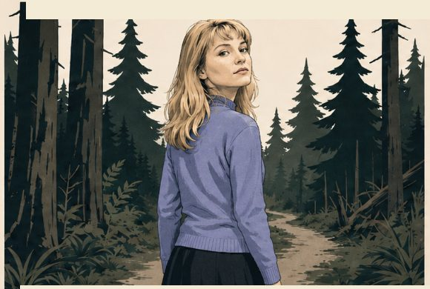
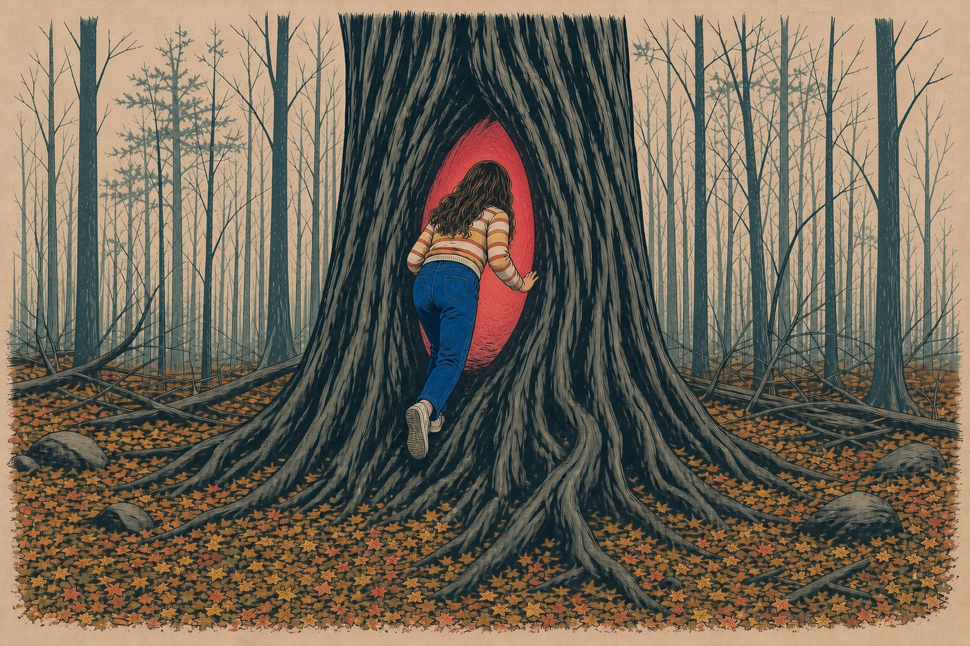

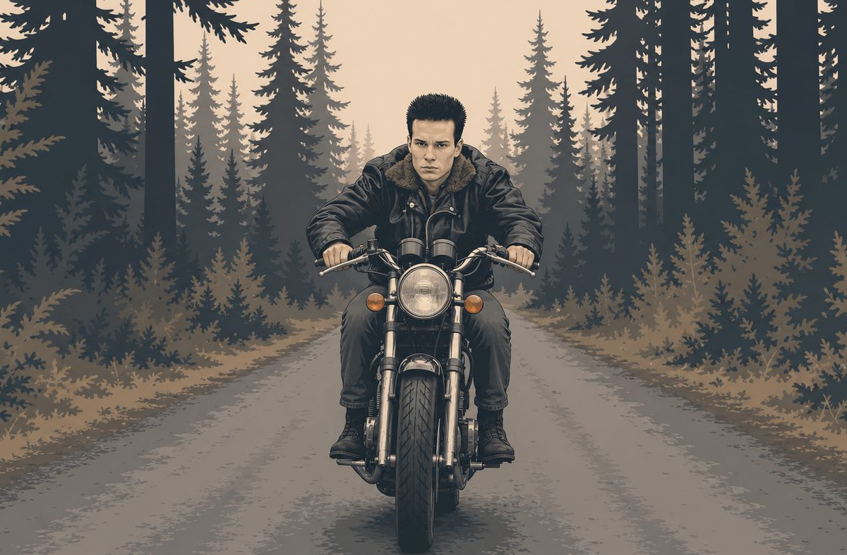
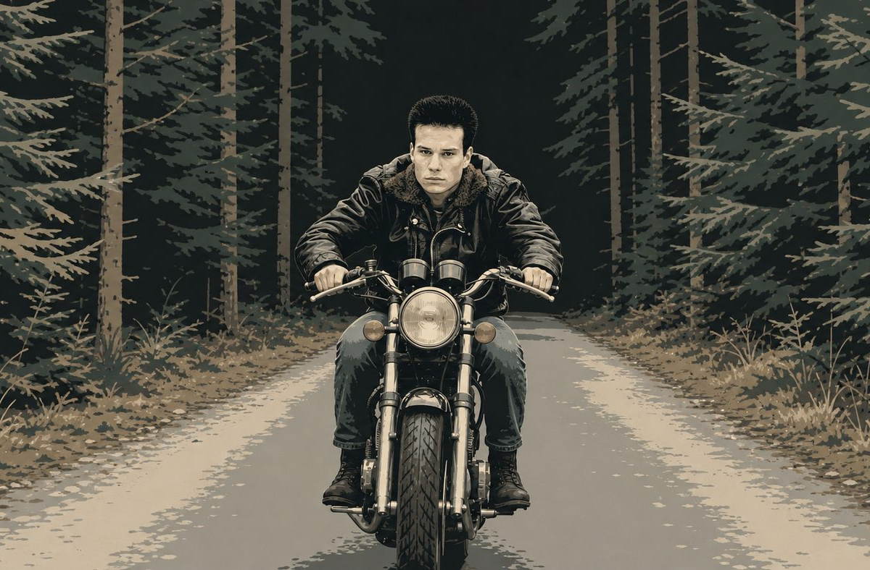
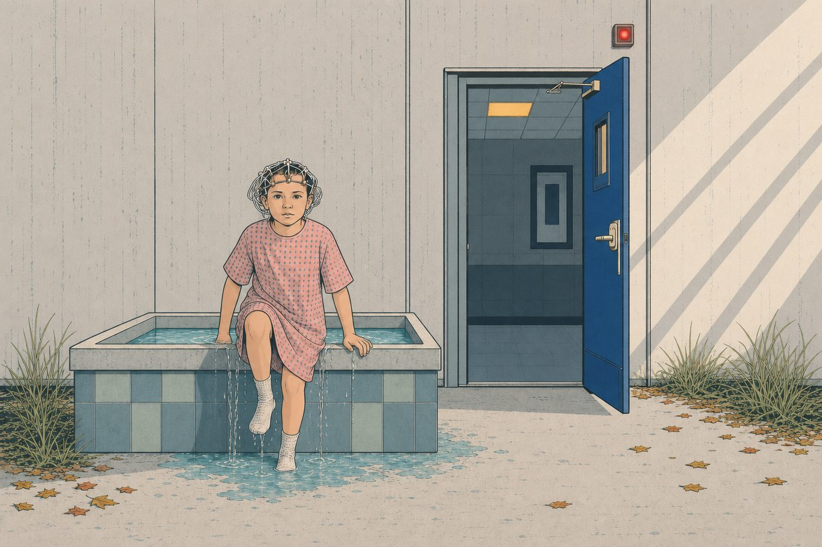
FORBES ENGLISH • PREPOSITIONS
4
FORBES ENGLISH • PREPOSITIONS
INTO
INTO
OUT OF
OUT OF
Nancy is climbing into the tree portal.
Eleven is getting out of the isolation bath.
James Hurley is riding out of the woods.
Use into for movement from outside to inside.
Use into for movement from outside to inside.
Use out of for movement from inside to outside.
Use out of for movement from inside to outside.
HAWKINS FIELD GUIDE
Forbes
ENGLISH
Notes:
[Sources]
- Identity references: user-supplied Stranger Things Season 1 character sheet in stranger things bible.pdf.
- User-supplied palette references: stranger things palette 2.jpg, stranger things palette 3.jpg, and st graphicnove;.jpg.
- User-supplied Hellfire Club emblem reference: codex-clipboard-5f3595d0-15de-4255-89d8-c79a6045cada.png.
- Artwork: AI-generated photorealistic composition proof, then AI-generated flat editorial vector-style transformation for slide 5.
[/Sources]

Slide 6
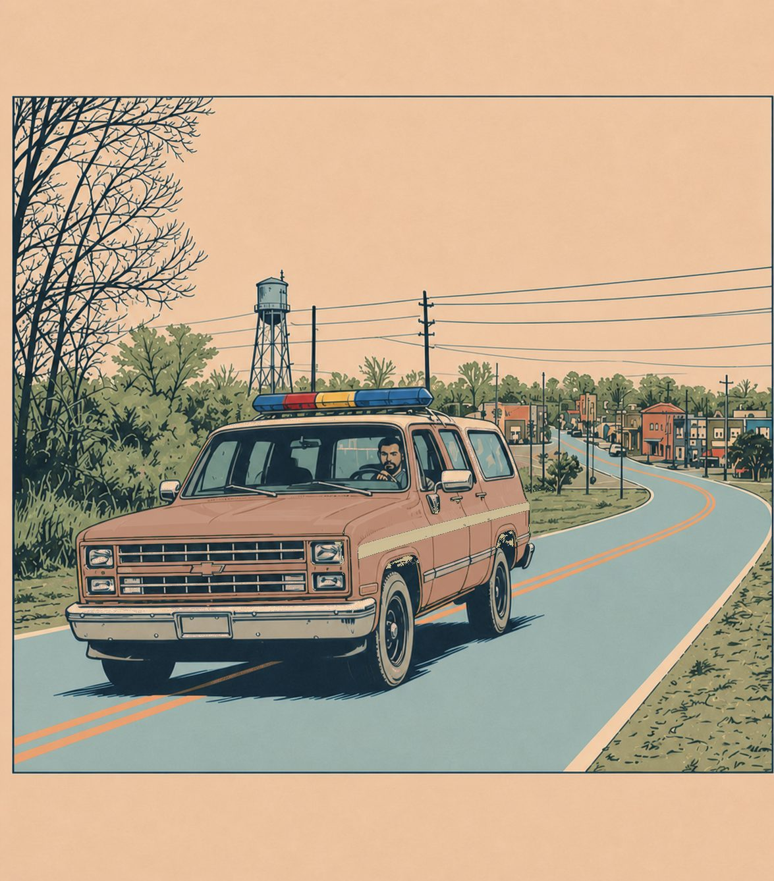
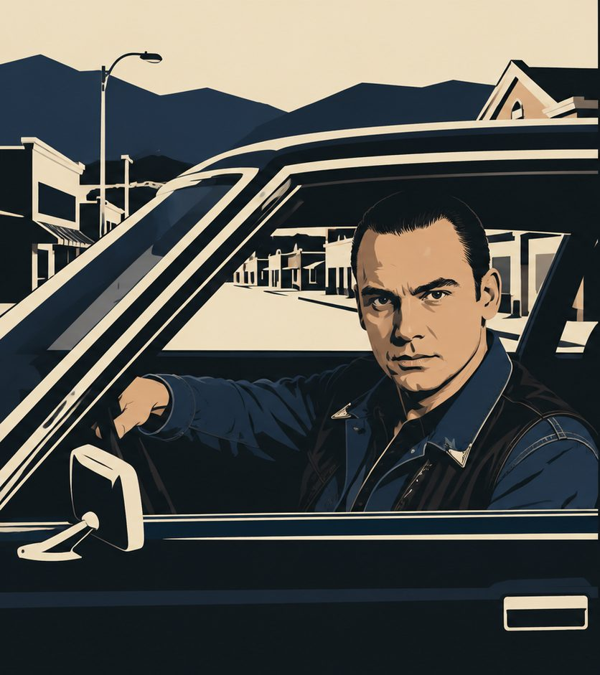

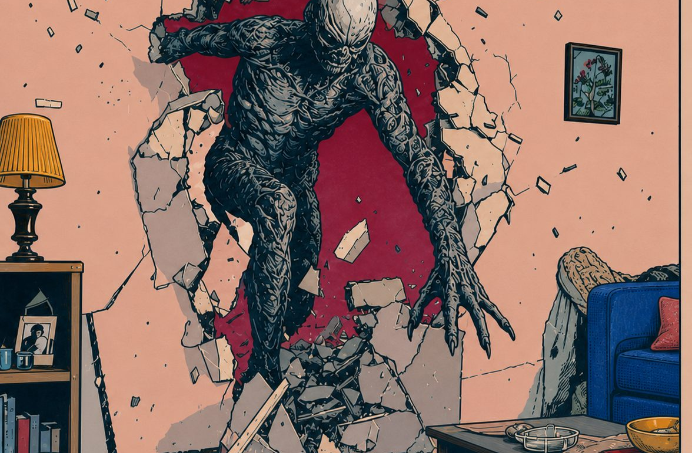
FORBES ENGLISH • PREPOSITIONS
FORBES ENGLISH • PREPOSITIONS
5
FORBES ENGLISH • PREPOSITIONS
5
AROUND
AROUND
THROUGH
THROUGH
IMAGE SLOT
Leo Johnson driving around town. The road should loop around town blocks or the Welcome sign, so the circular movement is unmistakable. Keep car small and palette restrained.
Hopper is driving around Hawkins.
The creature is breaking through the wall.
Leo is driving around town.
BOB is moving through the curtains.
AROUND
THROUGH
Use around for circular movement or movement within different parts of a place.
Use around for circular movement or movement within different parts of a place.
Use through for movement from one side of an enclosed space to the other.
Use through for movement from one side of an enclosed space to the other.
movement in a circle or along different parts of a place.
movement from one side of an enclosed space to the other.
HAWKINS FIELD GUIDE
Forbes
HAWKINS FIELD GUIDE
ENGLISH
Notes:
[Sources]
- Identity references: user-supplied Stranger Things Season 1 character sheet in stranger things bible.pdf.
- User-supplied palette references: stranger things palette 2.jpg, stranger things palette 3.jpg, and st graphicnove;.jpg.
- User-supplied Hellfire Club emblem reference: codex-clipboard-5f3595d0-15de-4255-89d8-c79a6045cada.png.
- Artwork: AI-generated photorealistic composition proof, then AI-generated flat editorial vector-style transformation for slide 6.
[/Sources]

Slide 7
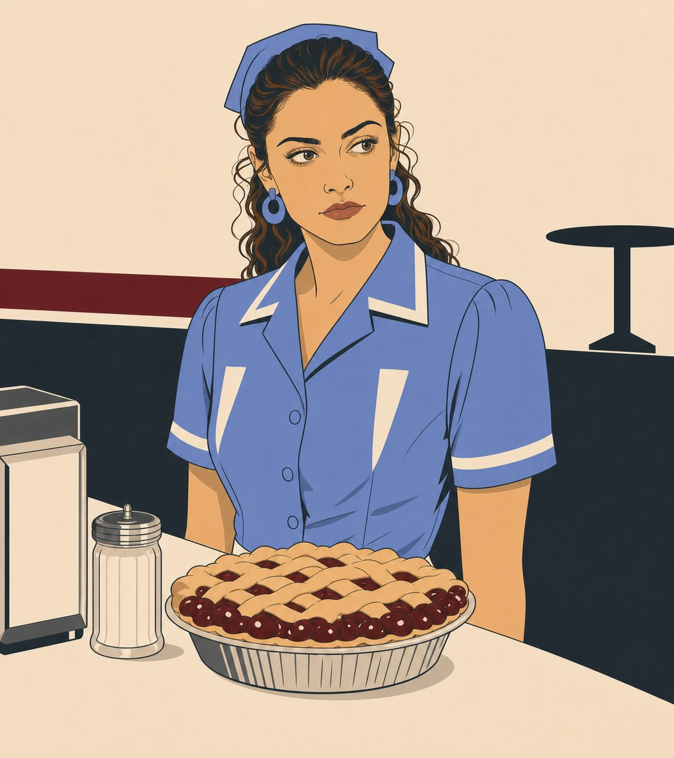
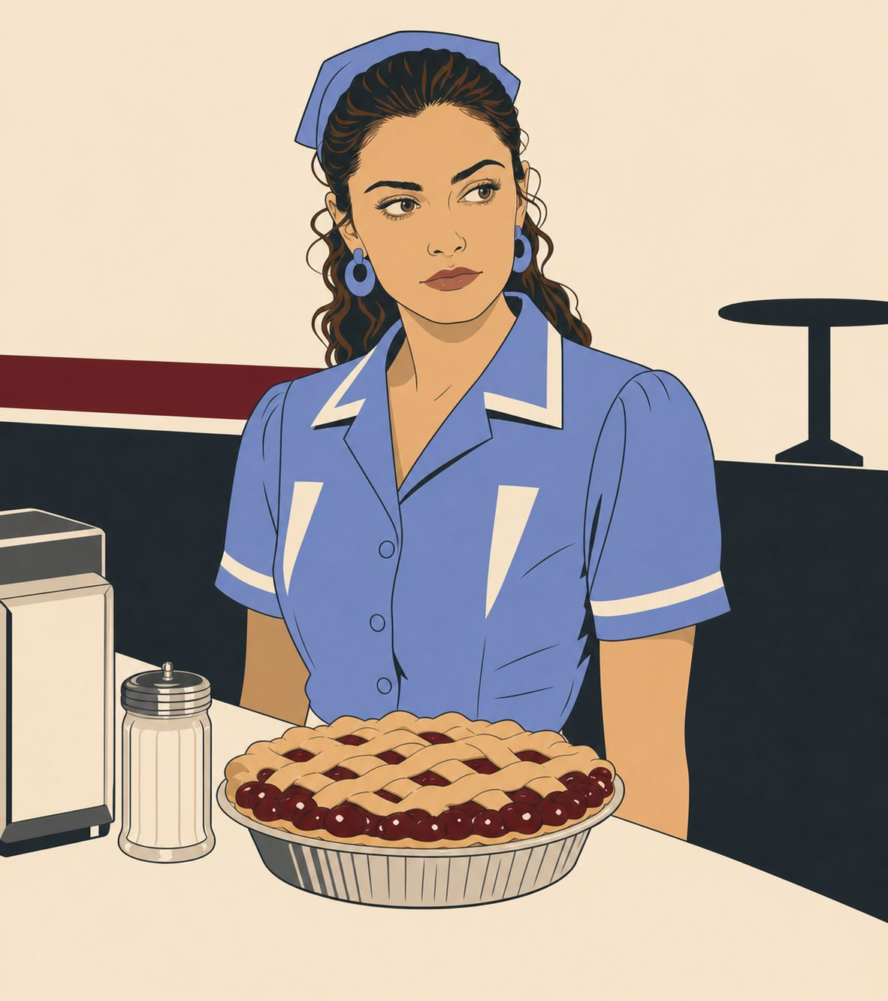
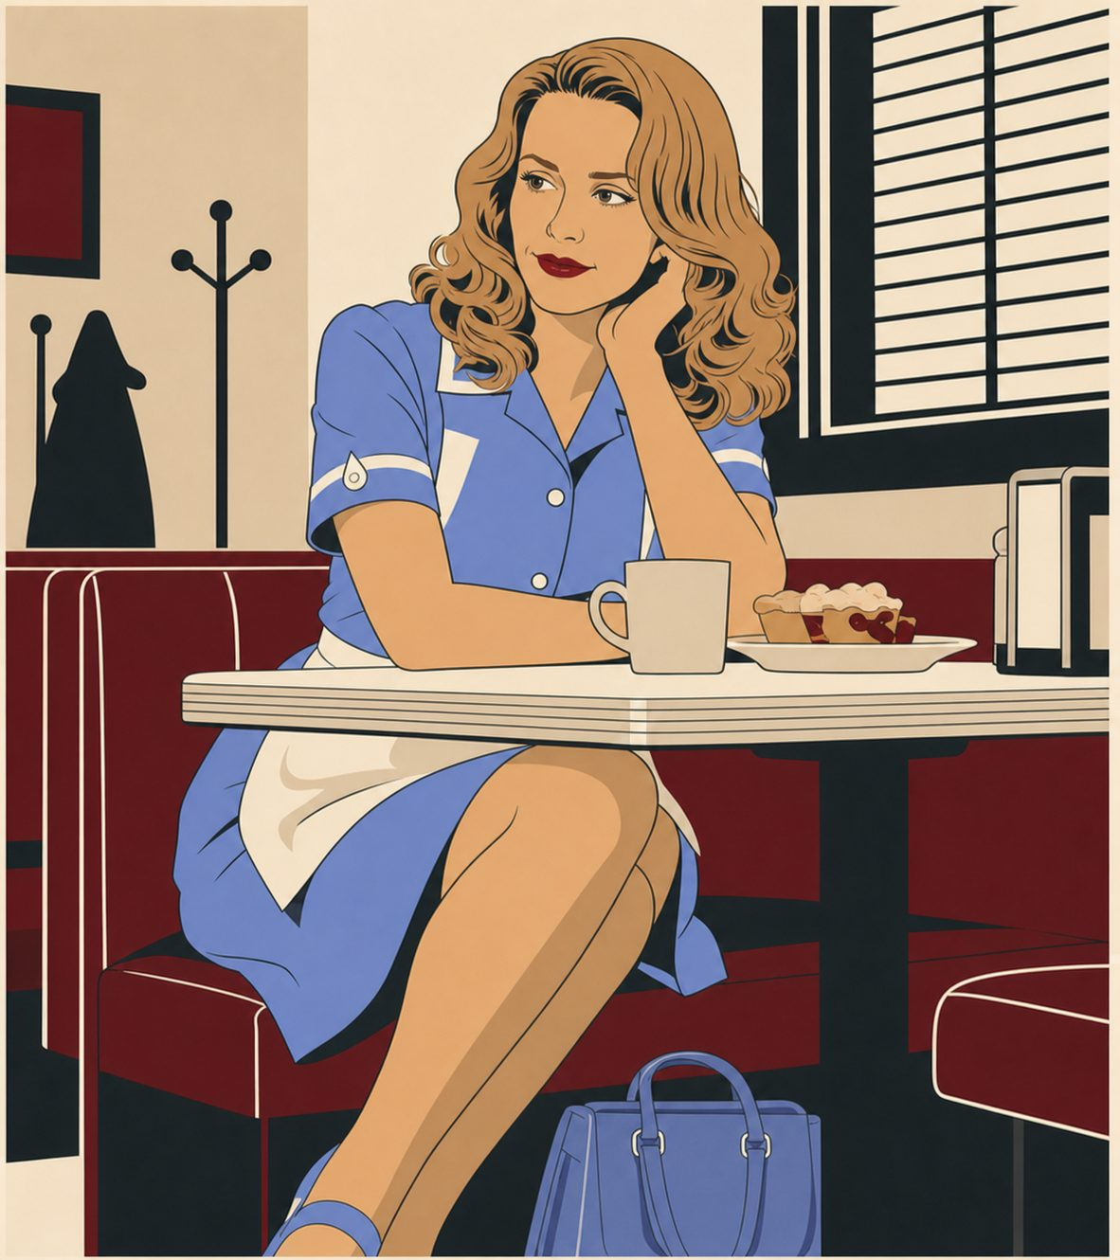
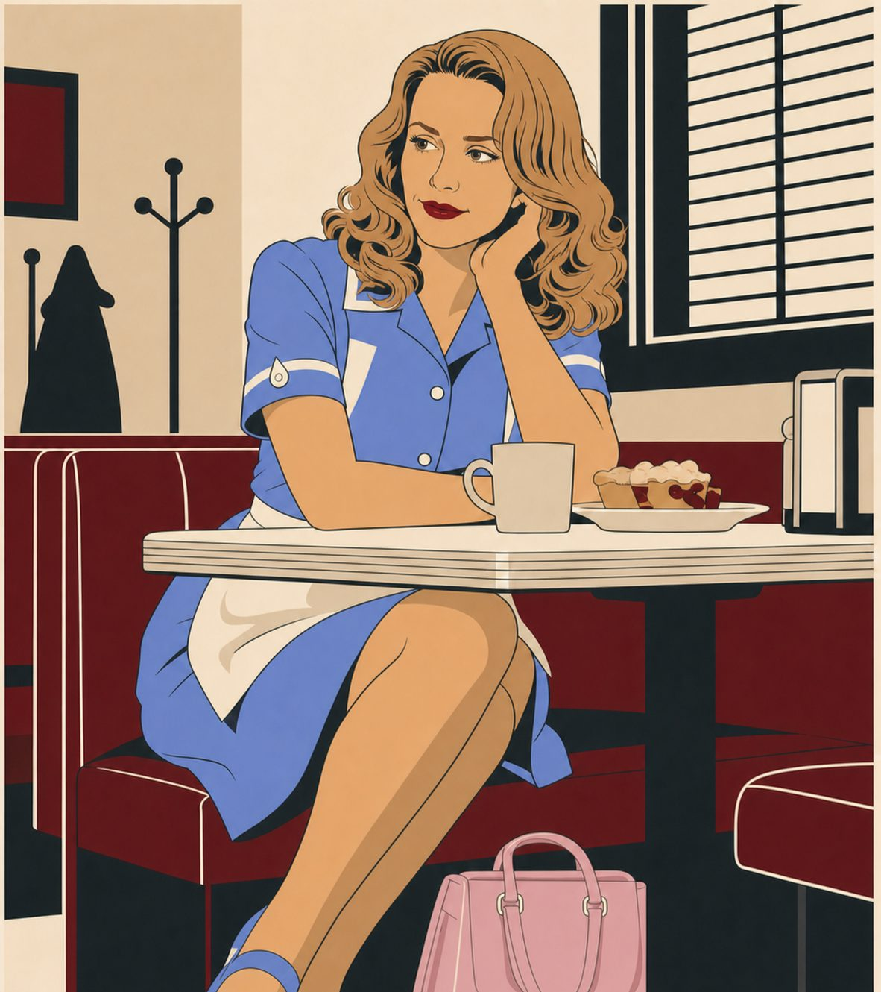
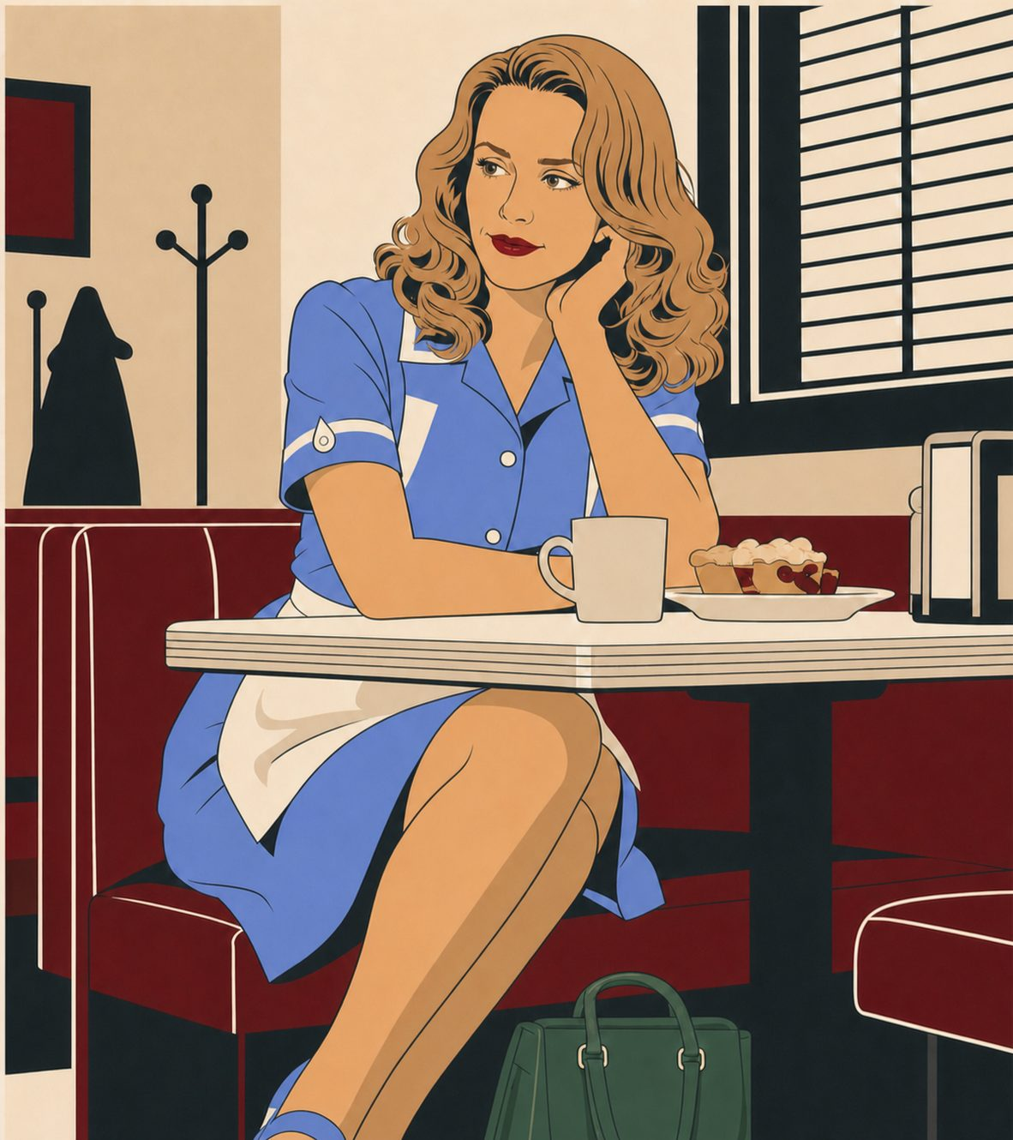
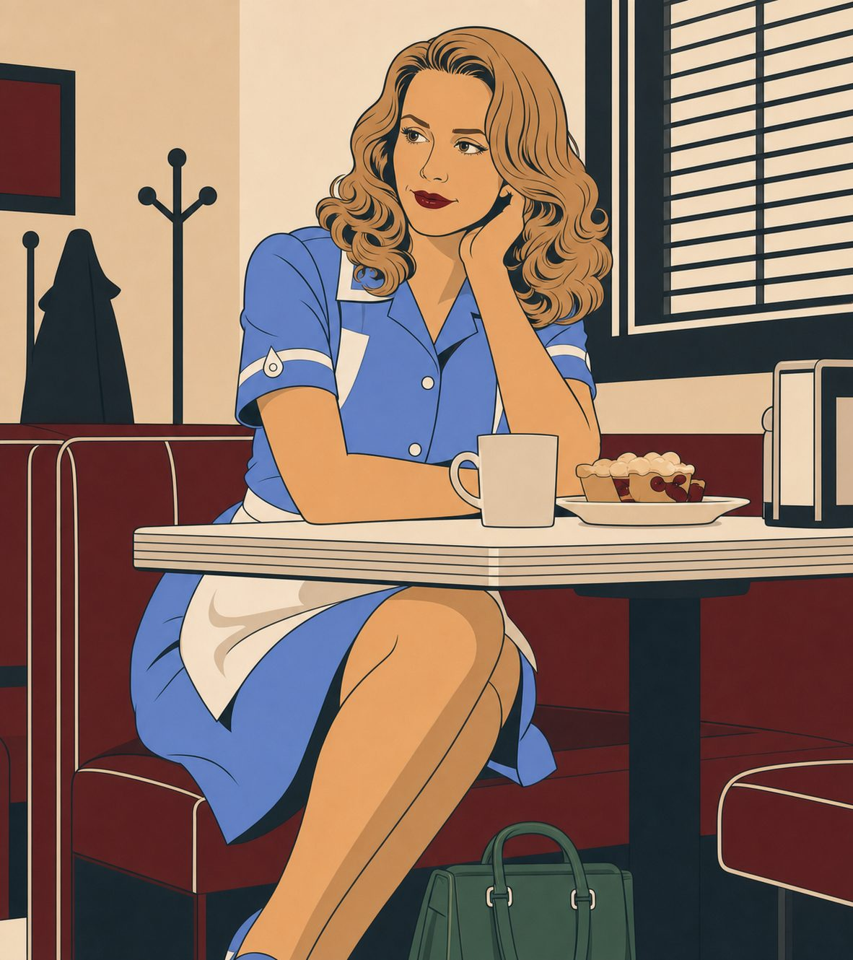
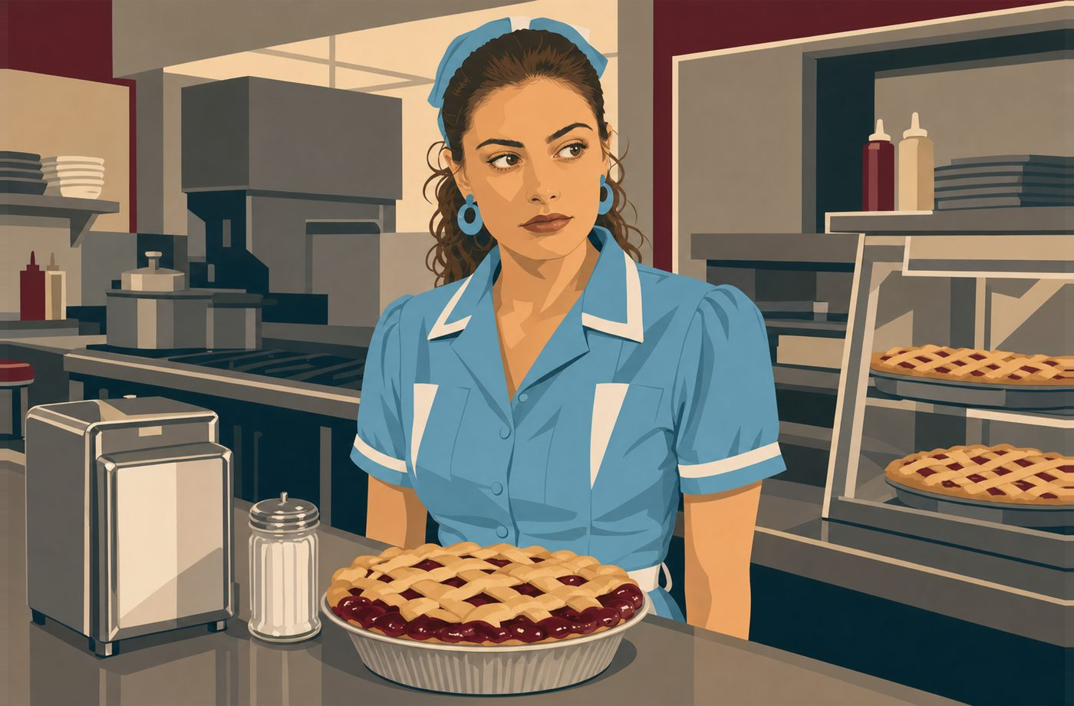
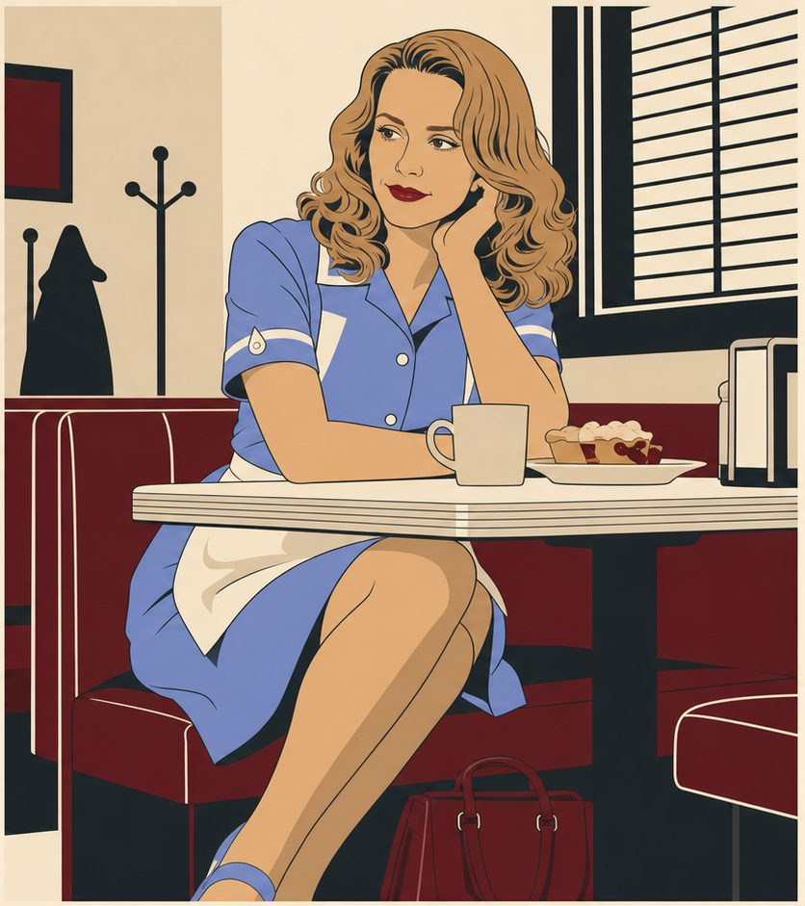
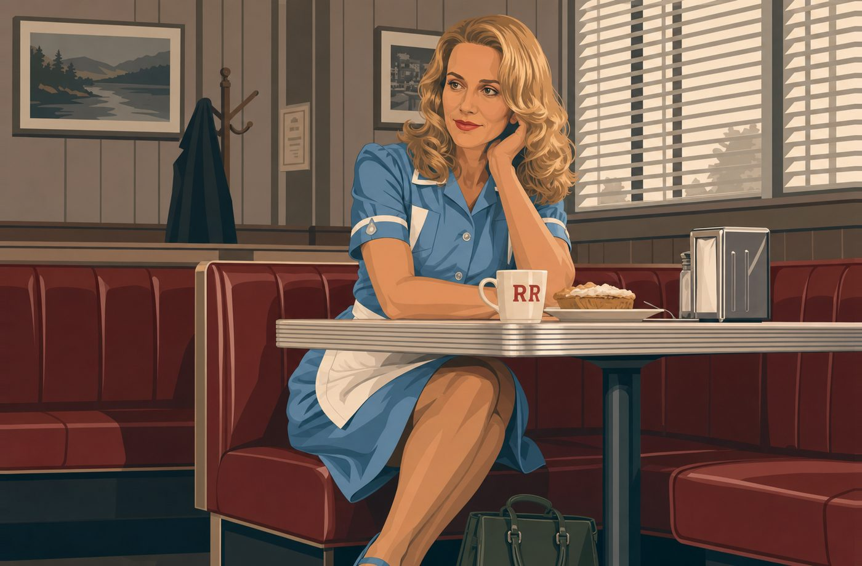
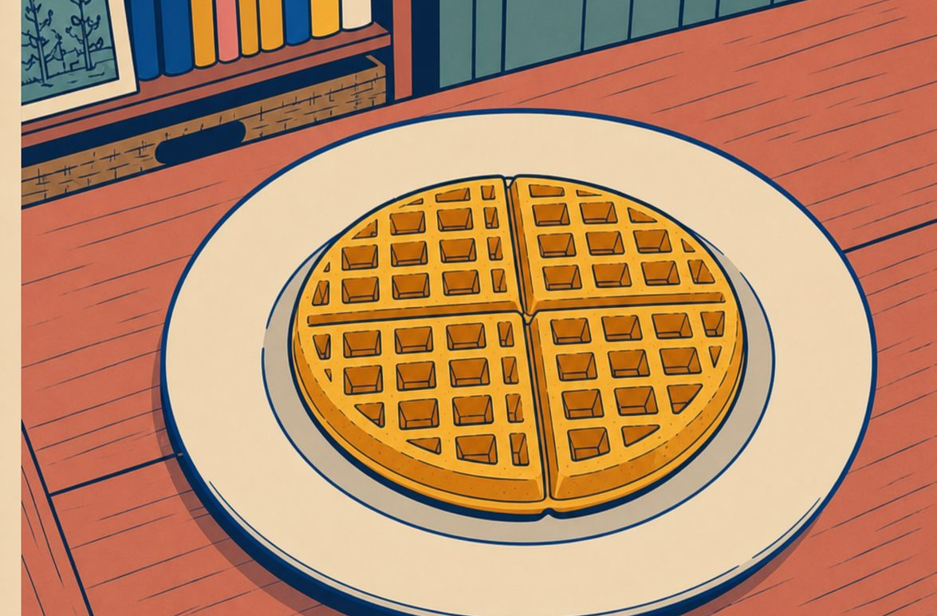
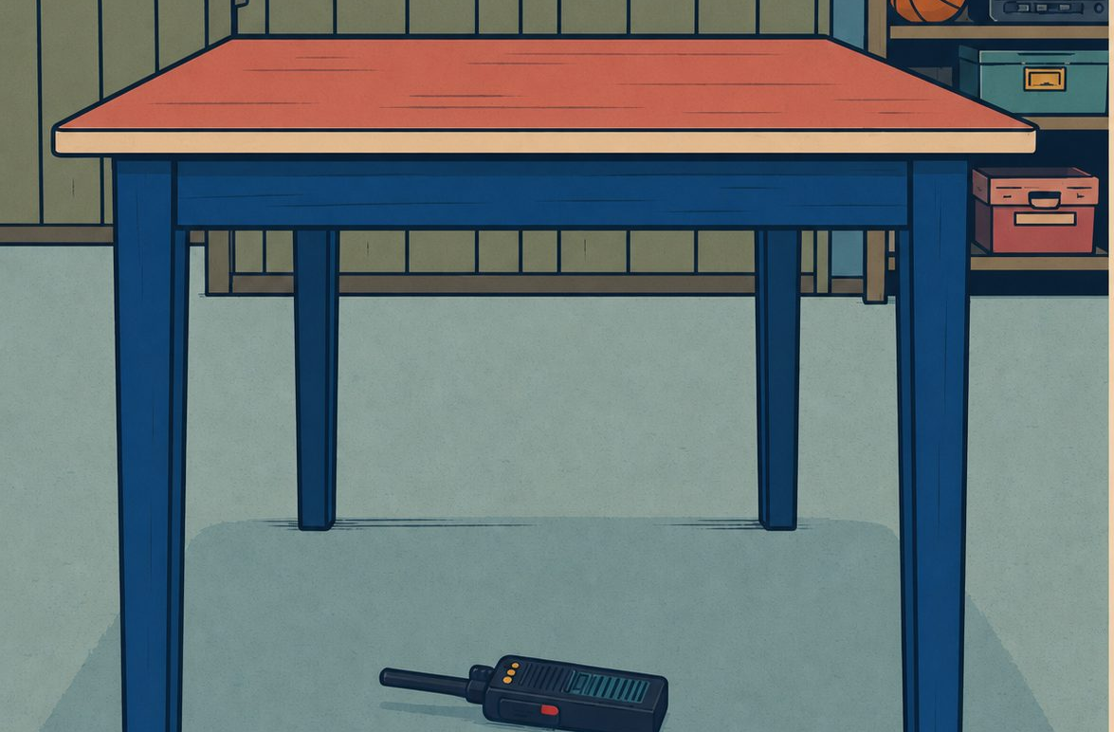
FORBES ENGLISH • PREPOSITIONS
FORBES ENGLISH • PREPOSITIONS
6
FORBES ENGLISH • PREPOSITIONS
6
ON
ON
UNDER
UNDER
IMAGE SLOT
Norma reaches under the RR counter for an order pad or coffee filters. Counter creates a clear upper/lower relationship.
Norma reaches under the RR counter for an order pad.
The pie is on the counter.
The green bag is under the table.
The waffle is on the plate.
The order pad is under the counter.
The bag is under the table.
The walkie-talkie is under the table.
The order pad is under the counter.
ON
UNDER
Use on when something touches and is supported by a surface.
Use on when something touches and is supported by a surface.
Use under when something is lower than, and often covered by, another thing.
Use under when something is lower than, and often covered by, another thing.
touching and supported by a surface.
lower than something, often covered by it.
HAWKINS FIELD GUIDE
Forbes
HAWKINS FIELD GUIDE
ENGLISH
Notes:
[Sources]
- Identity references: user-supplied Stranger Things Season 1 character sheet in stranger things bible.pdf.
- User-supplied palette references: stranger things palette 2.jpg, stranger things palette 3.jpg, and st graphicnove;.jpg.
- User-supplied Hellfire Club emblem reference: codex-clipboard-5f3595d0-15de-4255-89d8-c79a6045cada.png.
- Artwork: AI-generated photorealistic composition proof, then AI-generated flat editorial vector-style transformation for slide 7.
[/Sources]

Slide 8

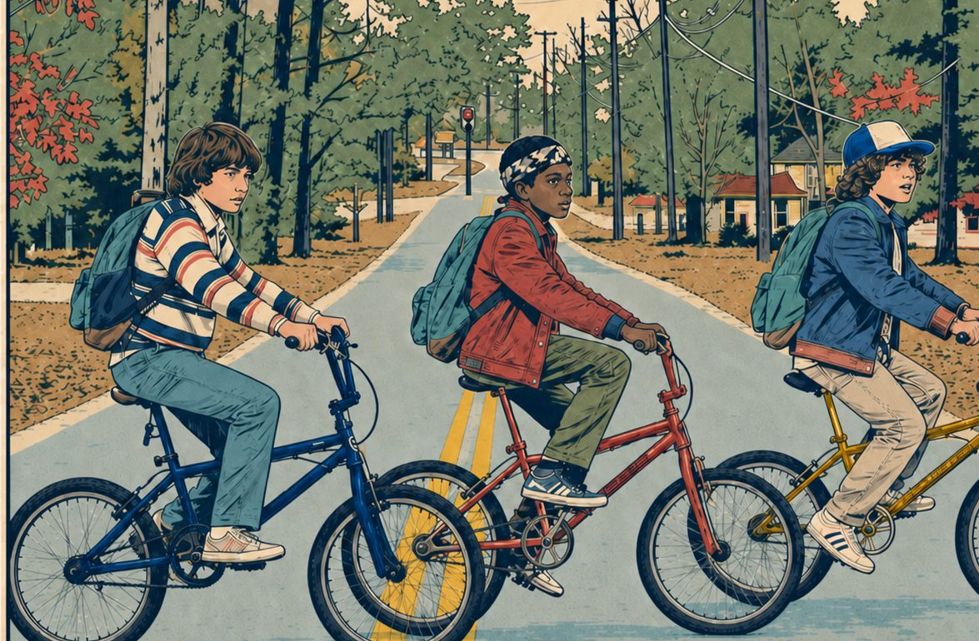
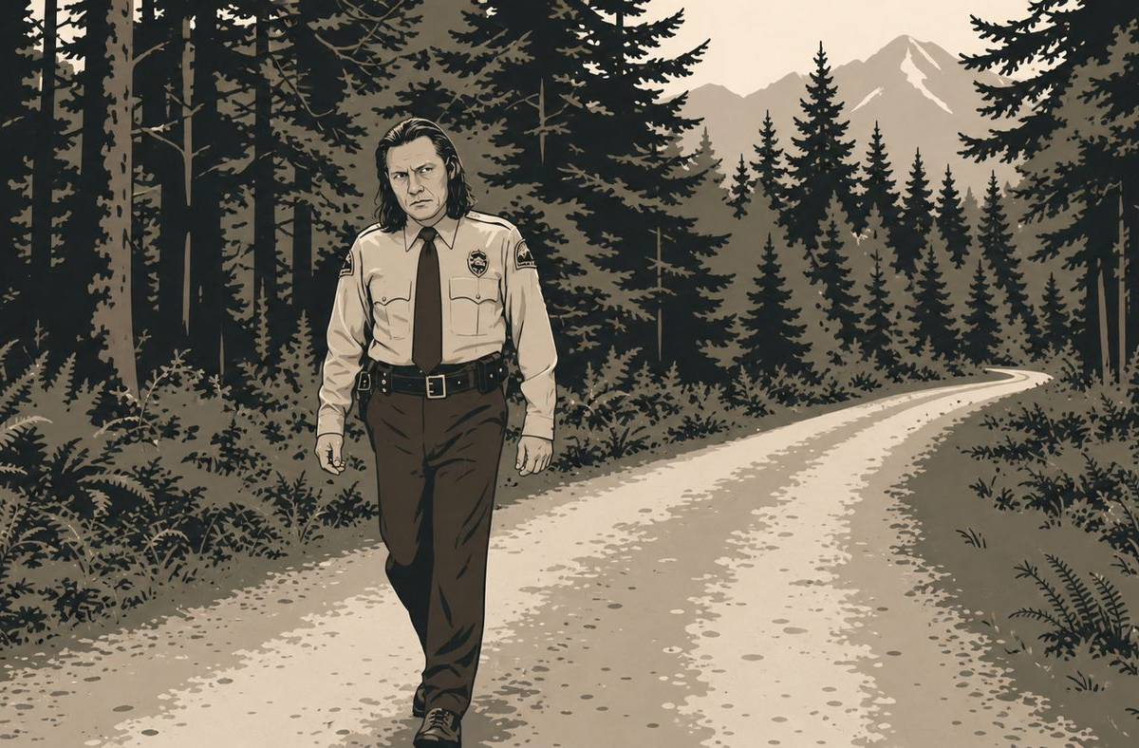
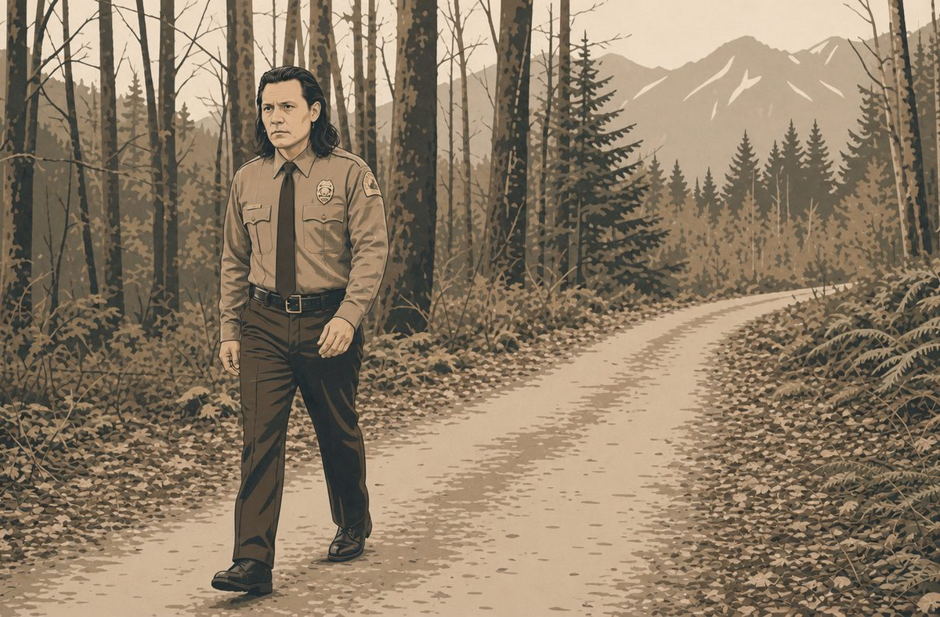
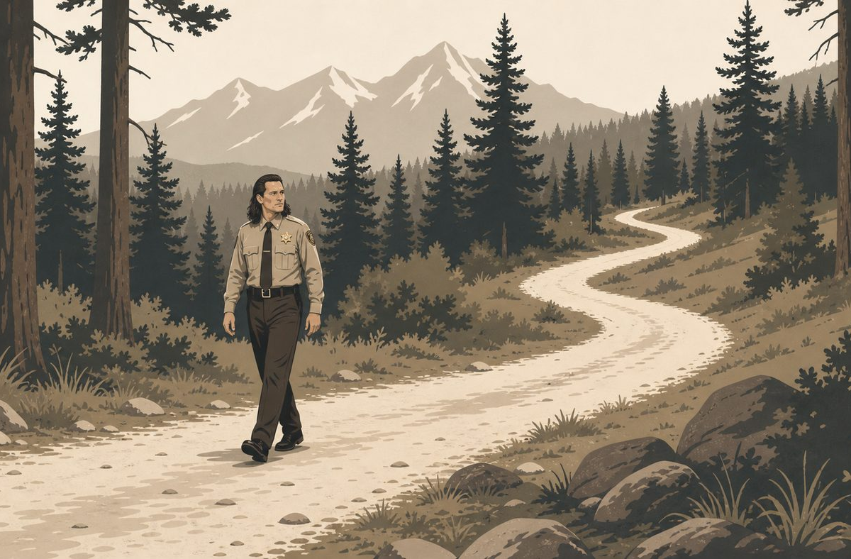
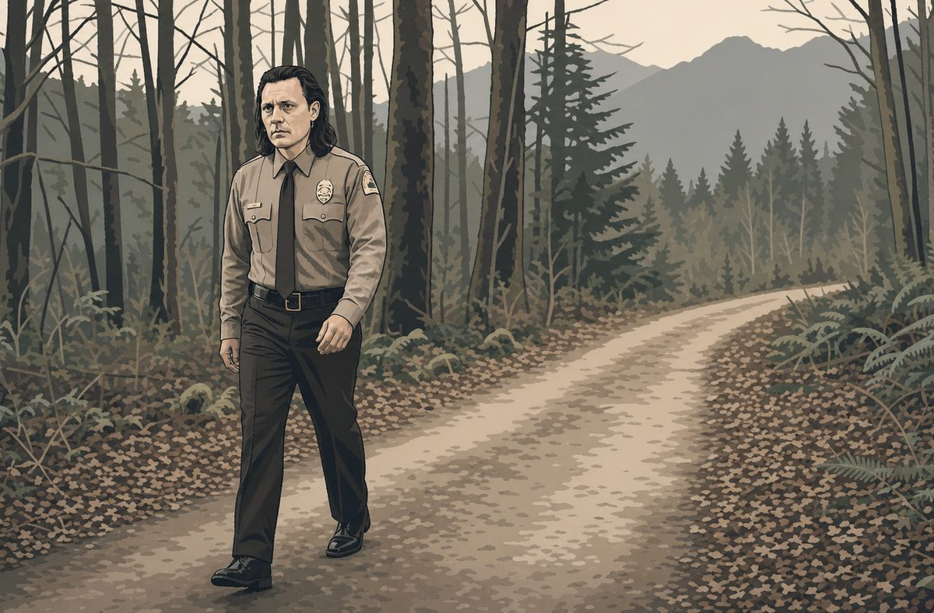

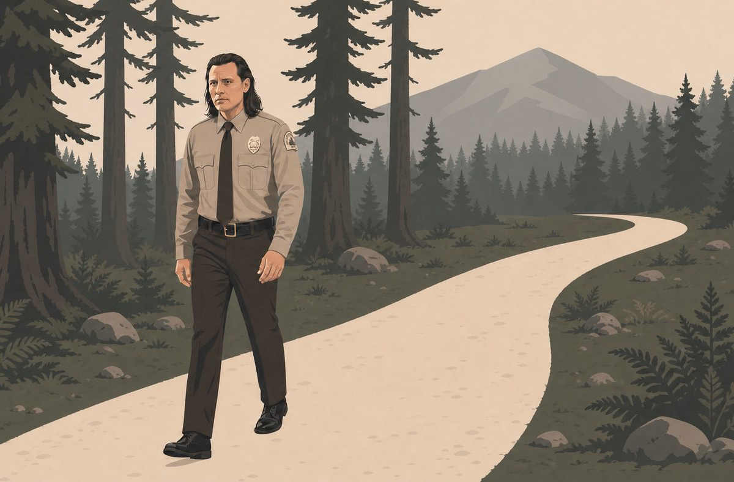
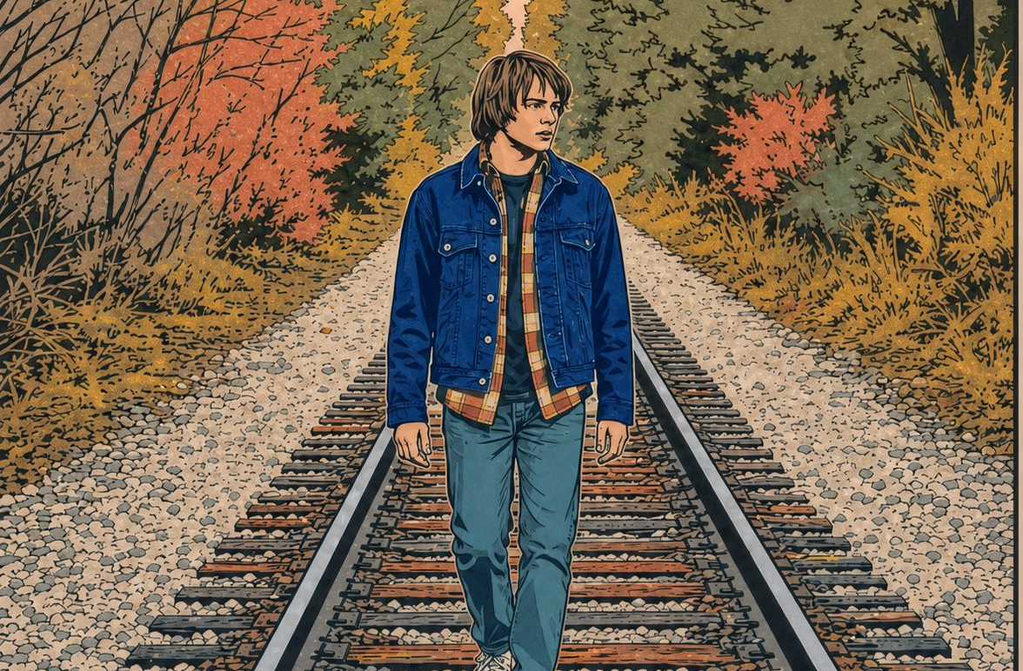
FORBES ENGLISH • PREPOSITIONS
FORBES ENGLISH • PREPOSITIONS
7
FORBES ENGLISH • PREPOSITIONS
7
ACROSS
ACROSS
ALONG
ALONG
IMAGE SLOT
Pete Martell walking across a river bridge or log crossing. The image must show movement from one side of the river to the other.
IMAGE SLOT
Deputy Hawk walking along a forest trail. Trail should stretch into the distance; Hawk follows its length, not crossing it.
Pete Martell crosses from one side of the river to the other.
Deputy Hawk follows the length of a forest trail.
The boys are cycling across the road.
Jonathan is walking along the railway tracks.
Pete is rowing across the river.
Hawk is walking along the trail.
ACROSS
ALONG
Use across for movement from one side to the other.
Use across for movement from one side to the other.
Use along for movement following the length of a path or edge.
Use along for movement following the length of a path or edge.
movement from one side to the other side.
movement following the length or line of something.
HAWKINS FIELD GUIDE
Forbes
HAWKINS FIELD GUIDE
ENGLISH
Notes:
[Sources]
- Identity references: user-supplied Stranger Things Season 1 character sheet in stranger things bible.pdf.
- User-supplied palette references: stranger things palette 2.jpg, stranger things palette 3.jpg, and st graphicnove;.jpg.
- User-supplied Hellfire Club emblem reference: codex-clipboard-5f3595d0-15de-4255-89d8-c79a6045cada.png.
- Artwork: AI-generated photorealistic composition proof, then AI-generated flat editorial vector-style transformation for slide 8.
[/Sources]

Slide 9
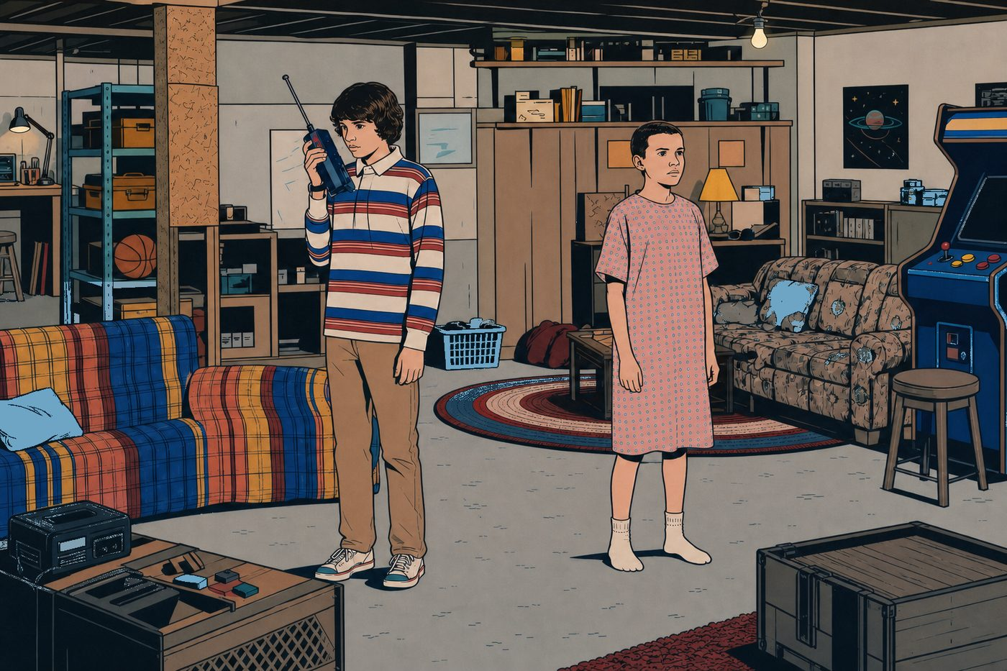
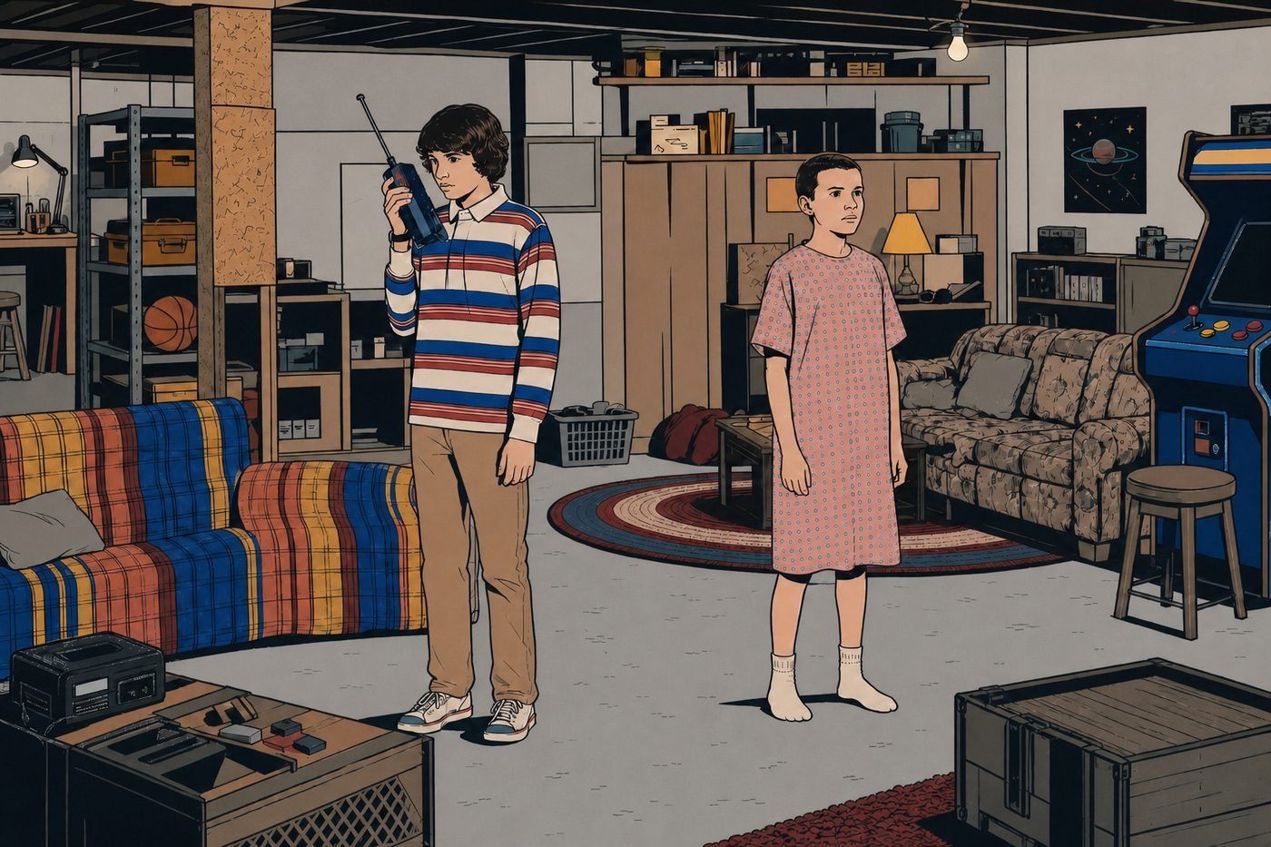


FORBES ENGLISH • PREPOSITIONS
FORBES ENGLISH • PREPOSITIONS
8
FORBES ENGLISH • PREPOSITIONS
8
NEAR
NEAR
NEXT TO
NEXT TO
IMAGE SLOT
Lucy is near Andy at the Sheriff’s Station reception desk. They are close, but not side by side. Desk and phone support the location.
IMAGE SLOT
Andy stands next to Sheriff Lucy at the station. Shoulder-to-shoulder placement makes next to obvious.
Lucy is close to Andy but not directly beside him.
Andy stands shoulder-to-shoulder next to Sheriff Lucy.
Lucy is standing near Andy.
Mike is standing near Eleven.
Lucas is sitting next to Dustin.
Lucy is standing near Andy.
NEAR
NEXT TO
Use near when something is close, but not necessarily directly beside.
Use near when something is close, but not necessarily directly beside.
Use next to when something is immediately beside another thing.
Use next to when something is immediately beside another thing.
close to something, but not necessarily beside it.
directly beside something or someone.
HAWKINS FIELD GUIDE
Forbes
HAWKINS FIELD GUIDE
ENGLISH
Notes:
[Sources]
- Identity references: user-supplied Stranger Things Season 1 character sheet in stranger things bible.pdf.
- User-supplied palette references: stranger things palette 2.jpg, stranger things palette 3.jpg, and st graphicnove;.jpg.
- User-supplied Hellfire Club emblem reference: codex-clipboard-5f3595d0-15de-4255-89d8-c79a6045cada.png.
- Artwork: AI-generated photorealistic composition proof, then AI-generated flat editorial vector-style transformation for slide 9.
[/Sources]

Slide 10

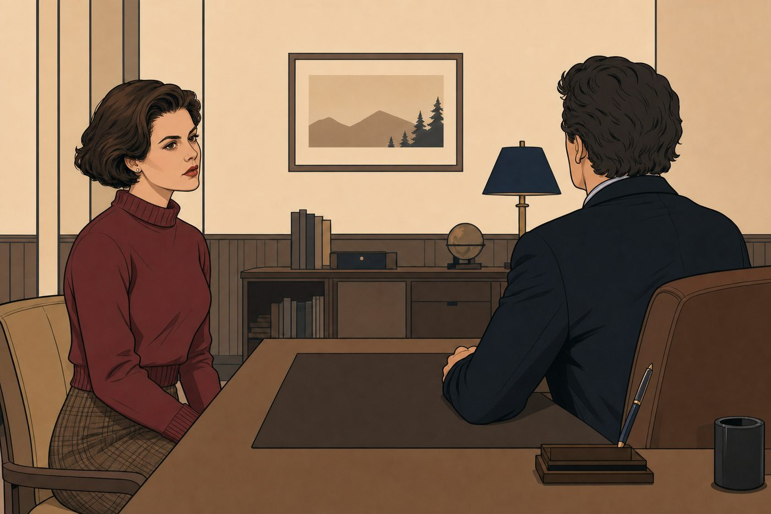



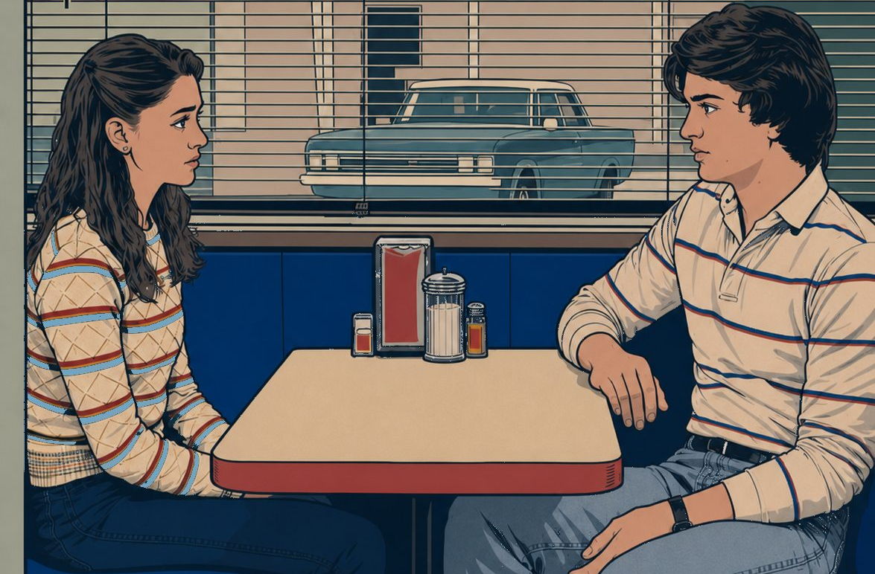
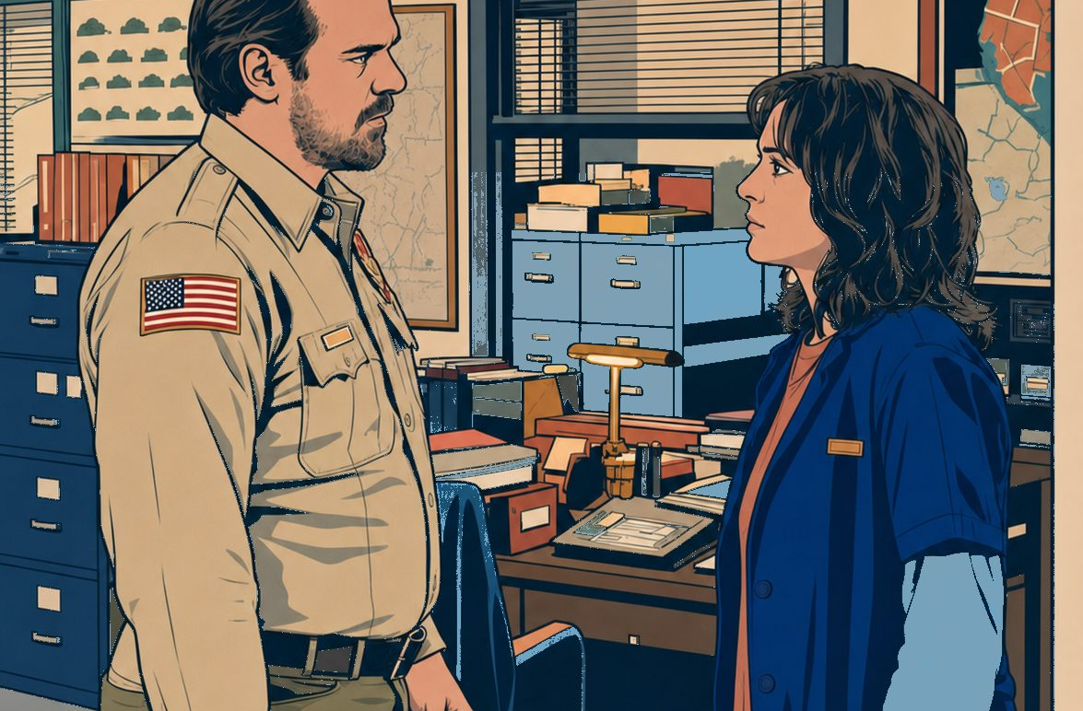
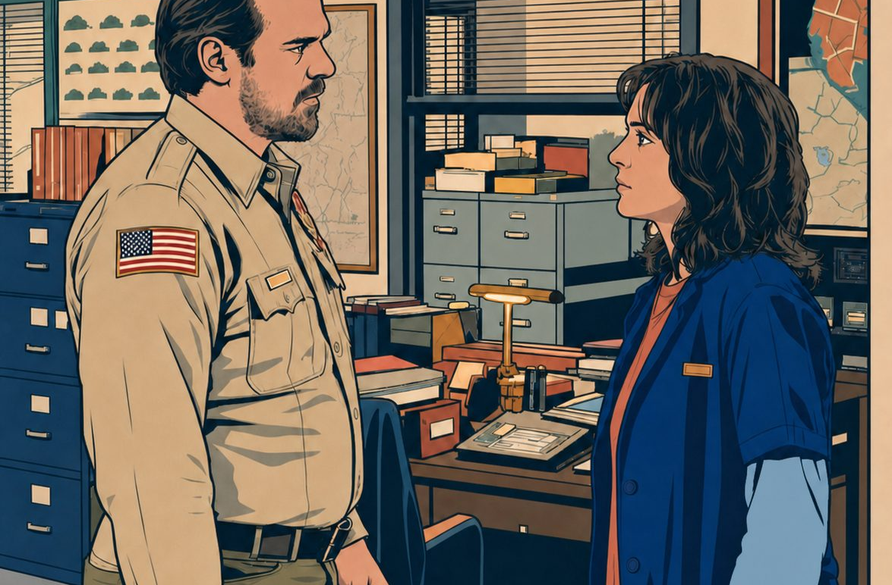
FORBES ENGLISH • PREPOSITIONS
FORBES ENGLISH • PREPOSITIONS
9
FORBES ENGLISH • PREPOSITIONS
9
OPPOSITE
OPPOSITE
FACING
FACING
Ben and Jerry face toward one another in the lobby.
Audrey is sitting opposite Ben.
Nancy is sitting opposite Steve.
Ben and Jerry are facing each other.
Audrey is sitting opposite Ben.
Hopper and Joyce are facing each other.
Ben and Jerry are facing each other.
OPPOSITE
FACING
Use opposite for positions on different sides of a space.
Use opposite for positions on different sides of a space.
Use facing when people or things are turned towards each other.
Use facing when people or things are turned towards each other.
on the other side of a space or object.
looking or pointing toward someone or something.
HAWKINS FIELD GUIDE
Forbes
HAWKINS FIELD GUIDE
ENGLISH
Notes:
[Sources]
- Identity references: user-supplied Stranger Things Season 1 character sheet in stranger things bible.pdf.
- User-supplied palette references: stranger things palette 2.jpg, stranger things palette 3.jpg, and st graphicnove;.jpg.
- User-supplied Hellfire Club emblem reference: codex-clipboard-5f3595d0-15de-4255-89d8-c79a6045cada.png.
- Artwork: AI-generated photorealistic composition proof, then AI-generated flat editorial vector-style transformation for slide 10.
[/Sources]

Slide 11

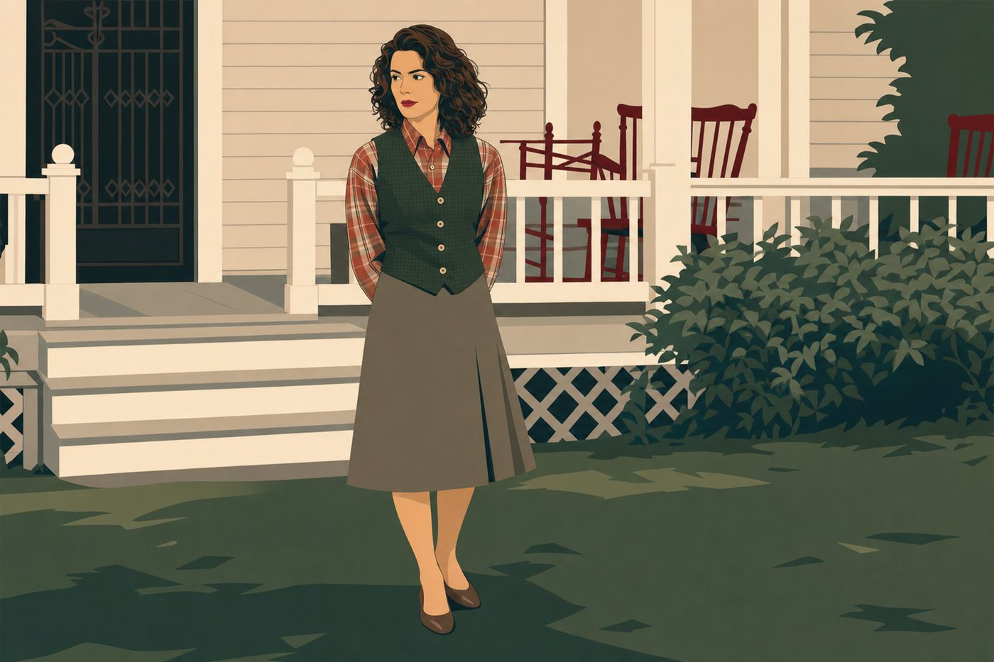
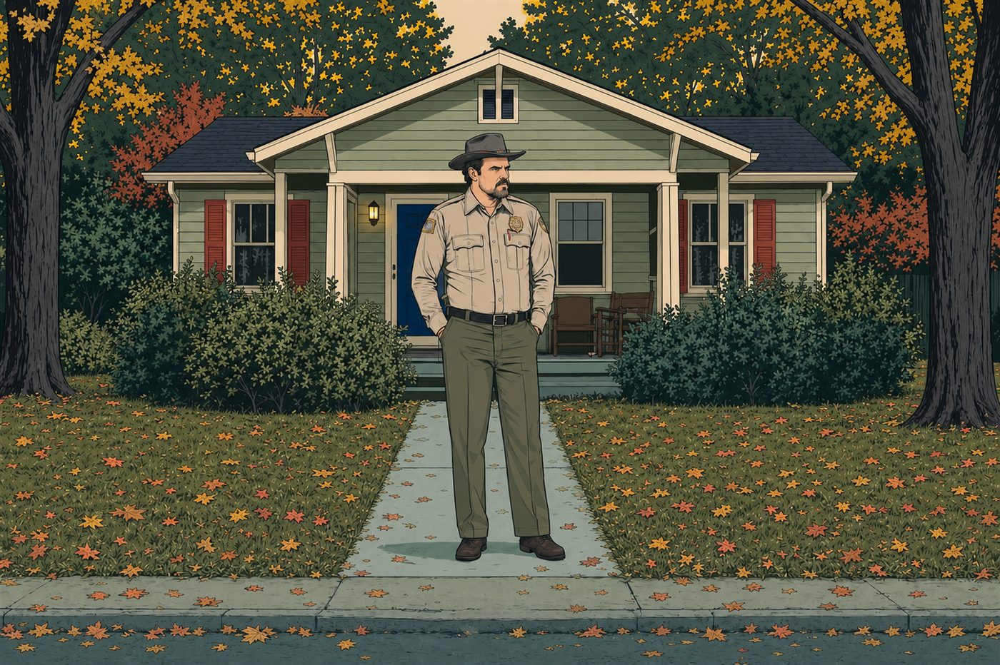
FORBES ENGLISH • PREPOSITIONS
FORBES ENGLISH • PREPOSITIONS
10
FORBES ENGLISH • PREPOSITIONS
10
INSIDE
INSIDE
OUTSIDE
OUTSIDE
IMAGE SLOT
Dr Jacoby inside his office. Colourful glasses, Hawaiian shirt, tapes or desk props. Room boundaries should be visible.
IMAGE SLOT
Sarah Palmer or Donna outside the Palmer house. Exterior wall, porch or doorway must clearly show the character is not indoors.
Dr Jacoby is clearly enclosed inside his office.
Donna stands outside the Palmer house.
Joyce is standing inside the house.
Hopper is standing outside the house.
Dr Jacoby is inside his office.
Donna is waiting outside the house.
INSIDE
OUTSIDE
Use inside for a position within a place, building or container.
Use inside for a position within a place, building or container.
Use outside for a position beyond the limits of a place or building.
Use outside for a position beyond the limits of a place or building.
within the limits of a place or container.
not within the limits of a place or building.
HAWKINS FIELD GUIDE
Forbes
HAWKINS FIELD GUIDE
ENGLISH
Notes:
[Sources]
- Identity references: user-supplied Stranger Things Season 1 character sheet in stranger things bible.pdf.
- User-supplied palette references: stranger things palette 2.jpg, stranger things palette 3.jpg, and st graphicnove;.jpg.
- User-supplied Hellfire Club emblem reference: codex-clipboard-5f3595d0-15de-4255-89d8-c79a6045cada.png.
- Artwork: AI-generated photorealistic composition proof, then AI-generated flat editorial vector-style transformation for slide 11.
[/Sources]

Slide 12
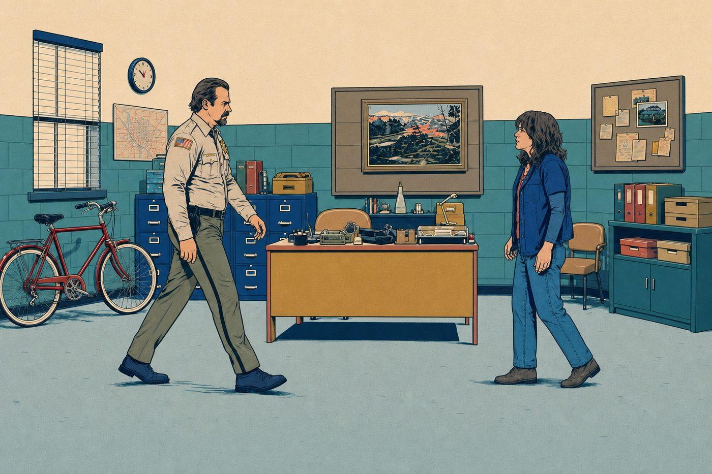
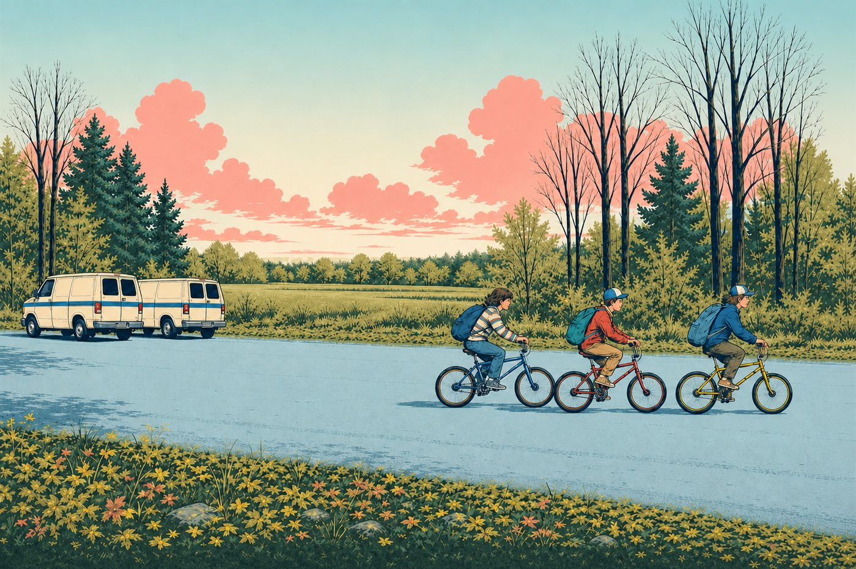
FORBES ENGLISH • PREPOSITIONS
FORBES ENGLISH • PREPOSITIONS
11
FORBES ENGLISH • PREPOSITIONS
11
TOWARDS
TOWARDS
AWAY FROM
AWAY FROM
IMAGE SLOT
The Man From Another Place moves away from Cooper across the chevron floor. Short silhouette, suit, distinctive hair, hands behind back.
The Man From Another Place moves away from Cooper.
The Giant is walking towards Cooper.
Hopper is walking towards Joyce.
The boys are cycling away from the vans.
The Giant is walking towards Cooper.
The Man From Another Place is moving away from Cooper.
TOWARDS
AWAY FROM
Use towards for movement in the direction of someone or something.
Use towards for movement in the direction of someone or something.
Use away from when the distance from someone or something increases.
Use away from when the distance from someone or something increases.
movement in the direction of someone or something.
movement so the distance from someone or something increases.
HAWKINS FIELD GUIDE
Forbes
HAWKINS FIELD GUIDE
ENGLISH
Notes:
[Sources]
- Identity references: user-supplied Stranger Things Season 1 character sheet in stranger things bible.pdf.
- User-supplied palette references: stranger things palette 2.jpg, stranger things palette 3.jpg, and st graphicnove;.jpg.
- User-supplied Hellfire Club emblem reference: codex-clipboard-5f3595d0-15de-4255-89d8-c79a6045cada.png.
- Artwork: AI-generated photorealistic composition proof, then AI-generated flat editorial vector-style transformation for slide 12.
[/Sources]

Slide 13
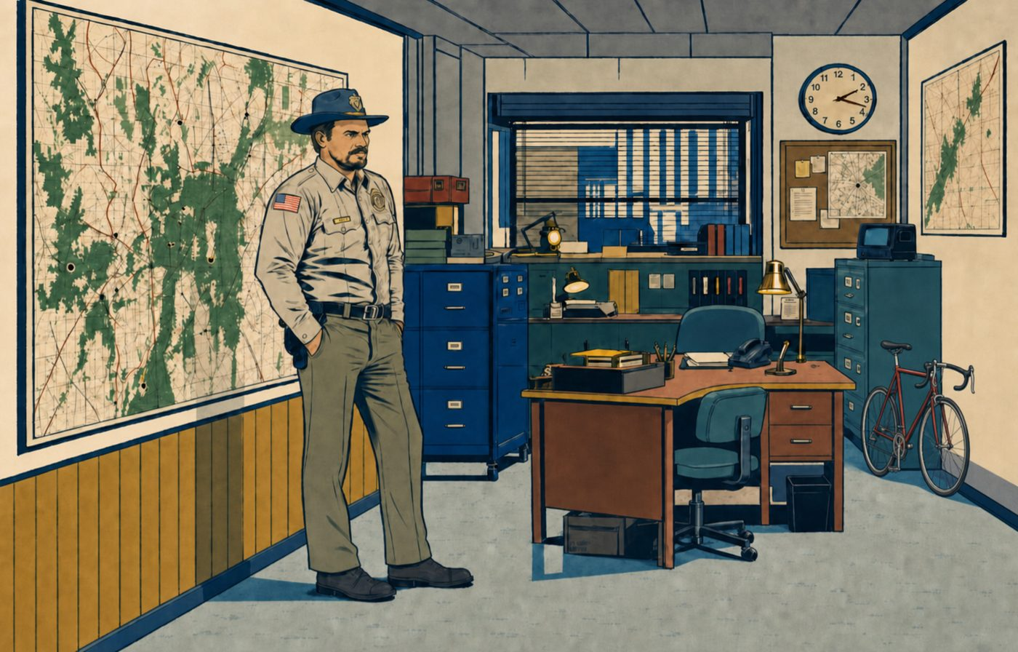

FORBES ENGLISH • PREPOSITIONS
FORBES ENGLISH • PREPOSITIONS
12
FORBES ENGLISH • PREPOSITIONS
12
BY
BY
UNTIL
UNTIL
IMAGE SLOT
Major Briggs standing by the Sheriff’s Station map or evidence board. He must be clearly next to it, calm, formal, recognisable.
IMAGE SLOT
Leland Palmer at the Palmer House with a clock or midnight shadow. The time endpoint must be visually clear, not just decorative.
Major Briggs stands by the Sheriff’s Station map.
Leland waits until the clock reaches midnight.
Hopper is standing by the map.
Bobby waits until midnight.
Major Briggs is standing by the map.
Mike is waiting until midnight.
Bobby waits until midnight.
BY
UNTIL
Use by for a position beside or very near something.
Use by for a position beside or very near something.
Use until for an action or state continuing up to a particular time.
Use until for an action or state continuing up to a particular time.
next to, near, or at the side of something.
up to a specific time; the action continues before that time.
HAWKINS FIELD GUIDE
Forbes
HAWKINS FIELD GUIDE
ENGLISH
Notes:
[Sources]
- Identity references: user-supplied Stranger Things Season 1 character sheet in stranger things bible.pdf.
- User-supplied palette references: stranger things palette 2.jpg, stranger things palette 3.jpg, and st graphicnove;.jpg.
- User-supplied Hellfire Club emblem reference: codex-clipboard-5f3595d0-15de-4255-89d8-c79a6045cada.png.
- Artwork: AI-generated photorealistic composition proof, then AI-generated flat editorial vector-style transformation for slide 13.
[/Sources]

Slide 14
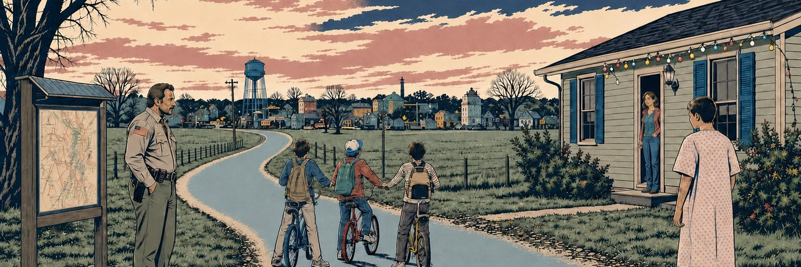
FORBES ENGLISH • PREPOSITIONS
13
FORBES ENGLISH • PREPOSITIONS
REVIEW
between / among • in front of / behind • above / over • into / out of • around / through • on / under • across / along • near / next to • opposite / facing • inside / outside • towards / away from • by / until
HAWKINS FIELD GUIDE
Forbes
ENGLISH
Notes:
[Sources]
- Identity and setting references: user-supplied stranger things bible.pdf and stranger.jpg.
- User-supplied palette references: stranger things palette 2.jpg, stranger things palette 3.jpg, and st graphicnove;.jpg.
- User-supplied Hellfire Club emblem reference: codex-clipboard-5f3595d0-15de-4255-89d8-c79a6045cada.png.
- Artwork: AI-generated composition proof and vector-style transformation created for this deck.
[/Sources]

