Slide 1
CHAPTER 4 Syntax ANALYSIS
Section 1 The Role of the Parser
1、Position of parser in compiler model
Notes: Parser is the core of the compiler
token
Source program
Lexical analyzer
Parse tree
Rest of front end
Intermediate representation
Parser
Get next token
Symbol table

Slide 2
CHAPTER 4 Syntax ANALYSIS
Section 1 The Role of the Parser
2、Parsing methods
  TOP-DOWN method
    Build parse trees from the top(root) to the bottom(leaves)
    The input is scanned from left to right
    LL(1) grammars (often implemented by hand)
  BOTTOM-UP method
    Start from the leaves and work up to the root
    The input is scanned from left to right
    LR grammars(often constructed by automated tools)

Slide 3
CHAPTER 4 Syntax ANALYSIS
Section 2 TOP-DOWN PARSING
1、Ideas of top-down parsing
  Find a leftmost derivation for an input string
  Construct a parse tree for the input starting from the root and creating the nodes of the parse tree in preorder.

Slide 4
CHAPTER 4 Syntax ANALYSIS
Section 2 TOP-DOWN PARSING
2、Main methods
  Predictive parsing (no backtracking)
  Recursive descent (involve backtracking)
  Notes: Backtracking is rarely needed to parse programming language constructs because backtracking is still not very efficient, and tabular methods are preferred

Slide 5
CHAPTER 4 Syntax ANALYSIS
Section 2 TOP-DOWN PARSING
3、Recursive descent
  A deducing procedure, which construct a parse tree for the string top-down from S. When there is any mismatch, the program go back to the nearest non-terminal, select another production to construct the parse tree
  If you produce a parse tree at last, then the parsing is success, otherwise, fail.

Slide 6
CHAPTER 4 Syntax ANALYSIS
Section 2 TOP-DOWN PARSING
E.g. Consider the grammar
S →cAd
A →ab | a
Construct a parse tree for the string “cad”

Slide 7
CHAPTER 4 Syntax ANALYSIS
Section 2 TOP-DOWN PARSING
3、Recursive descent
  Backtracking parsers are not seen frequently, because:
    Backtracking is not very efficient.
  Why backtracking occurred?
    A left-recursive grammar can cause a recursive-descent parser to go into an infinite loop.
    An ambiguity grammar can cause backtracking
    Left factor can also cause a backtracking

Slide 8
CHAPTER 4 Syntax ANALYSIS
Section 2 TOP-DOWN PARSING
4、Elimination of Left Recursion
1)Basic form of left recursion
Left recursion is the grammar contains the following kind of productions.
    P →Pα|β Immediate recursion
    or
    P →Aa , A→Pb Indirect recursion

Slide 9
CHAPTER 4 Syntax ANALYSIS
Section 2 TOP-DOWN PARSING
4、Elimination of Left Recursion
2)Strategy for elimination of Left Recursion
Convert left recursion into the equivalent right recursion
P → Pα|β
=> P->βα*
=> P →βP’ P’ →αP’|ε

Slide 10
CHAPTER 4 Syntax ANALYSIS
Section 2 TOP-DOWN PARSING
4、Elimination of Left Recursion
3)Algorithm
(1) Elimination of immediate left recursion
P → Pα|β
=> P->βα*
=> P →βP’ P’ →αP’|ε
(2) Elimination of indirect left recursion
Convert it into immediate left recursion first according to specific order, then eliminate the related immediate left recursion

Slide 11
Algorithm:
  (1)Arrange the non-terminals in G in some order as P₁,P₂,…,P_{n}, do step 2 for each of them.
  (2) for (i=1,i<=n,i++)
{for (k=1,k<=i-1,k++)
{replace each production of the form P_{i} →P_{k}γ
by P_{i} →δ₁ γ |δ ₂ γ |……| δ_{,n} γ;
where P_{k} →δ₁| δ₂|……| δ_{,n} are all the current P_{k} -productions
}
change P_{i} → P_{i}α₁| P_{i}α₂|…. | P_{i}α_{m}|β₁| β₂|….| β_{n}
  into P_{i} → β₁ P_{i} `| β₂ P_{i} `|……| β_{n} P_{i} `
  P_{i}`→α₁P_{i}`|α₂P_{i}`|……| α_{m}P_{i}`| ε}
  /*eliminate the immediate left recursion*/
  (3)Simplify the grammar.

Slide 12
E.g. Eliminating all left recursion in the following grammar:
(1) S → Qc|c (2)Q → Rb|b (3) R → Sa|a
Answer: 1)Arrange the non-terminals in the order:R,Q,S
2）for R: no actions.
for Q:Q → Rb|b Q → Sab|ab|b
for S: S → Qc|c S → Sabc|abc|bc|c;
then get S → (abc|bc|c)S`
S` → abcS`| ε
3) Because R,Q is not reachable, so delete them
so, the grammar is :
S → (abc|bc|c)S`
S` → abcS`| ε

Slide 13
CHAPTER 4 Syntax ANALYSIS
Section 2 TOP-DOWN PARSING
4、Elimination of Left Recursion
3)Algorithm
  Note: (1)If you arrange the non-terminals in different order, the grammar you get will be different too, but they can recognize the same language.
  (2) You cannot change the starting symbol

Slide 14
CHAPTER 4 Syntax ANALYSIS
Section 2 TOP-DOWN PARSING
5、Eliminating Ambiguity of a grammar
  Rewriting the grammar
  stmt→if expr then stmt|if expr then stmt else stmt|other
  ==>
  stmt →matched-stmt|unmatched-stmt
  matched-stmt →if expr then matched-stmt else matched-stmt|other
  unmatched-stmt →if expr then stmt|if expr then matched-stmt else unmatched-stmt

Slide 15
CHAPTER 4 Syntax ANALYSIS
Section 2 TOP-DOWN PARSING
6、Left factoring
  A grammar transformation that is useful for producing a grammar suitable for predictive parsing
  Rewrite the productions to defer the decision until we have seen enough of the input to make right choice

Slide 16
CHAPTER 4 Syntax ANALYSIS
Section 2 TOP-DOWN PARSING
6、Left factoring
  If the grammar contains the productions like A→δβ₁| δβ₂|…. | δβ_{n}
  Chang them into A→δA`
A`→β₁|β₂|…. |β_{n}

Slide 17
CHAPTER 4 Syntax ANALYSIS
Section 2 TOP-DOWN PARSING
7、Non-recursive Predictive Parsing
  1) key problem in predictive parsing
    The determining the production to be applied for a non-terminal
  2)Basic idea of the parser
  Table-driven and use stack

Slide 18
CHAPTER 4 Syntax ANALYSIS
Section 2 TOP-DOWN PARSING
  7、Non-recursive Predictive Parsing
  3) Model of a non-recursive predictive parser
Input
a+b……$
Stack
Output
S
$
Predictive Parsing Program
Parsing Table M

Slide 19
CHAPTER 4 Syntax ANALYSIS
Section 2 TOP-DOWN PARSING
  7、Non-recursive Predictive Parsing
  4) Predictive Parsing Program
    X: the symbol on top of the stack;
    a: the current input symbol
    If X=a=$, the parser halts and announces successful completion of parsing;
    If X=a!=$, the parser pops X off the stack and advances the input pointer to the next input symbol;

Slide 20
CHAPTER 4 Syntax ANALYSIS
Section 2 TOP-DOWN PARSING
7、Non-recursive Predictive Parsing
4) Predictive Parsing Program
  If X is a non-terminal, the program consults entry M[X,a] of the parsing table M. This entry will be either an X-production of the grammar or an error entry.

Slide 21
CHAPTER 4 Syntax ANALYSIS
Section 2 TOP-DOWN PARSING
E.g. Consider the following grammar, and parse the string id+id*id$
1.E → TE` 2.E` → +TE`
3.E` → ε 4.T → FT`
5.T` → *FT` 6.T` → ε
7.F → i 8.F →(E)

Slide 22
CHAPTER 4 Syntax ANALYSIS
Section 2 TOP-DOWN PARSING
Parsing table M
 | i | + | * | ( | ) | $
E | E→TE` |  |  | E→TE`
E` |  | E`→ +TE` |  |  | E`→ε | E`→ε
T | T→FT` |  |  | T→FT`
T` |  | T`→ε | T`→ *FT` |  | T`→ε | T`→ε
F | F→ i |  |  | F →(E)

Slide 23
CHAPTER 4 Syntax ANALYSIS
Section 2 TOP-DOWN PARSING
8、Construction of a predictive parser
1) FIRST & FOLLOW
  FIRST:
    If α is any string of grammar symbols, let FIRST(α) be the set of terminals that begin the string derived from α.
    If α → ε, then ε is also in FIRST(α)
    That is :
    α ∈V*, First(α)＝{a| α →a……,a ∈V_{T} }
+

Slide 24
CHAPTER 4 Syntax ANALYSIS
Section 2 TOP-DOWN PARSING
8、Construction of a predictive parser
1) FIRST & FOLLOW
  FOLLOW:
    For non-terminal A, to be the set of terminals a that can appear immediately to the right of A in some sentential form.
    That is: Follow(A)＝{a|S →…Aa…,a ∈V_{T} }
If S→…A, then $∈ FOLLOW(A)。

Slide 25
CHAPTER 4 Syntax ANALYSIS
Section 2 TOP-DOWN PARSING
8、Construction of a predictive parser
2) Computing FIRST(α)
  (1)to compute FIRST(X) for all grammar symbols X
    If X is terminal, then FIRST(X) is {X}.
    If X→ ε is a production, then add ε to FIRST(X).
    If X is non-terminal, and X → Y₁Y₂…Y_{k}，Y_{j}∈(V_{N}∪V_{T}),1≤j ≤k, then

Slide 26
{ j=1; FIRST(X)={}; //initiate
while ( j<k and ε∈ FIRST(Y_{j})) {
FIRST(X)=FIRST(X)∪(FIRST(Y_{j})-{ε})
j=j+1
}
IF (j=k and ε∈ FIRST(Y_{k}))
FIRST(X)=FIRST(X) ∪ {ε}
}

Slide 27
CHAPTER 4 Syntax ANALYSIS
Section 2 TOP-DOWN PARSING
8、Construction of a predictive parser
2) Computing FIRST(α)
  (2)to compute FIRST for any string α =X₁X₂…X_{n}，X_{i}∈(V_{N}∪V_{T}),1≤i ≤n
  {i=1; FIRST(α)={}; //initiate
  while (i<n and ε∈ FIRST(X_{j})) {
FIRST(α)=FIRST(α)∪(FIRST(X_{i})-{ε})
i=i+1
}
IF (i=n and ε∈ FIRST(X_{n}))
FIRST(α)=FIRST(α)∪{ε} }

Slide 28
CHAPTER 4 Syntax ANALYSIS
Section 2 TOP-DOWN PARSING
8、Construction of a predictive parser
3) Computing FOLLOW(A)
  (1) Place $ in FOLLOW(S), where S is the start symbol and $ is the input right end-marker.
  (2)If there is A →αBβ in G, then add (First(β)-ε) to Follow(B).
  (3)If there is A →αB, or A→αBβ where FIRST(β) contains ε，then add Follow(A) to Follow(B).

Slide 29
CHAPTER 4 Syntax ANALYSIS
Section 2 TOP-DOWN PARSING
E.g. Consider the following Grammar, construct FIRST & FOLLOW for each non-terminals
1.E → TE` 2.E` → +TE`
3.E` →ε 4.T → FT`
5.T` → *FT` 6.T` →ε
7.F → i 8.F →(E)

Slide 30
Answer:
First(E)=First(T)=First(F)={(, i}
First(E`)={+, ε}
First(T`)={*, ε}
Follow(E)= Follow(E`)={),$}
Follow(T)= Follow(T`)={+,),$}
Follow(F)={*,+,),$}

Slide 31
CHAPTER 4 Syntax ANALYSIS
Section 2 TOP-DOWN PARSING
8、Construction of a predictive parser
4) Construction of Predictive Parsing Tables
  Main Idea: Suppose A →α is a production with a in FIRST(α). Then the parser will expand A by α when the current input symbol is a. If α → ε, we should again expand A by α if the current input symbol is in FOLLOW(A), or if the $ on the input has been reached and $ is in FOLLOW(A).
*

Slide 32
CHAPTER 4 Syntax ANALYSIS
Section 2 TOP-DOWN PARSING
8、Construction of a predictive parser
4) Construction of Predictive Parsing Tables
  Input. Grammar G.
  Output. Parsing table M.

Slide 33
Method.
  1. For each production A →α , do steps 2 and 3.
  2. For each terminal a in FIRST(α), add A →α to M[A,a].
  3. If ε is in FIRST(α), add A →α to M[A,b] for each terminal b in FOLLOW(A). If ε is in FIRST(α) and $ is in FOLLOW(A), add A →α to M[A,$].
  4.Make each undefined entry of M be error.

Slide 34
E.g. Consider the following Grammar, construct predictive parsing table for it.
1.E → TE` 2.E` → +TE`
3.E` →ε 4.T → FT`
5.T` → *FT` 6.T` →ε
7.F → i 8.F →(E)

Slide 35
Answer:
First(E)=First(T)=First(F)={(, i}
First(E`)={+, ε}
First(T`)={*, ε}
Follow(E)= Follow(E`)={),$}
Follow(T)= Follow(T`)={+,),$}
Follow(F)={*,+,),$}

Slide 36
Predictive Parsing table M
 | i | + | * | ( | ) | $
E | E→TE` |  |  | E→TE`
E` |  | E`→ +TE` |  |  | E`→ε | E`→ε
T | T→FT` |  |  | T→FT`
T` |  | T`→ε | T`→ *FT` |  | T`→ε | T`→ε
F | F→ i |  |  | F →(E)

Slide 37
CHAPTER 4 Syntax ANALYSIS
Section 2 TOP-DOWN PARSING
9、LL(1) Grammars
E.g. Consider the following Grammar, construct predictive parsing table for it.
S → iEtSS` |a
S` → eS | ε
E →b

Slide 38
Predictive Parsing table M
 | a | b | e | i | t | $
S | S →a |  |  | S → iEtSS`
S` |  |  | S`→ eS S`→ ε |  |  | S`→ε
E |  | E →b

Slide 39
CHAPTER 4 Syntax ANALYSIS
Section 2 TOP-DOWN PARSING
9、LL(1) Grammars
  1)Definition
  A grammar whose parsing table has no multiply-defined entries is said to be LL(1).
  The first “L” stands for scanning the input from left to right.
  The second “L” stands for producing a leftmost derivation
  “1” means using one input symbol of look-ahead s.t each step to make parsing action decisions.

Slide 40
CHAPTER 4 Syntax ANALYSIS
Section 2 TOP-DOWN PARSING
9、LL(1) Grammars
Note: (1)No ambiguous can be LL(1).
  (2)Left-recursive grammar cannot be LL(1).
  (3)A grammar G is LL(1) if and only if whenever A →α | β are two distinct productions of G:

Slide 41
CHAPTER 4 Syntax ANALYSIS
Section 2 TOP-DOWN PARSING
10、Transform a grammar to LL(1) Grammar
  Eliminating all left recursion
  Left factoring

Slide 42
CHAPTER 4 SYNTAX ANALYSIS
Section 3 BOTTOM-UP Parsing
1、Basic idea of bottom-up parsing
Shift-reduce parsing
  LR parsing
    A much more general method
    Used in a number of automatic parser generators

Slide 43
CHAPTER 4 SYNTAX ANALYSIS
Section 3 BOTTOM-UP Parsing
2、Stack implementation of Shift-Reduce parsing
Input
……$
Stack
Output
$
Parsing Program
Parsing Table M

Slide 44
CHAPTER 4 SYNTAX ANALYSIS
Section 4 LR parsers
1、LR parser
  An efficient, bottom-up syntax analysis technique that can be used to parse a large class of context-free grammars
  LR(k)
    L: left-to-right scan
    R:construct a rightmost derivation in reverse
    k:the number of input symbols of look ahead

Slide 45
CHAPTER 4 SYNTAX ANALYSIS
Section 4 LR parsers
2、Advantages of LR parser
  It can recognize virtually all programming language constructs for which context-free grammars can be written
  It is the most general non backtracking shift-reduce parsing method
  It can parse more grammars than predictive parsers can
  It can detect a syntactic error as soon as it is possible to do so on a left-to-right scan of the input

Slide 46
CHAPTER 4 SYNTAX ANALYSIS
Section 4 LR parsers
3、Disadvantages of LR parser
  It is too much work to construct an LR parser by hand
  It needs a specialized tool,YACC, help it to generate a LR parser

Slide 47
CHAPTER 4 SYNTAX ANALYSIS
Section 4 LR parsers
4、Three techniques for constructing an LR parsing
  SLR: simple LR
  LR(1): canonical LR
  LALR: look ahead LR

Slide 48
CHAPTER 4 SYNTAX ANALYSIS
Section 4 LR parsers
5、The LR Parsing Model
input
a+b……$
stack
output
LR Parsing Program
S₀ $
action
goto

Slide 49
CHAPTER 4 SYNTAX ANALYSIS
Section 4 LR parsers
5、The LR Parsing Model
Note: 1)The driver program is the same for all LR parsers; only the parsing table changes from one parser to another
  2)The parsing program reads characters from an input buffer one at a time
  3)S_{i} is a state, each state symbol summarizes the information contained in the stack below it

Slide 50
CHAPTER 4 SYNTAX ANALYSIS
Section 4 LR parsers
5、The LR Parsing Model
Note: 4)Each state symbol summarizes the information contained in the stack
  5)The current input symbol are used to index the parsing table and determine the shift-reduce parsing decision
  6)In an implementation, the grammar symbols need not appear on the stack

Slide 51
CHAPTER 4 SYNTAX ANALYSIS
Section 4 LR parsers
6、The parsing table
  Action: a parsing action function
    Action[S,a]: S represent the state currently on top of the stack, and a represent the current input symbol. So Action[S,a] means the parsing action for S and a.

Slide 52
CHAPTER 4 SYNTAX ANALYSIS
Section 4 LR parsers
6、The parsing table
  Action: a parsing action function
    Shift
      The next input symbol is shifted onto the top of the stack
      Shift S, where S is a state
    Reduce
      The parser knows the right end of the handle is at the top of the stack, locates the left end of the handle within the stack and decides what non-terminal to replace the handle. Reduce by a grammar production A →α

Slide 53
CHAPTER 4 SYNTAX ANALYSIS
Section 4 LR parsers
6、The parsing table
  Action: a parsing action function
    Accept
      The parser announces successful completion of parsing.
    Error
      The parser discovers that a syntax error has occurred and calls an error recovery routine.

Slide 54
CHAPTER 4 SYNTAX ANALYSIS
Section 4 LR parsers
6、The parsing table
  Action conflict
    Shift/reduce conflict
      Cannot decide whether to shift or to reduce
    Reduce/reduce conflict
      Cannot decide which of several reductions to make
  Notes: An ambiguous grammar can cause conflicts and can never be LR,e.g.
  If_stmt syntax (if expr then stmt [else stmt])

Slide 55
CHAPTER 4 SYNTAX ANALYSIS
Section 4 LR parsers
6、The parsing table
  Goto: a goto function that takes a state and grammar symbol as arguments and produces a state

Slide 56
CHAPTER 4 SYNTAX ANALYSIS
Section 4 LR parsers
7、The algorithm
  The next move of the parser is determined by reading the current input symbol a, and the state S on top of the stack,and then consulting the parsing action table entry action[S,a].
  If action[S_{m},a_{i}]=shift S`,the parser executes a shift move ,enter the S` into the stack,and the next input symbol a_{i+1} become the current symbol.

Slide 57
CHAPTER 4 SYNTAX ANALYSIS
Section 4 LR parsers
7、The algorithm
  If action[S_{m},a_{i}]=reduce A →α, then the parser executes a reduce move. If the length of α is γ, then delete γ states from the stack, so that the state at the top of the stack is S_{m- γ} . Push the state S’=GOTO[S_{m- γ},A] and non-terminal A into the stack. The input symbol does not change.

Slide 58
CHAPTER 4 SYNTAX ANALYSIS
Section 4 LR parsers
7、The algorithm
  If action[S_{m},a_{i}]=accept, parsing is completed.
  If action[S_{m},a_{i}]=error, the parser has discovered an error and calls an error recovery routine.

Slide 59
E.g. the parsing action and goto functions of an LR parsing table for the following grammar.
E → E+T
E →T
T →T*F
T →F
F →(E)
F → i

Slide 60
state
ACTION
GOTO
i
+
*
(
)
$
E
T
F
0
S₅
S₄
1
2
3
1
S₆
accept
2
r₂
S₇
r₂
r₂
3
r₄
r₄
r₄
r₄
4
S₅
S₄
8
2
3
5
r₆
r₆
r₆
r₆
6
S₅
S₄
9
3
7
S₅
S₄
10
8
S₆
S₁₁
9
r₁
S₇
r₁
r₁
10
r₃
r₃
r₃
r₃
11
r₅
r₅
r₅
r₅

Slide 61
CHAPTER 4 SYNTAX ANALYSIS
Section 5 LR parsers
  1)S_{j} means shift and stack state j, and the top of the stack change into（j,a）;
  2)r_{j} means reduce by production numbered j;
  3)Accept means accept
  4)blank means error

Slide 62
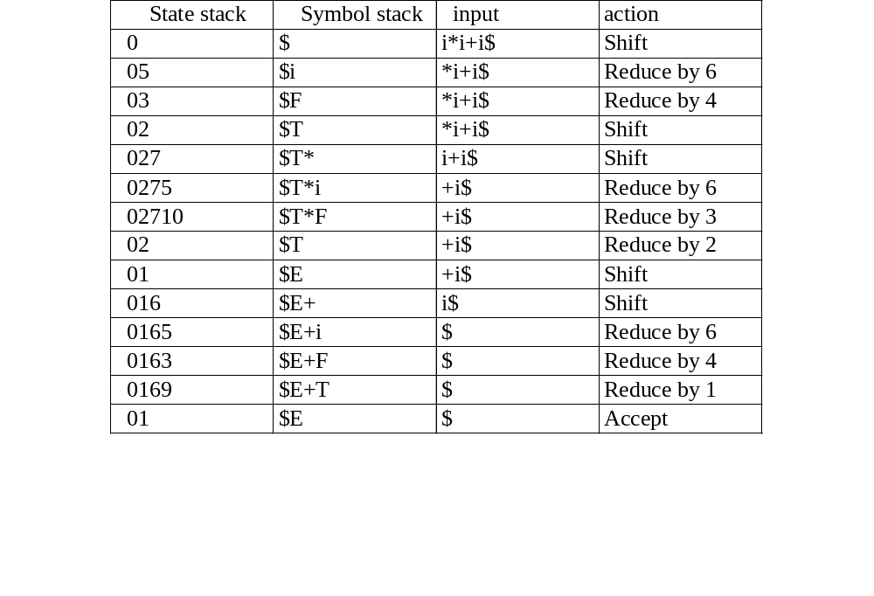
Moves of LR parser on i*i+i

Slide 63
CHAPTER 4 SYNTAX ANALYSIS
Section 4 LR parsers
8、LR Grammars
  A grammar for which we can construct a parsing table is said to be an LR grammar.
9、The difference between LL and LR grammars
  LR grammars can describe more languages than LL grammars

Slide 64
CHAPTER 4 SYNTAX ANALYSIS
Section 4 LR parsers
11、Canonical LR(0)
1）LR(0) item
  An LR(0) item of a grammar G is a production of G with a dot at some position of the right side.

Slide 65
Such as: A → XYZ yields the four items:
  A→•XYZ . We hope to see a string derivable from XYZ next on the input.
  A→X•YZ . We have just seen on the input a string derivable from X and that we hope next to see a string derivable from YZ next on the input.
  A→XY•Z
  A→X YZ•
The production A→ε generates only one item, A→•.
Each of this item is a viable prefixes

Slide 66
CHAPTER 4 SYNTAX ANALYSIS
Section 4 LR parsers
11、Canonical LR(0)
2) Construct the canonical LR(0) collection
  (1)Define a augmented grammar
    If G is a grammar with start symbol S,the augmented grammar G` is G with a new start symbol S`, and production S` →S
    The purpose of the augmented grammar is to indicate to the parser when it should stop parsing and announce acceptance of the input.

Slide 67
CHAPTER 4 SYNTAX ANALYSIS
Section 4 LR parsers
11、Canonical LR(0)
2)Construct the canonical LR(0) collection
  (2)the Closure Operation
    If I is a set of items for a grammar G, then closure(I) is the set of items constructed from I by the two rules:
      Initially, every item in I is added to closure(I).
      If A→α•Bβ is in CLOSURE(I), and B→γ is a production, then add the item B→•γ to CLOSURE(I); Apply this rule until no more new items can be added to CLOSURE(I).

Slide 68
CHAPTER 4 SYNTAX ANALYSIS
Section 4 LR parsers
11、Canonical LR(0)
2)Construct the canonical LR(0) collection
  (3)the Goto Operation
    Form: goto(I,X),I is a set of items and X is a grammar symbol
    goto(I,X)is defined to be the CLOSURE(J)，X ∈( V_{N}∪ V_{T}), J={all items like A→αX•β| A→α•Xβ∈I}。

Slide 69
CHAPTER 4 SYNTAX ANALYSIS
Section 4 LR parsers
11、Canonical LR(0)
3)The Sets-of-Items Construction
  void ITEMSETS-LR0()
  { C:={CLOSURE(S` →•S)} /*initial*/
  do
  { for (each set of items I in C and each grammar symbol X )
  IF (Goto(I,X) is not empty and not in C)
  {add Goto(I,X) to C}
  }while C is still extending
  }

Slide 70
e.g. construct the canonical collection of sets of LR(0) items for the following augmented grammar.
S` →E E →aA|bB A →cA|d B →cB|d
Answer:1、the items are：
1. S` →•E 2. S` →E• 3. E → •aA
4. E → a•A 5. E → aA• 6. A → •cA
7. A → c•A 8. A → cA • 9. A → •d
10. A → d• 11. E → •bB 12. E → b•B
13. E → bB• 14. B → •cB 15. B → c•B
16.B → cB• 17. B → •d 18. B → d•

Slide 71
A
4:A→c•A
A→ •cA
A→ •d
c
8:A→c A •
d
10:A→ d •
d
c
2:E→a•A
A→ •cA
A→ •dc
a
A
6:E→aA •
0: S`→•E
E→ •aA
E→ •bB
E
1: S`→ E •
B
b
3: E→b•B
B→ •cB
B→ •d
7:E→bB•
d
c
5: B→c•B
B→ •cB
B→ •d
d
11:B→ d •
c
B
9:B→cB •

Slide 72
CHAPTER 4 SYNTAX ANALYSIS
Section 4 LR parsers
12、SLR(1) Parsing Table Algorithm
  Input. An augmented grammar G`
  Output. The SLR parsing table functions action and goto for G`
  Method.
  (1) Construct C={I₀,I₁,…I_{n}}, the collection of sets of LR(0) items for G`.
  (2) State i is constructed from I_{i}. The parsing actions for state i are determined as follows:

Slide 73
CHAPTER 4 SYNTAX ANALYSIS
Section 4 LR parsers
12、SLR(1) Parsing Table Algorithm
Method
  (2)
  (a) If [A→α•aβ] is in I_{i} and goto(I_{i},a)= I_{j}, then set ACTION[i,a]=“Shift j”, here a must be a terminal.
  (b) If [A→α• ]∈I_{k}, then set ACTION[k,a]=r_{j} for all a in follow(A); here A may not be S`, and j is the No. of production A→α .
  (3) The goto transitions for state I are constructed for all non terminals A using the rule: if goto (I_{i},A)= I_{j}, then goto[i,A]=j

Slide 74
CHAPTER 4 SYNTAX ANALYSIS
Section 4 LR parsers
12、SLR(1) Parsing Table Algorithm
Method
  (4) All entries not defined by rules 2 and 3 are made “error”
  (5) The initial state of the parser is the one constructed from the set of items containing [S` → S•].
  If any conflicting actions are generated by the above rules, we say the grammar is not SLR(1).

Slide 75
e.g. construct the SLR(1) table for the following grammar
0. S` →E 1. E → E+T
2. E →T 3. T →T*F
4.T →F 5. F →(E)
6. F → i

Slide 76
i
I₅
I₀：S’→•E
E →•E+T
E →•T
T →•T*F
T →•F
F →•(E)
F →•i
I₂：E →T•
T → T•*F
I₇：T →T*•F
F →•(E)
F →•i
F
T
*
I₁₀：T →T*F •
(
I₄
E
I₁：S’ →E•
E →E•+T
*
I₉：E →E+T •
T→T • * F
+
I₆： E →E+•T
T →•T*F
T →•F
F →•(E)
F →•i
T
(
I₄：F’→(•E)
E →•E+T
E →•T
T →•T*F
T →•F
F →•(E)
F →•i
(
F
I₃
F
i
I₅
I₅：F →i•
i
i
E
I₈：F → (E•)
E →E•+T
)
I₁₁：F →(E)•
F
I₃：T →F•
(
T
I₂

Slide 77
state
ACTION
GOTO
i
+
*
(
)
$
E
T
F
0
S₅
S₄
1
2
3
1
S₆
accept
2
r₂
S₇
r₂
r₂
3
r₄
r₄
r₄
r₄
4
S₅
S₄
8
2
3
5
r₆
r₆
r₆
r₆
6
S₅
S₄
9
3
7
S₅
S₄
10
8
S₆
S₁₁
9
r₁
S₇
r₁
r₁
10
r₃
r₃
r₃
r₃
11
r₅
r₅
r₅
r₅

Slide 78
CHAPTER 4 SYNTAX ANALYSIS
Section 4 LR parsers
12、SLR(1) Parsing Table Algorithm
Note : Every SLR(1) grammar is unambiguous, but there are many unambiguous grammars that are not SLR(1).
E.G. 1. S` →S 2. S →L=R
3. S →R 4. L →*R
5. L → i 6. R →L

Slide 79
0: S`→•S
S→ •L=R
S→ •R
L→ •*R
L→ •I
R→ •L
R
3:S→R•
7:L→*R•
*
4:L→*•R
R→ •L
L→ •*R
L→ •i
R
L
*
8:R→L•
i
S
i
1: S`→S•
*
L
L
5:L→i •
i
6: S→L=•R
R→ •L
L→ •*R
L→ •i
2: S→L•=R
R→ L•
=
R
9:S→L=R•

Slide 80
state
ACTION
GOTO
=
i
*
$
S
L
R
0
S₅
S₄
1
2
3
1
acc
2
S₆/ r₆
r₆
3
r₃
4
S₅
S₄
8
7
5
r₅
r₅
6
S₅
S₄
8
9
7
r₄
r₄
8
r₆
r₆
9
r₂

Slide 81
CHAPTER 4 SYNTAX ANALYSIS
Section 4 LR parsers
12、 SLR(1) Parsing Table Algorithm
  Notes: In the above grammar , the shift/reduce conflict arises from the fact that the SLR parser construction method is not powerful enough to remember enough left context to decide what action the parser should take on input = having seen a string reducible to L. That is “R=“ can be a part of any right sentential form. So when “L” appears on the top of stack and “=“ is the current character of the input buffer , we can not reduce “L” into “R”.

Slide 82
CHAPTER 4 SYNTAX ANALYSIS
Section 4 LR parsers
12、 SLR(1) Parsing Table Algorithm
G2:
1. S` →S 2. S →AaAb|BbBa
3. A →ε 4. B →ε

Slide 83
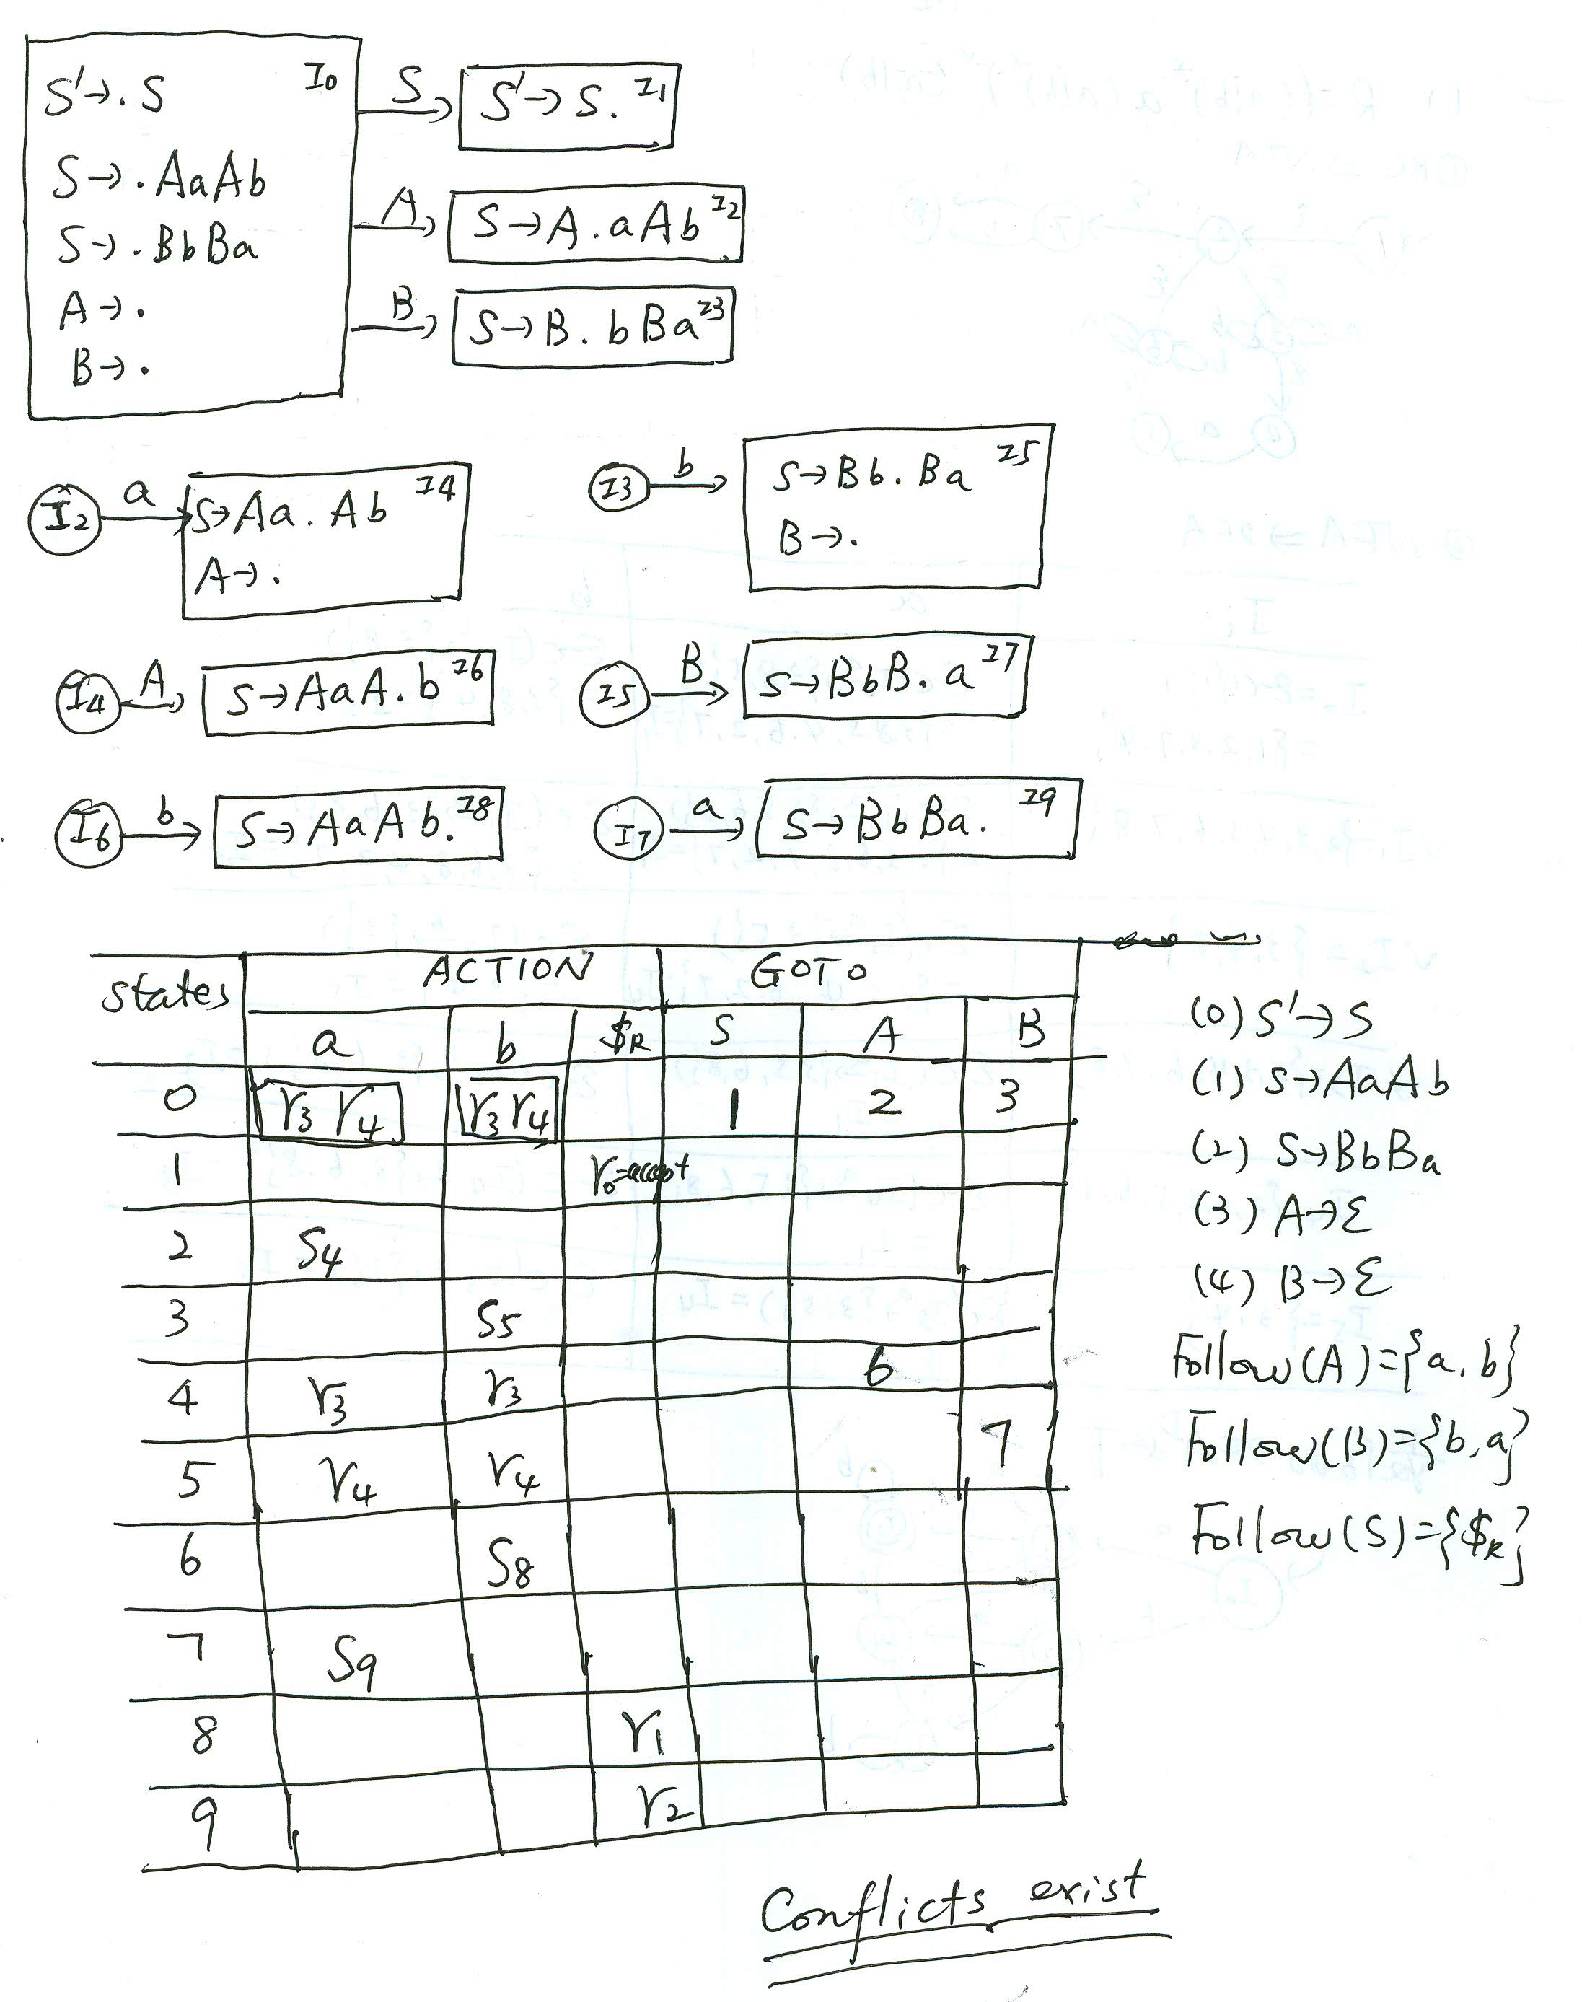

Slide 84
CHAPTER 4 SYNTAX ANALYSIS
Section 4 LR parsers
13、LR(1) item
How to rule out invalid reductions?
  By splitting states when necessary, we can arrange to have each state of an LR parser indicate exactly which input symbols can follow a handle α for which there is a possible reduction to A.
Item (A→α•β,a) is an LR(1) item, “1” refers to the length of the second component, called the look-ahead of the item.

Slide 85
CHAPTER 4 SYNTAX ANALYSIS
Section 4 LR parsers
13、LR(1) item
Note：1)The look-ahead has no effect in an item of the form (A→α•β,a), where β is not ε,but an item of the form (A→α•,a) calls for a reduction by A→α only if the next input symbol is a.
2)The set of such a’s will always be a proper subset of FOLLOW(A).

Slide 86
CHAPTER 4 SYNTAX ANALYSIS
Section 4 LR parsers
14、Valid LR(1) item
Formally, we say LR(1) item (A→α•β,a) is valid for a viable prefix γ if there is a derivation S`→δAω→δαβω, where
  γ= δα,and
  Either a is the first symbol of ω, or ω is ε and a is $.

Slide 87
CHAPTER 4 SYNTAX ANALYSIS
Section 4 LR parsers
15、Construction of the sets of LR(1) items
  Input. An augmented grammar G`
  Output. The sets of LR(1) items that are the set of items valid for one or more viable prefixes of G`.
  Method. The procedures closure and goto and the main routine items for constructing the sets of items.

Slide 88
function closure(I);
{ do { for (each item (A→α•Bβ,a) in I,
each production B → γ in G`,
and each terminal b in FIRST(βa)
such that (B→• γ ,b) is not in I )
add (B→• γ ,b) to I;
}while there is still new items add to I;
return I
}

Slide 89
function goto(I,X);
{ let J be the set of items (A→αX•β,a) such that (A→α• X β,a) is in I ;
return closure(J)
}

Slide 90
Void items (G`);
{C={closure({ (S`→•S,$)})};
do { for (each set of items I in C and each grammar symbol X
such that
goto(I,X) is not empty and not in C )
add goto(I,X) to C
} while there is still new items add to C;
}

Slide 91
e.g.compute the items for the following grammar:
1. S` →S 2. S →CC
3. C →cC|d
Answer: the initial set of items is I₀：

Slide 92
I₀
S` →•S,$
S→•CC,$
C→•cC, c|d
C→•d,c|d
Now we compute goto(I₀,X) for the various values of X. And then get the goto graph for the grammar.

Slide 93
I0: S' -> •S, $ I6: C -> c•C, $
S -> •CC, $ C -> •cC, $
C -> •cC, c/d C -> •d, $
C -> •d, c/d
I1: S' -> S•, $ I7: C -> d•, $
I8: C -> cC•, c/d I9: C -> cC•, $
I2: S -> C•C, $
C -> •cC, $
C -> •d, $
I3: C -> c•C, c/d I4: C -> d•, c/d
C -> •cC, c/d
C -> •d, c/d
I5: S -> CC•, $

Slide 94




s
C
C
c
c
C
d
c
d
c
d
C
d

Slide 95
CHAPTER 4 SYNTAX ANALYSIS
Section 4 LR parsers
16、Construction of the canonical LR parsing table
  Input. An augmented grammar G`
  Output. The canonical LR parsing table functions action and goto for G`
  Method.
  (1) Construct C={I₀,I₁,…I_{n}}, the collection of sets of LR(1) items for G`.
  (2) State i is constructed from I_{i}. The parsing actions for state i are determined as follows:

Slide 96
CHAPTER 4 SYNTAX ANALYSIS
Section 4 LR parsers
16、Construction of the canonical LR parsing table
  Method
  (2)
  a) If [A→α•aβ,b] is in I_{i} and goto(I_{i},a)= I_{j}, then set ACTION[i,a]=“Shift j”, here a must be a terminal.
  b) If [A→α• ,a]∈I_{i}, A!=S`,then set ACTION[i,a]=r_{j}; j is the No. of production A→α .
  c) If [S`→•S,$]is in I_{i}, then set ACTION[i,$] to “accept”

Slide 97
CHAPTER 4 SYNTAX ANALYSIS
Section 4 LR parsers
16、Construction of the canonical LR parsing table
  Method
  (3) The goto transitions for state i are determined as follows: if goto (I_{i},A)= I_{j}, then goto[i,A]=j.
  (4) All entries not defined by rules 2 and 3 are made “error”
  (5) The initial state of the parser is the one constructed from the set of items containing [S`→• S,$].
  If any conflicting actions are generated by the above rules, we say the grammar is not LR(1).

Slide 98
e.g.construct the canonical parsing table for the following grammar:
1. S` →S 2. S →CC
3. C →cC 4. C →d

Slide 99
S
I0: S’ →.S
S →.CC
C →.c C
C →.d
I1: S’ →S
C
C
I2: S →C.C
C →.c C
C →.d
I5: S →CC.
c
d
c
d
I3: C →c.C
C →.c C
C →.d
C
I6: C →cC.
I4: C →d.
d
c

Slide 100
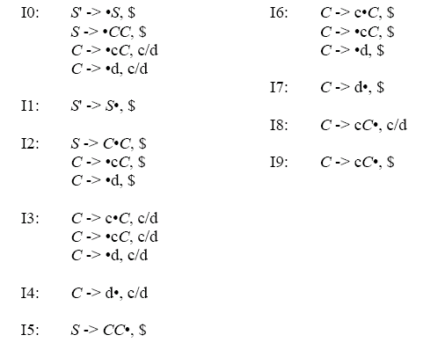

Slide 101
state | Action |  |  | goto
 | c | d | $ | S | C
0 | S₃ | S₄ |  | 1 | 2
1 |  |  | acc
2 | S₆ | S₇ |  |  | 5
3 | S₃ | S₄ |  |  | 8
4 | r₃ | r₃
5 |  |  | r₁
6 | S₆ | S₇ |  |  | 9
7 |  |  | r₃
8 | r₂ | r₂
9 |  |  | r₂

Slide 102
CHAPTER 4 SYNTAX ANALYSIS
Section 4 LR parsers
16、 Construction of the canonical LR parsing table
  Notes: 1)Every SLR(1) grammar is an LR(1) grammar
  2)The canonical LR parser may have more states than the SLR parser for the same grammar.

Slide 103
CHAPTER 4 SYNTAX ANALYSIS
Section 4 LR parsers
17、LALR(lookahead-LR)
1)Basic idea
Merge the set of LR(1) states having the same core
Notes: (1)When merging, the GOTO sub-table can be merged without any conflict, because GOTO function just relies on the core
(2) When merging, the ACTION sub-table can also be merged without any conflicts, but it may occur the case of merging of error and shift/reduce actions. We assume non-error actions

Slide 104
CHAPTER 4 SYNTAX ANALYSIS
Section 4 LR parsers
17、LALR(lookahead-LR)
1)Basic idea
Merge the set of LR(1) states having the same core
Notes: (3)After the set of LR(1) states are merged, an error may be caught lately, but the error will eventually be caught, in fact, it will be caught before any more input symbols are shifted.

Slide 105
CHAPTER 4 SYNTAX ANALYSIS
Section 4 LR parsers
17、LALR(lookahead-LR)
1)Basic idea
Merge the set of LR(1) items having the same core
Notes: (4)After merging, the conflict of reduce/reduce may be occurred.

Slide 106
S’→S
S →aBd|bCd|aCe|bBe
B →c
C →c

Slide 107
S
I0: S’→.S
S →.aBd
S →.bCd
S →.aCe
S →.bBe
I1: S’→S.
I2: S →a.Bd
S →a.Ce
B →.c
C →.c
B
d
a
I4: S→aB.d
I9: S→aBd.
C
e
I5: S→aC.e
I10: S→aCe.
c
b
c
I6: B →c.
C →c.
I3: S →b.Be
S →b.Cd
B →.c
C →.c
B
e
I7: S→bB.e
I11: S→bBe.
C
d
I8: S→bC.d
I12: S→bCd.

Slide 108
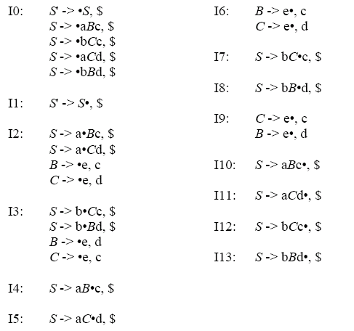
{B →c.,d C →c.,e}
{B →c.,e C →c.,d}

Slide 109
CHAPTER 4 SYNTAX ANALYSIS
Section 4 LR parsers
17、LALR(look-ahead-LR)
2)The sets of LR(1) states having the same core
  The states which have the same items but the look-ahead symbols are different, then the states are having the same core.
  Notes: We may merge these sets with common cores into one set of states.

Slide 110
CHAPTER 4 SYNTAX ANALYSIS
Section 5 Using ambiguous grammars
1、Using Precedence and Associative to Resolve Parsing Action Conflicts
Grammar: E→E+E|E*E|(E)|i
E →E+T|T
T →T*F|F
F →(E)|i
i+i+i*i+i

Slide 111
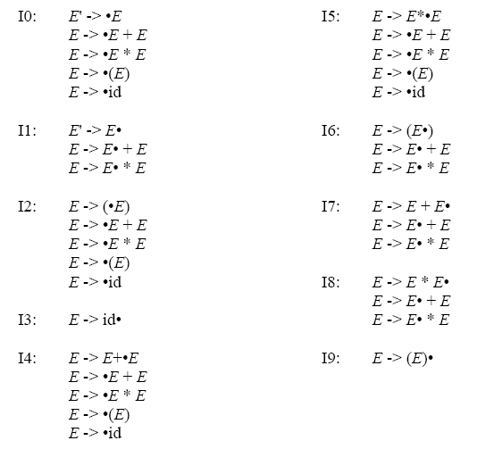

Slide 112
E
E’ →.E,$ I0
E →.E+E,$|+|*
E →.E*E,$|+|*
E →.(E),$|+|*
E →.i,$|+|*
E’ →E.,$ I1
E →E.+E,$|+|*
E →E.*E,$|+|*
E →E+.E,$|+|* I4
E →.E+E,$|+|*
E →.E*E,$|+|*
E →.(E),$|+|*
E →.i,$|+|*
I7
E
+
(
I2
i
I3
i
E →i.,$|+|* I3
*
(
i
E →E*.E,$|+|* I5
E →.E+E,$|+|*
E →.E*E,$|+|*
E →.(E),$|+|*
E →.i,$|+|*
E
E →(.E),$|+|* I2
E →.E+E,$|+|*
E →.E*E,$|+|*
E →.(E),$|+|*
E →.i,$|+|*
E →(E.),$|+|* I6
E →E.+E,$|+|*
E →E.*E,$|+|*
I8
E
(
I2
)
i
I3
(
E →(E).,$|+|* I9
E →E+E.,$|+|* I7
E →E.+E,$|+|*
E →E.*E,$|+|*
E →E*E.,$|+|* I8
E →E.+E,$|+|*
E →E.*E,$|+|*

Slide 113
CHAPTER 4 SYNTAX ANALYSIS
Section 5 Using ambiguous grammars
2、The “Dangling-else” Ambiguity
Grammar:
S’→S
S →if expr then stmt else stmt
|if expr then stmt
|other
S’→S
S →iSeS|iS|a

Slide 114
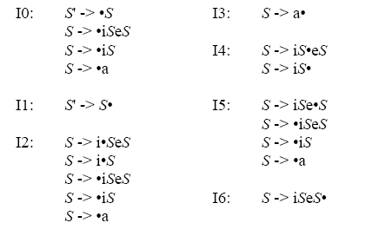

Slide 115
S’ →.S,$ I0
S →.iS,$
S →.iSeS,$
S →.a,$
S’ →S.,$ I1
S →i.S,$ I2
S →i.SeS,$
S →.iS,e|$
S →.iSeS,e|$
S →.a,e|$
S →iS.,$ I4
S →iS.eS,$
S’ →a.,$ I3
S →i.S,e|$ I5
S →i.SeS,e|$
S →.iS,e|$
S →.iSeS,e|$
S →.a,e|$
S’ →a.,e|$ I6
S →iSe.S,$ I7
S →.iS,$
S →.iSeS,$
S →.a,$
S →iSe.S,e|$ I10
S →.iS,e|$
S →.iSeS,e|$
S →.a,e|$
S →iS.,e|$ I8
S →iS.eS,e|$
S →iSeS.,$ I9
S →iSeS.,e|$ I11
I2—I5,I3—I6,I4—I8,I7—I10,I9—I11

Slide 116
CHAPTER 4 SYNTAX ANALYSIS
Section 6 Parser Generator Yacc
1、Creating an input/output translator with Yacc
Yacc specification translate.y
Yacc
Compiler
y.tab.c
C
Compiler
y.tab.c
a.out
input
a.out
output

Slide 117
CHAPTER 4 SYNTAX ANALYSIS
Section 6 Parser Generator Yacc
2、Three parts of a Yacc source program
declaration
%%
translation rules
%%
supporting C-routines
Notes: The form of a translation rule is as followings:
<Left side>: <alt> {semantic action}

Slide 118
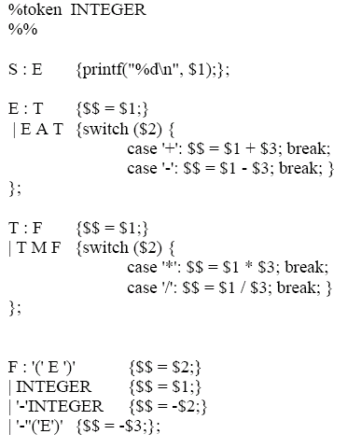
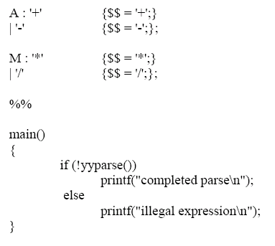

Slide 119
Syntax Analysis
Context-Free Grammar
Specification
Push-down Automation
Tool
Table-driven
Skill
Top-down,
Bottom-UP
Methods
Top-down
Bottom-Up
Derivation-Matching
Shift-Reducing
LR Parsing
Recursive-descent
Predictive
Layered Automation
First,Follow
SLR(1)
LR(1)
LALR(1)

Slide 120
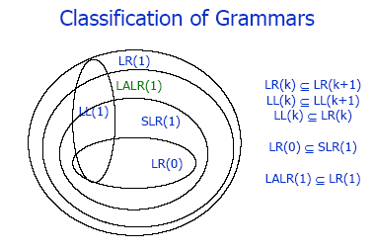

Slide 121
Recursive Descent Analyses
Advantages: Easy to write programs
Disadvantages: Backtracking, poor efficiency
a
Predictive Analyses : predict the production which is used when a non-terminated occurs on top of the analyses stack
Skills : First, Follow
Disadvantages: More pre-processes(Elimination of left recursions , Extracting maximum common left factors)
A
Controller
……….
LL(1) Parse Table
First(α) A→α
Follow(A) A→ε

Slide 122
Simple LR Analyses : based on determined LFA, state stack and symbol stack (two stacks)
Skills : LR item and Follow(A)
Disadvantages: cannot solve the problems of shift-reduce conflict and reduce-reduce conflict
LR(1) analyses

Slide 123
SLR(1) Parser:
b
a
i
Controller
γ
….
SLR(1) Parse Table
$
0
symbol
state
LR items (Shift items, Reducible items) LR item ε–extension (A→α•Bβ) ➔(B→•γ)
Follow(A) A→ η

Slide 124
Canonical LR Analyses(LR(1))
Skills : LR(1) item and Look-ahead symbol
Disadvantages: more states
LALR(1)
Skills : Merge states with the same core
Disadvantages: maybe cause reduce-reduce conflict

Slide 125
LR(1) Parser:
b
a
i
Controller
γ
….
LR(1) Parse Table
$
0
symbol
state
LR items (Shift items, Reducible items) LR item ε–extension (A→α•Bβ,a) ➔(B→•γ,first(βa) )

Slide 126
Generation of Parse Tree
Generating the reduce node(top-level) while reducing in the process of parsing

Slide 127
e.g. construct the parse tree for the string “i+i*i” under SLR(1) of the following grammar
0. S` →E 1. E → E+T
2. E →T 3. T →T*F
4.T →F 5. F →(E)
6. F → i

Slide 128
state
ACTION
GOTO
i
+
*
(
)
$
E
T
F
0
S₅
S₄
1
2
3
1
S₆
accept
2
r₂
S₇
r₂
r₂
3
r₄
r₄
r₄
r₄
4
S₅
S₄
8
2
3
5
r₆
r₆
r₆
r₆
6
S₅
S₄
9
3
7
S₅
S₄
10
8
S₆
S₁₁
9
r₁
S₇
r₁
r₁
10
r₃
r₃
r₃
r₃
11
r₅
r₅
r₅
r₅

Slide 129
E
E
T
T
T
F
F
F
i + i * i

