Slide 1
SQL语句作业

Slide 2
题一
【问题1】
SELECT A FROM R;
【问题2】
SELECT * FROM R WHERE B='17';
【问题3】
SELECT * FROM R,S;
SELECT * FROM R CROSS JOIN S;
【问题4】
SELECT R.A,S.C FROM R,S WHERE R.C=S.A;
【问题5】
SELECT* from R
UNION
SELECT* FROM S;

Slide 3
【问题6】
SELECT R.* FROM R,S WHERE R.A=S.A AND R.B=S.B AND R.C=S.C;
SELECT A,B,C FROM R
INTERSECT
SELECT A,B,C FROM S;
【问题7】
SELECT * FROM R WHERE NOT EXISTS (SELECT * from S WHERE R.A=S.A AND R.B=S.B AND R.C=S.C);
SELECT A,B,C FROM R
MINUS
SELECT A,B,C FROM S;
【问题8】
SELECT R.A,R.B,S.C FROM R,S WHERE R.B=S.B;

Slide 4
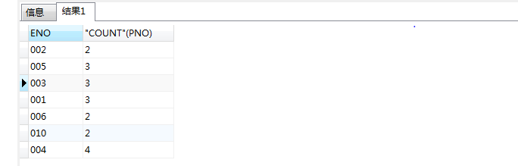
题二
【问题1】创建EMP关系的SQL语句，职工编号唯一识别一个职工，职工姓名不能为空
CREATE TABLE EMP(
ENO CHAR(8) PRIMARY KEY,
ENAME CHAR(8) NOT NULL,
SEX CHAR(2),
ECITY CHAR(10));
【问题2】查询至少参加两个项目的职工编号和参与的项目数。
SELECT EMPPROJECT.ENO, COUNT (PNO)
FROM EMPPROJECT
GROUP BY EMPPROJECT.ENO
HAVING COUNT (PNO) >= 2;

Slide 5
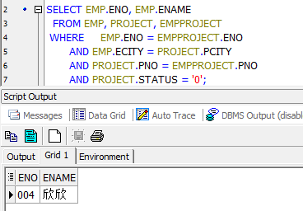
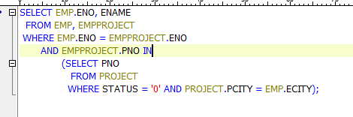
题二
【问题3】查询参与居住城市正在进行的工程项目的职工编号和姓名。
SELECT EMP.ENO, EMP.ENAME
FROM EMP, PROJECT, EMPPROJECT
WHERE EMP.ENO = EMPPROJECT.ENO
AND EMP.ECITY = PROJECT.PCITY
AND PROJECT.PNO = EMPPROJECT.PNO
AND PROJECT.STATUS = '0';
使用循环嵌套，
会影响查询效率

Slide 6
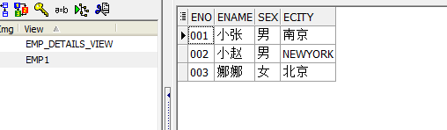
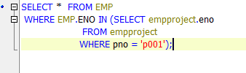
题二
【问题4】假设项目编号为“ P001”的项目负责人李强(其用户名为 U1)有对参与该项目的 职工进行查询的权限。建立视图 emp 和进行授权的 SQL 语句。
CREATE VIEW EMP1
AS
SELECT *
FROM EMP
WHERE EXISTS
(SELECT *
FROM EMPPROJECT
WHERE EMPPROJECT.PNO = 'p001' AND EMP.ENO = EMPPROJECT.ENO)
WITH CHECK OPTION;
GRANT SELECT ON EMP1 to U1;
使用in函数，查询速度变慢

Slide 7
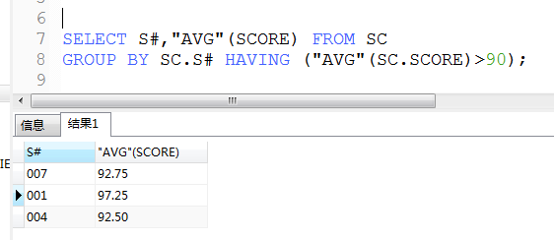
题三
【问题1】查询平均成绩达到优秀（ 90 分以上）的同学的姓名和课程名
SELECT S#,AVG(SCORE) FROM SC
GROUP BY SC.S# HAVING (AVG(SC.SCORE)>90);

Slide 8
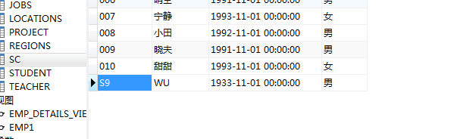
题三
【问题2】往基本表 Student 中插入一个学生元组（‘ S9’，‘ WU’， ‘ 1993’，‘男’ ）；
INSERT INTO STUDENT VALUES('S9','WU',"TO_DATE"('1933', 'YYYY'),'男');
【问题3】把 WANG 同学的选课和成绩全部删去；
DELETE FROM SC
WHERE EXISTS
(SELECT * FROM STUDENT
WHERE STUDENT.SNAME='WANG'
AND STUDENT.S#=SC.S#);

Slide 9
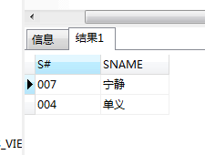
题三
【问题4】查询学过编号“ 001”并且也学过编号“ 002”课程的同学的学号、姓名
SELECT STUDENT.S#,STUDENT.SNAME FROM STUDENT,SC
WHERE SC.C#='001' AND SC.S#=SC.S# AND EXISTS
(SELECT * FROM SC sc2 WHERE sc2.C#='002'AND sc2.S#=STUDENT.S#);
SELECT STUDENT.S#,STUDENT.SNAME FROM STUDENT
WHERE STUDENT.S# IN
(SELECT SC1.S# FROM SC sc1 WHERE sc1.C#='001' AND EXISTS
(SELECT sc2.S# FROM SC sc2 WHERE sc2.C#='002' AND sc1.S#=sc2.S#));

Slide 10
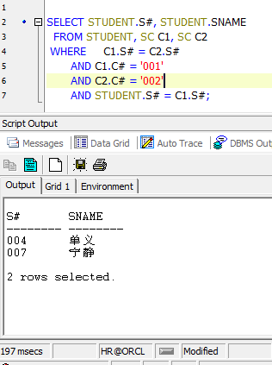
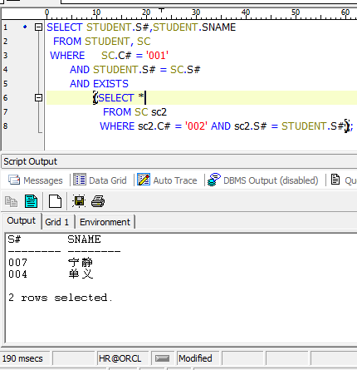
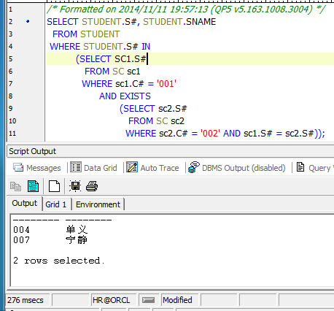
使用exists减少
查询时间
没有嵌套
有两层嵌套，
并且使用in函数

Slide 11
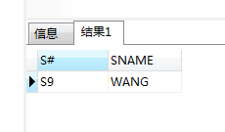
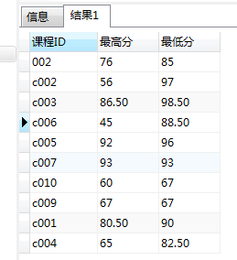
题三
【问题5】查询所有课程成绩都不及格的同学的学号、姓名
SELECT STUDENT.S#,STUDENT.SNAME FROM STUDENT
WHERE NOT EXISTS
(SELECT * FROM SC WHERE SC.SCORE>60 AND SC.S#=STUDENT.S#);
【问题6】查询各科成绩最高和最低的分，以如下形式显示： 课程 ID，最高分，最低分
SELECT SC.C# AS 课程ID,MIN(SC.SCORE)AS 最高分,MAX(SC.SCORE)AS 最低分
FROM SC
GROUP BY SC.C#;

Slide 12
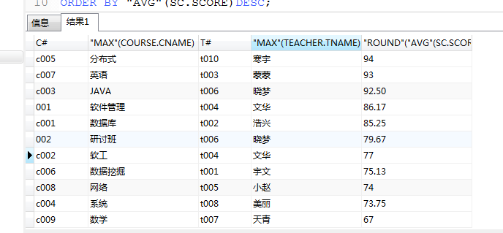
题三
【问题7】查询不同老师所教不同课程平均分从高到低显示
SELECT COURSE.C#,MAX(COURSE.CNAME),TEACHER.T#,
MAX(TEACHER.TNAME),ROUND(AVG(SC.SCORE), 2)
FROM COURSE,SC,TEACHER
WHERE COURSE.C#=SC.C# AND COURSE.T#=TEACHER.T#
GROUP BY COURSE.C#,TEACHER.T#
ORDER BY AVG(SC.SCORE)DESC;

Slide 13
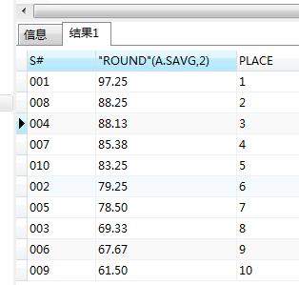
题三
【问题8】查询学生平均成绩及其名次；
SELECT a.S#,
ROUND (a.savg, 2),
(SELECT COUNT (b.S#)
FROM ( SELECT SC.S#, AVG (SC.SCORE) AS savg
FROM SC
GROUP BY SC.S#) b
WHERE b.SAVG > a.savg)
+ 1
AS place
FROM ( SELECT SC.S#, AVG (SC.SCORE) AS savg
FROM SC
GROUP BY SC.S#
ORDER BY "AVG" (SC.SCORE) DESC) a;

Slide 14
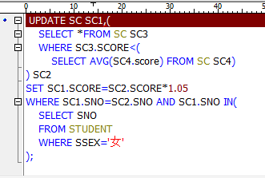

题三
【问题9】把低于总平均成绩的女同学成绩提高 5%；
UPDATE SC SET SC.SCORE=SC.SCORE*1.05
WHERE SC.SCORE<(SELECT AVG(SC.SCORE) FROM SC)
AND SC.S# IN(SELECT STUDENT.S# FROM STUDENT WHERE STUDENT.SSEX='女');
Update 后面只允许
有一张表

Slide 15
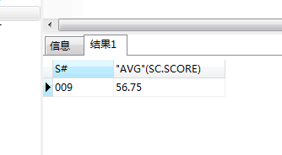
题三
【问题10】查询两门以上不及格课程的同学的学号及其平均成绩
SELECT SC.S#, AVG (SC.SCORE)
FROM SC
WHERE SC.S# IN ( SELECT SC.S#
FROM SC
WHERE SC.SCORE < 60
GROUP BY SC.S#
HAVING (COUNT (*) > 2))
GROUP BY SC.S#;

Slide 16
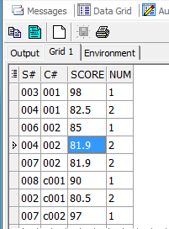
题三
【问题11】查询每门功成绩最好的前两名
SELECT *
FROM (SELECT SC.*,
DENSE_RANK () OVER (PARTITION BY SC.C# ORDER BY SC.SCORE DESC)
AS num
FROM sc) a
WHERE a.num <= 2
ORDER BY A.C#, A.SCORE DESC;

Slide 17
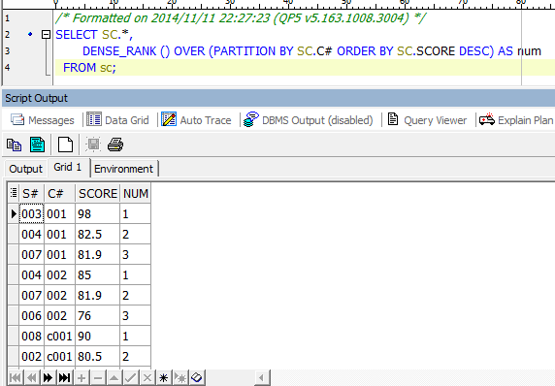
rank() over([partition by col1] order by col2)
是没有重复值的排序(即使两天记录相等也是不重复的)，可以利用它来实现分页
dense_rank() over([partition by col1] order by col2) 是连续排序，两个第二名仍然跟着第三名
row_number() over([partition by col1] order by col2) 是跳跃拍学，两个第二名下来就是第四名
其中[partition by col1]可省略。

Slide 18
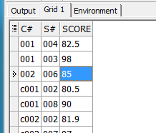
简洁易懂，但要保证
没有重复的成绩
SELECT C#, S#, SCORE
FROM SC SC1
WHERE (SELECT COUNT (*)
FROM SC SC2
WHERE SC2.C# = SC1.C# AND SC2.SCORE >= SC1.SCORE) <= 2
ORDER BY C#;
select sc0.sno,sc0.cno,score from sc sc0 where score in (select top 2 score
from sc where sc0.cno= cno order by score desc) order by sc0.cno;
Top 用于SQL SEVER中

Slide 19
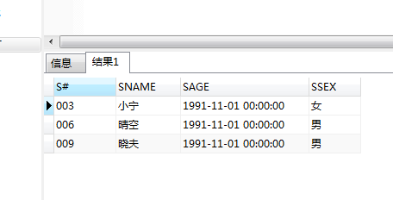
题三
【问题12】 1991 年出生的学生名单(注： Student 表中 Sage 列的类型是 datetime)
SELECT * FROM STUDENT
WHERE SUBSTR(TO_CHAR(STUDENT.SAGE,'YYYY'), 1, 4) ='1991';

Slide 20
SELECT *
FROM STUDENT
WHERE SAGE <= '1991-12-31 23:59:59' AND SAGE >= '1991-1-1 0:0:0';
SELECT *
FROM STUDENT
WHERE SAGE BETWEEN TO_DATE
('1991-1-1 0:0:0', 'yyyy-mm-dd hh24:mi:ss')
AND TO_DATE
('1991-12-31 23:59:59', 'yyyy-mm-dd hh24:mi:ss');

Slide 21
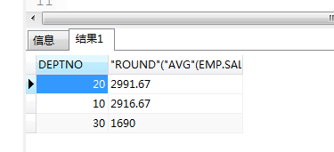
题四
【问题1】薪水大于 1200 的雇员，按照部门编号进行分组，分组后的平均薪水必须大于1500，查询各分组的平均工资，按照工资的倒序进行排列。
SELECT EMP.DEPTNO,ROUND(AVG(EMP.SAL), 2)
FROM EMP WHERE EMP.SAL>1200
GROUP BY EMP.DEPTNO HAVING("AVG"(EMP.SAL)>1500)
ORDER BY AVG(EMP.SAL) DESC ;

Slide 22
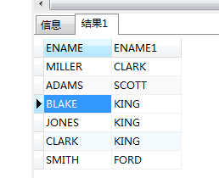
题四
【问题2】查询每个雇员和其经理的姓名。
SELECT a.ENAME,b.ENAME FROM EMP a,EMP b WHERE a.MGR=b.EMPNO;
SELECT a.ENAME,b.ENAME
FROM EMP a
join EMP b ON(a.MGR=b.EMPNO);

Slide 23
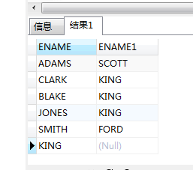
题四
【问题3】查询每个雇员和其经理的姓名（包括公司老板本身（他上面没有经理））。
SELECT a.ENAME,b.ENAME
FROM EMP a LEFT JOIN EMP b ON(a.MGR=b.EMPNO);
使用左连接

Slide 24
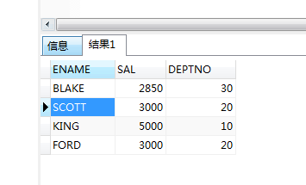
题四
【问题4】查询每个部门中工资最高的人的姓名、薪水和部门编号。
SELECT a.ENAME,a.SAL,a.DEPTNO
FROM EMP a,(SELECT DEPTNO,MAX(SAL)AS SAL FROM EMP GROUP BY DEPTNO) b
WHERE a.DEPTNO=b.DEPTNO AND a.SAL=b.SAL;

Slide 25
SELECT ENAME, SAL, e.DEPTNO
FROM EMP e
JOIN
( SELECT MAX (SAL) AS max_sal, DEPTNO
FROM EMP
GROUP BY DEPTNO) s
ON (e.SAL = s.max_sal AND e.DEPTNO = s.DEPTNO);
意思都是一样的，
但更加美观

Slide 26
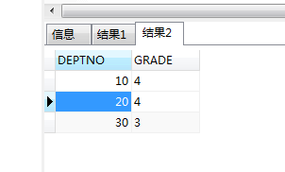
题四
【问题5】查询每个部门平均工资所在的等级。
SELECT a.DEPTNO, SALGRADE.GRADE
FROM SALGRADE,
( SELECT EMP.DEPTNO, AVG (EMP.SAL) AS SAL
FROM EMP
GROUP BY EMP.DEPTNO) a
WHERE a.SAL BETWEEN SALGRADE.LOSAL AND SALGRADE.HISAL;

Slide 27
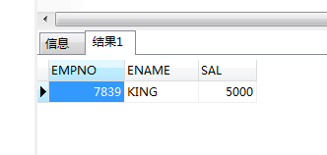
题四
【问题6】不准用库函数，求雇员表中薪水的最高值。
SELECT EMP.EMPNO, EMP.ENAME, EMP.SAL
FROM EMP
WHERE EMP.SAL NOT IN (SELECT DISTINCT a.SAL
FROM EMP a, EMP b
WHERE a.SAL < b.SAL);
主要考察逻辑

Slide 28
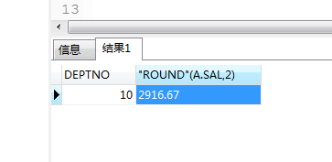
题四
【问题7】平均薪水最高的部门的部门编号。
SELECT a.DEPTNO, ROUND (a.SAL, 2)
FROM ( SELECT EMP.DEPTNO, AVG (EMP.SAL) AS SAL
FROM EMP
GROUP BY EMP.DEPTNO) a
WHERE a.SAL IN (SELECT MAX (b.SAL)
FROM ( SELECT EMP.DEPTNO, AVG (EMP.SAL) AS SAL
FROM EMP
GROUP BY EMP.DEPTNO) b);

Slide 29
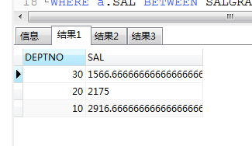
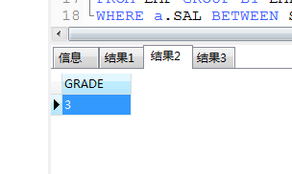
题四
【问题8】查询平均薪水的等级最低的部门名称
求部门薪水的平均值
SELECT EMP.DEPTNO,AVG(EMP.SAL) AS SAL FROM EMP GROUP BY EMP.DEPTNO;
求部门平均薪水所在等级的最小值
SELECT MIN (SALGRADE.GRADE) AS GRADE
FROM SALGRADE,
( SELECT EMP.DEPTNO, AVG (EMP.SAL) AS SAL
FROM EMP
GROUP BY EMP.DEPTNO) a
WHERE a.SAL BETWEEN SALGRADE.LOSAL AND SALGRADE.HISAL;

Slide 30
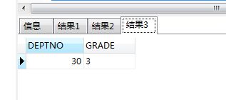
题四
求查询平均薪水的等级最低的部门名称
SELECT *
FROM dept
WHERE DEPT.DEPTNO IN
(SELECT x.deptno
FROM (SELECT a.DEPTNO, SALGRADE.GRADE
FROM SALGRADE,
( SELECT EMP.DEPTNO,
AVG (EMP.SAL) AS SAL
FROM EMP
GROUP BY EMP.DEPTNO) a
WHERE a.SAL BETWEEN SALGRADE.LOSAL
AND SALGRADE.HISAL) x
WHERE x.GRADE IN
(SELECT MIN (SALGRADE.GRADE) AS GRADE
FROM SALGRADE,
( SELECT EMP.DEPTNO, "AVG" (EMP.SAL) AS SAL
FROM EMP
GROUP BY EMP.DEPTNO) a
WHERE a.SAL BETWEEN SALGRADE.LOSAL AND SALGRADE.HISAL));
得到各部门的平均工资等级
求等级最小的部门编号
得到最低的部门平均工资等级

Slide 31
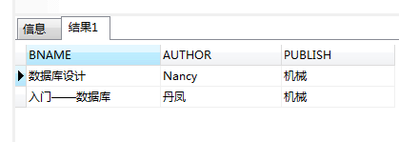
题五
【问题1】查询名称中包含“数据库”的图书的图书名称，作者，出版社和出版日期
SELECT BOOK.BNAME,BOOK.AUTHOR,BOOK.PUBLISH FROM BOOK WHERE BOOK.BNAME LIKE '%数据库%';

Slide 32
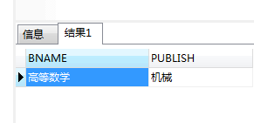
题五
【问题2】查询提供销售(图书表中有)但没有销售过(没在订单明细表中出现)的图书名称和 出版社。
SELECT BOOK.BNAME,BOOK.PUBLISH FROM BOOK WHERE
not EXISTS
(SELECT* FROM ORDERDETAIL where BOOK.BID=ORDERDETAIL.BID);

Slide 33
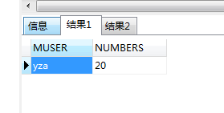
题五
【问题3】查询订购图书数量最多的会员名及其订购的数量。
SELECT ORDERS.MUSER,SUM(ORDERDETAIL.NUMBERS) AS NUMBERS
FROM ORDERS,ORDERDETAIL
WHERE ORDERS.OID=ORDERDETAIL.OID
GROUP BY ORDERS.MUSER
HAVING SUM(ORDERDETAIL.NUMBERS)>=
ALL(SELECT SUM(b.NUMBERS) FROM ORDERS a,ORDERDETAIL b
WHERE a.OID=b.OID
GROUP BY a.MUSER);

Slide 34
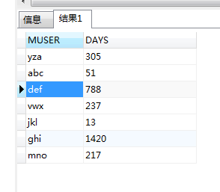
题五
【问题4】为了统计会员的购买行为信息，实施有意义的客户关怀策略，查询会员的平均 订购间隔时间（订单表中 ORDERDATE 为订购日期， SHIPMENTDATE 为出货日期），考虑多次购买图书和一次购买图书的情况。
SELECT ORDERS.MUSER,
CASE WHEN COUNT(ORDERS.OID)>1
THEN ROUND(TRUNC(MAX(ORDERS.ORDERDATE)-MIN(ORDERS.ORDERDATE))/COUNT(ORDERS.OID), 0)
ELSE TRUNC(SYSDATE-MAX(ORDERS.ORDERDATE))
END AS days
FROM ORDERS GROUP BY ORDERS.MUSER;

Slide 35

题五
【问题5】会员订购图书后，将本次订购的销售额累加到该会员的消费额中，并按照本次 订单的销售额计算积分累加到该会员的积分中 (每 20 元增加 1 个积分，不足 20 元不计入积分)。
CREATE TRIGGER mpoint
AFTER INSERT ON orders
FOR each ROW
BEGIN
UPDATE member SET member.cunsumption=member.cunsumption+new.sales,
member.points=member.points+new.sales/20
WHERE member.muser=new.muser;
END;

Slide 36
Thanks!

