Slide 1
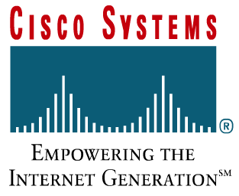
Routing Protocols
RIP and OSPF

Slide 2
Routing and Routers
RIPv1/RIPv2
  RIP History
  Differences Between RIP v1 and RIP v2
  Configuration of RIP v2
OSPF(single area)
  Link-state routing protocol
  Single-area OSPF concepts
  Single-area OSPF configuration
Notes:
距离矢量协议 链路状态协议
OSPF重要性下降，不讲了今年

Slide 3
RIP History
RIP v1 is considered an interior gateway protocol that is classful.
  RIP v1 is a distance vector protocol that broadcasts its entire routing table to each neighbor router at predetermined intervals. The default interval is 30 seconds.
  RIP uses hop count as a metric, with 15 as the maximum number of hops.
RIP v1 is capable of load balancing over as many as six equal-cost paths, with four paths as the default
RIP was originally specified in RFC 1058

Slide 4
RIP History
RIPv1 has the following limitations:
  It does not send subnet mask information in its updates.
  It sends updates as broadcasts on 255.255.255.255 .
  It does not support authentication.
  It is not able to support VLSM or Classless Interdomain Routing (CIDR).
Notes:
1.不发送子网掩码
2.Ip层的广播信息发送形式，使得除了路由器之外的不用的pc服务器也消耗了资源
不支持认证—安全性，交换报文之前要认证路由器之间的身份

Slide 5
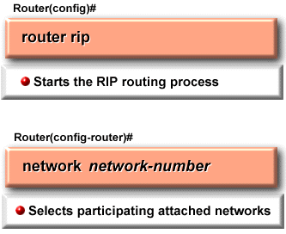
RIP Configuration
The router rip command selects RIP as the routing protocol.
The network command assigns a NIC-based network address to which a router will be directly connected.

Slide 6
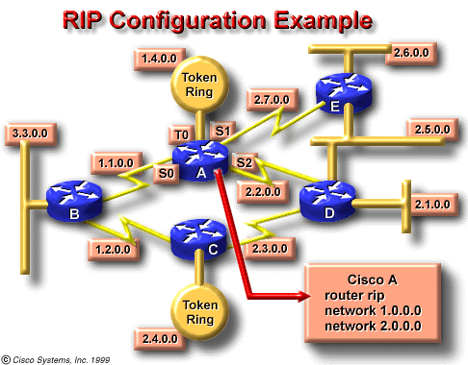
RIP Configuration
router rip
network 1.0.0.0
network 2.0.0.0

Slide 7
RIP v2
RIP v2 is an improved version of RIP v1 and shares the following features:
  It is a distance vector protocol that uses a hop count metric.
  It uses holddown timers to prevent routing loops – default is 180 seconds.
  It uses split horizon to prevent routing loops.
  It uses 16 hops as a metric for infinite distance.
Notes:
抑制计时器
水平分割

Slide 8
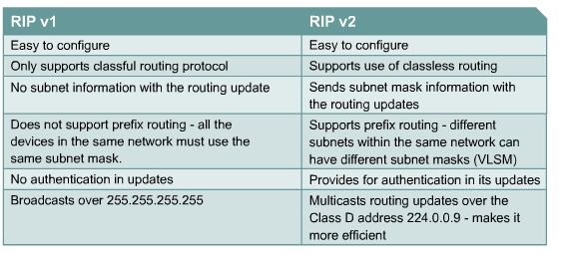
Comparing RIPv1 and RIPv2
Notes:
无类路由
子网掩码
可知路径涉及网段
可使用变长子网掩码
换成主播地址
D类地址
A 0
B 10
C 110 （1100 0000-1101 1111（223））
D 1110
广播组（配置了rip2的所有路由器—这样就不包括所有无关的pc服务器的其他无关机器，消耗资源小）

Slide 9
RIP v2 Configuration
The router command starts the routing process.
The network command causes the implementation of the following three functions:
  The routing updates are multicast out an interface.
  The routing updates are processed if they enter that same interface.
  The subnet that is directly connected to that interface is advertised.
Notes:
0网段有歧义所以不能用，不知道是儿子还是爸爸
1网段同理
Rip2之后0实际可用，因为后面跟了/26、24可区分
1不行

Slide 10
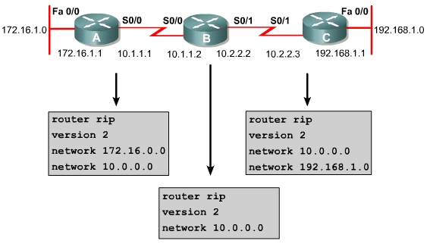
RIP v2 Configuration Example
Select a routing protocol
Select rip version 2 as the routing protocol
Mandatory configuration command for each IP routing process

Slide 11
Verifying &Troubleshooting
Verifying RIP v2
  Router# show ip protocols
    Verifying the RIP Configuration
  Router# show ip route
    Displaying the IP Routing Table
Troubleshooting RIP v2
  Router# debug ip rip
    display RIP routing updates sent and received.
  Router# undebug all (/no debug all)
    Router# turn off all debugging

Slide 12
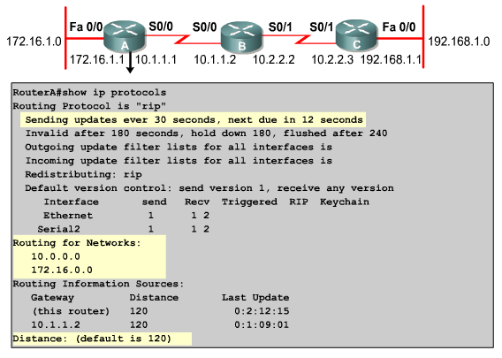


Slide 13
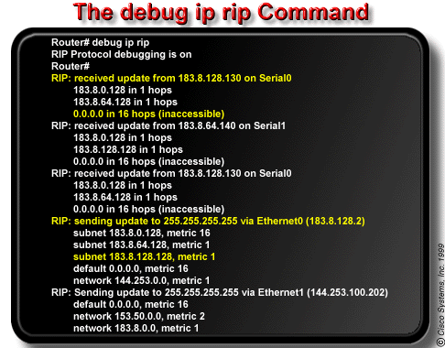
The debug ip rip command displays RIP routing updates as they are sent and received. In this example, the update is sent by 183.8.128.130.
It reported on three routers, one of which is inaccessible because its hop count is greater than 15. Updates were then broadcast through 183.8.128.2.

Slide 14
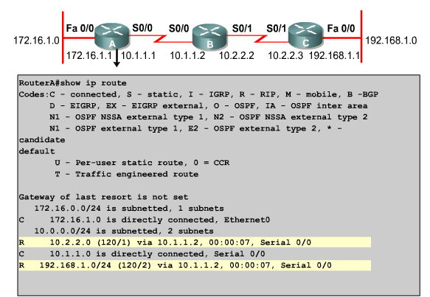
Notes:
. Use the show running-config or show ip protocols privileged EXEC commands on the router to check for a possible misconfigured routing protocol.

Slide 15
Routing and Routers
RIPv1/RIPv2
  RIP History
  Differences Between RIP v1 and RIP v2
  Configuration of RIP v2
OSPF(single area)
  Link-state routing protocol
  Single-area OSPF concepts
  Single-area OSPF configuration
Notes:
到此为止，后面不学

Slide 16
OSPF Overview
Open Shortest Path First (OSPF) is a link-state routing protocol based on open standards.
It is described in several standards of the Internet Engineering Task Force (IETF)
  The most recent description is RFC 2328.
OSPF is becoming the preferred IGP protocol when compared with RIPv1 and RIPv2 because it is scalable.

Slide 17
Routing Information
The state of the link is a description of an interface and the relationship to its neighboring routers.
The collection of link-states forms a link-state database, sometimes called a topological database.
Routers apply the Dijkstra shortest path first (SPF) algorithm to build the SPF tree, with themselves as the root.
Routers calculate the best paths through SPF tree, then best paths are selected and placed in the routing table.

Slide 18
OSPF vs. RIP
OSPF
RIP
Uses Metrics such as Bandwidth
Appropriate for Large Networks
Can further subdivide a network into areas
Supports VLSM
Fast convergence
Supports equal-cost multipath
Uses Hop Count
Designed for Small Networks (15 hops)
Flat hierarchy design
Non VLSM (for RIP v1)

Slide 19
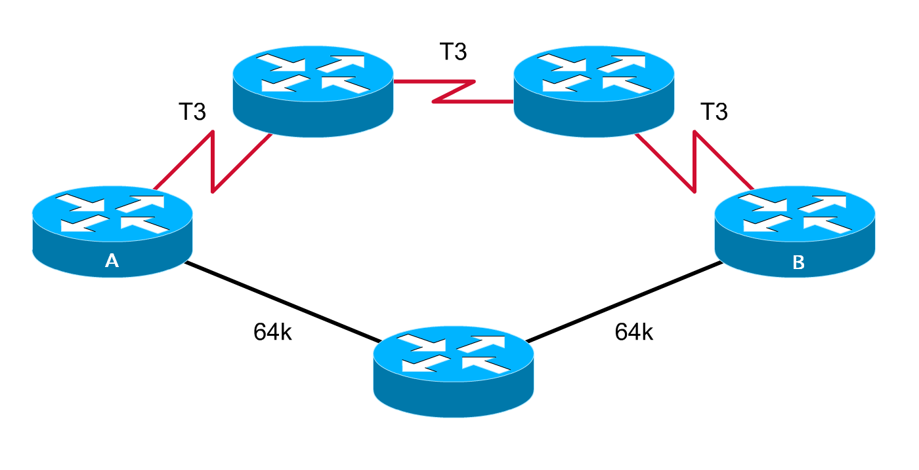
OSPF vs. RIP (cont.)
What is the Best Path from A to B?
OSPF Chosen Path
RIP Chosen Path
Notes:
OSPF chooses the best path based on bandwidth and therefore the T3 link are chosen.
RIP in the other hand uses Hop count and chooses the path that has the minimum number of hops to the destination.

Slide 20
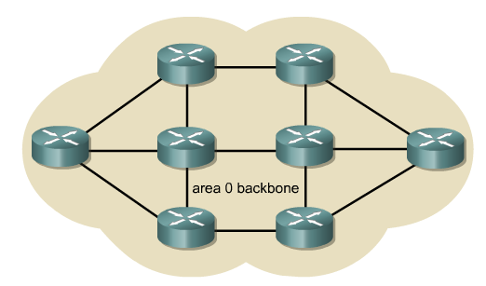
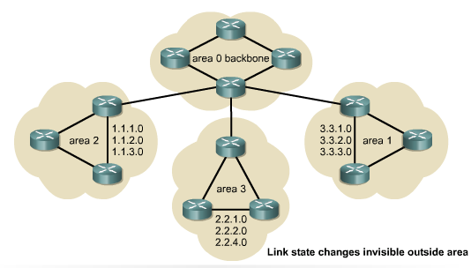
OSPF Feature
OSPF overcomes these limitations
  More robust
  More scalable
Large OSPF networks use a hierarchical design.

Slide 21

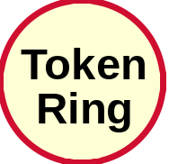
OSPF Terminology
Link
A physical connection between two network devices

Slide 22
OSPF Terminology
Neighbors
Link-State
The status of a link between two routers, including information about a router's interface and its relationship to neighbouring routers.

Slide 23
OSPF Terminology
Neighbors
Cost = 10
Cost = 1785
Cost = 6
Cost
The value assigned to a link
Rather than hops, link-state protocols assign a cost to a link, which is based on the bandwidth of the link

Slide 24
OSPF Terminology
Neighbors
Link
Area 1
Cost = 10
Area 0
Cost = 1785
Cost = 6
Area
A collection of networks/routers having the same area ID
Each router within an area has the same link-state information

Slide 25
OSPF Terminology
Autonomous System
Neighbors
Link
Area 1
Cost = 10
Area 0
Cost = 1785
Cost = 6

Slide 26
OSPF Terminology
Autonomous System
Neighbors
Link
Area 1
Cost = 10
Cost = 1785
Cost = 6
Area 0
Neighborship
Database
Lists Neighbors
A listing of all the neighbors to which a router has established a bi-directional communication.

Slide 27
OSPF Terminology
Neighbors
Autonomous System
Link
Area 1
Area 0
Cost = 10
Cost = 1785
Cost = 6
Neighborship
Database
Lists Neighbors
Topology
Database
Lists All Routes
A list of information about all other routers in the internetwork. It shows the internetwork topology.

Slide 28
OSPF Terminology
Autonomous System
Neighbors
Link
Area 1
Cost = 10
Area 0
Cost = 1785
Cost = 6
Neighborship
Database
Lists Neighbors
Topology
Database
Lists All Routes
Routing
Table
Lists Best Routes
Sometimes known as the forwarding database
The routing table for each router is unique.

Slide 29
OSPF Terminology
DR
BDR
Designated Router (DR)
One router on an OSPF multiaccess network that is elected to represent all the routers in that network
Backup Designated Router (BDR)
A standby router that becomes the DR, if the original DR fails.

Slide 30
OSPF Areas
Areas are defined with a 32 bits number
  Can be either in IP format or single decimal value
  Area 0 or Area 0.0.0.0
Area 0: A single area whose area number is 0
OSPF uses a 2 level hierarchical model
In multi-area OSPF networks, all areas are required to connect to area 0(backbone)

Slide 31


OSPF Areas Example
Area 1
ABR
Area 0 (Backbone)
ABR
Area 4
Area 2
Area 3
Notes:
OSPF has to have at least one Area (Area 0 ). This area is the bacbone were all the other areas must be connected to.
ABR: Area border Routers are routers that have interfaces in more than one area, generally between Area 0 and other areas.

Slide 32
OSPF Operations
OSPF uses neighbor adjacencies to gain full knowledge of the network.
OSPF operation include five steps:
  Step1: Set up the adjacency relationships
  Step2: Elect DR and BDR (if needed)
  Step3: Discover the routes
  Step4: Choose appropriate routes
  Step5: Maintain the route information
OSPF has seven states. Briefly, they are:
  Init, 2Way, Ex Start, Exchange, Loading, Full

Slide 33
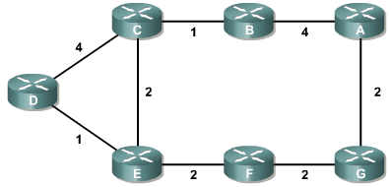
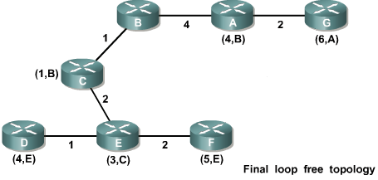

Set up the Neighbor Relationships
The shortest path algorithm calculates a loop-free topology using the node as the starting point and examining in turn information it has about adjacent nodes.
starting point

Slide 34
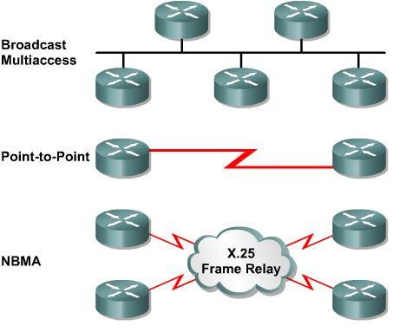
Elect DR and BDR
OSPF Network Types
  Broadcast multi-access, such as Ethernet
  Point-to-point networks
  Nonbroadcast multi-access (NBMA)

Slide 35
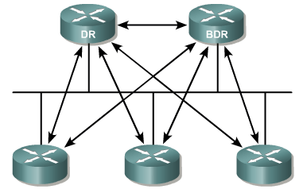
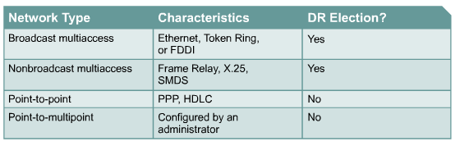
DR & BDR
Each router then forms adjacency with DR and BDR
The DR sends link-state information to all other routers on the segment using the multicast address of 224.0.0.5 for all OSPF routers.
To ensure that DR/BDR see the link states all routers send on the segment, the multicast address for all DR/BDRs, 224.0.0.6, is used.

Slide 36
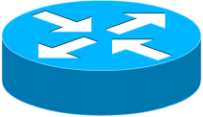
OSPF in Multi-Access media
Giga/Fast/Ethernet, FDDI, Token Ring
DR
BDR
BDR
DR
Notes:
DR : Designated Routers >>
Reduce OSPF traffic on Multiaccess Links
Store and Distribute neighbors LSDBs
BDR exist as a backup for redundancy.
DR election:
OSPF Priority is used in the selection : 1 – 255, default = 1, 0 for noncandidate
If priorities are the same, higher Loopback IP address.
In case of no existing Loopbacks highest IP address of interfaces are used.
OSPF Order of events:
Establish router adjacencies
Elect a Designated Router
Discover Routes
Select appropriate routes
Maintain routing info
Relies on IP packets for delivery of routing information (uses protocol number 89)

Slide 37
OSPF Packets
There are 5 types of OSPF routing protocol packets
  Function Name
  Hello Hello
  Database Description DBD
  Link-State Request LSR
  Link-State Update LSU
  Link-State Acknowledgement LSAck

Slide 38
OSPF Hello Protocol
When a router starts an OSPF routing process on an interface, it sends a hello packet and continues to send hellos at regular intervals.
The rules that govern the exchange of OSPF hello packets are called the Hello protocol.
Hello packets are addressed to 224.0.0.5.
Hellos are sent every 10 seconds by default on broadcast multi-access and point-to-point networks.
On interfaces that connect to NBMA networks, such as Frame Relay, the default time is 30 seconds.

Slide 39
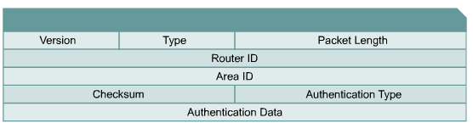
OSPF Packet Header
For the hello packet the type field is set to 1.

Slide 40
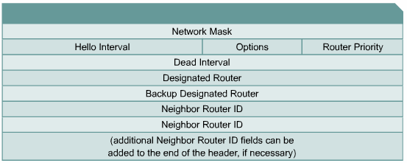
OSPF Hello Protocol
OSPF Hello Packet Header

Slide 41
Which Router will be DR?
Priority + Router ID, the biggest is DR, the second biggest is BDR.
Priority: 1-255 Default=1
Router ID
  A loopback IP address
  If the absence of loopback IP address, the highest-value address interface IP
  If the interface goes down, the router must re-establishing adjacency and readvertising LSA

Slide 42
Steps in the Operation of OSPF
172.16.5.1/24
E0
172.16.5.2/24
E1
A
B
Down State
I am router ID 172.16.5.1 and I see no one.
Init State
Router B
Neighbors List
172.16.5.1/24, int E1
I am router ID 172.16.5.2, and I see 172.16.5.1.
Router A
Neighbors List
172.16.5.2/24, int E0
Two-Way State

Slide 43
Steps in the Operation of OSPF
Priority:1
DR
Priority:1
E0
172.16.5.1
E0
172.16.5.2
Exstart State
afadjfjorqpoeru
39547439070713
I will start exchange because I have router ID 172.16.5.1.
Hello
No, I will start exchange because I have a
higher router ID.
afadjfjorqpoeru
39547439070713
Hello
Exchange State
afadjfjorqpoeru
39547439070713
Here is a summary of my link-state database.
DBD
afadjfjorqpoeru
39547439070713
DBD
Here is a summary of my link-state database.

Slide 44
Steps in the Operation of OSPF
DR
E0
172.16.5.1
E0
172.16.5.2
afadjfjorqpoeru
39547439070713
afadjfjorqpoeru
39547439070713
LSAck
Thanks for the information!
LSAck
Loading State
afadjfjorqpoeru
39547439070713
I need the complete entry for network 172.16.6.0/24.
LSR
afadjfjorqpoeru
39547439070713
Here is the entry for network 172.16.6.0/24.
LSU
afadjfjorqpoeru
39547439070713
LSAck
Thanks for the information!
Full State

Slide 45
Review: OSPF Operation
Step1: Set up the adjacency relationships
Step2: Elect DR and BDR (if needed)
Step3: Discover the routes
Step4: Choose appropriate routes
Step5: Maintain the route information

Slide 46
Step 1: Establish Router Adjacencies
Routers send hello packet at an interval
If a neighbor founded:
  Add the neighbor to the neighborship database
Discover the network type
  If a multi-access network, enter the DR/BDR election process and enter Step 2.
  If point-to-point or point-to-multipoint, no DR/BDR is elected and skip Step 2.
  If the DR/BDR fields in the hello packet’s header is already occupied (i.e. a DR/BDR pair already exists), no DR/BDR election occurs and skip Step 2.

Slide 47
Step 2: Elect a DR and a BDR
If no other router online, the router becomes the DR. The next router to “come up” will be the BDR.
If multiple routers (two or more) come online simultaneously, then…
  The router with the highest priority becomes DR
    Priority of zero means “never DR”
  If there is a tie, then the router with the highest router ID becomes DR
    Router ID is the highest loopback or interface IP address
  Router with second highest priority or router ID becomes the BDR

Slide 48
Step 2: Elect a DR and a BDR
BDR becomes DR if the DR fails.
However…
  If a new OSPF router joins the network with a higher priority or router ID, the current DR and BDR do not change.
    It would become the new BDR only if the current DR failed or the new DR only if the current DR and BDR failed.

Slide 49
Step 3: Discover Routes
Previously explained in the ExStart to Full State
  Routers determine “master/slave” relationship
  DR/BDR in multiaccess networks exchange LSAs and all DRothers send the DR/BDR their Type 2 DBDs.
  If necessary, a router may enter the loading state by sending a LSR requesting more information
    All routers must wait in Loading State until the requesting router is fully updated.
  Routers now enter the Full State

Slide 50
4. Select Appropriate Routes
The SPF Algorithm is now calculated in parallel with every other router on the network.
  Remember: All routers must have identical link-state databases before this can occur.
  The SPF uses cost as its metric
  SPF adds up the cost for each path from itself to the destination, builds a tree with the router as the root
  OSPF then installs the least cost path in the routing table
    Up to 4 equal cost paths will be installed for load sharing

Slide 51
5. Maintain Routing Information
The regular exchange of Hellos is the mechanism OSPF uses to detect a new neighbor or a downed neighbor.
  Hello packets are sent at different default intervals depending on the type of network.
    For links with speeds T1 (1.544 Mbps) or greater, every 10 second: broadcast multiaccess and point-to-point links
    For links with less than a T1, every 30 seconds: nonbroadcast multiaccess links
    The “dead interval” is four times the hello interval.

Slide 52
Maintaining Routing Information
Link-State Change
DR
1
x
LSU
x
A
B
Router A tells all OSPF DRs on 224.0.0.6

Slide 53
Maintaining Routing Information
2
Link-State Change
LSU
DR
1
x
LSU
x
A
B
Router A tells all OSPF DRs on 224.0.0.6
DR tells others on 224.0.0.5

Slide 54
Maintaining Routing Information
Link-State Change
2
LSU
DR
1
LSU
x
x
3
A
B
LSU
Router A tells all OSPF DRs on 224.0.0.6
DR tells others on 224.0.0.5

Slide 55
Maintaining Routing Information
2
2
Link-State Change
LSU
DR
4
I need to update
my routing table.
4
1
1
1
x
LSU
x
3
3
A
B
LSU
Router A tells all OSPF DRs on 224.0.0.6
DR tells others on 224.0.0.5

Slide 56
Basic OSPF Configuration
Enable OSPF on the router
  process-id
    Value: 1 ~ 65535
    Identify multiple OSPF processes on one router
    Usually keep the same process ID throughout the entire AS
Identify IP networks on the router
Router (config) # router ospf process-id
Router (config-router) # network address wildcard-mask area area-id
The network address can be a whole network, a subnet, or the address of the interface.

Slide 57
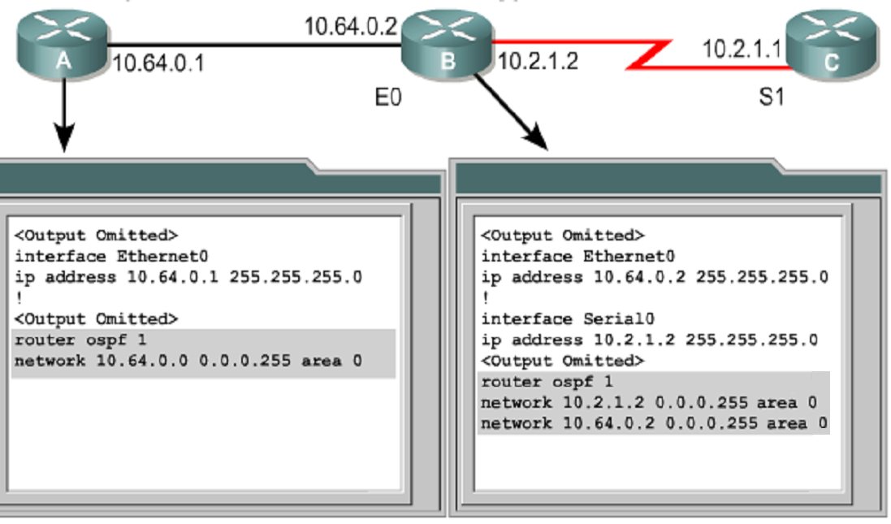
Basic OSPF Configuration

Slide 58
Configuring a Loopback Address
To add stability to OSPF router ID
  The loopback interface must be configured before the OSPF process starts
  When configuring loopbacks, use a /32 mask to avoid potential routing problems
  It is recommended that you use the loopback address (private or public address) on all key routers in your OSPF based network.
Router (config) # interface loopback number
Router (config-if) # ip address address subnet-mask
Note: no shutdown command is not needed.

Slide 59
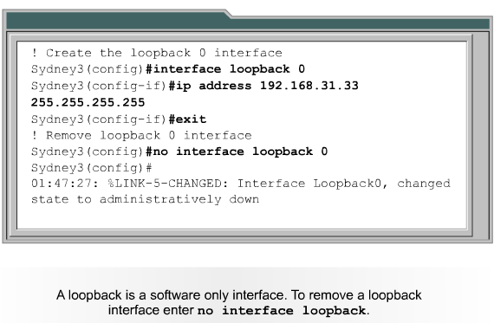
Configuring a Loopback Address Example

Slide 60
Modifying OSPF Interface Priority
To manipulate DR/BDR elections
  number
    Value: 0 ~ 255, default is 1
    A priority of 0 indicates an interface cannot be elected as DR or BDR
Monitoring OSPF interface priority
Router (config-if) # ip ospf priority number
Router # show ip ospf [interface type number]

Slide 61
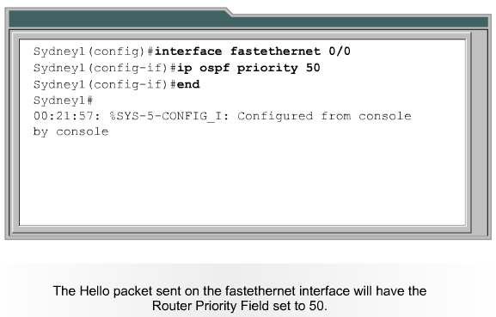
Setting OSPF Priority Example
A router with the highest OSPF priority will win the election for DR.

Slide 62
OSPF Cost = Metric
Cost is applied on all router link paths
16 bits number (1 – 65,535)
Lower metric = more desirable
Route decision is made on total cost of the path.
Metric is derived from Bandwidth
100,000,000
Formula COST =
Bandwidth
OSPF Cost for T1 = 100,000,000 / 1,544,000 = 64

Slide 63
OSPF Path Cost
All interfaces connected to the same link must agree on the cost of that link. Otherwise, the link will be considered down
  A Cisco router’s default cost for a serial link is 1784 ( 56Kbps bandwidth )
  If the line is a slower speed, you must specify the real link speed
1 ~ 65535
Router (config-if) # ip ospf cost number
Kbps
Router (config-if) # bandwidth number

Slide 64
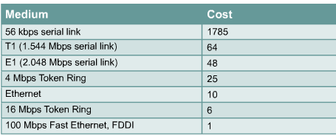

Modifying OSPF Cost Metric Example
A common situation requiring a cost change is in a multi-vendor routing environment. A cost change would ensure that one vendor’s cost value would match another vendor’s cost value.
Another situation is when Gigabit Ethernet is being used. The default cost assigns the lowest cost value of 1 to a 100 Mbps link.

Slide 65
Configuring OSPF Timers
All routers in an OSPF area must agree on the same hello interval and the same dead intervals , default:
  10 seconds for links with T1 or greater (broadcast )
  30 seconds for links with less than T1 (non-broadcast)
  Dead interval = 4 * hello interval
Changing the hello interval
Router(config-if)# ip ospf hello-interval seconds
Router(config-if)# ip ospf dead-interval seconds
Note: The dead interval will automatically adjust to four times the new hello interval.

Slide 66
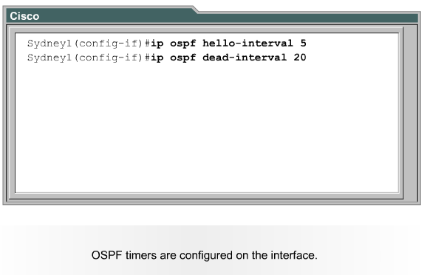
Configuring OSPF Timers Example

Slide 67
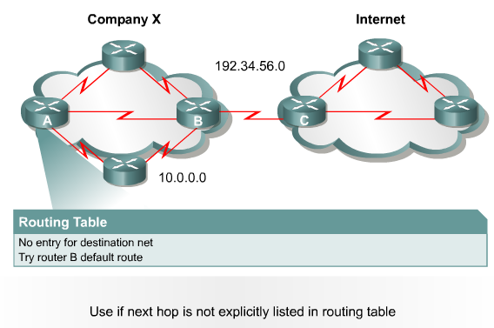
OSPF - Propagating a Default Route

Slide 68
OSPF - Propagating a Default Route
Step1: Configure default route
Router(config)# ip route 0.0.0.0 0.0.0.0 [interface | next-hop address]
Step2: propagate this route to all the routers
Router(config-router)# default-information originate

Slide 69




