Slide 1
Chapter 2
The Relational Model

Slide 2
Ch2 The Relational Model
2.1 The CAP Database
2.2 Naming the Parts of a Database
2.3 Relational Rules
2.4 Keys, Superkeys, and Null Values
2.5 Relational Algebra
2.6 Set-Theoretic Operations
2.7 Native Relational Operations
2.8 The Interdependence of Operations
2.9 Illustrative Examples
2.10 Other Relational Operations
Database Principles & Programming

Slide 3
2.2 Naming the Parts of a Database
Terminology (术语)
  Table (Relation)
    Old: file of records
  Column names (Attributes)
    Old: field names of records
  Rows (Tuples)
    Old: records of a file
  Table heading (Schema)
    Old: set of attributes
Database Principles & Programming

Slide 4
2.2 Naming the Parts of a Database
关系模型 | 关系数据库管理系统(SQL) | 文件系统
Relation （关系） | Table （表） | File of Records
Attribute （属性） | Column （列） | Field
Tuple （元组） | Row （行） | Record
Schema （模式） | Table Heading （表头） | Type of Record
Database Principles & Programming

Slide 5
2.2 Naming the Parts of a Database
table name
column name
CUSTOMERS
cid
cname
city
discnt
c001
TipTop
Duluth
10.00
c002
Basics
Dallas
12.00
table heading
c003
Allied
Dallas
8.00
c004
ACME
Duluth
8.00
c006
row
ACME
Kyoto
0.00
table
column
Database Principles & Programming

Slide 6
2.3 Relational Rules
Rule 1. First Normal Form Rule
  Can't have multi-valued fields.
Rule 2. Access Rows by Content Only Rule
  Can't say: the third row down from the top.
    No order to the rows
    No order to the columns
Rule 3. The Unique Row Rule
  Entity Integrity Rule (实体完整性)
Database Principles & Programming

Slide 7
2.4 Keys, Superkeys, and Null Values
Key & Superkey
Primary Key
Database Principles & Programming

Slide 8
2.4 Keys, Superkeys, and Null Values
Theorem 2.4.2. Every table T has at least one key.
Proof. Given a table T with Head(T) = {A₁ . . . A_{n}}.
  令 K := Head(T), 则K是表T的一个超键(superkey)
  While (K是表T的超键)
  {
    IF (存在K的一个真子集S，且S也是T的超键)
    THEN { K:=S; continue; }
    ELSE break;
  }
  Return key ‘K’ for T;
Database Principles & Programming

Slide 9
2.4 Keys, Superkeys, and Null Values
Null Values (空值)
Database Principles & Programming

Slide 10
2.5 Relational Algebra
Relational Algebra（关系代数）
  abstract language introduced by E. F. Codd
information stored in the form of tables
results of a query in table form
operations of relational algebra
Database Principles & Programming

Slide 11
2.5 Relational Algebra
set-theoretic operations
NAME | SYMBOL | FORM | EXAMPLE
UNION (并) | ∪ | UNION | R ∪ S
INTERSECTION (交) | ∩ | INTERSECT | R ∩ S
DIFFERENCE (差) | – | MINUS | R – S
PRODUCT (乘积) | × | TIMES | R × S
Database Principles & Programming

Slide 12
native relational operations
NAME | SYMBOL | FORM | EXAMPLE
PROJECT (投影) | R [ ] | R [ ] | R[A_{i1},…,A_{ik}]
 | π |  | π_{Ai1,…,Aik} (R)
SELECT (选择) | R where C | R where C | R where A₁=5
 | δ | δ_{C}(R) | δ_{A1=5} (R)
JOIN (联接) | ∞ | JOIN | R ∞ S
DIVISION (除法) | ÷ | DIVIDEBY | R ÷ S
Database Principles & Programming

Slide 13
Difference between join and division
 | T = R ∞ S | T = R ÷ S
Head(R) | {A₁,…,A_{n},B₁,…,B_{k}} | {A₁,…,A_{n},B₁,…,B_{m}}
Head(S) | {B₁,…,B_{k},C₁,…,C_{m}} | { B₁,…,B_{m} }
Head(T) | {A₁,…,A_{n},B₁,…,B_{k}, C₁,C₂,…,C_{m}} | { A₁,A₂,…,A_{n} }
Database Principles & Programming

Slide 14
Result of T=R∞S | A row t is in the table R∞S if and only if there are two rows u in R and v in S, such that u[B_{i}] = v[B_{i}] for all i (1≤i≤k); then t[A_{i}] = u[A_{i}] for all i, 1≤i≤n t[C_{i}] = v[C_{i}] for all i, 1≤i≤m t[B_{i}] = u[B_{i}] = v[B_{i}] for all i, 1≤i≤k
Result of T=R÷S | T contains the largest possible set of rows t such that for each row s in S, we can find one row r in R, where t(A_{i}) = r(A_{i}) for 1≤i≤n and s(B_{j}) = r(B_{j}) for 1≤j≤m
Database Principles & Programming

Slide 15
ch2 重点、难点总结
1：关系的合并运算
2：特殊运算（‘差’运算）的使用方法
3：‘除’ 运算与‘联接’运算的区别
4：特殊运算（ ‘除’ 运算）的使用方法

Slide 16
总结1：关系的合并运算
并运算
集合运算
差运算
交运算
笛卡尔乘积
关系运算
自然联接
联接运算
θ-联接
外联接
正确的表示方法！

Slide 17
总结2：特殊运算（‘差’运算）的使用方法
‘差’ 运算
  当查询条件带有‘否定’语义，或者具有明显的‘排它性’的时候，通常需要使用两个子查询之间的‘差’运算
  ‘差’运算的运算对象（关系）中，通常需要包含其关键字

Slide 18
总结3：‘除’ 运算与‘联接’运算的区别
‘除’ 运算与‘联接’运算的区别
  我们将查询的结果关系称为‘目标对象’，用于定义查询条件的关系称为‘条件对象’
  在决定某个元组t是否属于结果关系时，
    如果只需要从条件对象中找到一个元组c并使得查询条件成立，那么就直接使用‘联接’运算
    如果需要条件对象中的所有元组都能使得查询条件成立，那么就使用‘除’运算

Slide 19
T=R∞S | A row t is in the table R∞S if and only if there are two rows u in R and v in S, such that u[B_{i}] = v[B_{i}] for all i (1≤i≤k); then t[A_{i}] = u[A_{i}] for all i, 1≤i≤n t[C_{i}] = v[C_{i}] for all i, 1≤i≤m t[B_{i}] = u[B_{i}] = v[B_{i}] for all i, 1≤i≤k
Database Principles & Programming

Slide 20
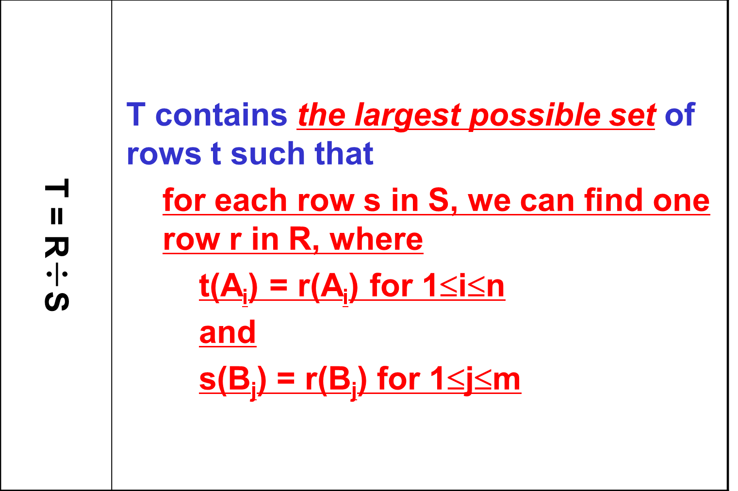
Database Principles & Programming

Slide 21
总结4：特殊运算（ ‘除’ 运算）的使用方法
‘除’ 运算表达式的表示方法
  ‘被除数’关系中必须包含‘目标对象’和‘条件对象’的关键字，‘除数’关系中只含‘条件对象’的关键字
  ‘被除数’和‘除数’关系中不能含其它‘不必要’的多余属性

Slide 22
Chapter 3
Basic SQL Query Language

Slide 23
Ch3 Basic SQL Query Language
3.1 Introduction
3.2 Setting Up the Database
3.3 Simple Select Statements
3.4 Subqueries
3.5 UNION Operators and FOR ALL Conditions
3.6 Some Advanced SQL Syntax
3.7 Set Functions in SQL
3.8 Groups of Rows in SQL
3.9 A Complete Description of SQL Select
3.10 Insert, Update, and Delete Statements
Database Principles & Programming

Slide 24
Basic SQL
Data Type in SQL
SQL statement
  CREATE TABLE
  Simple Select Statement
    Relational Algebra vs SQL Query Statement
      single table, product, natural join, theta join
    table & column alias
Database Principles & Programming

Slide 25
SQL
Simple SELECT statement
  SQL查询语句(Select statement)的格式
    与关系代数查询表达式的关系
    单表查询，多表联接查询
  DISTINCT
  表与列的换名
  查询谓词：
    BETWEEN … AND …
    IS NULL
    LIKE
  结果排序：ORDER BY

Slide 26
Simple Select Statement
predicate
  distinct
  The IN Predicate
    expr [NOT] IN ( subquery )
  The Quantified Comparison Predicate
    expr θ SOME|ANY|ALL ( subquery )
  The EXISTS Predicate
    [NOT] EXISTS ( subquery )
  The BETWEEN Predicate
    expr [NOT] BETWEEN expr1 AND expr2
Database Principles & Programming

Slide 27
Simple Select Statement
predicate (cont.)
  The IS NULL Predicate
    column IS [NOT] NULL
  The LIKE Predicate
    column [NOT] LIKE val1 [ ESCAPE val2 ]
      underscore ( _ ): any single character
      percent ( % ): any sequence of zero or more characters
Database Principles & Programming

Slide 28
SQL
子查询(Subquery)
  表名的作用域
  独立子查询 / 相关子查询
  查询谓词：
    IN, NOT IN
    SOME / ANY / ALL
    EXISTS, NOT EXISTS
复杂查询
  自连接：相同表之间的连接查询
  关系代数中的除法在SQL中的表示

Slide 29
Subqueries
Relational Algebra | SQL Predicate
natural join | IN
 | = SOME
 | EXISTS
difference | NOT IN
 | <> ALL
 | NOT EXISTS
Database Principles & Programming

Slide 30
SQL
统计查询
  统计查询
  分组统计查询 (GROUP BY)
  分组统计选择查询
    (GROUP BY … HAVING …)
数据更新语句
  INSERT, DELETE, UPDATE

