Slide 1
Chapter 6
Database Design

Slide 2
Contents
6.1 Introduction to E-R Concepts
6.2 Further Details of E-R Diagrams
6.3 Additional E-R Concepts
6.4 Case Study
6.5 Normalization: Preliminaries
6.6 Functional Dependencies
6.7 Lossless Decompositions
6.8 Normal Forms
Database Principles & Programming

Slide 3
Review of E-R Model (1)
E-R Model
  Entity
  Attribute
    Identifier, Descriptor, Composite Attribute, Multi-Valued Attribute
  Relationship
    Card(E, R) = (x, y)
      single-valued/multi-valued participation
      mandatory/optional participation
    One-to-One, Many-to-Many, Many-to-One
Database Principles & Programming

Slide 4
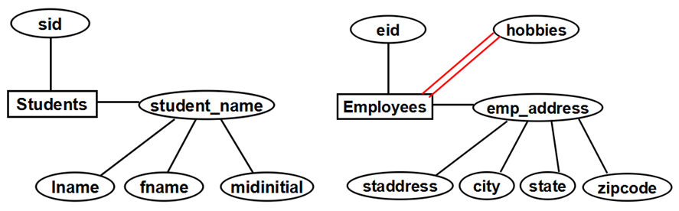
Examples of E-R diagrams (1)

Slide 5
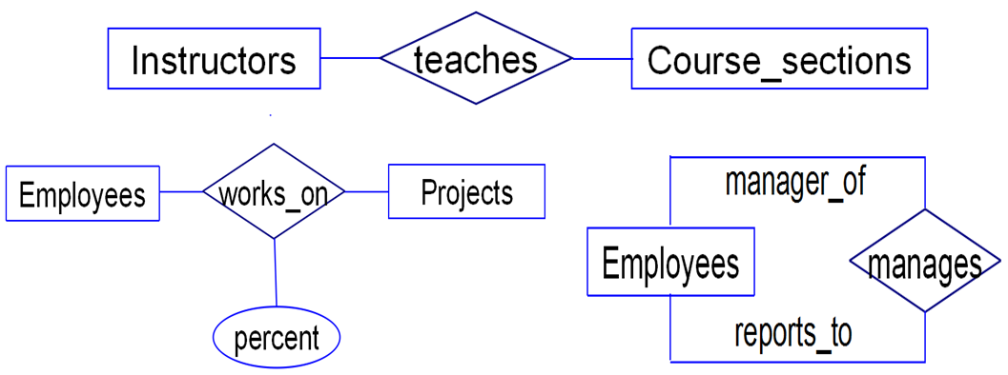
Examples of E-R diagrams (2)

Slide 6
Review of E-R Model (2)
Transform E-R Model to Relations
  Rule 1: Entity
  Rule 2: Multi-valued Attribute
  Rule 3: N-N Relationships
  Rule 4. N-1 Relationships
  Rule 5: 1-1 Relationships: Optional on one side
  Rule 6: 1-1 Relationships: Mandatory on both sides
Database Principles & Programming

Slide 7
Rule 3: N-N Relationships
  Employees(eid, straddr, city, ……)
  Projects(prid, proj_name, due_date)
  works_on(eid, prid, percent)
works_on
Employees
Projects
(1, N)
(0, N)
percent
Database Principles & Programming

Slide 8

Rule 4. N-1 Relationships
insid
secid
Instructors(insid, lname, ……)
Course_sections(secid, insid, course, …)
Database Principles & Programming

Slide 9
Rule 5: 1-1 Relationships: Optional on one side
ssn
DLno
having
Person
DrivingLicense
(0,1)
(1,1)
name
birthdate
validdate
class
Person(ssn, name, birthdate)
DrivingLicense(DLno, validdate, class, ssn)
Database Principles & Programming

Slide 10
Rule 6: 1-1 Relationships: Mandatory on both sides
ssn
scid
having
Student
StudentCard
(1,1)
(1,1)
name
department
class
Student(ssn, name, scid, department, class)
Database Principles & Programming

Slide 11
Review of E-R Model (3)
Cardinality of Attributes (x, y)
eid
hobbies
(1,N)
(1,1)
Employees
emp_address
(0,1)
(1,1)
(1,1)
(1,1)
(1,1)
staddress
city
state
zipcode
Database Principles & Programming

Slide 12
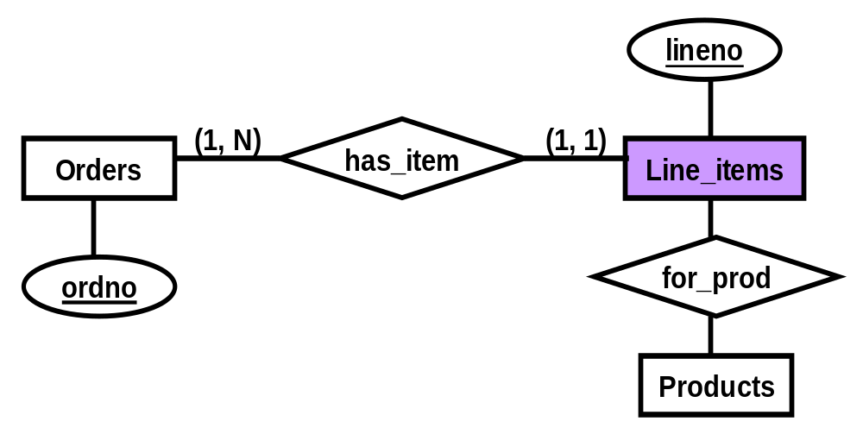
Review of E-R Model (4)
Weak Entities
Database Principles & Programming

Slide 13
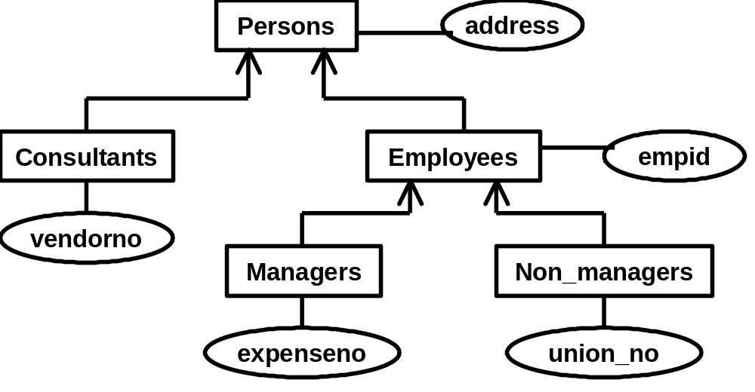
Review of E-R Model (5)
Generalization Hierarchies
Database Principles & Programming

Slide 14
Review of Functional Dependency
Functional Dependency (FD, 函数依赖)
  Def. of FD
  Armstrong’s Axioms (Armstrong公理)
Minimal Cover (最小覆盖)
  Closure of a Set of FDs (函数依赖集的闭包)
  FD Set Cover (函数依赖集的覆盖)
  Equivalence of two sets of FDS (函数依赖集的等价)
  Algorithm 6.6.13：最小覆盖计算算法
Closure of a Set of Attributes (属性集的闭包)
  Algorithm 6.6.12：属性集闭包计算算法

Slide 15
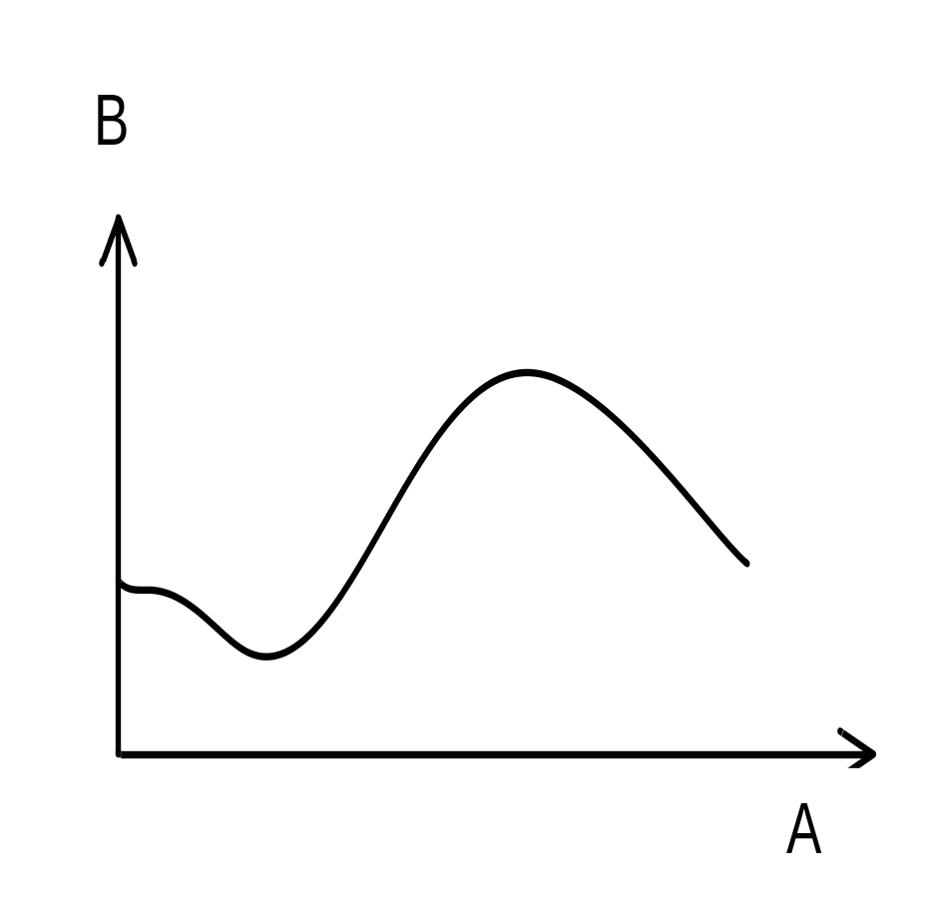
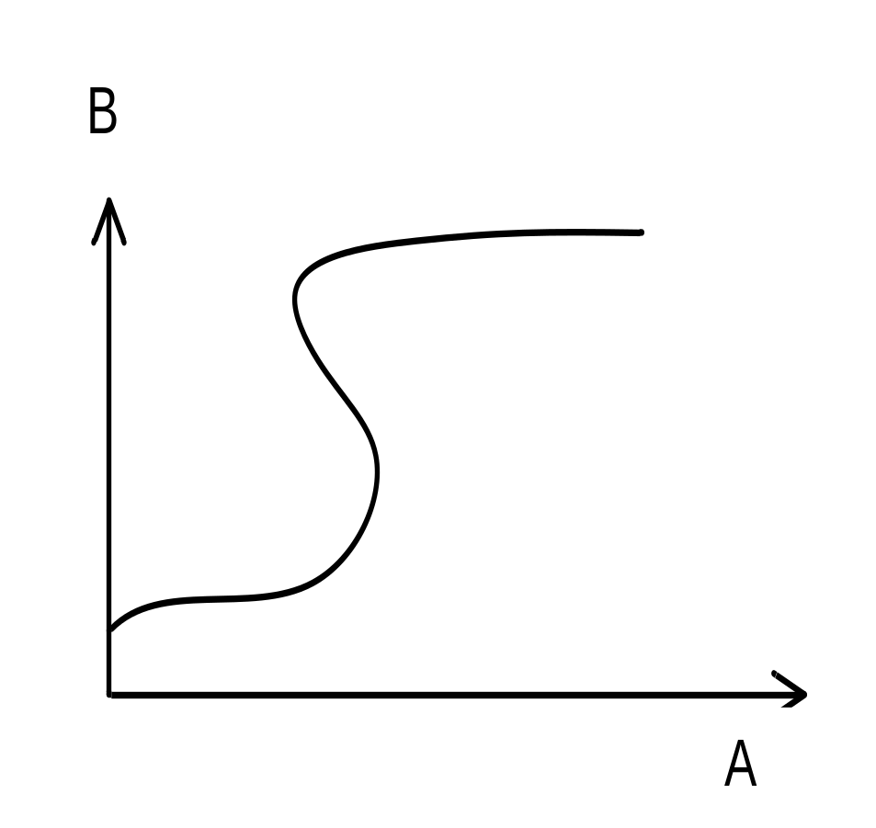
A →B
A →B
A functionally determines B. Each value of A corresponds to only one value of B.
A does not functionally determine B. Some values of A correspond to more than one value of B.
Figure 6.18 Graphical Depiction of Functional Dependency

Slide 16
（一对一）
（一对多）
（多对多）
A
B
A
B
A
B
X1
X2
X3
X4
Y1
Y2
Y3
Y4
X1
X2
X3
Y1
Y2
Y3
Y4
X1
X2
X3
Y1
Y2
Y3
A → B
B → A
B → A
(none)

Slide 17
Review of Armstrong’s Axioms
Armstrong’s Axioms
Rule 1(自反规则): If Y⊆X，then X→Y
Rule 2(传递规则): If X→Y and Y→Z ，then X→Z
Rule 3(增广规则): If X→Y, then XZ→YZ
Some Implications of Armstrong’s
Rule 4(合并规则): If X→Y and X→Z，then X→YZ
Rule 5(分解规则): If X→YZ，then X→Y and X→Z
Rule 6(伪传递规则):If X→Y，and WY→Z，then XW→Z
Rule 7(聚积规则): If X→YZ and Z→W，then X→YZW

Slide 18
Review of Minimal Cover
Closure of a Set of FDs (函数依赖集F的闭包)
  F⁺ = { X→A | F╞ X→A }
FD Set Cover (函数依赖集的覆盖)
  F covers G iff G ⊆ F⁺
Equivalence of two sets of FDS (函数依赖集的等价)
  F covers G and G covers F

Slide 19
Review of Functional Dependency
Closure of a Set of Attributes (属性集的闭包)
  Algorithm 6.6.12：属性集闭包计算算法
Minimal Cover (最小覆盖)
  Algorithm 6.6.13：最小覆盖计算算法

Slide 20
Review of Closure of a Set of Attributes
Def. 6.6.11: X⁺_{F} = { A | X → A ∈ F⁺ }
algorithm 6.6.12
X⁺ := X;
repeat
  oldX⁺ := X⁺;
  for each functional dependency Y→Z in F do
    if Y⊆ X⁺ then X⁺ := X⁺ ∪ Z;
until ( oldX⁺ = X⁺ )

Slide 21
Algorithm 6.6.13：Minimal Cover
step 1: From the set F of FDs, we create an equivalent set H of FDs, with only single attributes on the right side.
step 2: From the set H of FDs, successively remove individual FDs that are inessential in H.
step 3: From the set H of FDs, successively replace individual FDs with FDs that have a smaller number of attributes on the left-hand side, as long as the result does not change H⁺.
step 4: From the remaining set of FDs, gather all FDs with equal left-hand sides and use the union rule to create an equivalent set of FDs M where all left-hand sides are unique.

Slide 22
Review of Normalization
The process of normalization
  Decompositions of table T
  Head(T) = Head(T₁) ∪ Head(T₂) ∪ ...... ∪ Head(T_{k})
Lossless Decomposition (无损分解)
  T ≡ T₁ ∞ T₂ ∞ ... ∞ T_{k}
  Theorem 6.7.3 & 6.7.4：无损分解的判定定理
Lossy Decomposition (有损分解)
  T ⊂ T₁ ∞ T₂ ∞ ... ∞ T_{k}

Slide 23
Content of next
Def. 6.8.3 FD Preserved (依赖保持性)
Superkey & Key
  Algorithm to Find Candidate Key
  PRIME ATTRIBUTE (主属性)
  NON-PRIME ATTRIBUTE (非主属性)
Normal Forms:
  2NF, 3NF, BCNF
Algorithm 6.8.8

Slide 24
6.8 Normal Forms
An Algorithm to Find Candidate Key
  Given a table T with a set F of FDs
set K := Head(T) ;
for each attribute A in K
  {
    compute (K – A)_{F}⁺ ;
    if (K – A)_{F}⁺ contains all the attributes in T, then
    {
      set K := K – { A } ;
    }
  }
Database Principles & Programming

Slide 25
BCNF和3NF定义的对比
BCNF
  for any FD X→A in F⁺ that lies in T (all attributes of X and A in T), A is a single attribute not in X, then X must be a superkey for T
3NF
  for any FD X→A implied by F that lies in T, if A is a single non-prime attribute not in X, then X must be a superkey for T.
Database Principles & Programming

Slide 26
3NF和2NF定义的对比
3NF
  for any X→A implied by F that lies in T, if A is a single non-prime attribute not in X, then X must be a superkey for T.
2NF
  for any X → A implied by F that lies in T, if A is a single non-prime attribute not in X, then X is not properly contained in any key of T.
Database Principles & Programming

Slide 27
6.8 Normal Forms
Algorithm 6.8.8
  replace F with minimal cover of F;
  S = Φ;
  for all X→Y in F
      if, for all Z∈S, X ∪ Y ⊈ Z
      then S = S ∪ Heading(X ∪ Y )
    end for
  If, for all candidate keys K for T:
      for all Z∈S, K ⊈ Z
  then choose a candidate key K and set S = S ∪ Heading(K)
Database Principles & Programming

