Slide 1
Chapter 1
Introduction

Slide 2
Ch1. Introduction
what we will learn in this course?
  concepts & Skills you need to make a database work
  not how to build one, but how to set one up
Database Principles & Programming

Slide 3
Terminology
DataBase Management System
  数据库管理系统，简称 DBMS
  http://en.wikipedia.org/wiki/Database_management_system
DataBase (数据库)
  http://en.wikipedia.org/wiki/Database
DataBase User (数据库用户)
Database Principles & Programming

Slide 4
Ch1. Introduction
DataBase Management System
  (数据库管理系统，简称 DBMS)
  is a program product for keeping computerized records (on disk) about an enterprise.
  Example of records
    Records about sales
    Records about students
    Records about library inventory and loans
      ……
Database
Database Principles & Programming

Slide 5
Ch1. Introduction
Database Users
  End users
    Casual users √
    Naive users
  Application programmers √
  DataBase Administrators (DBA) √
Database Principles & Programming

Slide 6

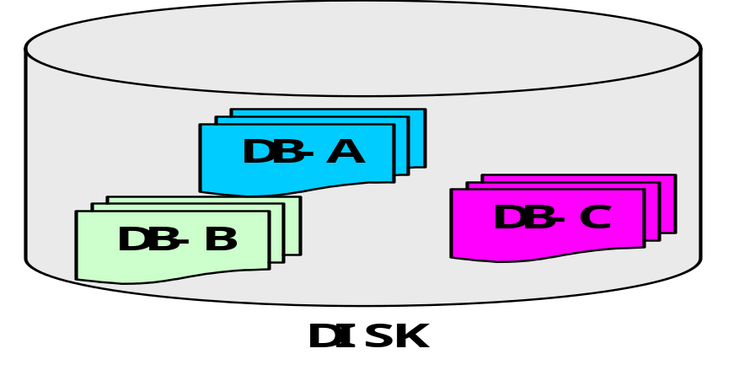
Ch1. Introduction
End Users
DBAs
Internet/Intranet
Database Management System
Architecture of Database System
Database Principles & Programming

Slide 7
Ch1. Introduction
DataBase Management System
  (数据库管理系统，简称 DBMS)
  is a program product for keeping computerized records (on disk) about an enterprise.
  Example of records
    Records about sales
    Records about students
    Records about library inventory and loans
      ……
Data Model
Database
Database Principles & Programming

Slide 8
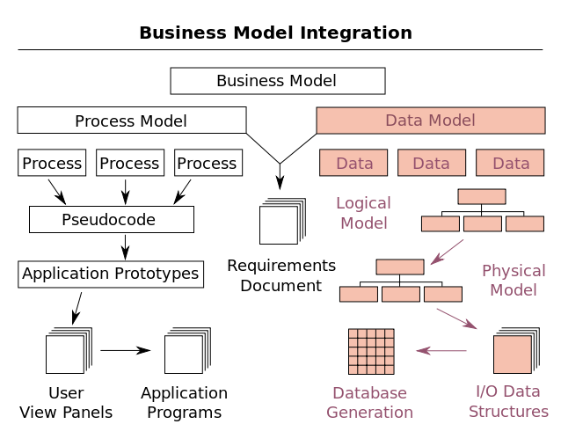
Data Model
Database Principles & Programming

Slide 9
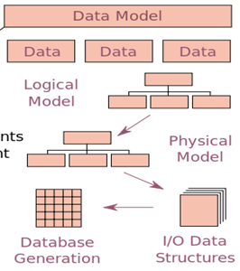

Slide 10
Terminology
Data Model (数据模型)
  http://en.wikipedia.org/wiki/Data_model
  Hierarchical Data Model (层次数据模型)
  Network Data Model (网状数据模型)
  Relational Model (关系模型)
  Object-Oriented Model (面向对象模型)
Database Principles & Programming

Slide 11
Terminology
Data Model
  Hierarchical Data Model
  Network Data Model
  Relational Model
  Object-Oriented Model
Object-Relational Model
(对象关系模型)
Database Principles & Programming

Slide 12
Ch1. Introduction
History of Database Systems
  Hierarchical Data Model (层次数据模型)
    1968, IMS (Information Management System)
    Different kinds of records relate to one another in a hierarchical from.
      A directed tree (有向树)
headquarter
branch
Example: a hierarchical datamodel for a bank
employee
Database Principles & Programming

Slide 13
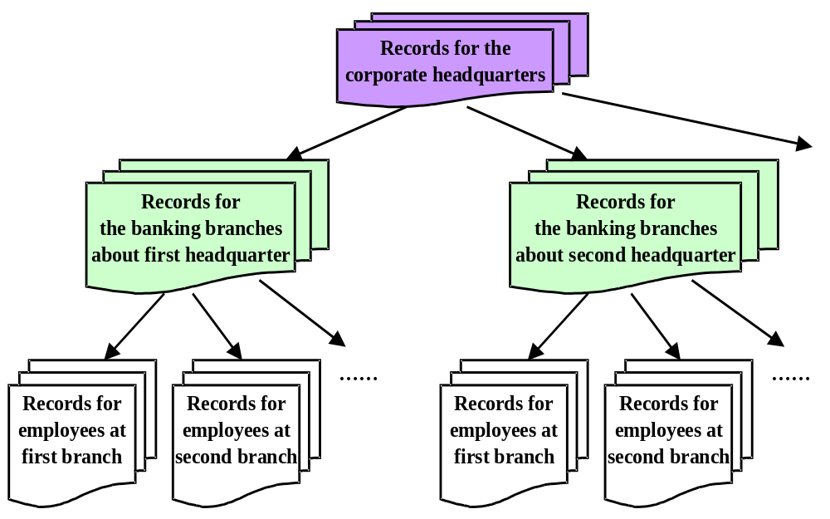
a database for a bank
Database Principles & Programming

Slide 14
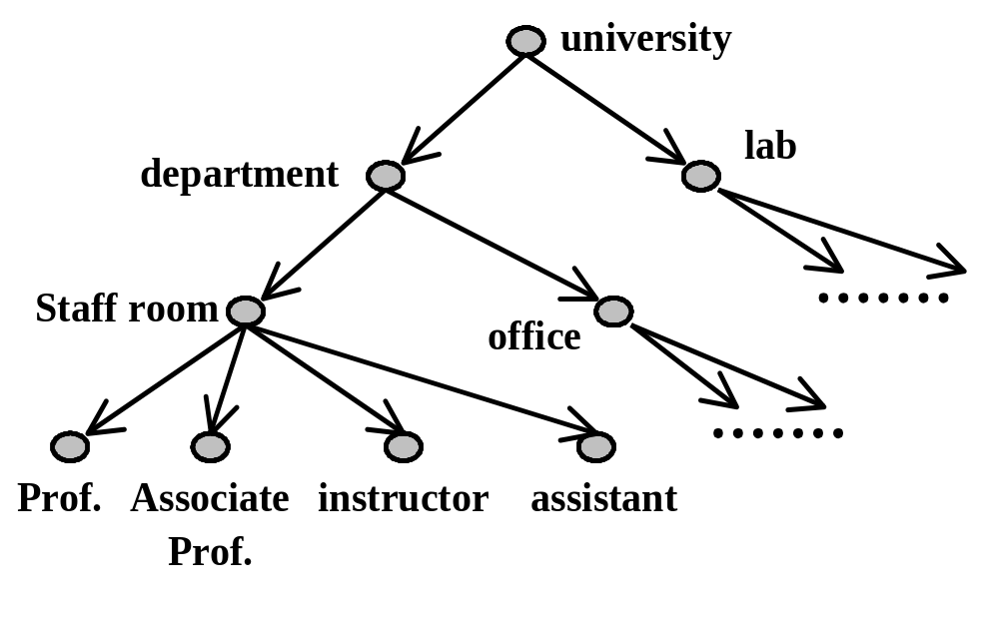
Another example of hierarchical data model
Database Principles & Programming

Slide 15
Ch1. Introduction
History of Database Systems (cont.)
  Network Data Model (网状数据模型)
    1970, IDMS
      was conceived as a result of the 1971 CODASYL report
    A generalization of the hierarchical model where a set of records in one layer might have two different containing hierarchies at the next layer up.
      A directed graph without circuits
        (有向无环图)
Database Principles & Programming

Slide 16
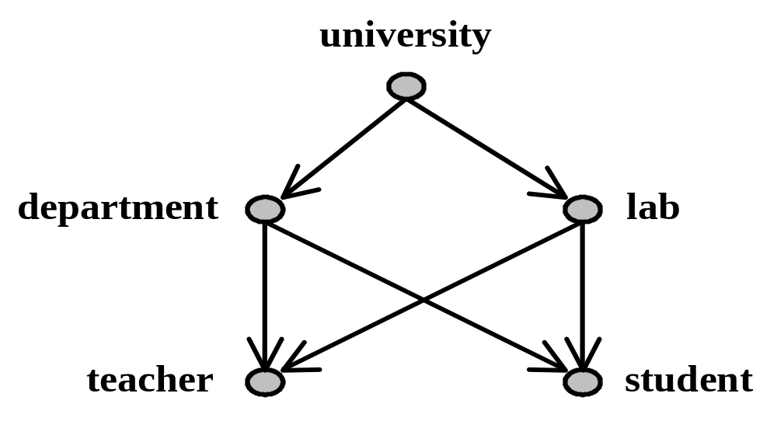
Ch1. Introduction
Example of network data model
Database Principles & Programming

Slide 17
Ch1. Introduction
History of Database Systems (cont.)
  Relational Model (关系模型)
    our data will look like tables.
  Relational Database (关系数据库)
    All Information is represented in the form of named tables with labeled columns.
  Relational DBMS (关系数据库管理系统)
Database Principles & Programming

Slide 18
Ch1. Introduction
students
sid | lname | fname | class | telephone
1 | Jones | Allan | 2 | 555-1234
2 | Smith | John | 3 | 555-4321
3 | Brown | Harry | 2 | 555-1122
5 | White | Edward | 3 | 555-3344
Figure 1.1a Relational Student Enrollment Database
Database Principles & Programming

Slide 19
Ch1. Introduction
students
sid | lname | fname | class | telephone
1 | Jones | Allan | 2 | 555-1234
2 | Smith | John | 3 | 555-4321
3 | Brown | Harry | 2 | 555-1122
5 | White | Edward | 3 | 555-3344
courses
cno
cname
croom
time
101
French I
2-104
MW2
102
French II
2-113
MW3
105
Algebra
3-105
MW2
108
Calculus
2-113
MW4
Figure 1.1a Relational Student Enrollment Database
Database Principles & Programming

Slide 20
Ch1. Introduction
students
enrollment
sid | lname | fname | class | telephone
1 | Jones | Allan | 2 | 555-1234
2 | Smith | John | 3 | 555-4321
3 | Brown | Harry | 2 | 555-1122
5 | White | Edward | 3 | 555-3344
sid
cno
major
1
101
No
1
108
Yes
courses
2
105
No
cno | cname | croom | time
101 | French I | 2-104 | MW2
102 | French II | 2-113 | MW3
105 | Algebra | 3-105 | MW2
108 | Calculus | 2-113 | MW4
3
101
Yes
3
108
No
5
102
No
5
105
No
Figure 1.1a Relational Student Enrollment Database
Database Principles & Programming

Slide 21
Ch1. Introduction
students
enrollment
sid | lname | fname | class | telephone
1 | Jones | Allan | 2 | 555-1234
2 | Smith | John | 3 | 555-4321
3 | Brown | Harry | 2 | 555-1122
5 | White | Edward | 3 | 555-3344
sid | cno | major
1 | 101 | No
1 | 108 | Yes
2 | 105 | No
3 | 101 | Yes
3 | 108 | No
5 | 102 | No
5 | 105 | No
courses
cno | cname | croom | time
101 | French I | 2-104 | MW2
102 | French II | 2-113 | MW3
105 | Algebra | 3-105 | MW2
108 | Calculus | 2-113 | MW4
Figure 1.1a Relational Student Enrollment Database
Database Principles & Programming

Slide 22
Ch1. Introduction
History of Database Systems (cont.)
  Object-Relational Model (对象关系模型)
  Object-Relational Database
  Object-Relational DBMS
Database Principles & Programming

Slide 23
Ch1. Introduction
students
sid | name |  | class | telephone | enrollment
 | lname | fname |  |  | cno | major
1 | Jones | Allan | 2 | 555-1234 | 101 | No
 |  |  |  |  | 108 | Yes
2 | Smith | John | 3 | 555-4321 | 105 | No
3 | Brown | Harry | 2 | 555-1122 | 101 | Yes
 |  |  |  |  | 108 | No
5 | White | Edward | 3 | 555-3344 | 102 | No
 |  |  |  |  | 105 | No
Figure 1.1b Object-Relational Student Enrollment Database
Database Principles & Programming

