Slide 1
GROUP BY & HAVING
  SELECT DEP, JOB, AVG(SAL)
  FROM EMPL
  WHERE JOB <> 'M'
  GROUP BY DEP, JOB
  HAVING AVG(SAL) > 28000
  ORDER BY AVG(SAL) DESC

Slide 2
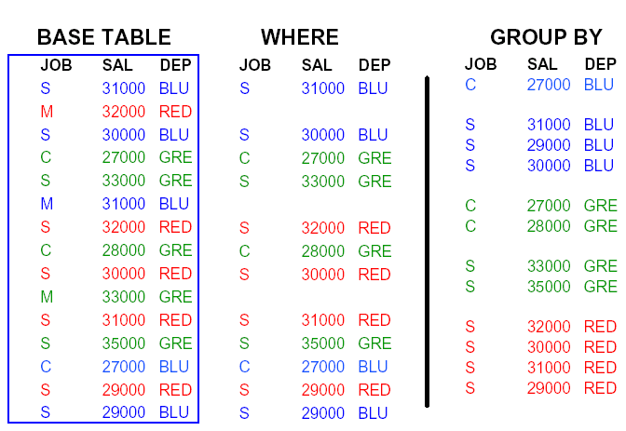

Slide 3
