Slide 1
Chapter 6
Database Design

Slide 2
Ch6 Database Design
Logical Database Design
  also known as
    Database Design
    Database Modeling
Database Principles & Programming

Slide 3
Ch6 Database Design
  Database design is the process of producing a detailed data model of a database.
  This logical data model contains all the needed logical and physical design choices and physical storage parameters needed to generate a design in a Data Definition Language, which can then be used to create a database.
  A fully attributed data model contains detailed attributes for each entity.
Database Principles & Programming

Slide 4
Ch6 Database Design
how do we?
  analyze an enterprise
  list the data items for a database
  decide how to place these data items columns in relational tables
Database Principles & Programming

Slide 5
Ch6 Database Design
For example: student-course database
  attributes of student: sno, sname, dept, sage
  attributes of course: cno, cname
  attribute of student&course: grade
we can put them all in the same table.
  R(sno, sname, dept, sage, cno, cname, grade)
consider the SCG database (next slide), see any problems with that ?
Database Principles & Programming

Slide 6
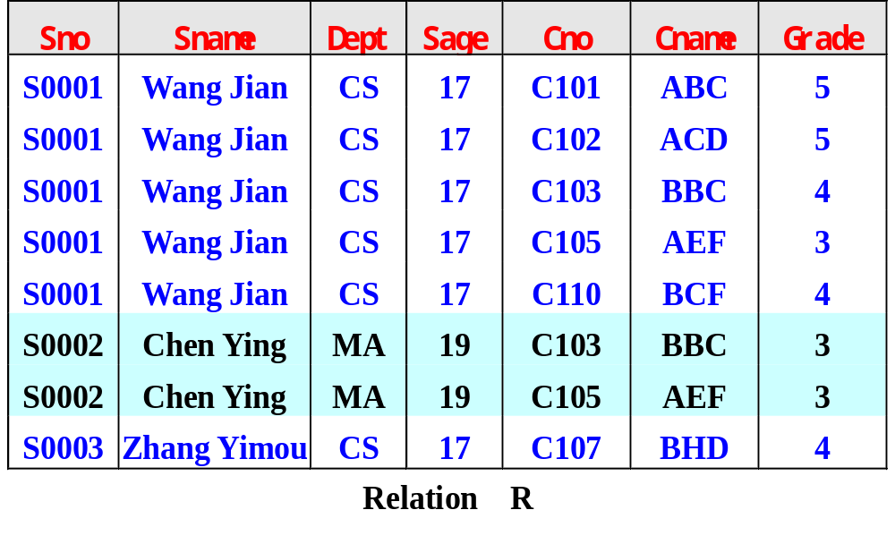
The SCG Database
Database Principles & Programming

Slide 7
Ch6 Database Design
Problems
  redundency（数据冗余）
  abnormity of update（修改异常）
  abnormity of delete（删除异常）
  abnormity of insert（插入异常）
Database Principles & Programming

Slide 8
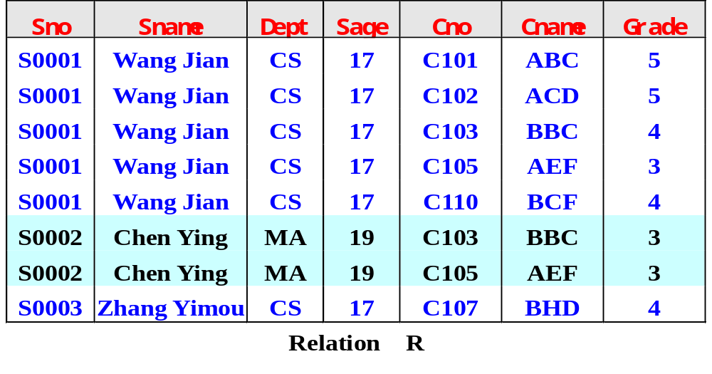
Ch6 Database Design
redundency（数据冗余）
  waste of disk space
Database Principles & Programming

Slide 9
Ch6 Database Design
abnormity of update（修改异常）
  waste of time
  user might get it wrong
Database Principles & Programming

Slide 10
Ch6 Database Design
abnormity of delete（删除异常）
  might lose some informations
Database Principles & Programming

Slide 11
Ch6 Database Design
abnormity of delete（删除异常）
  might lose some informations
需要删除学生:
“S0003, Zhang Yimou, CS, 17”
Database Principles & Programming

Slide 12
Ch6 Database Design
abnormity of delete（删除异常）
  might lose some informations
因此需要删除该学生所在的元组，结果会导致C107这门课程的信息也一起被删除。
Database Principles & Programming

Slide 13
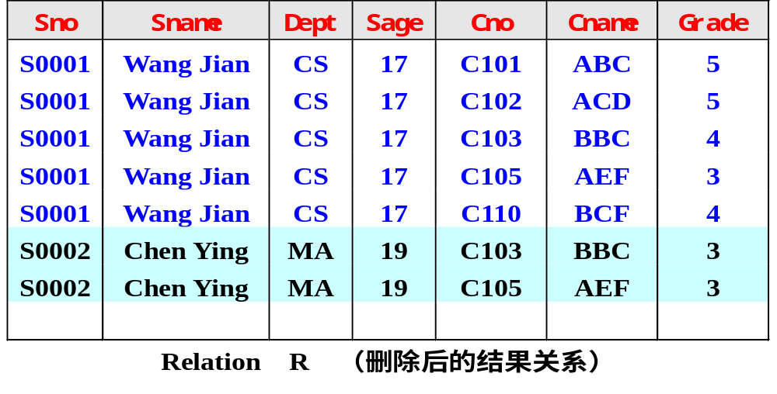
Ch6 Database Design
abnormity of delete（删除异常）
  might lose some informations
Database Principles & Programming

Slide 14
Ch6 Database Design
abnormity of insert（插入异常）
  unsuccessful insert
Database Principles & Programming

Slide 15
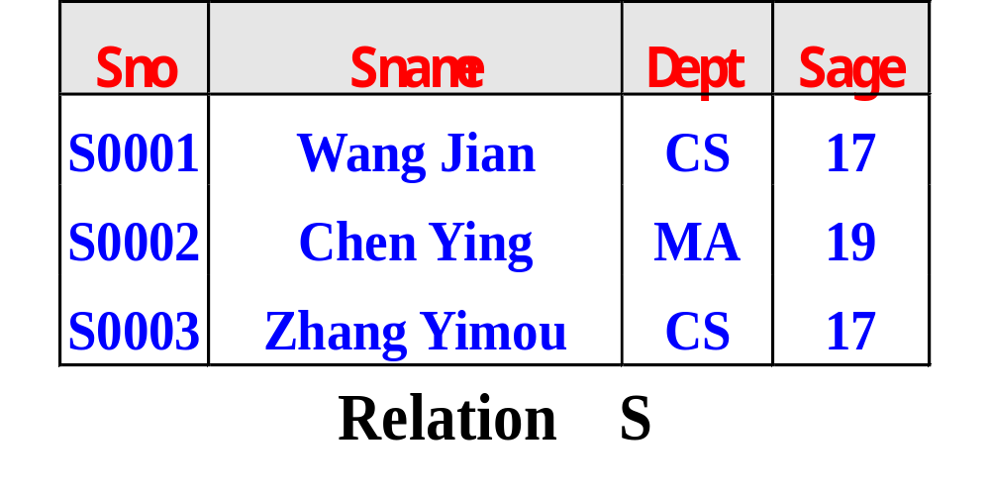
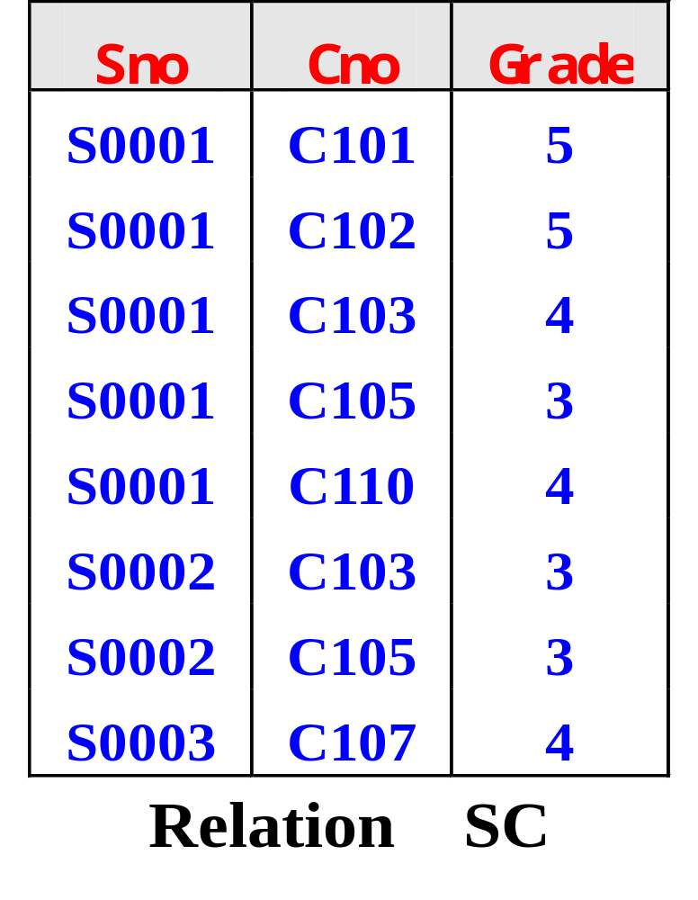
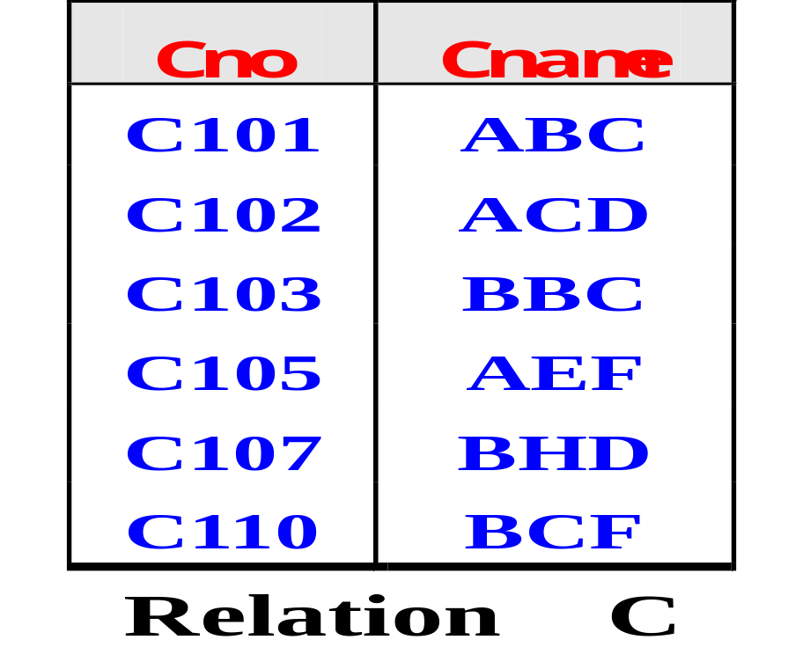
The SCG Database (another approach)
Database Principles & Programming

Slide 16
Contents
6.1 Introduction to E-R Concepts
6.2 Further Details of E-R Diagrams
6.3 Additional E-R Concepts
6.4 Case Study
6.5 Normalization: Preliminaries
6.6 Functional Dependencies
6.7 Lossless Decompositions
6.8 Normal Forms
Database Principles & Programming

Slide 17
6.1 Introduction to E-R Concepts
An Entity-Relationship(ER) model is an abstract way to describe a database.
A design approach, called Entity-Relationship modelling, is more intuitive, less mechanical, but basically leads to the same end design.
Database Principles & Programming

Slide 18
6.1 Introduction to E-R Concepts
Entity-Relationship Model
  Proposed by Peter Chen (1976):
    The Entity-Relationship Model: Toward a Unified View of Data
Peter Chen (Pin-shan Chen)
Database Principles & Programming

Slide 19
6.1 Introduction to E-R Concepts
E-R Model
  three fundamental data classification objects
    entity
    attribute
    relationship
the contents of this section
  Entities, Attributes, and Simple E-R Diagrams
  Transforming Entities and Attributes to Relations
  Relationships among Entities
Database Principles & Programming

Slide 20
6.1 Introduction to E-R Concepts
Entities, Attributes, and Simple E-R Diagrams
  Def. 6.1.1 Entity （实体）
    An entity is a collection of distinguishable real-world objects with common properties.
  E.g., college registration database:
    Students
    Instructors
    Class_rooms
    Courses
    Course_sections
      different offerings of a single course, generally at different times by different instructors
Database Principles & Programming

Slide 21
6.1 Introduction to E-R Concepts
Normally
  an entity such is mapped to a relational table
    represents a set of objects
  each row is an entity occurrence, or entity instance
    represents a particular object
Database Principles & Programming

Slide 22
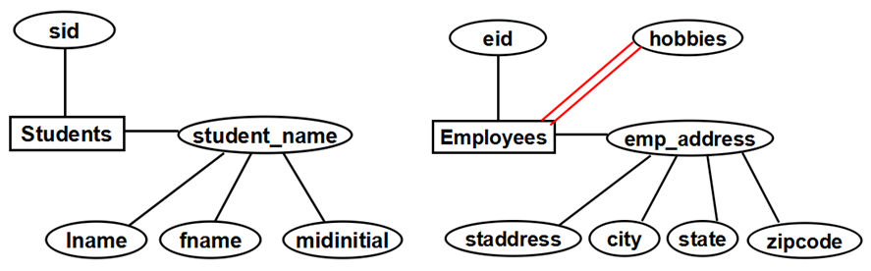
6.1 Introduction to E-R Concepts
Def. 6.1.2 Attribute （属性）
  An attribute is a data item that describes a property of an entity or a relationship (defined below).
Figure 6.2 Example of E-R Diagrams with Entities and Attributes
Database Principles & Programming

Slide 23
Attributes of 'Students'
sid
Students
student_name
Entity
lname
fname
midinitial
Attributes of 'student_name'
Figure 6.2 Example of E-R Diagrams with Entities and Attributes
Database Principles & Programming

Slide 24
eid
hobbies
Employees
emp_address
'hobbies' is a multi-valued attribute, and others are single-valued attributes
staddress
city
state
zipcode
three attributes of 'Employees'
Figure 6.2 Example of E-R Diagrams with Entities and Attributes
Database Principles & Programming

Slide 25
6.1 Introduction to E-R Concepts
special terminology for special kinds of attributes (Figure 6.2, pg. 333)
  identifier (candidate key，候选键)
    An identifier is an attribute or set of attributes that uniquely identifies an entity instance.
  primary identifier （主键）
Database Principles & Programming

Slide 26
6.1 Introduction to E-R Concepts
sid
Primary Identifier
Students
student_name
lname
fname
midinitial
Database Principles & Programming

Slide 27
6.1 Introduction to E-R Concepts
Primary Identifier
eid
hobbies
Employees
emp_address
staddress
city
state
zipcode
Database Principles & Programming

Slide 28
6.1 Introduction to E-R Concepts
  descriptor
    A descriptor is a non-key attribute, descriptive.
      Students.age
      Employees.name
Database Principles & Programming

Slide 29
6.1 Introduction to E-R Concepts
  a composite attribute
    a group of simple attributes that together describe a property.
      Students.student_name
      Employees.emp_address
Database Principles & Programming

Slide 30
6.1 Introduction to E-R Concepts
sid
Composite Attribute
Students
student_name
lname
fname
midinitial
Database Principles & Programming

Slide 31
6.1 Introduction to E-R Concepts
eid
hobbies
Composite Attribute
Employees
emp_address
staddress
city
state
zipcode
Database Principles & Programming

Slide 32
6.1 Introduction to E-R Concepts
  a multi-valued attribute
    can take on multiple values for a single entity instance.
eid
hobbies
Employees
emp_address
staddress
city
state
zipcode
Database Principles & Programming

Slide 33
E-R diagrams
  a entity
    representing as a rectangle
  a single-valued attribute
    representing as a oval
    attached by a straight line to the entity.
  a composite attribute
    is also in an oval attached directly to the entity
    the simple attributes that make up the composite are attached to the composite oval.
  a multi-valued attribute
    is attached by a double line to the entity it describes.
Database Principles & Programming

Slide 34
6.1 Introduction to E-R Concepts
Transforming Entities and Attributes to Relations
  Transformation Rule 1
    An entity is mapped to a single table. The single-valued attributes of the Entity are mapped to columns (composite attributes are mapped to multiple simple columns).
    Entity occurrences become rows of the table.
  Example 6.1.1, pg. 334
Students(sid, lname, fname, midiaitia)
Employees(eid, staddress, city, state, zipcode)
Database Principles & Programming

Slide 35
6.1 Introduction to E-R Concepts
Transforming Entities and Attributes to Relations
  Transformation Rule 2
    A multi-valued attribute must be mapped to its own table.
  Example 6.1.2, pg.335
  No longer true in ORDBMS !
Employees(eid, staddress, city, state, zipcode)
hobbies(hobby, eid)
Database Principles & Programming

Slide 36
6.1 Introduction to E-R Concepts
Relationships（联系）among Entities
  Def. 6.1.3. Relationship (pg. 335).
    Given an ordered list of m entities, E1, E2, . . . , Em, (where the same entity may occur more than once in the list)
    a relationship R defines a rule of correspondence between the instances of these entities.
    Specifically, R represents a set of m-tuples, a subset of the Cartesian product of entity instances.
Database Principles & Programming

Slide 37
Figure 6.3: Examples of Relationships
Instructors teaches Course_sections
teaches
Instructors
Course_sections
Database Principles & Programming

Slide 38
Figure 6.3: Examples of Relationships
Employees works_on Projects(percent of time)
works_on
Employees
Projects
percent
Database Principles & Programming

Slide 39
Figure 6.3: Examples of Relationships
Employees manages Employees
    ring, or recursive relationship
manager_of
manages
Employees
reports_to
Database Principles & Programming

Slide 40
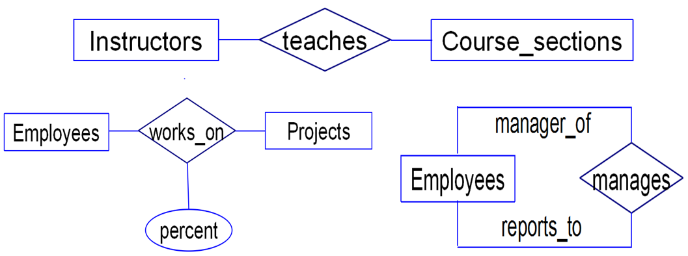
Figure 6.3: Examples of Relationships
Instructors teaches Course_sections
Employees works_on Projects(percent of time)
Employees manages Employees
Figure 6.3:Examples of E-R Diagrams with Relationships
Database Principles & Programming

Slide 41
6.1 Introduction to E-R Concepts
Figure 6.3, pg. 336
  Employees works_on Projects, where works_on is a relationship. works_on has the connected attribute ‘percent’.
  Note:
    percent, associated with relationship, i.e., a value with each relationship instance.
    The relationship instance represents a specific pairing of an Employees instance with a Projects instance;
    percent represents the percent of time an employee instance works on that project.
Database Principles & Programming

Slide 42
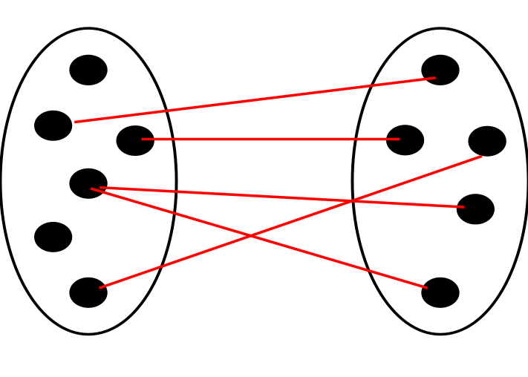
6.2 Further Details of E-R Diagrams
Cardinality of Entity Participation in a Relationship
  Look at Figure 6.6.
    Entities E and F, relationship R.
    Lines between dots.
      Dots are entity instances.
      Lines are relationship instances.
E R F
Database Principles & Programming

Slide 43
6.2 Further Details of E-R Diagrams
  If all dots in the entity E have AT MOST one line coming out, we say:
    max-card(E, R) = 1
  If more than one line out is possible, we say:
    max-card(E, R) = N
  If all dots in the entity E have AT LEAST one line coming out, we say:
    min-card(E, R) = 1
  If some dots might not have a line coming out, we say:
    min-card(E, R) = 0
Database Principles & Programming

Slide 44
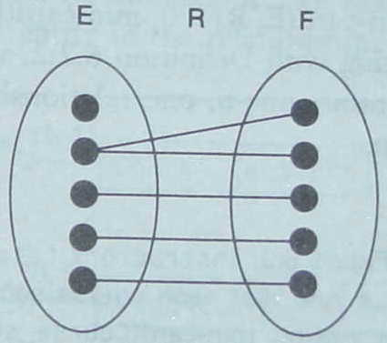
6.2 Further Details of E-R Diagrams
  max-card(E, R) = ?
  min-card(E, R) = ?
  max-card(F, R) = ?
  min-card(F, R) = ?
Database Principles & Programming

Slide 45
6.2 Further Details of E-R Diagrams
  max-card(E, R) = N
  min-card(E, R) = 0
  max-card(F, R) = 1
  min-card(F, R) = 1
Database Principles & Programming

Slide 46
6.2 Further Details of E-R Diagrams
Def. 6.2.1 Card(E, R)
  We combine these, by saying card(E, R) = (x, y) if:
    min-card(E, R) = x and max-card(E, R) = y
    x is either 0 or 1, and y is either 1 or N
card(E, R) = (0, N)
card(F, R) = (1, 1)
Database Principles & Programming

Slide 47
(0, N)
(1, 1)
(0, N)
(1, N)
(0, N)
(0, 1)
Figure 6.7: An E-R Diagrams with Labels(x,y) on Entity-Relationship Connections
Database Principles & Programming

Slide 48
6.2 Further Details of E-R Diagrams
manager-of
reports-to
Manage
Emps_One
Emps_Two
(0, N)
(0, 1)
Employee1 in Emps_One is a manager of Employee2 in Emps_Two.
Database Principles & Programming

Slide 49
6.2 Further Details of E-R Diagrams
Def 6.2.2
  if max-card(X, R) = 1 then X is said to have single-valued participation(单值参与) in the relationship R.
  If max-card(X, R) = N, then X is said to be multi-valued participation（多值参与） in this relationship.
Database Principles & Programming

Slide 50
(0, N)
(1, 1)
(0, N)
(1, N)
(0, N)
(0, 1)
single-valued participation:......
multi-valued participation:......
Database Principles & Programming

Slide 51
6.2 Further Details of E-R Diagrams
Def 6.2.3
  If min-card(X, R) = 1, X is said to have mandatory participation（强制参与） in the relationship R
  if min-card(X, R) = 0, then optional participation（可选参与）
Database Principles & Programming

Slide 52
(0, N)
(1, 1)
(0, N)
(1, N)
(0, N)
(0, 1)
mandatory participation:......
optional participation:......
Database Principles & Programming

Slide 53
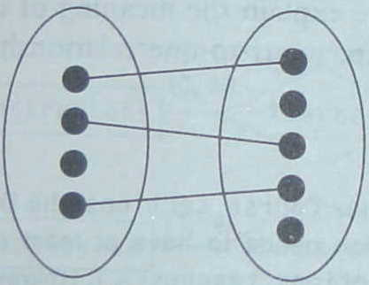
6.2 Further Details of E-R Diagrams
One-to-One, Many-to-Many, and Many-to-One Relationship (Figure 6.6)
  One-to-One (1-1) relationship
    both entities are single-valued in the relationship (max-card concept only)
E
R
F
Database Principles & Programming

Slide 54
6.2 Further Details of E-R Diagrams
One-to-One, Many-to-Many, and Many-to-One Relationship (Figure 6.6)
  Many-to-One (N-1)
    one entity is multi-valued and one is single valued
Database Principles & Programming

Slide 55
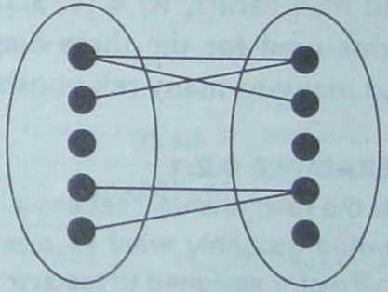
6.2 Further Details of E-R Diagrams
One-to-One, Many-to-Many, and Many-to-One Relationship (Figure 6.6)
  Many-to-Many (N-N)
    both entities are multi-valued
E
R
F
Database Principles & Programming

Slide 56
(0, N)
(1, 1)
(0, N)
(1, N)
(0, N)
(0, 1)
one-to-one:......
one-to-many:......
many-to-many:......
Database Principles & Programming

Slide 57
6.2 Further Details of E-R Diagrams
Transforming Binary Relationships（二元联系）to Relations
  Transformation Rule 3. N-N Relationships
    When two entities E and F take part in a many-to-many binary relationship R, the relationship is mapped to a representative table T in the related relational database design.
Database Principles & Programming

Slide 58
6.2 Further Details of E-R Diagrams
Transformation Rule 3. (cont.)
  The table T contains columns for all attributes in the primary keys of both tables transformed from entities E and F.
    this set of columns forms the primary key for the table T.
  T also contains columns for all attributes attached to the relationship.
Database Principles & Programming

Slide 59
6.2 Further Details of E-R Diagrams
  Example 6.2.2
    Employees(eid, straddr, city, ……)
    Projects(prid, proj_name, due_date)
    works_on(eid, prid, percent)
works_on
Employees
Projects
(1, N)
(0, N)
percent
Database Principles & Programming

Slide 60
6.2 Further Details of E-R Diagrams
Transformation Rule 4. N-1 Relationships
  represent with foreign key in entity with single valued participation (the Many side).
    Since max-card(F,R)=1, each row of T is related by a foreign key value to at most one instance of the entity E.
  Example 6.2.3: teachers
    Instructors(insid, lname, ……)
    Course_sections(secid, insid, course, …)
Database Principles & Programming

Slide 61
6.2 Further Details of E-R Diagrams
Transformation Rule 5&6. 1-1 Relationships
  Optional on one side
    Represent as two tables, foreign key column in one with mandatory participation: column defined to be NOT NULL.
  Mandatory on both sides
    never can break apart. It's appropriate to think of this as two entities in a single table.
Database Principles & Programming

Slide 62
6.3 Additional E-R Concepts
Cardinality of Attributes
  Def 6.3.1 ( Figure 6.10, pg. 347 )
    (0, ?) means don't have to say not null (optional)
      midinitial, emp_address
    (1, ?) means do (mandatory)
      sid, student_name, lname, fname, city, ......
    (?, 1) single valued attribute
      sid, eid
    (?, N) multi-valued
      hobbies
Database Principles & Programming

Slide 63
6.3 Additional E-R Concepts
sid
(1, 1)
(1, 1)
Students
student_name
(1, 1)
(1, 1)
(0, 1)
lname
fname
midinitial
Figure 6.10 (1) Students
Database Principles & Programming

Slide 64
6.3 Additional E-R Concepts
eid
hobbies
(1, N)
(1, 1)
Employees
emp_address
(0, 1)
(1, 1)
(1, 1)
(1, 1)
(1, 1)
staddress
city
state
zipcode
Figure 6.10 (2) Employees
Database Principles & Programming

Slide 65
6.3 Additional E-R Concepts
Weak Entities
  Def 6.3.2
    A weak entity is an entity whose occurrences are dependent for their existence, through a relationship R, on the occurrence of another (strong) entity.
    Figure 6.11, pg. 347
Database Principles & Programming

Slide 66
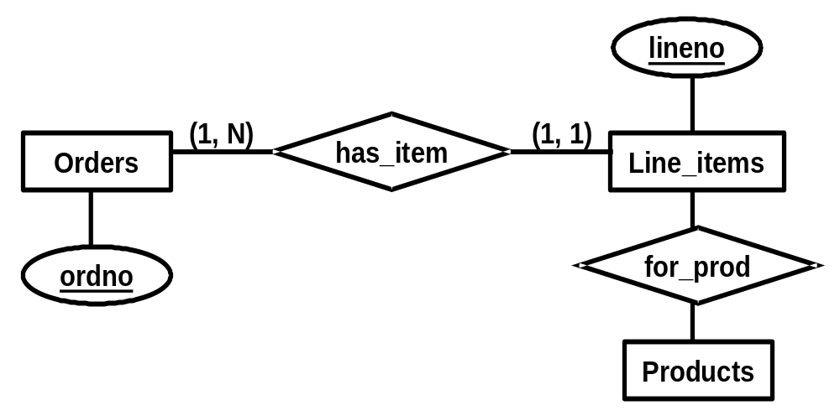
6.3 Additional E-R Concepts
Figure 6.11
Database Principles & Programming

Slide 67
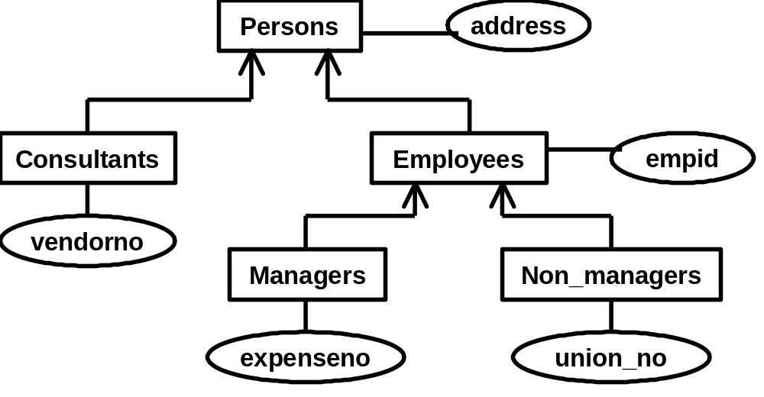
6.3 Additional E-R Concepts
Generalization Hierarchies
  Figure 6.12, pg. 349
Database Principles & Programming

Slide 68
6.4 Case Study
Figure 6.13 & 6.14
  E-R Design for a Simple Airline Reservation Database
    Entity
      Passengers Flights
      Seats Gates
    Relationship
      Travels_On ( Passengers, Flights )
      Has_Seat ( Flights, Seats )
      Seat_Assign ( Passengers, Seats )
      Marshals ( Flights, Gates )
Database Principles & Programming

Slide 69
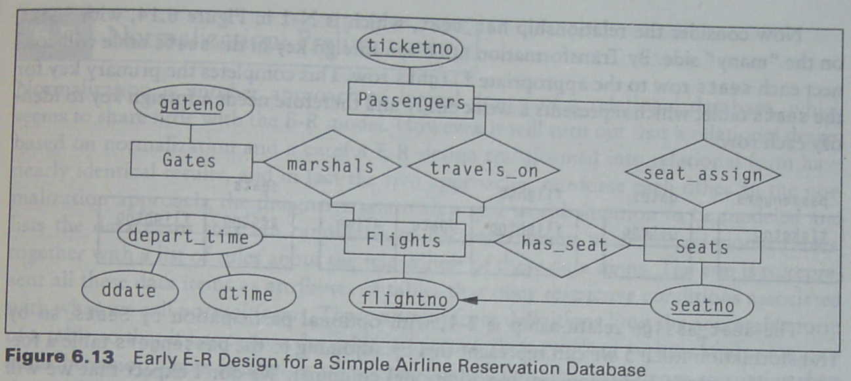
Database Principles & Programming

Slide 70
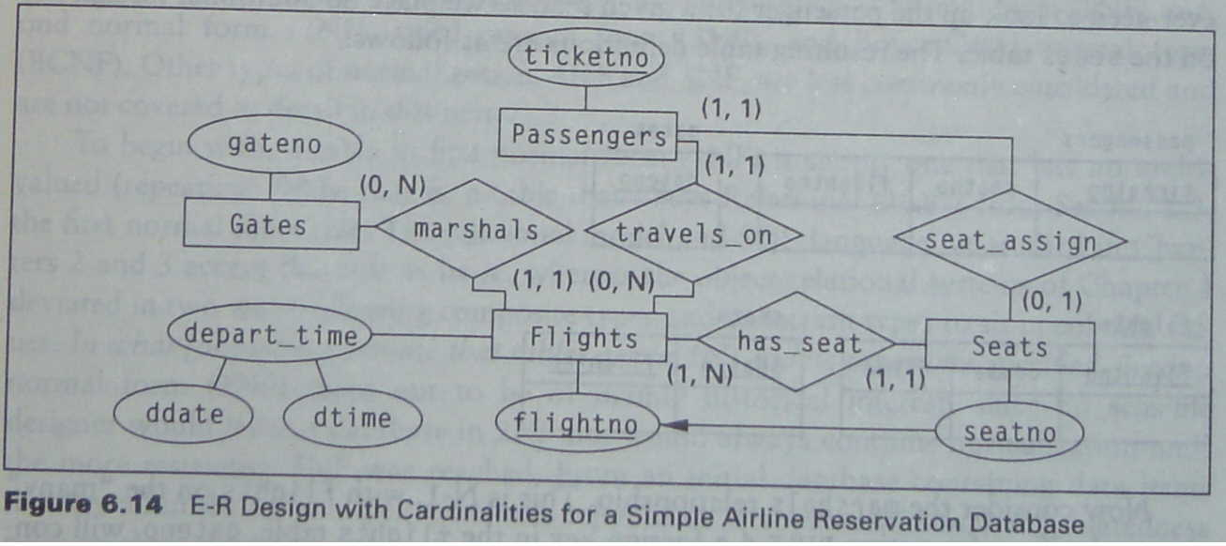
6.4 Case Study
Figure 6.13 & 6.14
Database Principles & Programming

Slide 71
6.4 Case Study
[例6.4.1]设有一个图书借阅管理数据库，已知：
    图书的属性有书号（具有唯一性）、书名
    读者的属性有借书证号（具有唯一性，每个读者只能有一个借书证号）、姓名、身份证号、住址、电话
    出版社的属性有出版社名称（具有唯一性）、地址、联系电话。
  其中：
    每本图书只能有一个出版社出版发行
    每个读者可以同时借阅多本图书，也可以在不同时候借阅同一本图书
    系统需要记录每本图书被借阅的借阅日期和归还日期
  请用E-R模型表示该数据库系统的概念模型，并将其转换成等价的关系模式。
Database Principles & Programming

Slide 72
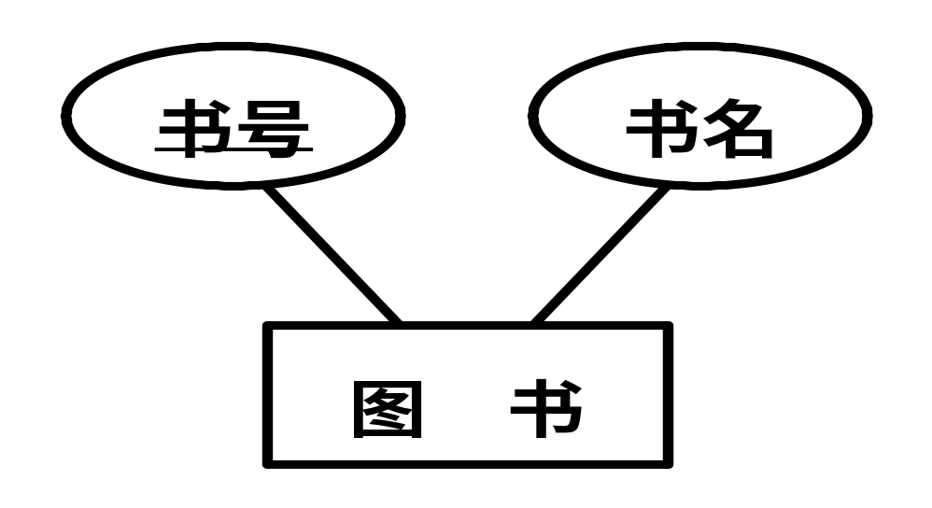
6.4 Case Study
[例6.4.1]设有一个图书借阅管理数据库，已知：
  图书的属性有书号（具有唯一性）、书名
  读者的属性有借书证号(具有唯一性，每个读者只能有一个借书证号)、姓名、身份证号、住址、电话
  出版社的属性有出版社名称（具有唯一性）、地址、联系电话。
Database Principles & Programming

Slide 73
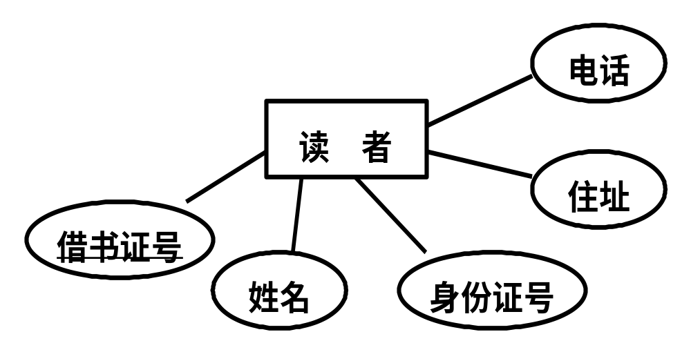
6.4 Case Study
[例6.4.1]设有一个图书借阅管理数据库，已知：
  图书的属性有书号（具有唯一性）、书名
  读者的属性有借书证号(具有唯一性，每个读者只能有一个借书证号)、姓名、身份证号、住址、电话
  出版社的属性有出版社名称（具有唯一性）、地址、联系电话。
Database Principles & Programming

Slide 74
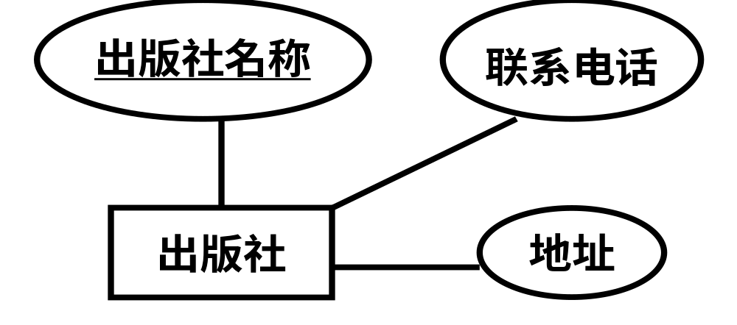
6.4 Case Study
[例6.4.1]设有一个图书借阅管理数据库，已知：
  图书的属性有书号（具有唯一性）、书名
  读者的属性有借书证号(具有唯一性，每个读者只能有一个借书证号)、姓名、身份证号、住址、电话
  出版社的属性有出版社名称（具有唯一性）、地址、联系电话。
Database Principles & Programming

Slide 75
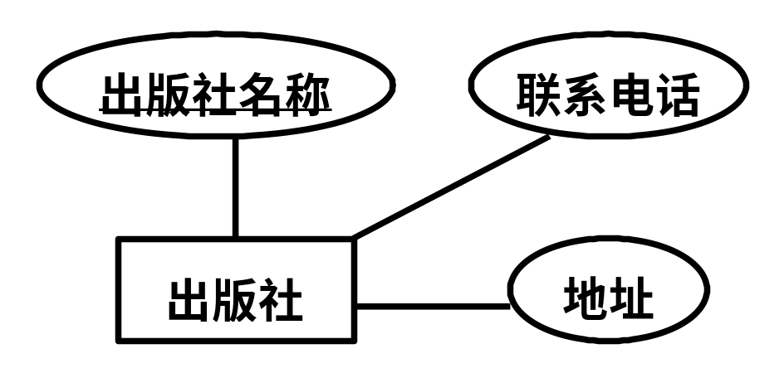
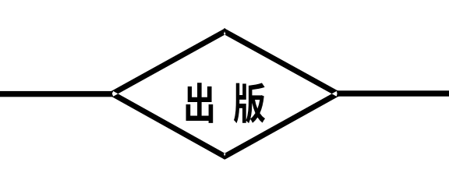
6.4 Case Study
其中：
  每本图书只能有一个出版社出版发行
  每个读者可以同时借阅多本图书，也可以在不同时候借阅同一本图书
  系统需要记录图书被借阅的借阅日期和归还日期
(1,1)
(0,N)
Database Principles & Programming

Slide 76
6.4 Case Study
其中：
  每本图书只能有一个出版社出版发行
  每个读者可以同时借阅多本图书，也可以在不同时候借阅同一本图书
  系统需要记录图书被借阅的借阅日期和归还日期
借 阅
(0,N)
(0,N)
Database Principles & Programming

Slide 77
6.4 Case Study
其中：
  每本图书只能有一个出版社出版发行
  每个读者可以同时借阅多本图书，也可以在不同时候借阅同一本图书
  系统需要记录图书被借阅的借阅日期和归还日期
借阅日期
归还日期
借 阅
(0,N)
(0,N)
Database Principles & Programming

Slide 78
(1,1)
(1,1)
(1,1)
(1,1)
(1,1)
(0,N)
(1,1)
(0,N)
借阅日期
(1,1)
借 阅
(0,N)
(0,N)
归还日期
(0,1)
(0,1)
(1,1)
(1,1)
(1,1)
Database Principles & Programming

Slide 79
(1,1)
(1,1)
(1,1)
(1,1)
(1,1)
  图书（书号，书名）
  出版社（出版社名称，联系电话，地址）
转换得到的关系模式
Database Principles & Programming

Slide 80
(1,1)
(1,1)
(1,1)
(1,1)
(1,1)
(0,N)
(1,1)
  图书（书号，书名）
  出版社（出版社名称，联系电话，地址）
  图书（书号，书名，出版社名称）
  出版社（出版社名称，联系电话，地址）
‘图书’和‘出版社’实体集转换得到的关系模式
加入‘出版’联系后的关系模式
Database Principles & Programming

Slide 81
(0,N)
(0,1)
(1,1)
(1,1)
(1,1)
  读者（借书证号，姓名，身份证号，地址）
  读者电话（借书证号，电话）
‘读者’实体集转换得到的关系模式
Database Principles & Programming

Slide 82
(1,1)
(1,1)
借阅 ( 借书证号, 书号, 借阅日期, 归还日期 )
‘借阅’联系转换得到的关系模式
(0,N)
借阅日期
(1,1)
借 阅
(0,N)
(0,N)
归还日期
(0,1)
(0,1)
(1,1)
(1,1)
(1,1)
Database Principles & Programming

Slide 83
Case Study
[例6.4.1] 转换得到的关系模式如下
  图书（书号，书名，出版社名称）
  出版社（出版社名称，联系电话，地址）
  读者（借书证号，姓名，身份证号，地址）
  读者电话（借书证号，电话）
  借阅 ( 借书证号, 书号, 借阅日期, 归还日期 )
每个读者可以同时借阅多本图书，也可以在不同时候借阅同一本图书
‘借阅’关系的关键字应该是什么？
Database Principles & Programming

Slide 84
6.4 Case Study
[例6.4.2]假设需要设计一个用于NBA篮球比赛的数据库系统，需要记录的信息有：
    每个球员的球衣号码、姓名、身高、体重和位置
    每个球队的名称和主场使用的体育馆的名称
    每场比赛的比赛日期和比分
  其中：
    每个球员只能效力于一个球队
    比赛采用主客场多循环方式
  请用E-R模型表示该数据库系统的概念模型，并将其转换成等价的关系模式。
Database Principles & Programming

Slide 85
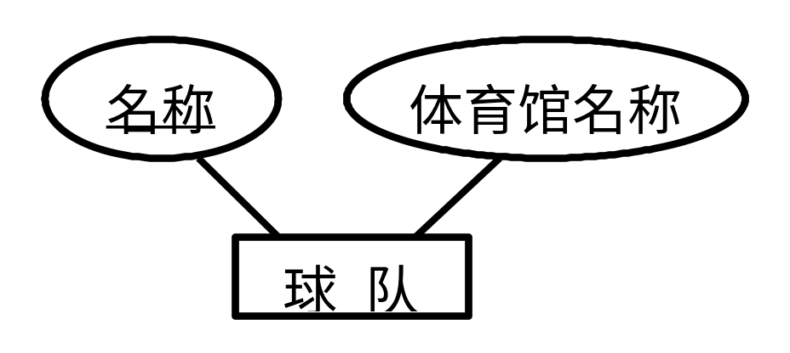
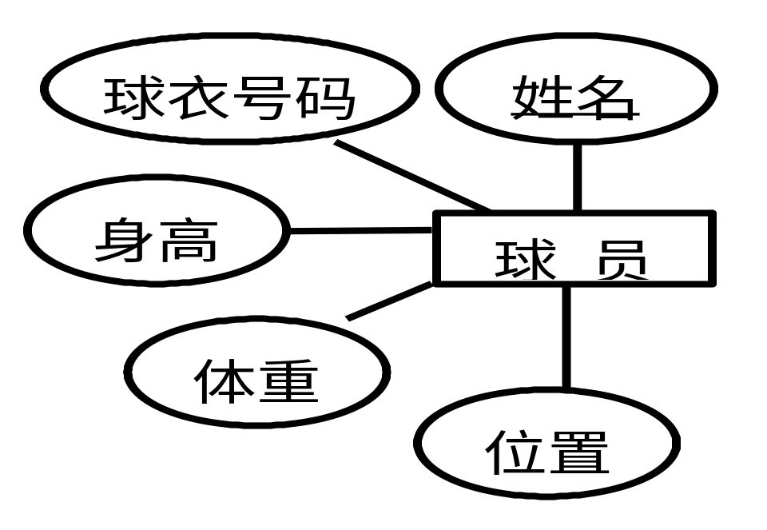
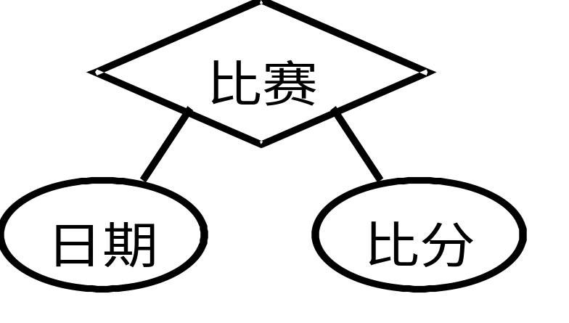
签约
(0,1)
(1,N)
主队
客队
(1,N)
(1,N)
Database Principles & Programming

Slide 86
签约
(0,1)
(1,N)
向关系模型的转换
主队
客队
(1,N)
(1,N)
Database Principles & Programming

Slide 87
Brief Summary
Database Design
E-R Model
  Entity
  Attribute
    Identifier
    Descriptor
    Composite Attribute
    Multi-Valued Attribute
  Relationship
    Card(E, R) = (x, y)
    One-to-One, Many-to-Many, Many-to-One
Transform E-R Model to Relations
  Rule 1 ~ 6
Database Principles & Programming

Slide 88
6.5 Normalization(规范化): Preliminaries
Normal Form (NF，范式)
A Running Example
  Figure 6.15 (pg. 354)
    Employee
    Department
    Skill
  Def. 6.5.1 Update Anomaly
  Def. 6.5.2 Delete Anomaly, Insert Anomaly
Database Principles & Programming

Slide 89
Functional Dependency (FD, 函数依赖)
Armstrong’s Axioms (Armstrong公理)
Closure of a Set of FDs (函数依赖集F的闭包)
FD Set Cover (函数依赖集的覆盖)
Minimal Cover (最小覆盖)
Closure of a Set of Attributes (属性集的闭包)
Database Principles & Programming

Slide 90
6.6 Functional Dependencies
Functional Dependency (FD)
Def. 6.6.1 A→B (A functionally determines B, or B is functionally dependent on A)
  For any rows r₁ and r₂ in T,
    if r₁(A) = r₂(A) then r₁(B) = r₂(B).
读作“A函数决定B”，或者读作“B函数依赖于A”
Example 6.6.1
  emp_id, emp_name, emp_phone, dept_name
Database Principles & Programming

Slide 91
The SCG Database
Sno
Sname
Dept
Sage
Cno
Cname
Grade
S0001
Wang Jian
CS
17
C101
ABC
5
S0001
Wang Jian
CS
17
C102
ACD
5
S0001
Wang Jian
CS
17
C103
BBC
4
S0001
Wang Jian
CS
17
C105
AEF
3
S0001
Wang Jian
CS
17
C110
BCF
4
S0002
Chen Ying
MA
19
C103
B
BC
3
S0002
Chen Ying
MA
19
C105
AEF
3
S0003
Zhang Yimou
CS
17
C107
BHD
4
Database Principles & Programming

Slide 92
The SCG database
Sno | Sname | Dept | Sage | Cno | Cname | Grade
S0001 | WangJian | CS | 17 | C101 | ABC | 5
S0001 | WangJian | CS | 17 | C102 | ACD | 5
S0001 | WangJian | CS | 17 | C103 | BBC | 4
S0001 | WangJian | CS | 17 | C105 | AEF | 3
S0001 | WangJian | CS | 17 | C110 | BCF | 4
S0002 | ChenYin | MA | 19 | C103 | BBC | 3
S0002 | ChenYin | MA | 19 | C105 | AEF | 3
S0003 | ZhangFei | CS | 17 | C107 | BHD | 4
Sno → Sname ?
Database Principles & Programming

Slide 93
The SCG database
Sno | Sname | Dept | Sage | Cno | Cname | Grade
S0001 | WangJian | CS | 17 | C101 | ABC | 5
S0001 | WangJian | CS | 17 | C102 | ACD | 5
S0001 | WangJian | CS | 17 | C103 | BBC | 4
S0001 | WangJian | CS | 17 | C105 | AEF | 3
S0001 | WangJian | CS | 17 | C110 | BCF | 4
S0002 | ChenYin | MA | 19 | C103 | BBC | 3
S0002 | ChenYin | MA | 19 | C105 | AEF | 3
S0003 | ZhangFei | CS | 17 | C107 | BHD | 4
Sno → Sname
Sno → Dept ?
Database Principles & Programming

Slide 94
The SCG database
Sno | Sname | Dept | Sage | Cno | Cname | Grade
S0001 | WangJian | CS | 17 | C101 | ABC | 5
S0001 | WangJian | CS | 17 | C102 | ACD | 5
S0001 | WangJian | CS | 17 | C103 | BBC | 4
S0001 | WangJian | CS | 17 | C105 | AEF | 3
S0001 | WangJian | CS | 17 | C110 | BCF | 4
S0002 | ChenYin | MA | 19 | C103 | BBC | 3
S0002 | ChenYin | MA | 19 | C105 | AEF | 3
S0003 | ZhangFei | CS | 17 | C107 | BHD | 4
Sno → Sname
Sno → Dept
Sno → Cno ?
Database Principles & Programming

Slide 95
The SCG database
Sno | Sname | Dept | Sage | Cno | Cname | Grade
S0001 | WangJian | CS | 17 | C101 | ABC | 5
S0001 | WangJian | CS | 17 | C102 | ACD | 5
S0001 | WangJian | CS | 17 | C103 | BBC | 4
S0001 | WangJian | CS | 17 | C105 | AEF | 3
S0001 | WangJian | CS | 17 | C110 | BCF | 4
S0002 | ChenYin | MA | 19 | C103 | BBC | 3
S0002 | ChenYin | MA | 19 | C105 | AEF | 3
S0003 | ZhangFei | CS | 17 | C107 | BHD | 4
Sno → Sname
Sno → Dept
Sno → Cno ×
Cno → Cname ?
Database Principles & Programming

Slide 96
The SCG database
Sno | Sname | Dept | Sage | Cno | Cname | Grade
S0001 | WangJian | CS | 17 | C101 | ABC | 5
S0001 | WangJian | CS | 17 | C102 | ACD | 5
S0001 | WangJian | CS | 17 | C103 | BBC | 4
S0001 | WangJian | CS | 17 | C105 | AEF | 3
S0001 | WangJian | CS | 17 | C110 | BCF | 4
S0002 | ChenYin | MA | 19 | C103 | BBC | 3
S0002 | ChenYin | MA | 19 | C105 | AEF | 3
S0003 | ZhangFei | CS | 17 | C107 | BHD | 4
Sno → Sname
Sno → Dept
Sno → Cno ×
Cno → Cname
Cno → Sno ?
Database Principles & Programming

Slide 97
The SCG database
Sno | Sname | Dept | Sage | Cno | Cname | Grade
S0001 | WangJian | CS | 17 | C101 | ABC | 5
S0001 | WangJian | CS | 17 | C102 | ACD | 5
S0001 | WangJian | CS | 17 | C103 | BBC | 4
S0001 | WangJian | CS | 17 | C105 | AEF | 3
S0001 | WangJian | CS | 17 | C110 | BCF | 4
S0002 | ChenYin | MA | 19 | C103 | BBC | 3
S0002 | ChenYin | MA | 19 | C105 | AEF | 3
S0003 | ZhangFei | CS | 17 | C107 | BHD | 4
Sno → Sname
Sno → Dept
Sno → Cno ×
Cno → Cname
Cno → Sno ×
Database Principles & Programming

Slide 98
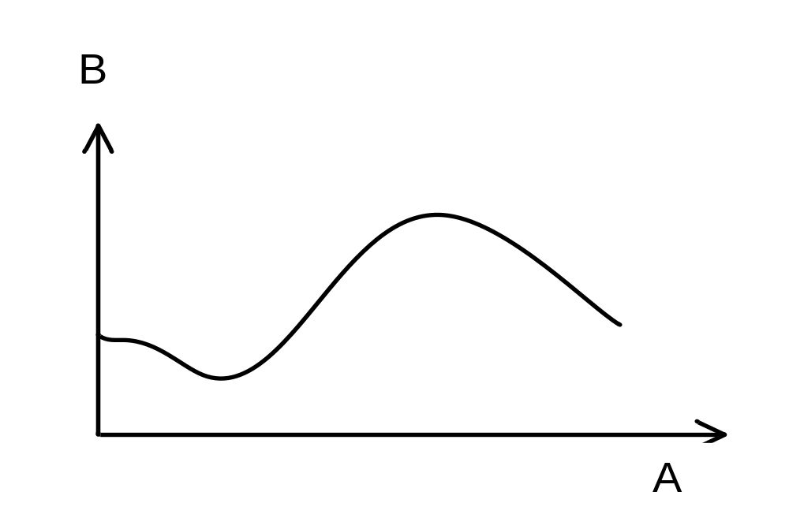
Each value of A corresponds to only one value of B.
A functionally determines B.
Figure 6.18(a) Graphical Depiction of Functional Dependency
Database Principles & Programming

Slide 99
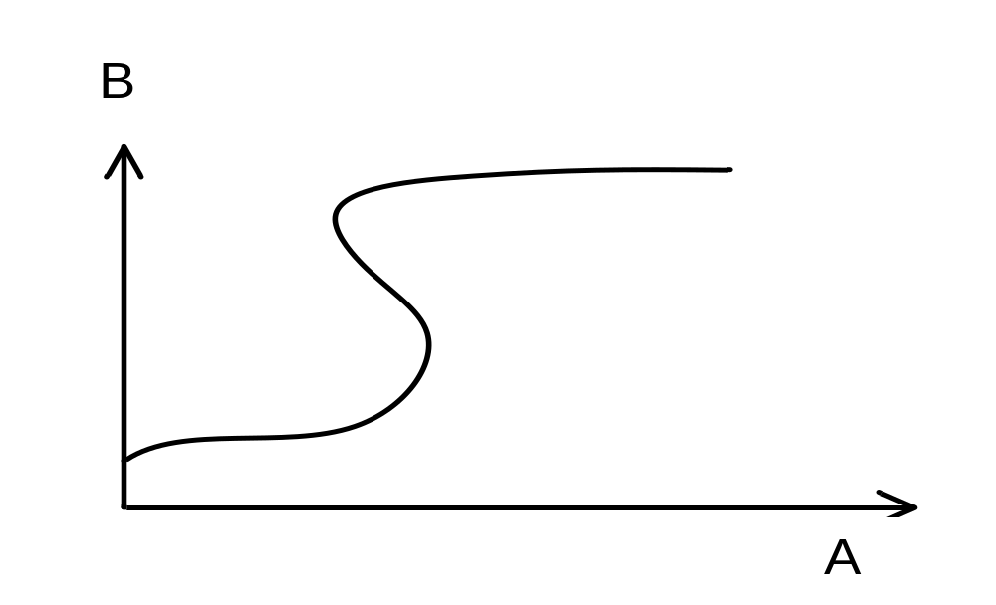
Some values of A correspond to more than one value of B.
A does not functionally determine B.
Figure 6.18(b) Graphical Depiction of Functional Dependency
Database Principles & Programming

Slide 100
A functionally determines B. Each value of A corresponds to only one value of B.
A does not functionally determine B. Some values of A correspond to more than one value of B.
Figure 6.18 Graphical Depiction of Functional Dependency
Database Principles & Programming

Slide 101
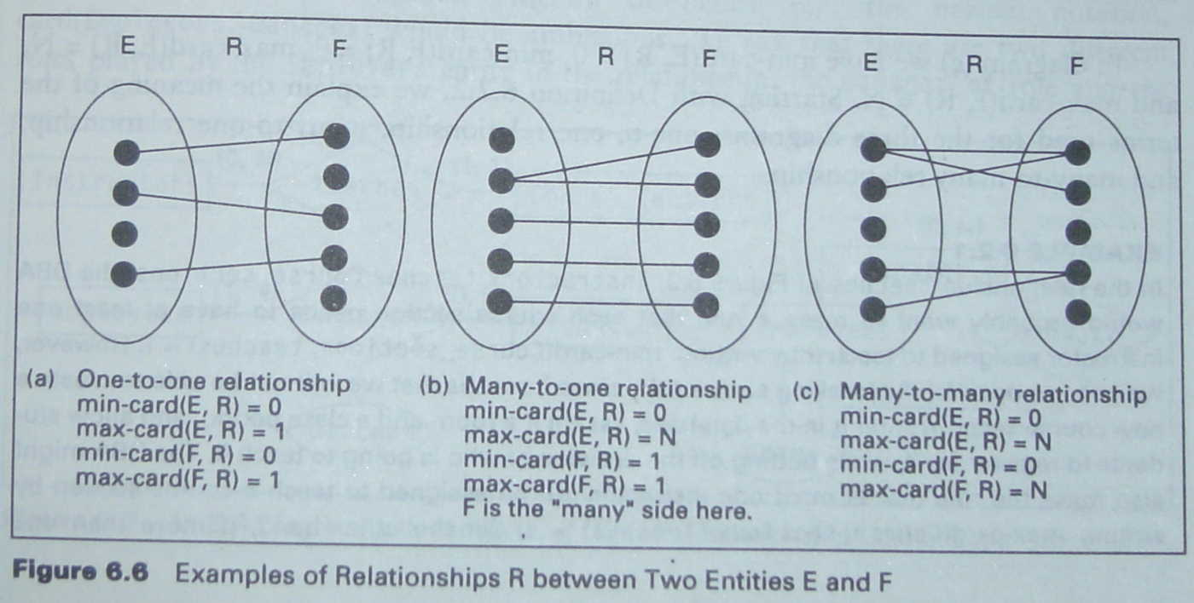
我们借用前面的图6.6，假设这里的E和F为两个属性，连线表示：在关系R中，E和F之间的取值对应关系
E → F
F → E
F → E
(none)
Database Principles & Programming

Slide 102
6.6 Functional Dependencies
Example 6.6.2
A
B
T1
X1
X2
X3
X4
X5
X6
Y1
Y2
A | B
x1 | y1
x2 | y2
x3 | y1
x4 | y1
x5 | y2
x6 | y2
A→B ?
B→A ?
A → B
Database Principles & Programming

Slide 103
6.6 Functional Dependencies
A
B
Example 6.6.2
T2
X1
X2
X3
X4
Y1
Y2
Y3
Y4
A | B
x1 | y1
x2 | y4
x3 | y2
x4 | y3
A→B ?
B→A ?
A → B
B → A
Database Principles & Programming

Slide 104
6.6 Functional Dependencies
A
B
Example 6.6.2
T3
X1
X2
X3
Y1
Y2
Y3
Y4
A | B
x1 | y1
x2 | y3
x3 | y2
x2 | y4
A→B ?
B→A ?
B → A
Database Principles & Programming

Slide 105
6.6 Functional Dependencies
A
B
Example 6.6.2
T4
X1
X2
X3
Y1
Y2
Y3
A | B
x1 | y1
x2 | y2
x3 | y2
x2 | y3
A→B ?
B→A ?
(none)
Database Principles & Programming

Slide 106
6.6 Functional Dependencies
Example 6.6.2
T1
T2
T3
T4
A | B
x1 | y1
x2 | y2
x3 | y1
x4 | y1
x5 | y2
x6 | y2
A | B
x1 | y1
x2 | y4
x3 | y2
x4 | y3
A | B
x1 | y1
x2 | y3
x3 | y2
x2 | y4
A | B
x1 | y1
x2 | y2
x3 | y2
x2 | y3
A→B √
B→A ×
A→B √
B→A √
A→B ×
B→A √
A→B ×
B→A ×
Database Principles & Programming

Slide 107
（一对一）
（一对多）
（多对多）
A
B
A
B
A
B
X1
X2
X3
X4
Y1
Y2
Y3
Y4
X1
X2
X3
Y1
Y2
Y3
Y4
X1
X2
X3
Y1
Y2
Y3
A → B
B → A
B → A
(none)
Database Principles & Programming

Slide 108
6.6 Functional Dependencies
Armstrong’s Axioms
  从已知的一些函数依赖，可以推导出另外一些函数依赖，这就需要一系列推理规则。
  函数依赖的推理规则最早出现在1974年W.W.Armstrong 的论文里，这些规则常被称作“Armstrong 公理”
  最基本的推理规则只有3条，由这3条基本规则可以定义出若干条‘扩充规则’
Database Principles & Programming

Slide 109
6.6 Functional Dependencies
Armstrong’s Axioms
  Rule 1（自反规则）：Inclusion Rule
    If Y⊆X，then X → Y
  Rule 2（传递规则）：Transitivity Rule
    If X → Y and Y → Z ，then X → Z
  Rule 3（增广规则）： Augmentation rule
    If X → Y, then XZ → YZ
Figure 6.19 (pg. 363)
Database Principles & Programming

Slide 110
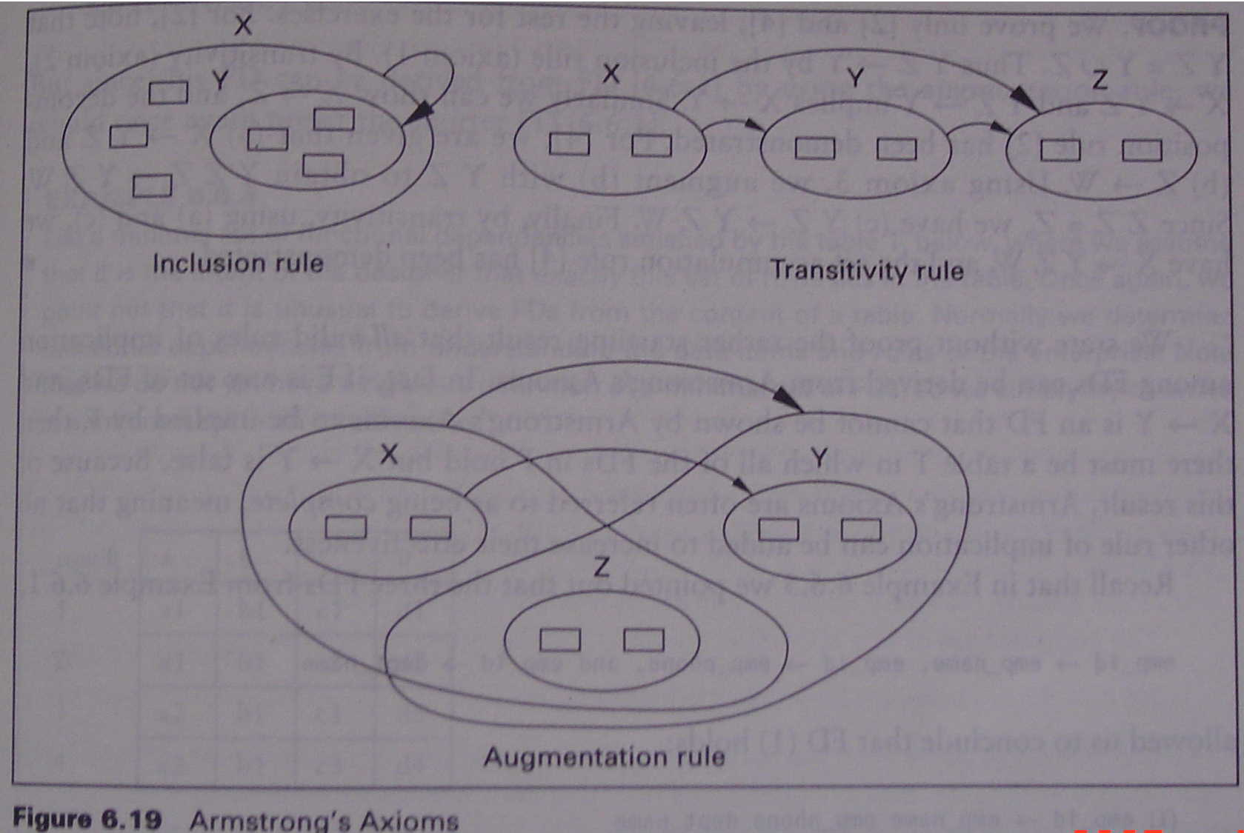
Database Principles & Programming

Slide 111
6.6 Functional Dependencies
Rule 1: Inclusion Rule
  If Y⊆X，then X → Y
Proof：
  设t₁, t₂是关系R中的任意两个元组(t₁∈R, t₂∈R), 且它们在属性集X上的值相等(t₁[X] = t₂[X])
  由于Y是X的子集，即X ⊇ Y
  因此必有t₁[Y] = t₂[Y]
Database Principles & Programming

Slide 112
6.6 Functional Dependencies
Rule 2: Transitivity Rule
  If X → Y and Y → Z ，then X → Z
Proof：
  设 t₁∈R, t₂∈R, 如果 t₁[X] = t₂[X] ………………(1)
  由(1)及X→Y得：t₁[Y] = t₂[Y] ………………... (2)
  由(2)及Y→Z得：t₁[Z] = t₂[Z]
Database Principles & Programming

Slide 113
6.6 Functional Dependencies
Rule 3: Augmentation rule
  If X → Y, then XZ → YZ
Proof：
  设 t₁∈R, t₂∈R, 如果 t₁[XZ] = t₂[XZ], 则：
      t₁[X] = t₂[X] …………………………(1)
      t₁[Z] = t₂[Z] …………………………(2)
  由(1)及X→Y得： t₁[Y] = t₂[Y] …………(3)
  由(2)及(3)得：t₁[YZ] = t₂[YZ]
Database Principles & Programming

Slide 114
6.6 Functional Dependencies
Theorem 6.6.8 Some Implications of Armstrong’s（pg. 363）
  Rule 4: Union Rule （合并规则）
    If X → Y and X → Z ，then X → YZ
  Rule 5: Decomposition Rule （分解规则）
    If X → YZ，then X → Y，and X → Z
  Rule 6: Pseudotransitivity Rule （伪传递规则）
    If X → Y，and WY → Z，then XW → Z
  Rule 7: Set accumulation rule （聚积规则）
    If X → YZ and Z → W，then X → YZW
Database Principles & Programming

Slide 115
6.6 Functional Dependencies
Rule 4: Union Rule
    If X → Y and X → Z ，then X → YZ
Proof:
  We have (a) X→Y and (b) X→Z.
  By Armstrong's Augmentation rule and (a), we have (c) XX→XY. But XX is X UNION X = X, so (c) can be rewritten (d) X→XY.
  Now by (b) and augmentation, we have (e) XY→YZ.
  And by (d) and (e) and transitivity, we have X→YZ, the desired result.
Database Principles & Programming

Slide 116
6.6 Functional Dependencies
Rule 5: Decomposition Rule
    If X→YZ, then X→Y, and X→Z
Proof:
  We have (a) X→YZ.
  By Armstrong's Inclusion Rule, we have (b) YZ→Y and (c) YZ→Z.
  By (a) and (b) and Armstrong’s Transitivity Rule, we have X→Y.
  By (a) and (c) and Armstrong’s Transitivity Rule, we have X→Z.
Database Principles & Programming

Slide 117
6.6 Functional Dependencies
Rule 6: Pseudotransitivity Rule
    If X→Y, and WY→Z, then XW→Z
Proof:
  We have (a) X→Y and (b) WY→Z.
  By Armstrong's Augmentation Rule and (a), we have (c) WX→WY.
  By (c) and (b) and Armstrong’s Transitivity Rule, we have (d) WX→Z.
  But WX = XW, so (d) can be rewritten XW→Z, the desired result.
Database Principles & Programming

Slide 118
6.6 Functional Dependencies
Rule 7: Set Accumulation Rule
    If X → YZ and Z → W, then X → YZW
Proof:
  We have (a) X→YZ and (b) Z→W.
  By Armstrong's Augmentation Rule and (b), we have (c) YZ Z→YZ W.
  But YZ Z = (Y ∪ Z) ∪ Z = Y ∪ (Z ∪ Z) = Y ∪ Z = YZ, so (c) can be rewritten (d) YZ→YZW.
  By (a) and (d) and Armstrong’s Transitivity Rule, we have X→YZW, the desired result.
Database Principles & Programming

Slide 119
6.6 Functional Dependencies
Example 6.6.4: relation T
  Find FDs in relation T
A | B | C | D
a1 | b1 | c1 | d1
a1 | b1 | c2 | d2
a2 | b1 | c1 | d3
a2 | b1 | c3 | d4
Database Principles & Programming

Slide 120
6.6 Functional Dependencies
A | B | C | D
a1 | b1 | c1 | d1
a1 | b1 | c2 | d2
a2 | b1 | c1 | d3
a2 | b1 | c3 | d4
首先考虑决定因素和依赖因素都是单个属性的情况：
A → B
A → C
A → D
√
B → A
B → C
B → D
C → A
C → B
C → D
D → A
D → B
D → C
☓
☓
√
☓
☓
√
√
☓
☓
☓
√
Database Principles & Programming

Slide 121
6.6 Functional Dependencies
A | B | C | D
a1 | b1 | c1 | d1
a1 | b1 | c2 | d2
a2 | b1 | c1 | d3
a2 | b1 | c3 | d4
也可以按照如下顺序考虑可能存在的函数依赖情况：
A → B
A → C
A → D
√
B → A
B → C
B → D
C → A
C → B
C → D
D → A
D → B
D → C
☓
☓
√
☓
☓
√
√
☓
☓
☓
√
Database Principles & Programming

Slide 122
A | B | C | D
a1 | b1 | c1 | d1
a1 | b1 | c2 | d2
a2 | b1 | c1 | d3
a2 | b1 | c3 | d4
A → B C → B D → ABC
其次，再考虑决定因素是多个属性的情况：
在FD的左边不需要考虑含有属性 D 的情况，why ?
在FD的左边不需要考虑含有属性 B 的情况，why ?
因此只需要考虑下述的FD是否成立：
AC → B ? AC → D ?
Database Principles & Programming

Slide 123
A | B | C | D
a1 | b1 | c1 | d1
a1 | b1 | c2 | d2
a2 | b1 | c1 | d3
a2 | b1 | c3 | d4
A → B C → B
D → A D → B D → C
AC → B ? AC → D ?
在上述的FD关系中，我们不用考虑 AC → B，why ?
因此，最后只需要考虑下面的一个FD是否可能成立？
√
AC → D ?
Database Principles & Programming
2007年度-教育部-IBM精品课程-南京大学计算机科学与技术系

Slide 124
6.6 Functional Dependencies
A | B | C | D
a1 | b1 | c1 | d1
a1 | b1 | c2 | d2
a2 | b1 | c1 | d3
a2 | b1 | c3 | d4
该关系上可能存在的函数依赖：
A → B C → B
D → A B C
AC → D
Database Principles & Programming

Slide 125
形如1)和2)这两种情况的函数依赖，都属于是可能成立的，并且可以从已写出的这六个函数依赖中推导出来。
在情况3)中，可以用已写出的这六个函数依赖来证明它是否成立。
A | B | C | D
a1 | b1 | c1 | d1
a1 | b1 | c2 | d2
a2 | b1 | c1 | d3
a2 | b1 | c3 | d4
该关系上可能存在的函数依赖：
A → B C → B AC → D
D → A B C
思考问题：为什么没有写出
  左边含有属性D的其它的那些可能的FD？
  右边为单个属性B的其它的那些可能的FD？
  右边为多个属性的那些可能的FD？
Database Principles & Programming
2007年度-教育部-IBM精品课程-南京大学计算机科学与技术系

Slide 126
Content of next
Closure of a Set of FDs (函数依赖集F的闭包 )
FD Set Cover (函数依赖集的覆盖)
Equivalence of two sets of FDS (函数依赖集的等价)
Closure of a Set of Attributes (属性集的闭包)
  Algorithm 6.6.12
Minimal Cover (最小覆盖)
  Algorithm 6.6.13
Database Principles & Programming

Slide 127
6.6 Functional Dependencies
Def. 6.6.9 Closure of a Set of FDs (函数依赖集F的闭包，记为 F⁺ )
  Given a set F of FDs on attributes of a table T, we define the CLOSURE of F, symbolized by F⁺, to be the set of all FDs implied by F.
    There are two FDs (a) and (b) in F. By Armstrong’s Axioms and (a) and (b), we can get a new FD (c), then (c) is a FD implied by F.
    If FD (d) is a trivial dependency (A→A, B→B, etc.), then (d) is a FD implied by F.
Database Principles & Programming

Slide 128
6.6 Functional Dependencies
Example 6.6.5
  F = { A→B, B→C, C→D, D→E, E→F, F→G, G→H }
  all FDs in F are element of F⁺
  by Armstrong’s inclusion rule, A→A, B→B, AB→B ...... are element of F⁺
  by Armstrong’s transitivity rule, A→C, A→D, ...... are element of F⁺
  by Armstrong’s augmentation rule, AD→BD, ABD→BCD, ...... are element of F⁺
  by Armstrong’s union rule, A→AB, A→BC, A→ABC, ..., A→ABCDEFGH, ...... are element of F⁺
  ......
Another Example
Database Principles & Programming

Slide 129
6.6 Functional Dependencies
Def. 6.6.10 FD Set Cover (函数依赖集的覆盖)
  A set F of FDs on a table T is said to COVER another set G of FDs on T if the set G can be derived by implication rules from the set F, i.e., if G⊆F⁺.
函数依赖集的等价
  If F covers G and G covers F, we say the two sets of FDs are equivalent, F≡G.
Database Principles & Programming

Slide 130
Database Principles & Programming

Slide 131
6.6 Functional Dependencies
Example 6.6.6: Consider the two sets of FDs on the set of attributes {A,B,C,D,E}
    F = { B→CD, AD→E, B→A }
    G = { B→CDE, B→ABC, AD→E }
  F covers G ?
  G covers F ?
Database Principles & Programming

Slide 132
6.6 Functional Dependencies
Ex. 6.6.6
  F: (f₁) B→CD (f₂) AD→E (f₃) B→A
  G: (g₁) B→CDE (g₂) B→ABC (g₃) AD→E }
F covers G ?
g₁ can be derived from the set F ?
  by f₁ and f₃ and union rule, we have ① B→ACD
  by f₂ and augmentation rule, we have ②CDAD→CDE, and can be rewritten ③ ACD→CDE
  by ① and ③ and transitivity rule, we have g₁
Database Principles & Programming

Slide 133
6.6 Functional Dependencies
Ex. 6.6.6
  F: (f₁) B→CD (f₂) AD→E (f₃) B→A
  G: (g₁) B→CDE (g₂) B→ABC (g₃) AD→E }
F covers G ?
g₂ can be derived from the set F ?
  by f₁ and decomposition rule, we have ① B→C
  by ① and f₃ and union rule, we have ② B→AC
  by ② and augmentation rule, we have g₂ B→ABC
Database Principles & Programming

Slide 134
6.6 Functional Dependencies
Ex. 6.6.6
  F: (f₁) B→CD (f₂) AD→E (f₃) B→A
  G: (g₁) B→CDE (g₂) B→ABC (g₃) AD→E }
F covers G ?
g₃ is an element of the set F.
Database Principles & Programming

Slide 135
6.6 Functional Dependencies
Ex. 6.6.6
  F: (f₁) B→CD (f₂) AD→E (f₃) B→A
  G: (g₁) B→CDE (g₂) B→ABC (g₃) AD→E }
G covers F ?
  f₁ can be derived from the set G ?
    by g₁ and decomposition rule, we have f₁ B→CD
  f₂ is an element of the set G.
  f₃ can be derived from the set G ?
    by g₂ and decomposition rule, we have f₃ B→A
Database Principles & Programming

Slide 136
6.6 Functional Dependencies
Def. 6.6.11 Closure of a Set of Attributes（属性集的闭包）
  Given a set X of attributes in a table T and a set F of FDs on T, we define the CLOSURE of the set X (under F), denoted by X⁺ or X⁺_{F}, as the largest set of attributes Y such that X→Y is in F⁺.
      X⁺_{F} = { A | X → A ∈ F⁺ }
Database Principles & Programming

Slide 137
6.6 Functional Dependencies
  algorithm 6.6.12
X⁺ := X;
repeat
  oldX⁺ := X⁺;
  for each functional dependency Y→Z in F do
    if Y⊆ X⁺ then X⁺ := X⁺ ∪ Z;
until ( oldX⁺ = X⁺ )
Database Principles & Programming

Slide 138
6.6 Functional Dependencies
Example 6.6.7: F = { (f₁) B→CD, (f₂) AD→E, (f₃) B→A }, compute B⁺ ?
set X = B⁺ = { B }
first loop
  the left side of f₁ is a subset of B⁺, then
    B⁺ = B⁺ union {C D} = {B C D}
  the left side of f₂ is’n a subset of B⁺ , then f₂ does not apply at this time
  the left side of f₃ is a subset of B⁺, then
    B⁺ = B⁺ union {A} = {A B C D}
  X ≠ B⁺, go to step b)
Database Principles & Programming

Slide 139
6.6 Functional Dependencies
second loop
  X = B⁺ = { A B C D }
  skip the FDs that have been applied before
  the left side of f₂ is a subset of B⁺ , then
      B⁺ = B⁺ union {E} = {A B C D E}
  X ≠ B⁺, go to step b)
third loop
  X = B⁺ = {A B C D E}
  loop through FDs in F again
  end with X = B⁺
return B⁺
Database Principles & Programming

Slide 140
6.6 Functional Dependencies
Algorithm 6.6.13 Minimal Cover (最小覆盖)
  a minimal set M of FDs that covers a given set F of FDs.
  step 1: From the set F of FDs, we create an equivalent set H of FDs, with only single attributes on the right side.
Database Principles & Programming

Slide 141
X
B
C
A
D
E
F
Figure 6.20 Example of an Inessential FD: X→A
step 2: From the set H of FDs, successively remove individual FDs that are inessential in H.
  An FD X→Y is inessential in a set H of FDs, if X→Y can be removed from H, with result J, so that H⁺=J⁺, or H=J.
  That is, removal of the FD from H has no effect on H⁺.
Database Principles & Programming

Slide 142
X
B
C
A
D
E
F
Figure 6.20 Example of an Inessential FD: X→A
Let:
  F = {B→D, D→E, C→F, BC→A, EF→A}
  H = F – {BC→A} = {B→D, D→E, C→F, EF→A}
BC→A is inessential in F because of F⁺=H⁺
Database Principles & Programming

Slide 143
X
B
C
D
A
E
Figure 6.21 Example of an FD: X→A where B can be removed
step 3: From the set H of FDs, successively replace individual FDs with FDs that have a smaller number of attributes on the left-hand side, as long as the result does not change H⁺.
Database Principles & Programming

Slide 144
X
B
C
D
A
E
Figure 6.21 Example of an FD: X→A where B can be removed
Let: F = {C→E, E→B, BCD→A}
We say B can be removed from BCD→A (replace BCD→A by CD→A) because:
  Let: H = { C→E, E→B, CD→A }
  We have: F⁺ = H⁺
Database Principles & Programming

Slide 145
6.6 Functional Dependencies
  step 4: From the remaining set of FDs, gather all FDs with equal left-hand sides and use the union rule to create an equivalent set of FDs M where all left-hand sides are unique.
Database Principles & Programming

Slide 146
6.6 Functional Dependencies
Example 1
  Suppose X = { a, b, c, d } and
    F = { a → b, b c → d, a c → d }
  Give the minimal cover M for the set F of FDs.
Example 2
  Suppose Y = { a, b, c, d } and
    G = { a → a c, b → a b c, d → a b c }
  Give the minimal cover N for the set G of FDs.
Database Principles & Programming

Slide 147
6.6 Functional Dependencies
Example 6.6.8 Construct the minimal cover cover M for the set F of FDs.
  F:
    A B D → A C
    C → B E
    A D → B F
    B → E
Database Principles & Programming

Slide 148
Content of next
The process of normalization
  Decompositions of table
Lossless Decomposition & Lossy Decomposition
  Theorem 6.7.3 & 6.7.4
FD Preserved
Database Principles & Programming

Slide 149
6.7 Lossless Decompositions
The process of normalization
  decompose a table into two or more small tables
    projecting onto two or more subsets of columns that cover all columns and have some columns in common.
  but it doesn't always work when join back that keep all information of original table.
    Always get ALL rows back, but
    might get MORE
      see example 6.7.1 (pg. 374, next slide)
Database Principles & Programming

Slide 150
6.7 Lossless Decompositions
ABC ≠ AB join BC
example 6.7.1
ABC
A
B
C
AB join BC
a1
100
c1
A
B
C
a2
200
c2
a1
100
c1
a3
300
c3
a2
200
c2
a4
200
c4
a2
200
c4
a3
300
c3
a4
200
c2
AB
BC
a4
200
c4
A
B
B
C
a1
100
100
c1
a2
200
200
c2
a3
300
300
c3
a4
200
200
c4
Database Principles & Programming

Slide 151
6.7 Lossless Decompositions
Def. 6.7.1 Lossless Decomposition (无损性分解)
        lossless-join decomposition
For any table T with an associated set of functional dependencies F, a decomposition of T into k tables is a set of tables {T₁, T₂, ..., T_{k}}, with two properties:
for every table T_{i} in the set, Head(T_{i}) is a proper subset of Head(T);
Head(T) = Head(T₁) ∪ Head(T₂) ∪ ...... ∪ Head(T_{k})
Database Principles & Programming

Slide 152
6.7 Lossless Decompositions
Def. 6.7.1 (cont.)
  Given any specific content of T, the rows of T are projected onto the columns of each T_{i} as a result of the decomposition.
  A decomposition of a table T with an associated set F of FDs is said to be a lossless decomposition if, for any possible future content of T, the FDs in F guarantee that the following relationship will hold:
      T ≡ T₁ ∞ T₂ ∞ ... ∞ T_{k}
Database Principles & Programming

Slide 153
6.7 Lossless Decompositions
Lossy Decomposition
  a decomposition of T is {T₁, T₂, ..., T_{k}}
  We join the tables of the decomposition, we might get back other rows that were not originally present, so
        T ⊂ T₁ ∞ T₂ ∞ ... ∞ T_{k}
Database Principles & Programming

Slide 154
Ex 6.7.1 A Lossy Decomposition
      (A Loss-Join Decomposition)
ABC
A
B
C
AB join BC
a1
100
c1
A
B
C
a2
200
c2
a1
100
c1
a3
300
c3
a2
200
c2
a4
200
c4
a2
200
c4
a3
300
c3
a4
200
c2
AB
BC
a4
200
c4
A
B
B
C
a1
100
100
c1
a2
200
200
c2
a3
300
300
c3
a4
200
200
c4
Database Principles & Programming

Slide 155
Ex 6.7.2 A Different Content for Table ABC
ABC = AB join BC
ABC
A
B
C
AB join BC
a1
100
c1
A
B
C
a2
200
c2
a1
100
c1
a3
300
c3
a2
200
c2
a3
300
c3
AB
BC
A
B
B
C
a1
100
100
c1
a2
200
200
c2
a3
300
300
c3
Database Principles & Programming

Slide 156
6.7 Lossless Decompositions
Def. 6.7.2 A database schema is the set of headings of all tables in a database, together with the set of all FDs that the designer wishes to hold on the join of those tables.
ABC
Ex 6.7.3 Table ABC with a FD: B→C
  Assume the table content of ABC is (left).
A
B
C
a1
100
c1
a2
200
c2
  If we tried to insert a row (a4, 200, c4), this insert would fail. Why?
a3
300
c3
a4 | 200 | c4
a4 | 200 | c2
  but, we can insert a row (a4, 200, c2) to this table.
Database Principles & Programming

Slide 157
Ex 6.7.3 Table ABC with a FD: B→C
ABC
AB join BC
A
B
C
A
B
C
a1
100
c1
a1
100
c1
a2
200
c2
a2
200
c2
a3
300
c3
a3
300
c3
a4
200
c2
a4
200
c2
AB
BC
A
B
B
C
a1
100
100
c1
a2
200
200
c2
a3
300
300
c3
ABC ≡ AB join BC, why?
a4
200
Database Principles & Programming

Slide 158
6.7 Lossless Decompositions
Theorem 6.7.4. Given a table T with a set F of FDs valid on T, then a decomposition of T into two tables {T₁, T₂} is a lossless decomposition if one of the following functional dependencies is implied by F:
    Head(T₁) ∩ Head(T₂) → Head(T₁)
    Head(T₁) ∩ Head(T₂) → Head(T₂)
PROOF. (pg. 379)
  Assume Head(T) = { X, Y, Z }, Head(T₁) = { X, Y }, Head(T₂) = { Y, Z }, then
      Head(T₁) ∩ Head(T₂) = { Y }
Database Principles & Programming

Slide 159
6.7 Lossless Decompositions
Ex 6.7.4: In Example 6.7.3
ABC
AB join BC
A
B
C
A
B
C
a1
100
c1
a1
100
c1
a2
200
c2
a2
200
c2
a3
300
c3
a3
300
c3
a4
200
c2
a4
200
c2
AB
BC
A
B
B
C
a1
100
100
c1
a2
200
200
c2
a3
300
300
c3
a4
200
Database Principles & Programming

Slide 160
6.7 Lossless Decompositions
Ex 6.7.5 CUSTORDS
Ex 6.7.6 Lossless Join Decomposition with Multiple Tables: T ⇒ { T₁, T₂, ......,T_{k} }
  we can demonstrate losslessness by using the two-table result in a recursive manner.
    (((T₁ ∞ T₂) ∞ T₃)... ∞ T_{k})
Database Principles & Programming

Slide 161
6.7 Lossless Decompositions
Ex. Give a decomposition of table T(A,B,C) with a set F of FDs: ρ = {T₁, T₂}
  Is it a lossless decomposition ?
  F = { A→B }, T₁(A, B), T₂(A, C)
  F = { A→C, B→C }, T₁(A, B), T₂(A, C)
  F = { A→B }, T₁(A, B), T₂(B, C)
  F = { A→B, B→C }, T₁(A, C), T₂(B, C)
Database Principles & Programming

Slide 162
6.7 Lossless Decompositions
Ex. Give a decomposition of table T(A,B,C,D) with a set F of FDs {A→B, B→C, A→D , D→C}:
    T₁ (A,B) T₂ (A,C) T₃ (A,D)
  Is it a lossless decomposition ?
  i.e.
    T₁ and T₂ is a lossless decomposition ?
    (T₁ ∞ T₂) and T₃ is a lossless decomposition ?
Database Principles & Programming

Slide 163
6.8 Normal Forms
emp_info ( emp_id, emp_name, emp_phone, dept_name, dept_phone, dept_mgrname, skill_id, skill_name, skill_date, skill_lvl )
  emp_id→{emp_name, emp_phone, dept_name}
  dept_name→{dept_phone, dept_mgrname}
  skill_id→skill_name
  {emp_id, skill_id}→{skill_date, skill_lvl}
Figure 6.22 & 6.23
Database Principles & Programming

Slide 164
6.8 Normal Forms
emps(emp_id, emp_name, emp_phone, dept_name, dept_phone, dept_mgrname)
  emp_id→{emp_name, emp_phone, dept_name}
  dept_name→{dept_phone, dept_mgrname}
skills(emp_id,skill_id,skill_name,skill_date,skill_lvl)
  skill_id→skill_name
  {emp_id, skill_id} → {skill_date, skill_lvl}
Figure 6.24
Database Principles & Programming

Slide 165
6.8 Normal Forms
Proposition 6.8.1
  The key for the emp_info table is the attribute set (emp_id, skill_id)
    This is also the key for the skills table
    the emps table has a key consisting of the single attribute emp_id
PROOF.
  By Theorem 6.7.3.
Database Principles & Programming

Slide 166
6.8 Normal Forms
Proposition 6.8.2
  The factorization of the emp_info table into the emps table and skills table is a true lossless decomposition.
PROOF.
  By the theorem 6.7.4.
Database Principles & Programming

Slide 167
6.8 Normal Forms
Figure 6.26
  emps(emp_id, emp_name, emp_phone, dept_name)
  depts(dept_name, dept_phone, dept_mgrname)
  emp_skills(emp_id, skill_id, skill_date, skill_lvl)
  skills(skill_id, skill_name)
Ex 6.8.2
  Figure 6.26
  Figure 6.24
  Figure 6.25
Database Principles & Programming

Slide 168
6.8 Normal Forms
Def. 6.8.3 FD Preserved (依赖保持性)
  Given a database schema with a universal table T and a set of functional dependencies F, let {T₁, T₂, ......,T_{k} } be a lossless decomposition of T.
  Then an FD X→Y of F is said to be preserved in the decomposition of T, or alternatively the decomposition of T preserved the FD X→Y, if for some table T_{i} of the decomposition, X∪Y⊆Head(T_{i}).
  When this is the case, we also say that the FD X→Y is preserved in T_{i} or that it lies in T_{i} or is in T_{i}.
Database Principles & Programming

Slide 169
6.8 Normal Forms
Def. 6.8.3 依赖保持性
  设关系模式R上的函数依赖集为F，将关系模式R分解为{T₁, T₂, ......,T_{k} }这k个子关系模式，从函数依赖集F中可以推导出的在子关系模式T_{i}上所存在的函数依赖集为F_{i} (i=1,2,…,k)
  如果函数依赖集F和（F₁∪F₂∪…∪F_{k}）是相互等价的，即F⁺ = (F₁∪F₂∪…∪F_{k})⁺，则我们称该分解是具有依赖保持性的
Database Principles & Programming

Slide 170
Content of next
Superkey & Key
  Algorithm to Find Candidate Key
  PRIME ATTRIBUTE (主属性)
  NON-PRIME ATTRIBUTE (非主属性)
Normal Forms:
  2NF, 3NF, BCNF
Algorithm 6.8.8
Database Principles & Programming

Slide 171
6.8 Normal Forms
Theorem 6.7.3. Given a table T with a set of FDs F and a set of attributes X in Head(T), then
  X is a superkey of T iff
    X functionally determines all attributes in T
      i.e., X→Head(T)
    Equivalently:
      X⁺_{F} = Head(T)
Database Principles & Programming

Slide 172
6.8 Normal Forms
An Algorithm to Find Candidate Key
  Given a table T with a set F of FDs
set K := Head(T) ;
for each attribute A in K
  {
    compute (K – A)_{F}⁺ ;
    if (K – A)_{F}⁺ contains all the attributes in T, then
    {
      set K := K – { A } ;
    }
  }
Database Principles & Programming

Slide 173
6.8 Normal Forms
Find candidate key for this table R.
  R (A, B, C, D)， F: { B→D, AB→C }
  R (A, B, C)， F: { A→B, B→A, A→C }
  R (A, B, C, D)， F: { A→C, CD→B }
Database Principles & Programming

Slide 174
6.8 Normal Forms
R (A, B, C, D)， F: { B→D, AB→C }
解：K = { A, B, C, D }
  ∵ {K–A}⁺ = {B,C,D}⁺ = {B,C,D} ≠ U
  ∵ {K–B}⁺ = {A,C,D}⁺ = {A,C,D} ≠ U
  ∵ {K–C}⁺ = {A,B,D}⁺ = {A,B,D, C} = U
    ∴ K = K–C = {A,B,D}
  ∵ {K–D}⁺ = {A,B}⁺ = {A,B, D, C} = U
    ∴ K = K–D = {A,B}
  return K.
Database Principles & Programming

Slide 175
6.8 Normal Forms
R (A, B, C)， F: { A→B, B→A, A→C };
解1：K = { A, B, C }
  ∵ {K–A}⁺ = {B,C, A} = U ∴ K = K–A = {B,C}
  ∵ {K–B}⁺ = {C} ≠ U
  ∵ {K–C}⁺ = {B, A, C} = U ∴ K = K–C = {B}
  return { B }
Database Principles & Programming

Slide 176
6.8 Normal Forms
R (A, B, C)， F: { A→B, B→A, A→C };
解2：K = { A, B, C }
  ∵ {K–B}⁺ = {A,C, B} = U ∴ K = K–B = {A,C}
  ∵ {K–A}⁺ = {C} ≠ U
  ∵ {K–C}⁺ = {A,B,C} = U ∴ K = K–C = {A}
  return {A}
Database Principles & Programming

Slide 177
6.8 Normal Forms
Def. 6.8.5 A PRIME ATTRIBUTE
  A prime attribute of a table T is any attribute that is part of a key for that table
    not necessarily a primary key
Def. A NON-PRIME ATTRIBUTE
Database Principles & Programming

Slide 178
6.8 Normal Forms
Schema | Key | Prime attributes | Non-prime attributes | BCNF?
R (A, B, C, D) { B→D, AB→C } | ？ | ？ | ？ | ？
R (A, B, C) { A→B, B→A, A→C } | ？ | ？ | ？ | ？
R (A, B, C, D) { A→C, CD→B } | ？ | ？ | ？ | ？
Database Principles & Programming

Slide 179
6.8 Normal Forms
Schema | Key | Prime attributes | Non-prime attributes | BCNF?
R (A, B, C, D) { B→D, AB→C } | AB | ？ | ？
R (A, B, C) { A→B, B→A, A→C } | A B | ？ | ？
R (A, B, C, D) { A→C, CD→B } | AD | ？ | ？
Database Principles & Programming

Slide 180
6.8 Normal Forms
Schema | Key | Prime attributes | Non-prime attributes | BCNF?
R (A, B, C, D) { B→D, AB→C } | AB | A, B | C, D | ？
R (A, B, C) { A→B, B→A, A→C } | A B | A, B | C | ？
R (A, B, C, D) { A→C, CD→B } | AD | A, D | B, C | ？
Database Principles & Programming

Slide 181
6.8 Normal Forms
Schema | Key | Prime attributes | Non-prime attributes | BCNF?
R (A, B, C, D) { B→D, AB→C } | AB | A, B | C, D | No
R (A, B, C) { A→B, B→A, A→C } | A B | A, B | C | Yes
R (A, B, C, D) { A→C, CD→B } | AD | A, D | B, C | No
Database Principles & Programming

Slide 182
6.8 Normal Forms
Normal Forms:
  BCNF
  2NF
  3NF
Algorithm 6.8.8
Database Principles & Programming

Slide 183
6.8 Normal Forms
Def. 6.8.4. Boyce-Codd Normal Form, or BCNF.
  A table T in a database schema with FD set F is in BCNF iff
    for any FD X→A in F⁺ that lies in T (all attributes of X and A in T), A is a single attribute not in X, then
      X must be a superkey for T
Database Principles & Programming

Slide 184
6.8 Normal Forms
  emps(emp_id, emp_name, emp_phone, dept_name)
    emp_id → {emp_name, emp_phone, dept_name}
  depts(dept_name, dept_phone, dept_mgrname)
    dept_name → {dept_phone, dept_mgrname}
  emp_skills(emp_id, skill_id, skill_date, skill_lvl)
    {emp_id, skill_id} → {skill_date, skill_lvl}
  skills(skill_id, skill_name)
    skill_id → skill_name
Figure 6.26
Database Principles & Programming

Slide 185
6.8 Normal Forms
Def. 6.8.6. Third Normal Form (3NF).
  A table T in a database schema with FD set F is in 3NF iff,
    for any FD X→A implied by F that lies in T, if A is a single non-prime attribute not in X, then X must be a superkey for T.
Database Principles & Programming

Slide 186
6.8 Normal Forms
BCNF和3NF定义的对比
BCNF
  for any FD X→A in F⁺ that lies in T (all attributes of X and A in T), A is a single attribute not in X, then X must be a superkey for T
3NF
  for any FD X→A implied by F that lies in T, if A is a single non-prime attribute not in X, then X must be a superkey for T.
Database Principles & Programming

Slide 187
6.8 Normal Forms
Example 6.8.6 (Figure 6.29)
  Each of the tables in this schema is in BCNF, and therefore in 3NF.
Example 6.8.7 (Figure 6.28)
  This table is in 3NF but not in BCNF.
Theorem: If table T is BCNF, then T is 3NF.
Database Principles & Programming

Slide 188
6.8 Normal Forms
Example 6.8.8 Head(T) = {A B C D}, and FD set F as follows: F ={ A B → C D, D → B }
  Find candidate key for table T
  Table T is 3NF ?
  Table T is BCNF ?
Database Principles & Programming

Slide 189
6.8 Normal Forms
Def. 6.8.7. Second Normal Form (2NF)
  A table T with FD set F is in 2NF iff:
    for any X → A implied by F that lies in T, where A is a single non-prime attribute not in X, then X is not properly contained in any key of T.
Ex 6.8.9
  Figure 6.25
Database Principles & Programming

Slide 190
6.8 Normal Forms
3NF和2NF定义的对比
3NF
  for any X→A implied by F that lies in T, if A is a single non-prime attribute not in X, then X must be a superkey for T.
2NF
  for any X → A implied by F that lies in T, if A is a single non-prime attribute not in X, then X is not properly contained in any key of T.
Database Principles & Programming

Slide 191
6.8 Normal Forms
  emps(emp_id, emp_name, emp_phone, dept_name, dept_phone, dept_mgrname)
    emp_id → {emp_name, emp_phone, dept_name}
    dept_name → {dept_phone, dept_mgrname}
  emp_skills(emp_id, skill_id, skill_date, skill_lvl)
    {emp_id, skill_id} → {skill_date, skill_lvl}
  skills(skill_id, skill_name)
    skill_id → skill_name
Figure 6.25
Database Principles & Programming

Slide 192
Example of Normal Forms
Relations
  emp_info(emp_id, emp_name, emp_phone, dept_name, dept_phone, dept_mgrname, skill_id, skill_name, skill_date, skill_lvl)
Functionally Dependents
  emp_id→{emp_name, emp_phone, dept_name}
  dept_name→{dept_phone, dept_mgrname}
  skill_id→skill_name
  {emp_id, skill_id}→{skill_date, skill_lvl}
Database Principles & Programming

Slide 193
Is 2NF ?
Relations
  emp_info ( emp_id, emp_name, emp_phone,
        dept_name, dept_phone, dept_mgrname,
        skill_id, skill_name, skill_date, skill_lvl )
Functionally Dependents
  emp_id → {emp_name, emp_phone, dept_name}
  dept_name → {dept_phone, dept_mgrname}
  skill_id → skill_name
  {emp_id, skill_id} → {skill_date, skill_lvl}
Figure 6.23
Database Principles & Programming

Slide 194
Is 2NF ?
Relations 1
  Emps ( emp_id, emp_name, emp_phone,
      dept_name, dept_phone, dept_mgrname )
Functionally Dependents in Relations 1
  emp_id → {emp_name, emp_phone, dept_name}
  dept_name → {dept_phone, dept_mgrname}
Relations 2
  Skills ( emp_id, skill_id, skill_name, skill_date,
      skill_lvl )
Functionally Dependents in Relations 2
  skill_id → skill_name
  {emp_id, skill_id} → {skill_date, skill_lvl}
Figure 6.24
Database Principles & Programming

Slide 195
Is 2NF ?
Relations 1
  Emps ( emp_id, emp_name, emp_phone,
      dept_name, dept_phone, dept_mgrname )
  emp_id → {emp_name, emp_phone, dept_name}
  dept_name → {dept_phone, dept_mgrname}
Relations 2
  Emp_Skills ( emp_id, skill_id, skill_date, skill_lvl )
  {emp_id, skill_id} → {skill_date, skill_lvl}
Relations 3
  Skills ( skill_id, skill_name)
  skill_id → skill_name
Figure 6.25
Database Principles & Programming

Slide 196
Is 3NF ?
Relations 1
  Emps ( emp_id, emp_name, emp_phone,
      dept_name, dept_phone, dept_mgrname )
  emp_id → {emp_name, emp_phone, dept_name}
  dept_name → {dept_phone, dept_mgrname}
Relations 2
  Emp_Skills ( emp_id, skill_id, skill_date, skill_lvl )
  {emp_id, skill_id} → {skill_date, skill_lvl}
Relations 3
  Skills ( skill_id, skill_name)
  skill_id → skill_name
Figure 6.25
Database Principles & Programming

Slide 197
Is 3NF ?
  emps(emp_id, emp_name, emp_phone, dept_name)
    emp_id → {emp_name, emp_phone, dept_name}
  depts(dept_name, dept_phone, dept_mgrname)
    dept_name → {dept_phone, dept_mgrname}
  emp_skills(emp_id, skill_id, skill_date, skill_lvl)
    {emp_id, skill_id} → {skill_date, skill_lvl}
  skills(skill_id, skill_name)
    skill_id → skill_name
Figure 6.26
Database Principles & Programming

Slide 198
Is BCNF ?
  emps(emp_id, emp_name, emp_phone, dept_name)
    emp_id → {emp_name, emp_phone, dept_name}
  depts(dept_name, dept_phone, dept_mgrname)
    dept_name → {dept_phone, dept_mgrname}
  emp_skills(emp_id, skill_id, skill_date, skill_lvl)
    {emp_id, skill_id} → {skill_date, skill_lvl}
  skills(skill_id, skill_name)
    skill_id → skill_name
Figure 6.26
Database Principles & Programming

Slide 199
6.8 Normal Forms
Algorithm 6.8.8: An Algorithm to Achieve Well-Behaved 3NF Decomposition
  This algorithm, given a universal table T and set F of FDs, generates a lossless join decomposition of T that is in 3NF and preserves all FDs of F.
  The output is a set S of headings (sets of attributes) for tables in the final database schema.
Database Principles & Programming

Slide 200
6.8 Normal Forms
Algorithm 6.8.8
  replace F with minimal cover of F;
  S = Φ;
  for all X→Y in F
      if, for all Z∈S, X ∪ Y ⊈ Z
      then S = S ∪ Heading(X ∪ Y )
    end for
  If, for all candidate keys K for T:
      for all Z∈S, K ⊈ Z
  then choose a candidate key K and set S = S ∪ Heading(K)
Database Principles & Programming

Slide 201
Example of Normal Forms
Relations
  emp_info(emp_id, emp_name, emp_phone, dept_name, dept_phone, dept_mgrname, skill_id, skill_name, skill_date, skill_lvl)
Functionally Dependents
  emp_id→{emp_name, emp_phone, dept_name}
  dept_name→{dept_phone, dept_mgrname}
  skill_id→skill_name
  {emp_id, skill_id}→{skill_date, skill_lvl}
Database Principles & Programming

Slide 202
3NF
Relations
  Emps ( emp_id, emp_name, emp_phone, dept_name )
  Depts ( dept_name, dept_phone, dept_mgrname)
  Emp_Skills ( emp_id, skill_id, skill_date, skill_lvl )
  Skills ( skill_id, skill_name)
Functionally Dependents
  emp_id → {emp_name, emp_phone, dept_name}
  dept_name → {dept_phone, dept_mgrname}
  skill_id → skill_name
  {emp_id, skill_id} → {skill_date, skill_lvl}
Figure 6.26
Database Principles & Programming

Slide 203
X
B
C
A
D
E
F
Figure 6.20 Example of an Inessential FD: X→A
Database Principles & Programming

Slide 204
X
B
C
D
A
E
Figure 6.21 Example of an FD: X→A where B can be removed
Database Principles & Programming

