Slide 1
Chapter 8
Indexing

Slide 2
Indexing
    8.1 The Concept of Indexing
    8.2 Disk Storage
    8.3 The B-Tree Index
    8.4 Clustered and Non-Clustered Indexes
    8.5 A Hash Primary Index
    8.6 Throwing Darts at Random Slots
Indexing

Slide 3
8.1 The Concept of Indexing
Index
  an index is like a card catalog in a library.
  Each card (entry) has:
    (keyvalue, row-pointer)
    keyvalue is for lookup
    row-pointer (ROWID) is enough to locate row on disk (one I/O)
Indexing

Slide 4
8.1 The Concept of Indexing
Index: (keyvalue, row-pointer)
  Entries are placed in Alphabetical order by lookup key in "B-tree" (usually), also might be hashed.
    An index is a lot like memory resident structures.
    But index is disk resident. Like the data itself, often won't all fit in memory at once.
  Index can be regarded as a table with two columns: keyvalue and row-pointer
Indexing

Slide 5
8.1 The Concept of Indexing
Figure 8.1: the SQL Create Index Statement
CREATE [ UNIQUE ] INDEX indexname
  ON tablename (colname [ASC | DESC]
      { , colname [ASC | DESC] ...});
DROP INDEX indexname;
UNIQUE
  keyvalue and row is one-to-one
  we can use UNIQUE INDEX to implement UNIQUE constraints in Create Table Statement.
Indexing

Slide 6
8.1 The Concept of Indexing
Example 8.1.1
    create index citiesx on customers(city);
  each index key value (i.e., city name) in the citiesx index can correspond to a large number of different customers rows.
Indexing

Slide 7
8.1 The Concept of Indexing
Example 8.1.2
    create unique index cidx on customers(cid);
  each index key value in the cidx index only correspond to a customers rows.
    Index key is quite different from relational concept of primary key or candidate key.
    But, we can use UNIQUE INDEX and NOT NULL to implement primary key or candidate key.
Indexing

Slide 8
8.1 The Concept of Indexing
Indexing
  After being created, index is sorted and placed on disk.
    Sort is by column value asc or desc, as in SORT BY description of Select statement.
  NOTE
    LATER CHANGES to a table are immediately reflected in the index, don't have to create a new index.
Indexing

Slide 9
8.2 Disk Storage
Database Storage
  Computer memory
    very fast but Volatile (挥发性的) storage.
  Disk storage
    very slow but non-volatile and very cheap.
Indexing

Slide 10
8.2 Disk Storage
main memory
small
fast
high
cache
memory
secondary storage
disk
tertiary storage
tape
CD
big
slow
low
size
speed
cost
Indexing

Slide 11
8.2 Disk Storage
Disk Access
  Seek time .008 seconds
    The disk arm moves in or out to the proper cylinder position.
  Rotational latency .004 seconds
    The disk platter rotates to the proper angular position.
  Transfer time .0005 seconds
    The disk arm reads/writes the disk page on the appropriate surface.
  access memory: 10⁻⁸~10⁻⁷ seconds
Indexing

Slide 12
8.2 Disk Storage
Memory Buffer (Figure 8.2, pg. 472)
  Read pages into memory buffer so can access them.
    Once to right place on disk, transfer time is cheap.
  Everytime want a page from disk, hash on dkpgaddr, h(dkpgaddr) to entry in Hashlookaside table to see if that page is already in buffer.
Indexing

Slide 13
8.2 Disk Storage
Memory Buffer (cont.)
  Advantages
    saved disk I/O
    find something for CPU to do while waiting for I/O.
      This is one of the advantages of multi-user timesharing.
      Can do CPU work for other users while waiting for this disk I/O.
Indexing

Slide 14
8.2 Disk Storage
Create Tablespace in ORACLE
  Figure 8.3, pg. 476
  Tablespace
    made up of OS files cross
Indexing

Slide 15
8.2 Disk Storage
Data Storage Pages and Row Pointers (Figure 8.6, pg. 480)
  A row on most architectures is a contiguous sequence of bytes. N rows placed on one page (called a Block in ORACLE).
  Header info names the kind of page (data segment, index segment), and the page number (in ORACLE the OS file and page number).
Indexing

Slide 16
8.2 Disk Storage
ROWs in page
  Rows added right to left from right end on block.
  Row Directory entries left to right on left after header. Give offsets of corresponding row beginnings.
  Provide number of row slot on page.
Indexing

Slide 17
8.2 Disk Storage
  When new row added, tell immediately if we have free space for new directory entry and new row.
  Conceptually, all space in middle, implies when delete row and reclaim space must shift to fill in gap.
    Also might have "Table Directory" in block when have CLUSTER.
Indexing

Slide 18
8.2 Disk Storage
Disk Pointer
  A row in a table can be uniquely specified with the page number (P) and slot number (S).
Rows Extending Over Several Pages
  Product Variations
Indexing

Slide 19
Indexing
  8.1 The Concept of Indexing
  8.2 Disk Storage
  8.3 The B-Tree Index
  8.4 Clustered and Non-Clustered Indexes
  8.5 A Hash Primary Index
  8.6 Throwing Darts at Random Slots
Indexing

Slide 20
8.3 The B-Tree Index
The B-Tree
  Each node of the tree
    takes up a full disk page
    has a lot of fanout
Indexing

Slide 21
Create Index statement in ORACLE
CREATE [ UNIQUE | BITMAP ] INDEX
    [schema.]indexname ON tablename
    ( colname [ ASC | DESC ]
      { , colname [ ASC | DESC ] … } )
    [ TABLESPACE tblespace ] [ STORAGE . . . ]
    [ PCTFREE n ] [ ...... ]
    [ NOSORT ]
    UNIQUE | BITMAP
    ASC | DESC
    TABLESPACE
    PCTFREE
    NOSORT
Indexing

Slide 22
8.3 The B-Tree Index
Creating Index
  reads through all rows on disk (assume N)
  pulls out (keyvalue, rowid) pairs for each row
  Get following list (in order by keyvals) put out on disk
  (keyval₁, rowid₁) (keyval₂, rowid₂) . . . (keyval_{N}, rowid_{N})
  If have NOSORT clause, rows are in right order, so don’t have to sort.
Indexing

Slide 23
Table S
Index sdx
Index ndx
ROWID
sno
name
dept
age
sno
ROWID
name | ROWID
Li | 2
Lin | 5
Lo | 4
Lu | 1
Sen | 7
Shen | 8
Wang | 6
Xu | 3
1
S₁
Lu
CS
18
S₁
1
2
S₂
Li
CS
17
S₂
2
3
S₃
Xu
MA
18
S₃
3
4
S₄
Lo
CS
18
S₄
4
5
S₅
Lin
PH
19
S₅
5
6
S₆
Wang
CS
17
S₆
6
7
S₇
Sen
MA
17
S₇
7
8
S₈
Shen
PH
18
S₈
8
create unique index sdx on S(sno) NOSORT;
create index ndx on S(name) PCTFREE 25;
Indexing

Slide 24
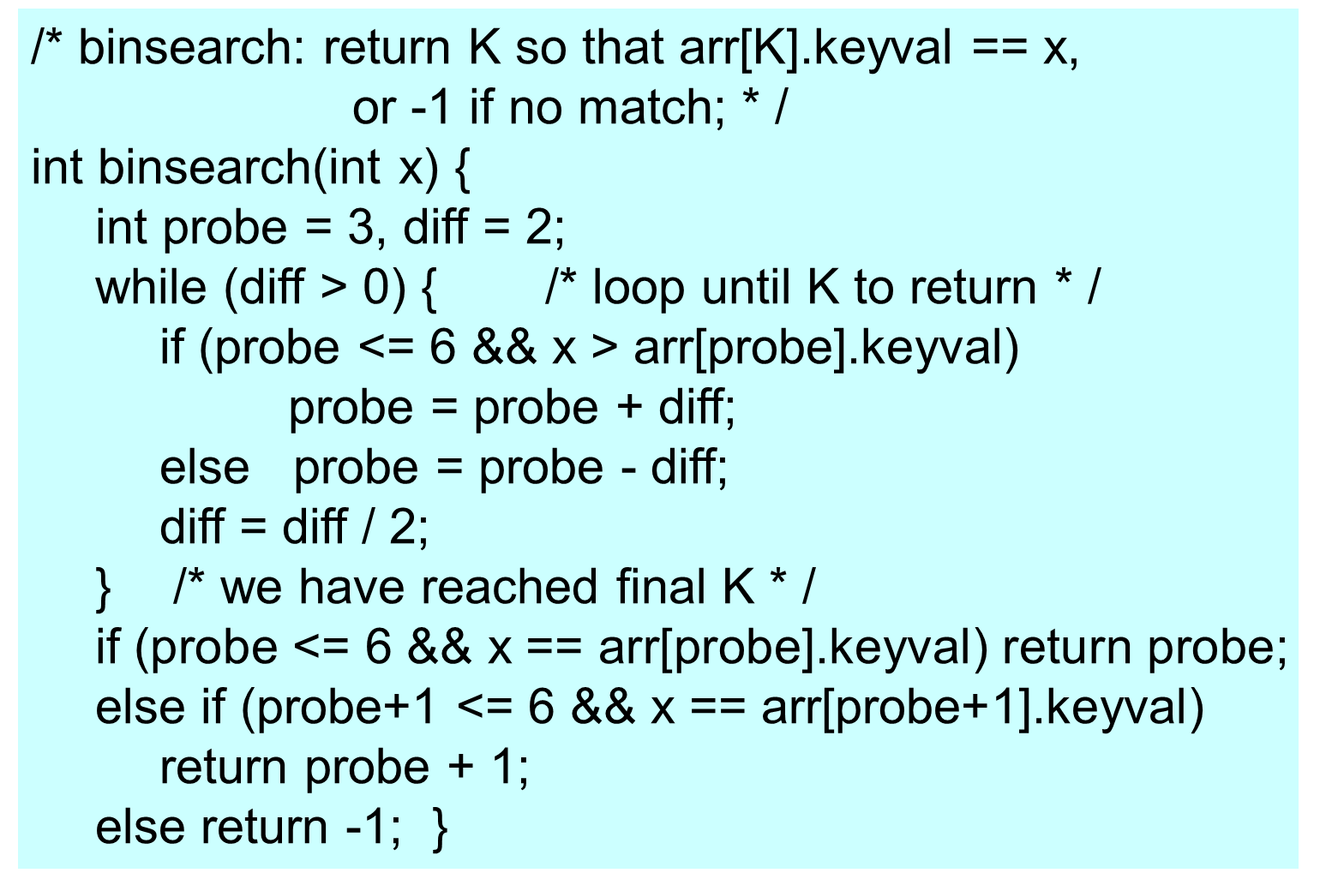
Example 8.3.1 (pg. 486) Idea of Binary Search
Indexing

Slide 25
8.3 The B-Tree Index
Exp 8.3.2 Binary of a Million Index Entries
  number of entries: 1000000 (10⁶)
  size of entry: 8 bytes
  size of disk page: 2k bytes
    number of entries in each disk page: 250
    total number of disk pages: 4000
  average number of disk I/O
    log₂4000 + 1 ≈ 13
Indexing

Slide 26
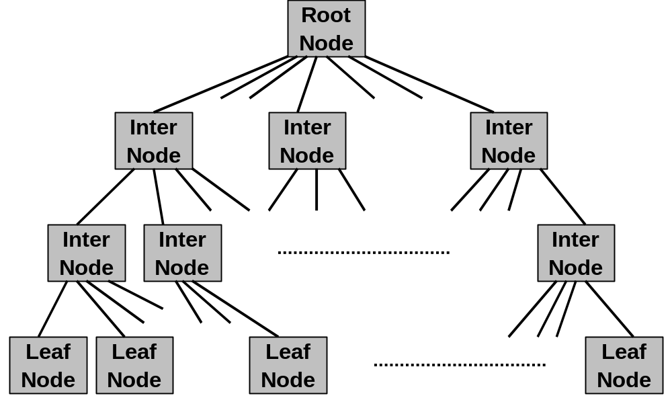
8.3 The B-Tree Index
Example 8.3.3 B-Tree Structure
  Layout all entries on leaf nodes
Level 1: Root Node
Level 2 ~ Level N-1: Directory Nodes
Level 2 ~ Level N-1: Directory Nodes
Level N:
Leaf Node
Indexing

Slide 27
8.3 The B-Tree Index
P₁
K₁
P₂
K₂
……
P_{m}
K_{m}
P_{m+1}
The Structure of B-Tree Node
  K₁,K₂,…,K_{m} are keyvalues, and K₁<K₂<…<K_{m}
  n is maximum number of keyvalue in a node
  Leaf Node: ⎣(n+1)/2⎦ ≤ m ≤ n
    P_{i} is a ROWID which keyvalue is K_{i} (i=1,2,…,m)
    P_{m+1} is a pointer to next leaf node
Indexing

Slide 28
8.3 The B-Tree Index
P₁
K₁
P₂
K₂
……
P_{m}
K_{m}
P_{m+1}
  Root Node: 1 ≤ m ≤ n
  Inter Node：⎡(n-1)/2⎤ ≤ m ≤ n
    P_{i} is a pointer to child node (root node of sub-tree T_{i})
    for each keyvalue K on sub-tree T_{i}, we have
      If i = 1: K < K₁
      If 1< i ≤ m: K_{i-1} ≤ K < K_{i}
      If i = m+1: K ≥ K_{m}
Indexing

Slide 29
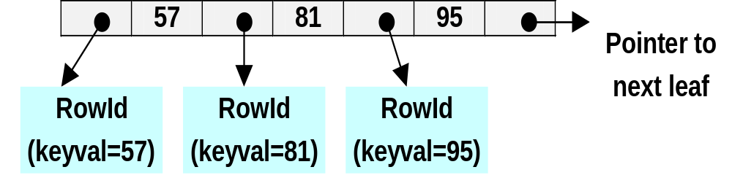
8.3 The B-Tree Index
Example: leaf node ( n= 3 )
Indexing

Slide 30
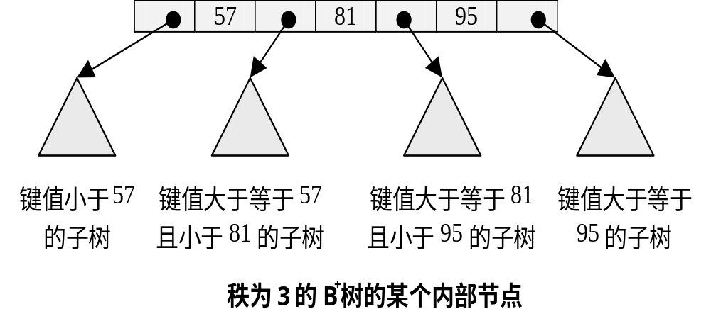
8.3 The B-Tree Index
Example: directory or root node ( n= 3 )
Indexing

Slide 31
Example 8.3.3 ( cont. )
  number of entries: 1000000 (10⁶)
  size of entry: 8 bytes
  size of disk page: 2k bytes
    number of entries in each node(disk page)
      2k / 8 ≈ 250
    total number of leaf node
      1000000 / 250 = 4000
    total number of directory node:
      4000 / 250 = 16
    root node
  average number of disk I/O
    3 (depth of the B-Tree) + 1 = 4
      (root node) + (directory node) + (leaf node)
Indexing

Slide 32
8.3 The B-Tree Index
How to create an index
  sort all entries on leaf nodes
  create directory, and directory to directory
Fanout f of B-Tree
  the maximum number of entries on a B-Tree node
Depth of B-Tree
  If total number of rows is N, then
    depth = log _{f} ( N )
Indexing

Slide 33
8.3 The B-Tree Index
Dynamic changes in the B-tree
  Figure 8.12 (pg. 491)
    Insert following key values into B-Tree ( n = 3 )
      7, 96, 41, 39, 88, 65, 55, 62
  Idea of [ PCTFREE n ]
Indexing

Slide 34
Def 8.3.1: Properties of the B-Tree (B⁺ Tree)
  Every node is disk-page sized and resides in a well-defined location on the disk.
  Nodes above the leaf level contain directory entries, with (n–1) separator keys and n disk pointers to lower-level B-tree nodes.
  Nodes at the leaf level contain entries with (keyval, ROWID) pairs pointing to individual rows indexed.
  All nodes below the root are at least half full with entry information.
    This is not often enforced after multiple deletes.
  The root node contains at least two entries (one keyvalue).
    except when only one row is indexed and the root is a leaf node.
Indexing

Slide 35
8.3 The B-Tree Index
Algorithm on B-Tree
  search
  insert
  delete
    update = delete + insert
Indexing

Slide 36
8.3 The B-Tree Index
The ORACLE Bitmap Index
  A bitmap index uses ONE bitmap for each distinct keyval.
    A bitmap takes the place of a ROWID list, specifying a set of rows.
      one bit vs a ROWID ( row )
        1: the row have the keyval
        0: the row don’t have the keyval
Example
  Figure 8.18 ( pg. 501 )
Indexing

Slide 37
8.4 Clustered and Non-Clustered Indexes
The idea of a clustered index
  The rows of the table are in the same order as the index entries — by keyvalue.
    In most database products, default placemen of rows on data pages on disk is in order by load or by insertion (heap).
      Figure 8.19 (pg. 504)
Example 8.4.1
  department store – branch stores
Indexing

Slide 38
8.5 A Hash Primary Index
Idea
  Rows in a table located in hash cluster are placed in pseudo-random data page slots using a hash function, and looked up the same way, often with only one I/O.
  Also, no order by keyvalue
    Successive keyvals are not close together, probably on entirely different pages
      depends on hash function
Indexing

Slide 39
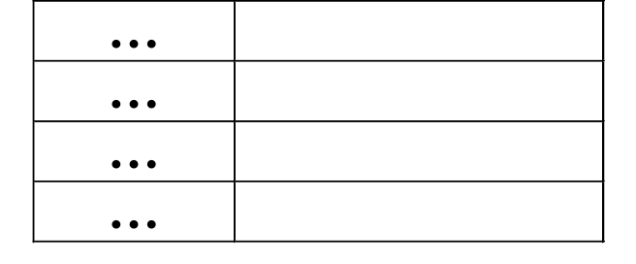
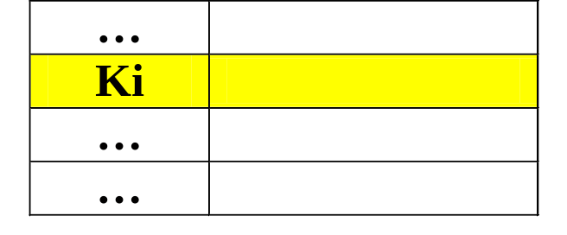
8.5 A Hash Primary Index
data file
hash(K_{i})
keyvalue
(K_{i})
……
Indexing

Slide 40
8.5 A Hash Primary Index
Tuning HASHKEYS and SIZE in a Hash Cluster
  total number of slots: S
  the number of slots on a disk block: B
    total number of disk blocks: S/B
  collision
    two distinct key values hashed to same slot.
Indexing

Slide 41
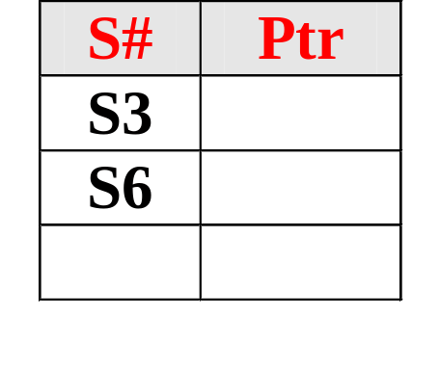
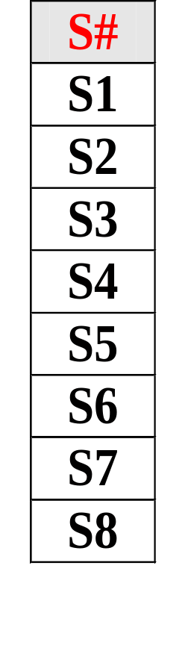
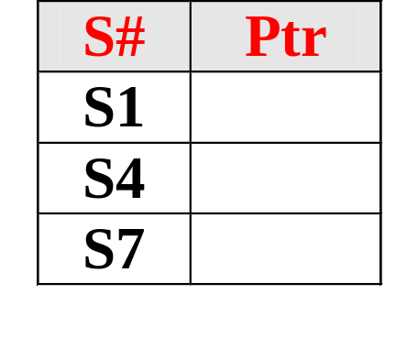
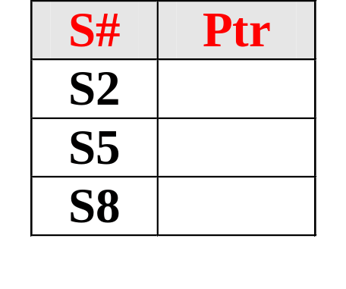
8.5 A Hash Primary Index
bucket 0
bucket 1
bucket 2
Schematic Picture of a Hash ( mod 3 )
Indexing

Slide 42

8.5 A Hash Primary Index
bucket 0
S#
SN
SD
SA
S₁
LU
CS
18
S₂
LI
CS
17
bucket 1
S₃
XU
MA
18
S₄
LO
CS
18
S₅
LI
PH
19
bucket 2
S₆
WA
CS
17
S₇
SE
MA
17
S₈
EN
PH
18
Schematic Picture of a Hash Index
Indexing

