Slide 1

WANs

Slide 2
WANs
WAN Technology & Devices
WANs & The OSI Model
WAN Accessing Methods
  PPP/HDLC
  ISDN
  ADSL
  SONET
  HFC

Slide 3
WAN Services
A WAN is the communications network that connects LANs through a WAN Service Provider
WANs operate at the first three layers of the OSI, but focus mainly on the physical and data link layers.

Slide 4
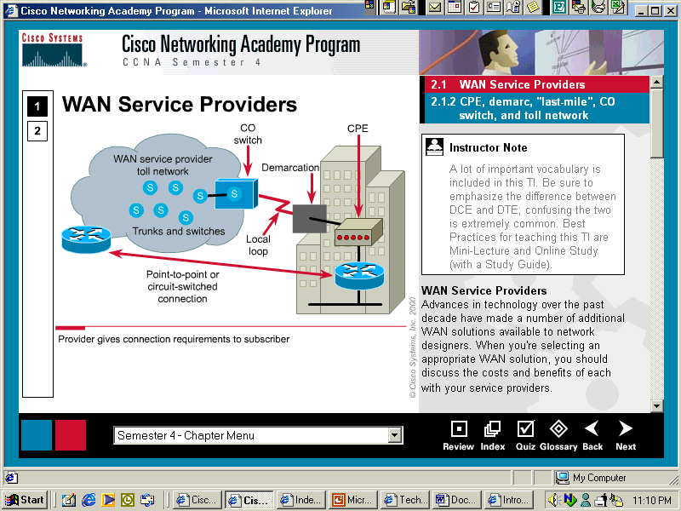

WAN Physical Structure
Toll Network – collection of switches/trunks in WAN cloud
CO Switch – nearest point of presence for the WSP’s service
CPE: Customer Premises Equipment
CO: Central Office
Local loop – extends from the CPE (at the demarc) to the CO
CPE – devices located on premises, either owned or leased

Slide 5
WAN Virtual Circuits
Switched Virtual Circuits (SVCs) are WAN paths to the destination established and terminated on demand.
  Three phases:
    Circuit establishment – creates the virtual circuit
    Data transfer – sending and receiving user data
    Circuit termination – tearing down the virtual circuit
  Telephone service and ATM use SVCs
  Increased use of bandwidth but decreased cost
Permanent Virtual Circuits (PVCs) are permanently established circuits with one mode: data transfer
  X.25 and Frame Relay use PVCs
  Decreased use of bandwidth but increased cost

Slide 6
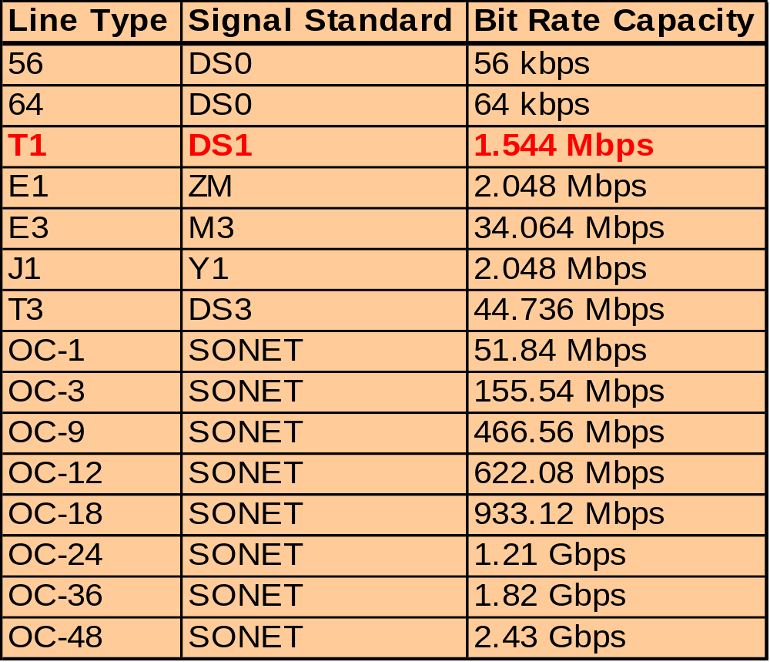
Link Types & Bandwidth

Slide 7
WAN Devices
In order to connect to a leased line, the customer must have…
  Access to the service provider’s circuit
  An appropriate router port available
  A CSU/DSU, modem, ISDN Terminal Adapter, etc.

Slide 8
Modems
Also called CSU/DSUs (channel service units/digital service units)
Interface with voice-grade connection in order to convert analog signal to digital.
Leased line
Router
CSU/DSU
CSU/DSU
Router

Slide 9
WANs
WAN Technology & Devices
WANs & The OSI Model
WAN Accessing Methods
  PPP/HDLC
  ISDN
  ADSL
  SONET
  HFC

Slide 10
WAN Standards
What layers of the OSI model do WAN standards mainly describe?
  Physical and Data Link Layers

Slide 11
WAN Physical Layer
Protocols that describe how to provide electrical, mechanical, operational, and functional connections for WAN services.
These services are most often obtained from WAN service providers, alternate carriers, post-telephone, and telegraph (PTT) agencies.
Describes the interface between the data terminal equipment (DTE) and the data circuit-terminating equipment (DCE).

Slide 12
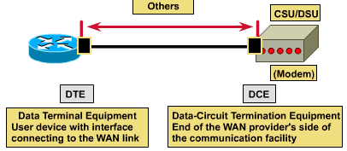
WAN Physical Layer
Typically, the DCE is the service provider and the DTE is the attached device.
In this model, the services offered to the DTE are made available through a modem or a CSU/DSU.

Slide 13
WAN Physical Layer
Several physical layer standards specifying this interface between the DTE & DCE are...
  EIA/TIA-232 (RS-232)
  EIA/TIA-449
  V.24
  V.35
  X.21
  G.703
  EIA-530

Slide 14
WAN Data-Link Layer
WAN data link protocols describe how frames are carried between systems on a single data link.
They include protocols designed to operate over dedicated point-to-point, multipoint, and multi-access switched services.
WAN standards are defined and managed by a number of recognized authorities, including the following agencies: ITU-T, ISO, IETF, & EIA

Slide 15
Data-link Encapsulations
The WAN data link layer defines how data is encapsulated for transmission to remote sites
  Point-to-Point Protocol (PPP): developed by the IETF. PPP contains a protocol field to identify the network-layer protocol
  High-Level Data Link Control (HDLC): an ISO standard, HDLC not compatible between different vendors because of the way each vendor has chosen to implement it. HDLC supports point-to-point/multipoint configurations
  Frame Relay: uses simplified encapsulation with no error correction over high-quality digital facilities.
  ISDN: a set of digital services that transmits voice and data over existing phone lines.
  Link Access Procedure, Balanced (LAPB): For packet-switched networks used to encapsulate packets at Layer 2 of the X.25 stack. Provides reliability and flow control on a point-to-point basis.

Slide 16
WANs
WAN Technology & Devices
WANs & The OSI Model
WAN Accessing Methods
  PPP/HDLC
  ISDN
  ADSL
  SONET
  HFC

Slide 17
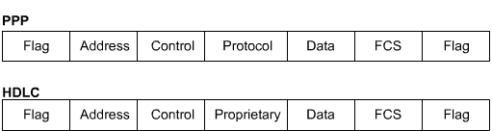
Serial line frame fields
The two most common point-to-point WAN encapsulations are HDLC and PPP
All the serial line encapsulations share a common frame format, which has the following fields
The choice of encapsulation protocol depends on the WAN technology and the communicating equipment.

Slide 18
PPP and HDLC
PPP is a standard serial-line encapsulation method
  Developed by IETF; replacing SLIP
  Contains a field to identify the network layer protocol
  PPP can check for link quality during connection establishment
  Provides authentication through Password Authentication Protocol (PAP) and Challenge Handshake Authentication Protocol (CHAP).
HDLC is Cisco's default encapsulation for serial lines
  No windowing or flow control
  A proprietary type code is inserted in the frame which means that HDLC framing is not interoperable with other vendors' equipment.
  Used when both ends of a dedicated-line connection are routers running Cisco IOS

Slide 19
PPP
The most widely used layer-2 protocol over serial links
Developed from SLIP, which
  Supports only IP protocol
  Doesn’t support dynamic IP assignment
  Doesn’t support authentication
  Doesn’t support compression
  Doesn’t support error detection
PPP offers the following features:
  Network protocol multiplexing
  Dynamic assignment of IP addresses
  Authentication: PAP, CHAP
  Compression
  Error detection

Slide 20
PPP components
Uses HDLC(ISO HDLC, not Cisco HDLC) as a basis to encapsulate layer 3 datagrams.
Implements LCP (Link Control Protocol) for:
  Connection establishment
  Connection configuration options
  Link-quality testing
Implements NCP (Network Control Protocol) to select and configure layer 3 protocol.

Slide 21
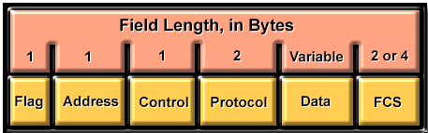
PPP frame format
Flag: Beginning or end of a frame, 01111110
Address:11111111,broadcast address
Control:00000011,user data is transferred as disorder frames
Protocol: The protocol type in data field
Data: Datagram, maximum default is 1500 bytes
FCS: Error controlling

Slide 22
PPP session establishment/ termination
To establish communications over a point-to-point link, PPP goes through four distinct phases:
  Link establishment and configuration negotiation (LCP).
  Link quality testing.
  Network layer protocol configuration (NCP).
  Link termination.

Slide 23
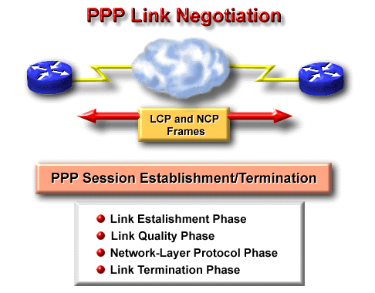
Phase 1. Link establishment

Slide 24
Phase 1. Link establishment
Link establishment is the first phase before any network-layer datagrams can be exchanged
  Each PPP device sends LCPs to open the connection
  LCP packets contain a configuration option field that allows devices to negotiate the use of options such as compression and authentication protocol, etc.
  If a configuration option is not included in an LCP packet, the default value for that configuration option is assumed.
  This phase is complete when a configuration acknowledgment frames has been sent and received.

Slide 25
Phase 2. Link quality determination
LCP packets are sent and received to measure the error rate on the link if configured to do so
Authentication, if used, takes place before the network-layer protocol configuration phase begins.
LCP can delay transmission of network-layer protocol information until this phase is completed.

Slide 26
Phase3. Network layer protocol configuration
In this phase, the PPP devices send NCP packets to choose and configure one or more network-layer protocols (such as IP).
When each of the chosen network-layer protocols has been configured, datagrams from each network-layer protocol can be sent over the link.

Slide 27
Phase4. Link termination
LCP can terminate the link at any time:
  At the user request;
  Quality of the link;
  Timeout.
When LCP closes the link, it informs the network-layer protocols so that they can take appropriate action.

Slide 28
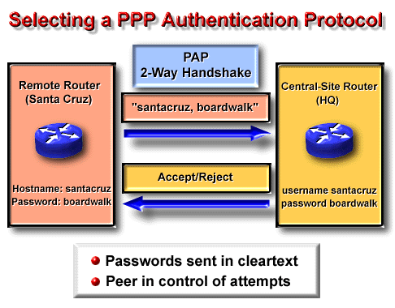
PAP

Slide 29
PAP
The calling side of the link enter authentication information to help ensure that the user has the network administrator's permission to make the call.
Remote node establishes its identity, using a two-way handshake PAP.
Username/password pair is repeatedly sent by the remote node until authentication is acknowledged or the connection is terminated
Passwords are sent across the link in clear text.
Remote node is authenticated only once after the connection establishment phase.

Slide 30
PAP
Configuration of remote router
Router(config)#hostname RTA
RTA(config)#int s0
RTA(config)#ip address 192.168.2.1 255.255.255.0
RTA(config)#encapsulation ppp
RTA(config)#ppp pap sent-username RTA password ciscoA
RTA(config)#no shut

Slide 31
PAP
Configuration of service provider router
Router(config)#hostname RTB
RTB(config)#username RTA password CiscoA
RTB(config)#int s0
RTB(config)#ip address 192.168.2.2 255.255.255.0
RTB(config)#clock rate 56000
RTB(config)#encapsulation ppp
RTB(config)#ppp authentication pap
RTB(config)#no shut

Slide 32
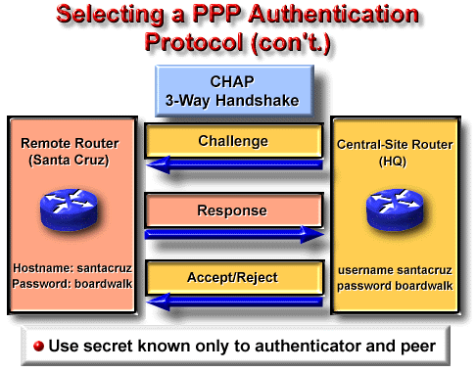
CHAP

Slide 33
CHAP
The called party periodically verifies the calling side, using a three-way handshake CHAP protocol.
CHAP does not allow a caller to attempt authentication without a challenge (random number).
The host (called party ) sends a challenge message to the remote node.
The remote node responds with a value (encrypted value including: the received challenge, its username and its password).
The host checks the response against its own value
  If the values match, the authentication is acknowledged
  Otherwise, the connection is terminated

Slide 34

CHAP: Challenging
user | pass
RTA | cisco
user | pass
RTB | cisco
User dialing
RTB
RTA
01 | id | random | RTA
01: type of challenging packet
id: identifier of the challenging packet
random: a random generated by RTA
MD5
hash

Slide 35
CHAP: Acknowledgement
user | pass
RTA | cisco
user | pass
RTB | cisco
User dialing
RTB
RTA
01 | id | random | RTA
MD5
02 | id | hash | RTB
hash

Slide 36
CHAP: Verifying Acknowledgement
user | pass
RTA | cisco
user | pass
RTB | cisco
User dialing
RTB
RTA
01 | id | random | RTA
MD5
02 | id | hash | RTB
MD5
hash
hash
=?

Slide 37
CHAP
Configuration of remote router
Router(config)#hostname RTA
RTA(config)#username RTB password CiscoA
RTA(config)#int s0
RTA(config)#ip address 192.168.2.1 255.255.255.0
RTA(config)#encapsulation ppp
RTA(config)#no shut

Slide 38
CHAP
Configuration of service provider router
Router(config)#hostname RTB
RTB(config)#username RTA password CiscoA
RTB(config)#int s0
RTB(config)#ip address 192.168.2.2 255.255.255.0
RTB(config)#clock rate 56000
RTB(config)#encapsulation ppp
RTB(config)#ppp authentication chap
RTB(config)#no shut

Slide 39
WANs
WAN Technology & Devices
WANs & The OSI Model
WAN Accessing Methods
  PPP/HDLC
  ISDN
  ADSL
  SONET
  HFC

Slide 40
What is ISDN?
Integrated Services Digital Networks allow digital signals to be transmitted over existing phone lines.
  Provides connectivity for remote sites
ISDN has the following benefits:
  Can carry voice, video, and data
  Faster call setup than modems (sometimes<1s) using the out-of-band D (or Delta) channel
  Offers faster data transfer using the B (or Barrier) channels at 64kps

Slide 41
BRI and PRI
There are two ISDN services:
  BRI (Basic Rate Interface)
  PRI (Primary Rate Interface).
The ISDN BRI service offers two B channels and one D channel.
ISDN BRI delivers a total bandwidth of a 144-kbps (2B+D=144kps) line into three separate channels.
BRI B channel service operates at 64 kbps and is meant to carry user data and voice traffic.
The third channel, the D channel, is a 16 kbps signalling channel used to carry instructions that tell the telephone network how to handle each of the B channels.

Slide 42


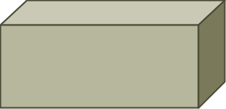
BRI and PRI
Channel
Capacity
Mostly Used for
B
64kbps
Circuit-switched data (HDLC, PPP)
D
16kbps
Signaling information (LAPD)
BRI
NT1
D
2B
Service
provider
network
PRI
CSU/DSU
D
23 or 30B
BRI and PRI are used globally for ISDN
Notes:
Purpose: The figure explains BRI and PRI.
Emphasize: Be aware of geographic variations regarding ISDN services. With PRI, for example, there are 23 B channels in the United States and Japan and 30 in Europe.
Highlight that LAPD is the data link protocol on the D channel and PPP is typically seen on the B channels.

Slide 43
ISDN Switches & SPIDs
You must know the Service Profile Identifier (SPID) your ISP is using to identify you and configure your line.
SPIDs are 14 digits and can actually be a phone number plus a 4 digit trailer.
  For example:
    Phone Number: (510) 555-1234
    SPID: 51055512340001

Slide 44
Standard
ISDN utilizes a suite of ITU-T standards spanning the physical, data-link, and network layers of the OSI reference model.
Several encapsulation choices are available. The two most common encapsulations are PPP and HDLC.
ISDN defaults to HDLC. However, PPP is much more robust because it provides an excellent mechanism for authentication and negotiation of compatible link and protocol configuration.
ISDN interfaces allow only a single encapsulation type.

Slide 45
DDR
ISDN LAN routers provide routing between ISDN BRI and the LAN by using dial-on-demand routing (DDR).
DDR automatically establishes and releases circuit-switched calls, providing transparent connectivity to remote sites based on networking traffic.
DDR also controls establishment and release of secondary B channels based on load thresholds.

Slide 46



DDR
Corporate
Dallas
PSTN
Chicago
ISDN
I need to send
data to Dallas.
Connect when needed
Disconnect when finished
ISDN or PSTN
Notes:
Purpose: This figure introduces students to DDR.
Emphasize: Explain that DDR is used to refer to a collection of dialup features.

Slide 47
WANs
WAN Technology & Devices
WANs & The OSI Model
WAN Accessing Methods
  PPP/HDLC
  ISDN
  ADSL
  SONET
  HFC

Slide 48
xDSL技术
xDSL 技术就是用数字技术对现有的模拟电话用户线进行改造，使它能够承载宽带业务
虽然标准模拟电话信号的频带限制在 300~3400kHz 范围内，但用户线本身实际可通过的信号频率仍超过 1 MHz
xDSL 技术把 0~4 kHz 低端频谱留给传统电话使用，而把原来没有被利用的高端频谱留给用户上网使用
DSL ：数字用户线(Digital Subscriber Line)
DSL 的前缀 x 表示在数字用户线上实现的不同宽带方案

Slide 49
xDSL 的几种类型
ADSL (Asymmetric Digital Subscriber Line)：非对称数字用户线
HDSL (High speed DSL)：高速数字用户线
SDSL (Single-line DSL)：1 对线的数字用户线
VDSL (Very high speed DSL)：甚高速数字用户线
IDSL ：ISDN 用户线
RADSL (Rate-Adaptive DSL)：速率自适应 DSL，是 ADSL 的一个子集，可自动调节线路速率

Slide 50
ADSL 的极限传输距离
ADSL 的极限传输距离与数据率以及用户线的线径都有很大的关系（用户线越细，信号传输时的衰减就越大），而所能得到的最高数据传输速率与实际的用户线上的信噪比密切相关。
例如，0.5 毫米线径的用户线，传输速率为 1.5 ~ 2.0 Mb/s 时可传送 5.5 公里，但当传输速率提高到 6.1 Mb/s 时，传输距离就缩短为 3.7 公里。
如果把用户线的线径减小到0.4毫米，那么在6.1 Mb/s的传输速率下就只能传送2.7公里

Slide 51
ADSL 的特点
上行和下行带宽不对称
  上行指从用户到 ISP，而下行指从 ISP 到用户
ADSL 在用户线（铜线）的两端各安装一个 ADSL 调制解调器。
我国目前采用的方案是离散多音调 DMT (Discrete Multi-Tone)调制技术。这里的“多音调”就是“多载波”或“多子信道”的意思。

Slide 52
DMT 技术
DMT 调制技术采用频分复用的方法，把 40 kHz 以上一直到 1.1 MHz 的高端频谱划分为许多的子信道，其中 25 个子信道用于上行信道，而 249 个子信道用于下行信道。
每个子信道占据 4 kHz 带宽（严格讲是 4.3125 kHz），并使用不同的载波（即不同的音调）进行数字调制。这种做法相当于在一对用户线上使用许多小的调制解调器并行地传送数据。

Slide 53
DMT 技术的频谱分布
频谱
上行信道
下行信道
传统电话
…
…
频率
(kHz)
0
4
~40
~138
~1100

Slide 54
ADSL 的数据率
由于用户线的具体条件往往相差很大（距离、线径、受到相邻用户线的干扰程度等都不同），因此 ADSL 采用自适应调制技术使用户线能够传送尽可能高的数据率。
当 ADSL 启动时，用户线两端的 ADSL 调制解调器就测试可用的频率、各子信道受到的干扰情况，以及在每一个频率上测试信号的传输质量。
ADSL 不能保证固定的数据率。对于质量很差的用户线甚至无法开通 ADSL。
通常下行数据率在 32 kb/s 到 6.4 Mb/s 之间，而上行数据率在 32 kb/s 到 640 kb/s 之间。

Slide 55





至 ISP
基于 ADSL 的接入网
端局或远端站
电话
分离器
PS
ATU-C
用户线
PS
ATU-C
ATU-R
区域宽带网
ATU-C
居民家庭
DSLAM
至本地电话局
数字用户线接入复用器 DSLAM (DSL Access Multiplexer)
接入端接单元 ATU (Access Termination Unit)
ATU-C（C 代表端局 Central Office）
ATU-R（R 代表远端 Remote）
电话分离器 PS (POTS Splitter)

Slide 56
第二代 ADSL
ADSL2（G.992.3 和 G.992.4）
ADSL2+（G.992.5）
通过提高调制效率得到了更高的数据率。例如，ADSL2 要求至少应支持下行 8 Mb/s、上行 800 kb/s的速率。而 ADSL2+ 则将频谱范围从 1.1 MHz 扩展至2.2 MHz，下行速率可达 16 Mb/s（最大传输速率可达25 Mb/s），而上行速率可达 800 kb/s。
采用了无缝速率自适应技术 SRA (Seamless Rate Adaptation)，可在运营中不中断通信和不产生误码的情况下，自适应地调整数据率。
改善了线路质量评测和故障定位功能，这对提高网络的运行维护水平具有非常重要的意义。

Slide 57
WANs
WAN Technology & Devices
WANs & The OSI Model
WAN Accessing Methods
  PPP/HDLC
  ISDN
  ADSL
  SONET
  HFC

Slide 58
同步光纤网SONET和同步数字系列SDH
旧的数字传输系统存在着许多缺点。其中最主要的是以下两个方面：
速率标准不统一。
  如果不对高次群的数字传输速率进行标准化，国际范围的高速数据传输就很难实现。
不是同步传输。
  在过去相当长的时间，为了节约经费，各国的数字网主要是采用准同步方式。

Slide 59
同步光纤网 SONET
同步光纤网 SONET (Synchronous Optical Network) 的各级时钟都来自一个非常精确的主时钟（铯原子钟，精度优于10⁻¹¹秒）
第 1 级同步传送信号 STS-1 (Synchronous Transport Signal)的传输速率是 51.84 Mb/s。
光信号则称为第 1 级光载波 OC-1，OC 表示Optical Carrier。

Slide 60
同步数字系列 SDH
ITU-T 以美国标准 SONET 为基础，制订出国际标准同步数字系列 SDH (Synchronous Digital Hierarchy)。
一般可认为 SDH 与 SONET 是同义词。
SDH 的基本速率为 155.52 Mb/s，称为第 1 级同步传递模块 (Synchronous Transfer Module)，即 STM-1，相当于 SONET 体系中的 OC-3 速率。

Slide 61
SONET 的 OC 级/STS 级与 SDH 的 STM 级的对应关系
线路速率 (Mb/s) | SONET 符号 | ITU-T 符号 | 表示线路速率 的常用近似值
51.840 | OC-1/STS-1 | ⎯
155.520 | OC-3/STS-3 | STM-1 | 155 Mb/s
466.560 | OC-9/STS-9 | STM-3
622.080 | OC-12/STS-12 | STM-4 | 622 Mb/s
933.120 | OC-18/STS-18 | STM-6
1244.160 | OC-24/STS-24 | STM-8
2488.320 | OC-48/STS-48 | STM-16 | 2.5 Gb/s
4976.640 | OC-96/STS-96 | STM-32
9953.280 | OC-192/STS-192 | STM-64 | 10 Gb/s
39813.120 | OC-768/STS-768 | STM-256 | 40 Gb/s

Slide 62
SONET 的体系结构
SDH
终端
SDH
终端
复用器
或
分用器
复用器
或
分用器
转发器
转发器
段
段
段
(section)
(section)
(section)
线路 (line)
路径 (path)
路径层
路径层
线路层
线路层
线路层
线路层
段层
段层
段层
段层
段层
段层
光子层
光子层
光子层
光子层
光子层
光子层

Slide 63
SONET 标准的四个光接口层
光子层(Photonic Layer)
  处理跨越光缆的比特传送。
段层(Section Layer)
  在光缆上传送 STS-N 帧。
线路层(Line Layer)
  负责路径层的同步和复用。
路径层(Path Layer)
  处理路径端接设备 PTE (Path Terminating Element)之间的业务的传输。

Slide 64
WANs
WAN Technology & Devices
WANs & The OSI Model
WAN Accessing Methods
  PPP/HDLC
  ISDN
  ADSL
  SONET
  HFC

Slide 65
光纤同轴混合网
HFC (Hybrid Fiber Coax)
HFC 网是在目前覆盖面很广的有线电视网 CATV 的基础上开发的一种居民宽带接入网。
HFC 网除可传送 CATV 外，还提供电话、数据和其他宽带交互型业务。
现有的 CATV 网是树形拓扑结构的同轴电缆网络，它采用模拟技术的频分复用对电视节目进行单向传输。而 HFC 网则需要对 CATV 网进行改造，

Slide 66
HFC 的主要特点
HFC网的主干线路采用光纤
  HFC 网将原 CATV 网中的同轴电缆主干部分改换为光纤，并使用模拟光纤技术。
  在模拟光纤中采用光的振幅调制 AM，这比使用数字光纤更为经济。
  模拟光纤从头端连接到光纤结点(fiber node)，即光分配结点 ODN (Optical Distribution Node)。在光纤结点光信号被转换为电信号。在光纤结点以下就是同轴电缆。

Slide 67
HFC 网采用结点体系结构
HFC 的主要特点
放大器
光纤结点
模拟光纤
头端
服务区
服务区
同轴电缆
分路器
引入线
服务区

Slide 68
HFC 的主要特点
具有比 CATV 网更宽的频谱，且具有双向传输功能
下行信道
上行
信道
原有模拟电视
数字信号
保留
频率(MHz)
5 40 50 550 750 1000

Slide 69
用户接口盒UIB (User Interface Box)
每个家庭要安装一个用户接口盒
用户接口盒 要提供三种连接，即：
  使用同轴电缆连接到机顶盒(set-top box)，然后再连接到用户的电视机。
  使用双绞线连接到用户的电话机。
  使用电缆调制解调器连接到用户的计算机。

Slide 70
电缆调制解调器(Cable Modem)
电缆调制解调器是为 HFC 网而使用的调制解调器。
电缆调制解调器最大的特点就是传输速率高。其下行速率一般在 3∼10 Mb/s之间，最高可达 30 Mb/s，而上行速率一般为 0.2∼2 Mb/s，最高可达 10 Mb/s。
电缆调制解调器比在普通电话线上使用的调制解调器要复杂得多，并且不是成对使用，而是只安装在用户端。

Slide 71
HFC 网的最大优点
具有很宽的频带，并且能够利用已经有相当大的覆盖面的有线电视网。
要将现有的 450 MHz 单向传输的有线电视网络改造为 750 MHz 双向传输的 HFC 网（还要将所有的用户服务区互连起来而不是一个个 HFC 网的孤岛），也需要相当的资金和时间。
在电信政策方面也有一些需要协调解决的问题。

Slide 72
FTTx 技术
FTTx（光纤到……）也是一种实现宽带居民接入网的方案。这里字母 x 可代表不同意思。
  光纤到家 FTTH (Fiber To The Home)：光纤一直铺设到用户家庭可能是居民接入网最后的解决方法。
  光纤到大楼 FTTB (Fiber To The Building)：光纤进入大楼后就转换为电信号，然后用电缆或双绞线分配到各用户。
  光纤到路边 FTTC (Fiber To The Curb)：从路边到各用户可使用星形结构双绞线作为传输媒体。

Slide 73




