Slide 1

OSI Layer 2:
Data Link Layer

Slide 2
Layer2: Data Link Layer
Overview of the Data Link Layer
Ethernet and CSMA/CD
  LLC and MAC Sub-layers
  Media Access Control in MAC Sub-layer
  Flow Control in LLC Sub-layer
  Development of Ethernet
Wireless LAN and CSMA/CA
Layer 2 Devices

Slide 3
Data Link Layer
Problem:How to transfer data correctly on a instable link?
The DATA LINK LAYER provides:
  Access to the networking media
  Physical transmission across the media
Layer 2 protocols (procedures) define:
  The format of data exchanged on a link
  The action of the two nodes on the link
In Data Link Layer, ‘procedure’ = ‘protocol’
Node
Node
frame
frame
  Node：Host and router in the network
  Link：The channel connects the adjacent nodes

Slide 4
LANS and the Data Link Layer
Main tasks:
  Error notification
  Network topology
  Flow control
Differences between Layer 1 and Layer 2:
  Layer 1 cannot communicate with the upper-level layers; Layer 2 does that with Logical Link Control (LLC).
  Layer 1 cannot decide which host will transmit or receive binary data from a group;
  Layer 2 does that with Media Access Control (MAC)
  Layer 1 cannot name or identify computers;
  Layer 2 uses an addressing (or naming) process.
  Layer 1 can only describe streams of bits;
  Layer 2 uses framing to organize or group the bits.
Notes:
识别上层协议
不知道是不是发给自己的
识别地址
数据结构

Slide 5
Services provided by Layer 2
Three services provided to the network layer (by LLC)
  Connectionless service with no acknowledgement, used on:
    Reliable links (upper layers to ensure the data correctness)
    Real-time tasks
    Most of LANs
  Connectionless service with acknowledgements: unreliable link, such as the wireless network
  Connection service with acknowledgements
Notes:
Connection service 通信之前先a发东西：我要通信，b再应答，才建立通信（像是打电话）
。。connectionless 不管对方是否存在，直接把东西发过去（像发邮件，可能石沉大海）
Less又分为以下两种
With acknowledgements 每次发东西只有受到应答才进行下一步，保证传输可靠性
Without 直接发送，不管是否应答，一直继续下去
共分成三种
以太网就是第一种，因为悠闲线路认为非常可靠，默认都能收到，好处是传输效率最高
无线一般第二种 connectionless 使带宽降低了一倍（因为要等待应答） 所以距离越远信号越差。。
蓝牙通信第三种，因为先配对

Slide 6
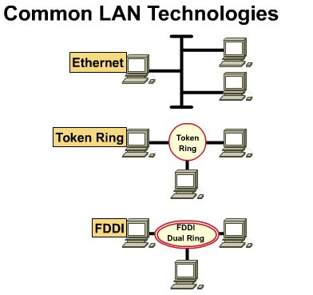
Media Access Control in Common LANs
Ethernet - logical bus topology (information flow is on a linear bus) and physical star or extended star (wired as a star)
Token Ring - logical ring topology (information flow is in a ring) and a physical star topology (wired as a star)
FDDI - logical ring topology (information flow is in a ring) and physical dual-ring topology (wired as a dual-ring)
Notes:
令牌环 双环
先规定数据传输的方向 顺时针或者逆时针 同一时刻要确定在一个令牌环上传输的设备是确定的一个设备
第一种不确定

Slide 7
Access Methods for Media-Access Control
Two broad categories:
  Deterministic—taking turns
    Token Ring and FDDI
  Non-deterministic (probabilistic)—first come, first served
    Ethernet/802.3

Slide 8
Deterministic MAC Protocols
A special data token circulates the ring.
When a host receives the token, it can transmit data instead of the token. This is called seizing the token.
When the transmitted frame comes back around to the transmitter, the station transmits a new token; the frame is removed or stripped from the ring.

Slide 9
Non-Deterministic MAC Protocols
This MAC protocol is called Carrier Sense Multiple Access with Collision Detection (CSMA/CD)
To use this shared-medium technology, Ethernet allows the networking devices to arbitrate for the right to transmit.

Slide 10
LAN Transmission Methods
LAN data transmissions fall into 3 classifications:
unicast--a single packet is sent from the source to a single destination on a network
multicast--consists of a single data packet that is sent to a specific subset of nodes on the network.
broadcast--consists of a single data packet that is transmitted to all nodes on the network.

Slide 11
Layer2: Data Link Layer
Overview of the Data Link Layer
Ethernet and CSMA/CD
  LLC and MAC Sub-layers
  Media Access Control in MAC Sub-layer
  Flow Control in LLC Sub-layer
  Development of Ethernet
Wireless LAN and CSMA/CA
Layer 2 Devices

Slide 12
LAN Standards
Define the physical media and the connectors used to connect devices to media
Define the way devices communicate at the DATA LINK LAYER
The DATA LINK LAYER defines how data is transported over a physical media.
The DATA LINK LAYER also defines how to encapsulate protocol-specific traffic in such a way that traffic going to different upper-layer protocols can use the same channel as it goes up the stack.

Slide 13
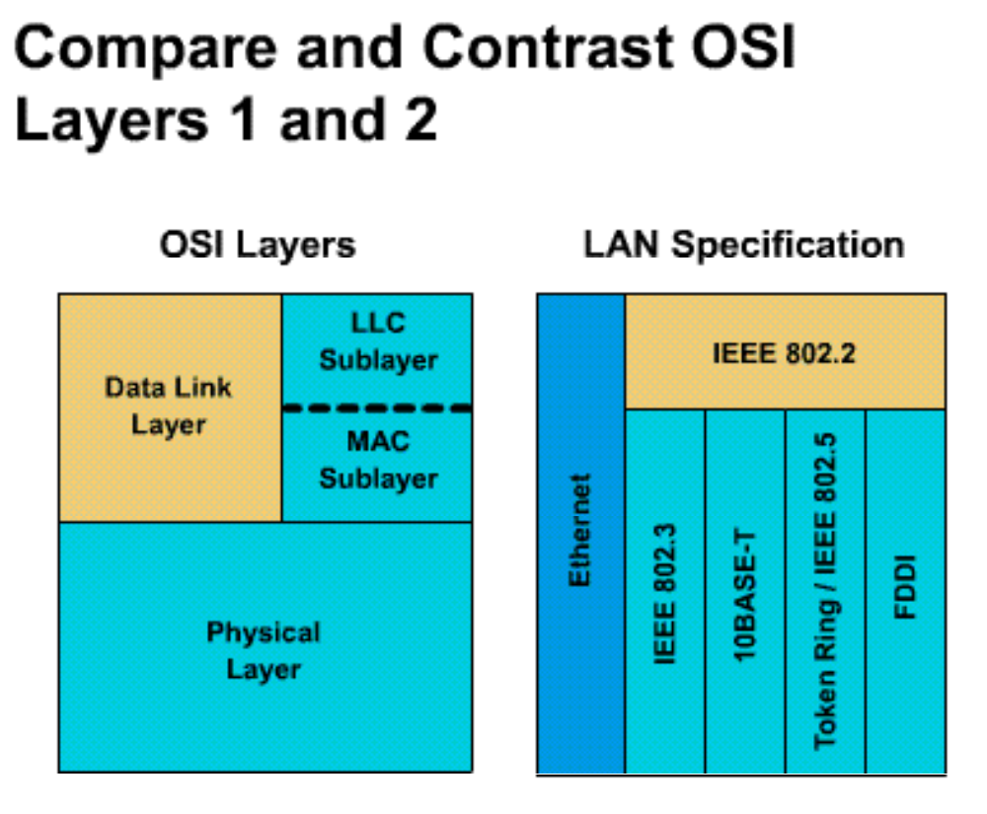
LAN Standards
Data link layer is broken into two parts by IEEE :
  Media Access Control (MAC) (transitions down to media)
  Logical Link Control (LLC) (transitions up to the network layer)

Slide 14
LAN Standards
The IEEE standard appears, at first glance, to violate the OSI model in two ways.
  First, it defines its own layer (LLC), including its interfaces, etc.
  Second, it appears that the MAC layer standards, 802.3 and 802.5, cross over the Layer 2/Layer 1 interface.
However, 802.3 and 802.5 define the naming, framing, and Media Access Control rules around which specific technologies were built.

Slide 15
LAN Standards
MAC sublayer (802.3)
  Defines how to transmit frames on the physical wire
  Handles physical addressing
  Define network topology
  Define line discipline.
LLC sublayer (802.2)
  logically identifies different protocol types and then encapsulates them.
  Use SAP identifier to perform the logical identification
  The type of LLC frame depends on what identifier the upper layer protocol expects.

Slide 16
Media Access Control Sublayer
# of bytes 8 6 6 2 Variable 4
Preamble
Dest. add.
Source add.
Length
Data
FCS
Ethernet II uses “Type” here and does not use 802.2
0000.0C XX.XXXX
MAC Layer 802.3
IEEE assigned Vendor assigned
MAC address

Slide 17
MAC Sub-layer: Fields in a Frame
Begin with an alternating pattern of 1s and 0s called a preamble. (10101011)
The preamble tells receiving stations that a frame is coming.
# of bytes 8 6 6 2 Variable 4
Preamble
Dest. add.
Source add.
Length
Data
FCS
Ethernet II uses “Type” here and does not use 802.2
0000.0C XX.XXXX
IEEE assigned Vendor assigned

Slide 18
MAC Sub-layer: Fields in a Frame
Destination and source physical address fields
  source address: always a unicast address
  destination address: unicast, multicast, or broadcast.
# of bytes 8 6 6 2 Variable 4
Preamble
Dest. add.
Source add.
Length
Data
FCS
Ethernet II uses “Type” here and does not use 802.2
0000.0C XX.XXXX
IEEE assigned Vendor assigned

Slide 19
MAC Sub-layer: Fields in a Frame
length field indicates the number of bytes of data that follow this field and precede the frame check sequence field.
The data field contains the information you want to send.
# of bytes 8 6 6 2 Variable 4
Preamble
Dest. add.
Source add.
Length
Data
FCS
Ethernet II uses “Type” here and does not use 802.2
0000.0C XX.XXXX
IEEE assigned Vendor assigned
Notes:
重点!!
Length实际上没用 后来改成type的信息
保证兼容: 小的就是type 大的就是length

Slide 20
MAC Sub-layer: Fields in a Frame
FCS field (four bytes) contains a cyclic redundancy check value
  The sending device creates the CRC
  The receiving device recalculates the CRC to check for damage that might have occurred to the frame in transit.
# of bytes 8 6 6 2 Variable 4
Preamble
Dest. add.
Source add.
Length
Data
FCS
Ethernet II uses “Type” here and does not use 802.2
0000.0C XX.XXXX
IEEE assigned Vendor assigned
Notes:
循环冗余校验 看教材
发送方和接收方约定一个很长的数字,结果储存余数如果比对一样的话就认为对了
但是不能保证一定可以发现错误,因为可能负负得正刚好余数相同
如果真的错了上层协议即第四层协议还会有校验

Slide 21
Logical Link Control Sublayer
The Logical Link Control (LLC) sublayer manages communication between devices over a single link
LLC is defined in the IEEE 802.2 specification and supports both connectionless and connect-oriented services.
LLC sublayer allows part of the DATA LINK LAYER to function independently from existing technologies.
  A single LLC sub-layer can be compatible with different MAC sub-layers.
Notes:
把lc的额外信息去掉
第二层大概知道上层是什么机制
Lc可以和不同的mac介质访问控制 指针配对

Slide 22
LLC Sub-layer: Encapsulation
Network Layer
Packet
LLC
LLC | Packet
Data Link
Layer
MAC
MAC | LLC | Packet | MAC
Physical Layer
Media
(a) Position of LLC (b) Encapsulation
Notes:
Llc比mac更加高级
封装的时候llc封装在data部分
Data首部会有一部分写llc的信息
Llc为上层服务提供接口,有下层的支持

Slide 23
LLC Sub-layer: Encapsulation
The LLC takes the network protocol data (packet), and adds more control information to help deliver the packet to its destination.
It adds two addressing components of the 802.2 specification to identify the upper layer protocol at each end :
  The Destination Service Access Point (DSAP)
  The Source Service Access Point (SSAP)
This repackaged data then travels to the MAC for further encapsulation of the data.
Notes:
基于第二层的通讯
协调上层协议ok了再展开通讯
这个了解就行
一般以太网没有这个概念的
不重要这里

Slide 24
Layer2: Data Link Layer
Overview of the Data Link Layer
Ethernet and CSMA/CD
  LLC and MAC Sub-layers
  Media Access Control in MAC Sub-layer
  Flow Control in LLC Sub-layer
  Development of Ethernet
Wireless LAN and CSMA/CA
Layer 2 Devices

Slide 25
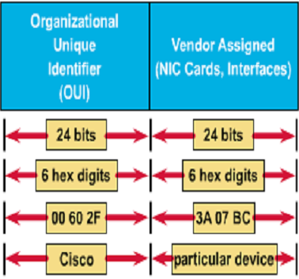
Hexadecimal Numbers as MAC Addresses
MAC addresses are 48 bits and are always expressed as 12 hexadecimal digits.
The first 6 hexadecimal digits (from left to right), which the IEEE administers, identify the manufacturer or vendor and comprise the Organizational Unique Identifier (OUI).
The remaining 6 hex digits comprise the interface serial number, administered by specific vendor.
0000.0c12.3456 or 00-00-0c-12-34-56
Notes:
一般用十六进制数字表示mac
一个编号能支持2^24个设备
可以几个厂商合买,用不掉的话,分段分着用
唯一标示
全球的网络设备都有唯一的网络地址
最高位和第二位有些特殊的含义,了解 ipconfig 网络所有的配置信息

Slide 26
Ethernet 802.3 Broadcast
Broadcast
  The destination MAC: all 1s (FFFF.FFFF.FFFF)
Broadcasting can seriously affect the performance of stations by interrupting them unnecessarily
So broadcasts should be used only when:
  The MAC address of the destination is unknown
  The destination is all hosts
Notes:
Dhcp server自动分配IP地址,向局域网内发送广播,server收到信息后,分配给我ip,我拿到之后向外广播我的mac和ip信息,如果ip重复之后可以警告地址冲突,然后人为再处理
Ipv6中淡化了广播这个东西

Slide 27
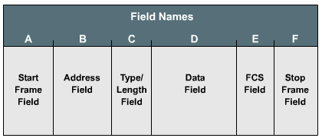
Framing
Framing is the Layer 2 encapsulation process.
A frame is a Layer 2 protocol data unit (PDU).
A frame has sections called fields, and each field is composed of bytes.
  frame start field
  address field
  length/type/control field
  data field
  frame check sequence field
  frame stop field
Notes:
Pdu 每层有每层的数据单元
由一块一块的区域组成,每个区域有特殊的含义

Slide 28
Ethernet Media Access Control
——CSMA/CD: History
Ethernet /IEEE 802.3 MAC mechanism: CSMA/CD.
CSMA/CD stems from ALOHA
In 1970s, Norman Abramson designed ALOHA
Pure ALOHA:
  Hosts always can send the data if they want:
    If the signals collided, back off appropriate amount of time and resend
Slotted ALOHA:
  Hosts always can send the data if they want, but they must wait for a new slot :
    If the signals collided, back off appropriate amount of time and resend

Slide 29
Ethernet Media Access Control
——CSMA/CD: History
Question: Why don’t we listen to the channel first to make sure that the channel is free?
  That is CSMA(Carrier Sense Multiple Access)
1-persist CSMA :
  Hosts always can send the data (have the probability of 1) if they find the channel is free; if the channel is busy,they will listen to the channel and wait :
    If the signals collided, back off appropriate amount of time and resend
Notes:
1-发现为空立即传输 persist- 如果正在忙就死等
还是有冲突的可能

Slide 30
Ethernet Media Access Control
——CSMA/CD: History
non-persist CSMA :
  Hosts always can send the data (have the probability of 1) if they find the channel is free. if the channel is busy, they will wait for a while to listen to the channel again :
    If the signals collided, back off appropriate amount of time and resend
p-persist CSMA(working on slotted channel) :
  If the hosts find the channel is free, they will send the data in this slot at a probability of p, or propone the sending operation to the next slot at a probability of 1-p; if the channel is busy, they will wait until the next slot:
    If the signals collided, back off appropriate amount of time and resend
Notes:
类似于轮询
概率p,类比上页第一种类型

Slide 31
Ethernet Media Access Control
——CSMA/CD
Another improvement of ALOHA: Listen to the channel while transmitting data. If a collision detected, all transmissions will be cancelled at once
CSMA/CD(Carrier Sense Multiple Access)
  Use CSMA mechanism to judge if the host should send the data
  In the transmitting process, listen to the channel at the same time
    When a collision detected, broadcast the jam signal
    Back off algorithms determine when the colliding stations can retransmit.
Notes:
Jam signal 全是111111短字符 因为比较短 所以可以很快传遍整个网络
别的设备知道之后就等一会再侦听

Slide 32
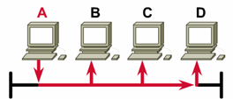
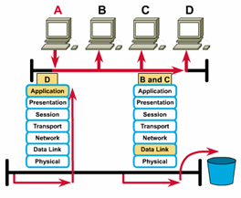
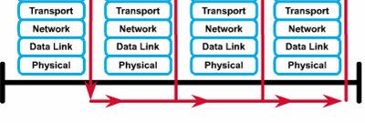
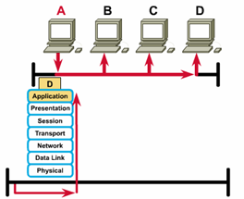
Ethernet Operation
1
3
4
2
Ethernet is broadcast network—that is, each station can see all the frames, regardless of whether they are the destination
Whether a station is the destination is judged by MAC address
Destination station sends data up OSI layers. Other nodes discard frame
Notes:
直连局域网
Bc在收到后在第二层就丢弃了
D发现mac地址是匹配的,再一层一层往上送
电信号广播链路机制
如果中间有一个交换机或者路由器就不是这样的场景了

Slide 33
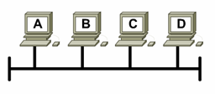
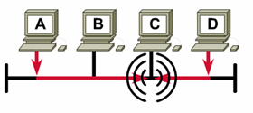
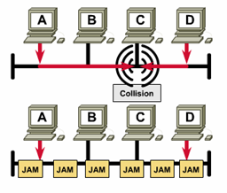
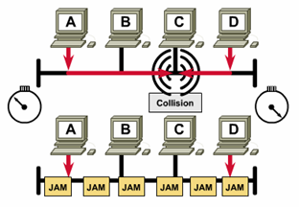
Ethernet Operation
1
Listen then transmit
Broadcast jam signal
Collision occurs
Devices back off appropriate amount of time and then retransmit
2
3
4
Notes:
出现冲突后怎么办
一边发送一边听
如果发现电信号是自己发送的就知道有冲突了
所哟节点都会收到冲突信号
回退算法 设定一个等待时间 回退算法 使时间尽可能不一致 从而避免下一次冲突 时间过去之后再动

Slide 34
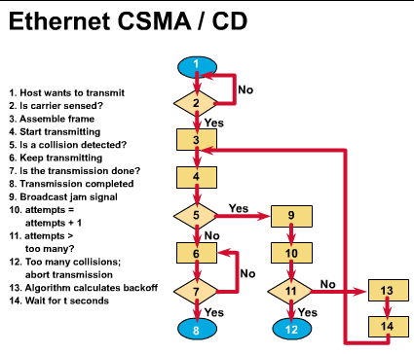
Notes:
1有没有数据传输
2看线路是否忙
3组成帧
第五步发生冲突
为尝试次数记录,如果太多次的话 就放弃 认为网络不可用
54321规则 如果设备过多会有反复冲突,尝试次数太多,网卡会把传输断掉,必须人为手工解决
回退一段时间13,此时认为所有设备都已经回退了
回退时间机制,为什么以太网是46bytes的数据
这会使 最小64个字节 双绞线 100m
发送64个字节的话,可以保证整条路线上来回, 判断是否被独自占用
51.2ns
10m百m适用
千兆还是保留了,为了兼容性

Slide 35
Layer2: Data Link Layer
Overview of the Data Link Layer
Ethernet and CSMA/CD
  LLC and MAC Sub-layers
  Media Access Control in MAC Sub-layer
  Flow Control in LLC Sub-layer
  Development of Ethernet
Wireless LAN and CSMA/CA
Layer 2 Devices
Notes:
CSMA/CD carrier sense multiple access / collision detection 载波监听多点接入/冲突检测
LLC logical link contral数据链路控制

Slide 36
Flow Control in LLC Sub-layer
An Unrestricted Simplex Protocol
工作在理想情况，基于几个假设：
  单工传输
  发送方无休止工作（要发送的信息无限多）
  接收方无休止工作（缓冲区无限大）
  通信线路（信道）不损坏或丢失信息帧
工作过程
  发送程序：取数据，构成帧，发送帧；
  接收程序：等待，接收帧，送数据给高层
Notes:
LLC logical link contral数据链路控制

Slide 37
Flow Control in LLC Sub-layer
A Simplex Stop-and-Wait Protocol
增加约束条件：接收方不能无休止接收。
解决办法：接收方每收到一个帧，给发送方回送一个响应。
工作过程
  发送程序：取数据，成帧，发送帧，等待响应帧；
  接收程序：等待，接收帧，送数据给高层，回送响应帧

Slide 38
Flow Control in LLC Sub-layer
A Simplex Protocol for a Noisy Channel
增加约束条件：信道有差错，信息帧可能损坏或丢失
解决办法：出错重传
带来的问题：
  什么时候重传 —— 定时
  响应帧损坏怎么办（重复帧）—— 发送帧头中放入序号
  为了使帧头精简，序号取多少位 —— 1位
发方在发下一个帧之前等待一个肯定确认的协议叫做PAR(Positive Acknowledgement with Retransmission)或ARQ(Automatic Repeat reQuest)
注意:由于确认帧中没有序号，超时时间不能太短，否则协议失败。因此假设协议的发送和接收严格交替进行

Slide 39
Flow Control in LLC Sub-layer
滑动窗口协议（Sliding Window Protocol）：
  发送的信息帧都有一个序号(0 ~ 2^{n} – 1)
  发送端保持一个已发送但尚未确认的帧的序号表，称为发送窗口
    上界：要发送的下一个帧的序号
    下界：未得到确认的帧的最小编号
    发送窗口大小 = 上界 - 下界，大小可变
    发送端每发送一个帧，序号取上界值，上界加1
    每接收到一个正确响应帧，下界加1；
  接收端有一个接收窗口，大小固定，但不一定与发送窗口相同
    上界：允许接收的序号最大的帧
    下界：希望接收的帧
    接收窗口容纳允许接收的信息帧，落在窗口外的帧均被丢弃
    序号等于下界的帧被正确接收，并产生一个响应帧，上界、下界都加1。接收窗口大小不变。

Slide 40
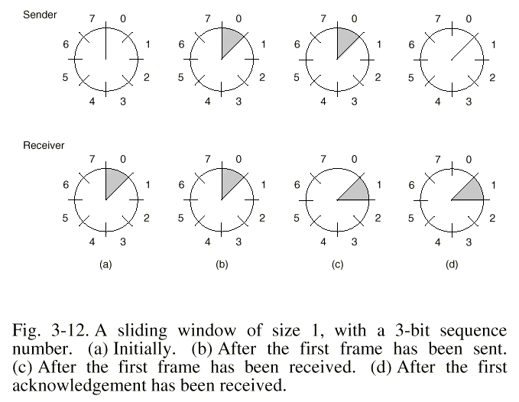

Slide 41
Flow Control in LLC Sub-layer
卫星信道传输速率50kbps，往返传输延迟500ms，则:
  若传输一个1000bit的帧，时间为：
  发送时间 + 信息信道延迟 + 确认信道延迟（确认帧很短，忽略发送时间）= 1000bit / 50kbps + 250ms + 250ms = 520ms
  信道利用率 = 20 / 520 ≈ 4%
信道带宽b比特/秒，帧长度L比特，往返传输延迟R秒，则信道利用率为 (L/b) / (L/b + R) = L / (L + Rb)
结论
  传输延迟大，信道带宽高，帧短时，信道利用率低

Slide 42
Flow Control in LLC Sub-layer
解决办法：流水线技术 (pipelining)
  连续发送多帧后再等待确认
带来的问题
  信道误码率高时，对损坏帧的重传非常多
两种基本方法
  退后n帧(go back n)
    接收方从出错帧起丢弃所有后继帧
    接收窗口为1
    对于出错率较高的信道，浪费带宽
  选择重传(selective repeat)
    接收窗口大于1，先暂存出错帧的后继帧；
    只重传坏帧
    对最高序号的帧进行确认
    接收窗口较大时，需较大缓冲区

Slide 43
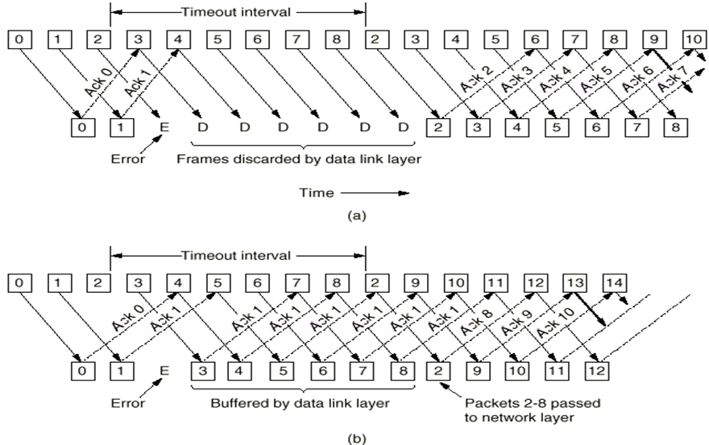

Slide 44
Layer2: Data Link Layer
Overview of the Data Link Layer
Ethernet and CSMA/CD
  LLC and MAC Sub-layers
  Media Access Control in MAC Sub-layer
  Flow Control in LLC Sub-layer
  Development of Ethernet
Wireless LAN and CSMA/CA
Layer 2 Devices

Slide 45
IEEE
Title and Comments
802
Standards for Local and Metropolitan Area Networks
802.1
LAN and MAN Bridging and Management
8
0
2
S
T
A
N
D
A
R
D
S
802.2
Logical Link Control
802.3
CSMA/CD Access Method
802.3u
Fast Ethernet
802.3z
Gigabit Ethernet
802.4
Token Passing Bus Access Method
802.5
Token Ring Access Method
802.6
Distributed Queue Dual Bus Access Method (for WANs)
802.7
Broadband Local Area Networks
802.8
Fiber-Optic Local and Metropolitan Area Networks
802.9
Integrated Services
802.10
LAN/MAN Security
802.11
Wireless LANs
802.12
High-speed LANs
802.14
Cable TV Access Method

Slide 46
Ethernet and IEEE 802.3
Ethernet is the most widely used LAN technology.
Xerox Corporation’s Palo Alto Research Center (PARC) developed Ethernet in the early 1970s.
Ethernet is well suited to applications where a local communication medium must carry sporadic, occasionally heavy traffic at high peak data rates.
Notes:
sporadic |spəˈrædɪk|
adjective
零星的 ‹fighting›; 偶尔的 ‹outbursts›; 间或出现的 ‹patches›

Slide 47
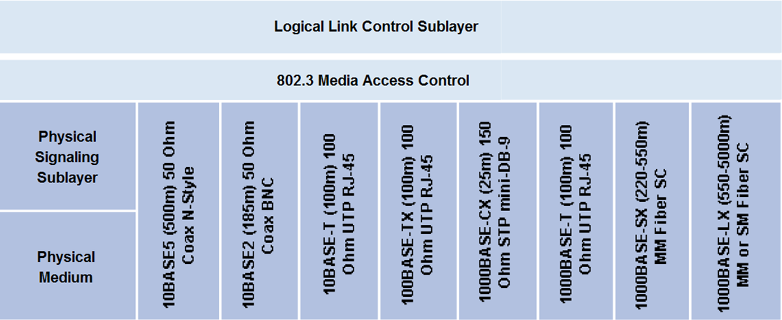
The Ethernet Family Tree

Slide 48
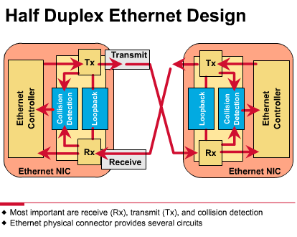
Ethernet Signaling
10BaseT signals use Manchester encoding
10Base-T transceivers are designed to send and receive signals over a segment that consists of 4 wires
  1 pair of wires for transmitting data
  1 pair of wires for receiving data
Half-duplex

Slide 49
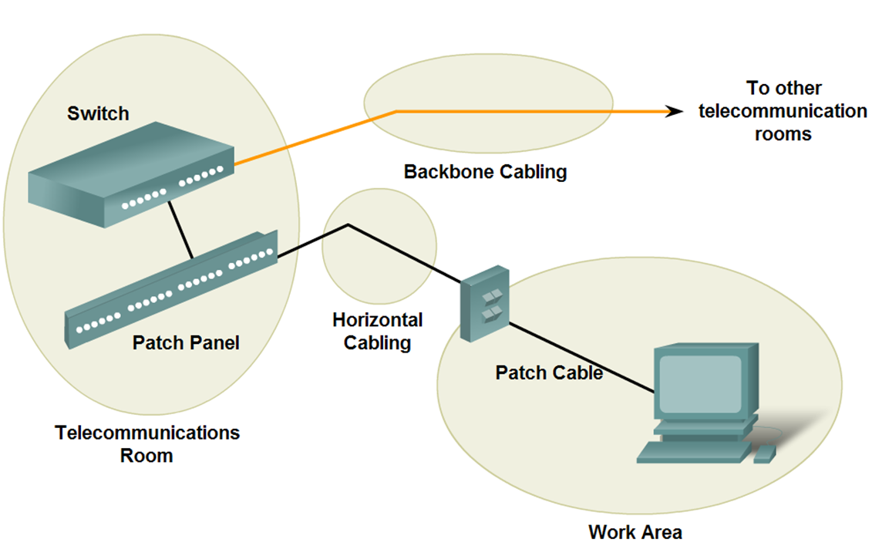
Ethernet 10BaseT Media and Topologies
Horizontal cabling topology must be a star
Maximum length of horizontal cabling for UTP cable is 90m
Maximum length for patch cords at the telecom outlet/connector is 3 m
Maximum length for patch cords/jumpers at the horizontal cross-connect is 6m

Slide 50
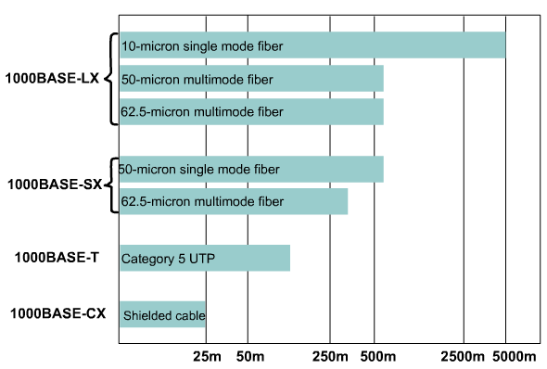
1000BASE Ethernet

Slide 51
1000BASE-T
1000BASE-T (IEEE 802.3ab) was developed to provide additional bandwidth to help alleviate these bottlenecks.
  Fast Ethernet/100BASE-TX: Cat 5 copper cable
  1000BASE-T: would pass the Cat 5e test.
  Most installed Cat 5 cable can pass 5e certification if properly terminated.
  1000BASE-T standard is interoperable with 10BASE-T and 100BASE-TX.
Notes:
可互操作的

Slide 52
1000BASE-T
Cat 5e cable can reliably carry up to 125 Mbps of traffic, then how to get 1000 Mbps of bandwidth?
  use all four pairs of wires instead of the traditional two pairs of wires used by 10BASE-T and 100BASE-TX. This provides 250 Mbps per pair.
  Full-duplex
  Since the information travels simultaneously across the four paths, the circuitry has to divide frames at the transmitter and reassemble them at the receiver.
  using 4D-PAM5 line encoding

Slide 53
1000BASE-SX and 1000BASE-LX
Using NRZ encoding
The signal can be pulsed into the fiber using:
  Short-wavelength
    850 nm laser or LED source
    multimode optical fiber (1000BASE-SX)
    lower-cost but shorter distances
  Long-wavelength
    1310 nm laser source
    either single-mode or multimode optical fiber (1000BASE-LX)
    Laser sources used with single-mode fiber can achieve distances of up to 5000 meters.
The Media Access Control method treats the link as point-to-point.
full duplex: transmitting (Tx) and receiving (Rx)
Gigabit Ethernet permits only a single repeater between two stations

Slide 54
Layer2: Data Link Layer
Overview of the Data Link Layer
Ethernet and CSMA/CD
  LLC and MAC Sub-layers
  Media Access Control in MAC Sub-layer
  Flow Control in LLC Sub-layer
  Development of Ethernet
Wireless LAN and CSMA/CA
Layer 2 Devices
Notes:
CSMA/CA
Carrier sense multiple access/collision avoidance
载波监听多点接入/避免冲突

Slide 55
Wireless LAN
Wireless LAN
  Communications based on cells
  The signals sent by a station can only be received by the stations nearby
  Short-distance transmission
Wireless LAN Standard
  IEEE 802.11
  IEEE 802.11b
  IEEE 802.11a
  IEEE 802.11g
  IEEE 802.11n

Slide 56
Wireless LAN Standard
IEEE 802.11
  A key technology: Direct Sequence Spread Spectrum (DSSS)
  DSSS applies to wireless devices operating within a 1 to 2 Mbps range.
  DSSS may operate at up to 11 Mbps but will not be considered compliant above 2 Mbps
IEEE 802.11b
  Also called Wi-Fi™
  It increased transmission capabilities to 11 Mbps
  All 802.11b systems are backward compliant in that they also support 802.11 for 1 and 2 Mbps data rates for DSSS only
  Achieves higher data throughput rate by using a different coding technique from 802.11
  Operate within 2.4 GHz
Notes:
Dsss了解
11a 和11b 相互不兼容 兼容的网卡价格呵呵
11a 后来被放弃掉了 价格原因

Slide 57
Wireless LAN Standard
IEEE 802.11a
  Covers WLAN devices operating in the 5 GHz transmission band.
  Using the 5 GHz
  802.11a is capable of supplying data throughput of 54 Mbps and with proprietary technology known as "rate doubling" has achieved 108 Mbps.
  In practice, a more standard rating is 20-26 Mbps.
Notes:
载波频率越高显然速度会更快,因为信息量更大

Slide 58
Wireless LAN Standard
IEEE 802.11g
  provides the same throughout as 802.11a (54Mbps) but with backwards compatibility for 802.11b
  using Othogonal Frequency Division Multiplexing (OFDM) technology.
IEEE 802.11n: next generation WLAN
  provide double bandwidth than 802.11g, that is, 108Mbps, and theoretically up to 500-600Mbps
Notes:
Othogonal Frequency Division Multiplexing: 正交频分复用
11g相当于11b的第二代,主要改进就是速度提升了
b/g/n都是2.4赫兹
A因为少所以贵喽
Ofdm正交频分复用了解
11n可以作为第三代

Slide 59
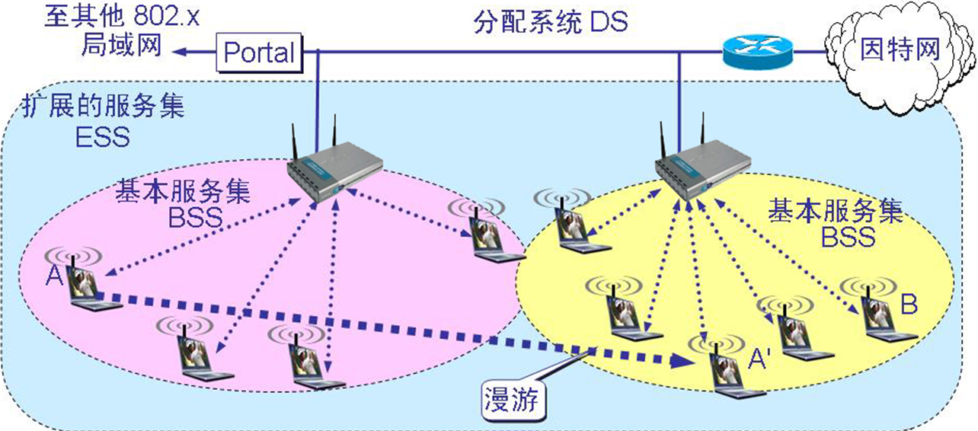
Wireless LAN Topology
Infrastructure mode and ad-hoc mode
Fig. Infrastructure Mode
Notes:
基础结构模式
下面这个图应该是第一种模式 ds+接入点 (njuwlan)
自组织Ad-hoc 没有接入点,通过22相连
接入点要用802.3 802.2等等打包转换任务

Slide 60
Wireless LAN: Infrastructure Mode
A Basic Service Set(BSS) includes a Base Station(BS) and several wireless hosts
  All hosts can communicate with each other directly in local BSS
Access Point (AP) acts as a Base Station(BS) for infrastructure mode
  AP is hard wired to the cabled LAN to provide Internet access and connectivity to the wired network
  When an AP is installed, a Service Set Identifier(SSID) and a channel are assigned
  The range of the cell will be from 91.44 to 152.4 meters (300 to 500 feet)
A BSS can connect to another BSS via a Distribution System(DS), and constructs an Extended Service Set (ESS)
Notes:
NJU-WLAN -> SSID在机器中会转换成其他的标识符
每个接入点的辐射范围大概90-150m

Slide 61
Accessing Procedure
When a client is activated within the WLAN
  it will start "listening" for a compatible device with which to "associate“
This is referred to as "scanning"
  Active scanning
  Passive scanning
Notes:
我们一般用的是被动扫描
Probe

Slide 62
Active scanning
Cause a probe request to be sent from the wireless node seeking to join the network.
The probe request will contain the Service Set Identifier (SSID) of the network it wishes to join
When an AP with the same SSID is found, the AP will issue a probe response
The authentication and association steps are completed.

Slide 63
Passive scanning
Listen for beacon management frames (beacons), which are transmitted by the AP (infrastructure mode) or peer nodes (ad hoc)
When a node receives a beacon that contains the SSID of the network it is trying to join, an attempt is made to join the network.
Passive scanning is a continuous process and nodes may associate or disassociate with APs as signal strength changes.
Notes:
Probe request 探察帧,向外广播勾搭
主动被动是指相对于host来讲的
Beacon信标获取过程的主被动
主动模式一般是需要特殊保密需求的时候,禁止AP不断的向外发beacon,隐匿存在可以避免攻击,只为知道ssid的host才能获取服务,为了安全性

Slide 64
Frames in WLAN
WLANs do not use a standard 802.3 frame.
There are three types of frames
  Control Frames
  Management frames
  Data frames(Only data frames are similar to 802.3 frames)
The payload of wireless data frames and 802.3 frames is 1500 bytes
  However, an Ether frame may not exceed 1518 bytes whereas a wireless frame could be as large as 2346 bytes.
  Usually the WLAN frame size will be limited to 1518 bytes as it is most commonly connected to a wired Ethernet network.

Slide 65






Why We Need CSMA/CA?
Collisions can occur in WLAN, but the stations can only know the transmission nearby, so CSMA/CD is not a good choice.
  Hidden Station Problem
    When A is transmitting data to B, C can’t detect the transmission between A and B, so perhaps C will decide to transmit data to B and result in a collision at B.
  Exposed Station Problem
    When B is transmitting data to A, C can detect the transmission, so C will not transmit data to D. But that is a mistake.
B
A
B
C
D
A
C
D
Notes:
回顾上一课::::Carrier sense multiple access/collision detection 载波侦听多路接入 冲突监听----发之前先侦听一下看一下有没有占用,如果没有你就可以发,如果占用了,都闭嘴,接着听;如果同时发现空了同时发还是可能冲撞,这是就需要回退算法,让整个路线上的机器停下来,所有去墙角去数数等待,2^n这个数数,数完了再去听,如果没人讲话就能讲了.听到碰撞信号之后,会发一个jam信号,为了尽快让其他设备知道已经发生冲撞,这么丧心病狂是为了尽快让所有设备知道发生了冲撞
………………………..avoidance ……冲突避免
在无线网络中,同样不允许发生碰撞,发之前先听有人发就别发了,没人就可以发,和上一课一样,思路一样.无线网络环境更加复杂.
隐藏站点问题:c意识不到a的存在,因为距离太远了,于是b就呵呵了….这种情况没有很好的解决方法
暴露站点问题:b先发,c也想发给d,但是他因为听到b在说话,误以为d也在听b说话,所以不敢发.恰恰与上面相反….草木皆兵了…实际上c完全可以给d发信息
相比来讲隐藏站点问题更严重,会导致出错,而且无法解决,后者效率低,没有那么严重,不会导致传输出错

Slide 66
Multiple Accessing Mechanism
Ethernet
  Signals is transmitted to all stations on the cable.
  The sending station detects the collisions.
  At a time, only an effective frame can be transmitted on the channel.
WLAN
  Signals is transmitted to stations near to the sending station on the cable
  The MAC protocol must try it best to ensure only a sending station near to the receiving station
  The receiving station detects the collisions.
  At a time, multiple effective frames can be transmitted on the channel.
Notes:
Wlan很难感知到发生了碰撞,不能像有线一样让发送方来检测碰撞,只有接收方才能检测碰撞.

Slide 67
CSMA/CA
CSMA/CA（Carrier Sense Multiple Access with Collision Avoidance）
  发送站点在发送数据前，以控制短帧刺激接收站点发送应答短帧，使接收站点周围的站点监听到该帧，从而在一定时间内避免数据发送
  基本过程
    A向B发送RTS（Request To Send）帧，A周围的站点在一定时间内不发送数据，以保证CTS帧返回给A；
    B向A回答CTS（Clear To Send）帧，B周围的站点在一定时间内不发送数据，以保证A发送完数据；
    A开始发送
    若控制帧RTS或CTS发生冲突，采用二进制指数后退算法等待随机时间，再重新开始。
Notes:
!!!!!!!!!!!!!!
因为检测不到冲突,所以只能避免
Rts让A周围的ap先闭嘴
Cts让B周围的ap闭嘴(静默)
现在阿隐藏站点问题重新来看:在b发cts这一步,让c感知到cts静默了,c在这一时间段内不在给b发,所以这个机制下解决了.
暴露….:此机制解决不了
解决根本问题就行了

Slide 68
The Actual Throughput
When a source node sends a frame, the receiving node returns a positive acknowledgment (ACK).
  This can cause consumption of 50% of the available bandwidth.
  This reduces the actual data throughput to a maximum of 5.0 to 5.5 Mbps on an 802.11b wireless LAN rated at 11 Mbps.
Performance of the network will also be affected by signal strength
  As the signal becomes weaker, Adaptive Rate Selection (ARS) may be invoked
  The transmitting unit will drop the data rate from 11 Mbps to 5.5 Mbps, from 5.5 Mbps to 2 Mbps or 2 Mbps to 1 Mbps.
Notes:
信号不好,误码率高的话,每次降低一半,知道满足标准为止.所以信号差一点,速度会差的很离谱

Slide 69
Layer2: Data Link Layer
Overview of the Data Link Layer
Ethernet and CSMA/CD
  LLC and MAC Sub-layers
  Media Access Control in MAC Sub-layer
  Flow Control in LLC Sub-layer
  Development of Ethernet
Wireless LAN and CSMA/CA
Layer 2 Devices
Notes:
第二层最典型的就是网卡
有个收发器属于一层设备
其他都属于二层设备负责封装和解封装
逻辑链路控制主要和第三层打交道

Slide 70
Layer 2 Devices—NICs
NICs perform important Layer 2 data link layer functions:
  Logical Link Control - communicates with upper layers in the computer
  Media Access Control - provides structured access to shared access media
  naming - provides a unique MAC address identifier
  framing - part of the encapsulation process, packaging the bits for transport
  signaling - creates signals and interface with the media by using built-in transceivers
Notes:
网卡 mac地址 唯一标识符 负责对帧进行封装解封装,信号处理
网桥 根据mac地址进行过滤,不依靠特定的协议来进行运作,可以有效提升网络性能,因为大碰撞域可以切成小的..
网桥:左边信号只能在左边碰撞,右边…. Hub则会左边信号跑到右边
但是网桥本身性能弱点,会成为瓶颈,过滤,漏斗能力,软件负责处理报文,处理帧的能力并不强
网桥有两种类型:

Slide 71
Layer 2 Devices—Bridges
Bridges divide traffic into segments and filters traffic based on the MAC address, not based on protocols.
Bridges can improve network performance by reducing large collision domains.
Bridges work best where traffic is low from one segment of a network to other segments.
  When traffic between network segments becomes heavy, bridges can become a bottleneck and slow down communication.

Slide 72
Layer 2 Devices—Bridges
  Transparent Bridge
    “透明”是指局域网上的站点并不知道所发送的帧将经过哪几个网桥，因为网桥对各站来说是看不见的
    透明网桥是一种即插即用设备，其标准是 IEEE 802.1D
    目前以太网中使用得最多的网桥
  Source routing Bridge
    源路由(source route)网桥在发送帧时将详细的路由信息放在帧的首部中,从而使每个经过的网桥都了解帧的路径
    在令牌环网络中被广泛使用
Notes:
1不用装驱动 win95
支持usb 通用串行总线 universal uni bus
实验串行口不能随便拔

Slide 73


Layer 2 Devices—Bridges
以太网网桥的工作原理
（透明网桥）
网桥
站地址
接口
站表
①
1
②
1
③
1
接口管理
软件
网桥协议
实体
④
2
⑤
2
⑥
2
接口 1
缓存
接口 2
网桥
接口 1
接口 2
网段 A
1
2
网段 B
①
②
③
④
⑤
⑥

Slide 74
Transparent Bridge
若从 A 发出的帧从接口 x 进入了某网桥，那么从这个接口出发沿相反方向一定可把一个帧传送到 A。
网桥每收到一个帧，就记下其源地址和进入网桥的接口，作为转发表中的一个项目。
在收到一个新的帧时，将转发表中已收集到的地址记录取出，与此帧的目的地址匹配，找到对应的接口，并向该接口转发。
在网桥的转发表中写入的信息除了地址和接口外，还有帧进入该网桥的时间，其原因是：
  拓扑可能经常变化
  站点也可能会更换适配器（这就改变了站点的地址）
  工作站并非总是处于工作状态
把每个帧到达网桥的时间登记下来，就可以在转发表中只保留网络拓扑的最新状态信息，使得网桥中的转发表能反映当前网络的最新拓扑

Slide 75
Transparent Bridge
Problem: When a device on a network wants to send data, but does not know the destination address.
  Send out a broadcast to all devices on a network.
  Since every device on the network has to pay attention to such broadcasts, bridges always forward them.
Too many broadcasts can result in a broadcast storm, and it can cause:
  network time-outs
  traffic slowdowns
  less than acceptable performance.
Notes:
对广播没有抵抗能力
尽量不要用广播帧,会破坏网络性能,除非协议要求发广播,才发,正常情况下不要发广播
eg交换机形成的环状->一个广播帧在环路中….网络风暴,大家反复乱发越发越收越搞越多…最后把几个交换机的cpu都呵呵了,占用几乎所有资源

Slide 76
Source Route Bridge
透明网桥容易安装，但网络资源的利用不充分
源路由(source route)网桥在发送帧时将详细的路由信息放在帧的首部中
源站以广播方式向欲通信的目的站发送一个发现帧，每个发现帧都记录所经过的路由
发现帧到达目的站时就沿各自的路由返回源站
源站在得知这些路由后，从所有可能的路由中选择出一个最佳路由
凡从该源站向该目的站发送的帧的首部，都必须携带源站所确定的这一路由信息
Notes:
先探察帧多条路线到达b,采用算法计算最佳路线,以后发的时候加上首部的路径,以后就按规矩走了.但是前期探查需要一定开销,这个在令牌环这种才用吧

Slide 77
Layer 2 Devices—Switches
Perform two basic operations:
  switching data frames: a frame is received on an input medium and then transmitted to an output medium
  maintenance of switching operations: Switches build and maintain switching tables and search for loops. Routers build and maintain both routing tables and service tables.
Notes:
维护转发表
准确建表

Slide 78
Layer 2 Devices—Switches
Switching is a technology that alleviates congestion in Ethernet LANs by reducing traffic and increasing bandwidth.
  Switches create dedicated network segments, or point-to-point connections, and connecting these segments in a virtual network within the switch.
  This is called a virtual circuit because it exists only when two nodes need to communicate and is established within the switch
  You can think of each switch port as a micro-bridge; this process is called microsegmentation.
  Each switch port gives the full bandwidth of the medium to each host
Notes:
构成微分段
Hub 网桥可以切换2边为 一个广播域 两个碰撞域
路由器因为默认不转发广播,所以会切换成 2个广播域,2个碰撞域

Slide 79
Layer 2 Devices—Switches
LAN switch reduces the size of collision domains
However, All hosts connected to the switch are still in the same broadcast domain.
  That is, a broadcast from one node will still be seen by all other nodes connected through the LAN switch.

Slide 80
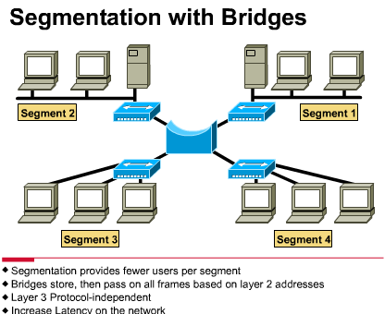
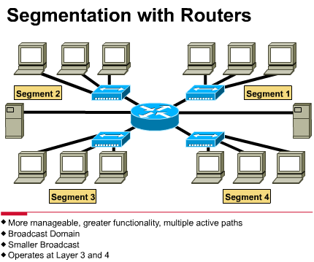
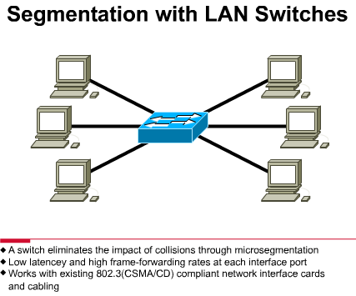
Segmentation of a Collision Domain
We can create collision domains using:
  Bridge (Layer 2)
  Switch (Layer 2)
  Router (Layer 3)

Slide 81
Bridge Segmentation of a Collision Domain
Ethernet LANs that use a bridge for segmenting the LAN provide more bandwidth per user because there are fewer users on the segment.
Bridges pass on data frames regardless of which Layer 3 protocol is used.
Bridges increase the latency (delay) in a network by 10 to 30 percent because of the decision making that is required.
A bridge is considered a store-and-forward device because it must receive the entire frame and verify the cyclic redundancy check before forwarding can take place
Notes:
网桥 存储转发 报文全收,如果有校验还要校验,先存到缓存里面看看有么有问题再转发,但是效率低,可能增加时延
交换机 直通转发 以太网的帧结构回顾那个长条状的图 …|post addres(目的mac)|source address| 收到目的地址之后紧接着就可以收一个字节发一个字节,不需要等到所有缓冲收完再发

Slide 82
Switch Segmentation of a Collision Domain
Switches are significantly faster because they switch in hardware, while bridges switch in software.
A 10 Mbps Ethernet LAN and a 100 Mbps Ethernet LAN can be connected by using a switch.
In a switched Ethernet implementation, the available bandwidth can reach close to 100 percent.
Shared Ethernet networks perform best when kept to less than 30 to 40 percent of full capacity because of CSMA/CD.
Some switches support cut-through switching, which reduces latency and delays, while bridges only support store-and-forward switching.
Notes:
路由器更吊
2个广播域2个碰撞域
默认不转发广播
根据数据报文,根据网络层报文,网络层逻辑地址,转发能力更强,但是速度没有交换器快,时延

Slide 83
Router Segmentation of a Collision Domain
Router can create the highest level of segmentation:
  Create smaller collision domains
  Create smaller broadcast domains: routers do not forward broadcasts unless programmed to do so.
Routers accomplish forwarding of packets by examining the destination logical address on the data packet and then looking in its routing table for forwarding instructions
Because routers perform more functions than bridges, they operate with a higher rate of latency.
Routers can work as gateway:
  be used to connect different networking media and different LAN technologies

Slide 84




