Slide 1
Constraint Satisfaction Problems (CSP)
(Where we postpone making difficult decisions until they become easy to make)
R&N: Chap. 5

Slide 2
What we will try to do ...
Search techniques make choices in an often arbitrary order. Often little information is available to make each of them
In many problems, the same states can be reached independent of the order in which choices are made (“commutative” actions)
Can we solve such problems more efficiently by picking the order appropriately? Can we even avoid making any choice?

Slide 3
Constraint Propagation
Place a queen in a square
Remove the attacked squares from future consideration

Slide 4
Constraint Propagation
5 5 5 5 5 6 7
6
6
5
5
5
5
6
Count the number of non-attacked squares in every row and column
Place a queen in a row or column with minimum number
Remove the attacked squares from future consideration

Slide 5
Constraint Propagation
4 3 3 3 4 5
3
4
4
3
3
5
Repeat

Slide 6
Constraint Propagation
3 3 3 4 3
4
3
2
3
4

Slide 7
Constraint Propagation
3 3 3 1
4
2
2
1
3

Slide 8
Constraint Propagation
2 2 1
2
2
1

Slide 9
Constraint Propagation
1 2
2
1

Slide 10
Constraint Propagation
1
1

Slide 11
Constraint Propagation

Slide 12
What do we need?
More than just a successor function and a goal test
We also need:
  A means to propagate the constraints imposed by one queen’s position on the positions of the other queens
  An early failure test
Explicit representation of constraints
Constraint propagation algorithms

Slide 13
Constraint Satisfaction Problem (CSP)
Set of variables {X₁, X₂, …, X_{n}}
Each variable X_{i} has a domain D_{i} of possible values. Usually, D_{i} is finite
Set of constraints {C₁, C₂, …, C_{p}}
Each constraint relates a subset of variables by specifying the valid combinations of their values
Goal: Assign a value to every variable such that all constraints are satisfied

Slide 14
Map Coloring
NT
NT
Q
Q
WA
WA
SA
SA
NSW
NSW
V
V
T
T
7 variables {WA,NT,SA,Q,NSW,V,T}
Each variable has the same domain:
{red, green, blue}
No two adjacent variables have the same value:
WA≠NT, WA≠SA, NT≠SA, NT≠Q, SA≠Q,
SA≠NSW, SA≠V, Q≠NSW, NSW≠V

Slide 15
8-Queen Problem
8 variables X_{i}, i = 1 to 8
The domain of each variable is: {1,2,…,8}
Constraints are of the forms:
  X_{i} = k ➔ X_{j} ≠ k for all j = 1 to 8, j≠i
  Similar constraints for diagonals
All constraints are binary

Slide 16
Street Puzzle
1
2
3
4
5
N_{i} = {English, Spaniard, Japanese, Italian, Norwegian}
C_{i} = {Red, Green, White, Yellow, Blue}
D_{i} = {Tea, Coffee, Milk, Fruit-juice, Water}
J_{i} = {Painter, Sculptor, Diplomat, Violinist, Doctor}
A_{i} = {Dog, Snails, Fox, Horse, Zebra}
The Englishman lives in the Red house
The Spaniard has a Dog
The Japanese is a Painter
The Italian drinks Tea
The Norwegian lives in the first house on the left
The owner of the Green house drinks Coffee
The Green house is on the right of the White house
The Sculptor breeds Snails
The Diplomat lives in the Yellow house
The owner of the middle house drinks Milk
The Norwegian lives next door to the Blue house
The Violinist drinks Fruit juice
The Fox is in the house next to the Doctor’s
The Horse is next to the Diplomat’s
Who owns the Zebra?
Who drinks Water?

Slide 17
Street Puzzle
1
2
3
4
5
N_{i} = {English, Spaniard, Japanese, Italian, Norwegian}
C_{i} = {Red, Green, White, Yellow, Blue}
D_{i} = {Tea, Coffee, Milk, Fruit-juice, Water}
J_{i} = {Painter, Sculptor, Diplomat, Violinist, Doctor}
A_{i} = {Dog, Snails, Fox, Horse, Zebra}
∀i,j∈[1,5], i≠j, N_{i} ≠ N_{j}
The Englishman lives in the Red house
The Spaniard has a Dog
The Japanese is a Painter
The Italian drinks Tea
The Norwegian lives in the first house on the left
The owner of the Green house drinks Coffee
The Green house is on the right of the White house
The Sculptor breeds Snails
The Diplomat lives in the Yellow house
The owner of the middle house drinks Milk
The Norwegian lives next door to the Blue house
The Violinist drinks Fruit juice
The Fox is in the house next to the Doctor’s
The Horse is next to the Diplomat’s
∀i,j∈[1,5], i≠j, C_{i} ≠ C_{j}
...

Slide 18
Street Puzzle
1
2
3
4
5
N_{i} = {English, Spaniard, Japanese, Italian, Norwegian}
C_{i} = {Red, Green, White, Yellow, Blue}
D_{i} = {Tea, Coffee, Milk, Fruit-juice, Water}
J_{i} = {Painter, Sculptor, Diplomat, Violinist, Doctor}
A_{i} = {Dog, Snails, Fox, Horse, Zebra}
The Englishman lives in the Red house
The Spaniard has a Dog
The Japanese is a Painter
The Italian drinks Tea
The Norwegian lives in the first house on the left
The owner of the Green house drinks Coffee
The Green house is on the right of the White house
The Sculptor breeds Snails
The Diplomat lives in the Yellow house
The owner of the middle house drinks Milk
The Norwegian lives next door to the Blue house
The Violinist drinks Fruit juice
The Fox is in the house next to the Doctor’s
The Horse is next to the Diplomat’s
(N_{i} = English) ⇔ (C_{i} = Red)
(N_{i} = Japanese) ⇔ (J_{i} = Painter)
(N₁ = Norwegian)
(C_{i} = White) ⇔ (C_{i+1} = Green)
(C₅ ≠ White)
(C₁ ≠ Green)
left as an exercise

Slide 19
Street Puzzle
1
2
3
4
5
N_{i} = {English, Spaniard, Japanese, Italian, Norwegian}
C_{i} = {Red, Green, White, Yellow, Blue}
D_{i} = {Tea, Coffee, Milk, Fruit-juice, Water}
J_{i} = {Painter, Sculptor, Diplomat, Violinist, Doctor}
A_{i} = {Dog, Snails, Fox, Horse, Zebra}
The Englishman lives in the Red house
The Spaniard has a Dog
The Japanese is a Painter
The Italian drinks Tea
The Norwegian lives in the first house on the left
The owner of the Green house drinks Coffee
The Green house is on the right of the White house
The Sculptor breeds Snails
The Diplomat lives in the Yellow house
The owner of the middle house drinks Milk
The Norwegian lives next door to the Blue house
The Violinist drinks Fruit juice
The Fox is in the house next to the Doctor’s
The Horse is next to the Diplomat’s
(N_{i} = English) ⇔ (C_{i} = Red)
(N_{i} = Japanese) ⇔ (J_{i} = Painter)
(N₁ = Norwegian)
(C_{i} = White) ⇔ (C_{i+1} = Green)
(C₅ ≠ White)
(C₁ ≠ Green)
unary constraints

Slide 20
Street Puzzle
1
2
3
4
5
N_{i} = {English, Spaniard, Japanese, Italian, Norwegian}
C_{i} = {Red, Green, White, Yellow, Blue}
D_{i} = {Tea, Coffee, Milk, Fruit-juice, Water}
J_{i} = {Painter, Sculptor, Diplomat, Violinist, Doctor}
A_{i} = {Dog, Snails, Fox, Horse, Zebra}
The Englishman lives in the Red house
The Spaniard has a Dog
The Japanese is a Painter
The Italian drinks Tea
The Norwegian lives in the first house on the left → N₁ = Norwegian
The owner of the Green house drinks Coffee
The Green house is on the right of the White house
The Sculptor breeds Snails
The Diplomat lives in the Yellow house
The owner of the middle house drinks Milk → D₃ = Milk
The Norwegian lives next door to the Blue house
The Violinist drinks Fruit juice
The Fox is in the house next to the Doctor’s
The Horse is next to the Diplomat’s

Slide 21
Street Puzzle
1
2
3
4
5
N_{i} = {English, Spaniard, Japanese, Italian, Norwegian}
C_{i} = {Red, Green, White, Yellow, Blue}
D_{i} = {Tea, Coffee, Milk, Fruit-juice, Water}
J_{i} = {Painter, Sculptor, Diplomat, Violinist, Doctor}
A_{i} = {Dog, Snails, Fox, Horse, Zebra}
The Englishman lives in the Red house → C₁ ≠ Red
The Spaniard has a Dog → A₁ ≠ Dog
The Japanese is a Painter
The Italian drinks Tea
The Norwegian lives in the first house on the left → N₁ = Norwegian
The owner of the Green house drinks Coffee
The Green house is on the right of the White house
The Sculptor breeds Snails
The Diplomat lives in the Yellow house
The owner of the middle house drinks Milk → D₃ = Milk
The Norwegian lives next door to the Blue house
The Violinist drinks Fruit juice → J₃ ≠ Violinist
The Fox is in the house next to the Doctor’s
The Horse is next to the Diplomat’s

Slide 22
Task Scheduling
T₁
T₂
T₄
T₃
Four tasks T₁, T₂, T₃, and T₄ are related by time constraints:
  T₁ must be done during T₃
  T₂ must be achieved before T₁ starts
  T₂ must overlap with T₃
  T₄ must start after T₁ is complete
Are the constraints compatible?
What are the possible time relations between two tasks?
What if the tasks use resources in limited supply?
How to formulate this problem as a CSP?

Slide 23
3-SAT
n Boolean variables u₁, ..., u_{n}
p constraints of the form
u_{i}* ∨ u_{j}* ∨ u_{k}*= 1
where u* stands for either u or ¬u
Known to be NP-complete

Slide 24
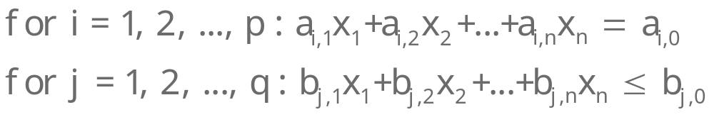
Finite vs. Infinite CSP
Finite CSP: each variable has a finite domain of values
Infinite CSP: some or all variables have an infinite domain
E.g., linear programming problems over the reals:
We will only consider finite CSP

Slide 25
CSP as a Search Problem
n variables X₁, ..., X_{n}
Valid assignment: {X_{i1} ← v_{i1}, ..., X_{ik} ← v_{ik}}, 0≤ k ≤ n,
such that the values v_{i1}, ..., v_{ik} satisfy all constraints relating the variables X_{i1}, ..., X_{ik}
Complete assignment: one where k = n
[if all variable domains have size d, there are O(d^{n}) complete assignments]
States: valid assignments
Initial state: empty assignment {}, i.e. k = 0
Successor of a state:
{X_{i1}←v_{i1}, ..., X_{ik}←v_{ik}} → {X_{i1}←v_{i1}, ..., X_{ik}←v_{ik}, X_{ik+1}←v_{ik+1}}
Goal test: k = n

Slide 26
{X_{i1}←v_{i1}, ..., X_{ik}←v_{ik}}
{X_{i1}←v_{i1}, ..., X_{ik}←v_{ik}, X_{ik+1}←v_{ik+1}}
r = n−k variables with s values → r×s branching factor

Slide 27
A Key property of CSP: Commutativity
The order in which variables are assigned values has no impact on the reachable complete valid assignments
Hence:
One can expand a node N by first selecting one variable X not in the assignment A associated with N and then assigning every value v in the domain of X
[→ big reduction in branching factor]

Slide 28
{X_{i1}←v_{i1}, ..., X_{ik}←v_{ik}}
{X_{i1}←v_{i1}, ..., X_{ik}←v_{ik}, X_{ik+1}←v_{ik+1}}
r = n−k variables with s values → s branching factor
r = n-k variables with s values → r×s branching factor
The depth of the solutions in the search tree is un-changed (n)

Slide 29
4 variables X₁, ..., X₄
Let the valid assignment of N be:
A = {X₁ ← v₁, X₃ ← v₃}
For example pick variable X₄
Let the domain of X₄ be {v_{4,1}, v_{4,2}, v_{4,3}}
The successors of A are all the valid assignments among:
{X₁ ← v₁, X₃ ← v₃ , X₄ ← v_{4,1} }
{X₁ ← v₁, X₃ ← v₃ , X₄ ← v_{4,2} }
{X₁ ← v₁, X₃ ← v₃ , X₄ ← v_{4,2} }

Slide 30
A Key property of CSP: Commutativity
The order in which variables are assigned values has no impact on the reachable complete valid assignments
Hence:
One can expand a node N by first selecting one variable X not in the assignment A associated with N and then assigning every value v in the domain of X
[→ big reduction in branching factor]
One need not store the path to a node
→ Backtracking search algorithm

Slide 31
Backtracking Search
Essentially a simplified depth-first algorithm using recursion

Slide 32
Backtracking Search
(3 variables)
Assignment = {}

Slide 33
Backtracking Search
(3 variables)
X₁
v₁₁
Assignment = {(X₁,v₁₁)}

Slide 34
Backtracking Search
(3 variables)
X₁
v₁₁
X₃
v₃₁
Assignment = {(X₁,v₁₁), (X₃,v₃₁)}

Slide 35
Backtracking Search
(3 variables)
X₁
v₁₁
Then, the search algorithm
backtracks to the previous variable (X₃) and tries another value
X₃
v₃₁
X₂
Assume that no value of X₂
leads to a valid assignment
Assignment = {(X₁,v₁₁), (X₃,v₃₁)}

Slide 36
Backtracking Search
(3 variables)
X₁
v₁₁
X₃
v₃₁
v₃₂
X₂
Assignment = {(X₁,v₁₁), (X₃,v₃₂)}

Slide 37
Backtracking Search
(3 variables)
The search algorithm
backtracks to the previous variable (X₃) and tries another value. But assume that X₃ has only two possible values. The algorithm backtracks to X₁
X₁
v₁₁
X₃
v₃₁
v₃₂
X₂
X₂
Assume again that no value of
X₂ leads to a valid assignment
Assignment = {(X₁,v₁₁), (X₃,v₃₂)}

Slide 38
Backtracking Search
(3 variables)
X₁
v₁₁
v₁₂
X₃
v₃₁
v₃₂
X₂
X₂
Assignment = {(X₁,v₁₂)}

Slide 39
Backtracking Search
(3 variables)
X₁
v₁₁
v₁₂
X₃
X₂
v₃₁
v₃₂
v₂₁
X₂
X₂
Assignment = {(X₁,v₁₂), (X₂,v₂₁)}

Slide 40
Backtracking Search
(3 variables)
X₁
v₁₁
v₁₂
X₃
X₂
v₃₁
v₃₂
v₂₁
X₂
X₂
The algorithm need not consider
the variables in the same order in
this sub-tree as in the other
Assignment = {(X₁,v₁₂), (X₂,v₂₁)}

Slide 41
Backtracking Search
(3 variables)
X₁
v₁₁
v₁₂
X₃
X₂
v₃₁
v₃₂
v₂₁
X₂
X₂
X₃
v₃₂
Assignment = {(X₁,v₁₂), (X₂,v₂₁), (X₃,v₃₂)}

Slide 42
Backtracking Search
(3 variables)
X₁
v₁₁
v₁₂
X₃
X₂
v₃₁
v₃₂
v₂₁
The algorithm need
not consider the values
of X₃ in the same order
in this sub-tree
X₂
X₂
X₃
v₃₂
Assignment = {(X₁,v₁₂), (X₂,v₂₁), (X₃,v₃₂)}

Slide 43
Backtracking Search
(3 variables)
X₁
v₁₁
v₁₂
X₃
X₂
v₃₁
v₃₂
v₂₁
Since there are only
three variables, the
assignment is complete
X₂
X₂
X₃
v₃₂
Assignment = {(X₁,v₁₂), (X₂,v₂₁), (X₃,v₃₂)}

Slide 44
Backtracking Algorithm
CSP-BACKTRACKING(A)
  If assignment A is complete then return A
  X ← select a variable not in A
  D ← select an ordering on the domain of X
  For each value v in D do
      Add (X←v) to A
      If A is valid then
        result ← CSP-BACKTRACKING(A)
        If result ≠ failure then return result
      Remove (X←v) from A
  Return failure
Call CSP-BACKTRACKING({})
[This recursive algorithm keeps too much data in memory.
An iterative version could save memory (left as an exercise)]

Slide 45
Critical Questions for the Efficiency of CSP-Backtracking
CSP-BACKTRACKING(A)
  If assignment A is complete then return A
  X ← select a variable not in A
  D ← select an ordering on the domain of X
  For each value v in D do
      Add (X←v) to A
      If a is valid then
        result ← CSP-BACKTRACKING(A)
        If result ≠ failure then return result
      Remove (X←v) from A
  Return failure

Slide 46
Critical Questions for the Efficiency of CSP-Backtracking
Which variable X should be assigned a value next?
The current assignment may not lead to any solution, but the algorithm still does know it. Selecting the right variable to which to assign a value may help discover the contradiction more quickly
In which order should X’s values be assigned?
The current assignment may be part of a solution. Selecting the right value to assign to X may help discover this solution more quickly
More on these questions in a short while ...

Slide 47
Critical Questions for the Efficiency of CSP-Backtracking
Which variable X should be assigned a value next?
The current assignment may not lead to any solution, but the algorithm does not know it yet. Selecting the right variable X may help discover the contradiction more quickly
In which order should X’s values be assigned?
The current assignment may be part of a solution. Selecting the right value to assign to X may help discover this solution more quickly
More on these questions in a short while ...

Slide 48
Critical Questions for the Efficiency of CSP-Backtracking
Which variable X should be assigned a value next?
The current assignment may not lead to any solution, but the algorithm does not know it yet. Selecting the right variable X may help discover the contradiction more quickly
In which order should X’s values be assigned?
The current assignment may be part of a solution. Selecting the right value to assign to X may help discover this solution more quickly
More on these questions in a short while ...

Slide 49
Critical Questions for the Efficiency of CSP-Backtracking
Which variable X should be assigned a value next?
The current assignment may not lead to any solution, but the algorithm does not know it yet. Selecting the right variable X may help discover the contradiction more quickly
In which order should X’s values be assigned?
The current assignment may be part of a solution. Selecting the right value to assign to X may help discover this solution more quickly
More on these questions very soon ...

Slide 50
Forward Checking
A simple constraint-propagation technique:
1
2
3
4
5
6
7
8
Assigning the value 5 to X₁
leads to removing values from
the domains of X₂, X₃, ..., X₈
X₁ X₂ X₃ X₄ X₅ X₆ X₇ X₈

Slide 51
Forward Checking in Map Coloring
NT
Constraint graph
Q
WA
NSW
T
SA
V
WA | NT | Q | NSW | V | SA | T
RGB | RGB | RGB | RGB | RGB | RGB | RGB

Slide 52
Forward Checking in Map Coloring
NT
Q
WA
NSW
T
SA
V
WA | NT | Q | NSW | V | SA | T
RGB | RGB | RGB | RGB | RGB | RGB | RGB
R | RGB | RGB | RGB | RGB | RGB | RGB
Forward checking removes the value Red of NT and of SA

Slide 53
Forward Checking in Map Coloring
NT
Q
WA
NSW
T
SA
V
WA | NT | Q | NSW | V | SA | T
RGB | RGB | RGB | RGB | RGB | RGB | RGB
R | GB | RGB | RGB | RGB | GB | RGB
R | GB | G | RGB | RGB | GB | RGB

Slide 54
Forward Checking in Map Coloring
NT
Q
WA
NSW
T
SA
V
WA | NT | Q | NSW | V | SA | T
RGB | RGB | RGB | RGB | RGB | RGB | RGB
R | GB | RGB | RGB | RGB | GB | RGB
R | B | G | RB | RGB | B | RGB
R | B | G | RB | B | B | RGB

Slide 55
Forward Checking in Map Coloring
Empty set: the current assignment
{(WA ← R), (Q ← G), (V ← B)}
does not lead to a solution
WA | NT | Q | NSW | V | SA | T
RGB | RGB | RGB | RGB | RGB | RGB | RGB
R | GB | RGB | RGB | RGB | GB | RGB
R | B | G | RB | RGB | B | RGB
R | B | G | RB | B | B | RGB

Slide 56
Forward Checking (General Form)
Whenever a pair (X←v) is added to assignment A do:
For each variable Y not in A do:
For every constraint C relating Y to
the variables in A do:
Remove all values from Y’s domain
that do not satisfy C

Slide 57
Modified Backtracking Algorithm
CSP-BACKTRACKING(A, var-domains)
  If assignment A is complete then return A
  X ← select a variable not in A
  D ← select an ordering on the domain of X
  For each value v in D do
      Add (X←v) to A
      var-domains ← forward checking(var-domains, X, v, A)
      If no variable has an empty domain then
      (i) result ← CSP-BACKTRACKING(A, var-domains)
      (ii) If result ≠ failure then return result
      Remove (X←v) from A
  Return failure

Slide 58
Modified Backtracking Algorithm
CSP-BACKTRACKING(A, var-domains)
  If assignment A is complete then return A
  X ← select a variable not in A
  D ← select an ordering on the domain of X
  For each value v in D do
      Add (X←v) to A
      var-domains ← forward checking(var-domains, X, v, A)
      If no variable has an empty domain then
      (i) result ← CSP-BACKTRACKING(A, var-domains)
      (ii) If result ≠ failure then return result
      Remove (X←v) from A
  Return failure
No need any more to
verify that A is valid

Slide 59
Modified Backtracking Algorithm
CSP-BACKTRACKING(A, var-domains)
  If assignment A is complete then return A
  X ← select a variable not in A
  D ← select an ordering on the domain of X
  For each value v in D do
      Add (X←v) to A
      var-domains ← forward checking(var-domains, X, v, A)
      If no variable has an empty domain then
      (i) result ← CSP-BACKTRACKING(A, var-domains)
      (ii) If result ≠ failure then return result
      Remove (X←v) from A
  Return failure
Need to pass down the
updated variable domains

Slide 60
Modified Backtracking Algorithm
CSP-BACKTRACKING(A, var-domains)
  If assignment A is complete then return A
  X ← select a variable not in A
  D ← select an ordering on the domain of X
  For each value v in D do
      Add (X←v) to A
      var-domains ← forward checking(var-domains, X, v, A)
      If no variable has an empty domain then
      (i) result ← CSP-BACKTRACKING(A, var-domains)
      (ii) If result ≠ failure then return result
      Remove (X←v) from A
  Return failure

Slide 61
Which variable X_{i} should be assigned a value next?
→ Most-constrained-variable heuristic
→ Most-constraining-variable heuristic
In which order should its values be assigned?
→ Least-constraining-value heuristic
These heuristics can be quite confusing
Keep in mind that all variables must eventually get a value, while only one value from a domain must be assigned to each variable

Slide 62
Most-Constrained-Variable Heuristic
Which variable X_{i} should be assigned a value next?
Select the variable with the smallest remaining domain
[Rationale: Minimize the branching factor]

Slide 63
8-Queens
Forward checking
New assignment
4 3 2 3 4
Numbers
of values for
each un-assigned
variable

Slide 64
8-Queens
Forward checking
New assignment
3 2 1 3
New numbers
of values for
each un-assigned
variable

Slide 65
Map Coloring
NT
NT
Q
WA
WA
SA
SA
NSW
V
T
SA’s remaining domain has size 1 (value Blue remaining)
Q’s remaining domain has size 2
NSW’s, V’s, and T’s remaining domains have size 3
→ Select SA

Slide 66
Most-Constraining-Variable Heuristic
Which variable X_{i} should be assigned a value next?
Among the variables with the smallest remaining domains (ties with respect to the most-constrained-variable heuristic), select the one that appears in the largest number of constraints on variables not in the current assignment
[Rationale: Increase future elimination of values, to reduce future branching factors]

Slide 67
Map Coloring
NT
Q
WA
SA
SA
NSW
V
T
Before any value has been assigned, all variables have a domain of size 3, but SA is involved in more constraints (5) than any other variable
→ Select SA and assign a value to it (e.g., Blue)

Slide 68
Modified Backtracking Algorithm
CSP-BACKTRACKING(A, var-domains)
  If assignment A is complete then return A
  X ← select a variable not in A
  D ← select an ordering on the domain of X
  For each value v in D do
      Add (X←v) to A
      var-domains ← forward checking(var-domains, X, v, A)
      If no variable has an empty domain then
      (i) result ← CSP-BACKTRACKING(A, var-domains)
      (ii) If result ≠ failure then return result
      Remove (X←v) from A
  Return failure
1) Most-constrained-variable heuristic
2) Most-constraining-variable heuristic
3) Least-constraining-value heuristic
Select the variable with the smallest remaining domain
Select the variable that appears in the largest number of
constraints on variables not in the current assignment

Slide 69
Least-Constraining-Value Heuristic
In which order should X’s values be assigned?
Select the value of X that removes the smallest number of values from the domains of those variables which are not in the current assignment
[Rationale: Since only one value will eventually be assigned to X, pick the least-constraining value first, since it is the most likely not to lead to an invalid assignment]
[Note: Using this heuristic requires performing a forward-checking step for every value, not just for the selected value]

Slide 70
Map Coloring
NT
NT
Q
WA
WA
SA
NSW
V
{}
T
Q’s domain has two remaining values: Blue and Red
Assigning Blue to Q would leave 0 value for SA, while assigning Red would leave 1 value

Slide 71
Map Coloring
NT
NT
Q
WA
WA
SA
NSW
V
{Blue}
T
Q’s domain has two remaining values: Blue and Red
Assigning Blue to Q would leave 0 value for SA, while assigning Red would leave 1 value
→ So, assign Red to Q

Slide 72
Modified Backtracking Algorithm
CSP-BACKTRACKING(A, var-domains)
  If assignment A is complete then return A
  X ← select a variable not in A
  D ← select an ordering on the domain of X
  For each value v in D do
      Add (X←v) to A
      var-domains ← forward checking(var-domains, X, v, A)
      If no variable has an empty domain then
      (i) result ← CSP-BACKTRACKING(A, var-domains)
      (ii) If result ≠ failure then return result
      Remove (X←v) from A
  Return failure
1) Most-constrained-variable heuristic
2) Most-constraining-variable heuristic
3) Least-constraining-value heuristic

Slide 73
Applications of CSP
CSP techniques are widely used
Applications include:
  Crew assignments to flights
  Management of transportation fleet
  Flight/rail schedules
  Job shop scheduling
  Task scheduling in port operations
  Design, including spatial layout design
  Radiosurgical procedures

Slide 74
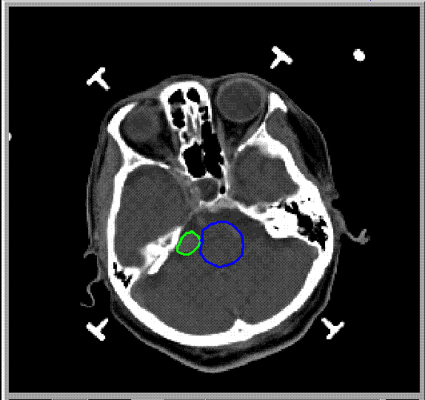
Radiosurgery
Minimally invasive procedure that uses a beam of radiation as an ablative surgical instrument to destroy tumors
Tumor = bad
Critical structures
= good and sensitive
Brain = good

Slide 75
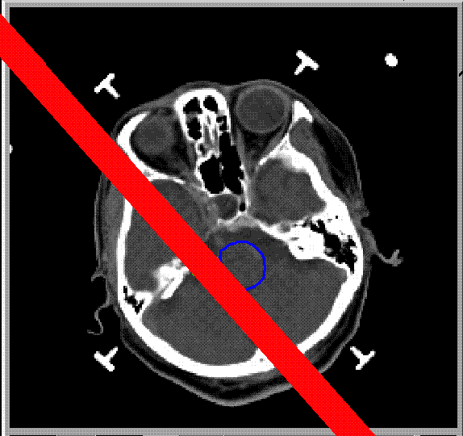
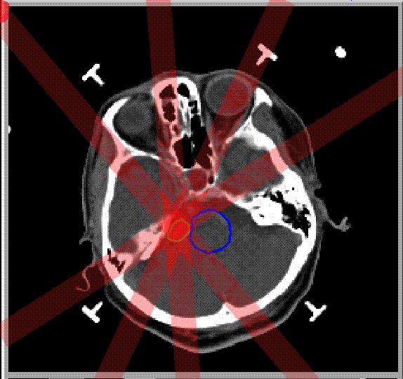
Problem
Burn tumor without damaging healthy tissue

Slide 76
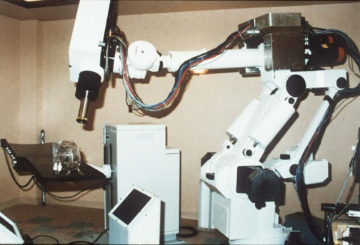
The CyberKnife
linear accelerator
robot arm
X-Ray
cameras

Slide 77
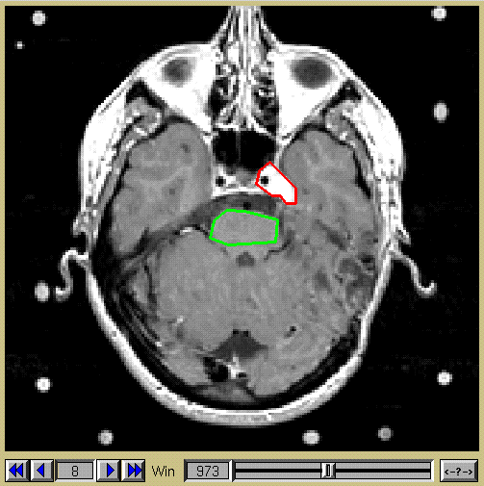
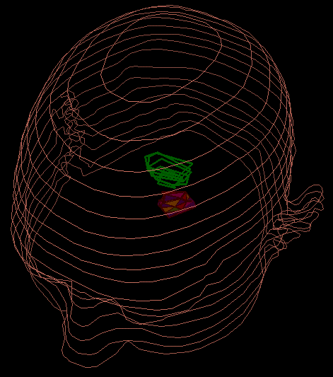
Inputs
1) Regions of interest
Notes:
I changed title

Slide 78
Inputs
2) Dose constraints
Dose to tumor
Tumor
Falloff of dose
around tumor
Dose to critical
structure
Critical
Falloff of dose
in critical structure

Slide 79
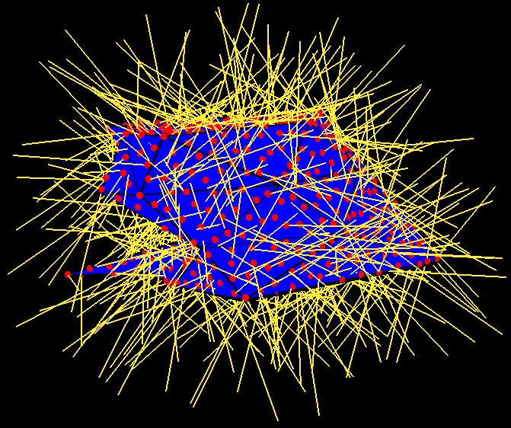



Beam Sampling

Slide 80
Constraints
2000 ≤ Tumor ≤ 2200
  2000 ≤ B2 + B4 ≤ 2200
  2000 ≤ B4 ≤ 2200
  2000 ≤ B3 + B4 ≤ 2200
  2000 ≤ B3 ≤ 2200
  2000 ≤ B1 + B3 + B4 ≤ 2200
  2000 ≤ B1 + B4 ≤ 2200
  2000 ≤ B1 + B2 + B4 ≤ 2200
  2000 ≤ B1 ≤ 2200
  2000 ≤ B1 + B2 ≤ 2200
T
B1
T
B2
C
B4
0 ≤ Critical ≤ 500
  0 ≤ B2 ≤ 500
B3
2000 < Tumor < 2200
  2000 < B2 + B4 < 2200
  2000 < B4 < 2200
  2000 < B3 + B4 < 2200
  2000 < B3 < 2200
  2000 < B1 + B3 + B4 < 2200
  2000 < B1 + B4 < 2200
  2000 < B1 + B2 + B4 < 2200
  2000 < B1 < 2200
  2000 < B1 + B2 < 2200
2000 < Tumor < 2200
  2000 < B4
  2000 < B3
  B1 + B3 + B4 < 2200
  B1 + B2 + B4 < 2200
  2000 < B1

Slide 81
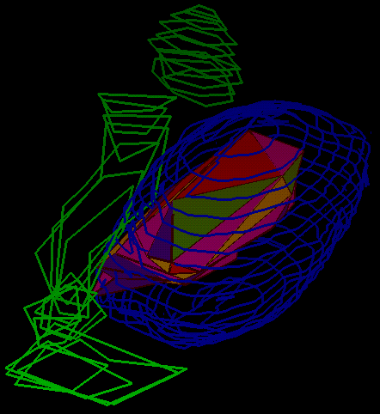
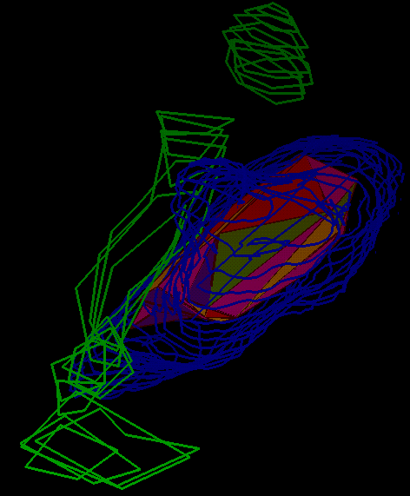
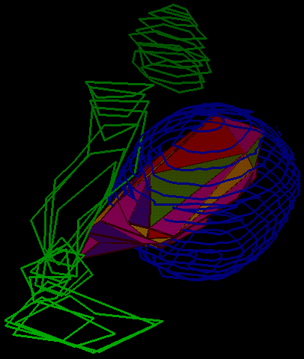
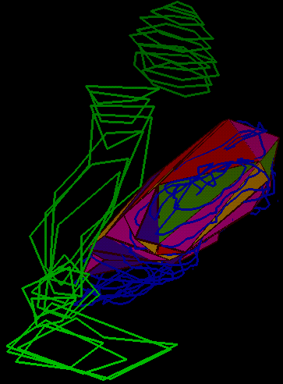
Case Results
50% Isodose
Surface
80% Isodose
Surface
LINAC system
Cyberknife

Slide 82


