Slide 1

Welcome
to
Presentation…

Slide 2

Top 4 Map
What is map
Use of map
Use of advantages & disadvantages of map
Types of map

Slide 3

What is map?
A map is a symbolic depiction emphasizing relationships between element of same space.
map is a diagrammatic of an area of land or sea showing physical features , cities , roads etc.

Slide 4
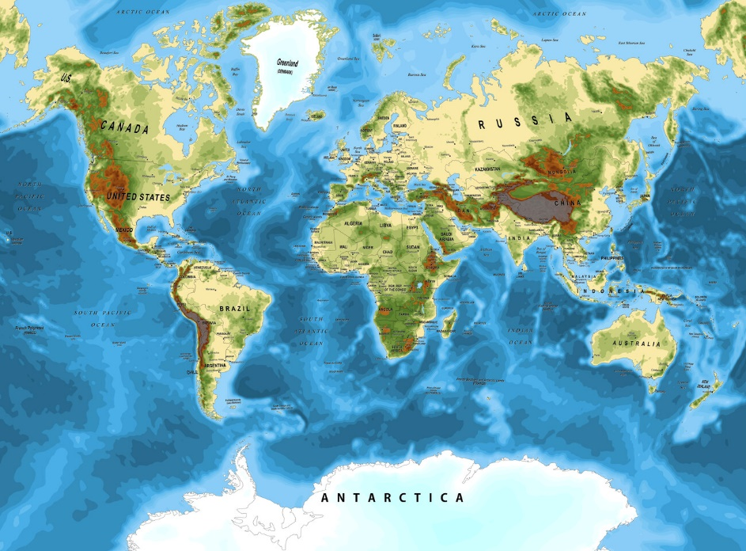
Use of map
Generally we use maps as a reference to show political boundaries
landforms water bodies and the positions of cites map also help us to
know the routes of area landmark location etc.

Slide 5
Use of advantages & disadvantages of map
Advantages
Disadvantages
Helps with
Navigation
Can Be
Inaccurate
Provides
Information
Can Be
Misleading
Help with
Planning
Can Be
Confusing
Can Help
Solve Problems
Can Be
Expensive
Promotes Understanding
and Appreciation
Can Be
Outdated

Slide 6
Types of map
General Reference
Thematic Maps
Topographic Maps
Cadastral Maps and Plans
Navigation Charts
Series Maps

Slide 7

Thank You …

