Slide 1
Capstone Project by Innocentia
Facebook Page Metrics Analysis

Slide 2
Introduction
Objective: Understand drivers of Facebook page engagement
Dataset: Facebook Page Posts Metrics (UCI)
Approach:
- Data collection and loading
- Cleaning and preprocessing
- Exploratory Data Analysis (EDA)
- Statistical testing
- Visualisation
- Reporting of business insights
Notes:
Goal is to identify factors that drive engagement using public Facebook Metrics data.

Slide 3
Dataset Description
Source: UCI Machine Learning Repository
~500 posts from a cosmetics brand's Facebook page
Features:
- Page total likes
- Post Type (Photo, Link, Status, Video)
- Category
- Paid / Unpaid indicator
- Post month/day/time
- Likes, Comments, Shares
- Total Interactions
Notes:
Describes the dataset features in detail for context.

Slide 4
Data Collection & Loading
- Loaded CSV data using pandas
- Verified dataset shape and columns
- Described variables for context
- Ensured data was ready for analysis
Notes:
Shows how the dataset was loaded and checked.

Slide 5
Data Cleaning & Preprocessing
- Removed missing/null values
- Dropped duplicate rows
- Converted Paid column to binary (0/1)
- Checked and corrected data types
- Detected and handled outliers using IQR
Notes:
Details the data cleaning steps aligned with guidelines.

Slide 6
Exploratory Data Analysis (EDA)
- Descriptive statistics for numeric features
- Distribution of Total Interactions (Histogram)
- Post Type counts (Bar chart)
- Boxplots of Total Interactions by Post Type
- Correlation heatmap for numeric variables
Notes:
Explains the EDA techniques applied with clear visualisation plan.

Slide 7
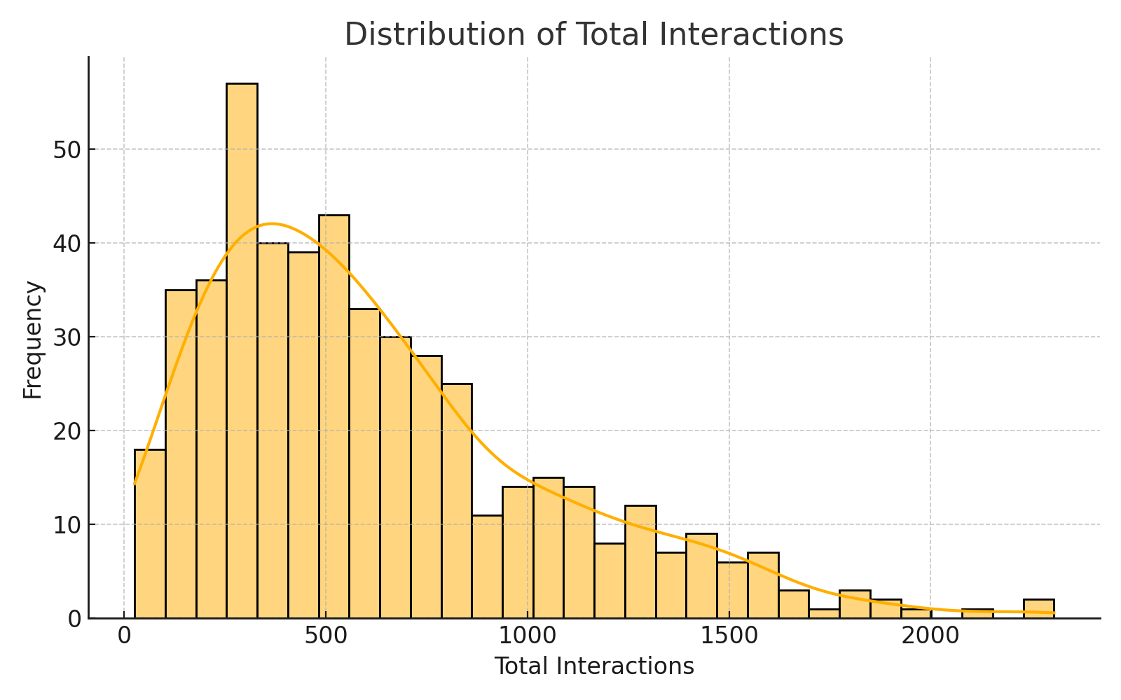
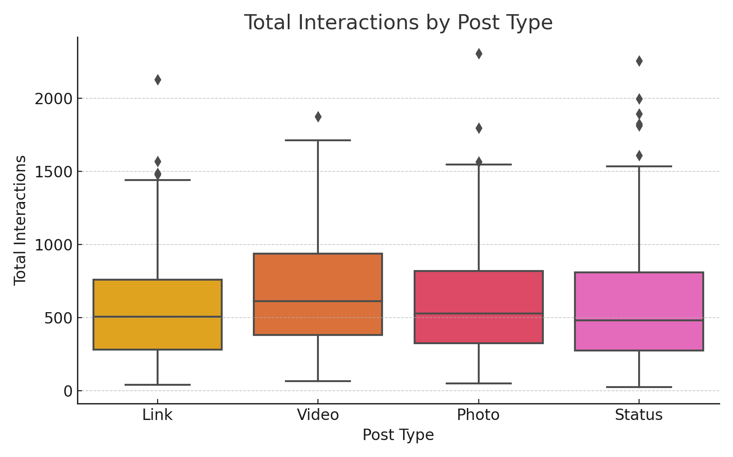
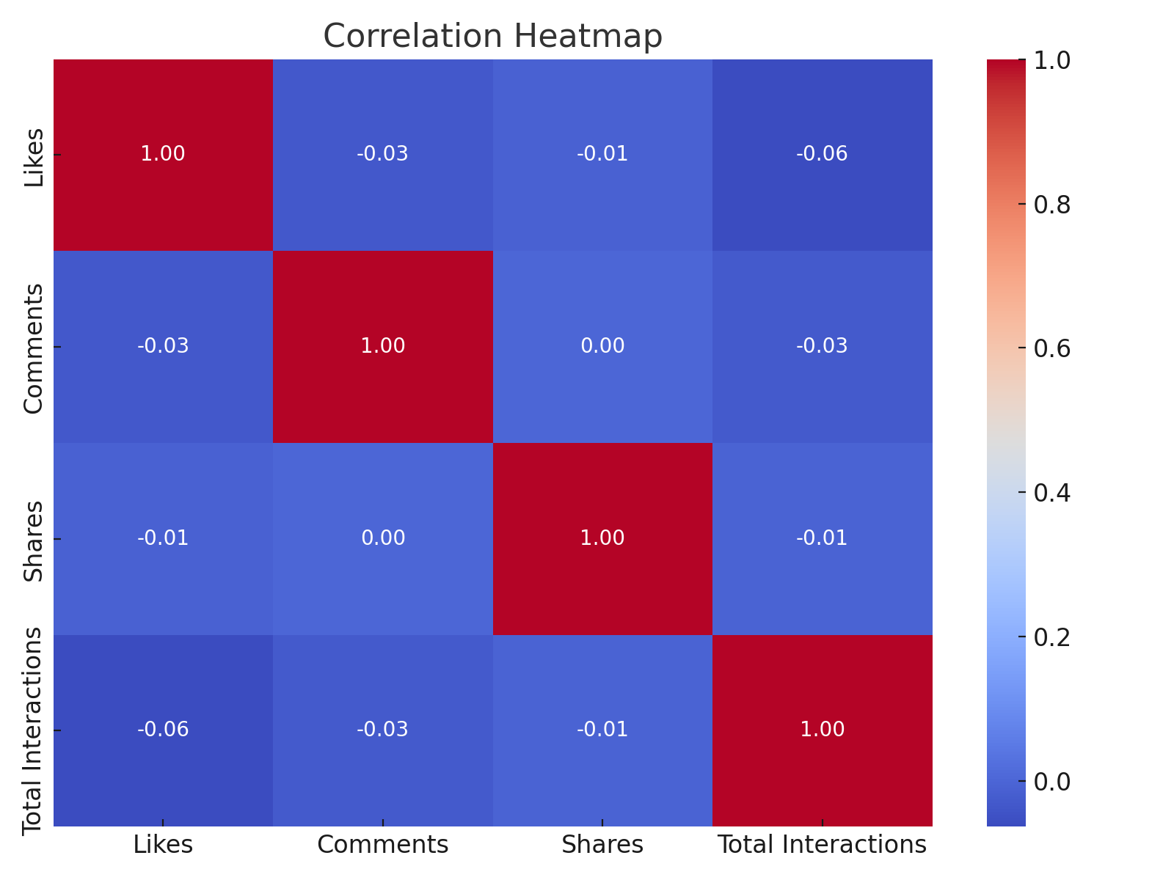
Example Visuals
- Histogram: Total Interactions
- Boxplot: Interactions by Post Type
- Correlation Heatmap
Notes:
These are the key visuals created in the analysis.

Slide 8
Statistical Testing
Hypothesis: Paid promotion increases Total Interactions
Method: Independent two-sample t-test
Result: P-value > 0.05
Conclusion: No statistically significant difference between Paid and Unpaid posts
Notes:
Outlines hypothesis test procedure and interpretation.

Slide 9
Insights
- Post Type is a strong driver of engagement
• Photos and Videos show higher median interactions
- Paid promotion did not show statistically significant improvement
- Suggests content strategy should prioritise high-performing formats
Notes:
Highlights key findings from analysis.

Slide 10
Recommendations
- Focus on high-quality Photos and Videos
- Conduct A/B testing for Paid promotion strategies
- Monitor Likes, Shares, Comments over time
- Consider predictive modelling in future work
Notes:
Provides actionable suggestions for management.

Slide 11
Conclusion
- Cleaned, explored, and analysed Facebook Page data
- Identified actionable drivers of engagement
- Delivered clear recommendations to improve content strategy
Notes:
Wraps up with a summary of the entire capstone.

