Slide 1


INNOVARE TECHNICAL CL UB
THINK BIG, BUILD SMART, PITCH BOLD!

Slide 2





















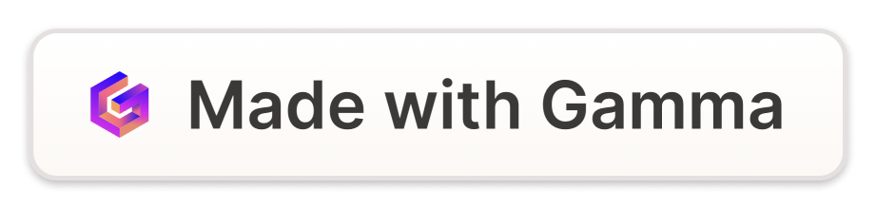
Get instant answers anytime, anywhere.
Helps students & faculty with queries and tasks.
Fee payments, schedules, FAQs, and more.
Connects with college systems for efficiency.
Faster responses, better communication.

Slide 3













College Chatbots:
Benefits, Challenges & Future Potential
퀽�Admissions – FAQs, application guidance 퀽�Course Info – Schedules, syllabi, instructor details 퀽�Financial Aid – Options, deadlines, eligibility
퀽�Automated Task Handling – Reduces workload 퀽�Announcements – Quick & efficient communication 퀽�Research Assistance – Saves time for innovation 퀽�Administrative Tasks – Improves efficiency

Slide 4




Problem and Solutions
🛑
Traditional campus support systems face challenges:
❌ Delayed Responses – Long wait times for student queries
❌ High Workload – Faculty & staff overwhelmed with repetitive tasks
❌ Costly Operations – High expenses for managing support teams
✅
🤖 24/7 AI Assistance – Instant answers, no wait times
퀽�Task Automation – Handles FAQs, schedules, fee queries, and more 퀽�Seamless Integration – Connects with LMS, websites & college portals 퀽�Cost-Effective – Reduces workload and operational costs

Slide 5





How Its Work & Tech stack
🛠
User Interaction – Students/faculty ask queries via website, app, or messaging platforms.
AI Processing – The chatbot uses NLP (Natural Language Processing) to understand the question.
Database & API Access – Fetches relevant data from college databases, LMS, or websites.
Response Generation – Provides instant answers or redirects users to the right department.
Continuous Learning – Improves accuracy using machine learning from past interactions.

Slide 6
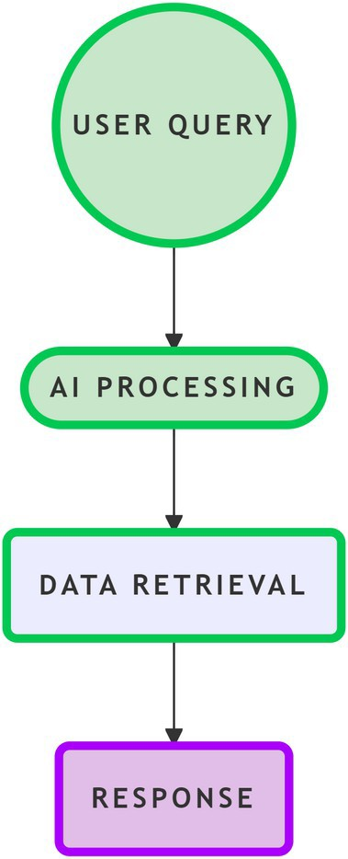
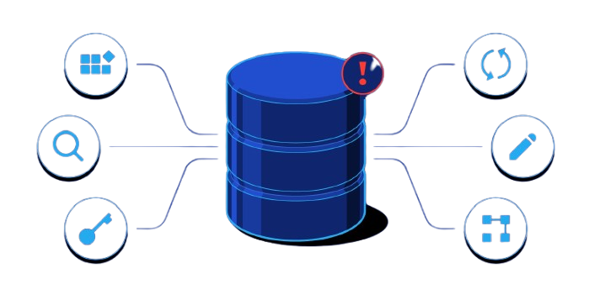

💻 Tech Stack:
AI & NLP: OpenAI GPT, Google Dialogflow, Rasa Backend: Python, Node.js, Flask, Django Frontend: React, Angular, HTML/CSS
Database: MySQL, PostgreSQL, Firebase, MongoDB Cloud & Hosting: AWS, Google Cloud, Azure
Integration: WhatsApp API, Slack API, LMS APIs (Moodle,
Blackboard)

Slide 7


MARKET POTENTIAL & GROWTH
Growing Demand for AI in Education – The global education chatbot market isexpected to grow significantly.
Market Value – Expected to reach $994 million by 2030, growing at a 23.5% CAGR (Compound Annual Growth Rate).
Adoption by Institutions – Universities & colleges increasingly use AI-poweredchatbots to enhance student support.
Rising Student Expectations – Demand for instant, 24/7 assistance.
Seamless Integration – Chatbots integrating with LMS, college portals, and mobile apps.

Slide 8


Feasibility & Viability
퀽�Technical Feasibility ✅
✔Can i t be built? Yes, using AI & NLP models like OpenAI GPT, Google Dialogflow, and Rasa.
✔Major Challenges:
Data Privacy & Security – Needs encryption & compliance (GDPR, FERPA). Accurate
Responses – AI must be trained on real student queries.
Context Awareness – Requires memory-based AI to recall past interactions.
퀽�Scalability 퀼�
✔Can it expand? Yes, it can handle thousands of queries at once.
✔Future Growth:
Integrate with more college systems (admissions, library, student portals).
Advanced AI for better personalization & proactive assistance.

Slide 9

Conclusion
A college chatbot is like a helpful digital assistant for campuses, available 24/7 to answer student and faculty questions instantly. It makes things easier by handling common queries about courses, deadlines, and other college information, reducing the workload for staff. This not only improves student engagement but also helps
colleges save money— some have cut costs by up to 30%! For example, Georgia State University used a chatbot and saw a 3.2% increase in student retention. In the future,
these chatbots can assist with admissions, career guidance, and even mental health support. With the right setup, they make education more accessible, efficient, and
cost-effective.

Slide 10


THA NK
Say
YOU
To Us
“When the College Chatbot answer your queries a t 3 AM…“

