Slide 1



IDEATHON - 2025
‘SAHKARM’
Presented by - ‘SYNTAX 404’

Slide 2
‘SAHKARM’
“Smart Coordination Smart Nation”
Sahkarm is a smart platform that helps the government plan, manage, and track public projects more efficiently. It uses advanced technologies like AI, blockchain, and digital mapping to improve communication, increase transparency, and ensure better use of resources. This makes government projects faster, more organized, and more effective.
Main Idea: Create a digital platform that integrates data from multiple government departments, ensuring that they collaborate before starting any infrastructure work.

Slide 3

We are Team ‘SYNTAX 404'
We are here to Present Project ‘SAHKARM’
Introducing the faces behind our work
★ Kalash - Team Leader and Presenter
✦ Kunjal - Presenter
✦ Hansika - Researcher and Report Maker
✦ Prince – Researcher and PPT designer

Slide 4
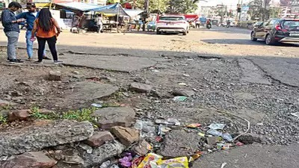
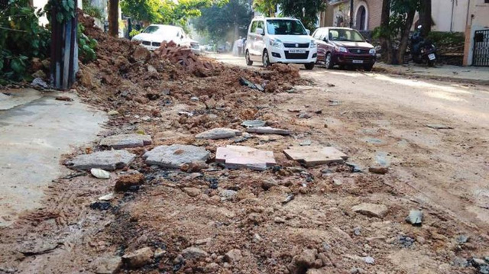
PROBLEMS AND REPORTS
◆ In India, a Lack of coordination between PWD (Road construction) and municipal bodies (sewage, water pipelines, electricity, etc) results in repeated infrastructure repairs, leading to wastage of "tax payers money" unnecessary public inconvenience, and corruption in tender approvals and project execution.
➤ Bhopal Road Repair Delays: A report from Times of India highlights how about 200 km of roads in Bhopal are in urgent need of repair due to damage from pipeline-laying projects. The lack of coordination between municipal bodies and other departments is delaying reconstruction efforts, leading to wasted funds and inefficiencies
- Report by ‘TIMES OF INDIA’
➤ A major dispute arose between the PWD and the Kerala Water Authority (KWA) regarding the poor condition of roads.
➤ Allegations surfaced that the road was damaged due to pipe-laying by KWA, with delays in refilling pits. Both agencies were asked to submit detailed reports to clarify the responsibility​
- Report by ‘TIMES OF INDIA’

Slide 5
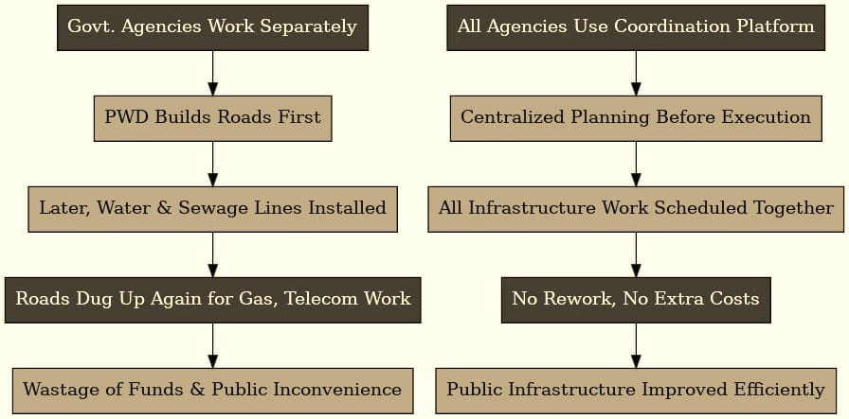
HOW SYSTEM WORKS :
Before
After our Solution

Slide 6

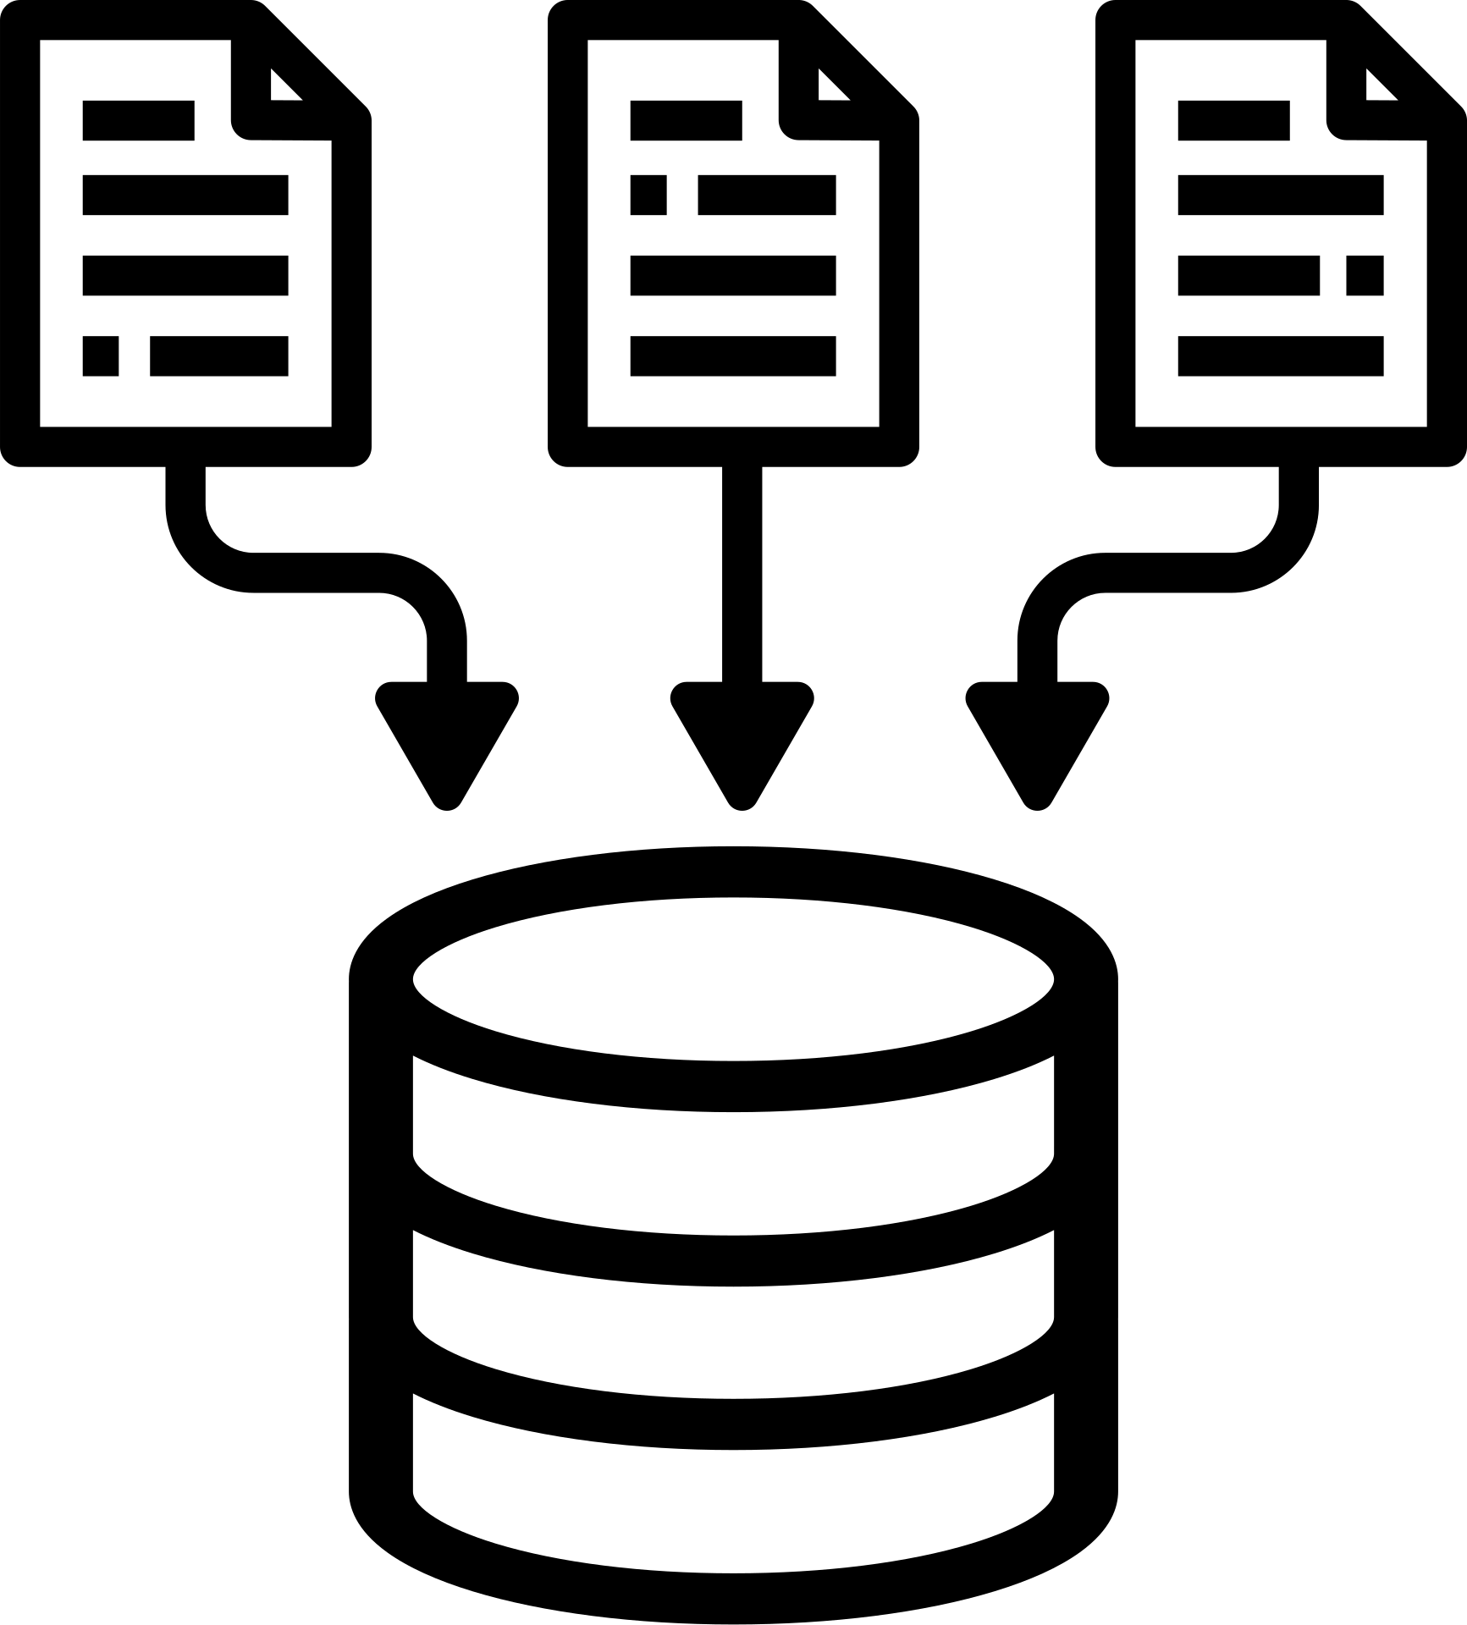
OUR SOLUTION
PWD
GAIL
UGD
◆ A Unified Government Infrastructure Coordination
Platform
A digital platform that integrates data from multiple government bodies (PWD, municipal, water, electricity, telecom, etc.). It ensures that all departments collaborate before initiating any work.
Centralized
DATABASE
The platform would bring together bodies like PWD, municipal corporations, water supply, electricity, telecom, and others to reduce inefficiency, wastage of funds, and improve overall urban planning.
★ Most Optimal Result★

Slide 7

ADDITIONAL FEATURES :
🔹 AI-Powered Decision Making:
AI can analyze project schedules & recommend the best timeline for combined work.
It can predict road degradation based on traffic & weather data.
🔹 Machine Learning for Pattern Recognition:
ML can analyze historical data of road breaks & repairs to detect patterns.
It helps in budget optimization for future projects.
🔹 Blockchain for Transparency:
Ensures tamper-proof project records, avoiding corruption in tenders.

Slide 8
Tech Stack used
Components
Tech Stack
● FrontEnd
→
React.js, Next.js
● BackEnd
→ Node.js, Spring Boot (Java), Django (Python)
● DataBase
→ PostgreSQL, MongoDB (for scalability)
● AI &ML
→ TensorFlow, Scikit-Learn, OpenAI API
● Blockchain
→ Hyperledger Fabric, Ethereum Smart Contracts

Slide 9

Market Potential :
♦ Government Contracts: The platform can be adopted by state or central governments.
♦ Subscription Model: Municipalities & PWDs pay a subscription fee.
♦ Data Analytics Services: Offer insights to governments for better planning.

Slide 10
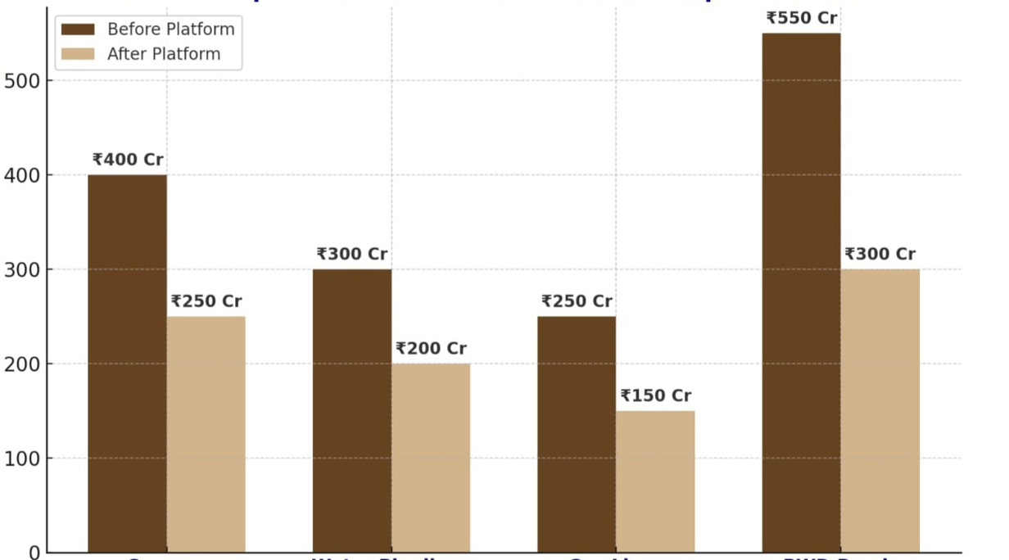
Government Benefits & Viability :→
Cost comparison before or after our implementations
♦ Public Benefit – Enhances efficiency in infrastructure planning and execution.
Government expenditures in crores
♦ Cost Efficiency – Reduces redundant projects and optimizes resource allocation.
Sewage
Water Pipelines
Gas lines
PWD Roads

Slide 11

So Sharks, are you in for investment?
😎

