Slide 1


Gujarat Technological University
NEW L. J. INSTITUTE OF ENGINEERING AND TECHNOLOGY
DEPARTMENT OF CSE(AIML)
ACADEMIC YEAR – 2024
Internship (42)
Urban Services Platform
STUDENT NAME:
Meet Dinesh Kumar Rana.
ENROLLMENT NUMBER:221433142029
HOD NAME:
Dr. Gaytri Pandi
CSE(AIML),
NEW LJIET.
GUIDED BY:
Mr. Mohit Patel
GUIDE NAME:
Mr. Mohit Patel
SEMESTER: 8th(CSE-AIML) DEPARTMENT OF CSE(AIML)

Slide 2
Outline
ABSTRACT
PROBLEMS IN EXISTING SYSTEM
PURPOSE OF THE PROJECT
FUNCTION REQUIREMENTS
SYSTEM MODULES
SYSTEM REQUIREMENTS
FRONT END AND BACK END OF SYSTEM

Slide 3
ABSTRACT
Urban Service Platform
Overview : The Urban Service platform is a comprehensive digital solution designed to connect urban residents with a wide range of essential services, such as plumbing, electrical repairs, cleaning, and carpentry. By creating a seamless interface between service providers and users, this platform simplifies the process of finding reliable professionals and ensures quality service delivery.
This project addresses the challenge of finding skilled and verified service providers in urban areas, offering convenience, transparency, and trust through a centralized system.

Slide 4
2. PROBLEMS IN EXISTING SYSTEM
Lack of Centralized Platform – Many urban service providers rely on disconnected websites, social media, or word-of-mouth, making it hard for users to find and compare services in one place.
Poor User Interface (UI) & User Experience (UX) – Many existing platforms are outdated, complex, or not mobile-friendly, leading to a frustrating experience for users.
No Real-Time Tracking & Scheduling – Customers have no way to track service provider availability or get real-time updates about their booking status.
Inefficient Matching Algorithm – Many platforms do not have an optimized system to match users with the most suitable service provider based on location, ratings, or expertise.

Slide 5
2. PROBLEMS IN EXISTING SYSTEM
Limited Verification & Authentication – Many platforms do not verify service providers properly, leading to security and trust issues..
Payment & Transaction Issues – Existing systems may lack secure digital payment options, refunds, or automated invoicing, making transactions inconvenient..
Scalability Problems – Some platforms struggle to handle large numbers of users, causing slow performance, crashes, or downtime during peak hours.
Weak Security Measures – Existing systems might lack proper encryption, leading to potential data breaches or unauthorized access to customer and service provider information.

Slide 6
3. PURPOSE OF THE PROJECT
The Urban Service Platform is a comprehensive digital solution designed to connect urban residents with verified service providers for essential home services like plumbing, electrical repairs, cleaning, and carpentry. It simplifies service booking, ensures transparent pricing, and enhances trust through verified professionals, customer reviews, and secure transactions. With real-time scheduling, automated service tracking, and seamless digital payments, the platform provides a user-friendly and efficient way for customers to access reliable services while empowering service providers with better visibility and business management tools.

Slide 7
4. FUNCTION REQUIREMENTS
1. User Management
User registration and login (Admin, Service Providers, Customers).
Role-based access control with specific permissions.
2. Service Management
Service provider registration and profile creation.
Categorization of services (Plumbing, Electrical, Cleaning, etc.)
3. Booking & Scheduling
Customers can book services for immediate or future appointments.
Real-time service provider availability and scheduling.

Slide 8
4. FUNCTION REQUIREMENTS
4. Payment & Transactions
Integration of secure payment gateways (UPI, Cards, Wallets).
Auto-generated invoices for completed transactions.
5. Notification & Alerts
Booking confirmations and service updates via Email/SMS/App.
Reminders for upcoming or rescheduled services.
6. Review & Feedback System
Customers can rate and review service providers.
Display of verified customer feedback for transparency.

Slide 9
5. SYSTEM MODULES
The Urban Service Platform consists of several interconnected modules that facilitate smooth interactions between customers, service providers, and administrators. Each module ensures a structured and efficient service management system.
1. User Management Module
Handles user registration, login, and authentication (Admin, Service Providers, Customers).
Implements role-based access control (RBAC) to manage user permissions.
2. Service Management Module
Allows service providers to register, list, and manage their services.
Categorizes services (Plumbing, Electrical, Cleaning, etc.).

Slide 10
5. SYSTEM MODULES
3. Booking & Scheduling Module
Facilitates real-time service booking and appointment scheduling.
Displays service providers’ availability to customers.
Tracks booking status (Pending, In Progress, Completed, Cancelled).
4. Payment & Transaction Module
Integrates secure payment gateways (UPI, Cards, Wallets, Net Banking).
Generates automated invoices after service completion.
Maintains transaction history for customers and providers.
5. Notification & Alert Module
Sends real-time alerts via Email, SMS, or Push Notifications.

Slide 11
6. SYSTEM REQUIREMENTS
System Requirements for Urban Services Platform (FARM Stack - FastAPI, React, MongoDB).
The system requirements for the Urban Services Platform, built using the FARM stack (FastAPI, React, MongoDB), are divided into hardware, software, and network requirements to ensure scalability, security, and high performance.

Slide 12
7. FRONT END AND BACK END OF SYSTEM
Frontend (React.js - User Interface)
Framework: React.js (with Next.js for SSR if needed)
Package Manager: npm / yarn
UI Library (Optional): Material-UI / Bootstrap / TailwindCSS
State Management: Redux / React Context API, Routing: React Router
Backend (FastAPI - Business Logic & API Handling)
Runtime: Python 3.8+
Framework: FastAPI
API Authentication: JWT / OAuth
Payment Integration: Stripe / Razorpay / PayPal API

Slide 13
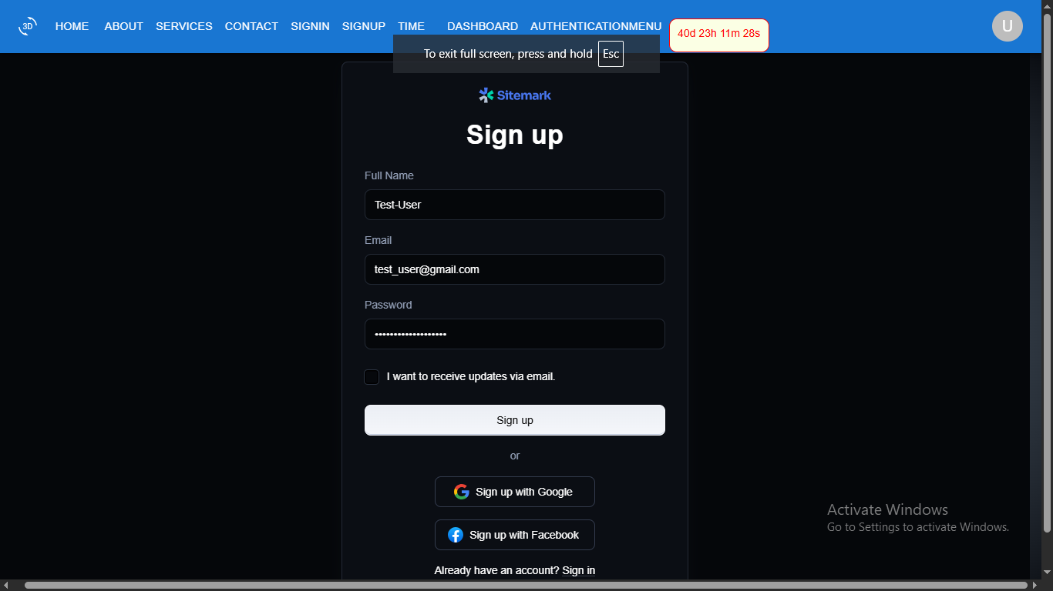
8. IMPLEMENTATION SCREENSHOT
The User Registration Form:

Slide 14
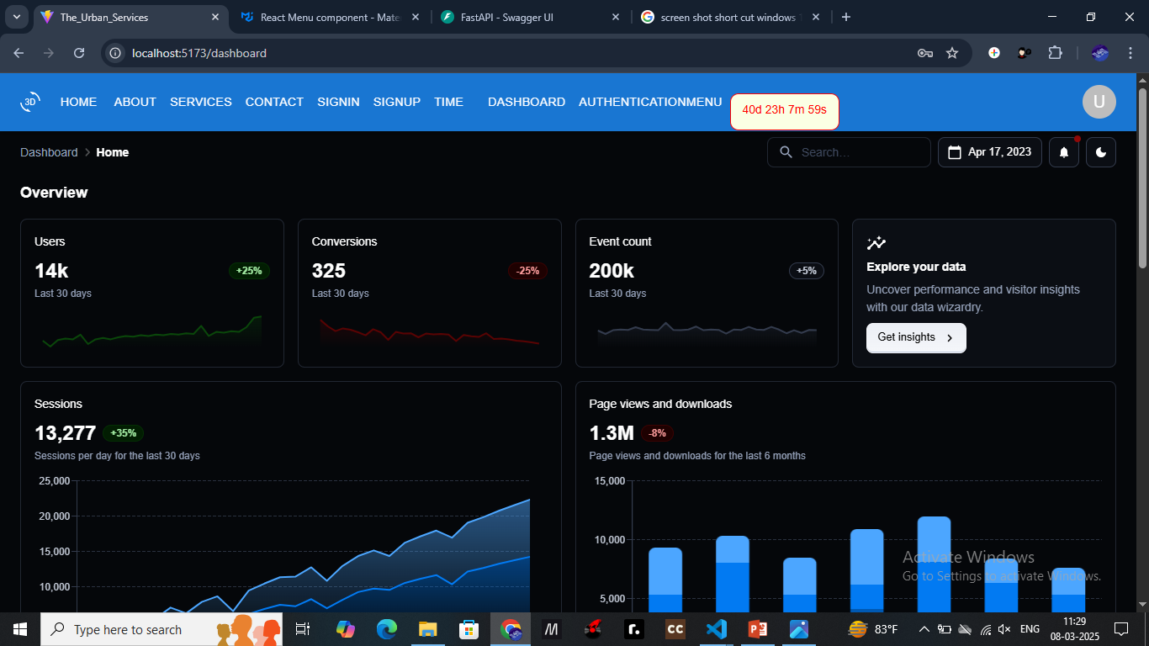
8. IMPLEMENTATION SCREENSHOT
The Main Dashboard For The Statistics:

Slide 15
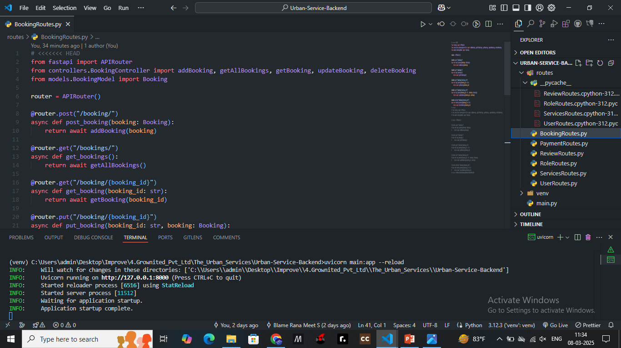
8. IMPLEMENTATION SCREENSHOT
The Back-End For With Fast - Api:

Slide 16


