Slide 1

USER GUIDE
Docusaurus — User Guide
Write, preview, illustrate and export your documentation
InnovateIt-ak / docusaurus • June 25, 2026

Slide 2
INTRODUCTION
What you can do
• Write — author your docs in Markdown / MDX, as usual.
• Assemble — reuse fragments with the #include directive — no import needed.
• Illustrate — embed architecture diagrams (LikeC4) and sketches (tldraw).
• Preview — live preview: any edit (even an included fragment) refreshes instantly.
• Export — generate one branded PDF and publish the site in a single command.
Docusaurus — user guide
2

Slide 3
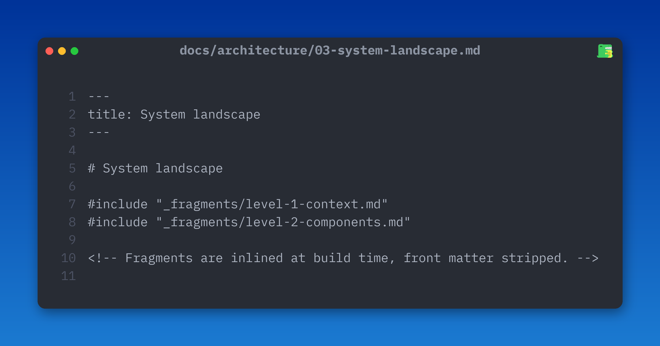
WRITE — MODULAR DOCUMENTATION
Assemble with #include
• Goal — compose one page from several files.
• write #include "path/file.md" on its own line.
– no import: content is inserted right there.
– path relative to the file; front matter stripped.
• Tip — an _fragments/ folder (underscore) stays out of the sidebar.
Docusaurus — user guide
3

Slide 4
PREVIEW — WORKFLOW
Run and preview the site
• make dev — starts the local server with live preview.
• Hot reload — edit a page or an included fragment → the preview updates itself.
• make prod — production build served behind Caddy.
• No toolchain to install — everything runs via Docker / docker-compose.
Docusaurus — user guide
4

Slide 5
REUSE — SINGLE SOURCE OF TRUTH
Reusable blocks: "Prerequisites"
• Markdown partial — factor a recurring block (e.g. "Prerequisites") into one file.
• Global MDX component — usable in any page, with no import.
• Nested includes — a fragment can include others (cycles are detected).
• Benefit — update the block once → every page follows.
Docusaurus — user guide
5

Slide 6
ILLUSTRATE — ARCHITECTURE DIAGRAMS
LikeC4 & tldraw
• LikeC4 — architecture diagrams (C4 model) described as text.
– /likec4 page to explore the interactive diagram.
– views: context, components, dev / prod deployments, use cases.
• tldraw — /tldraw page for free-form sketches and whiteboarding.
• Architecture docs — ready chapters: summary, stakeholders, ADRs, building blocks…
Docusaurus — user guide
6

Slide 7
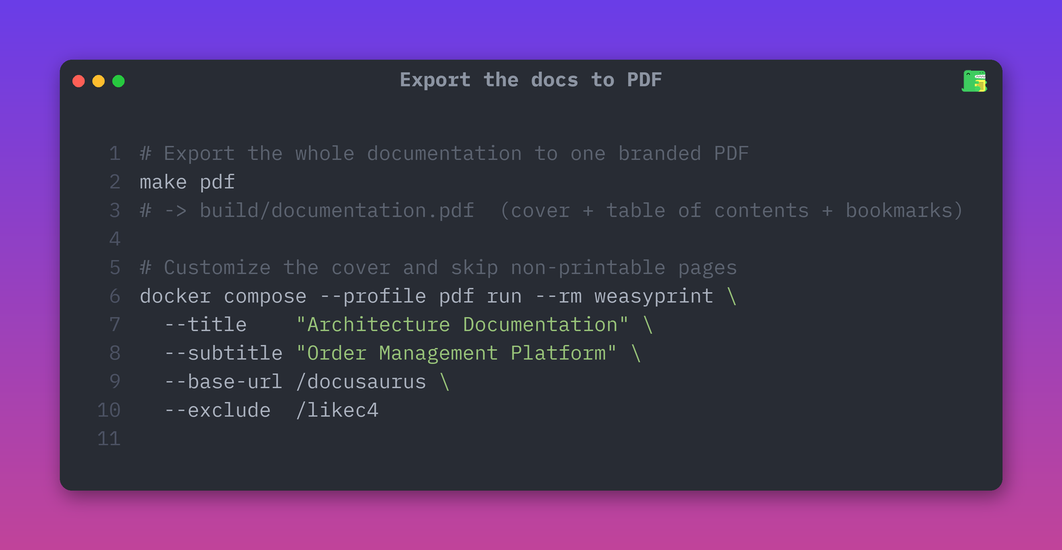
EXPORT — PROFESSIONAL PDF
Export the docs to PDF
• make pdf — assembles the whole docs into one branded PDF.
• cover page, table of contents (real page numbers), bookmarks.
• Customizable — title, subtitle, baseUrl, pages to exclude.
– e.g. exclude the interactive LikeC4 page (not printable).
Docusaurus — user guide
7

Slide 8
AUTOMATE — CI/CD
What happens on every push
• Site published — the site + documentation.pdf are deployed to GitHub Pages.
• PDF artifact — on every push / pull request the PDF is built and downloadable.
• Release PDF — on each release, the architecture PDF is proposed as a Pull Request.
• Nothing manual — you push, the pipeline does the rest.
Docusaurus — user guide
8

Slide 9
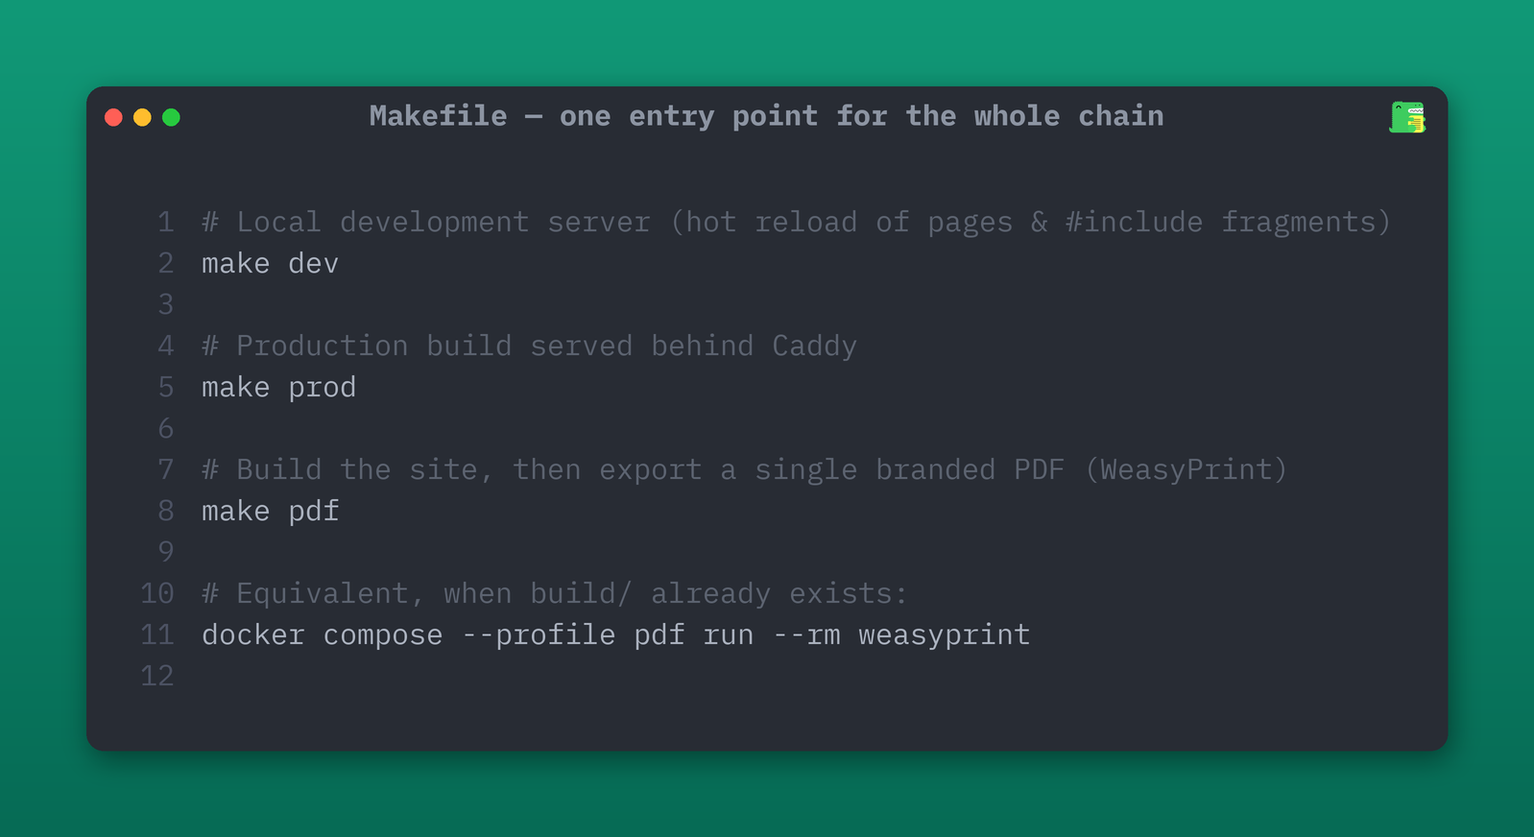
CHEAT SHEET — COMMANDS
The essential commands
• make dev — local server + live preview.
• make prod — production build (Caddy).
• make pdf — export the docs to PDF.
• One entry point — the Makefile orchestrates the whole chain.
Docusaurus — user guide
9

Slide 10
Cheat sheet
✓ make dev — start the local server (live preview)
✓ #include "file.md" — assemble reusable fragments
✓ "Prerequisites" — reuse one block everywhere, single source
✓ LikeC4 / tldraw — browse the architecture diagrams
✓ make pdf — export the whole docs as one branded PDF
✓ git push — site + PDF published automatically (CI/CD)
Happy writing! — InnovateIt-ak / docusaurus

