Slide 1

NETWORK AUTOMATION TOOLS V
Notes:
Welcome to Day 5, the final day. Over four days you moved from manual CLI to Ansible, to Python, to Terraform.
Today we bring it together on Arista EOS - a platform built for automation - and CloudVision, which manages a whole fleet from one place.
By the end you will automate Arista devices three ways and see how everything from the week fits into one workflow.

Slide 2

Network Automation Tools – Day 5
Notes:
Set the tone: Arista was designed with automation in mind, so many ideas from the week apply cleanly here.
This day also serves as the course capstone - we close by tying all five days together.

Slide 3
Where Day 4 Left Off
You built the AWS network as code with Terraform
init, plan, apply, and destroy became routine
You created a VPC, subnets, routing, and security groups
Outputs handed resource IDs to other tools
Today: automating Arista EOS and CloudVision
Virtualization
Notes:
Anchor Day 5 in Day 4. Terraform built the network; earlier days configured devices in it.
Today we return to device automation, on a platform - Arista EOS - that was built for it, and then scale up with CloudVision.
Frame the day as both new material and the capstone that ties the week together.

Slide 4

Agenda for Day 5
Arista EOS fundamentals and eAPI
Programmatic access with pyeapi
Automating Arista with Ansible
CloudVision - telemetry and change control
CloudVision automation and validated designs
Three hands-on labs and course wrap-up
Virtualization
Notes:
Preview the day: understand EOS and its API, automate it with Python and Ansible, then manage the fleet with CloudVision.
Each concept feeds the labs - eAPI/pyeapi in Lab 13, Ansible in Lab 14, CloudVision in Lab 15.
The final section wraps up the whole course and points to what to learn next.

Slide 5
Arista EOS Fundamentals
Virtualization
Notes:
Section one: what makes Arista EOS different and why it is automation-friendly.
The theme: EOS was designed as a programmable, Linux-based platform from day one.

Slide 6

Why Arista EOS?
Virtualization
Virtualization
A single EOS image across the entire product line
Built on standard Linux - open and programmable
Automation-first: eAPI, Python, and streaming telemetry
Popular in data centers and cloud networks
Consistent behavior makes automation predictable
Notes:
Arista's pitch is consistency and openness: one EOS image everywhere, built on Linux.
That consistency is a gift for automation - the same commands and APIs behave the same across the fleet.
EOS shipped with programmatic access as a first-class feature, not an afterthought.

Slide 7
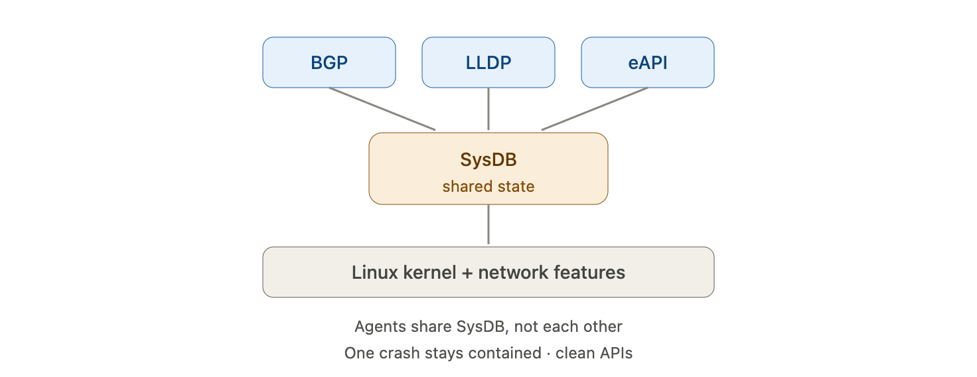
The EOS Architecture
Virtualization
Virtualization
A Linux kernel with network features layered on top
State is held in a central database called SysDB
Processes read and write shared state, not each other
A crash in one agent does not take down the box
This design is what enables clean telemetry and APIs
Notes:
EOS keeps all state in a central database, SysDB, that every process reads and writes.
Because agents talk to the database instead of each other, one failing agent does not crash the system.
That shared-state model is also why streaming telemetry and APIs are so natural on EOS - the data is already centralized.

Slide 8
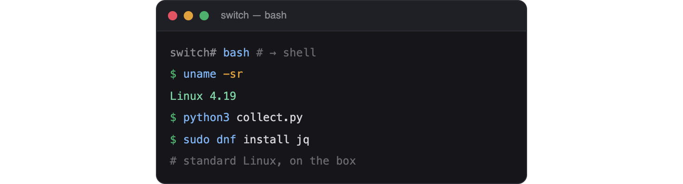
EOS and Linux
Virtualization
Virtualization
Drop to a real bash shell on the switch
Run standard Linux tools and scripts on-box
Install packages and custom agents
Familiar to anyone with Linux experience
Lowers the barrier to on-device automation
Notes:
EOS is genuinely Linux underneath - you can open a bash shell right on the switch.
This means standard tooling and even your own scripts can run on the device.
For engineers with Linux skills, a lot of that knowledge transfers directly.

Slide 9
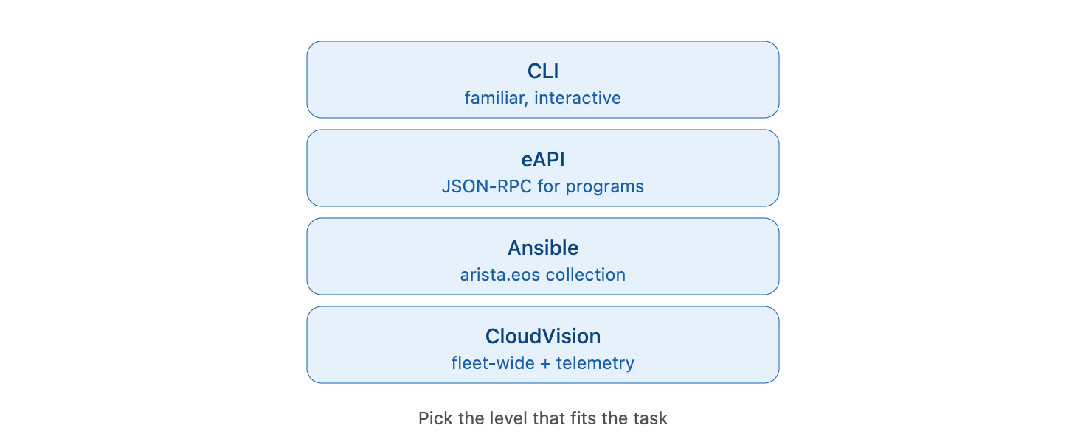
Management Options at a Glance
Virtualization
Virtualization
CLI - familiar interactive management
eAPI - JSON-RPC over HTTP for programs
Ansible - the arista.eos collection
CloudVision - fleet-wide management and telemetry
Pick the level that fits the task
Notes:
Give students the map of how you can manage EOS, from hands-on CLI to fleet-wide CloudVision.
Today we touch each layer: eAPI and pyeapi for scripts, Ansible for playbooks, CloudVision for scale.
The point is that these are complementary levels, not competing choices.

Slide 10
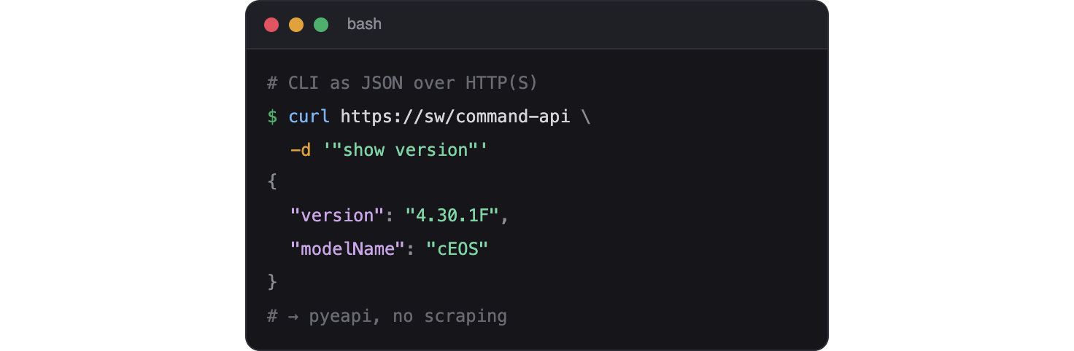
The eAPI Interface
Virtualization
Virtualization
eAPI exposes the CLI as a programmable API
Send commands, get structured JSON back
Runs over HTTP or HTTPS
The foundation for pyeapi and many tools
No screen-scraping required
Notes:
eAPI is the star of the Arista automation story - it turns every CLI command into an API call.
Crucially, it returns structured JSON, so there is nothing to parse.
Most Arista automation tools, including pyeapi and the Ansible modules, sit on top of eAPI.

Slide 11

Enabling eAPI
Virtualization
Virtualization
Enter management api http-commands
Enable the protocol - HTTPS is preferred
Confirm with show management api http-commands
Authenticate with a device username and password
Restrict access with an ACL in production
Notes:
eAPI is off by default; enabling it is a few lines of config under management api http-commands.
Prefer HTTPS, and confirm the API is running and active with the show command.
In production, lock it down with an access list - an open management API is a risk.

Slide 12
Arista EOS exposes a programmable interface that returns structured JSON. What is it called?
A. NETCONF
B. eAPI
C. SNMP
D. Syslog
Notes:
Knowledge check on Arista basics.
Prompt: which is Arista's JSON-RPC API over HTTP?

Slide 13
Arista EOS exposes a programmable interface that returns structured JSON. What is it called?
A. NETCONF
B. eAPI
C. SNMP
D. Syslog
Notes:
Answer: B - eAPI. It presents the CLI as an API and returns structured JSON.
NETCONF and SNMP are standards EOS also supports, but eAPI is Arista's native JSON-RPC interface.

Slide 14
eAPI and pyeapi
Virtualization
Notes:
Section two: talk to EOS from Python, first with raw eAPI, then with the pyeapi library.
This is the Arista equivalent of the Netmiko and NAPALM work from Day 3.

Slide 15
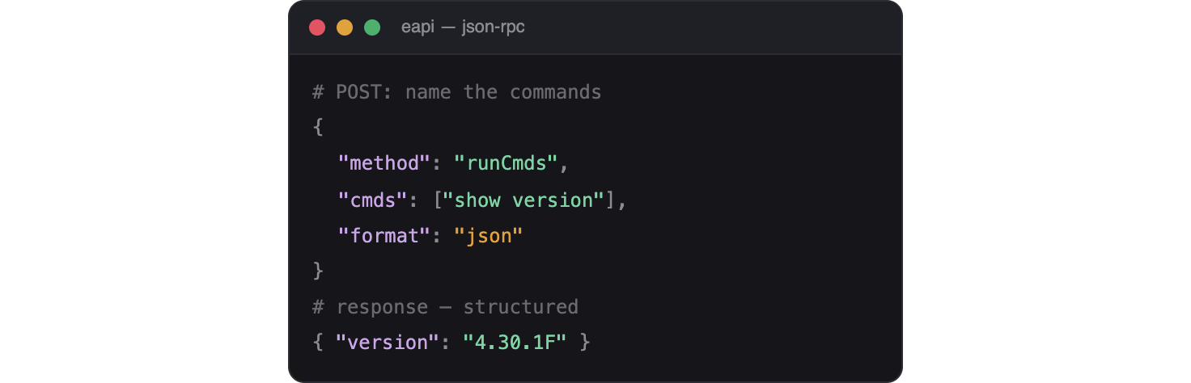
What Is eAPI?
Virtualization
Virtualization
A JSON-RPC API served by the switch over HTTP
You POST a list of CLI commands
The switch returns results as JSON
Ask for text or fully structured output
The programmatic front door to EOS
Notes:
eAPI works over JSON-RPC: you POST a request naming the commands you want run.
The response is JSON, and you can request structured data rather than raw text for most commands.
This makes EOS especially pleasant to automate compared with pure screen-scraping.

Slide 16
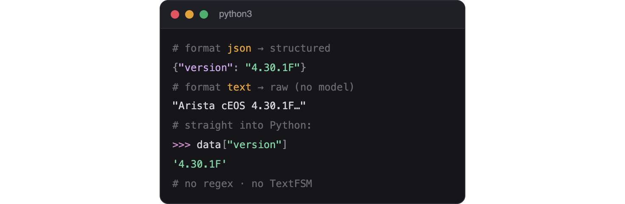
JSON-RPC and Structured Output
Virtualization
Virtualization
Request lists the commands and an output format
Format json gives structured data per command
Format text gives raw CLI output when needed
Structured output maps straight to Python dicts
No regex, no TextFSM templates required
Notes:
The request specifies both the commands and the format - json for structured data, text when a command has no model.
Structured JSON drops straight into Python as dictionaries, so you skip the parsing step entirely.
Contrast with Day 3, where Cisco output needed TextFSM - here the device does the structuring for you.

Slide 17
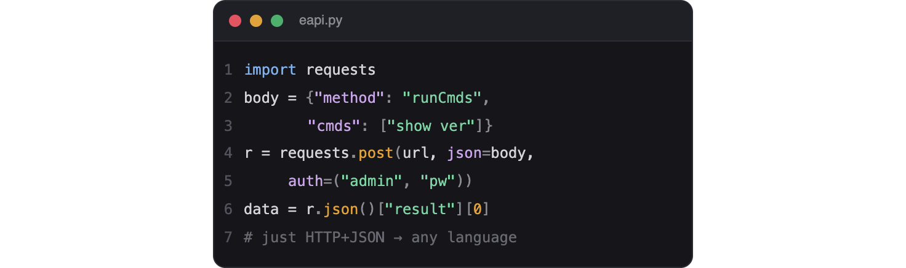
Calling eAPI with requests
Virtualization
Virtualization
Build a JSON-RPC payload with method runCmds
POST it to the switch over HTTPS with requests
Pass device credentials with basic auth
Read the JSON result and index into it
Works from any language, not just Python
Notes:
You can call eAPI with the same requests library from Day 3 - build the JSON-RPC body and POST it.
The method is runCmds, and the result carries one entry per command you sent.
Because it is just HTTP and JSON, any language can drive eAPI, which is part of its appeal.

Slide 18

The pyeapi Library
Virtualization
Virtualization
pyeapi is Arista's official Python client for eAPI
Handles the JSON-RPC details for you
Configure devices in an eapi.conf file
Connect by name, then run commands
Cleaner than hand-building requests
Notes:
pyeapi wraps eAPI so you do not assemble raw JSON-RPC by hand.
It reads connection details from an eapi.conf file, so credentials stay out of your script.
Think of it as the Arista counterpart to Netmiko - the convenient, purpose-built client.

Slide 19
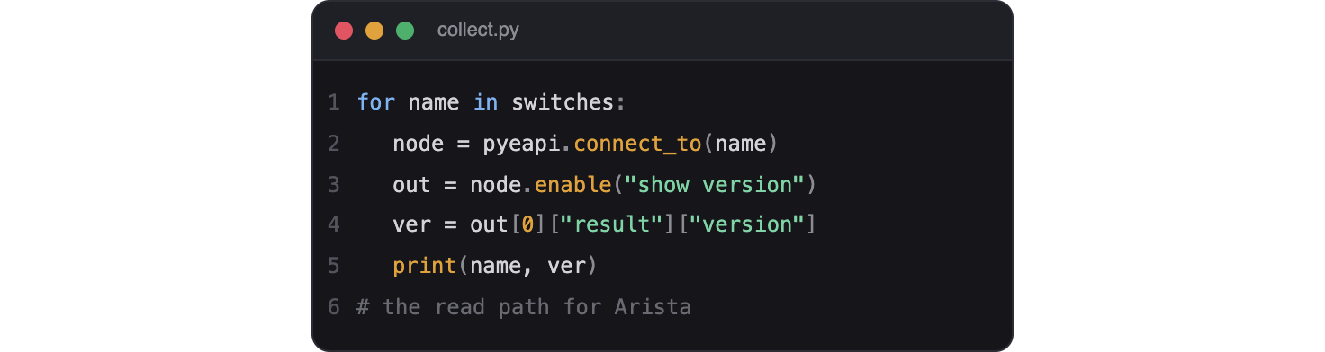
Running Show Commands
Virtualization
Virtualization
node.enable() runs show commands
Results come back as structured Python data
Index into the result by key, like a dictionary
Collect state across many switches in a loop
The read path for Arista automation
Notes:
With pyeapi, enable() runs show commands and hands back structured data.
You navigate the result by key - the same list-of-dictionaries fluency from earlier days pays off again.
Loop over a list of nodes to gather fleet-wide state, exactly as you did with Netmiko.

Slide 20

Sending Configuration
Virtualization
Virtualization
node.config() applies configuration commands
Pass a list of config lines to run
Changes take effect immediately on the device
Combine reads and writes in one script
The write path for Arista automation
Notes:
config() is the write path - hand it a list of config lines and pyeapi applies them.
This mirrors Netmiko's send_config_set from Day 3.
A typical script reads current state, decides, then writes - all through pyeapi.

Slide 21
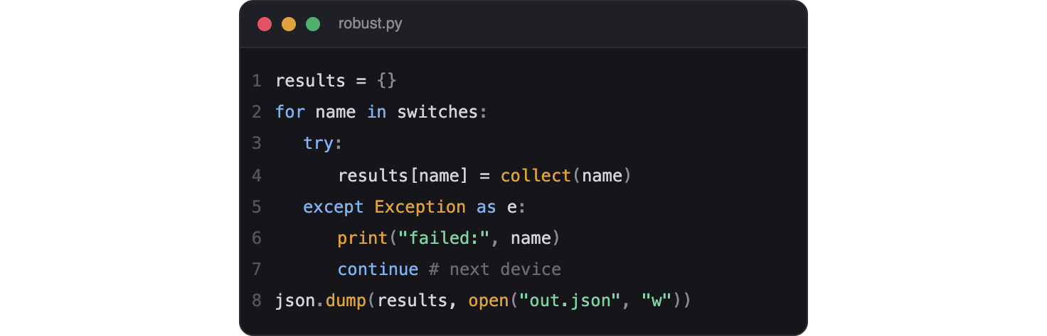
Handling Responses
Virtualization
Virtualization
Every command returns a structured result
Check for errors before trusting the data
Wrap calls in try and except for robustness
Log failures and continue across devices
Save structured results as JSON
Notes:
Robust scripts inspect the response and handle errors rather than assuming success.
Wrap eAPI calls in try/except so one unreachable switch does not stop the run - the same discipline as Day 3.
Structured results save cleanly to JSON for reporting or feeding other tools.

Slide 22
eAPI responses are returned in which format, making them easy to parse?
A. Raw CLI text only
B. JSON
C. CSV
D. Syslog messages
Notes:
Knowledge check on eAPI output.
Prompt: what structured format does eAPI return?

Slide 23
eAPI responses are returned in which format, making them easy to parse?
A. Raw CLI text only
B. JSON
C. CSV
D. Syslog messages
Notes:
Answer: B - JSON. eAPI returns structured JSON, so no scraping or templates are needed.
You can request text output for a specific command, but structured JSON is the default advantage.

Slide 24
Automating Arista with Ansible
Virtualization
Notes:
Section three: everything you learned about Ansible applies to Arista through the arista.eos collection.
The workflow is identical to Days 1 and 2 - only the modules change.

Slide 25

The arista.eos Collection
Virtualization
Virtualization
Install with ansible-galaxy collection install arista.eos
Provides eos_command, eos_config, eos_facts, and more
Connects over eAPI or SSH
Same playbook structure you already know
Idempotent config, just like cisco.ios
Notes:
The arista.eos collection is the direct parallel to cisco.ios from Day 1.
Your playbook skills transfer completely - only the module names and connection settings differ.
It can drive devices over eAPI (httpapi) or SSH (network_cli).

Slide 26
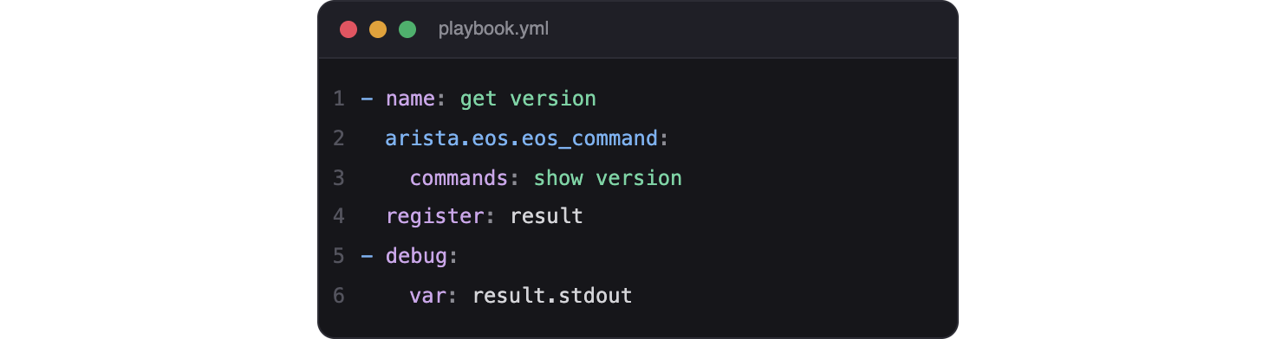
eos_command
Virtualization
Virtualization
Runs show and operational commands
Register the output for later use
Returns text or structured data
The read counterpart to eos_config
Mirrors ios_command from Day 1
Notes:
eos_command is the read module - run show commands and register the result.
Everything you learned about register and debug on Day 1 applies unchanged.
It is the Arista twin of ios_command.

Slide 27
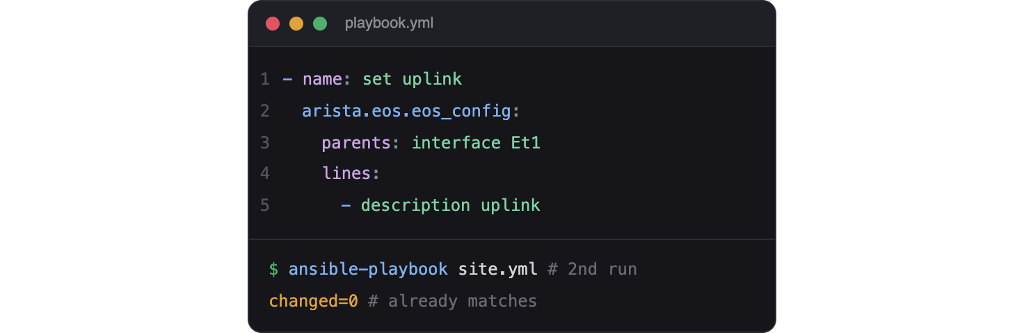
eos_config
Virtualization
Virtualization
Pushes configuration lines idempotently
Use lines and parents like ios_config
Compares against the running config
Reports changed only when it modifies the device
The write module for Arista
Notes:
eos_config works just like ios_config - lines and parents, idempotent by design.
A second run reports changed=0 because the device already matches, exactly as on Cisco.
This is the clearest sign that your Day 1 and 2 skills carry straight over.

Slide 28
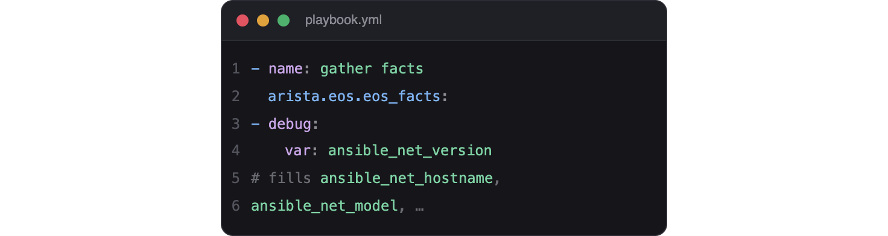
eos_facts
Virtualization
Virtualization
Gathers structured facts from the device
Populates ansible_net_ variables
Feed facts into templates and conditions
Works the same as ios_facts
Reliable, structured device data
Notes:
eos_facts collects normalized facts, filling the ansible_net_ variables you met on Day 1.
Those facts drive templates and when conditions just as before.
The consistency across vendors is the whole point of Ansible's model.

Slide 29
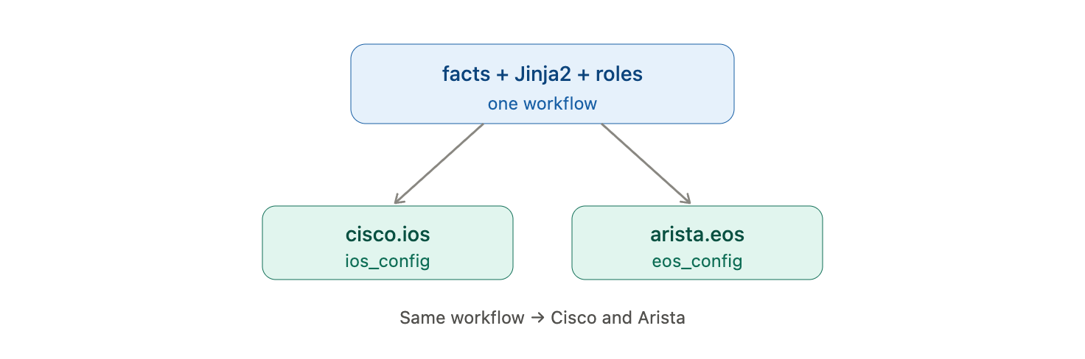
Structured Facts and Templates
Virtualization
Virtualization
Combine eos_facts with Jinja2 templates
Generate EOS config from per-device variables
Reuse the roles pattern from Day 2
One workflow across Cisco and Arista
Vendor-neutral automation in practice
Notes:
This slide closes the loop with Day 2: facts plus Jinja2 plus roles works identically on Arista.
You can literally reuse the roles pattern, swapping the modules for arista.eos.
The takeaway: a single Ansible workflow spans multiple vendors.

Slide 30
Which arista.eos module pushes configuration to an EOS device?
A. eos_command
B. eos_facts
C. eos_config
D. eos_show
Notes:
Knowledge check on the Arista Ansible collection.
Prompt: which module is the write path, like ios_config?

Slide 31
Which arista.eos module pushes configuration to an EOS device?
A. eos_command
B. eos_facts
C. eos_config
D. eos_show
Notes:
Answer: C - eos_config. It applies configuration idempotently, the Arista twin of ios_config.
eos_command runs show commands and eos_facts gathers data; eos_show is not a real module.

Slide 32
CloudVision
Virtualization
Notes:
Section four: CloudVision manages the whole Arista fleet from one place.
It shifts automation from per-device scripts to network-wide, state-driven management.

Slide 33
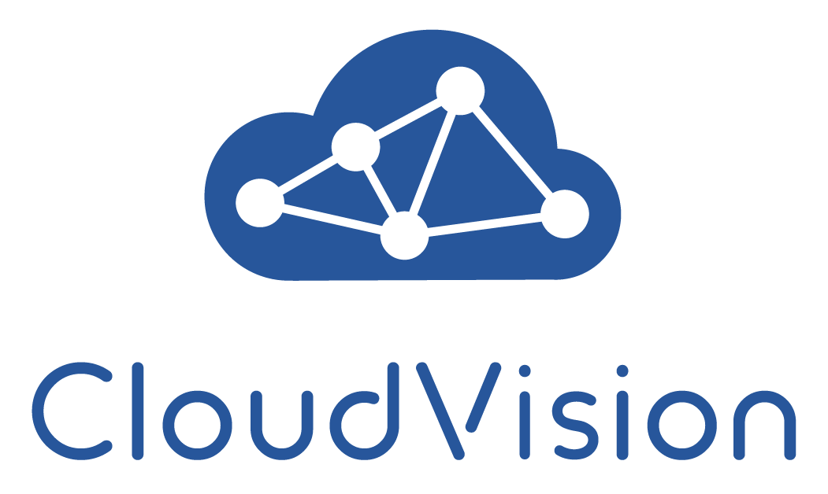
What Is CloudVision?
Virtualization
Virtualization
Arista's platform for fleet-wide management
One place to configure, monitor, and audit
Collects streaming telemetry from every device
Provides change control and rollback
Turns per-device work into network-wide workflows
Notes:
CloudVision, often called CVP, is the single pane of glass for an Arista network.
It centralizes configuration, telemetry, and change control across all devices.
This is the jump from automating one switch to managing the whole fabric as a system.

Slide 34

Streaming Telemetry
Virtualization
Virtualization
Devices stream state to CloudVision continuously
Far richer and faster than SNMP polling
See real-time and historical network state
Detect problems as they happen
The data backbone of CloudVision
Notes:
Instead of polling, EOS streams its state to CloudVision in near real time.
This gives both a live view and a historical record you can rewind through.
Streaming telemetry is what makes CloudVision's monitoring and analytics possible.

Slide 35
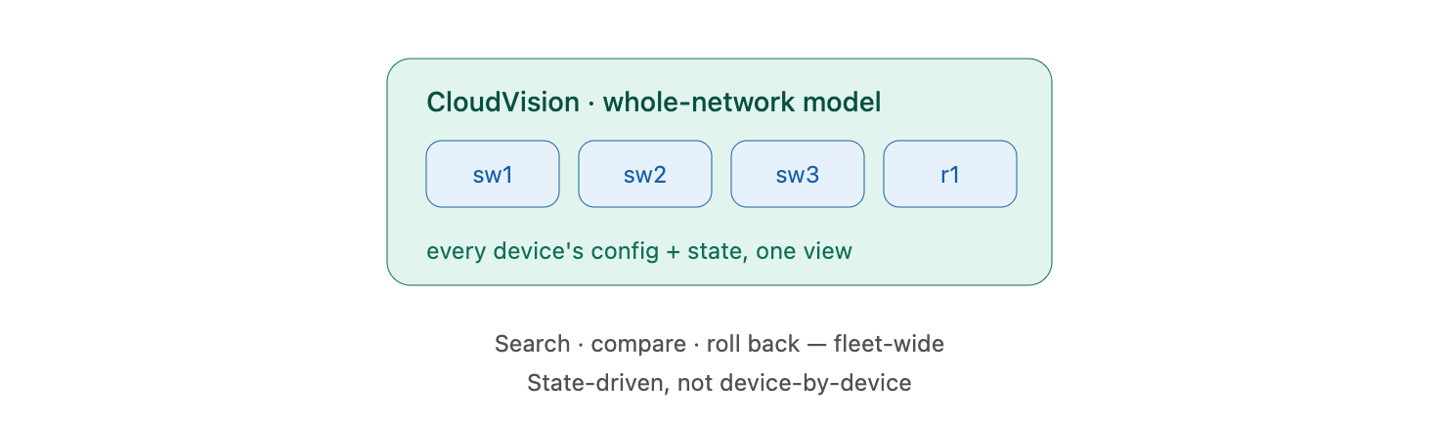
The Network-Wide State
Virtualization
Virtualization
CloudVision holds a model of the whole network
Every device's config and state in one view
Search and compare across the fleet
Roll back the entire network to a point in time
State-driven, not device-by-device
Notes:
CloudVision maintains a model of the entire network's configuration and state.
That lets you search, compare, and even roll the whole fabric back to an earlier point.
The mindset shift is from managing devices to managing the network as one entity.

Slide 36
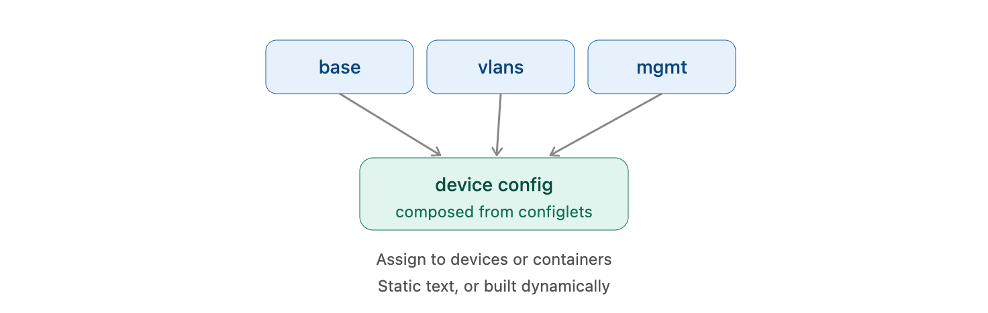
Configlets
Virtualization
Virtualization
A configlet is a reusable block of configuration
Assign configlets to devices or containers
Compose a device config from several configlets
Static text or generated by a builder
The building block of CloudVision config
Notes:
Configlets are CloudVision's unit of configuration - reusable blocks you assign to devices.
A device's full config is composed from the configlets attached to it and its container.
They can be static or generated dynamically by a configlet builder.

Slide 37
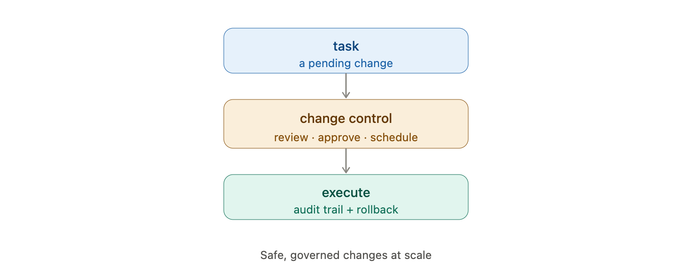
Tasks and Change Control
Virtualization
Virtualization
A pending change becomes a task
Tasks are grouped into change controls
Review, approve, and schedule changes
Execute with an audit trail and rollback
Safe, governed changes at scale
Notes:
CloudVision does not apply changes silently - it creates tasks that must be executed.
Grouping tasks into change controls adds review, approval, and scheduling.
This governance, with a full audit trail and rollback, is why enterprises adopt CloudVision.

Slide 38
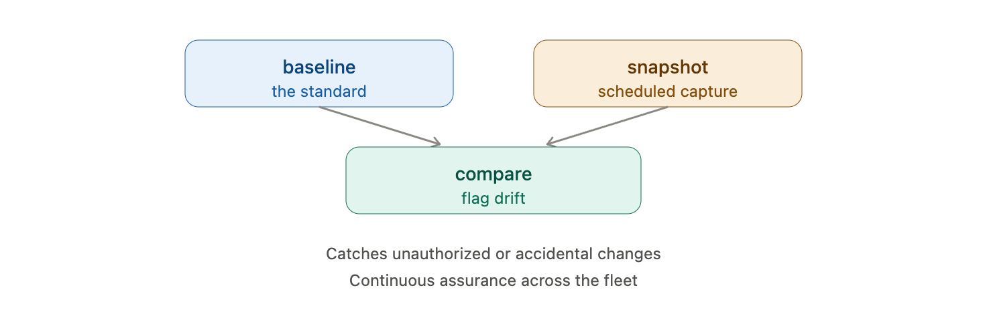
Snapshots and Compliance
Virtualization
Virtualization
Snapshots capture device state on a schedule
Compare against a baseline for drift
Compliance checks flag non-standard config
Catch unauthorized or accidental changes
Continuous assurance across the fleet
Notes:
Snapshots and compliance checks turn CloudVision into a continuous auditor.
Compare current state against a baseline to spot drift or unauthorized changes automatically.
This is the compliance story from Day 1, now applied fleet-wide and continuously.

Slide 39
CloudVision Automation
Virtualization
Notes:
Section five: drive CloudVision itself from code with its API and the cvprac library.
Now you automate the automation platform - configlets, tasks, and change control as code.

Slide 40
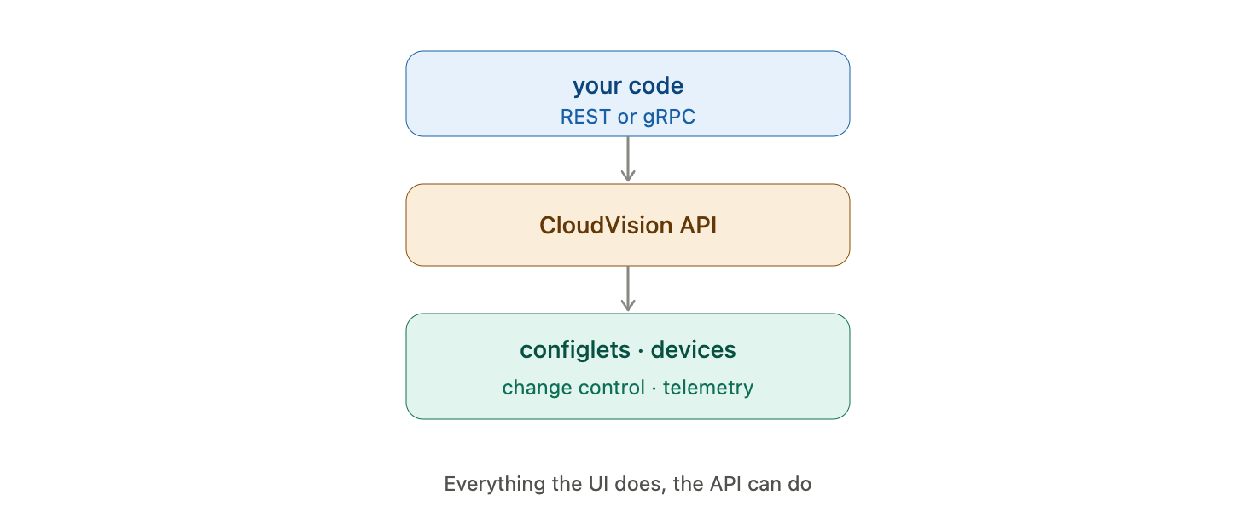
The CloudVision API
Virtualization
Virtualization
CloudVision exposes a full REST and gRPC API
Manage configlets, devices, and change control
Query telemetry and compliance programmatically
Everything the UI does, the API can do
The basis for automating CloudVision
Notes:
CloudVision is fully API-driven - the web UI is just one client of the same API.
That means every action, from assigning a configlet to launching a change control, can be scripted.
You can also pull telemetry and compliance data out for your own dashboards.

Slide 41
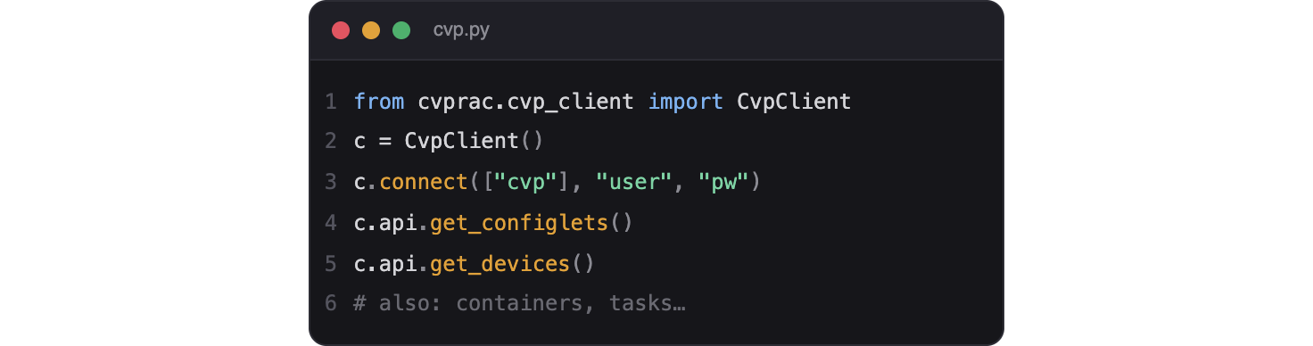
The cvprac Library
Virtualization
Virtualization
cvprac is Arista's Python client for CloudVision
Wraps the REST API in convenient methods
Authenticate, then call methods by name
Manage configlets, containers, and tasks in code
The practical way to automate CloudVision
Notes:
cvprac is to CloudVision what pyeapi is to a single switch - the official Python client.
It handles authentication and wraps the REST calls in clean methods.
This is how teams manage CloudVision as code rather than by clicking.

Slide 42
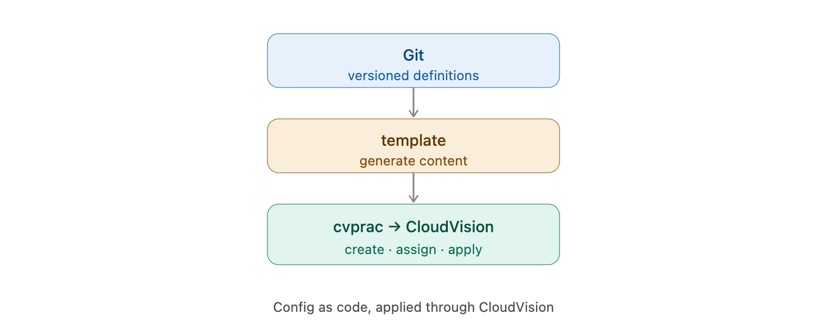
Managing Configlets in Code
Virtualization
Virtualization
Create and update configlets programmatically
Assign them to devices or containers
Generate configlet content from templates
Version configlet definitions in Git
Config as code, applied through CloudVision
Notes:
With cvprac you create, update, and assign configlets from a script.
Generate configlet content from Jinja2 templates and store the definitions in Git - config as code.
CloudVision then handles turning those configlets into device changes.

Slide 43
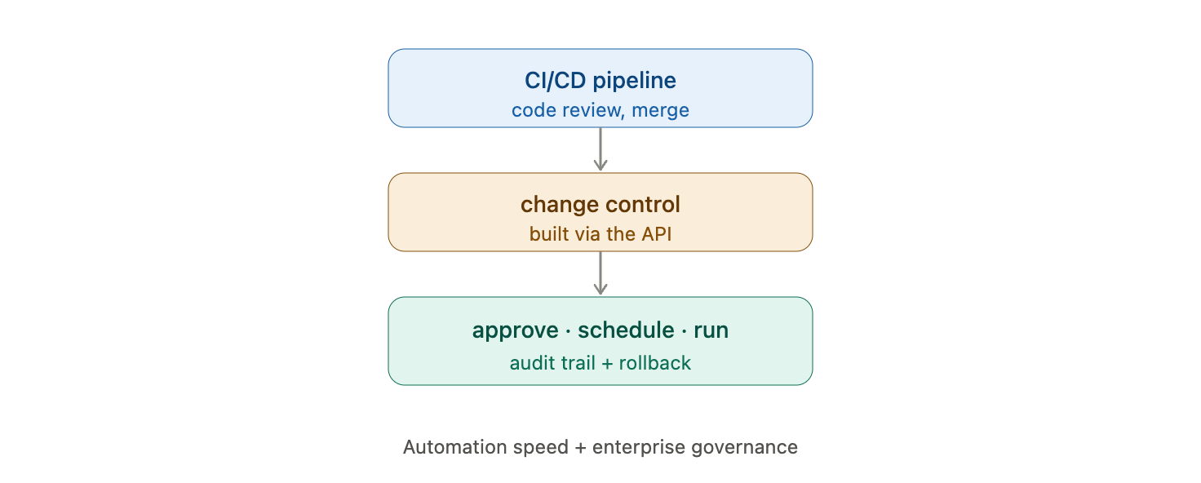
Automating Change Control
Virtualization
Virtualization
Build and submit change controls via the API
Automate approval and scheduled execution
Integrate with CI/CD pipelines
Roll changes out safely and repeatably
Governed automation end to end
Notes:
The API lets you assemble and submit change controls automatically.
This slots CloudVision into a CI/CD pipeline: code review triggers a controlled, auditable network change.
You get automation speed with enterprise governance - the best of both.

Slide 44
In CloudVision, what is the reusable block of configuration you assign to devices?
A. A playbook
B. A configlet
C. A getter
D. A tfvars file
Notes:
Knowledge check on CloudVision.
Prompt: what is CloudVision's unit of configuration?

Slide 45
In CloudVision, what is the reusable block of configuration you assign to devices?
A. A playbook
B. A configlet
C. A getter
D. A tfvars file
Notes:
Answer: B - a configlet. Devices are configured by the configlets assigned to them.
Playbooks, getters, and tfvars files come from other tools in the course, not CloudVision.

Slide 46
Infrastructure as Code with AVD
Virtualization
Notes:
Section six: Arista Validated Designs bring full infrastructure-as-code to the network fabric.
This is where templates, roles, and CloudVision combine into one design-driven workflow.

Slide 47
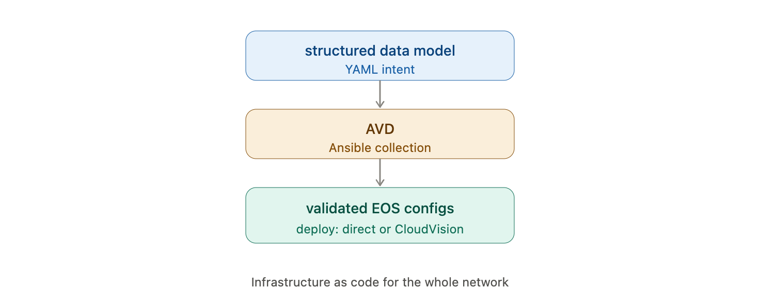
What Is AVD?
Virtualization
Virtualization
Arista Validated Designs - an Ansible collection
Describe the fabric in a structured data model
AVD generates complete, validated EOS configs
Deploy directly or through CloudVision
Infrastructure as code for the whole network
Notes:
AVD is Arista's flagship IaC approach - an Ansible collection that turns a data model into a whole fabric.
You describe intent in structured YAML; AVD generates tested, complete device configurations.
It is the culmination of the templates-and-roles ideas from Day 2, purpose-built for Arista.

Slide 48
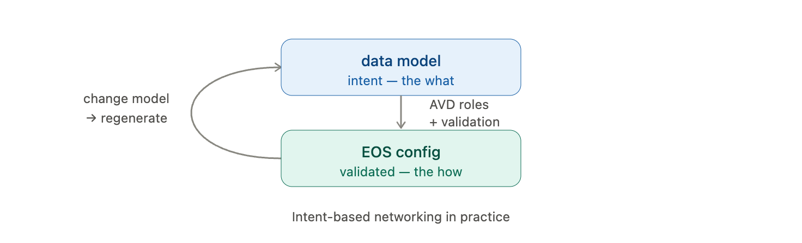
Data Models and Roles
Virtualization
Virtualization
Define the fabric intent in YAML variables
AVD roles turn that model into configuration
Built-in best practices and validation
Change the model, regenerate the fabric
Intent-based networking in practice
Notes:
In AVD you edit a data model, not device configs - the roles do the generation.
The designs encode Arista's best practices, so the output is validated by construction.
This is intent-based networking: you declare what you want, and the tooling produces the how.

Slide 49
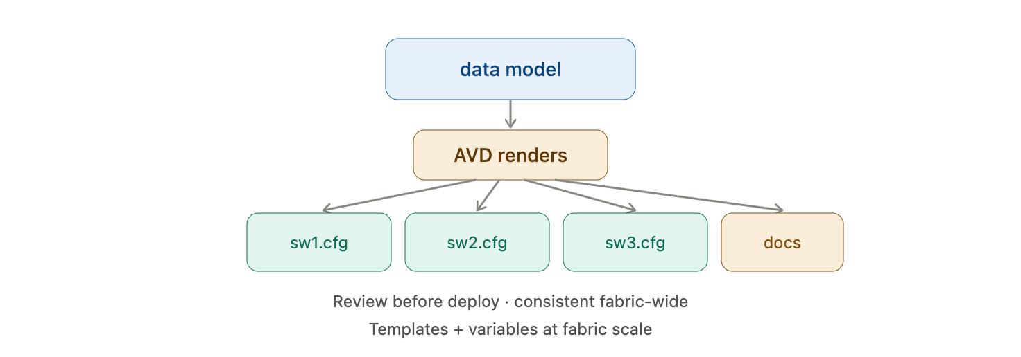
Generating EOS Configs
Virtualization
Virtualization
AVD renders per-device configuration from the model
Also produces documentation automatically
Review the generated configs before deploy
Consistent output across the entire fabric
Templates and variables at fabric scale
Notes:
From one data model, AVD renders every device's config and even the network documentation.
You review the generated output before anything is deployed - the plan-before-apply habit again.
It is the Day 2 template workflow scaled to an entire fabric.

Slide 50
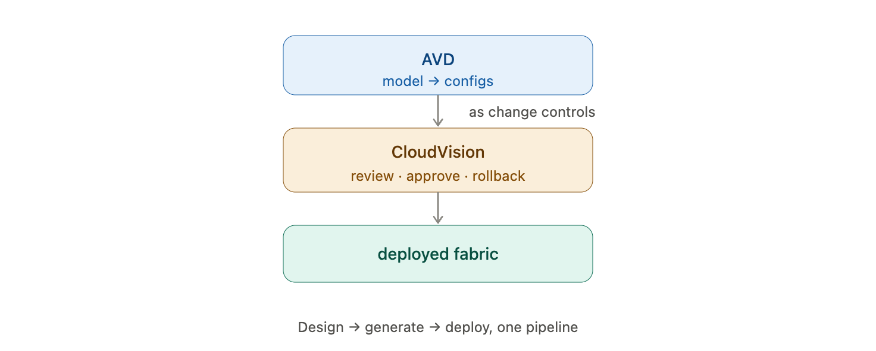
Deploying with CloudVision
Virtualization
Virtualization
AVD can push configs straight to CloudVision
Changes arrive as CloudVision change controls
Review and approve before execution
Full audit trail and rollback
Design, generate, deploy - one pipeline
Notes:
AVD integrates with CloudVision, delivering generated configs as change controls.
That means the governance, approval, and rollback we covered still apply to AVD-driven changes.
The result is a single pipeline from data model to a safely deployed fabric.

Slide 51
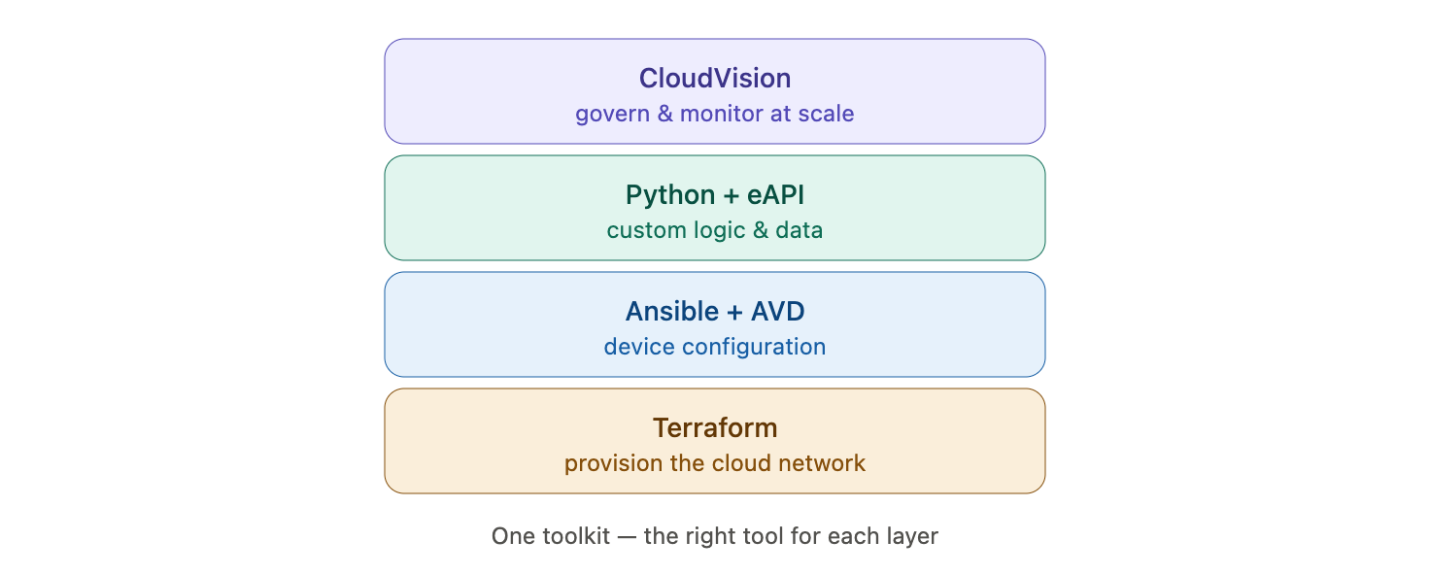
Where It All Comes Together
Virtualization
Virtualization
Terraform builds the cloud network
AVD and Ansible generate device configuration
Python and eAPI handle custom logic and data
CloudVision governs and monitors at scale
One toolkit, the right tool for each layer
Notes:
This is the capstone slide - show how the whole week forms one coherent toolkit.
Terraform provisions, Ansible and AVD configure, Python fills the gaps, CloudVision governs.
The skill is not any single tool but choosing the right one for each layer of the problem.

Slide 52
The Day 5 Labs
Virtualization
Notes:
Section seven: three Arista labs, then we close the course.
Note the Arista lab environment differs from the AWS Cisco lab used earlier.

Slide 53
Lab Environment Notes
Day 5 uses an Arista EOS lab with CloudVision
This is separate from the AWS Cisco environment
Your instructor provides access details
Confirm you can reach the switches and CloudVision
eAPI must be enabled on the lab devices
Virtualization
Notes:
Be clear that Day 5 runs on Arista gear, not the Cisco AWS lab from earlier days.
Depending on your setup this may be an Arista test-drive environment, virtual EOS nodes, or a CloudVision sandbox - the instructor supplies the details.
Before the labs, confirm connectivity and that eAPI is enabled on the devices.

Slide 54
Lab 13: eAPI and pyeapi
Goal: Automate an Arista switch with eAPI and pyeapi
Steps:
Enable eAPI on the switch and confirm it is running
Call eAPI directly with requests and read the JSON
Install pyeapi and connect to the device
Run show commands and inspect structured output
Push a small config change with pyeapi
Virtualization
Notes:
Lab 13 is the Arista equivalent of the Day 3 Netmiko lab, using eAPI and pyeapi.
The highlight is seeing structured JSON come straight from the device - no parsing needed.
Common snag: eAPI not enabled or HTTPS certificate warnings, handled as in Day 3.
Students finish by making a real config change through pyeapi.

Slide 55
Lab 14: Arista with Ansible
Goal: Manage Arista with the arista.eos collection
Steps:
Install the arista.eos collection
Write an inventory using the eAPI connection
Gather facts with eos_facts
Push configuration with eos_config
Confirm idempotency on a second run
Virtualization
Notes:
Lab 14 proves that your Day 1 and 2 Ansible skills transfer directly to Arista.
The only real differences are the collection, the modules, and the eAPI connection settings.
The idempotency check - changed=0 on the second run - should feel familiar and reassuring.
This ties the Ansible thread of the course to a second vendor.

Slide 56
Lab 15: CloudVision Automation
Goal: Automate CloudVision with the cvprac library
Steps:
Install cvprac and authenticate to CloudVision
List devices and existing configlets
Create or update a configlet from a template
Assign it and generate the resulting task
Execute the change control and verify
Virtualization
Notes:
Lab 15 - managing the whole fleet through CloudVision in code.
Students create a configlet, assign it, and drive the resulting task and change control via cvprac.
The governance is visible: the change appears as a reviewable, auditable change control.
This connects config-as-code to enterprise change management.

Slide 57
Across the course, which tool provisions cloud infrastructure rather than configuring existing devices?
A. Ansible
B. Netmiko
C. Terraform
D. NAPALM
Notes:
Course-wide knowledge check.
Prompt: which tool builds the network itself?

Slide 58
Across the course, which tool provisions cloud infrastructure rather than configuring existing devices?
A. Ansible
B. Netmiko
C. Terraform
D. NAPALM
Notes:
Answer: C - Terraform. It provisions infrastructure like VPCs and subnets, rather than configuring existing devices.
Ansible, Netmiko, and NAPALM all configure or query devices that already exist.

Slide 59
Course Summary - Five Days
Day 1: YAML, Ansible, and idempotency - the foundations
Day 2: Variables, templates, roles, and Vault
Day 3: Python - Netmiko, NAPALM, and APIs
Day 4: Terraform - infrastructure as code
Day 5: Arista EOS and CloudVision at scale
One toolkit - pick the right tool for each job
Virtualization
Notes:
Recap the whole journey: from manual CLI to a full automation toolkit across five days.
Emphasize the through-lines: declarative thinking, idempotency, structured data, and version control appear in every tool.
The real skill is judgment - knowing which tool fits which layer of a problem.
Congratulate the class on completing the course.

Slide 60
Where to Go Next
Build a project combining Terraform, Ansible, and Python
Explore CI/CD pipelines for network automation
Certifications: Arista ACE, Red Hat Ansible, HashiCorp Terraform
Keep a lab running to practice safely
Automation is a practice - keep building
Virtualization
Notes:
Point students toward continued growth: a combined project is the best way to cement the week.
CI/CD for networks is the natural next topic - automating the automation with pipelines and testing.
Certifications give structure if they want a credential to aim for.
Close with encouragement: fluency comes from building real things, so keep a lab and keep practicing.

