Slide 1

NETWORK AUTOMATION TOOLS II
Notes:
Welcome back. Day 1 gave us the foundations - YAML, Ansible, idempotency - and we configured two live routers.
Day 2 is where playbooks grow up. We make them dynamic with variables, generate config with templates, package everything into roles, and protect secrets with Vault.
By the end you will turn yesterday's one-off playbooks into reusable, production-style automation.

Slide 2

Network Automation Tools – Day 2
Notes:
Set the tone: same tools as Day 1, applied with structure and reuse in mind.
Today is less about new modules and more about how professionals organize automation so it scales across many devices and teams.

Slide 3
Where Day 1 Left Off
You installed Ansible and reached both Catalyst 8000V routers
You gathered facts with ios_command and ios_facts
You pushed config with ios_config and saw idempotency at work
You learned YAML: scalars, lists, and dictionaries
Today: make playbooks dynamic, reusable, and secure
Virtualization
Notes:
Anchor Day 2 in what they already did. Everything today extends yesterday's playbooks rather than replacing them.
Call back to idempotency specifically - it is the safety property that makes the reusable patterns today trustworthy.
The YAML they learned is exactly what variables, templates, and roles are written in.

Slide 4

Agenda for Day 2
Variables and facts - making playbooks dynamic
Jinja2 templates - generating configuration from data
Loops, conditionals, and handlers
Roles - packaging automation for reuse
Ansible Vault - protecting secrets
Scalable playbooks and three hands-on labs
Virtualization
Notes:
Preview the day. The morning builds four capabilities - variables, templates, roles, vault - that stack on top of each other.
Each concept feeds the labs: Lab 4 uses variables and templates, Lab 5 builds a role, Lab 6 secures secrets.
Reassure students this is still Ansible - no new tool to install, just deeper features.

Slide 5
Variables and Facts
Virtualization
Notes:
Section one: variables are what turn a hard-coded playbook into a flexible one.
Ask the room how they would configure fifty routers that each need a different IP. The answer is variables, and that is where we start.

Slide 6
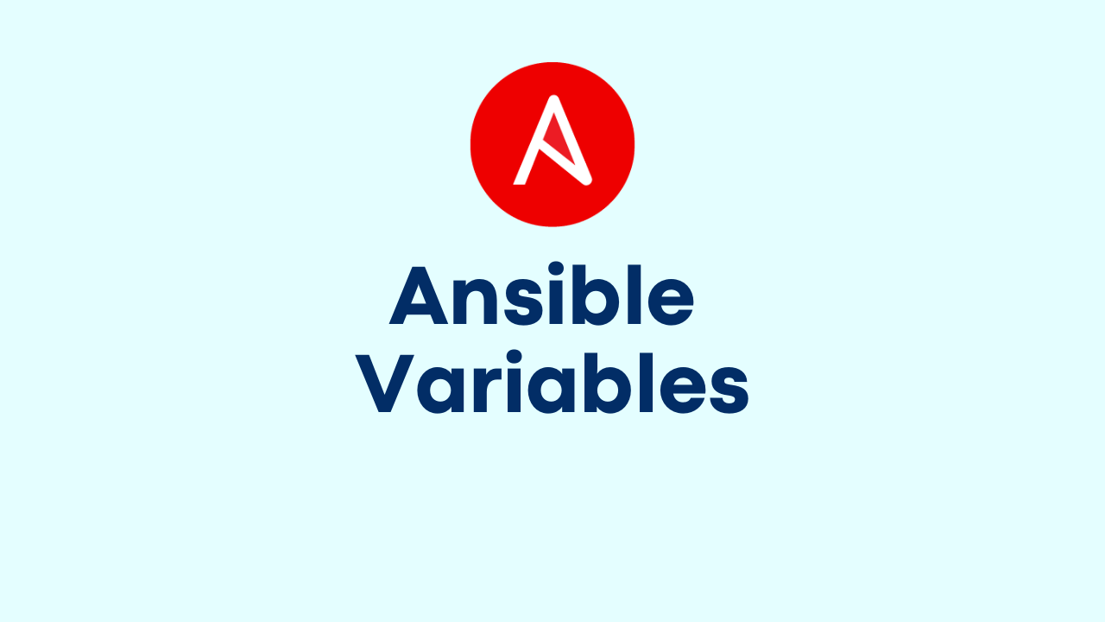
Why Variables Matter
Virtualization
Virtualization
Variables remove hard-coded values from your tasks
One playbook can configure many devices with different values
Change a value in one place, not in every task
Values come from inventory, files, facts, or the command line
The foundation for templates and roles later today
Notes:
The core idea: separate the logic (the playbook) from the data (the variables). That separation is what lets one playbook serve a whole fleet.
Give a concrete example: a single 'configure interface' task driven by a per-host IP variable configures every router correctly.
Foreshadow that templates and roles both depend heavily on variables, so this slide underpins the rest of the day.

Slide 7
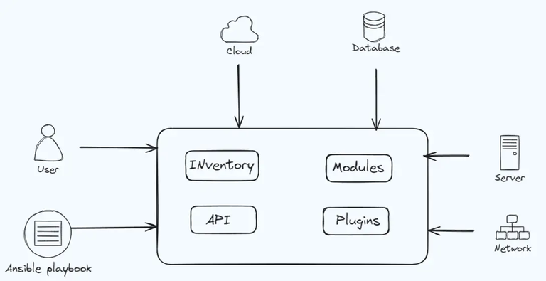
Where Variables Live
Virtualization
Virtualization
Inventory - values set per host or per group
host_vars/ and group_vars/ directories
vars and vars_files inside a playbook
Facts gathered from the device at runtime
Extra vars passed with -e on the command line
Notes:
There are several places to define a variable and knowing them prevents confusion later.
The most common in real projects are the host_vars and group_vars directories, covered on the next slide.
Note that facts are variables too - Ansible learns them from the device rather than you typing them.

Slide 8
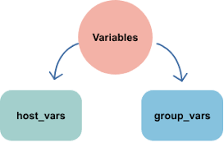
host_vars and group_vars
Virtualization
Virtualization
Ansible auto-loads files named after a host or group
group_vars/routers.yml applies to every host in routers
host_vars/c8kv-1.yml applies to just that device
Keeps device-specific data out of the playbook
The standard way to organize a real inventory
Notes:
This is the pattern professionals use. You never hard-code per-device values; you drop them in these directories and Ansible finds them automatically.
Emphasize the naming: the file must match the host or group name exactly for auto-loading to work.
Students set these up in Lab 4, so this slide is a direct preview.

Slide 9
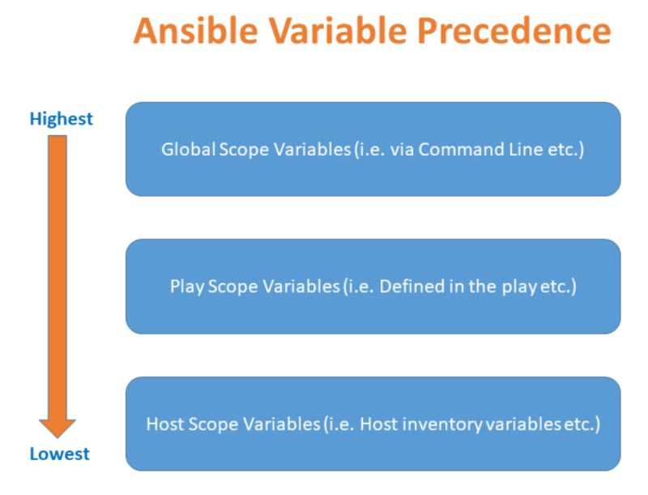
Variable Precedence
Virtualization
Virtualization
Many sources can set the same variable
More specific wins: host beats group beats all
Command-line extra vars with -e override almost everything
Role defaults are the weakest and easy to override
When in doubt, keep a variable in one predictable place
Notes:
Precedence is a common source of 'why did it use that value' confusion, so give the simple rule: more specific and later-loaded wins.
The two extremes worth memorizing: role defaults are the weakest, and -e on the command line is the strongest.
Advise a practical habit: do not scatter the same variable across many files; pick one home for each.

Slide 10
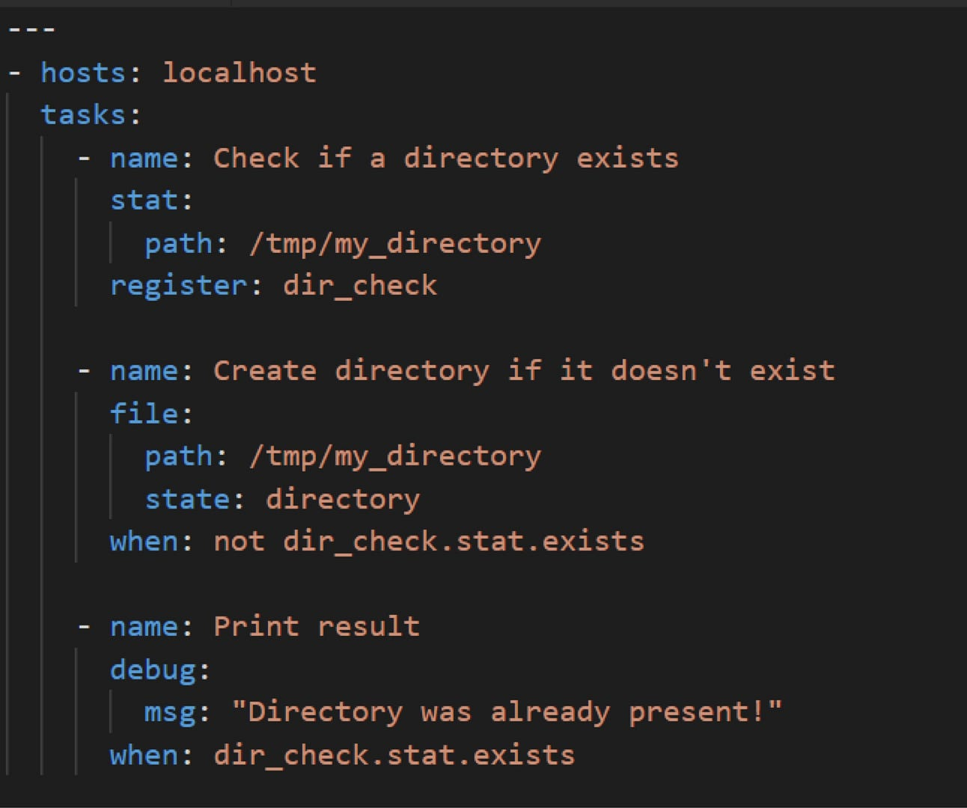
Registering Output
Virtualization
Virtualization
register captures a task's result into a variable
Reuse that output in later tasks or conditions
Access fields like result.stdout or result.rc
Combine with when to act only when needed
The bridge between gathering data and making decisions
Notes:
Register is how a playbook reacts to what it finds. You saw it in Day 1 capturing show-command output; today we use it to drive decisions.
Walk through the shape: run a task, register the result, then a later task references result.stdout or checks result.rc.
Pair this with the conditionals section coming up - register plus when is a powerful combination.

Slide 11
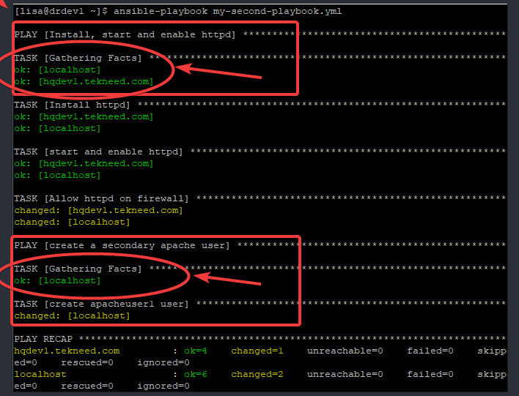
Facts and set_fact
Virtualization
Virtualization
Facts are data Ansible learns about a device
ios_facts populates ansible_net_ variables
set_fact creates your own variable during a run
Facts and set_fact values are available to later tasks
Use them to make a playbook adapt to each device
Notes:
Distinguish the two: facts are discovered automatically; set_fact is a value you compute and store yourself mid-run.
Remind them ios_facts is what fills ansible_net_hostname, ansible_net_version, and the interface list from Day 1.
set_fact is useful when you need to derive a value once and reuse it across several later tasks.

Slide 12

Magic Variables
Virtualization
Virtualization
inventory_hostname - the current host's inventory name
hostvars - reach another host's variables
groups - the list of hosts in each group
ansible_host - the address Ansible connected to
Built-in and always available - no need to define them
Notes:
Magic variables are provided by Ansible for free and show up constantly in real playbooks.
inventory_hostname is the one they will use most - it is how a task knows which device it is currently running against.
hostvars is more advanced: it lets one host read another host's data, useful for building configs that reference peers.

Slide 13
You want group_vars/routers.yml to apply to both routers but override one value on c8kv-1 only. Where does the override go?
A. In the playbook's vars section
B. In host_vars/c8kv-1.yml
C. In group_vars/all.yml
D. It cannot be done
Notes:
Knowledge check on variable scope and precedence. Let them reason it through before the reveal.
Prompt: which location is more specific than a group file?

Slide 14
You want group_vars/routers.yml to apply to both routers but override one value on c8kv-1 only. Where does the override go?
A. In the playbook's vars section
B. In host_vars/c8kv-1.yml
C. In group_vars/all.yml
D. It cannot be done
Notes:
Answer: B - host_vars/c8kv-1.yml. A host file is more specific than a group file, so its value wins for that host only.
Reinforce the precedence rule: host beats group, and the other hosts keep the group value.

Slide 15
Jinja2 Templating
Virtualization
Notes:
Section two: templates turn variables into real configuration text.
This is the moment automation starts to feel powerful - one template plus data generates correct config for every device.

Slide 16
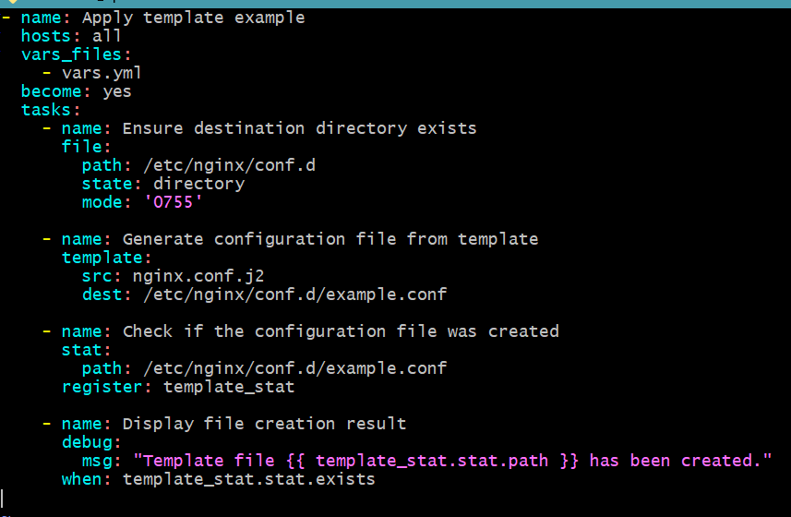
What Is Jinja2?
Virtualization
Virtualization
A templating engine built into Ansible
Fills placeholders in text with variable values
Turns a template plus data into a finished config
Same idea as mail-merge, for device configuration
Template files usually end in .j2
Notes:
Introduce Jinja2 by analogy: it is mail-merge for network configs. You write the letter once with blanks, and the data fills the blanks.
It is already part of Ansible - nothing extra to install.
The output is plain text, so it works for IOS config, hosts files, or any text artifact.

Slide 17
The template Module
Virtualization
Virtualization
template renders a .j2 file and copies the result to a destination
Source lives on the control node; output lands where you choose
Variables come from inventory, facts, and vars
Idempotent - it only writes when the rendered content changes
The workhorse for configuration generation
Notes:
The template module is the practical tool. Point out it is like the copy module but it renders Jinja2 first.
Stress idempotency again: if the rendered output matches what is already there, nothing is written and the task reports ok.
In Lab 4 they render a template on the control node, then push the result to the routers.

Slide 18
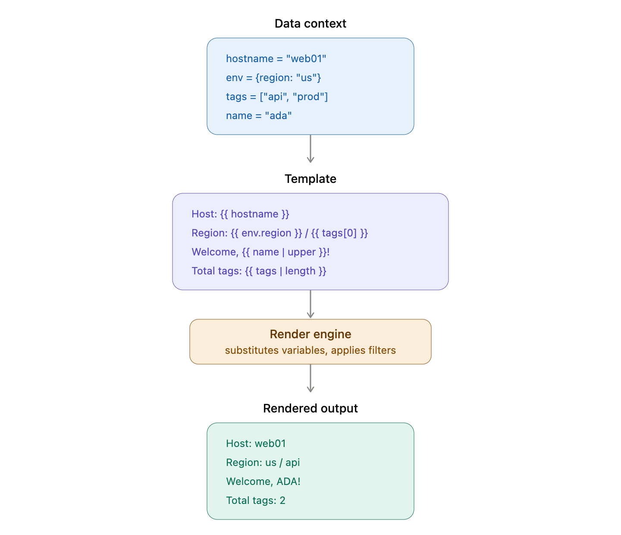
Jinja2 Expressions
Virtualization
Virtualization
Double curly braces insert a variable: hostname is in braces
Access dictionary keys and list items
Combine plain text and variables freely
Apply filters to transform values
Keep logic simple - templates shape text, not business logic
Notes:
Expressions are the blanks in the template. The double-brace syntax is the one piece of Jinja2 everyone must know.
Show how a template line mixes literal IOS keywords with braced variables to produce a real command.
Advise restraint: heavy logic belongs in variables or tasks, not buried in a template.

Slide 19
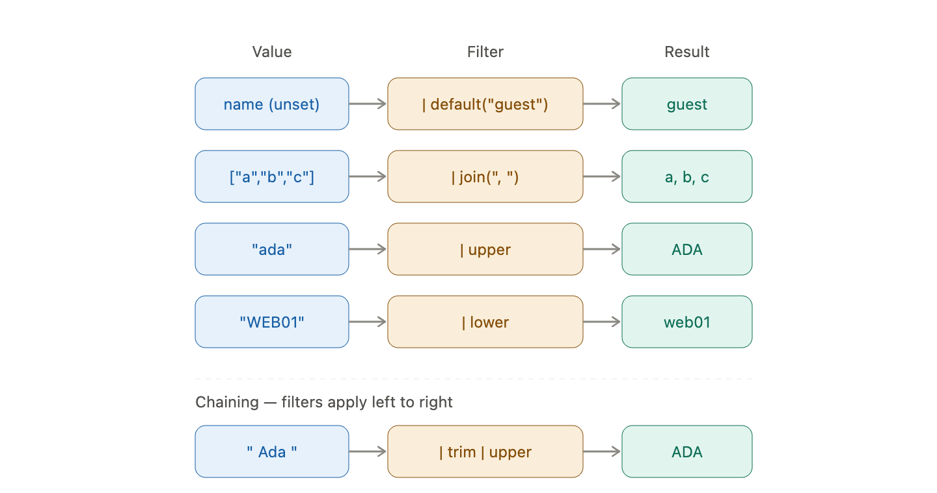
Jinja2 Filters
Virtualization
Virtualization
Filters transform a value with a pipe symbol
default - supply a fallback when a variable is unset
join - turn a list into a single string
upper and lower - change case
Chain filters for readable transformations
Notes:
Filters are small transformations applied with a pipe. They keep templates clean by doing formatting inline.
The default filter is the most useful safety net - it prevents an undefined-variable error by supplying a fallback.
join is handy for turning a list of values into a comma-separated string in one place.

Slide 20
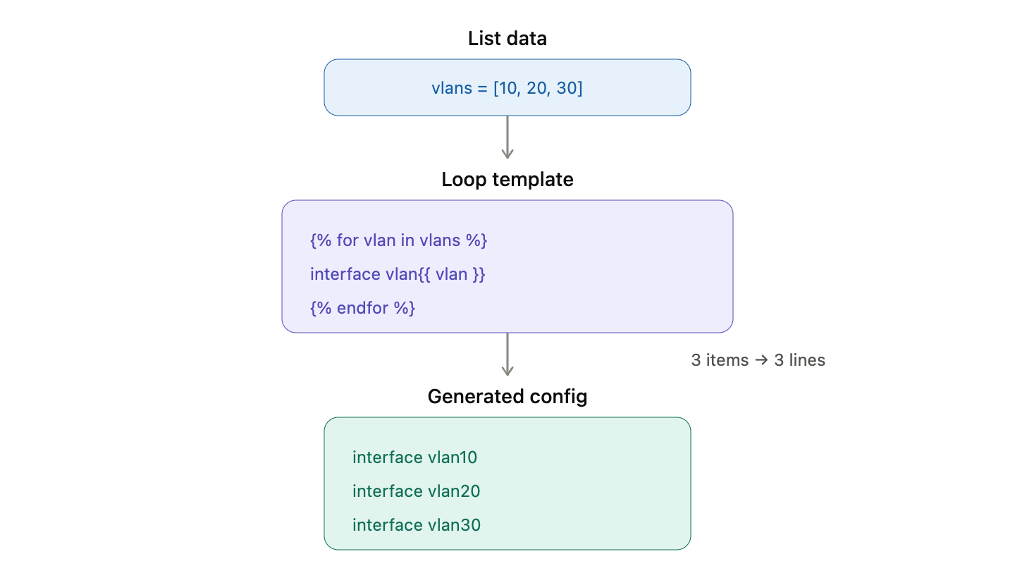
Jinja2 Loops
Virtualization
Virtualization
for loops repeat a block for each item in a list
Perfect for interfaces, VLANs, or neighbor lists
Wrapped in for and endfor tags
Generate many similar config lines from one template
Drive the loop with inventory or group data
Notes:
Loops are what make templates scale. Instead of writing ten interface blocks, you write one and loop over a list.
Give the mental model: the template author writes the pattern once; the data decides how many times it repeats.
This pairs directly with the list-of-dictionaries shape from Day 1 - loop over a list of interface dictionaries.

Slide 21
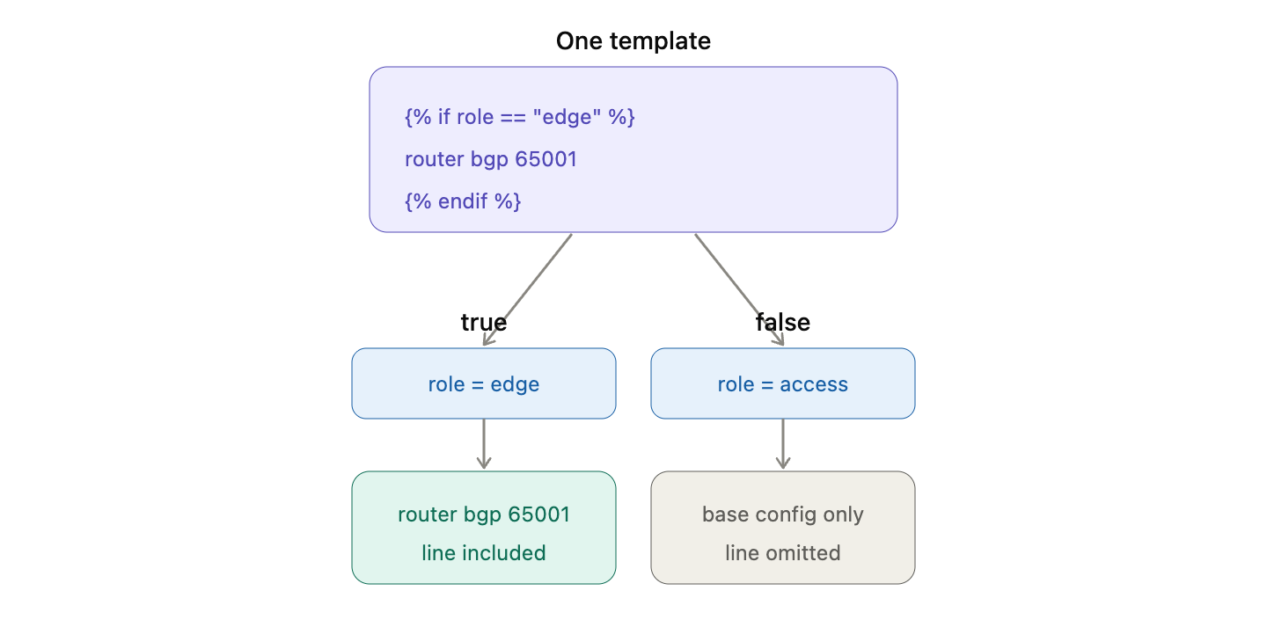
Jinja2 Conditionals
Virtualization
Virtualization
if blocks include text only when a condition holds
Wrapped in if and endif tags
Add optional config based on a variable or fact
Keep one template that fits many device roles
Combine with loops for compact, powerful templates
Notes:
Conditionals let a single template serve devices that need slightly different config.
Example: include an OSPF block only when a variable marks the device as a routing node.
Warn against over-nesting - a few conditions are fine, but deeply nested logic becomes unreadable fast.

Slide 22
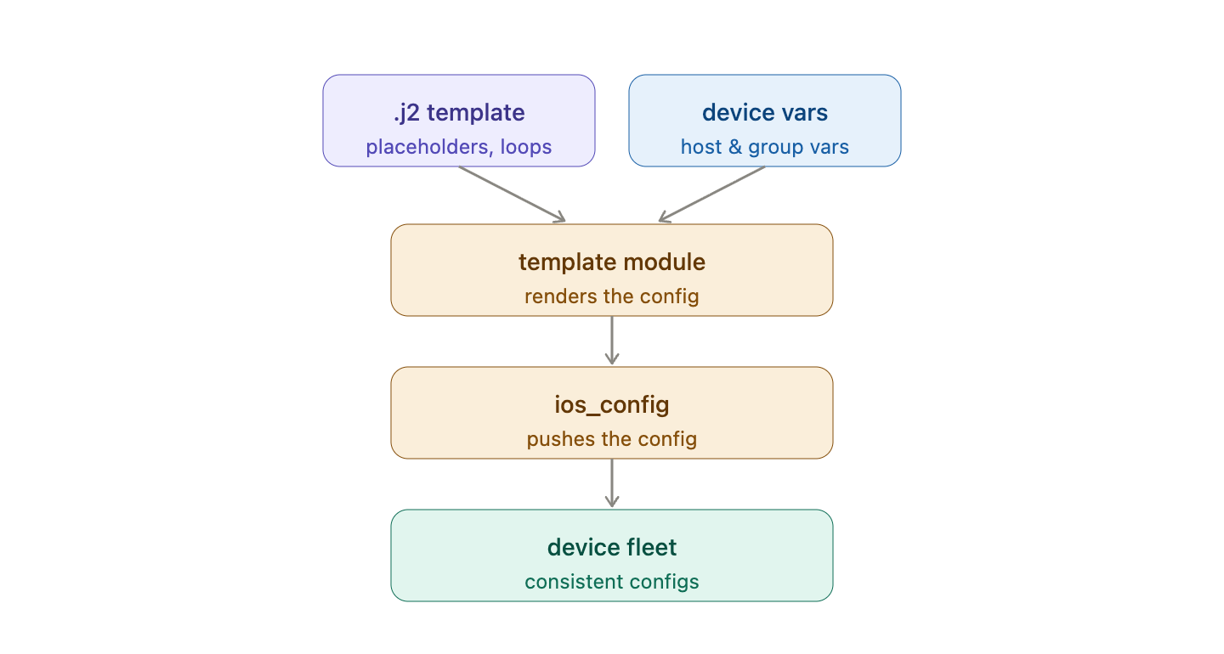
Generating Device Configs
Virtualization
Virtualization
Write a .j2 template with placeholders and loops
Store per-device values in host_vars and group_vars
Render each config with the template module
Push the result with ios_config
One template, consistent configs across the fleet
Notes:
This slide ties the section together into the real workflow they will run in Lab 4.
The pattern: one template plus per-device data equals a correct, unique config for every router.
This is exactly how large networks stay consistent - the template is the single source of truth for structure.

Slide 23
Which Ansible module renders a .j2 file and copies the result to a destination?
A. copy
B. ios_command
C. template
D. debug
Notes:
Knowledge check on the templating workflow.
Prompt: which module is like copy but processes Jinja2 first?

Slide 24
Which Ansible module renders a .j2 file and copies the result to a destination?
A. copy
B. ios_command
C. template
D. debug
Notes:
Answer: C - template. It renders the Jinja2 source, then places the output on the target.
copy moves a file unchanged; template renders it first, which is the key difference.

Slide 25
Loops, Conditionals, and Handlers
Virtualization
Notes:
Section three: control flow inside playbooks themselves, separate from templates.
These features let one playbook adapt its behavior per device and run expensive actions only when needed.

Slide 26
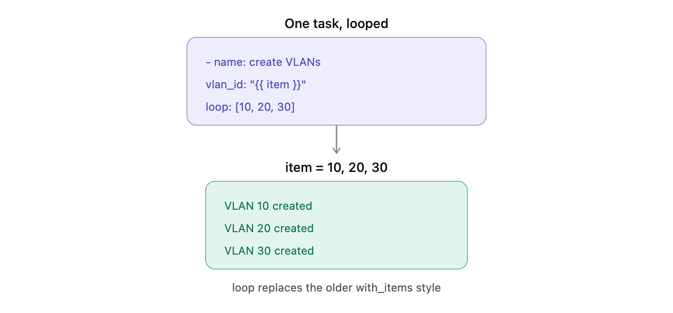
Loops in Tasks
Virtualization
Virtualization
The loop keyword repeats a task for each item
Reference the current value with the loop variable
Create many VLANs or users in one task
Cleaner than copying a task many times
Replaces the older with_items style
Notes:
Task loops are the playbook-level cousin of Jinja2 loops. Here the loop repeats a whole task, not a line of text.
Give a use case: create ten VLANs by looping one ios_vlans task over a list.
Mention that older playbooks use with_items; loop is the modern, preferred keyword.

Slide 27
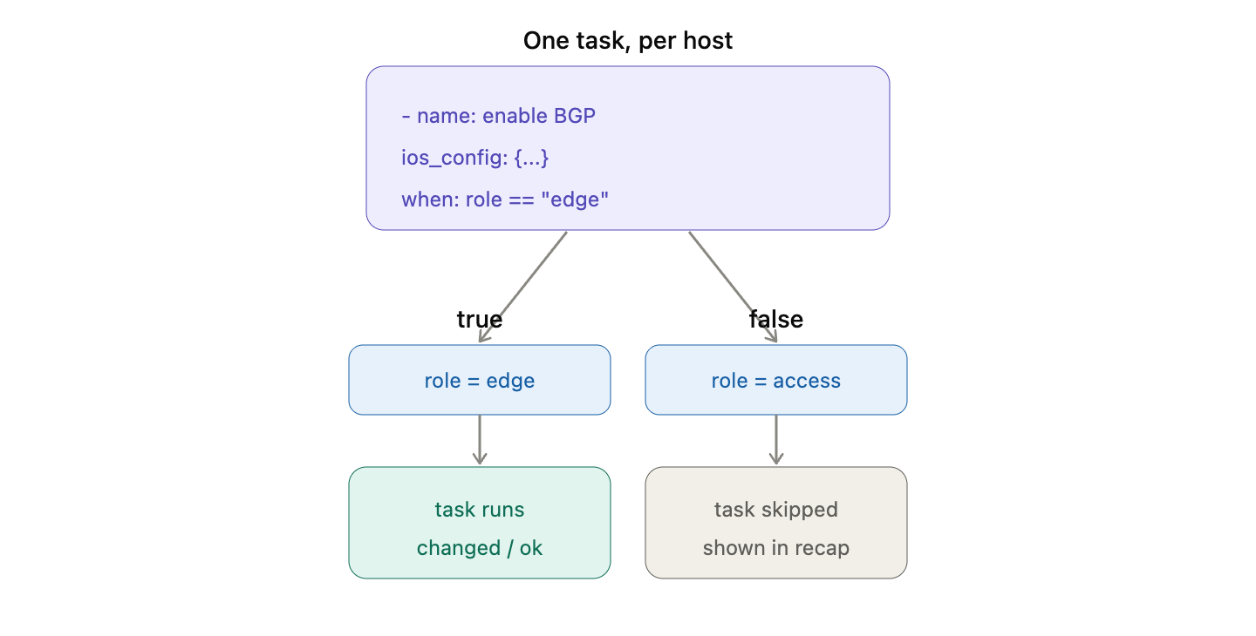
Conditionals with when
Virtualization
Virtualization
when runs a task only if a condition is true
Test facts, registered results, or variables
Skip tasks that do not apply to a device
Skipped tasks show as skipped in the recap
Keep one playbook that adapts per host
Notes:
when is how a playbook makes decisions. It reads a fact or a registered result and chooses whether to run a task.
Connect to the register slide: register a check, then use when to act only if the result requires it.
Point out that skipped tasks are normal and healthy - they appear in the recap under skipped.

Slide 28
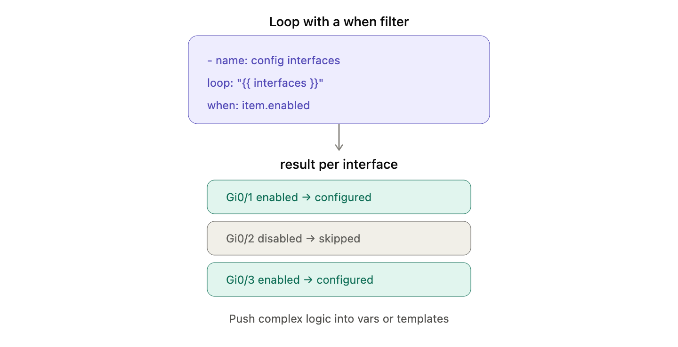
Combining Loops and Conditionals
Virtualization
Virtualization
Loop over a list and filter with when inside the loop
Apply a task only to items that match
Example: configure only interfaces marked enabled
Powerful, but keep it readable
Push complex logic into variables or templates
Notes:
Combining the two is common: iterate a list but act on only some items.
The enabled-interfaces example makes it concrete - loop all interfaces, but the when clause skips the disabled ones.
Caution: if the logic gets hairy, it is a sign to move it into the data or a template instead.

Slide 29
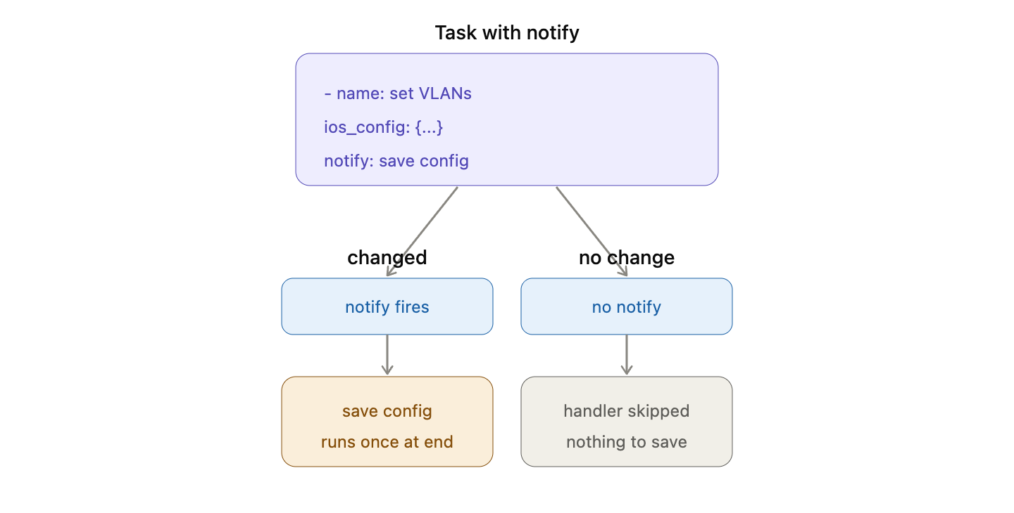
Handlers and notify
Virtualization
Virtualization
A handler is a task that runs only when notified
Tasks trigger a handler with notify
Handlers run once, at the end of the play
Classic use: save config only if something changed
Keeps expensive actions from running every time
Notes:
Handlers solve a real problem: do something costly only when it is actually needed.
The canonical example is saving the running config to startup - you only want that when a task actually changed the config.
Emphasize the mechanics: many tasks can notify a handler, but it still runs just once, after all tasks finish.

Slide 30
An Ansible handler runs when?
A. At the start of every play
B. Only when a task notifies it and reported a change
C. Once per task, always
D. Only in check mode
Notes:
Knowledge check on handlers.
Prompt: what has to happen for a handler to fire?

Slide 31
An Ansible handler runs when?
A. At the start of every play
B. Only when a task notifies it and reported a change
C. Once per task, always
D. Only in check mode
Notes:
Answer: B - only when a notifying task actually changed something. No change means no notification, so the handler is skipped.
This is why handlers are perfect for save-on-change: they do not run on an idempotent no-op run.

Slide 32
Roles
Virtualization
Notes:
Section four: roles are how you package automation so it can be reused and shared.
This is the single biggest step from hobby playbooks to professional, maintainable projects.

Slide 33
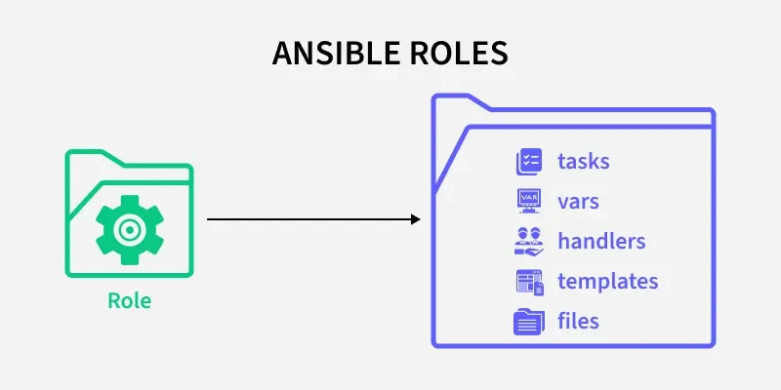
Why Roles?
Virtualization
Virtualization
Roles bundle tasks, variables, templates, and handlers together
Turn a long playbook into reusable building blocks
Share roles across projects and teams
A standard directory layout everyone recognizes
How real Ansible projects stay maintainable
Notes:
Frame the problem roles solve: a single giant playbook becomes unmanageable. Roles break it into named, reusable pieces.
The standard layout matters because any Ansible user can open a role and immediately know where things are.
Roles are also the unit of sharing - most content on Ansible Galaxy is roles.

Slide 34
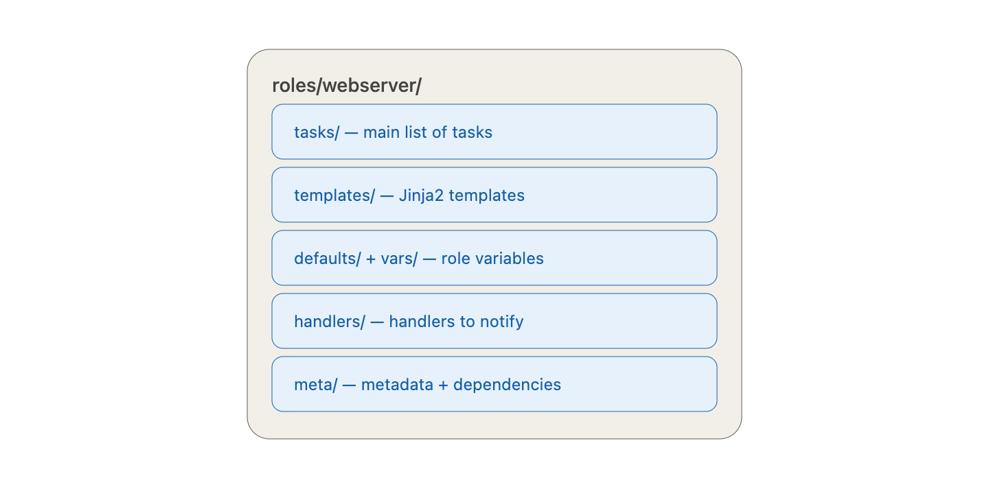
Anatomy of a Role
Virtualization
Virtualization
tasks/ - the main list of tasks
templates/ - Jinja2 templates the role uses
defaults/ and vars/ - the role's variables
handlers/ - handlers the role can notify
meta/ - role metadata and dependencies
Notes:
Walk the directories. Each one has a clear job, and Ansible loads main.yml from each automatically.
defaults versus vars is the precedence point from earlier: defaults are weak and meant to be overridden; vars are stronger.
meta is where you declare that this role depends on another, so Ansible runs them in the right order.

Slide 35
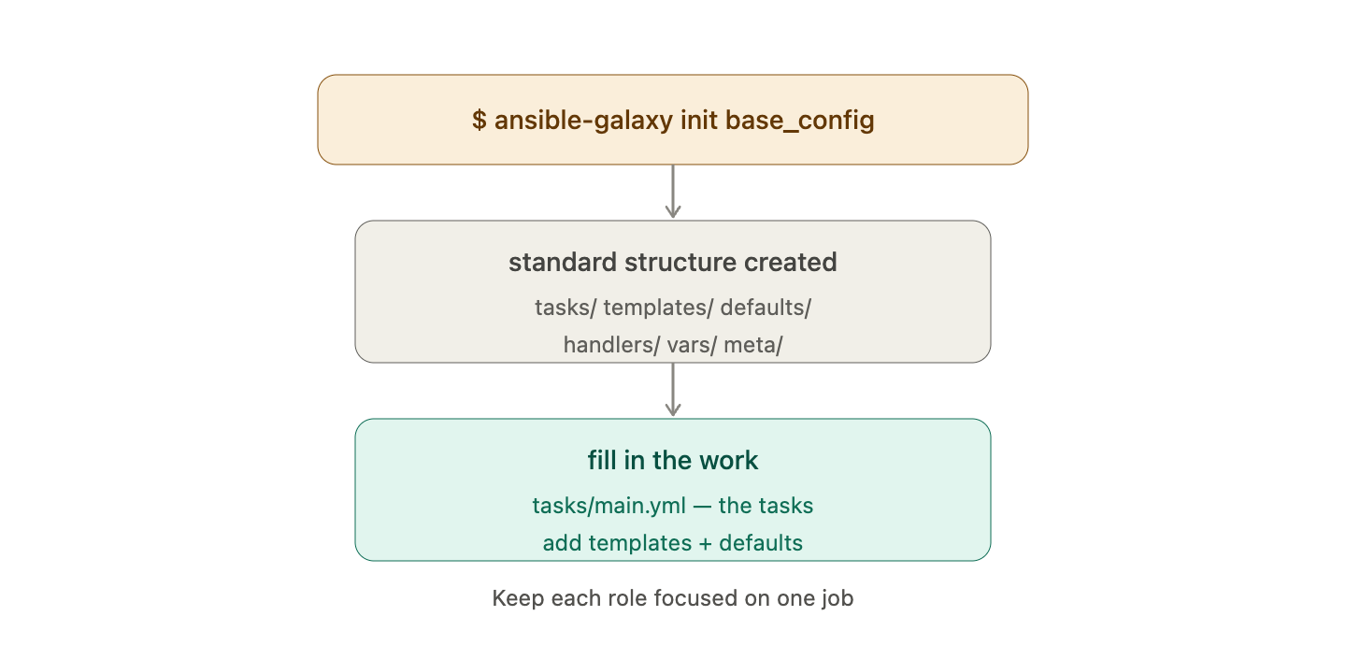
Creating a Role
Virtualization
Virtualization
Scaffold with: ansible-galaxy init base_config
It builds the standard directory structure for you
Fill in tasks/main.yml with the work to do
Add templates and defaults as needed
Keep each role focused on one job
Notes:
Show the one command that creates the whole skeleton - students do not build the folders by hand.
The design advice matters: a role should do one thing well. A base_config role, a vlans role, an ntp role, and so on.
This is exactly what Lab 5 has them do - scaffold a role and move existing work into it.

Slide 36
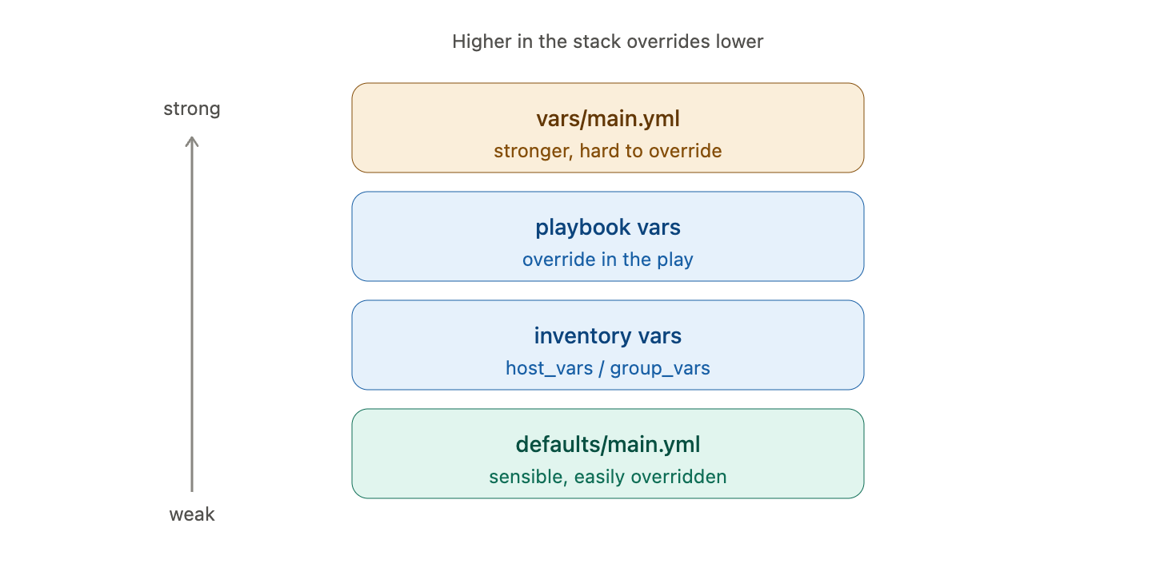
Role Variables and Defaults
Virtualization
Virtualization
defaults/main.yml - sensible values, easily overridden
vars/main.yml - stronger values, harder to override
Override role variables from inventory or the playbook
Document the variables a role expects
Good defaults make a role easy to reuse
Notes:
Reinforce precedence in the role context. Put the values you expect people to change in defaults.
A well-written role ships with defaults that work out of the box, so a new user can run it with zero configuration.
Documentation is part of the job: list the variables a role reads so others can use it safely.

Slide 37
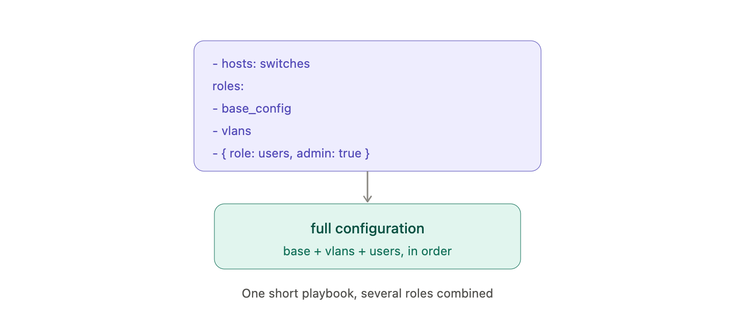
Using Roles in a Playbook
Virtualization
Virtualization
List roles under the roles key in a play
Ansible runs each role's tasks in order
Pass variables to a role when you call it
Combine several roles to build a full configuration
Playbooks become short and readable
Notes:
Show how thin the playbook becomes: a hosts line and a short list of roles.
The order in the roles list is the order they run, so dependencies and sequencing still matter.
This is the payoff - a readable top-level playbook that composes reusable roles.

Slide 38
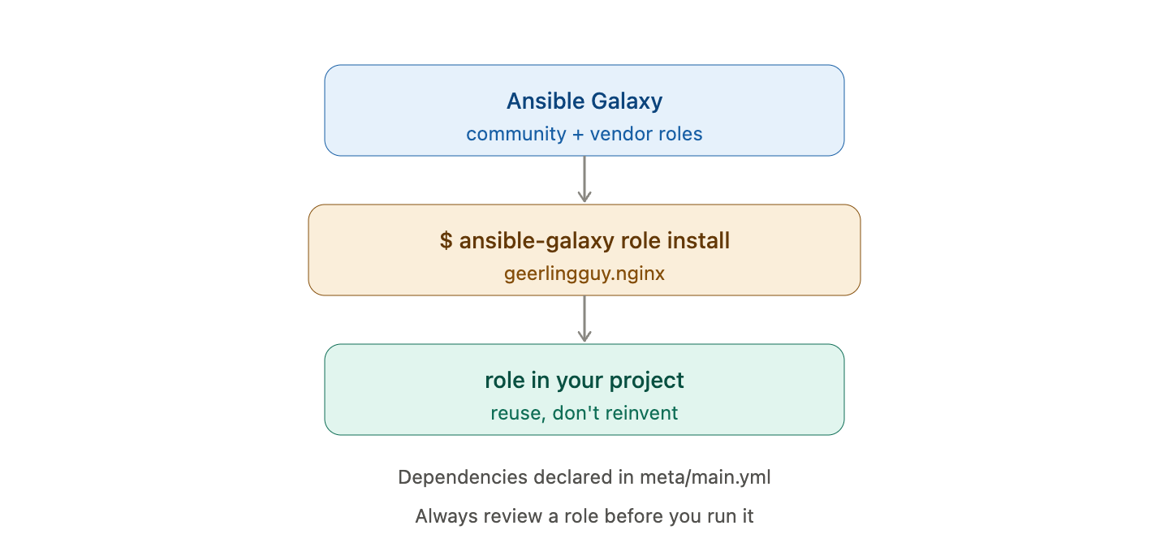
Sharing Roles with Galaxy
Virtualization
Virtualization
Ansible Galaxy hosts community and vendor roles
Install with ansible-galaxy role install
Declare dependencies in meta/main.yml
Reuse trusted roles instead of reinventing them
Always review a role before you run it
Notes:
Galaxy is the ecosystem for roles, just as it is for collections.
The reuse message: someone has probably already written a solid NTP or SNMP role - install and review rather than starting from scratch.
Security reminder: a role runs code against your devices, so read it before trusting it.

Slide 39
Which command scaffolds the standard directory structure for a new role?
A. ansible-galaxy collection install
B. ansible-playbook --init
C. ansible-galaxy init base_config
D. ansible-role new
Notes:
Knowledge check on roles.
Prompt: the scaffolding tool is part of ansible-galaxy.

Slide 40
Which command scaffolds the standard directory structure for a new role?
A. ansible-galaxy collection install
B. ansible-playbook --init
C. ansible-galaxy init base_config
D. ansible-role new
Notes:
Answer: C - ansible-galaxy init base_config. It creates the full standard role layout.
The collection install command manages collections, not roles, and the others are not real commands.

Slide 41
Ansible Vault and Secrets
Virtualization
Notes:
Section five: real automation needs credentials, and credentials must never sit in plain text.
Vault is Ansible's built-in answer for keeping secrets encrypted while still automating with them.

Slide 42
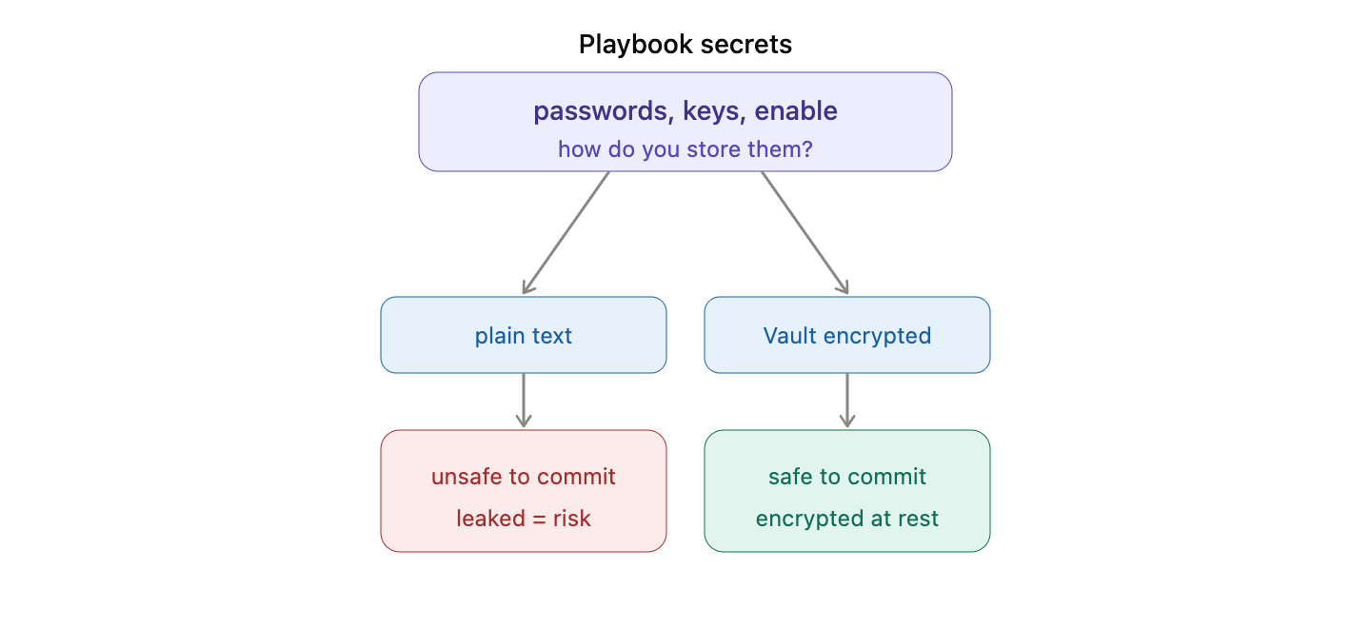
Why Secrets Need Protecting
Virtualization
Virtualization
Playbooks often need passwords, keys, and enable secrets
Never commit plain-text secrets to Git
Leaked credentials are a serious security risk
Ansible Vault encrypts secrets at rest
Encrypted files are safe to store in version control
Notes:
Make the risk vivid: a password pushed to a Git repo is effectively public and permanent in history.
Vault lets you keep secrets in the same repo as your playbooks, but encrypted so they are useless if leaked.
This is a non-negotiable practice in any real environment.

Slide 43
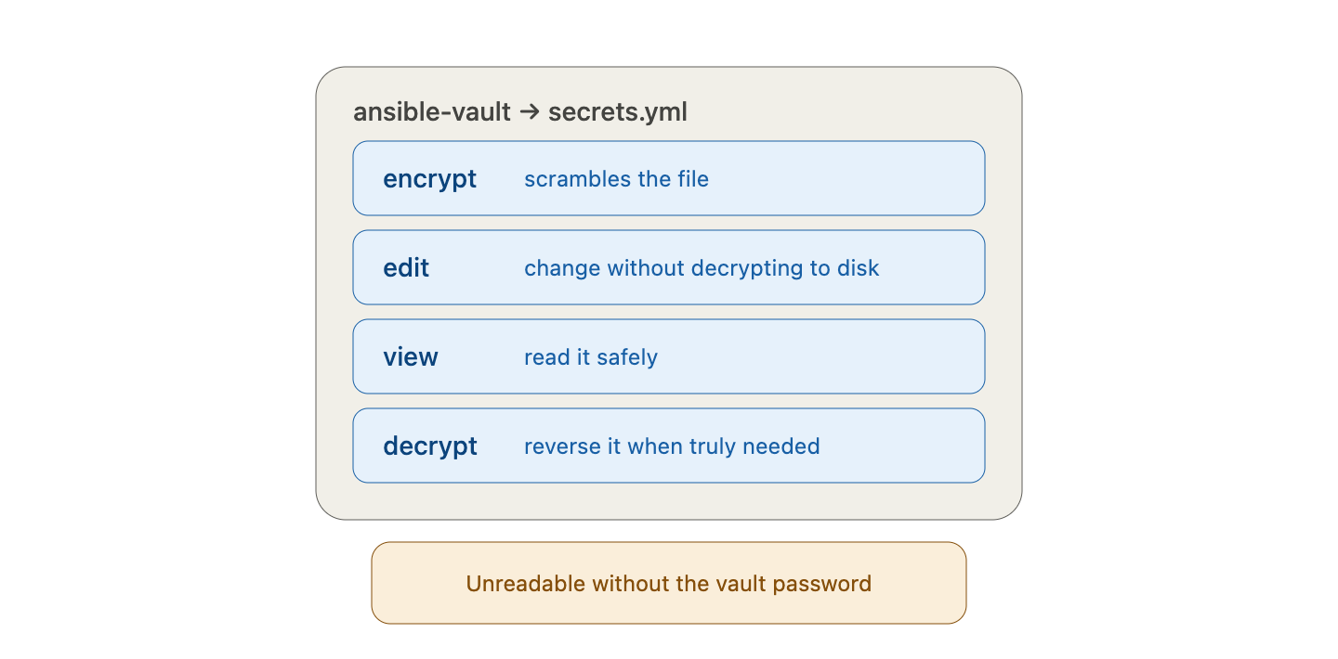
Encrypting Files with Vault
Virtualization
Virtualization
ansible-vault encrypt secrets.yml scrambles the file
ansible-vault edit changes it without decrypting to disk
ansible-vault view reads it safely
decrypt reverses it when you truly need to
The file is unreadable without the vault password
Notes:
Cover the everyday commands. edit is the important one - it lets you change a secret without ever leaving a plain-text copy on disk.
Stress that the vault password is the one thing that must be protected; lose it and the data is gone.
In Lab 6 they encrypt a credentials file and confirm it is unreadable.

Slide 44
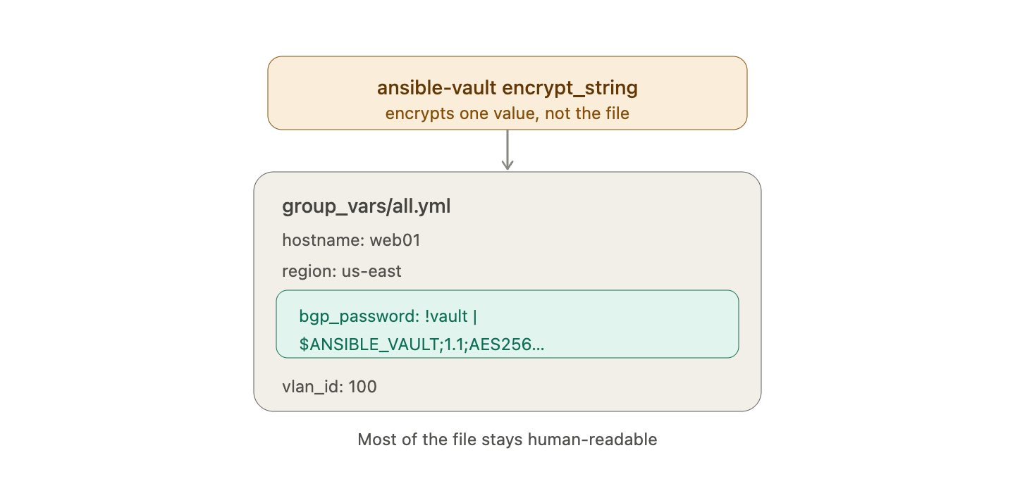
Encrypting Single Values
Virtualization
Virtualization
encrypt_string encrypts one value, not a whole file
Paste the encrypted blob directly into a vars file
Mix encrypted and plain values in the same file
Handy for a single password among normal settings
Keeps most of the file human-readable
Notes:
Sometimes you only need to hide one value in an otherwise readable file - that is what encrypt_string is for.
The output is a blob you drop straight into YAML next to your normal variables.
This keeps diffs readable while still protecting the sensitive line.

Slide 45
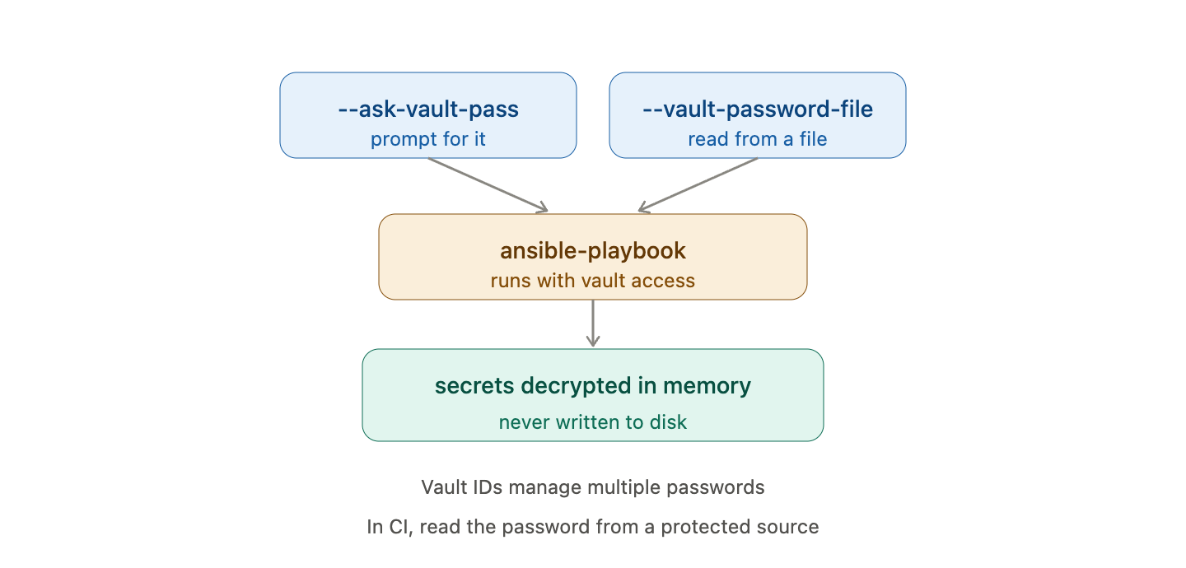
Running Playbooks with Vault
Virtualization
Virtualization
Supply the password with --ask-vault-pass
Or point to a file with --vault-password-file
Ansible decrypts secrets in memory at runtime
Use vault IDs to manage multiple passwords
In CI, read the password from a protected source
Notes:
Explain how a playbook actually uses encrypted data: Ansible decrypts it in memory only while running.
For interactive use, --ask-vault-pass prompts you; for automation, a password file or a secret manager supplies it.
Vault IDs let a project use different passwords for different environments, like dev and prod.

Slide 46
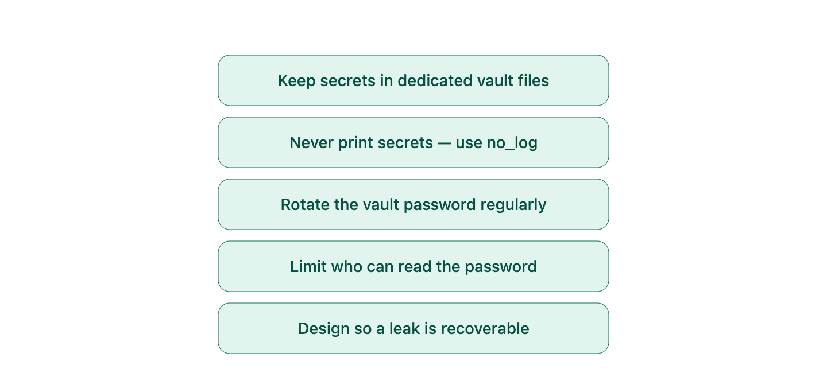
Vault Best Practices
Virtualization
Virtualization
Keep secrets in dedicated vault files
Never print secrets - use no_log on sensitive tasks
Rotate the vault password periodically
Limit who can read the vault password
Design so a leak is recoverable, not catastrophic
Notes:
Turn the mechanics into habits. Separate vault files keep encrypted and plain data cleanly divided.
no_log on a task prevents a secret from leaking into logs or verbose output - a common accidental exposure.
Rotation and access control are process, not tooling, but they are what actually keeps secrets safe over time.

Slide 47
Writing Scalable Playbooks
Virtualization
Notes:
Section six: the features that keep playbooks manageable and safe as they grow to hundreds of devices.
These are the finishing touches that separate a demo from a production change process.

Slide 48
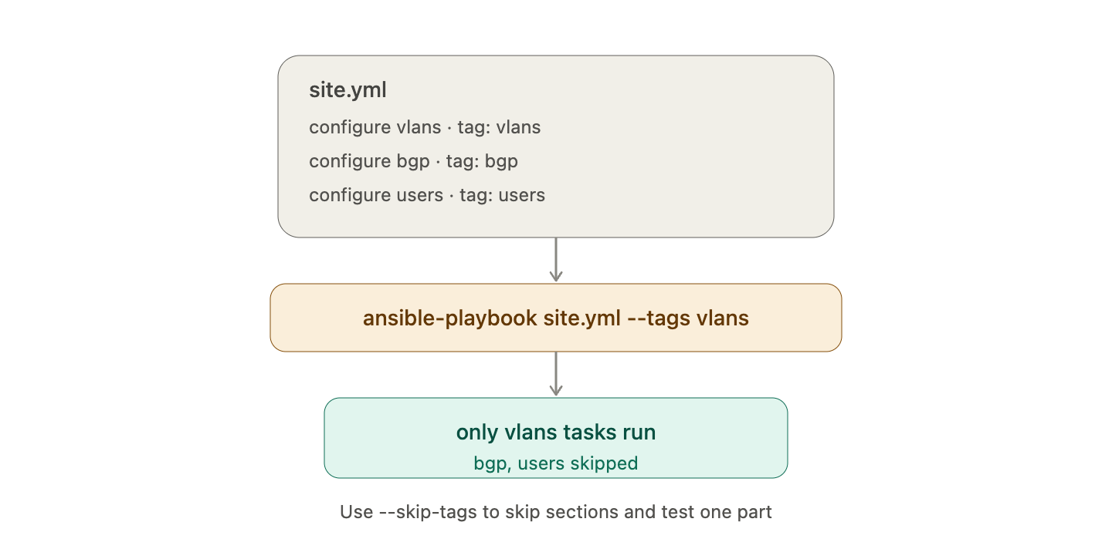
Tags - Running Part of a Playbook
Virtualization
Virtualization
Tag tasks, then run only the tags you want
Command: ansible-playbook site.yml --tags vlans
Skip sections with --skip-tags
Test one part without running the whole playbook
Essential as playbooks grow large
Notes:
Tags give you a scalpel instead of a sledgehammer - run just the VLAN tasks without touching everything else.
This is invaluable during development and during targeted change windows.
It is also the answer to the section's quiz, so make sure the concept lands.

Slide 49
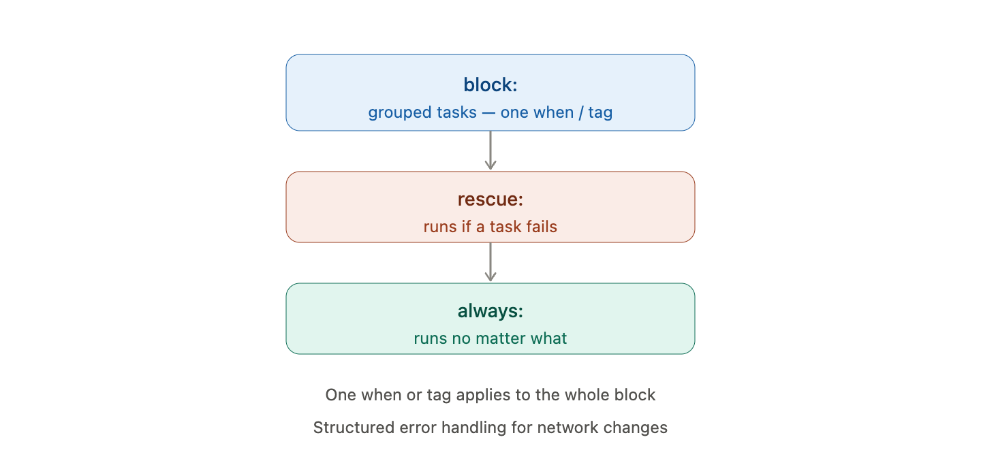
Blocks - Grouping Tasks
Virtualization
Virtualization
A block groups related tasks together
Apply one condition or tag to a whole group
rescue runs if any task in the block fails
always runs no matter what happens
Structured error handling for network changes
Notes:
Blocks are like try/rescue/finally for playbooks. Group tasks, then handle failure for the whole group in one place.
rescue is where you put cleanup or rollback steps if a change goes wrong.
always is for things you must do regardless, like re-enabling something you disabled.

Slide 50
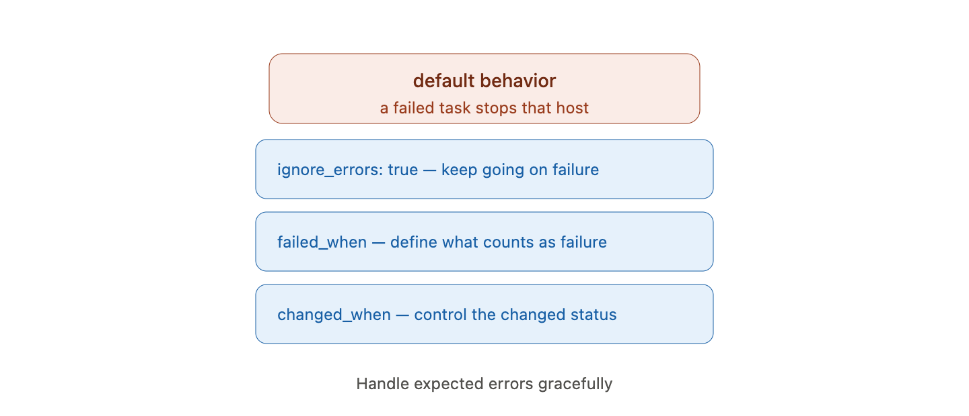
Error Handling
Virtualization
Virtualization
By default a failed task stops that host
ignore_errors: true keeps going on failure
failed_when defines what counts as failure
changed_when controls when a task reports changed
Handle expected errors gracefully
Notes:
Sometimes a non-zero result is not really a failure, and sometimes success is not really a change. These keywords give you control.
failed_when is powerful: you decide the condition, rather than accepting the module's default.
Callback to Day 1: changed_when false is how you stop a show command from always reporting changed.

Slide 51
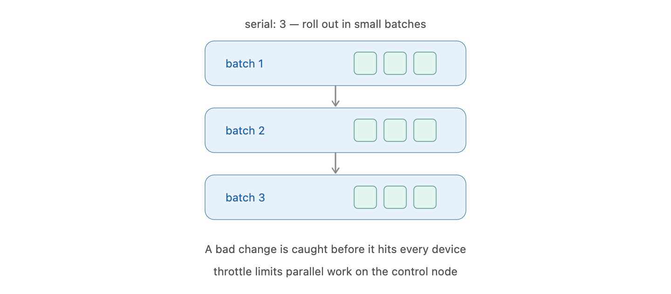
Controlling Rollout
Virtualization
Virtualization
serial limits how many hosts run at once
Roll changes out in small batches, not all at once
Catch a bad change before it hits every device
throttle limits parallel work on the control node
Safer large-scale change windows
Notes:
serial is the safety valve for big fleets: change five devices, verify, then continue, instead of hitting all five hundred at once.
This turns a risky mass change into a controlled, cancellable rollout.
throttle is about protecting the control node from doing too much work in parallel.

Slide 52
The Day 2 Labs
Virtualization
Notes:
Section seven: three labs that apply everything from today against the live routers.
Reset expectations on cost and boot time before students dive in.

Slide 53
Lab Environment Recap
Same AWS lab: control-node plus c8kv-1 and c8kv-2
Start your stopped router instances before you begin
Wait for IOS-XE to finish booting (4 to 6 minutes)
Work from the control node, as in Day 1
Stop the routers again when you finish
Virtualization
Notes:
Quick logistics slide. Most issues at the start of Day 2 are simply routers that were left stopped or are still booting.
Have them start the instances first thing so the boot time overlaps with this lecture.
Repeat the cost discipline: stop the routers at the end of the session.

Slide 54
Lab 04: Variables and Templates
Goal: Use variables and a Jinja2 template to generate per-router config
Steps:
Create group_vars/routers.yml and a host_vars file per router
Write a Jinja2 template for hostname and interface config
Render it with the template module on the control node
Push the rendered config with ios_config
Verify each router received its own values
Virtualization
Notes:
Lab 4 turns the morning's theory into a working template pipeline.
The key learning moment is seeing one template produce two different configs purely from the host_vars data.
Common snag: a variable defined in the wrong scope. Point them back to the precedence slide if values do not appear as expected.
Encourage them to render to a file first and inspect it before pushing to the device.

Slide 55
Lab 05: Building a Role
Goal: Package your configuration work into a reusable role
Steps:
Scaffold a role with ansible-galaxy init base_config
Move tasks, templates, and defaults into the role
Call the role from a short playbook against both routers
Override a default variable for one router
Confirm the role produces the same result as before
Virtualization
Notes:
Lab 5 is a refactor: take the working playbook from Lab 4 and reorganize it into a role.
The payoff moment is the tiny top-level playbook - just hosts and one role - doing the same work as before.
The override step proves the defaults mechanism: one router gets a different value without changing the role.
Stress that the behavior should be identical - roles change structure, not outcome.

Slide 56
Lab 06: Securing Secrets with Vault
Goal: Move device credentials into an encrypted Vault file
Steps:
Put login and enable secrets in a group_vars vault file
Encrypt it with ansible-vault encrypt
Reference the encrypted variables from your playbook
Run the playbook with --ask-vault-pass
Confirm secrets never appear in output or in Git
Virtualization
Notes:
Lab 6 closes the day by securing the credentials the earlier labs used.
The satisfying check is opening the encrypted file and seeing scrambled text, then running the playbook and watching it still work.
Have them try running without the vault password to see the failure - it drives home that the data is truly protected.
Reinforce no_log so secrets do not leak into verbose output.

Slide 57
You need to run only the VLAN tasks in a large playbook. What is the cleanest way?
A. Comment out every other task
B. Split the playbook into ten files
C. Tag those tasks and run with --tags
D. Use check mode
Notes:
Knowledge check on scalable playbooks.
Prompt: which feature is designed to run a subset of tasks?

Slide 58
You need to run only the VLAN tasks in a large playbook. What is the cleanest way?
A. Comment out every other task
B. Split the playbook into ten files
C. Tag those tasks and run with --tags
D. Use check mode
Notes:
Answer: C - tag the tasks and run with --tags. It runs exactly the tasks you want without editing the playbook.
Commenting out or splitting files is fragile; check mode previews changes but still targets everything.

Slide 59
Day 2 Summary
Variables and facts make playbooks dynamic
Jinja2 templates generate configuration from data
Roles package automation for reuse and sharing
Ansible Vault keeps secrets encrypted and safe
Tags, blocks, and serial make large rollouts manageable
Tomorrow: Python for networking - Netmiko, NAPALM, REST APIs
Virtualization
Notes:
Tie the day together around one theme: moving from writing playbooks to engineering automation that scales and is secure.
Check understanding: ask someone to explain the difference between a variable and a fact, or when a handler runs.
Preview Day 3: we drop from Ansible's declarative model into Python for cases that need full programmatic control.
Final reminder: stop the router instances before leaving.

Slide 60
Resources and What's Next
Ansible docs - templating, roles, and vault guides
Jinja2 documentation - filters and template syntax
Ansible Galaxy - browse community roles
Practice: convert a Day 1 playbook into a role
Day 3 preview: Python automation with Netmiko and NAPALM
Virtualization
Notes:
Point students to where they can deepen today's skills on their own.
The best practice exercise is converting one of yesterday's playbooks into a role - it consolidates everything from the roles section.
Set up Day 3: Python gives fine-grained control that complements, rather than replaces, Ansible.

