Slide 1

NETWORK AUTOMATION TOOLS IV
Notes:
Welcome to Day 4. So far we have configured devices - with Ansible, then with Python. Today we change what we automate.
Terraform provisions the infrastructure itself: the VPCs, subnets, routing, and security groups that our devices live in.
This is Infrastructure as Code for the cloud network. By the end of today you will build the entire AWS lab network from a few text files.

Slide 2

Network Automation Tools – Day 4
Notes:
Set the frame: we move up a layer, from configuring a router to creating the network it sits in.
Terraform is declarative like Ansible, but its job is standing up and tearing down cloud resources.

Slide 3
Where Day 3 Left Off
You automated device SSH with Netmiko in Python
You turned raw output into structured data with TextFSM and NAPALM
You read and changed config over RESTCONF
All of it configured devices that already existed
Today: build the network itself with Terraform
Virtualization
Notes:
Anchor Day 4 in Day 3. Everything so far assumed the network - the VPC, subnets, routers - was already there.
Today we automate the layer beneath: creating and destroying that cloud infrastructure on demand.
Frame Terraform as the tool that builds the stage the other tools perform on.

Slide 4

Agenda for Day 4
Infrastructure as Code and Terraform basics
The HCL language - resources, variables, outputs
The Terraform workflow - init, plan, apply, destroy
Building AWS network resources - VPC and subnets
Security groups and connectivity
Variables, reuse, and three hands-on labs
Virtualization
Notes:
Preview the arc: understand Terraform, learn its language, learn its workflow, then build the AWS network piece by piece.
Each concept feeds the labs - Lab 10 builds a VPC, Lab 11 adds routing and security, Lab 12 parameterizes and tears it all down.
Reassure students: HCL is data-like and readable, much closer to YAML than to a programming language.

Slide 5
Infrastructure as Code
Virtualization
Notes:
Section one: what Infrastructure as Code means and why Terraform leads the field.
Set the mindset - infrastructure becomes text files you version, review, and reuse.

Slide 6
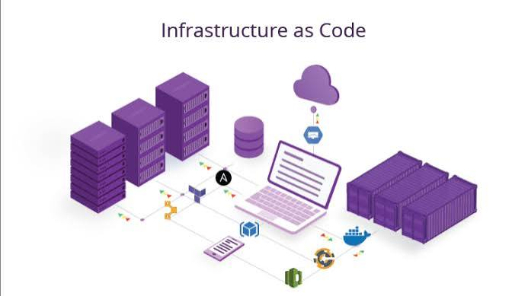
What Is Infrastructure as Code?
Virtualization
Virtualization
Define infrastructure in text files, not by clicking consoles
Version it in Git alongside your other code
Recreate identical environments on demand
Review changes before they happen
The same discipline you applied to device config, for the cloud
Notes:
Infrastructure as Code applies software practices to infrastructure: version control, review, and repeatability.
Contrast it with clicking through the AWS console - that is fast once, but not repeatable, reviewable, or documented.
Connect it to the whole course: IaC is the umbrella idea, and Terraform is how we do it for cloud networks.

Slide 7
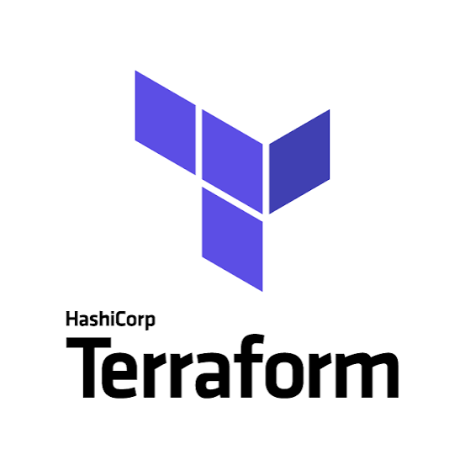
Why Terraform?
Virtualization
Virtualization
Declarative - you describe the desired infrastructure
Cloud-agnostic - one tool for AWS, Azure, GCP, and more
Huge provider ecosystem via the Terraform Registry
Plans changes before applying them
The de facto standard for infrastructure as code
Notes:
Terraform's appeal is that it is declarative and multi-cloud - the same tool and workflow across providers.
The plan step is a standout feature: you see exactly what will change before anything happens.
Its provider ecosystem means almost any service can be managed as code.

Slide 8
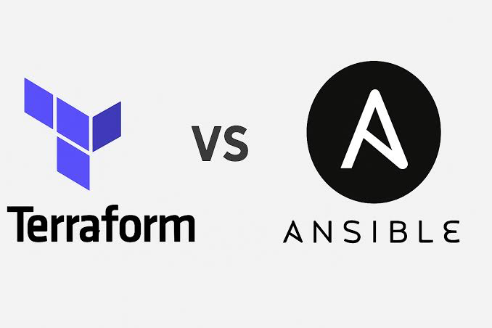
Terraform vs Ansible
Virtualization
Virtualization
Terraform - provisioning: create and destroy infrastructure
Ansible - configuration: set state on existing systems
Terraform tracks state; Ansible is stateless by default
Many teams use both - Terraform builds, Ansible configures
Right tool for the layer you are automating
Notes:
This is the key distinction of the day. Terraform stands infrastructure up and tears it down; Ansible configures what already exists.
Terraform keeps a state file to know what it manages; Ansible just enforces desired state each run.
The common pipeline: Terraform provisions the VPC and instances, then hands off to Ansible to configure them.

Slide 9
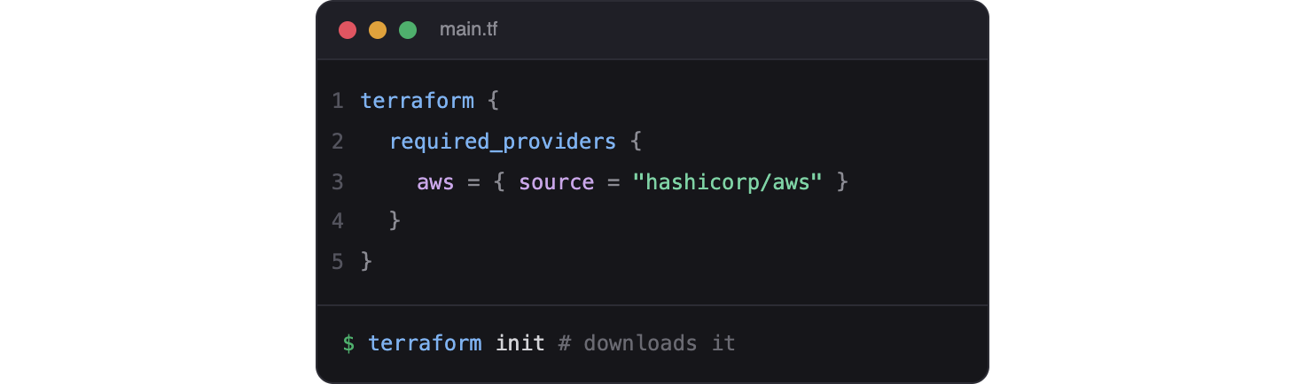
Providers and the Registry
Virtualization
Virtualization
A provider is a plugin for one platform, like aws
Providers expose resources you can manage
The Terraform Registry hosts official and community providers
Declare required providers in your configuration
terraform init downloads them for you
Notes:
Providers are how Terraform talks to a platform - the aws provider knows how to create VPCs, subnets, and security groups.
The Registry is the catalog, similar to Ansible Galaxy or PyPI.
You declare which providers you need, and init fetches them - no manual installation of plugins.

Slide 10
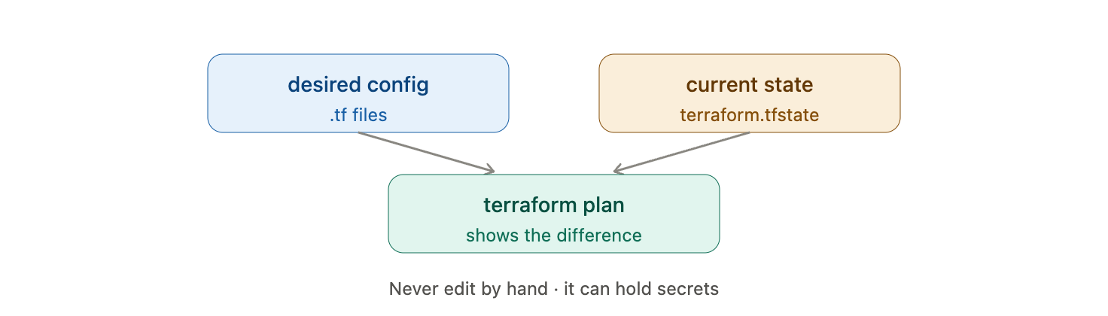
Terraform State
Virtualization
Virtualization
State records what Terraform has created
Stored in terraform.tfstate by default
Lets Terraform plan the difference to your desired config
Never edit the state file by hand
Protect it - it can contain sensitive values
Notes:
State is the concept that trips up newcomers, so give it attention. It is Terraform's memory of what exists.
Without state, Terraform could not tell the difference between creating new resources and updating existing ones.
Warn clearly: never hand-edit state, and treat it as sensitive - it can hold secrets. Later we cover remote state for teams.

Slide 11
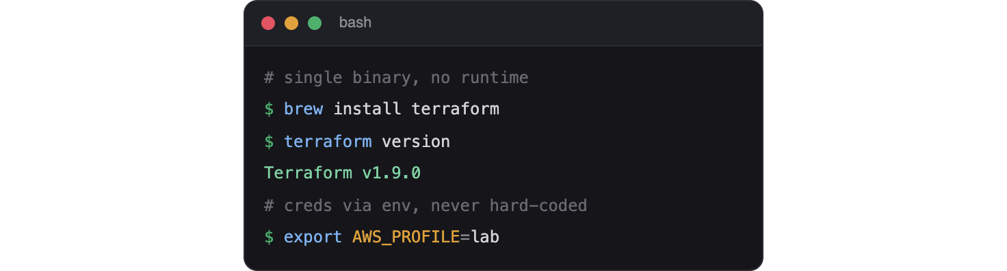
Installing Terraform
Virtualization
Virtualization
Terraform is a single binary - no runtime to install
Download it or use your package manager
Confirm with: terraform version
Configure AWS credentials for the provider
Use an IAM role or environment variables, never hard-coded keys
Notes:
Installation is trivial - one binary on the PATH.
The real setup is credentials: the aws provider needs permission to create resources, ideally via an IAM role on the control node.
Stress security: never put AWS keys directly in your .tf files, which get committed to Git.

Slide 12
Terraform records what it has created in a file so it can plan future changes. What is this called?
A. The plan
B. The state
C. The manifest
D. The registry
Notes:
Knowledge check on core Terraform concepts.
Prompt: what is Terraform's memory of existing resources?

Slide 13
Terraform records what it has created in a file so it can plan future changes. What is this called?
A. The plan
B. The state
C. The manifest
D. The registry
Notes:
Answer: B - the state. Terraform compares your desired config against state to decide what to change.
The plan is the preview of changes; the state is the record of what already exists.

Slide 14
The HCL Language
Virtualization
Notes:
Section two: HCL is the language you write Terraform in.
It is declarative and readable - if you handled YAML on Day 1, this will feel familiar.

Slide 15
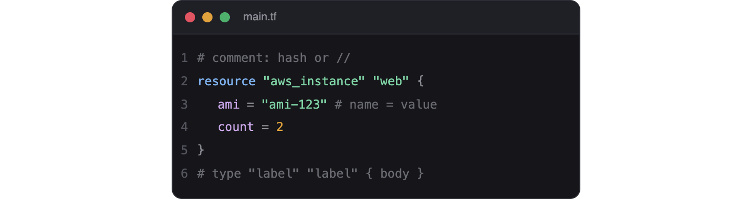
HCL - Blocks and Arguments
Virtualization
Virtualization
HCL is built from blocks that contain arguments
A block has a type, optional labels, and a body in braces
Arguments are name equals value pairs
Comments start with a hash or double slash
Files use the .tf extension
Notes:
Introduce the shape of HCL: blocks with braces, arguments as key = value.
Everything in Terraform - providers, resources, variables - is a block, so this pattern repeats everywhere.
Point out how readable it is; it describes what you want, not step-by-step instructions.

Slide 16

Resources
Virtualization
Virtualization
A resource block declares one piece of infrastructure
Syntax: resource type name then a body
Example: resource aws_vpc main
The type comes from the provider; the name is yours
Resources are the heart of every Terraform configuration
Notes:
Resources are the most important block - each one is a thing Terraform will create and manage.
The two labels matter: the first is the resource type from the provider, the second is a local name you choose to reference it.
Almost all of today's work is writing resource blocks for the AWS network.

Slide 17

Input Variables
Virtualization
Virtualization
variable blocks make a configuration reusable
Give each a type and an optional default
Reference a variable with var dot name
Change behavior without editing the main code
The Terraform equivalent of Ansible variables
Notes:
Input variables parameterize a configuration so the same code builds dev, test, or prod.
Define a variable block, then reference it as var.name wherever you need the value.
This mirrors the variables lesson from Day 2 - separate data from logic.

Slide 18
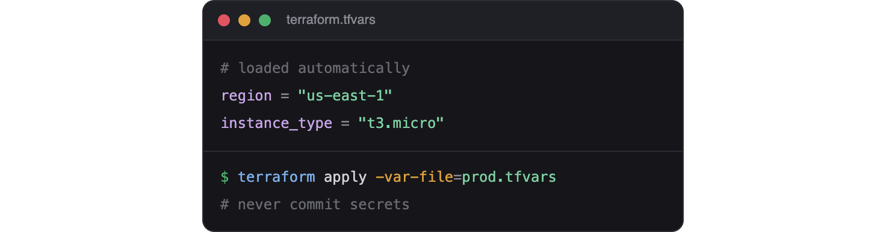
Variable Files - tfvars
Virtualization
Virtualization
A .tfvars file supplies values for your variables
terraform.tfvars is loaded automatically
Keep environment-specific values out of the main code
Pass a different file with -var-file
Never commit secrets in tfvars
Notes:
tfvars files are where the actual values live, keeping the .tf code generic.
terraform.tfvars loads by default; you can point at others for different environments.
Same warning as always - secrets do not belong in a committed file.

Slide 19
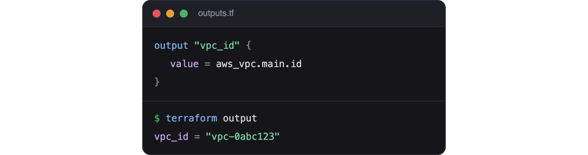
Outputs
Virtualization
Virtualization
output blocks expose values after apply
Print a VPC ID, subnet ID, or public IP
Feed outputs into other tools or modules
View them any time with terraform output
How Terraform hands information to the next step
Notes:
Outputs are how a Terraform run reports useful values back to you - the IDs and addresses of what it built.
They are essential for handoff: an output VPC ID can feed an Ansible inventory or another Terraform module.
terraform output re-displays them without re-running anything.

Slide 20

Locals and Expressions
Virtualization
Virtualization
locals define named values computed once
Reduce repetition and keep code readable
Expressions combine variables, functions, and references
Build names and tags dynamically
String interpolation uses dollar-brace syntax
Notes:
Locals are convenience values - compute something once, reuse it by name.
Expressions let you build values dynamically, like a consistent naming prefix across every resource.
Interpolation with the dollar-brace syntax inserts a value into a string, just like Python f-strings.

Slide 21

Referencing Resources
Virtualization
Virtualization
Refer to another resource's attributes by name
Form: type dot name dot attribute
Example: a subnet references aws_vpc main id
Terraform builds a dependency graph from these references
It creates resources in the correct order automatically
Notes:
This is the magic that makes Terraform easy: you reference one resource from another, and Terraform figures out the order.
A subnet that references its VPC's id will always be created after the VPC - you never manage ordering by hand.
This implicit dependency graph is a core reason Terraform is reliable.

Slide 22
Which Terraform block defines a piece of infrastructure to create, such as a VPC?
A. variable
B. output
C. resource
D. provider
Notes:
Knowledge check on HCL blocks.
Prompt: which block actually creates something?

Slide 23
Which Terraform block defines a piece of infrastructure to create, such as a VPC?
A. variable
B. output
C. resource
D. provider
Notes:
Answer: C - resource. Each resource block declares one piece of infrastructure Terraform manages.
variable and output pass data in and out; provider configures the platform plugin.

Slide 24
The Terraform Workflow
Virtualization
Notes:
Section three: the everyday cycle of commands you run.
The workflow is short and always the same - init, plan, apply, and eventually destroy.

Slide 25
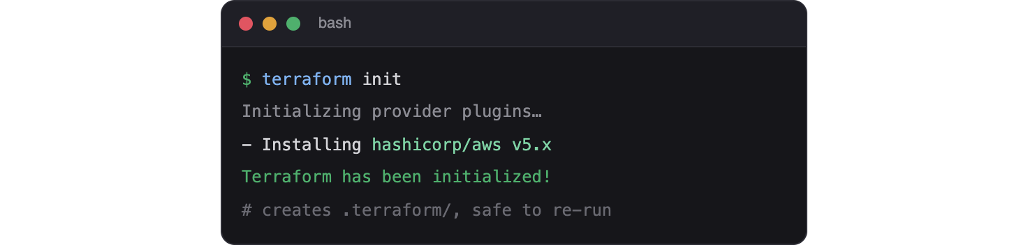
terraform init
Virtualization
Virtualization
Run once when you start or add a provider
Downloads the providers your config declares
Sets up the working directory and backend
Creates the .terraform directory
Safe to re-run any time
Notes:
init is the setup step - it reads your config, downloads providers, and prepares the directory.
You run it when you first clone a project or whenever you add a new provider or module.
It is idempotent and safe to re-run.

Slide 26
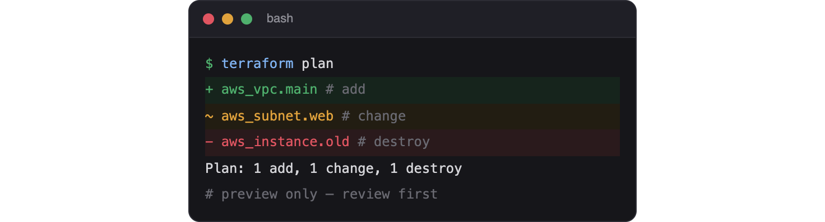
terraform plan
Virtualization
Virtualization
Shows exactly what Terraform will do
Compares your config against the current state
Marks resources to add, change, or destroy
Changes nothing - it is a preview
Always review the plan before applying
Notes:
plan is Terraform's killer feature and the habit to build - never apply blind.
It diffs your desired config against state and shows adds, changes, and destroys with plus and minus symbols.
Reviewing the plan is the cloud equivalent of Ansible's check and diff modes.

Slide 27

terraform apply
Virtualization
Virtualization
Executes the changes from the plan
Shows the plan again and asks for confirmation
Type yes to proceed
Updates the state file as it goes
Use with care - it creates real, billable resources
Notes:
apply is where real infrastructure gets created. It re-shows the plan and waits for your yes.
As it works, it records everything in state so future runs know what exists.
Remind students these are billable AWS resources - apply thoughtfully.

Slide 28

terraform destroy
Virtualization
Virtualization
Tears down everything in the configuration
Shows what will be destroyed and asks to confirm
The clean way to remove a lab environment
Prevents forgotten resources running up costs
Target a subset with care if needed
Notes:
destroy is the counterpart to apply - it removes what Terraform created, in the right order.
This is a huge advantage for lab and test environments: one command cleans up everything.
For a cost-controlled course, destroy is how students avoid leaving resources running.

Slide 29

Reading the Plan Output
Virtualization
Virtualization
A plus sign means a resource will be created
A minus sign means it will be destroyed
A tilde means it will be changed in place
A summary line counts add, change, and destroy
Read it carefully - especially any destroys
Notes:
Teach students to read the plan symbols fluently: plus creates, minus destroys, tilde updates.
The summary line - so many to add, change, destroy - is the quick health check before typing yes.
Unexpected destroys are the red flag to stop and investigate.

Slide 30
Which command previews changes without applying them?
A. terraform init
B. terraform plan
C. terraform apply
D. terraform destroy
Notes:
Knowledge check on the workflow.
Prompt: which step is the safe preview?

Slide 31
Which command previews changes without applying them?
A. terraform init
B. terraform plan
C. terraform apply
D. terraform destroy
Notes:
Answer: B - terraform plan. It shows what would change and modifies nothing.
init sets up the directory, apply makes the changes, destroy removes them.

Slide 32
Building the AWS Network
Virtualization
Notes:
Section four: the core of the day - writing the AWS network as Terraform resources.
This rebuilds the same lab network you clicked together in Day 1, now as code.

Slide 33

The aws Provider
Virtualization
Virtualization
Declare the aws provider and a region
Configure credentials outside the code
The provider unlocks aws_ resource types
Pin a provider version for reproducibility
One provider block serves the whole configuration
Notes:
The provider block configures the connection to AWS - mainly the region.
Keep credentials out of the block; rely on an IAM role or environment variables.
Pinning the version avoids surprise changes when a new provider release lands.

Slide 34

Creating a VPC
Virtualization
Virtualization
resource aws_vpc defines your virtual network
Set the cidr_block, such as 10.0.1.0/24
Enable DNS support and hostnames if needed
Tag it with a clear Name
Every other network resource lives inside it
Notes:
The VPC is the foundation - the private network everything else attaches to.
The cidr_block is the address range; match the 10.0.1.0/24 from the Day 1 lab.
Good tagging from the start makes resources findable in the console.

Slide 35
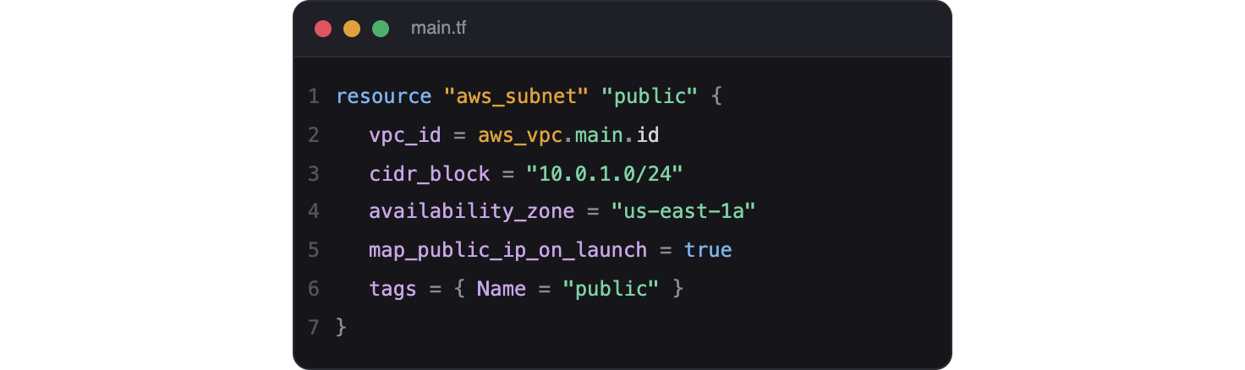
Creating Subnets
Virtualization
Virtualization
resource aws_subnet carves an address range from the VPC
Reference the VPC id so it lands inside
Set the subnet cidr_block and availability_zone
map_public_ip_on_launch for public subnets
Tag each subnet clearly
Notes:
Subnets divide the VPC into usable segments, each in one availability zone.
The subnet references the VPC id - that reference is what places it inside the VPC and sets creation order.
map_public_ip_on_launch makes instances in the subnet reachable, matching the Day 1 setup.

Slide 36
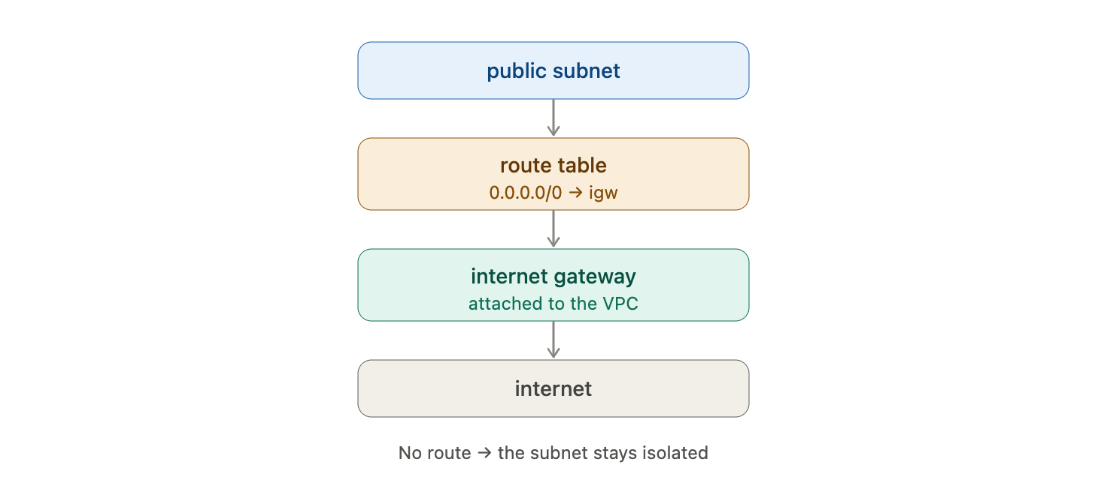
Internet Gateway and Routing
Virtualization
Virtualization
aws_internet_gateway gives the VPC internet access
Attach it to the VPC by id
aws_route_table holds your routing rules
Add a default route to the internet gateway
Without a route, the subnet stays isolated
Notes:
The internet gateway is the door to the internet; the route table decides who uses it.
The pattern: create the gateway, attach it to the VPC, then add a 0.0.0.0/0 route pointing at it.
This is exactly the manual Day 1 step, now expressed as three linked resources.

Slide 37

Route Table Associations
Virtualization
Virtualization
A route table only applies once associated with a subnet
aws_route_table_association links the two
Reference both the subnet id and route table id
Associate every subnet that needs the route
A common step to forget - then traffic mysteriously fails
Notes:
Creating a route table is not enough; it must be associated with a subnet to take effect.
The association resource links a subnet to a route table by their ids.
Call out that a missing association is a classic gotcha - the route exists but nothing uses it.

Slide 38
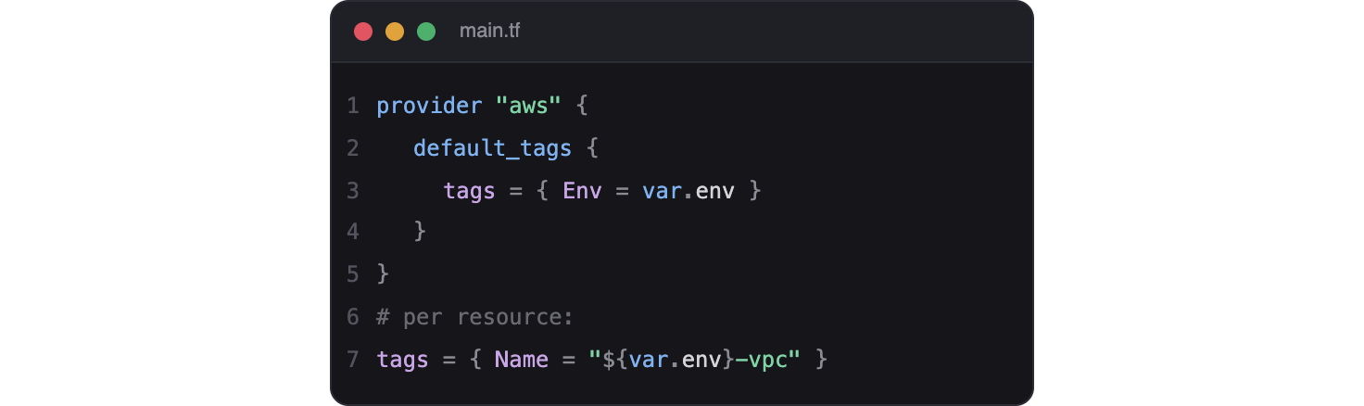
Tags and Naming
Virtualization
Virtualization
Tags label resources for humans and billing
Use a consistent Name on every resource
Build names from variables with expressions
Consistent tags make cleanup and audits easy
default_tags can apply tags across the board
Notes:
Tagging is not optional in real accounts - it drives cost tracking, automation, and cleanup.
A consistent naming scheme, built from a variable prefix, keeps a growing project navigable.
The provider's default_tags feature stamps the same tags on everything automatically.

Slide 39
Security Groups and Connectivity
Virtualization
Notes:
Section five: security groups are the firewall around your resources.
This is the other half of the Day 1 lab - the rules that let SSH, NETCONF, and RESTCONF through.

Slide 40
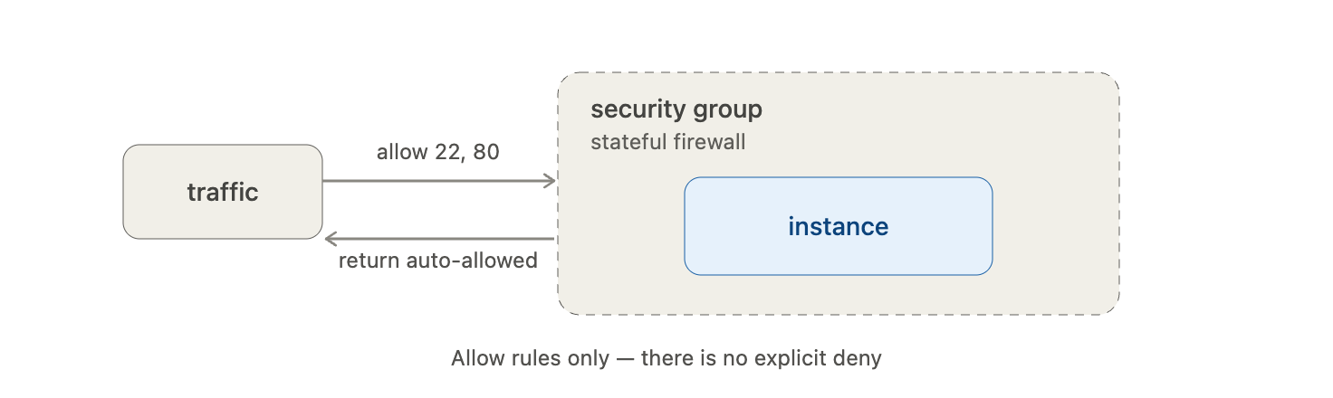
What Is a Security Group?
Virtualization
Virtualization
A stateful virtual firewall around a resource
Rules allow traffic; there is no explicit deny
Stateful - return traffic is allowed automatically
Attached to instances and other resources
The main way you control access in a VPC
Notes:
A security group is a stateful, allow-only firewall wrapped around a resource.
Stateful means you only write the inbound rule; the reply is permitted automatically - unlike a stateless NACL.
This is the control that opened SSH, NETCONF, and RESTCONF in the Day 1 lab.

Slide 41
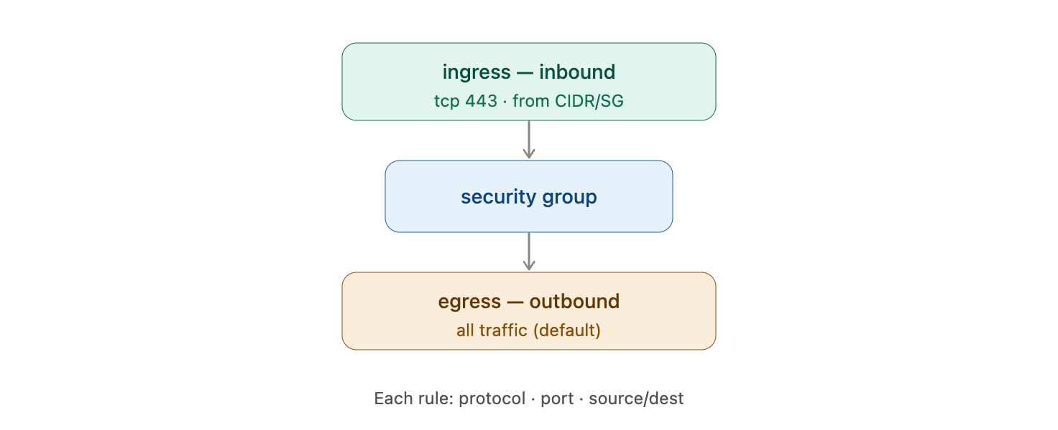
Ingress and Egress Rules
Virtualization
Virtualization
Ingress rules control inbound traffic
Egress rules control outbound traffic
Each rule sets protocol, port range, and source or destination
Sources can be a CIDR or another security group
Default egress often allows all outbound
Notes:
Ingress is traffic coming in; egress is traffic going out. Learn the direction clearly.
Each rule names a protocol, a port or range, and where the traffic may come from or go to.
Referencing another security group as a source is a powerful pattern for internal access.

Slide 42
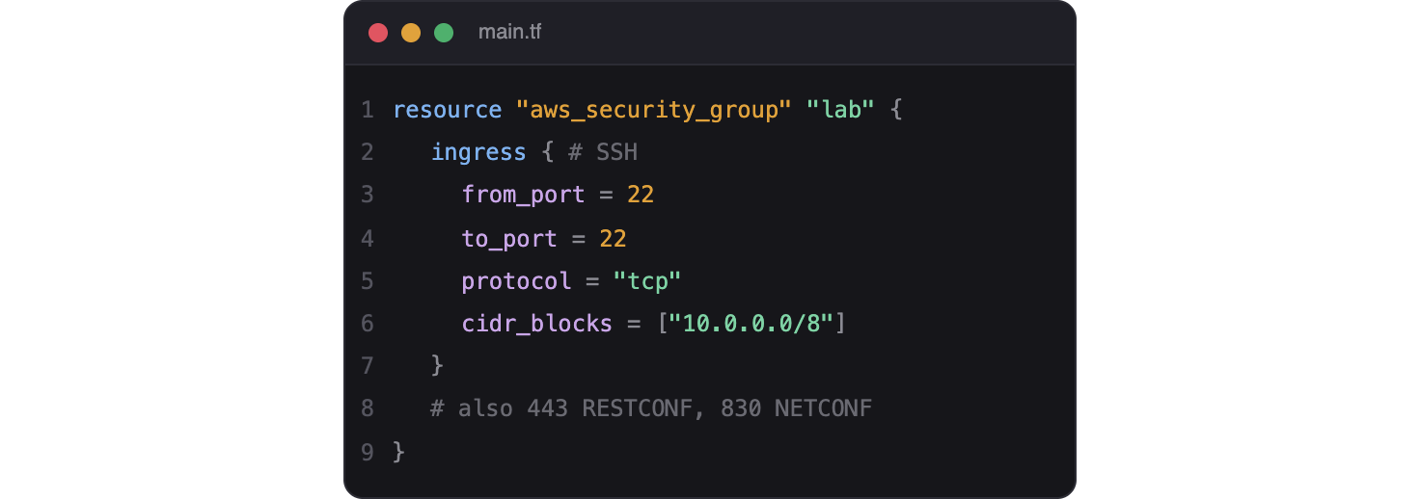
Writing SG Rules in Terraform
Virtualization
Virtualization
resource aws_security_group defines the group
Add ingress and egress blocks inside it
Set from_port, to_port, protocol, and cidr_blocks
Open 22 for SSH, 443 for RESTCONF, 830 for NETCONF
Mirror the exact rules from the Day 1 lab
Notes:
Show how the Day 1 security group becomes a Terraform resource with ingress blocks.
Each ingress block is one rule - port 22 for SSH, 443 for RESTCONF, 830 for NETCONF, matching Lab 1.
This is a satisfying moment: the table of rules from Day 1 becomes a few lines of code.

Slide 43
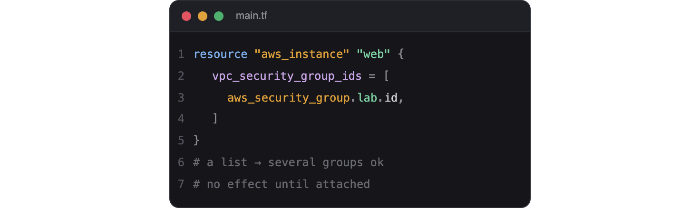
Attaching Security Groups
Virtualization
Virtualization
Reference the group's id from an instance
vpc_security_group_ids takes a list
One group can protect many resources
One resource can carry several groups
The group has no effect until it is attached
Notes:
A security group must be attached to a resource to do anything.
Instances take a list of group ids, so you can layer several groups on one resource.
Reinforce: an unattached security group is just an unused definition.

Slide 44
In an AWS security group, which rule type controls traffic coming INTO a resource?
A. egress
B. ingress
C. a route
D. a NACL
Notes:
Knowledge check on security groups.
Prompt: inbound traffic uses which rule type?

Slide 45
In an AWS security group, which rule type controls traffic coming INTO a resource?
A. egress
B. ingress
C. a route
D. a NACL
Notes:
Answer: B - ingress. Ingress rules govern inbound traffic; egress governs outbound.
Routes direct traffic between networks, and a NACL is a separate, stateless subnet-level control.

Slide 46
Variables, Outputs, and Reuse
Virtualization
Notes:
Section six: the features that turn a working config into a reusable, shareable one.
This is where Terraform projects grow up, much like roles did for Ansible.

Slide 47
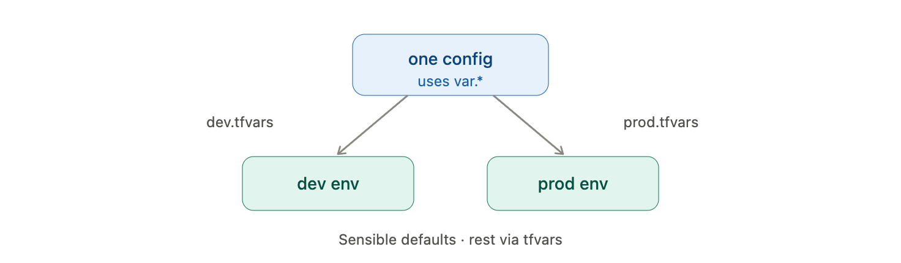
Parameterizing with Variables
Virtualization
Virtualization
Replace hard-coded values with variables
One config builds many environments
Group related variables logically
Provide sensible defaults where you can
Supply the rest through a tfvars file
Notes:
Parameterizing is the same lesson as Day 2 roles - separate the values from the structure.
A well-parameterized config builds dev and prod from the same code with different tfvars.
Good defaults keep the config runnable out of the box.

Slide 48
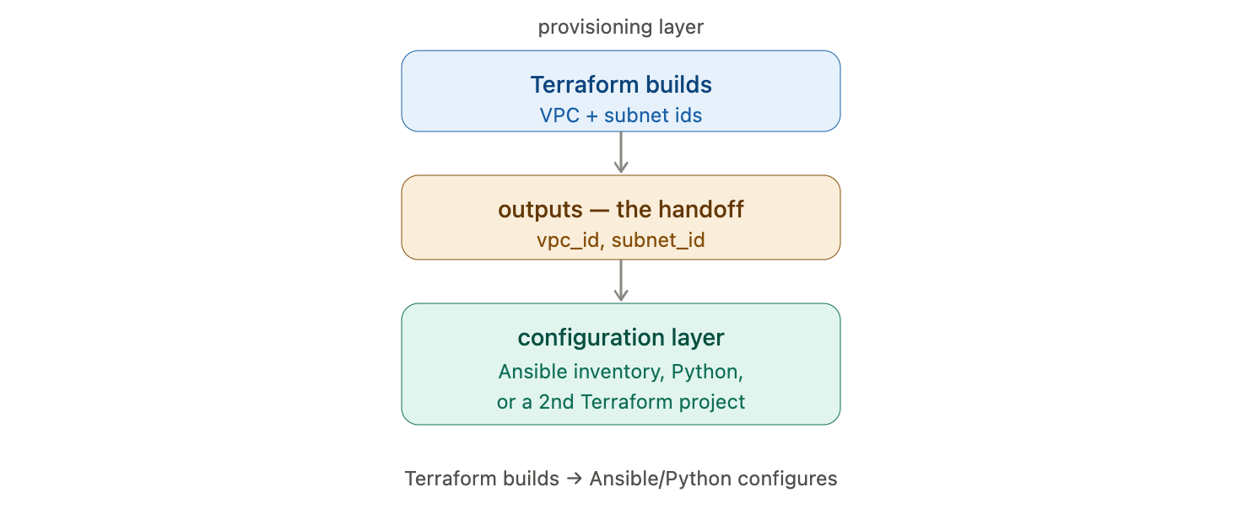
Outputs for Handoff
Virtualization
Virtualization
Expose the VPC, subnet, and security group ids
Hand those ids to Ansible or another tool
Outputs document what the config produced
Chain Terraform runs by consuming outputs
The bridge from provisioning to configuration
Notes:
Outputs are the handoff mechanism between the provisioning and configuration layers.
A Terraform-built VPC and subnet ids can feed straight into an Ansible inventory or a second Terraform project.
This is how the whole course connects - Terraform builds, then Ansible or Python configures.

Slide 49
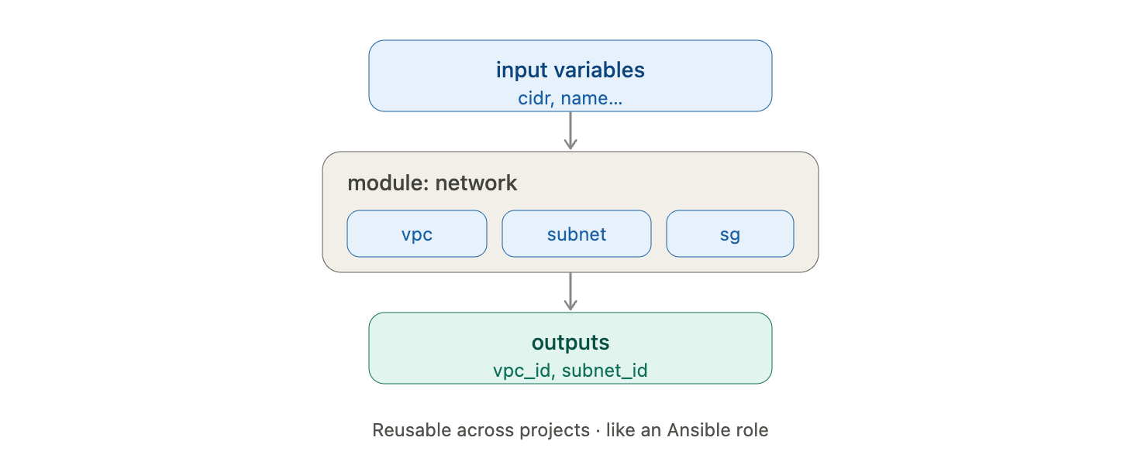
Introducing Modules
Virtualization
Virtualization
A module is a reusable package of Terraform code
Group related resources behind a clean interface
Call a module with input variables
Reuse the same module across projects
The Terraform equivalent of an Ansible role
Notes:
Modules are to Terraform what roles are to Ansible - packaged, reusable, parameterized building blocks.
A network module might create a A module is a reusable package of Terraform code
Group related resources behind a clean interface
Call a module with input variables
Reuse the same module across projects
The Terraform equivalent of an Ansible role
VPC, subnets, and routing behind a few inputs.
This keeps top-level configurations short and consistent.

Slide 50
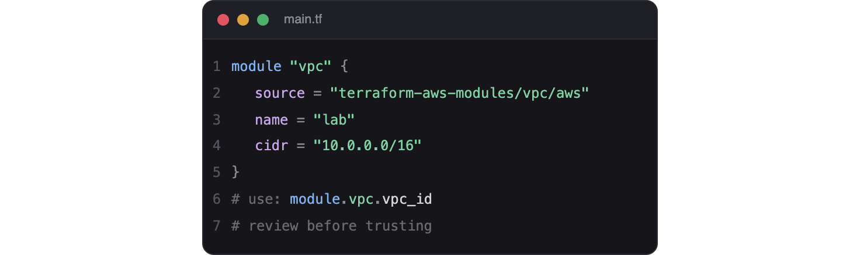
Using a Module
Virtualization
Virtualization
A module block references a source and inputs
Sources can be local paths or the Registry
Pass variables as the module's inputs
Consume the module's outputs afterward
Prefer well-maintained community modules
Notes:
Calling a module is like calling a role: point at its source and pass inputs.
The Registry hosts battle-tested modules - the aws vpc module is a common example.
Always review a module before trusting it, just as with roles.

Slide 51
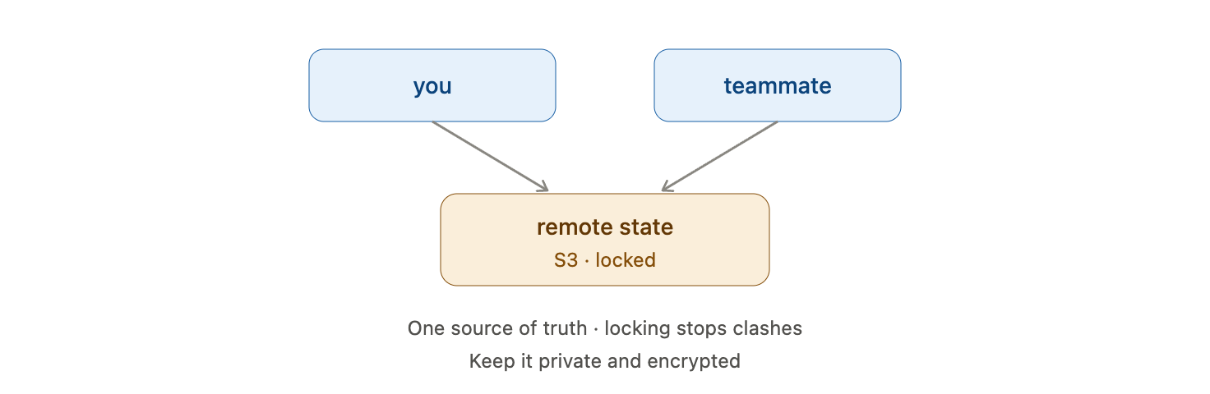
Remote State and Teams
Virtualization
Virtualization
Local state does not work for a team
Store state remotely, such as in an S3 backend
Locking prevents two people applying at once
Everyone shares one source of truth
Keep remote state private and encrypted
Notes:
Local state is fine solo but breaks the moment two people share a project.
A remote backend like S3 gives everyone one shared state, with locking to prevent conflicting applies.
Because state can hold secrets, the remote store must be private and encrypted.

Slide 52
The Day 4 Labs
Virtualization
Notes:
Section seven: three labs that build the lab network itself with Terraform.
Cover setup and the all-important destroy step so nothing is left running.

Slide 53
Lab Environment and Setup
Work from the control node with Terraform installed
Use an IAM role so no keys live in your code
Build in a fresh directory, separate from earlier labs
You will create real, billable AWS resources
Always run terraform destroy when you finish
Virtualization
Notes:
Logistics slide. Today you create infrastructure rather than configure devices, so cost discipline shifts to terraform destroy.
Using an IAM role on the control node keeps AWS credentials out of your .tf files entirely.
Emphasize the destroy habit - it is the clean, complete way to avoid surprise charges.

Slide 54
Lab 10: Build a VPC
Goal: Create a VPC and a subnet with Terraform
Steps:
Write a provider block for aws in a new directory
Add an aws_vpc resource with a 10.0.1.0/24 CIDR
Add an aws_subnet that references the VPC
Run terraform init, then plan, then apply
Confirm the VPC and subnet in the AWS console
Virtualization
Notes:
Lab 10 is the hands-on introduction - the smallest useful Terraform config that builds real infrastructure.
The key learning moment is the init-plan-apply cycle and seeing the plan before saying yes.
Common snag: AWS credentials or region not configured, which shows up at plan time.
Students should read the plan output carefully and match it to what appears in the console.

Slide 55
Lab 11: Routing and Security
Goal: Add internet access and a security group
Steps:
Add an aws_internet_gateway attached to the VPC
Create a route table with a default route to it
Associate the route table with your subnet
Add a security group allowing SSH, RESTCONF, NETCONF
Apply and verify the routing and rules
Virtualization
Notes:
Lab 11 completes the network - the routing and firewall that make the subnet usable.
This directly recreates the manual Day 1 steps as code: gateway, route, association, security group.
Highlight the association step, the classic thing to forget.
By the end they have rebuilt the entire Day 1 lab network from Terraform.

Slide 56
Lab 12: Variables and Outputs
Goal: Parameterize the config, then tear it down
Steps:
Replace hard-coded values with input variables
Supply values in a terraform.tfvars file
Add outputs for the VPC and subnet ids
Re-apply and view the outputs
Run terraform destroy to remove everything
Virtualization
Notes:
Lab 12 turns the working config into a reusable one and then cleans up.
Parameterizing and adding outputs is the professional finish - the config now builds any environment and reports its ids.
The final destroy is essential: it removes every resource and confirms nothing is left billing.
Have them watch the destroy plan to see the resources removed in dependency order.

Slide 57
Which command safely tears down everything Terraform created?
A. terraform remove
B. terraform delete
C. terraform destroy
D. terraform clean
Notes:
Knowledge check on cleanup.
Prompt: which is the real Terraform command to remove infrastructure?

Slide 58
Which command safely tears down everything Terraform created?
A. terraform remove
B. terraform delete
C. terraform destroy
D. terraform clean
Notes:
Answer: C - terraform destroy. It removes all managed resources in the correct order.
The other three are not real Terraform commands - destroy is the counterpart to apply.

Slide 59
Day 4 Summary
Infrastructure as Code makes networks repeatable and reviewable
Terraform is declarative and tracks state
The workflow is init, plan, apply, and destroy
You built a VPC, subnets, routing, and security groups as code
Variables, outputs, and modules make configs reusable
Tomorrow: Arista EOS and CloudVision automation
Virtualization
Notes:
Tie the day together: Terraform builds the network as code, the layer beneath everything we did in Days 1 to 3.
Check understanding - ask when they would use Terraform versus Ansible, or what state is for.
Preview Day 5: we return to device automation on Arista EOS, managed at scale through CloudVision.
Final reminder: run terraform destroy so no lab resources keep billing.

Slide 60
Resources and What's Next
Terraform documentation and the AWS provider reference
The Terraform Registry - providers and modules
HashiCorp Learn - guided Terraform tutorials
Practice: rebuild the lab network, then destroy it
Day 5 preview: Arista EOS and CloudVision
Virtualization
Notes:
Point students to the official docs and the Registry for going deeper.
The best exercise is building and destroying the lab network a few times until the workflow is second nature.
Set up Day 5: a return to device-level automation, this time on Arista with CloudVision at the center.

